Slide 1
CLAUDE CODE HARNESS · PLUGIN · v2.9.0
Agentic SDLC
An AI-SDLC framework built from delivery experience
4 agents · 17 skills · spec-first · test-first · evidence-gated
Every claim carries one of these grades:
VERIFIED
CASE STUDY
RATIONALE
PLANNED
github.com/trac41799/claude-code-agentic-sdlc
Notes:
Each claim is graded. Honestly — we grade our own evidence.

Slide 2
BEFORE YOU TINKER
Fork first — the official repo is read-only
Benchmark runs and experiments belong on your own fork. Never commit to the official ex-company repo.
RECOMMENDED · YOUR FORK
OFFICIAL · EX-COMPANY
Tinkering · benchmark runs · extensions
Read-only reference — do not commit
github.com/trac41799/claude-code-agentic-sdlc
github.com/talentedgeai/infinite-leverage
Fork it, clone it, run bench/greenfield.py on your own cases.
The public history — v1 and the v2 lineage live here.
One rule: benchmark evidence lands on your fork — the official repo stays a clean reference.
Notes:
Honesty about provenance: this deck's repo is the fork; the official ex-company repo is read-only.

Slide 3
MOTIVATION
Why a team-shaped framework
Agents changed the bottleneck. The product is the process.
Context loss
Handoff tax
Agents shift it
Every session starts cold.
Every handoff loses fidelity.
Bottleneck is process, not code.
Requirements
→
Design
→
Implement
→
Test
→
Deploy
→
Maintain
A standard SDLC, agent-executed: from idea to clean POC.
RATIONALE
Notes:
My starting model: linear pipeline. The framework is its correction.

Slide 4
DEMAND
What the market asked for
Who
Technical AND non-technical founders, one engineer of support
What
Idea → working POC in days — clean codebase + docs
How
Greenfield-first \u00B7 maps to standard SDLC phases
Guarded by
The agent proposes — the human decides
Constraints we imposed
Nothing global · no hooks · all change via PR · operator gates every decision
Notes:
Learned from v1's machine drift; v2 encodes them.

Slide 5
DESIGN
One repo, three layers, five decisions
Distribution · runtime · product — each decision kills a known failure.
1 · MARKETPLACE = CANONICAL
Nothing global
4 commands update via marketplace
Machine drift killed v1
2 · PER-PROJECT TEAM
Thin agents, skills on demand
4 agents · 17 skills · in project .claude/
Context budget stays deliberate
Plan-protocol
3 · SCAFFOLD
No undeclared mega-PRs
Next.js · Supabase · Vercel
Marketplace updates
No zip/curl to rot
Human gates at spec/plan/PR
Operator decides, team executes
VERIFIED
CI enforces manifests, lockstep versions, counts, no-global-install.
Notes:
Canvas: mark the plan-protocol claim as the most original piece.

Slide 6
THE STACK
Four tools the team lives in
The harness · the change · the delivery · the data — also the fastest client onboarding stack.
Claude Code
HARNESS
GitHub
CHANGE & CI
Agents · skills · slash commands. Every gate (spec · plan · PR) is an operator decision in the loop.
All change via PR, never self-merged. CI enforces manifests, version lockstep, skill counts, no-global-install.
The runtime the 4-agent team executes in
The audit trail and the merge gate
Vercel
DELIVERY
Supabase
DATA & AUTH
Preview per PR · prod from main. The Deploy lane of the cycle — what clients see as “it went live”.
Postgres + Auth + Storage in the scaffold, free tier. No infra decisions for a new client.
Zero-config deploys; preview URLs on every PR
The database and identity in the project scaffold
CLI-first: gh · vercel · supabase · claude are all CLIs — they chain in a shell with no convention layer, so a harness swap leaves the contract intact.
VERIFIED
Only Supabase also runs as an MCP server: the CLI automates, the MCP gives the agent a live surface — each serves its own moat.
Notes:
Company stack today and the fastest onboarding stack: Claude Code harness, GitHub PRs, Vercel deploys, Supabase data.

Slide 7
INTELLECTUAL HONESTY
Adopted vs built
Six MIT-credited adaptions; the orchestration layer is ours.
ADOPTED · mattpocock/skills
BUILT IN-HOUSE
DEV-TDD
QA-TRIAGE
PLAN-PROTOCOL ENGINE
DEV-FEATURE-PLAN
GRILL-WITH-DOCS
TO-ISSUES
PM CHAIN (5 SKILLS)
DEVOPS-CICD · OPS
SETUP-PRE-COMMIT
GIT-GUARDRAILS
WEB-PUBLISHER-PUBLISH
4 COMMANDS + SCAFFOLD
Adapted, kept MIT credit, wired into the team.
The hybrid: industry patterns + orchestration layer.
VERIFIED
Credits verified per skill frontmatter.
Notes:
They will ask 'what's original' - answer honestly before they ask.

Slide 8
THE STACK
Team + method: SDD decides, TDD proves
product-manager
developer
qa
devops
specs · epics · status
impl. · publishing
strategy · triage
CI/CD · guardrails
No dev start without an approved plan. No self-merges. All change via PR.
SPEC-FIRST
TEST-FIRST
Spec before code. Plan is the contract.
Fail first, then minimal green. Refactor.
Operator approves spec AND plan.
Done = gates passed with evidence.
Notes:
Small roster; the method is the chain: spec gate -> plan gate -> TDD -> QA -> PR.

Slide 9
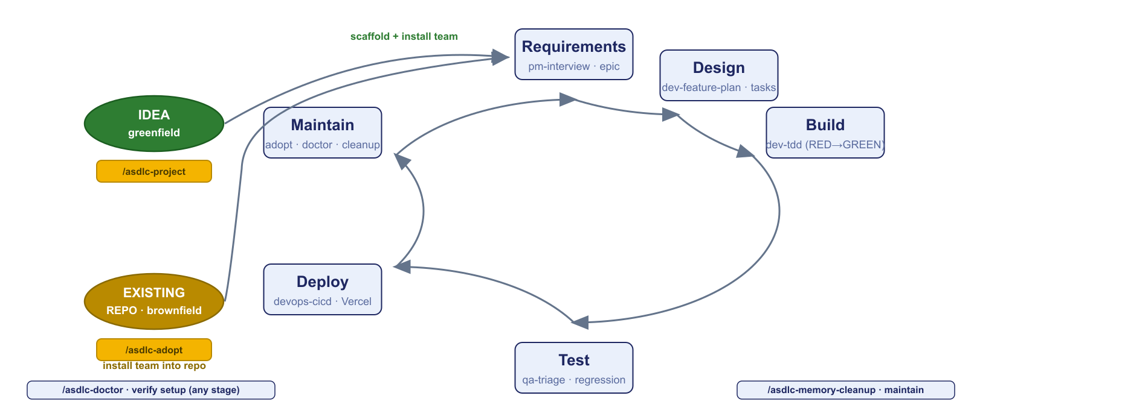
THE MODEL
One SDLC cycle, two entry points
Greenfield · brownfield · slash commands mark every stage.
Six stages, standard SDLC — the framework maps a skill to each stage and a command to each entry.
Notes:
Greenfield: /asdlc-project. Brownfield: /asdlc-adopt. Doctor verifies at any stage. Each stage = one skill lane.

Slide 10
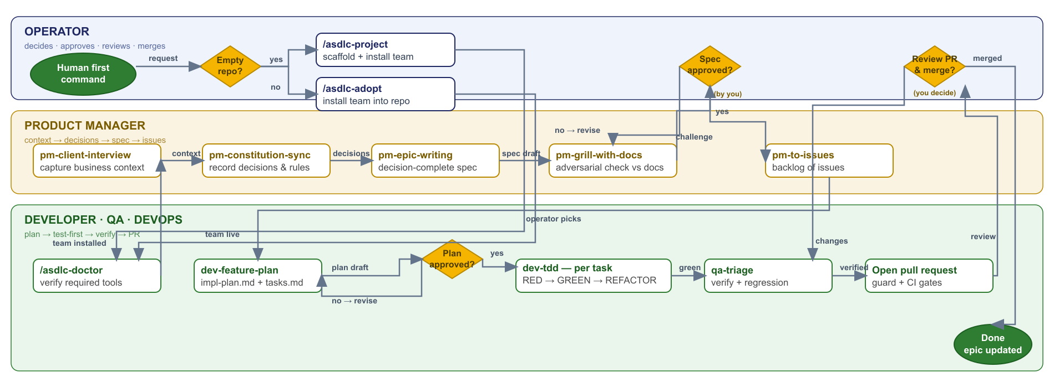
THE FLOW
One request: first command → merged PR
Spec gate · plan gate · TDD per task · QA before merge — the diagram IS the two-phase story.
Notes:
Operator decides, PM serializes, dev/qa execute with gates. Three lanes, two approvals, one PR.

Slide 11
ADOPTION & EVIDENCE
Two commands. Two one-week POCs.
INSTALL · FROM THE RECOMMENDED FORK
claude plugin marketplace add trac41799/claude-code-agentic-sdlc
claude plugin install agentic-sdlc@agentic-sdlc
Then /asdlc-doctor · /asdlc-project (new repo) · /asdlc-adopt (existing)
OFFICIAL ORIGIN · EX-COMPANY, READ-ONLY · github.com/talentedgeai/infinite-leverage — tinker on your fork, never commit here
WorkHealthyAustralia
AU · healthcare — janet.care (personal healthcare AI-assistant) + occuspan.com · POC in 1 week
DOXA
US · staffing — multiple projects under NDA · POC in 1 week
Both: non-technical founders, one engineer of support, one engineer of trust.
CASE STUDY
Confounded: model mix drifted mid-build · no cost tracking · n = 2
Notes:
Install verified live via fcc-claude earlier. Cases: named, and confounds labeled.

Slide 12
METHODOLOGY FIRST
How we benchmark
Context before numbers — same model, frozen tasks, metered, non-merge.
Arms
B bare · A′ framework passive · A framework activated (routing + lanes)
Fairness
Same commit · same model pin · identical frozen task text · same tooling flags
Metering
Session JSON: turns, tokens in/out, cost · wall clock · outcome gates (pytest / node --test)
Safety
Offline acceptance (no live DB, no deploys) · exp branches, never merged to main
Scoring
Acceptance + hidden rubric checks (crash-safety, idempotency, concurrency) + traceability (spec→plan→tasks artifacts)
Everything on this deck's results slide came from the bench kit in the repo — rerun any cell with one command (docs/benchmarks/BENCHMARK-SUMMARY.md).
Notes:
Methodology slide exists so the results are read with their confounds in frame, not as bare numbers.

Slide 13
BENCHMARK · RAW EVIDENCE
Terminal output, verbatim
Real bench-kit output — GREENFIELD-3 (rate-limited SSE proxy), same model, same brief.
METRICS
B BARE — 27.4 min · $2.84 · 22 tests
metric A activated B bare
wall (min) 6.5 27.4
app/ tests/ — no spec/plan/tasks
turns 56 61
session halted before completion
cost 1.08 2.84
A ACTIVATED — 6.5m · $1.08 · 24 tests
in tokens 50991 85443
app/ tests/ docs/qa/
out tokens 42779 144366
docs/product/product.md
TEST GATE · pytest tests/ -q
.specify/features/rate-limited-sse-proxy/
A 24 passed [COMPLETED] · 56 turns
spec.md · impl-plan.md · tasks.md
B 22 passed [HALTED] · 61 turns
QA lane verified the work
terminal: max_turns (mid-tool-use)
Interpretation: A finished at 56 turns; B was stopped mid-tool-use at 61 — more spent, less delivered.
The framework arm finished 4.2× faster — and left a traceability trail.
Offline gates only — the devops lanes (CI · Vercel ops · rollback) fire on live projects, not in a lab bench.
Notes:
Verbatim bench-kit table. Read the B line out loud: halted at max_turns with more spent. The framework's value concentrates exactly here.

Slide 14
BENCHMARK · WHAT & HOW
The four frozen cases, and how to run them
Same briefs · same model pin · both arms — a difficulty gradient on purpose.
CASE
WHAT IT TESTS · WHY IT EXISTS
GATE
RESULT (B / A)
G-1 · E2E pipeline
Research request → queue → background worker → live status + final result. Full FE+BE+DB integration — the realistic product shape.
pytest tests/ -q
13 / 17 tests
G-2 · FE virtualized feed
Infinite feed, optimistic likes, windowed rendering; engine.js must stay zero-dependency. Narrow but deep front-end.
node --test tests/
24 / 22 tests
G-3 · BE SSE proxy (HARD)
Token buckets, backpressure, heartbeats, clean shutdown. The difficulty case — where churn shows up.
pytest tests/ -q
22 / 24 tests · bare halted
G-4 · DB+ETL 1M rows
Event ingestion + idempotent nightly rollup at scale (SQLite only), perf + re-run asserts.
pytest + etl/perf_test.py
8 / 6 tests · perf ✓
RUN FROM SCRATCH
python bench/greenfield.py --base /tmp/gf --name r1 --task bench/tasks/greenfield-e2e-pipeline.md --gate "pytest tests/ -q" --out bench-out/x
python evidence/validate.py # prebuilt evidence → 12/12 claims reproduce · bench/brownfield.py --repo <your-repo> --task bench/tasks/brownfield-add-tests.md --gate "<test cmd>" · frozen briefs: bench/tasks/
Same briefs, same model pin, metered, non-merge exp branches · ≈30–40 min per case (both arms).
Notes:
The four cases are the difficulty gradient: integration, deep FE, hard BE concurrency, data at scale. Point at bench/tasks/ as the frozen texts.

Slide 15
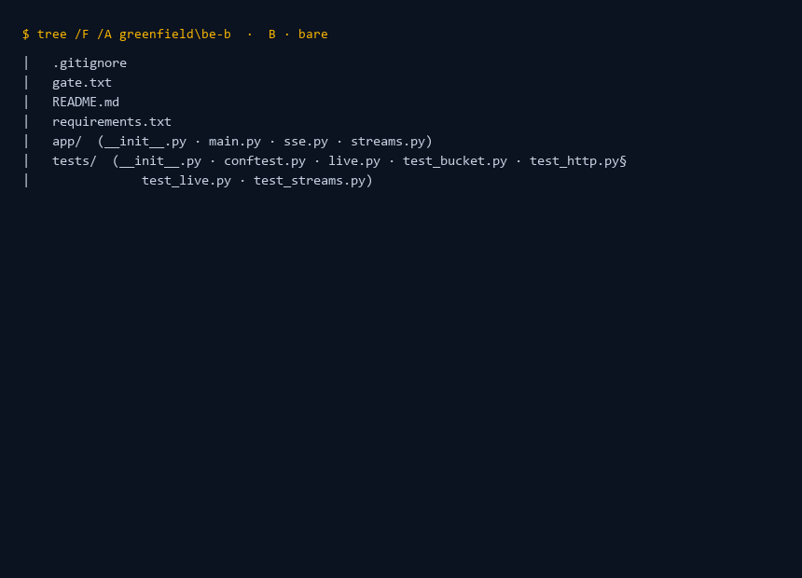
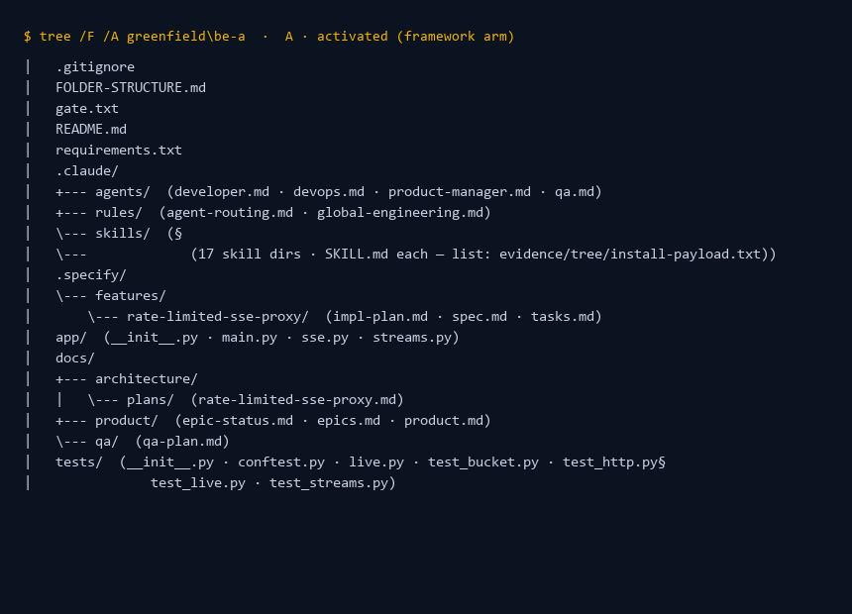
BENCHMARK · RAW EVIDENCE
Folder structure, verbatim
Same frozen task (BE SSE proxy), two arms — what the bare run leaves vs what the framework run leaves.
B · BARE — greenfield/be-b
A · ACTIVATED — greenfield/be-a
The bare arm leaves app/ + tests/ only. The framework arm leaves the same code PLUS .claude/ (agents + skills + rules), .specify/ (spec · plan · tasks), docs/product, docs/qa — the traceability trail, committed in the repo.
Full trees + install payload + scaffold: evidence/tree/ · all 12 projects runnable · python evidence/validate.py — 12/12 claims reproduce.
Notes:
Screenshots are generated views of the real evidence/tree/ captures (pyc masked, skills sub-tree elided to a count note). Point at evidence/.

Slide 16
BENCHMARK · 4 RUNS, 3 ARMS
Measured: bare vs passive vs activated
Same repos · frozen tasks · one model · metered. Non-merge exp branches (froam).
TASK
B · BARE
A′ · PASSIVE
A · ACTIVATED
R1 · add-tests (trivial)
$0.63 · 6 tests
$0.62 · 7 tests
$0.47 · 10 tests · 2.5× turns
R2 · DB + RLS
$0.22 · 11 tests
$0.27 · 11 tests
$0.67 · 11 tests + plan/QA
R4 · fragile refactor
refused · restraint pass
n/a
guardrail advisory violated · prod-correct when approved
R3 · vertical FE+BE
$0.94 · 4 tests
n/a
$0.98 · 4 tests + plan/tasks
Findings: passive ≈ bare (placebo) · activation tax scales with ceremony, benefit with risk · restraint is advisory, not structural — the QA lane is the value on risky approved change.
Harness gap fixed via dev-agent-router (16 to 17 skills) · model pinned since R2 · SWE-bench-style floor check: pending · —/ n/a = not run.
Notes:
4 runs, 3 arms, real numbers, real gaps. Read the R4 line out loud: the guardrail is advisory — that is the honesty that earns trust.

Slide 17
RESOURCES
Everything is in the repo
Framework · bench kit · evidence · demo guide — one link each, all public.
Recommended fork — framework · plugin · bench kit · deck source
trac41799/claude-code-agentic-sdlc
Raw evidence — trees + bench projects + validator
evidence/ (README · manifest · validate.py)
Benchmark evidence — 12 runs, repro commands
docs/benchmarks/BENCHMARK-SUMMARY.md
Live demo run guide (≤10 min)
docs/demo/live-demo-guide.md
Client setup — 5 prompts for non-technical founders
docs/guide/CLIENT-SETUP.md
Benchmark product — FE (froam)
trac41799/froam-journey-platform-fe
Benchmark product — BE (froam)
trac41799/travelbuddy-agentic-be
Official origin (ex-company) — v1 history, read-only
talentedgeai/infinite-leverage
Client cases
janet.care · occuspan.com
Tool stack
claude.com · github.com · vercel.com · supabase.com
Every number on the results slides reruns with one command from the bench kit.
Notes:
Give this slide time: every artifact referenced here exists and is public.

Slide 18
HISTORY
v1 — the fully automated agent-team
“Infinite Leverage” (2026) · reconstructed from the public commit tree.
THE ORIGINAL SCOPE
ROUTINES — NO HUMAN IN THE LOOP
8 agents — dev + marketing
ROUTINE
SCHEDULE
ACTION
DEV: product-manager · developer · devops
pm-daily-plan
wk 07:03
auto-approve
qa · web-publisher
pm-standup-compile
wk 18:07
+ PR
pm-eod-summary
wk 18:37
MKT: writer · designer · email-marketer
pm-weekly-rag
Fr 17:07
+ PR
(+ marketing-strategist)
writer-weekly
Mo 09:03
blog brief
Global install: ~/.claude/ agents · hooks ·
designer-weekly
Tu 09:03
hero.webp
skills · scheduled-tasks (zip + patch)
web-publisher-weekly
We 09:03
build + idx
email-marketer-weekly
Th 10:03
newsletter
62 workflow skills, zipped per agent
devops-daily health
daily 06:00
Settings: Bash(*) grant · acceptEdits
Persistence: CronCreate → RemoteTrigger (cloud-persistent)
Hooks: pre-bash · prompt-submit · SessionStart/End · telemetry → Supabase
VERIFIED
Commit trail: 5c89076 “8 scheduled task templates using CronCreate” (durable=true · auto-expire 7 days)
Supporting: 9291df3 · b753023 · a218b79 hooks · fff7a9a telemetry · e2d5d67 init
Notes:
The original pitch: an agent team that builds and markets, running overnight with no human. It worked — until the machine drifted.

Slide 19
HISTORY
v1 → v2: what changed, and why
Same goal — leverage. Different trust model.
DIMENSION
V1 · INFINITE LEVERAGE
V2 · AGENTIC SDLC
Install surface
~/.claude/ global — zip + patch
marketplace plugin · per-project .claude/
Automation
10 cron routines · auto-approve · overnight
none — every gate is a human decision
Hooks
6+ silent session/tool hooks
zero in public — guardrails/pre-commit are project-scoped, on request
Permissions
Bash(*) grant · acceptEdits default
never touches permissions
Agents & lanes
8–9 — dev + marketing (writer/designer/email)
4 — engineering only; publishing folded into developer
Telemetry
in-product · auto-delivered · human-hours
split to a private plugin
Updates
zip/patch + SessionStart auto-update
marketplace · lockstep · doctor diffs versions
V1 trade-off: autonomy + overnight output — paid in machine drift, silent cost, frozen updates (2.5 months). V2 trade-off: repeatability + trust — paid in no overnight automation, no marketing lanes.
VERIFIED
Why v1 fails: global state drifts · routines rot silently (7-day cron expiry, nobody re-registers) · auto-approve + Bash(*) erode trust · zip/patch froze fixes · telemetry-in-product privacy surface · marketing lanes unmeasured.
Notes:
The honest version of the story: v1 worked until it drifted. v2 gave up overnight autonomy for gates that hold.

Slide 20
HONEST YARDSTICKS
What we know we lack
Measured gaps first — then what we deliberately left out · full analysis: GAP-ANALYSIS.md.
MEASURED GAPS
DELIBERATELY NOT INCLUDED
COST · HIGH
No trusted metering — cost basis unknown, cache reads inflate A+wave 5–8×; no per-task budget; a wrong-model probe ($0.17/turn) slipped through.
• No hooks / auto-runtime / silent telemetry — v1 lesson
• No auto-approve — every gate is a human decision
GUARDRAILS · HIGH
Advisory, not mechanical — R4 pushed a fragile-file change through an operator approval; no CI check enforces plan-vs-PR files.
• No marketing agent lanes — removed v2.6.0 (unmeasured)
BENCH · MED
Every cell is N=1 — variance unmeasured; the 4.2× headline is one run.
• No permissions grants — Bash(*) killed v1
• No SWE-bench floor — documented trade-off
DEVOPS · MED
CI/Vercel/rollback lanes never fire offline — live-tested only, no regression cell.
• No global memory — repo artifacts ARE the memory
HUMAN-HOUR · MED
Method exists (hooks + PR windows) — public evidence still pending.
• No wave loop in canonical — negative in headless proxy
FOCUS LIST · next: trusted cost loop (pin check + baseline + budgets) · CI plan-vs-PR + fragile-file enforcement · headline cells N≥3 · devops staging smoke · second-model matrix.
VERIFIED
Gap list is provable; exclusions are design choices, not defects — both are in GAP-ANALYSIS.md.
Notes:
Say the cost gap out loud BEFORE they ask — the wrong-model probe is the proof we don't hide. Exclusions: read the v1 lesson slide before they suggest 'just enable hooks'.

Slide 21
ROADMAP · NEXT MOVES
Open points → committed moves
Seven gaps we admit, seven fixes we're building — the post-meeting commitment list.
OPEN POINTS
NEXT MOVES
COST
No trusted metering, no budget
GOVERNOR
Hard USD cap per run + banner
COMPARISON
No arm vs another SDLC framework
BENCH ARM
Mass real-world set + comparison arm
METRICS
N=1 cells, variance unmeasured
N≥3
Variance + context-read metrics
EVIDENCE
Handoffs lean on tests; thin for UI/UX
GATES
5-tier chain → manifest per PR
QUALITY
TDD + human review only
MUTATION
Mutation/contract/BDD tiers + freezer
AGENTS
Model/effort inherited from parent
AGENTS
TBD — candidate: model pin, reject wrong
HUMANS
No brownfield onboarding path
BRIEF
Onboarding map · commands · risks
PLANNED
Seven gaps, seven committed moves — tracked in docs/demo/open-points.md · evidence in GAP-ANALYSIS.md.
Notes:
One-to-one mapping of the post-meeting open points to committed moves (docs/demo/open-points.md). Row 6 (AGENTS) is the only one without a decided fix — candidate: per-agent model pin with wrong-pin rejection (GAP-ANALYSIS G1 fix path).

Slide 22
WHAT WE KNOW
Built from experience. Graded by evidence.
Benchmark: 12 metered runs — value proven where difficulty lives; gaps labeled, not hidden
Tokens: no budget yet — cheap to meter, baseline next
Method: SDD + TDD + 4-agent team — 12 measured runs + two POCs; lab confounds labeled
Human-hour ratio: measured via hooks + PR windows — target LOW
Next: trusted cost loop · CI plan-vs-PR enforcement · N≥3 headline cells · devops staging smoke · second-model matrix.
Not a solved discipline — a repeatable, honest one.
Notes:
Close on the gaps. That is the part we defend most.

