Slide 1
People OSINT Training

Slide 2
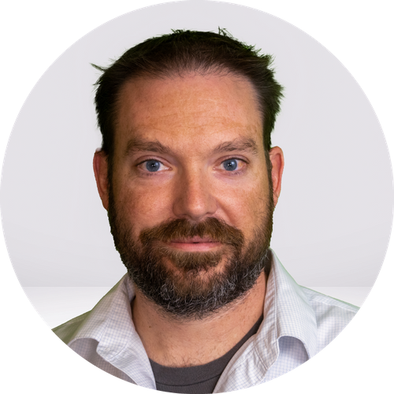
Tom Hocker
Senior Security Engineer - Kroger
Former Human Resources
Trace Labs Director
Operation Safe Escape Volunteer
DEF CON SECTF Contestant
Amateur Pythonista
Twttter: @human_decoded
Github: humanDecoded
Website: humandecoded.io
Discord: humanDecoded
Email: tom@humandecoded.io

Slide 3
Agenda
Groundwork
OSINT Overview
Intelligence
Investigations
Guidelines
Ethics
ROE
Safety
Setup
Objectives
OPSEC
Sock Puppets
VPNs
VMs
Note Taking
Organization
Techniques
Pivoting
Username Enumeration
Password Dumps
Photo Pivoting
Geolocation
Darkweb
Tools
Case Studies
Social Media Threats of Violence
Geolocating Organized Retail Crime
Connect phishing domains to IRL identities

Slide 4
Groundwork
What is OSINT?

Slide 5
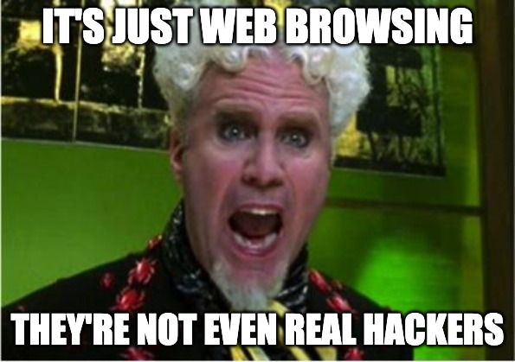

Slide 6
Groundwork
What is OSINT?
OSINT vs OSINF

Slide 7
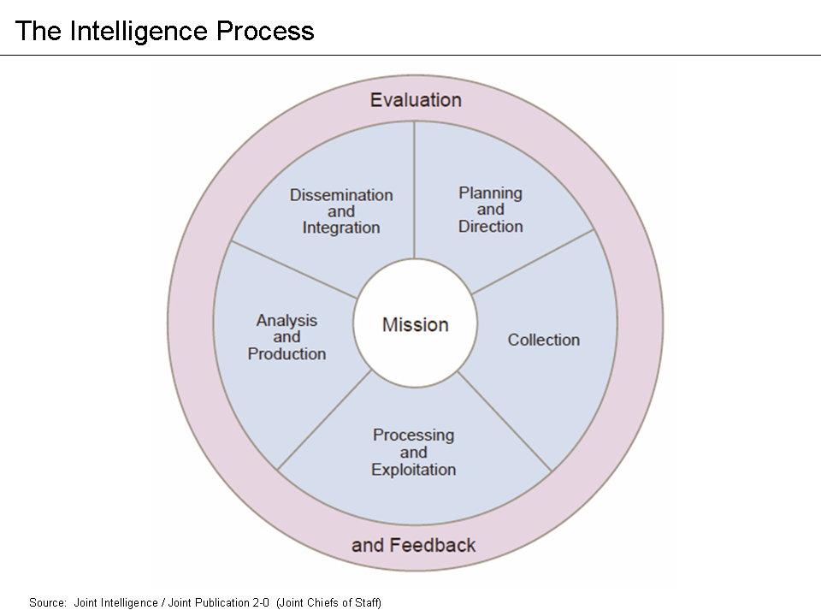
Groundwork
What is OSINT?
OSINT vs OSINF
Intelligence Life Cycle

Slide 8
Groundwork
What is OSINT?
OSINT vs OSINF
Intelligence Life Cycle
What can OSINT be used for?

Slide 9
Groundwork
What is OSINT?
OSINT vs OSINF
Intelligence Life Cycle
What can OSINT be used for?
Is OSINT legal?

Slide 10
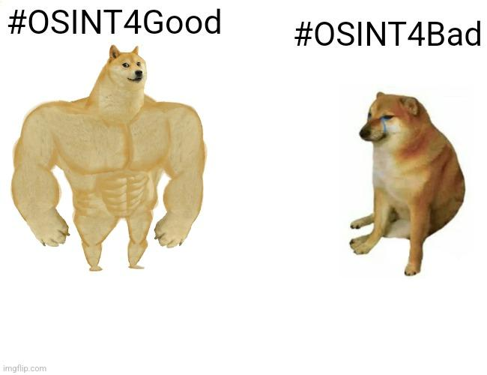
Groundwork

Slide 11
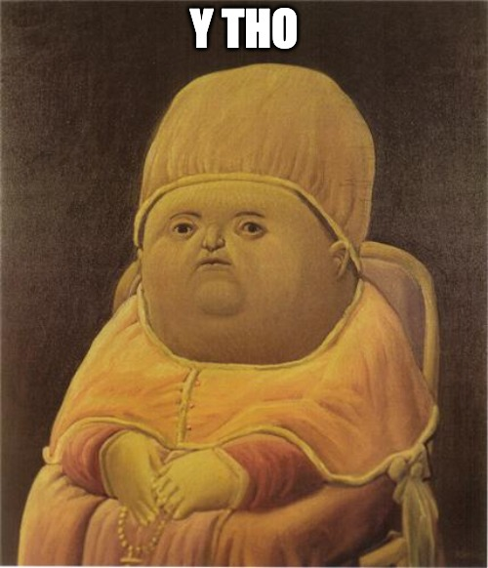
Guidelines and Guardrails

Slide 12
Guidelines and Guardrails
Ethics
Responsibility vs Legality

Slide 13
Guidelines and Guardrails
Ethics
Responsibility vs Legality
ROE
Allowed to do vs Willing to do

Slide 14
Guidelines and Guardrails
Ethics
Responsibility vs Legality
ROE
Allowed to do vs Willing to do
Reputation
Yours
Employer’s

Slide 15
Guidelines and Guardrails
Ethics
Responsibility vs Legality
ROE
Allowed to do vs Willing to do
Reputation
Yours
Employer’s
Responsibility
Do you sleep at night?
Where?

Slide 16
Guidelines and Guardrails
Ethics
Responsibility vs Legality
ROE
Allowed to do vs Willing to do
Reputation
Yours
Employer’s
Responsibility
Do you sleep at night?
Where?
Passive Recon

Slide 17
Guidelines and Guardrails
Ethics
Responsibility vs Legality
ROE
Allowed to do vs Willing to do
Reputation
Yours
Employer’s
Responsibility
Do you sleep at night?
Where?
Passive Recon
Grey Techniques

Slide 18
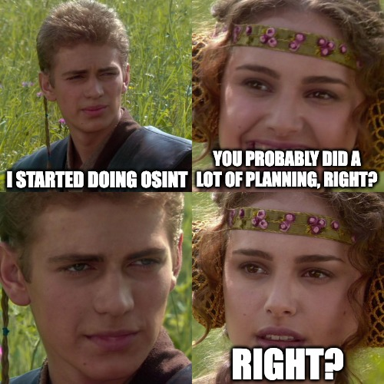
Setup – Before you open a Browser

Slide 19
Setup – Before you open a Browser
Story Time!!!!
Notes:
sectf prep story and intro to osint

Slide 20
Setup – Before you open a Browser
Define your objective

Slide 21
Setup – Before you open a Browser
Define your objective
Who, What, When, Where?

Slide 22
Setup – Before you open a Browser
Define your objective
Who, What, When, Where?
Define “redlines”

Slide 23
Setup – Before you open a Browser
Define your objective
Who, What, When, Where?
Define “redlines”
Define success

Slide 24
Setup – OPSEC
“By the time you realize you need better OPSEC…it’s too late” - SinWindie

Slide 25
Setup – OPSEC
What is OPSEC?

Slide 26
Setup – OPSEC
What is OPSEC?
How much do you need?

Slide 27
Setup – OPSEC
What is OPSEC?
How much do you need?
You will get burned. Plan accordingly

Slide 28
Setup – OPSEC
What is OPSEC?
How much do you need?
You will get burned. Plan accordingly
Mistakes are forever!
Notes:
dread pirate roberts
pompom

Slide 29
Setup – OPSEC – Sock Puppets
What even is a sock puppet?

Slide 30
Setup – OPSEC – Sock Puppets
What even is a sock puppet?
Why do you need them? -> “Why are drug dealers friending me?”

Slide 31
Setup – OPSEC – Sock Puppets
What even is a sock puppet?
Why do you need them? -> “Why are drug dealers friending me?”
Where do you need them?

Slide 32
Setup – OPSEC – Sock Puppets
What even is a sock puppet?
Why do you need them? -> “Why are drug dealers friending me?”
Where do you need them?
Creation, Care and Feeding
Mobile is your friend
Minimum effort
Make as many as possible

Slide 33
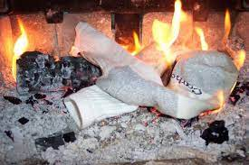
Setup – OPSEC – Sock Puppets
What even is a sock puppet?
Why do you need them? -> “Why are drug dealers friending me?”
Where do you need them?
Creation, Care and Feeding
Mobile is your friend
Minimum effort
Make as many as possible

Slide 34
Setup – OPSEC – Tools + Thoughts
VPNs – Obfuscating your IP

Slide 35
Setup – OPSEC – Tools + Thoughts
VPNs – Obfuscating your IP
VMs – Compartmentalization and Organization

Slide 36
Setup – OPSEC – Tools + Thoughts
VPNs – Obfuscating your IP
VMs – Compartmentalization and Organization
Operating Systems

Slide 37
Setup – OPSEC – Tools + Thoughts
VPNs – Obfuscating your IP
VMs – Compartmentalization and Organization
Operating Systems
Logs are forever

Slide 38
Setup – OPSEC – Tools + Thoughts
VPNs – Obfuscating your IP
VMs – Compartmentalization and Organization
Operating Systems
Logs are forever

Slide 39
Setup – Other Considerations
Note Taking
Screenshots
Report as you go
Take your time

Slide 40
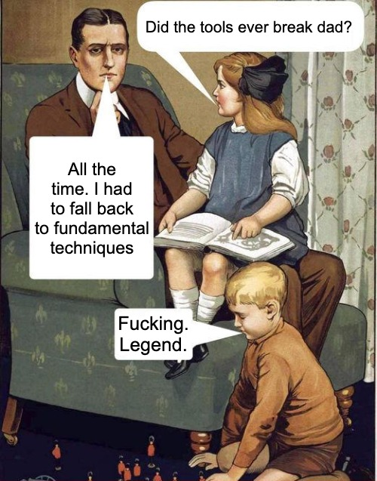
Techniques - Overview

Slide 41
Techniques - Overview
We all have to start somewhere…..and it’s the most important part
“Your techniques are dictated by your Environment…not the other way around”

Slide 42
Techniques - Overview
We all have to start somewhere…..and it’s the most important part
Take the time to see what’s in front of you
“Your techniques are dictated by your Environment…not the other way around”

Slide 43
Techniques - Overview
We all have to start somewhere…..and it’s the most important part
Take the time to see what’s in front of you
Seriously. Just Look.
“Your techniques are dictated by your Environment…not the other way around”

Slide 44
Techniques - Overview
We all have to start somewhere…..and it’s the most important part
Take the time to see what’s in front of you
Does the information in front of you answer your question?
“Your techniques are dictated by your Environment…not the other way around”

Slide 45
Techniques - Overview
We all have to start somewhere…..and it’s the most important part
Take the time to see what’s in front of you
Does the information in front of you answer your question?
Pivot
“Your techniques are dictated by your Environment…not the other way around”

Slide 46
Techniques – Username Enumeration
Uncover new identities and pivot points

Slide 47
Techniques – Username Enumeration
Uncover new identities and pivot points
Reinforce connections to existing intelligence

Slide 48
Techniques – Username Enumeration
Uncover new identities and pivot points
Reinforce connections to existing intelligence
Same handle != Same Person

Slide 49
Techniques – Username Enumeration
Uncover new identities and pivot points
Reinforce connections to existing intelligence
Same handle != Same Person
Let’s find all the “humanDecodeds” !!!

Slide 50
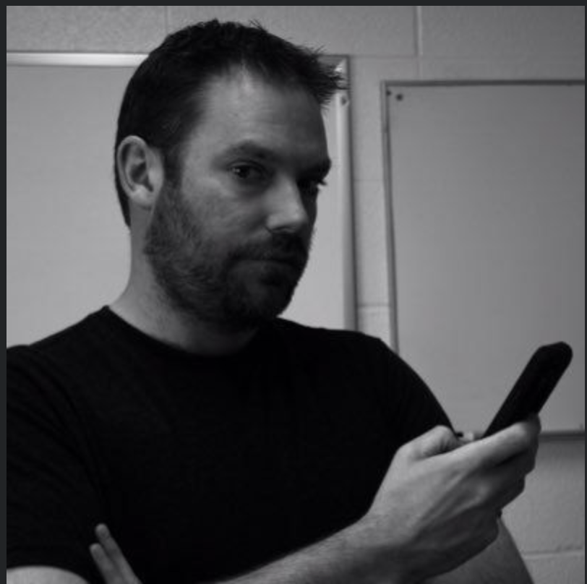
Techniques – Photos
What are the photos telling you?
Hobbies, Activities, Passions
Who else is in the photo?

Slide 51
Techniques – Photos
What are the photos telling you?
Hobbies, Activities, Passions
Who else is in the photo?
Where else is the photo?

Slide 52
Techniques – Photos
What are the photos telling you?
Hobbies, Activities, Passions
Who else is in the photo?
Where else is the photo?
Exif data

Slide 53
Techniques – Photos
What are the photos telling you?
Hobbies, Activities, Passions
Who else is in the photo?
Where else is the photo?
Exif data
Let’s go find Tom!

Slide 54
Techniques – Photos - Geolocation
Goal = “Where was this photo taken”
What do you know about the photo?
What is the photo telling you?
Time of day
Time of year
Scenery
Items in the picture
Artifacts to pivot on

Slide 55
Techniques – Photos - Geolocation
Goal = “Where was this photo taken”
What do you know about the photo?
What is the photo telling you?
Time of day
Time of year
Scenery
Items in the picture
Artifacts to pivot on
Demo time!!!

Slide 56
Techniques – Passwords
Password Dumps
HIBP -> enumeration
Breaches -> pivots and enriched information
Password Resets -> I don’t like these

Slide 57
Techniques – Passwords
Password Dumps
HIBP -> enumeration
Breaches -> pivots and enriched information
Password Resets -> I don’t like these
What can we learn about Tom?

Slide 58
Techniques – Phone Numbers
Great for validating other pieces of intelligence
Number of reverse lookup services
Might be able to lookup in data dumps

Slide 59
Techniques – People Search Services
They are (usually) pulling from open sources
Information is good but must be verified
Your searches are being logged

Slide 60
Techniques – People Search Services
They are (usually) pulling from open sources
Information is good but must be verified
Your searches are being logged
Let’s go find Tom!!!!

Slide 61
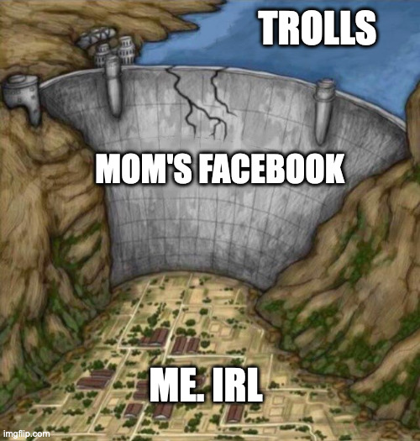
Techniques – Family and Friends
They will betray you….
Previously unknown photos or other PI
Pivot point to other social media accounts

Slide 62

Techniques – Darkweb
Username enumeration
PGP Keys
Speech patterns and phrases
Join date
Cross Posting
Oh no. My Iceberg graphic didn’t load :(

Slide 63
Questions - Final Thoughts - Next Steps

