Slide 1
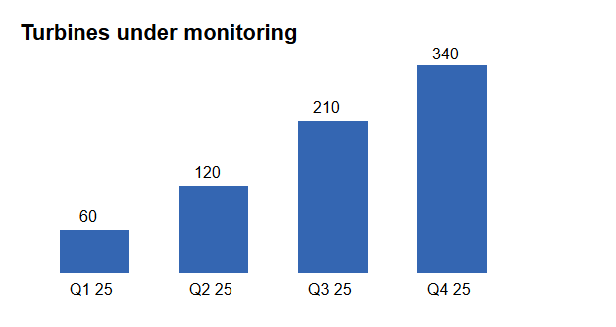
Traction
Growth since launch

