Slide 1
It’s not always Sunny in Relationally Rich Jobs: the Influence of Negative Beneficiary Contract
Author：Jordan D. Nielsen, Amy E. Colbert
2022, AMJ
2023.03.30
Notes:
这张PPT注明标题作者期刊等简要信息。
总的来说，推荐大家多用图表如流程图、框图等（Smartart），对所介绍内容进行总结性的介绍。

Slide 2
Subject Words
1. Beneficiary (people whom employees believe their actions at work have the potential to positively affect)
2. Negative contact (unpleasant interactions with people whom employees believe they have the potential to positively affect)
3. Social information processing theory
4. Perceived social worth
5. Perceived self-sacrifice
6. Emotional motivation
2
Notes:
论文的主题词，不限于摘要下的关键词，可以对较为关键的、难以理解的词加以解释。

Slide 3
Abstract
Contact with beneficiaries has been described as an important job characteristic for shaping perceptions about the social value of work; however, little is known about how to navigate experiences in which contact with beneficiaries is negative, which can explicitly undermine the conclusion that work is socially valuable. We draw from two tenets of social information processing theory to propose that negative contact with beneficiaries has a dual effect on employees. Whereas negative contact may make employees perceive low social worth, it may simultaneously lead employees to believe they are engaging in self-sacrifice for a worthy cause—a relatively positive justification of such experiences.
3
Notes:
不是把摘要复制，是把摘要中的关键部分单拿出来介绍，重点（如研究差距GAP、研究动机、理论应用视角）标红 or 加粗【若有的话】。

Slide 4
Research motivation
In real life, there are many negative contact behaviors between the service personnel and the service personnel. Specific examples of negative beneficiary contact include patients' unreasonable demands on nurses during hospitalization, students' disregard of teachers' teaching rules throughout the school year, various one-time customers' rude behavior towards baristas, and customers' active questioning of the ability of consultants during appointments. However, it is unclear how this negative contact behavior will affect employees' job satisfaction, because it will affect employees' job performance.
4
Notes:
研究动机，若上一张PPT中未充分揭示，则可以在这一张PPT中重点介绍。根据文章中的摘要和引言部分，可以按照现实动机和理论动机两方面介绍。适当的部分加以醒目标识。

Slide 5
Research motivation
Although prior studies have illuminated essential aspects of how employees cope with negative beneficiary contact, additional research is needed to directly assess how negative contact affects the perceived social value of one’s work and, perhaps more importantly, how employees can derive positive meaning from negative contact. Do these negative experiences simply undermine the perceived value of one’s work, or can employees justify such experiences in a way that helps them continue to see the value of their work? Under what conditions are employees more likely to make positive meaning from negative beneficiary contact, and what conditions allow such a justification to produce greater satisfaction and performance?
5
Notes:
同上

Slide 6
Theories
Social information processing theory
人们不可能生活工作在真空场所内，而是嵌套在充满丰富环境信息的组织中。社会信息处理理论认为个体的态度与行为受到环境信息的影响，如工作要求、环境预期等。
社会信息处理理论聚焦于人们如何确定期望、标准及态度，旨在解释工作环境如何影响员工各种反应和工作结果，其核心观点认为人是具有较高环境适应性的有机体，将主动或被动地收集所处组织释放的各种环境信息，并按照一定的有序过程处理信息，调整、控制自己的态度与行为。一方面，组织认可的信念、需要和理由等，直接帮助员工个体进行自我意义构建。如组织对工作要求所依据的道德标准和原则进行持续声明，促使员工拒绝此类陈述，或将其包含在自我评估中。另一方面，特定的人际环境和客观环境会将员工个体注意力集中在特定信息上，使此类信息更加突出，提高期望，暗示个体行为的逻辑后果。如同事或团队强调员工个体行为会对顾客造成不利影响，指出其行为不符合普适社会道德规范。
社会信息处理理论认为员工依靠环境信息评估工作的重要性和相关性，当一项行为符合群体标准时，组织员工将视其有较高参与价值，即员工个体会根据环境中释放的信号相应地调整自己的态度和行为，使自身与环境相融洽。当员工感受到高度积极的环境氛围时，往往会产生积极情绪，促进个人自我改进和心理发展。
6
Notes:
适当介绍本文所用理论，可以用中文介绍，更易理解

Slide 7
Theories
Application of social information processing theory in this paper
2. Rationalization
1. Information saliency
7
Notes:
总结上张PPT所展示理论在本文中的应用视角或论点，可以的话，可以用一定的图表表示。选项卡插入->插图->Smartart

Slide 8
Theories
1. Negative contact provides salient information that may make employees perceive a lack of value in their work (low perceived social worth)
2. Negative contact also may simultaneously lead employees to rationalize their work as self-sacrifice for a worthy cause.
8
Notes:
对上一张PPT中的图表表示的理论应用加以解释

Slide 9
Study1
Hypothesis
Hypothesis 1. Negative beneficiary contact is negatively related to perceived social worth.
Hypothesis 2. Negative beneficiary contact is positively related to perceived self-sacrifice.
Hypothesis 3. Perceived social worth is positively related to job satisfaction.
Hypothesis 4. Perceived social worth is positively related to (a) job performance and (b) helping behavior.
Hypothesis 5. Coworker emotional support moderates the relationship between perceived self-sacrifice and job satisfaction, such that the relationship is more positive at higher levels of support.
Hypothesis 6. Coworker emotional support moderates the relationship between perceived self-sacrifice and (a) job performance and (b) helping behavior, such that the relationship is more positive at higher levels of support.
9
Notes:
从这一张PPT开始，进入到正式的研究部分。由假设发展、假设检验等部分组成。首先是介绍本文中的假设。假设部分推荐用新罗马字体斜体。

Slide 10
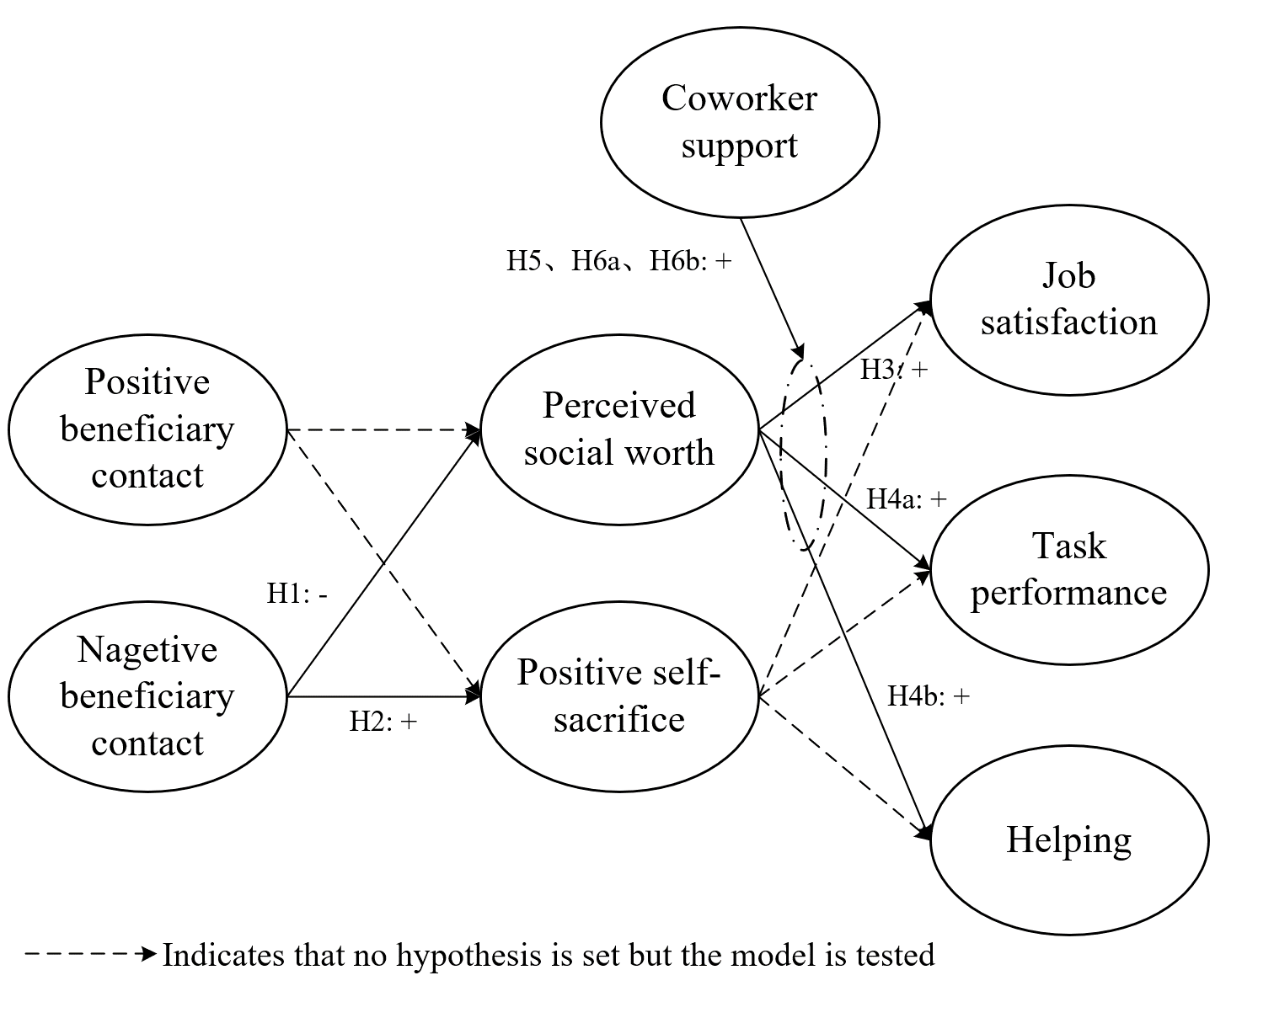
Study1
Hypothesis
10
Notes:
这张图原文中并没有，是我自己画的。这里推荐将假设以框图的形式表示。所选的文章中部分文章是没有的，需要大家自己动手画图进行标注，推荐用微软Visio作图。

Slide 11
Study1
Method
Survey
large academic medical center in the Midwestern United States
A time-lagged survey design
The first survey included measures of positive and negative beneficiary contact;
the second survey included measures of perceived social worth, perceived self-sacrifice, and coworker support;
the third survey included a measure of job satisfaction.
11
Notes:
这里讲述研究的方法部分，例如这里用的是问卷量表的方法。可以讲述一下样本来源、收集过程。另起一张PPT，将数据的相关性、信效度检验表格截图或自己做一个表格总结进行展示（若有的话）。

Slide 12
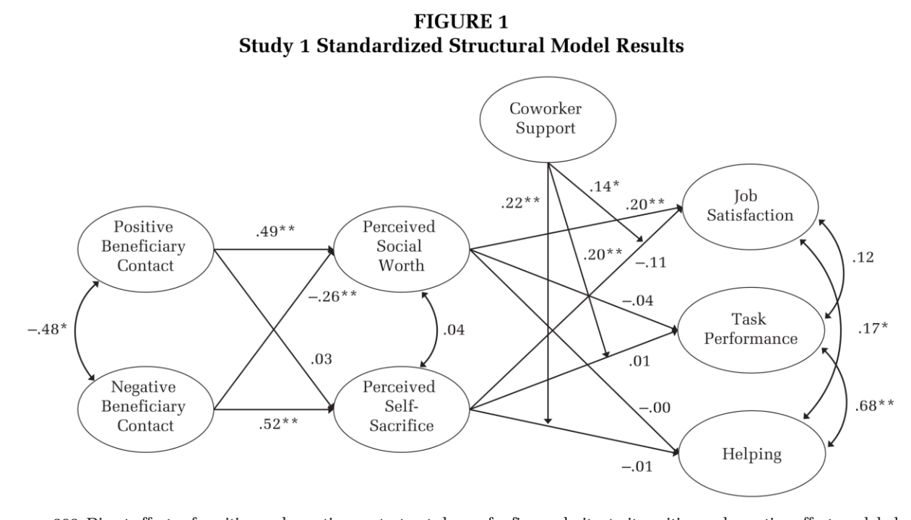
Study1
Result
12
Notes:
总结研究的结果。可以是表格，可以是框图。文章中分析结果表格一般都有，框图部分有。若有的话可以两者均展示。表格的话，需要对与前面假设相关的系数显著性等用框框圈起来。插入->形状->矩形等形状均可

Slide 13
Study1
Discussion
Coworker emotional support appears to enhance the motivational potential inherent in perceived self-sacrifice, and attenuates the negative relationships between perceived selfsacrifice and job satisfaction.
Limitation
Our ability to make causal inferences is limited by the study design.
Whether our findings apply to other work contexts where the concept of sacrifice and social worth may not be as salient.
Study 2
Study 3
13
Notes:
这里介绍文章的讨论部分和局限性。由于这篇文章分为了三个子研究，由局限性引入后续两个研究，这里的讨论和局限性较少。正常情况下，讨论部分分为总结性的讨论、理论贡献、实践启示（见20、21页）。之后可以另起一张PPT介绍局限性。

Slide 14
Study2
Hypothesis
Hypothesis 7. An attribution that a high level of negative contact is caused by the nature of the work will be associated with higher levels of perceived self-sacrifice than will a performance attribution.
Hypothesis 8. Affective commitment to beneficiaries will moderate the relationship between negative beneficiary contact and perceived self-sacrifice, such that the relationship is more positive at high levels of affective commitment.
14

Slide 15
Study2
Method
Experimental vignette methodology (Experimental vignette studies are particularly useful for strengthening internal validity)
Participants were given a scenario that asked them to imagine that they had just completed two years at a new job that was virtually identical to their current nursing job in terms of expectations and responsibilities. They were then randomly assigned to different vignettes that described their job experiences over the preceding two years.
We designed a high negative contact vignette that was explicit about experiencing negative interactions, drawing language directly from scale items used in Study 1 (e.g., “complain about or get angry with you”).
Three vignettes of approximately the same length were developed: negative contact attributed to the work itself, negative contact attributed to one’s own job performance, and a “low” negative contact condition that provided basic, neutral information from O*NET (onetonline.org) describing generic tasks and skills associated with a typical nursing position.
Participants were randomly assigned to one of the three vignettes. They were asked to click a button confirming that they had carefully read and imagined the scenario provided. After reading the vignette, they answered manipulation checks for negative contact and attribution (if applicable).
15
Notes:
这里研究2用的是实验方法，一般介绍实验方法的话，需要介绍一下实验的步骤，文章中会有介绍，适当粘贴就好。

Slide 16
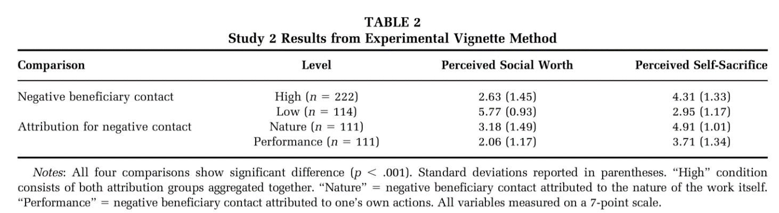
Study2
Result
16

Slide 17
Study2
Discussion
The results provide stronger grounds for making causal inferences regarding the relationship of negative beneficiary contact with perceived social worth and perceived self-sacrifice.
Study 2 rules out an alternative explanation for the results in Study 1: that employees may interpret negative contact as sacrificial as an excuse for poor performance.
Limitation
The study 2 is limited by a focus on one type of job, and the vast majority of participants were women.
Study 3
17

Slide 18
Study3
Method
Survey
we conducted a third study consisting of a two-wave survey of participants on the Prolific platform (www.prolific.co).
Subjects were recruited from the United States and considered eligible for the study if they worked full-time in a “customer-facing” position.
(e.g., customer service representatives, salespeople, clerks, analysts, healthcare professionals, inspectors, educators, accountants).
18

Slide 19
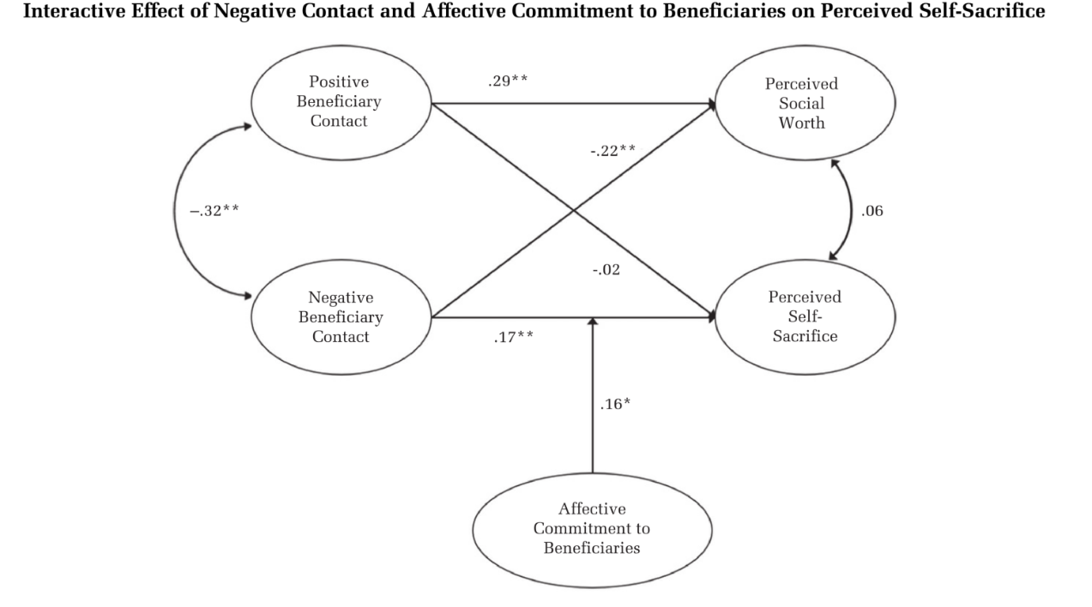
Study3
Result
19

Slide 20
General conclusion
Discussion
Negative contact was associated with perceptions of social worth (negatively) and self-sacrifice (positively), with the latter having a beneficial effect on job performance contingent on emotional support from coworkers;
The negative effect of self-sacrifice on job satisfaction was attenuated at high levels of emotional support. Perceived social worth predicted job satisfaction but did not predict job performance or helping behavior.
An experimental vignette methodology enabled us to draw causal inferences about the effects of high negative contact on social worth and self-sacrifice and show that these effects were contingent upon negative contact being attributed to the work itself rather than provocation by one’s wn actions.
The effect of negative contact on self-sacrifice was contingent on the employee’s affective commitment to beneficiaries.
20

Slide 21
General conclusion
Implication
On one hand, jobs should be designed so that they fulfill important employee needs; on the other hand, even enriched jobs require employees to continually justify their experiences so that they emphasize the positive aspects but minimize the negative aspects.
Organizations should be careful not to engage in malicious manipulation or exploitation, which is likely to end with resentful employees who question the moral foundations of their managers. Rather, leaders need to be perceived as genuine when sharing stories or highlighting positive social information in order to influence employees.
Organizations should clearly define the situations in which self-sacrifice accounts are appropriate and distinguish between negative beneficiary contact caused by employees and negative beneficiary contact that is inherent to the work.
Organizations that are considering a redesign or restructuring of jobs should consider the costs of increasing beneficiary contact in addition to whatever motivational benefits may result. This study demonstrates that high contact facilitates positive contact that inspires employees, but also exposes employees to negative contact that is costly and trying.
Redesign efforts should weigh the benefits and the costs, and provide the resources that employees will need to adequately sustain their work efforts with beneficiaries.
21

Slide 22
与案例的联系
案例中主要探讨了组织（蚌埠医院）中“员工忠诚度”、“员工激励”、“工作满意度”的问题。在这篇论文中，两位作者同样选取医院为研究背景，研究了护士这一服务人员在面对负面的受益人接触时对其工作满意度的影响。
与案例不同的是，案例的切入点是医院编外人员的员工忠诚度，考虑形成一个能够良好平衡编外人员和编内人员的管理制度和组织架构；而论文针对的是被服务人员的负面接触对护士工作满意度的影响，更加侧重员工心里感知自己的工作是否创造了价值，进而产生工作的满足感。
22
Notes:
可以用一张PPT，列两三点与案例的联系。

Slide 23


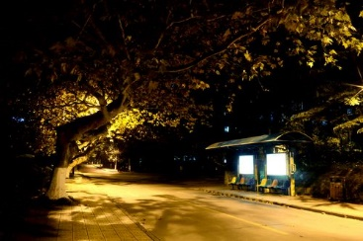
Thanks for your attention！

