Slide 1
ORIGINS AND DESTINATIONS, DISTANCES AND DIRECTIONS: ACCOUNTING FOR THE JOURNEY IN THE EMOTION REGULATION PROCESS
Author：Brent A. Scott
2020, AMR
2023.04.12
Notes:
这张PPT注明标题作者期刊等简要信息。
总的来说，推荐大家多用图表如流程图、框图等（Smartart），对所介绍内容进行总结性的介绍。

Slide 2
Subject Words
1.The Affect Circumplex
2. Emotional Distance
3. Emotional Direction
4. Depletion
5. Underlying Emotions
6. Inauthenticity
2

Slide 3
Abstract
Reconceptualize emotion regulation as a journey involving the joint interplay of distance, direction, and method of travel. Drawing from the circumplex model of affect, we introduce the concepts of “emotional distance” and “emotional direction” to map the discrepancies between the emotion an individual currently feels and the emotion that individual attempts to display via emotion regulation. We describe how emotional distance and emotional direction augment constructs and theories relevant to emotion regulation, and we explain how the combined consideration of distance, direction, and method of travel is necessary to fully understand the intrapersonal consequences of regulating emotion.
3

Slide 4
Research motivation
By demonstrating that distance, direction, and method of travel are all essential to fully understand the nature and consequences of emotion regulation, our framework extends and alters what is currently known about emotion regulation based on existing theories and provides a more holistic explanation of this complex phenomenon.
Better emotion regulation leads to better performance and well-being.
4
Notes:
同上

Slide 5
Theories
The Affect Circumplex
In prior research scholars have posited two major bipolar dimensions that govern the ordering of discrete emotions around the perimeter of the affect circumplex.
Watson and Tellegen (1985) proposed an alternate set of dimensions, labeled positive affect and negative affect, obtained by rotating the evaluation and arousal dimensions 45 degrees.
5
Notes:
适当介绍本文所用理论，可以用中文介绍，更易理解

Slide 6
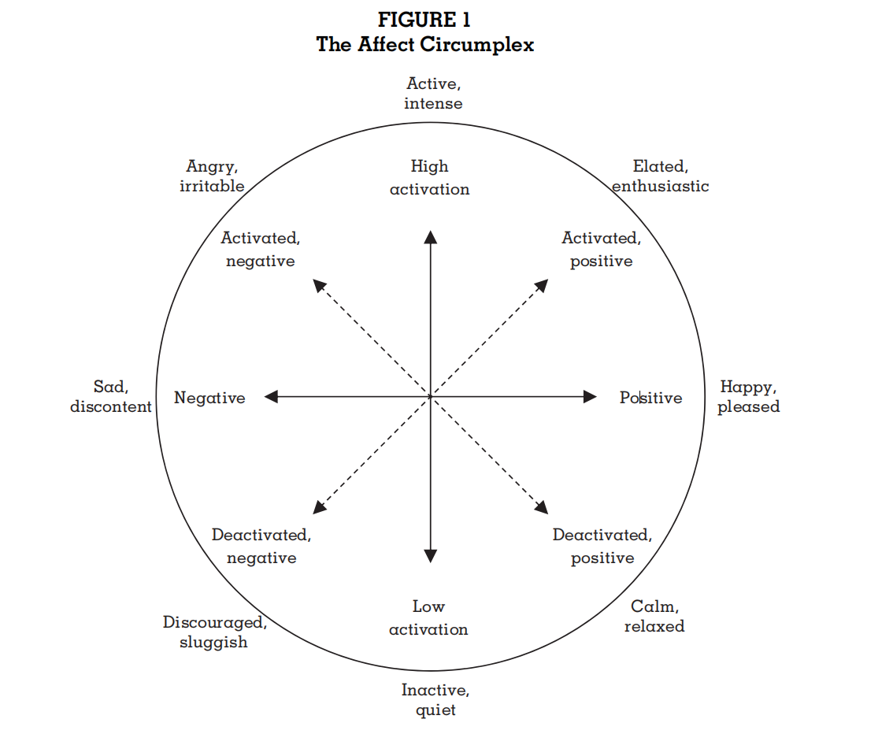
Theories
6
Notes:
总结上张PPT所展示理论在本文中的应用视角或论点，可以的话，可以用一定的图表表示。选项卡插入->插图->Smartart

Slide 7
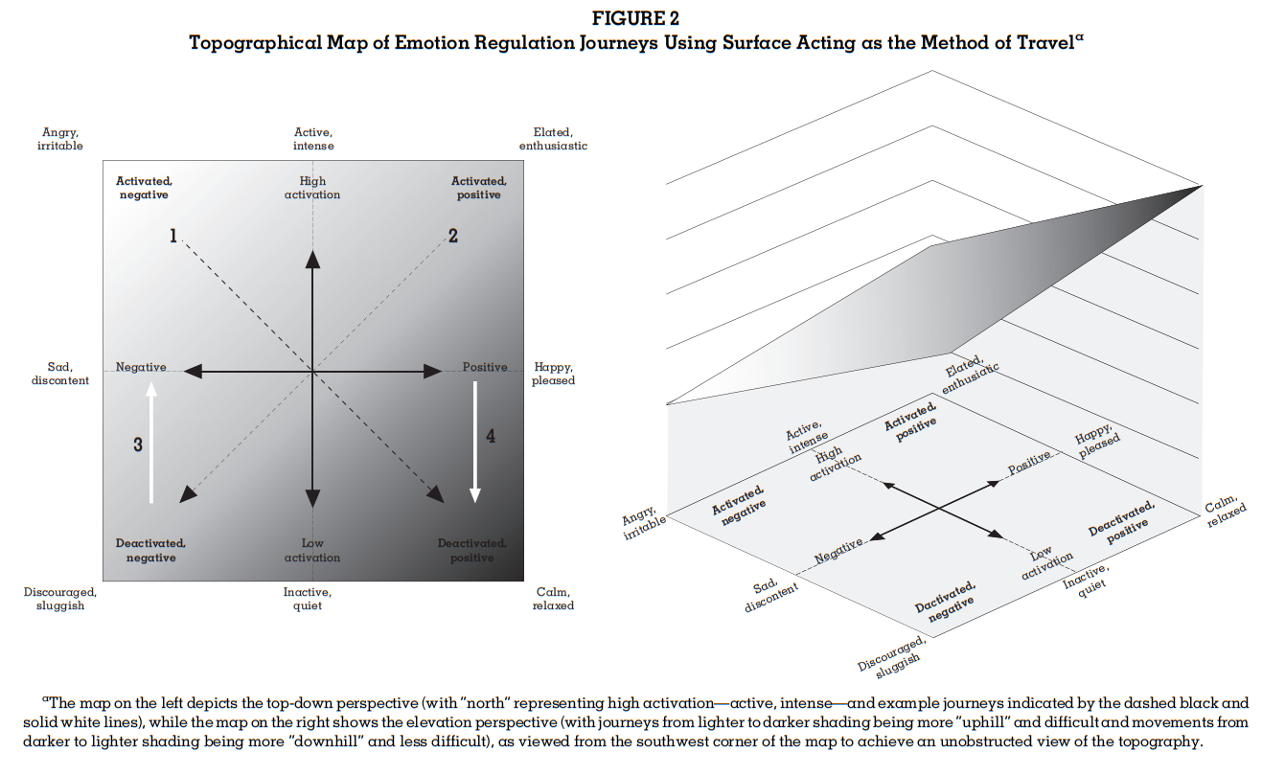
Study
7

Slide 8
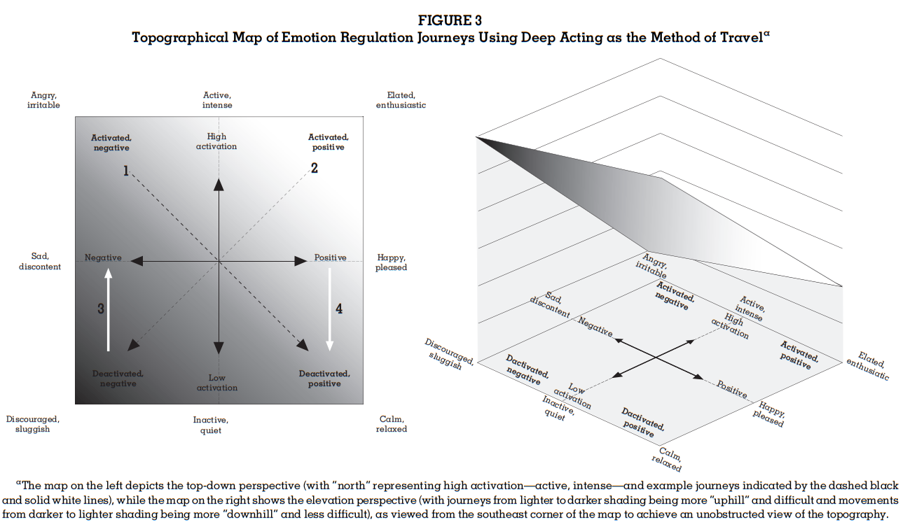
Study
8

Slide 9
Study
Depletion
Previous theories focus on method of regulation, but failed to recognize the origin and destination.
More changes, more depletion.
Hiding active feelings is more depleting.
9

Slide 10
Study
Depletion
Emotional distance and emotional direction jointly determine the depletion involved in an emotion regulation journey such that journeys become more depleting as (a) distance increases and/or (b) the direction is from a more activated state to a less activated state, regardless of the method of travel (i.e., surface acting or deep acting).
10

Slide 11
Study
Underlying Emotions
What a person truly feels matters
Surface acting from negative to positive is not as good as deep acting. Because faking positive emotions while feeling negative emotions is exhausting.
While surface acting from positive to negative emotions is better
11

Slide 12
Study
Underlying Emotions
Emotional direction and method of travel jointly determine the underlying emotions that are felt as a result of an emotion regulation journey. Journeys from negative to positive emotion are more harmful (more beneficial) when surface acting (deep acting) is used, whereas journeys from positive to negative emotion are more beneficial (more harmful) when surface acting (deep acting) is used.
12

Slide 13
Study
Inauthenticity
When distance travelled increases, inauthenticity increases.
Extraversion and neuroticism determines which kind of emotion is more authentic
People tend to ignore inauthenticity of negative emotions. Because taking them seriously is beneficial.
People realize inauthenticity of deactivated emotions more. Because active emotions will leak more easily.
13

Slide 14
Study
Inauthenticity
Emotional distance, emotional direction, and method of travel jointly determine the amount of inauthenticity felt during an emotion regulation journey. When surface acting (but not deep acting) is used, actors’ feelings of inauthenticity increase as (a) distance increases and/or (b) the direction is more trait incongruent.
Emotional distance, emotional direction, and method of travel jointly determine the amount of inauthenticity perceived by observers during an emotion regulation journey. When surface acting (but not deep acting) is used, observers’ perceptions of inauthenticity increase as (a) distance increases and/or (b) the direction is from a more activated negative state to a less activated positive state.
14

Slide 15
General conclusion
By virtue of the variety of emotions that individuals experience on a day-to-day basis and the emotions they may need to express in a given situation, the emotional journey they undertake when regulating their emotions may be far in some cases and near in others, and the route they take on that journey may be difficult in some cases and easy in others.
A joint consideration of differences in emotional distance and emotional direction holds great explanatory power for people’s subsequent well-being and performance.
15

Slide 16
与案例的联系
案例中大量涉及情绪调节，其中多为负面，不活跃的情绪向正面，活跃的情绪调节，根据上面提到的理论可以设计更合理的调节方法
马小燕：未采取 deep acting导致 leak of negative feelings
马宁：Deactivated & negative to deactivated & positive using deep acting
16
Notes:
可以用一张PPT，列两三点与案例的联系。

Slide 17


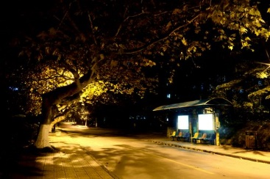
Thanks for your attention！

