Slide 1
Chapter 1-3 Course Implementation
计算机系统概论
Introduction to Computing Systems
（ CS1002A.01 ）
计算机科学与技术学院
School of Computer Science and Technology

Slide 2
Outline
1
Course and Crew
2
Computer is in Everything!
3
Why Take This Course?
4
Great Ideas in Computing Systems
5
What’s This Course All About ?
6
Summary

Slide 3
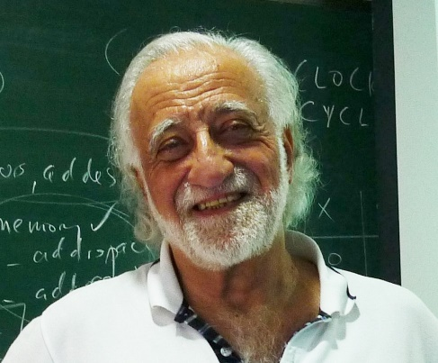
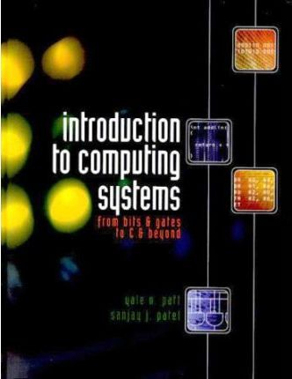
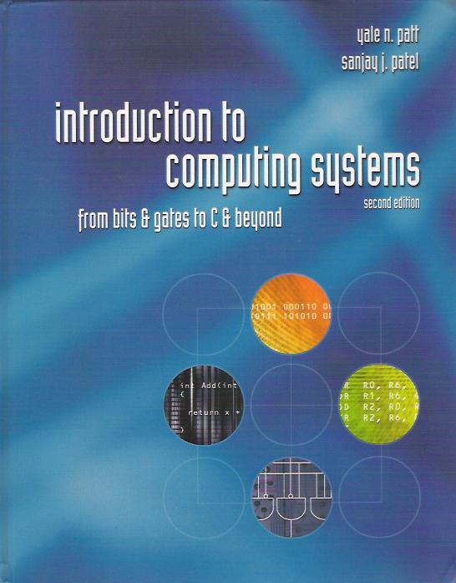
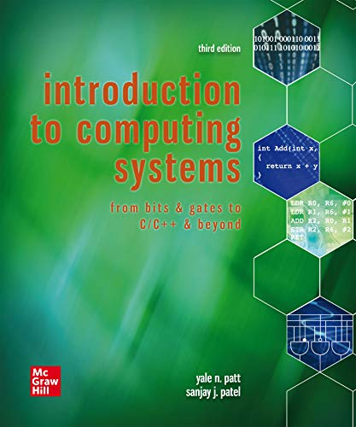
Text Book
Introduction to computer architecture(ISA)
How is data represented?
What are the pieces of a computer?
How do computers work?
Programming
How do I "talk" directly to the machine?-Assembly language
How do I program in “C”?-high level language(HLL)
Computer systems and computation
How do simple HW/SW elements come together to realize complex computations?
Introduction to Computing Systems: from bits and gates to C/C++and beyond(3nd edition),
Yale N. Patt and Sanjay J. Patel， September 2019, McGraw-Hill Higher Education

Slide 4
Text Book 参考资料 by Patt
工具和习题
https://highered.mheducation.com/sites/1260150534/student_view0/
试卷和参考 EE 306 - Exams (utexas.edu)
https://users.ece.utexas.edu/~patt/21f.306/exams.html
Introduction to Computing Systems: from bits and gates to C/C++and beyond(3nd edition),
Yale N. Patt and Sanjay J. Patel， September 2019, McGraw-Hill Higher Education

Slide 5
Text Book Components
Part 1: Hardware(Chapter 1-4)
Representing data,
transistors,
gates,
digital logic structures
von Neumann machine model
Part 2: Software: Assembly language(Chapter 5-10)
Instructions,
(structured) programming,
input/output,
relationship to hardware
Part 3: Software: C programming(Chapter11-19), selected
Syntax, operators, control structures, functions, pointers, recursion, data structures, relationship to assembly language
Assume already familiar with programming (C)

Slide 6
This Course Focus on
Chapt 2 Bits, Data Types, and Operations
How do we represent information using electrical signals?
Chapt 3 Digital Logic Structures
How do we build circuits to process information?
Chapt 4, 5,6 Computer Machine Model, Processor and Instruction Set
How do we build a processor out of logic elements?
What operations (instructions) will we implement?
Chapt 7 Assembly Language Programming
How do we use processor instructions to implement algorithms?
How do we write modular, reusable code? (subroutines)
Chapt 8 Data Structures
Chapt 9 I/O, Traps, and Interrupts
How does a processor communicate with outside world?
Chapt 11, C Implementation related to hardware

Slide 7
Abstraction Layers in Modern Systems
Application
Application
Algorithm and Data Structure
Programming Language/Compiler
Operating System/Virtual Machines
Instruction Set Architecture (ISA)
Microarchitecture
Gates/Register-Transfer Level (RTL)
Analog/Digital Circuits
Electronic Devices
Physics

Slide 8
Transformations Between Layers
How do we solve a problem using a computer? A systematic sequence of transformations between layers of abstraction.
Problem
Software Design:
choose algorithms and data structures
Algorithm
Programming:
use language to express design
Program
Compiling/Interpreting:
convert language to machine instructions
Instr Set
Architecture
Notes:
8
算法（Algorithm）是指解题方案的准确而完整的描述，是一系列解决问题的清晰指令，算法代表着用系统的方法描述解决问题的策略机制。也就是说，能够对一定规范的输入，在有限时间内获得所要求的输出。如果一个算法有缺陷，或不适合于某个问题，执行这个算法将不会解决这个问题。不同的算法可能用不同的时间，空间或效率来完成同样的任务。一个算法的优劣可以用空间复杂度与时间复杂度来衡量。

Slide 9
Deeper and Deeper…
Instr Set
Architecture
Processor Design:
choose structures to implement ISA
Microarch
Logic/Circuit Design:
gates and low-level circuits to implement computer components
Circuits
Process Engineering & Fabrication:
develop and manufacture lowest-level components
Devices
Notes:
9

Slide 10
Descriptions of Each Level
Problem Statement
stated using "natural language"
may be ambiguous, imprecise
Algorithm
step-by-step procedure, guaranteed to finish
definiteness, effective computability, finiteness
Program
express the algorithm using a computer language
high-level language, low-level language
Instruction Set Architecture (ISA)
specifies the set of instructions the computer can perform
data types, addressing mode

Slide 11
Descriptions of Each Level (cont.)
Microarchitecture
detailed organization of a processor implementation
different implementations of a single ISA
Logic Circuits
combine basic operations to realize microarchitecture
many different ways to implement a single function (e.g., addition)
Devices
properties of materials, manufacturability
Notes:
11

Slide 12
Many Choices at Each Level
Solve a system of equations
Red-black SOR
Gaussian
elimination
Jacobi
iteration
Multigrid
FORTRAN
C
C++
Java
Tradeoffs:
cost
performance
power
(etc.)
Sun SPARC
Intel x86
IBM PowerPC
Pentium 4
Core 2 Duo
AMD Athlon X2
Ripple-carry adder
Carry-lookahead adder
Static CMOS
Dynamic CMOS
Nanomechanical
Notes:
12
Sun and Java are trademarks of Sun Microsystems, Inc. SPARC is a trademark of SPARC International, Inc. Intel and Pentium are trademarks of Intel Corporation. IBM and PowerPC are trademarks of IBM Corporation. AMD and Athlon and trademarks of Advanced Micro Devices, Inc.
Red-Black Successive Over-Relaxation (SOR) is a method of solving partial differential equations. In the parallel version, the program divides the red and the black array into roughly equal size bands of rows, assigning each band to a different processor. Communication occurs across the boundary rows between bands. In the TreadMarks version, the arrays are allocated in shared memory, and processors synchronize using barriers. With PVM, each processor explicitly sends the boundary rows to its neighbors
In numerical analysis, a multigrid method (MG method) is an algorithm for solving differential equations using a hierarchy of discretizations.
行波进位（Ripple Carry）与超前进位（Loodahead Carry)

Slide 13
Course Objectives
Understand role & relationship of hardware and software
Exposure to （接触到）. . .
Machine organization
Assembly language programming
Understand how to build entire (slow) computing system
Hardware and software
Be distinguished from mere programmers
计算机系统（晶体管器件、数字逻辑、组成原理、高级语言的编译与汇编、高级语言的硬件实现、操作系统）核心概念和思想的最小集

Slide 14
Course Objectives
“Any sufficiently advanced technology is indistinguishable from magic.”
Arthur C. Clarke, "Profiles of The Future” (Clarke's 3rd law)
No magic: Computers should NOT be magic to computer scientists!
Bottom UP: Start with what they “know” (I wish)
Computing systems from transistors on up
The transistor as light switch
Choose a computer model that is simple
Not about “design”, but about “insight” into all computers
As the genius said: simple, but still rich
Continually build on what you know
Continually raising the level of abstraction
Memorizing as little as absolutely necessary
Trying very hard to not introduce magic

Slide 15
Courses Contents
Overview
Operations on bits, bytes (arithmetic, logical)
The transistor
Digital Logic
The finite state machine
The Von Neumann model
The LC-3 Instruction set architecture
Programming and Debugging
Assembly Language programming
Physical I/O
Subroutines, Calls, traps, interrupts
12. Transition to C
13. Programming in C

Slide 16
Computational model (Turing machine) vs. Structural model (Von structure)
T_{add}, T_{mul}
U
a,b,c
c(a+b)
Universal Turing Machine

Slide 17
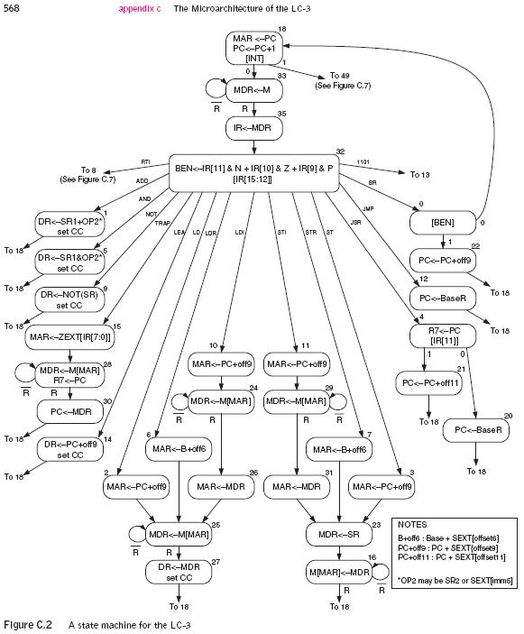
Computational model (Turing machine) vs. Structural model (Von structure)
T_{add}, T_{mul}
U
a,b,c
c(a+b)
Universal Turing Machine

Slide 18
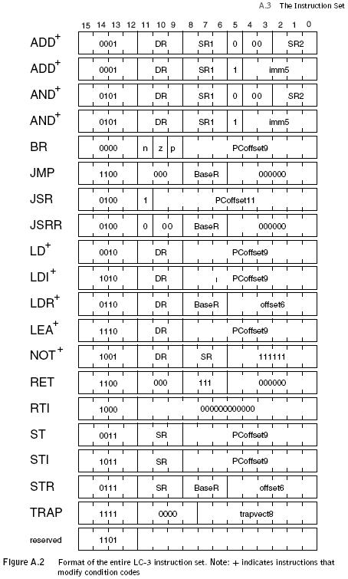
Instruction Set Architecture (ISA) vs. Finite State Machine

Slide 19
Instruction Set Architecture (ISA) vs. Finite State Machine

Slide 20
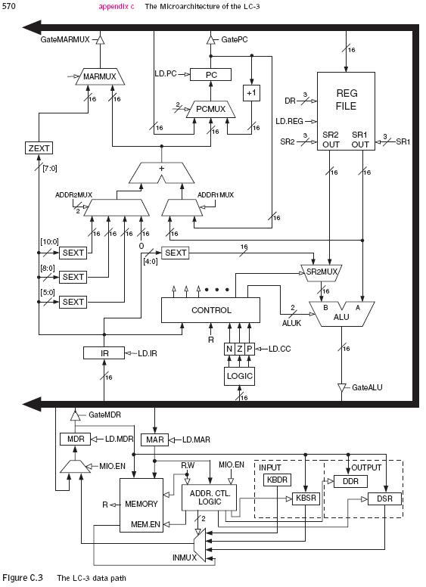
Computer microarchitecture vs. Finite State Machine

Slide 21
Levels of Abstraction
Application
Solve a system of equations
Algorithm and Data Structure
Gaussian
elimination
Jacobi
iteration
Programming Language/Compiler
Red-black SOR
Multigrid
Operating System/Virtual Machines
Instruction Set Architecture (ISA)
FORTRAN
C
C++
Java
Microarchitecture
Sun SPARC
Intel x86
IBM PowerPC
Gates/Register-Transfer Level (RTL)
Pentium 4
Core 2 Duo
AMD Athlon X2
Analog/Digital Circuits
Electronic Devices
Ripple-carry adder
Carry-lookahead adder
Physics
Static CMOS
Dynamic CMOS
Nanomechanical

Slide 22
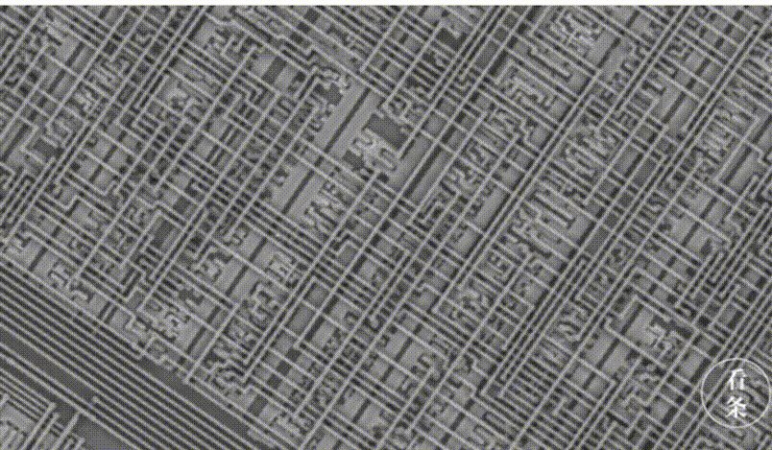
What’s this?
一座城市！

Slide 23

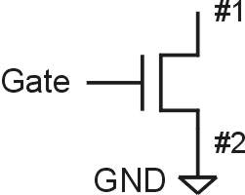
N-type MOS Transistor
Gate = 1
Gate = 0
Terminal #2 must be
connected to GND (0V).
抽象
MOS = Metal Oxide Semiconductor 金属氧化物半导体
two types: N-type and P-type
N-type
when Gate has positive voltage, short circuit between #1 and #2 (switch closed)
when Gate has zero voltage, open circuit between #1 and #2 (switch open)

Slide 24
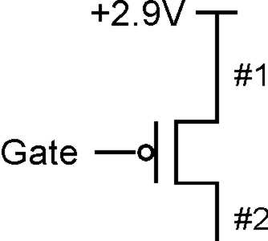
P-type MOS Transistor
Gate = 1
Gate = 0
Terminal #1 must be
connected to +2.9V.
P-type is complementary to N-type
when Gate has positive voltage, open circuit between #1 and #2 (switch open)
when Gate has zero voltage, short circuit between #1 and #2 (switch closed)

Slide 25
Levels of Abstraction
Application
Solve a system of equations
Algorithm and Data Structure
Gaussian
elimination
Jacobi
iteration
Programming Language/Compiler
Red-black SOR
Multigrid
Operating System/Virtual Machines
Instruction Set Architecture (ISA)
FORTRAN
C
C++
Java
Microarchitecture
Sun SPARC
Intel x86
IBM PowerPC
Gates/Register-Transfer Level (RTL)
Pentium 4
Core 2 Duo
AMD Athlon X2
Analog/Digital Circuits
Electronic Devices
Ripple-carry adder
Carry-lookahead adder
Physics
Static CMOS
Dynamic CMOS
Nanomechanical

Slide 26
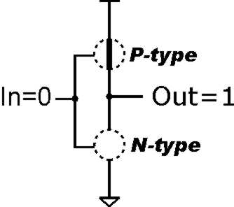
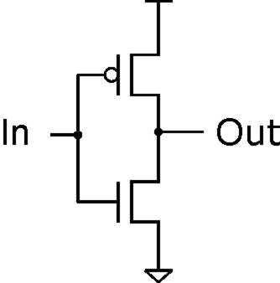
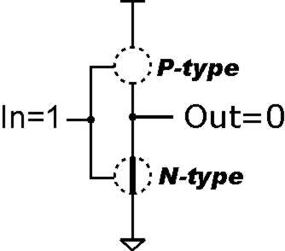
Inverter (NOT Gate)
2.9V
Truth table
0V
In | Out
0 V | 2.9 V
2.9 V | 0 V
In | Out
0 | 1
1 | 0

Slide 27
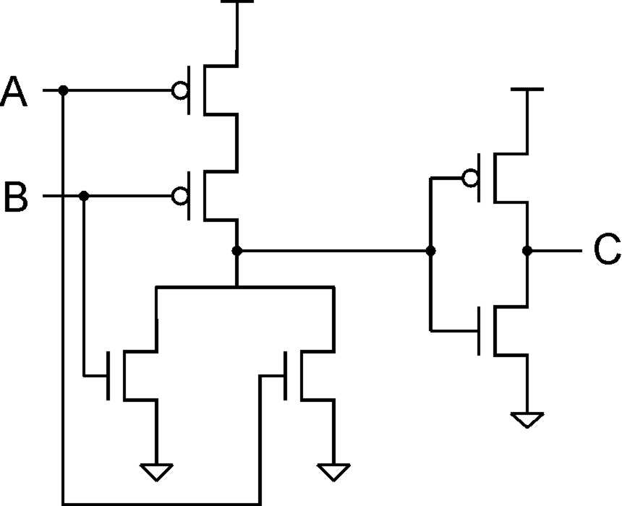
OR Gate
A | B | C
0 | 0 | 0
0 | 1 | 1
1 | 0 | 1
1 | 1 | 1
Add inverter to NOR.

Slide 28
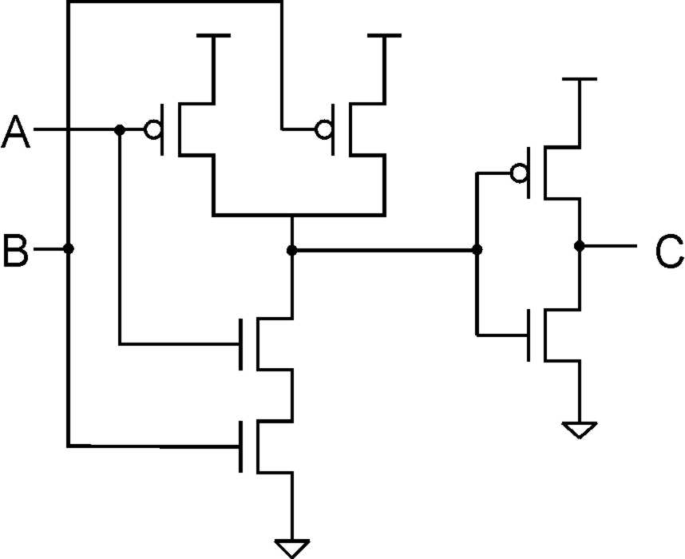
AND Gate
A | B | C
0 | 0 | 0
0 | 1 | 0
1 | 0 | 0
1 | 1 | 1
Add inverter to NAND.

Slide 29
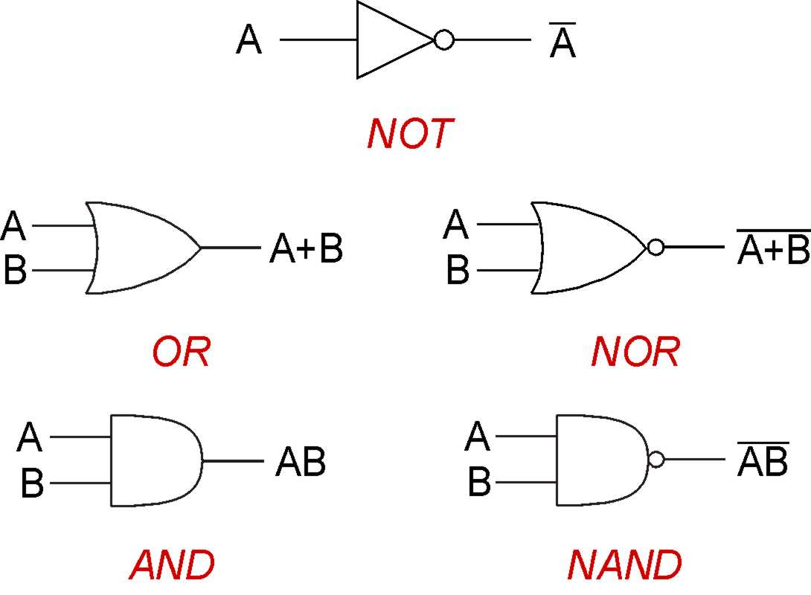
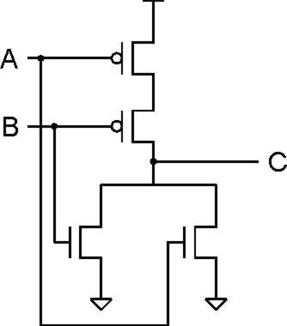
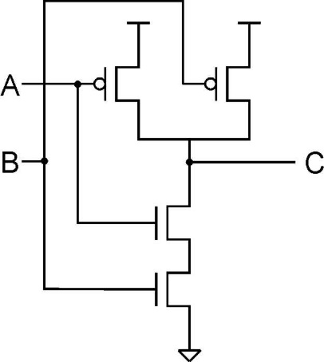
Gates

Slide 30
Levels of Abstraction
Application
Solve a system of equations
Algorithm and Data Structure
Gaussian
elimination
Jacobi
iteration
Programming Language/Compiler
Red-black SOR
Multigrid
Operating System/Virtual Machines
Instruction Set Architecture (ISA)
FORTRAN
C
C++
Java
Microarchitecture
Sun SPARC
Intel x86
IBM PowerPC
Gates/Register-Transfer Level (RTL)
Pentium 4
Core 2 Duo
AMD Athlon X2
Analog/Digital Circuits
Electronic Devices
Ripple-carry adder
Carry-lookahead adder
Physics
Static CMOS
Dynamic CMOS
Nanomechanical

Slide 31
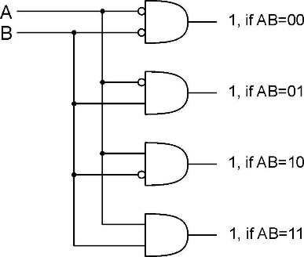
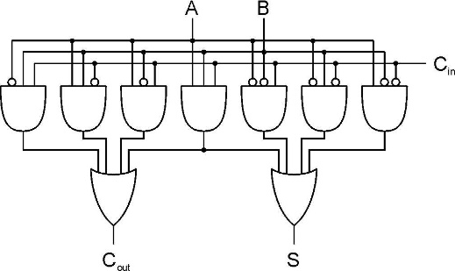
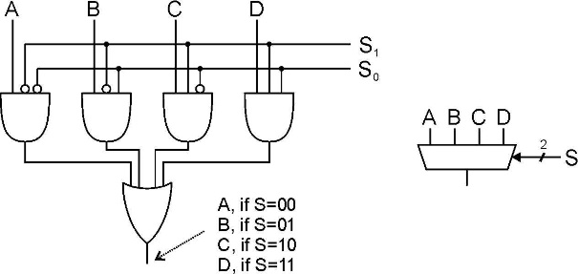
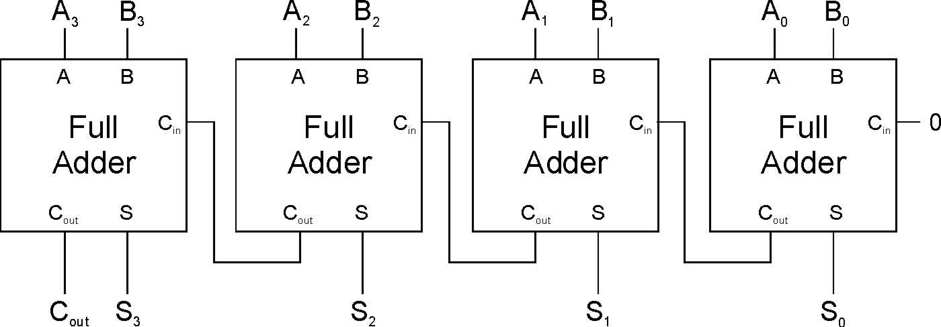
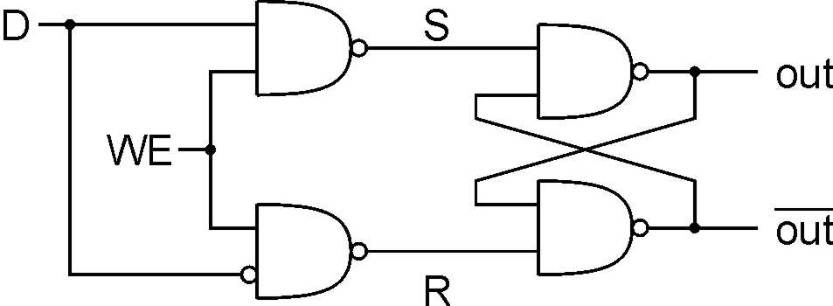
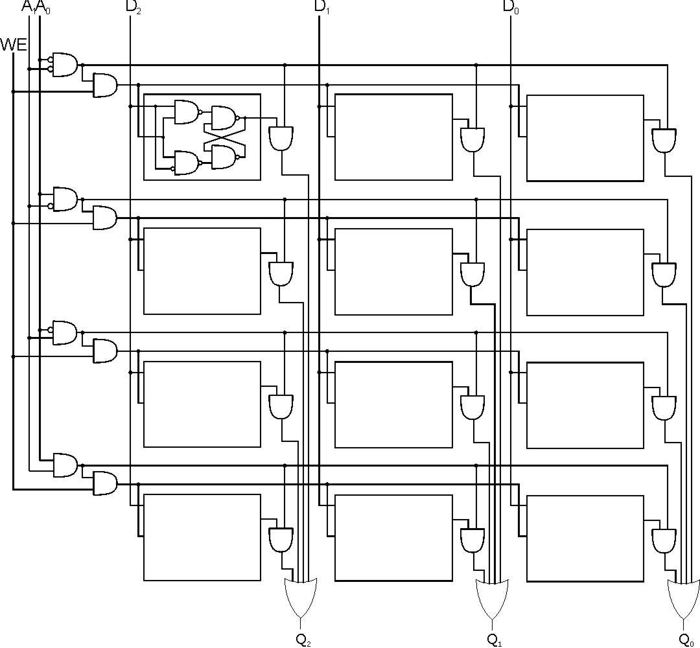
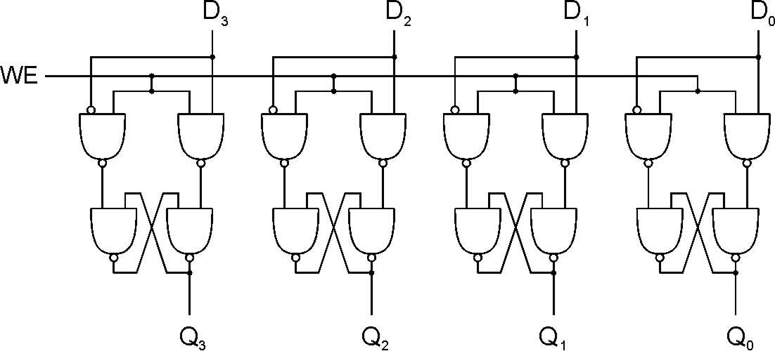
Basic Logical Structure

Slide 32
Levels of Abstraction
Application
Solve a system of equations
Algorithm and Data Structure
Gaussian
elimination
Jacobi
iteration
Programming Language/Compiler
Red-black SOR
Multigrid
Operating System/Virtual Machines
Instruction Set Architecture (ISA)
FORTRAN
C
C++
Java
Microarchitecture
Sun SPARC
Intel x86
IBM PowerPC
Gates/Register-Transfer Level (RTL)
Pentium 4
Core 2 Duo
AMD Athlon X2
Analog/Digital Circuits
Electronic Devices
Ripple-carry adder
Carry-lookahead adder
Physics
Static CMOS
Dynamic CMOS
Nanomechanical

Slide 33
LC-3 Data Path(Microarchitecture)
₁₆
GatePC
₁₆
GateMARMUX
LD.PC
PC
DR
₃
MARMUX
+1
REG FILE
₁₆
₂
PCMUX
₁₆
₁₆
₁₆
₁₆
₁₆
LD.REG
Control Unit
SR2
OUT
SR1
OUT
[7:0]
Processing Unit
SEXT
₊
SR2
₃
₃
SR1
ADDR2MUX
MUX
MUX
ADDR1MUX
₁₆
₁₆
[10:0]
₁₆
₁₆
₁₆
₁₆
₁₆
SEXT
[8:0]
LD.CC
₁₆
SEXT
FINITE STATE MACHINE
SR2MUX
[5:0]
SEXT
₁₆
N
Z
P
ALUK
_{A}
_{B}
[4:0]
SEXT
₂
ALU
LD.IR
IR
LOGIC
…
₁₆
₁₆
₁₆
RUN
GateALU
₁₆
GateMDR
₁₆
Memory Unit
LD.MDR
MDR
MEMORY
MAR
LD.MAR
₁₆
INPUT
OUTPUT
MIO.EN
MUX
₁₆
MEM.EN,R,W

Slide 34
Levels of Abstraction
Application
Solve a system of equations
Algorithm and Data Structure
Gaussian
elimination
Jacobi
iteration
Programming Language/Compiler
Red-black SOR
Multigrid
Operating System/Virtual Machines
Instruction Set Architecture (ISA)
FORTRAN
C
C++
Java
Microarchitecture
Sun SPARC
Intel x86
IBM PowerPC
Gates/Register-Transfer Level (RTL)
Pentium 4
Core 2 Duo
AMD Athlon X2
Analog/Digital Circuits
Electronic Devices
Ripple-carry adder
Carry-lookahead adder
Physics
Static CMOS
Dynamic CMOS
Nanomechanical

Slide 35
LC-3 ISA Overview
_{运算指令(Operate Instructions)}
₁₅
₁₄
₁₃
₁₂
₁₁
₁₀
₉
₈
₇
₆
₅
₄
₃
₂
₁
₀
_{数据移动指令}
_{(Data Movement Instructions)}
_{ADD}
₀
₀
₀
₁
_{DR}
_{SR1}
₀
₀
₀
_{SR2}
_{ADD}
₀
₀
₀
₁
_{DR}
_{SR1}
₁
_{Imm5}
_{取数指令(Load)}
_{AND}
₀
₁
₀
₁
_{DR}
_{SR1}
₀
₀
₀
_{SR2}
_{AND}
₀
₁
₀
₁
_{DR}
_{SR1}
₁
_{Imm5}
₁₅
₁₄
₁₃
₁₂
₁₁
₁₀
₉
₈
₇
₆
₅
₄
₃
₂
₁
₀
_{LD}
₀
₀
₁
₀
_{DR}
_{PCoffset9}
_{NOT}
₁
₀
₀
₁
_{DR}
_{SR1}
₁
₁
₁
₁
₁
₁
_{LDR}
₀
₁
₁
₀
_{DR}
_{BaseR}
_{PCoffset6}
_{Reserved}
₁
₁
₀
₁
_{LDI}
₁
₀
₁
₀
_{DR}
_{PCoffset9}
_{控制指令(Control Instructions)}
_{LEA}
₁
₁
₁
₀
_{DR}
_{PCoffset9}
₁₅
₁₄
₁₃
₁₂
₁₁
₁₀
₉
₈
₇
₆
₅
₄
₃
₂
₁
₀
_{存数指令(Store)}
_{BR}
₀
₀
₀
₀
_{n}
_{z}
_{p}
_{PCoffset9}
_{JSR}
₀
₁
₀
₀
₁
_{PCoffset11}
₁₅
₁₄
₁₃
₁₂
₁₁
₁₀
₉
₈
₇
₆
₅
₄
₃
₂
₁
₀
_{JSRR}
₀
₁
₀
₀
₀
₀
₀
_{BaseR}
₀
₀
₀
₀
₀
₀
_{ST}
₀
₀
₁
₁
_{SR}
_{PCoffset9}
_{RTI}
₁
₀
₀
₀
₀
₀
₀
₀
₀
₀
₀
₀
₀
₀
₀
₀
_{STR}
₀
₁
₁
₁
_{SR}
_{BaseR}
_{PCoffset6}
_{JMP}
₁
₁
₀
₀
₀
₀
₀
_{BaseR}
₀
₀
₀
₀
₀
₀
_{STI}
₁
₀
₁
₁
_{SR}
_{PCoffset9}
_{RET}
₁
₁
₀
₀
₀
₀
₀
₁
₁
₁
₀
₀
₀
₀
₀
₀
_{TRAP}
₁
₁
₁
₁
₀
₀
₀
₀
_{TrapVector8}

Slide 36
Outline
1
Course and Crew
2
What's the difference between “Big" and "Small"?
3
Why Take This Course?
4
Great Ideas in Computing Systems
5
What’s This Course All About ?
6
Summary

Slide 37
Abstraction Layers in Modern Systems
Application
Application
Algorithm and Data Structure
Programming Language/Compiler
Operating System/Virtual Machines
Instruction Set Architecture (ISA)
Microarchitecture
Gates/Register-Transfer Level (RTL)
Analog/Digital Circuits
Electronic Devices
Physics

Slide 38
Acknowledgements
Special thanks to Prof. An
This course is partly inspired by previous MIT 6.823 and Berkeley CS252 computer architecture courses created by my collaborators and colleagues:
Arvind (MIT)
Joel Emer (Intel/MIT)
James Hoe (CMU)
John Kubiatowicz (UCB)
David Patterson (UCB)
Krste Asanovic (UCB)

