Slide 1
Chapter 7 Assembly Language Program
计算机系统概论
Introduction to Computing Systems
（ CS1002A.01）
计算机科学与技术学院
School of Computer Science and Technology

Slide 2
Outline
1
1
Review
Review
2
2
From ENIAC to the Stored Program Computer
Assembly Language Overview
3
3
A Machine Structure：von Neumann Model
Assembly Process
4
4
Summary
Summary

Slide 3
Outline
1
1
Review
Review
2
2
From ENIAC to the Stored Program Computer
Assembly Language Overview
3
3
A Machine Structure：von Neumann Model
Assembly Process
4
4
Summary
Summary

Slide 4
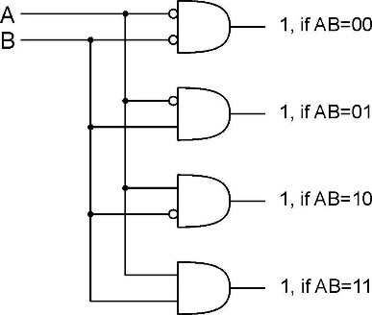
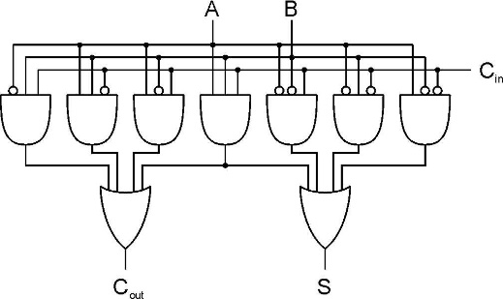
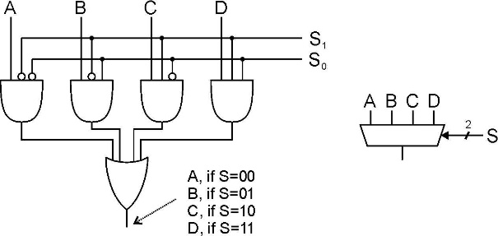
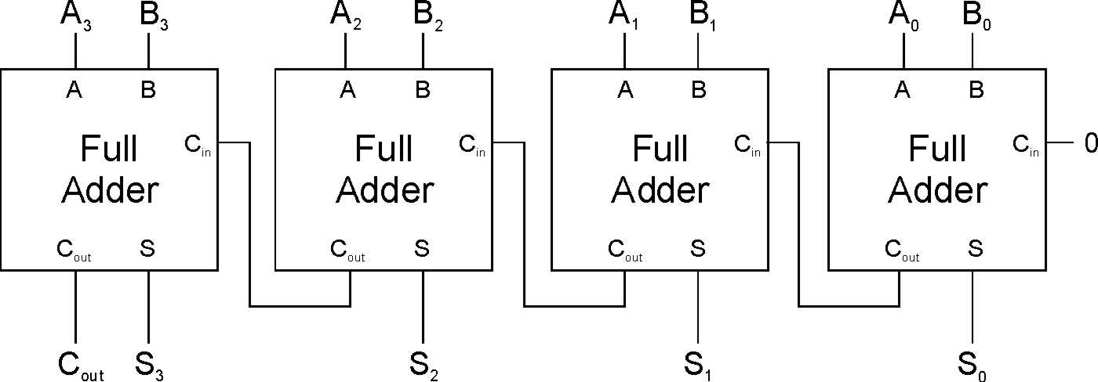
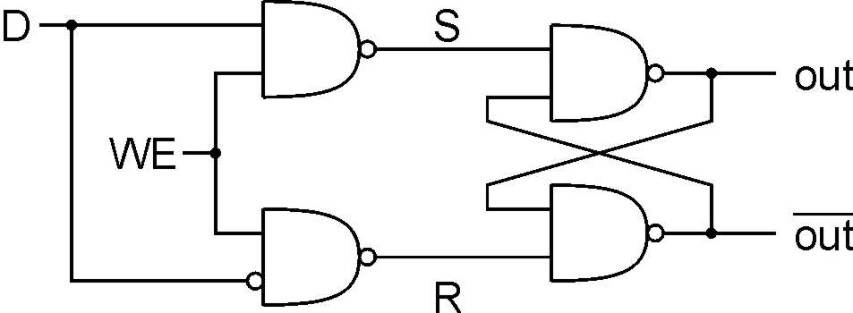
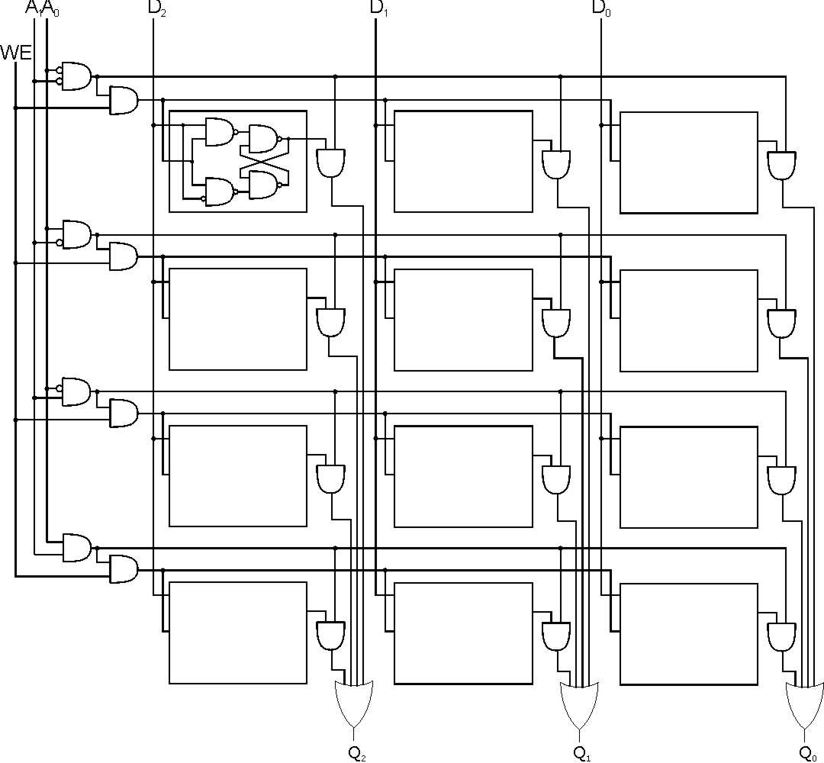
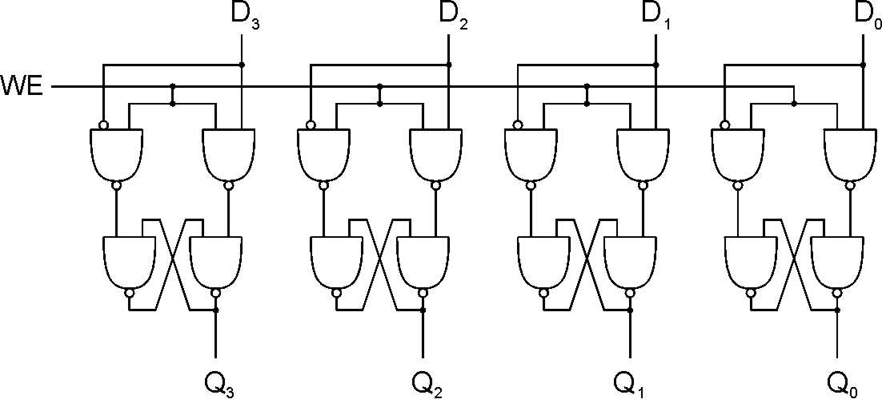
Review: The Transistor & Basic Logical Structure

Slide 5
Review: Von Neumann Model

Slide 6
Review: Von Neumann Model
So far, we’ve learned how to:
compute with values in registers
load data from memory to registers
store data from registers to memory

Slide 7
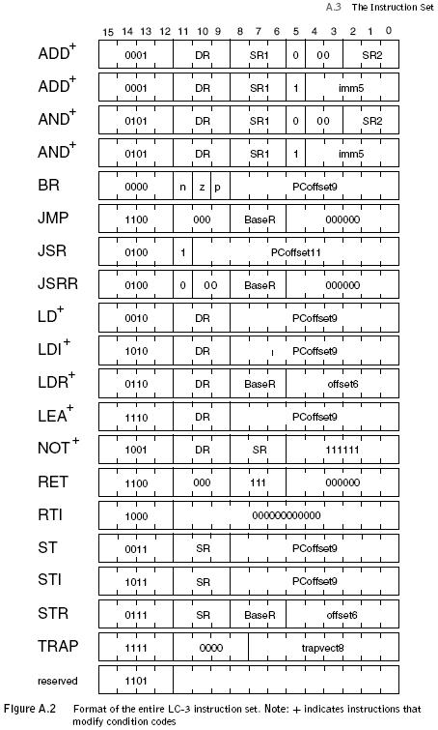
Review: The ISA
2023/11/16
7

Slide 8
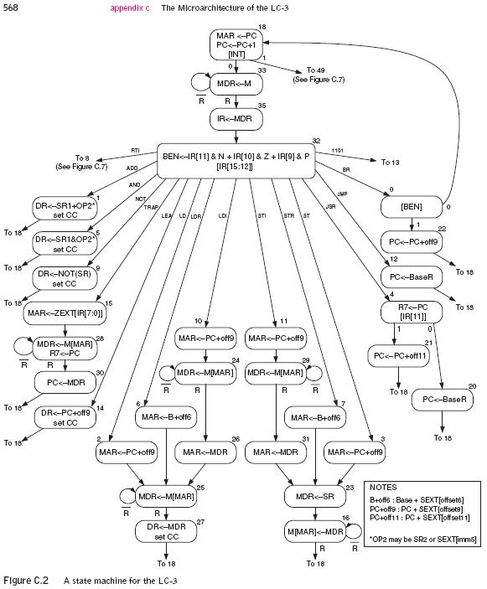
Review: The State Machine(Turing Machine equivalent)
F
D
EA
OP
EX
S
2023/11/16
8

Slide 9
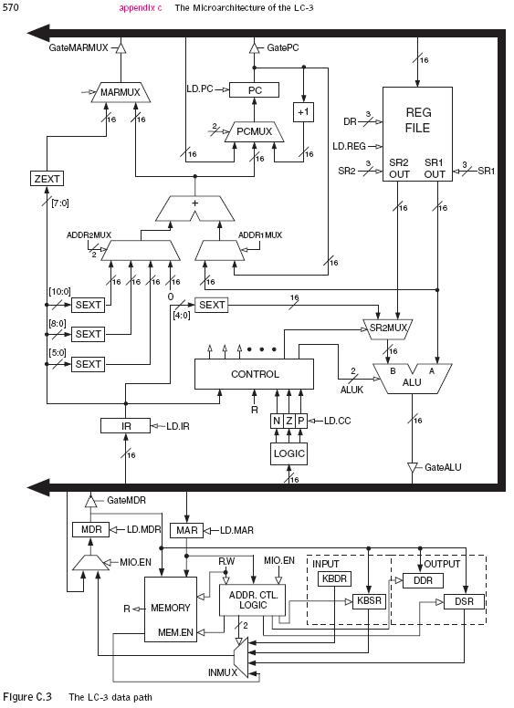
Review: The Data Path(von Neumann Model)
2023/11/16
9

Slide 10
Outline
1
1
Review
Review
2
2
From ENIAC to the Stored Program Computer
Assembly Language Overview
3
3
A Machine Structure：von Neumann Model
Assembly Process
4
4
Summary
Summary

Slide 11
An LC-3 Program
X4101
X4102
X4103
X4104
X4105
X4106
X4107
X4108
X4109
X410A
X410B
X410C
X410D
X410E
X410F
X4110
X4101
X4102
X4103
X4104
0 1 0 1 0 1 0 0 1 0 1 0 0 0 0 0
0 0 1 0 0 1 1 0 0 0 0 1 0 0 0 0
1 1 1 1 0 0 0 0 0 0 1 0 0 0 1 1
0 1 1 0 0 0 1 0 1 1 0 0 0 0 0 0
0 0 0 1 1 0 0 0 0 1 1 1 1 1 0 0
0 0 0 0 0 1 0 0 0 0 0 0 1 0 0 0
1 0 0 1 0 0 1 0 0 1 1 1 1 1 1 1
0 0 0 1 0 0 1 0 0 1 1 0 0 0 0 1
0 0 0 1 0 0 1 0 0 1 0 0 0 0 0 0
0 0 0 0 1 0 1 0 0 0 0 0 0 0 0 1
0 0 0 1 0 1 0 0 1 0 1 0 0 0 0 1
0 0 0 1 0 1 1 0 1 1 1 0 0 0 0 1
0 1 1 0 0 0 1 0 1 1 0 0 0 0 0 0
0 0 0 0 1 1 1 1 1 1 1 1 0 1 1 0
0 0 1 0 0 0 0 0 0 0 0 0 0 1 0 0
0 0 0 1 0 0 0 0 0 0 0 0 0 0 1 0
1 1 1 1 0 0 0 0 0 0 1 0 0 0 0 1
1 1 1 1 0 0 0 0 0 0 1 0 0 1 0 1
1 0 0 0 0 0 0 0 0 0 0 0 0 0 0 1
0 0 0 0 0 0 0 0 0 0 1 1 0 0 0 0
X8001
X8002
X8003
X8004
X8005
X8006
X8007
X8008
X8009
X800A
X800B
X800C
X800D
X800E
X800F
X8010
X8011
X8012
X8013
X8014
X8015
X8016
X8017
X8018
0 0 0 0 0 0 0 0 0 1 0 0 1 1 0 0
0 0 0 0 0 0 0 0 0 1 0 0 1 0 1 0
0 0 0 0 0 0 0 0 0 1 0 1 0 0 0 1
0 0 0 0 0 0 0 0 0 1 0 0 1 1 0 0
0 0 0 0 0 0 0 0 0 1 0 1 0 1 1 0
0 0 0 0 0 0 0 0 0 1 0 0 1 0 0 1
0 0 0 0 0 0 0 0 0 1 0 0 0 0 0 1
0 0 0 0 0 0 0 0 0 1 0 1 0 0 1 1
0 0 0 0 0 0 0 0 0 1 0 1 0 1 1 0
0 0 0 0 0 0 0 0 0 1 0 0 0 0 0 0
0 0 0 0 0 0 0 0 0 1 0 0 0 0 0 0
0 0 0 0 0 0 0 0 0 1 0 0 0 0 0 0
0 0 0 0 0 0 0 0 0 1 0 1 0 1 1 0
0 0 0 0 0 0 0 0 0 1 0 0 1 0 0 1
0 0 0 0 0 0 0 0 0 1 0 1 1 0 0 0
0 0 0 0 0 0 0 0 0 1 0 0 1 1 0 0
0 0 0 0 0 0 0 0 0 1 0 0 0 0 0 0
0 0 0 0 0 0 0 0 0 1 0 0 1 0 0 0
0 0 0 0 0 0 0 0 0 1 0 0 1 1 1 0
0 0 0 0 0 0 0 0 0 1 0 0 0 0 0 0
0 0 0 0 0 0 0 0 0 0 0 0 0 1 0 0
0 0 0 0 0 0 0 0 0 1 0 0 0 0 0 0
0 0 0 0 0 0 0 0 0 1 0 1 1 0 1 0
0 0 0 0 0 0 0 0 0 0 0 0 0 1 0 0

Slide 12
Human-Readable Machine Language
Computers like ones and zeros…
Humans like symbols…
Assembler (汇编器) is a program that turns symbols into machine instructions.
ISA-specific: close correspondence between symbols and instruction set
mnemonics (助记符) for opcodes
labels (标号) for memory locations
additional operations for allocating storage and initializing data
0001110010000110
ADD R6,R2,R6 ; increment index reg.
or
C = a + b;

Slide 13
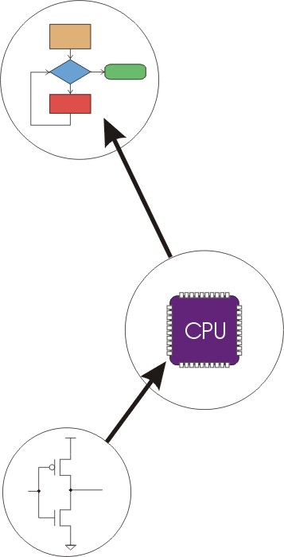
Great Idea #4: Software and Hardware Co-design
Application
Algorithm & Data Structure
Now, You are Here.
Language
Software
Machine Architecture, ISA
Hardware
Microarchiture
Logic and IC
Device
Computer System: Layers of Abstraction
Notes:
13

Slide 14
Great Idea #3: Abstraction Helps Us Manage Complexity
Application
Solve a system of equations
Algorithm and Data Structure
Gaussian
elimination
Jacobi
iteration
Programming Language/Compiler
Red-black SOR
Multigrid
Operating System/Virtual Machines
Instruction Set Architecture (ISA)
FORTRAN
C
C++
Java
Microarchitecture
Sun SPARC
Intel x86
IBM PowerPC
Gates/Register-Transfer Level (RTL)
Pentium 4
Core 2 Duo
AMD Athlon X2
Analog/Digital Circuits
Electronic Devices
Ripple-carry adder
Carry-lookahead adder
Physics
Static CMOS
Dynamic CMOS
Nanomechanical

Slide 15
An Assembly Language Program
;
; Program to multiply a number by the constant 6
;
.ORIG x3050
LD R1, SIX
LD R2, NUMBER
AND R3, R3, #0 ; Clear R3. It will
; contain the product.
; The inner loop
;
AGAIN ADD R3, R3, R2
ADD R1, R1, #-1 ; R1 keeps track of
BRp AGAIN ; the iteration.
;
HALT
;
NUMBER .BLKW 1
SIX .FILL x0006
;
.END

Slide 16
LC-3 Assembly Language Syntax
Each line of a program is one of the following:
an instruction
an assembler directive (or pseudo-op, 伪操作)
a comment
empty
Whitespace (between symbols) and case are ignored.
Comments (beginning with “;”) are also ignored.
An instruction has the following format:
LABEL OPCODE OPERANDS COMMENTS
optional
mandatory

Slide 17
Opcodes and Operands 操作码 和 操作数
Opcodes
reserved symbols that correspond to LC-3 instructions
listed in Appendix A
ex: ADD, AND, LD, LDR, …
Operands
registers -- specified by Rn, where n is the register number
numbers -- indicated by # (decimal) or x (hex)
label -- symbolic name of memory location
separated by comma
number, order, and type correspond to instruction format
ex: ADD R1,R1,R3 ADD R1,R1,#3 LD R6,NUMBER BRz LOOP

Slide 18
Labels and Comments 标号 和 注释
Label
placed at the beginning of the line
assigns a symbolic name to the address corresponding to line
ex: LOOP ADD R1,R1,#-1 BRp LOOP
Comment
anything after a semicolon (; 分号) is a comment
ignored by assembler
used by humans to document/understand programs
tips for useful comments:
avoid restating the obvious, as “decrement R1”
provide additional insight, as in “accumulate product in R6”
use comments to separate pieces of program

Slide 19
Assembler Directives (指示符)
Pseudo-operations
do not refer to operations executed by program
used by assembler
look like instruction, but “opcode” starts with dot
Opcode | Operand | Meaning
.ORIG | address | starting address of program
.END |  | end of program
.BLKW | n | allocate n words of storage
.FILL | n | allocate one word, initialize with value n
.STRINGZ | n-character string | allocate n+1 locations, initialize w/characters and null terminator

Slide 20
Example
.ORIG X3010
HELLO .STRINGZ ”Hello, World!”
x3010: x0048 x3011: x0065 x3012: x006C x3013: x006C x3014: x006F x3015: x002C x3016: x0020 x3017: x0057 x3018: x006F x3019: x0072 x301A: x006C x301B: x0064 x301C: x0021 x301D: x0000
00 | nul | 10 | dle | 20 | sp | 30 | 0 | 40 | @ | 50 | P | 60 | ` | 70 | p
01 | soh | 11 | dc1 | 21 | ! | 31 | 1 | 41 | A | 51 | Q | 61 | a | 71 | q
02 | stx | 12 | dc2 | 22 | " | 32 | 2 | 42 | B | 52 | R | 62 | b | 72 | r
03 | etx | 13 | dc3 | 23 | # | 33 | 3 | 43 | C | 53 | S | 63 | c | 73 | s
04 | eot | 14 | dc4 | 24 | $ | 34 | 4 | 44 | D | 54 | T | 64 | d | 74 | t
05 | enq | 15 | nak | 25 | % | 35 | 5 | 45 | E | 55 | U | 65 | e | 75 | u
06 | ack | 16 | syn | 26 | & | 36 | 6 | 46 | F | 56 | V | 66 | f | 76 | v
07 | bel | 17 | etb | 27 | ' | 37 | 7 | 47 | G | 57 | W | 67 | g | 77 | w
08 | bs | 18 | can | 28 | ( | 38 | 8 | 48 | H | 58 | X | 68 | h | 78 | x
09 | ht | 19 | em | 29 | ) | 39 | 9 | 49 | I | 59 | Y | 69 | i | 79 | y
0a | nl | 1a | sub | 2a | * | 3a | : | 4a | J | 5a | Z | 6a | j | 7a | z
0b | vt | 1b | esc | 2b | + | 3b | ; | 4b | K | 5b | [ | 6b | k | 7b | {
0c | np | 1c | fs | 2c | , | 3c | < | 4c | L | 5c | \ | 6c | l | 7c | |
0d | cr | 1d | gs | 2d | - | 3d | = | 4d | M | 5d | ] | 6d | m | 7d | }
0e | so | 1e | rs | 2e | . | 3e | > | 4e | N | 5e | ^ | 6e | n | 7e | ~
0f | si | 1f | us | 2f | / | 3f | ? | 4f | O | 5f | _ | 6f | o | 7f | del
n = 13, 占用了14个位置

Slide 21
Trap Codes
LC-3 assembler provides “pseudo-instructions”(伪指令) for each trap code, so you don’t have to remember them.
Code | Equivalent | Description
HALT | TRAP x25 | Halt execution and print message to console.
IN | TRAP x23 | Print prompt on console, read (and echo) one character from keybd. Character stored in R0[7:0].
OUT | TRAP x21 | Write one character (in R0[7:0]) to console.
GETC | TRAP x20 | Read one character from keyboard. Character stored in R0[7:0].
PUTS | TRAP x22 | Write null-terminated string to console. Address of string is in R0.

Slide 22
Style Guidelines
Use the following style guidelines to improve the readability and understandability of your programs:
Provide a program header, with author’s name, date, etc.,and purpose of program.
Start labels, opcode, operands, and comments in same column for each line. (Unless entire line is a comment.)
Use comments to explain what each register does.
Give explanatory comment(备注)for most instructions.
Use meaningful symbolic names.
Mixed upper and lower case for readability.
ASCIItoBinary, InputRoutine, SaveR1
Provide comments between program sections.
Each line must fit on the page -- no wraparound or truncations.
Long statements split in aesthetically (美学上) pleasing manner.

Slide 23
Sample Program
Count the occurrences of a character in a file. Remember this?

Slide 24
Program (1 of 2)
Address | Instruction | Comments
x3000 | 0 1 0 1 0 1 0 0 1 0 1 0 0 0 0 0 | R2 ← 0 (counter) AND R2,R2, #0
x3001 | 0 0 1 0 0 1 1 0 0 0 0 1 0 0 0 0 | R3 ← M[x3012] (ptr) LD R3, x3012 (LD R3, PTR)
x3002 | 1 1 1 1 0 0 0 0 0 0 1 0 0 0 1 1 | Input to R0 (TRAP x23) TRAP x23 (GETC)
x3003 | 0 1 1 0 0 0 1 0 1 1 0 0 0 0 0 0 | R1 ← M[R3] LDR R1, R3, #0
x3004 | 0 0 0 1 1 0 0 0 0 1 1 1 1 1 0 0 | R4 ← R1 – 4 (EOT) ADD R4,R1, #-4
x3005 | 0 0 0 0 0 1 0 0 0 0 0 0 1 0 0 0 | If Z, goto x300E BRz x300E (BRz OUTPUT)
x3006 | 1 0 0 1 0 0 1 0 0 1 1 1 1 1 1 1 | R1 ← NOT R1 NOT R1,R1
x3007 | 0 0 0 1 0 0 1 0 0 1 1 0 0 0 0 1 | R1 ← R1 + 1 ADD R1,R1,#1
X3008 | 0 0 0 1 0 0 1 0 0 1 0 0 0 0 0 0 | R1 ← R1 + R0 ADD R1,R1,R0
x3009 | 0 0 0 0 1 0 1 0 0 0 0 0 0 0 0 1 | If N or P, goto x300B BRnp x300B (BRnp GETCHAR)

Slide 25
Program (2 of 2)
Address | Instruction | Comments
x300A | 0 0 0 1 0 1 0 0 1 0 1 0 0 0 0 1 | R2 ← R2 + 1 ADD R2,R2,#1
x300B | 0 0 0 1 0 1 1 0 1 1 1 0 0 0 0 1 | R3 ← R3 + 1 ADD R3,R3,#1
x300C | 0 1 1 0 0 0 1 0 1 1 0 0 0 0 0 0 | R1 ← M[R3] LDR R1,R3,#0
x300D | 0 0 0 0 1 1 1 1 1 1 1 1 0 1 1 0 | Goto x3004 BRnzp x3004 (BRnzp TEST)
x300E | 0 0 1 0 0 0 0 0 0 0 0 0 0 1 0 0 | R0 ← M[x3013] LD R0,x3013 ( LD R0, ASCII)
x300F | 0 0 0 1 0 0 0 0 0 0 0 0 0 0 1 0 | R0 ← R0 + R2 ADD R0,R0,R2
x3010 | 1 1 1 1 0 0 0 0 0 0 1 0 0 0 0 1 | Print R0 TRAP x21 (OUT)
x3011 | 1 1 1 1 0 0 0 0 0 0 1 0 0 1 0 1 | HALT TRAP x25 (HALT)
X3012 | 1 0 0 1 0 0 0 0 0 0 0 0 0 0 0 0 | Starting Address of File (X9000)
x3013 | 0 0 0 0 0 0 0 0 0 0 1 1 0 0 0 0 | ASCII x30 (‘0’)

Slide 26
Char Count in Assembly Language (1 of 3)
01 ;
02 ; Program to count occurrences of a character in a file.
03 ; Character to be input from the keyboard.
04 ; Result to be displayed on the monitor.
05 ; Program only works if no more than 9 occurrences are
06 ; found.
07 ;
08 ; Initialization
09 ;
0A .ORIG x3000
0B AND R2, R2, #0 ; R2 is counter, initially 0
0C LD R3, PTR ; R3 is pointer to characters
0D GETC ; TRAP x23
0E ; R0 gets character input
0F LDR R1, R3, #0 ; R1 gets first character
10 ;
11 ; Test character for end of file
12 ;
TEST ADD R4, R1, #-4 ; Test for EOT
; (ASCII x04)
15 BRz OUTPUT ; If done, prepare the output

Slide 27
Char Count in Assembly Language (2 of 3)
16 ;
17 ; Test character for match. If a match, increment count.
18 ;
19 NOT R1, R1
1A ADD R1, R1, R0 ; If match, R1 = xFFFF
1B NOT R1, R1 ; If match, R1 = x0000
1C BRnp GETCHAR ; If no match, do not increment
1D ADD R2, R2, #1
1E ;
1F ; Get next character from file.
20 ;
21 GETCHAR ADD R3, R3, #1 ; Point to next character.
22 LDR R1, R3, #0 ; R1 gets next char to test
23 BRnzp TEST
24 ;
25 ; Output the count.
26 ;
27 OUTPUT LD R0, ASCII ; Load the ASCII template
28 ADD R0, R0, R2 ; Covert binary count to ASCII
29 OUT ; TRAP x21
2A ; ASCII code in R0 is displayed.
2B HALT ; TRAP x25,Halt machine

Slide 28
Char Count in Assembly Language (3 of 3)
2C ;
2D ; Storage for pointer and ASCII template
2E ;
2F ASCII .FILL x0030
30 PTR .FILL x9000
31 .END

Slide 29
Outline
1
1
Review
Review
2
2
From ENIAC to the Stored Program Computer
Assembly Language Overview
3
3
A Machine Structure：von Neumann Model
Assembly Process
4
4
Summary
Summary

Slide 30
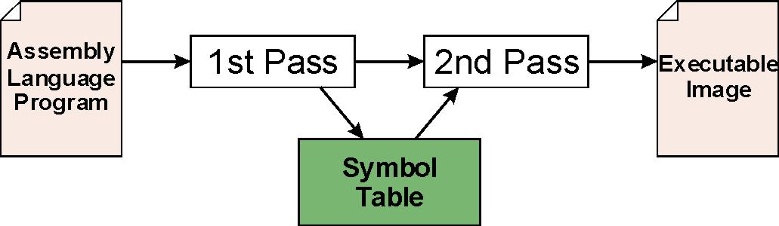
Assembly Process
Convert assembly language file (.asm) into an executable file (.obj) for the LC-3 simulator.
First Pass:
scan program file
find all labels and calculate the corresponding addresses; this is called the symbol table
Second Pass:
convert instructions to machine language, using information from symbol table

Slide 31
First Pass: Constructing the Symbol Table
Find the .ORIG statement, which tells us the address of the first instruction.
Initialize location counter (LC), which keeps track of the current instruction.
For each non-empty line in the program:
If line contains a label, add label and LC to symbol table.
Increment LC.
NOTE: If statement is .BLKW or .STRINGZ, increment LC by the number of words allocated.
Stop when .END statement is reached.
NOTE: A line that contains only a comment is considered an empty line.

Slide 32
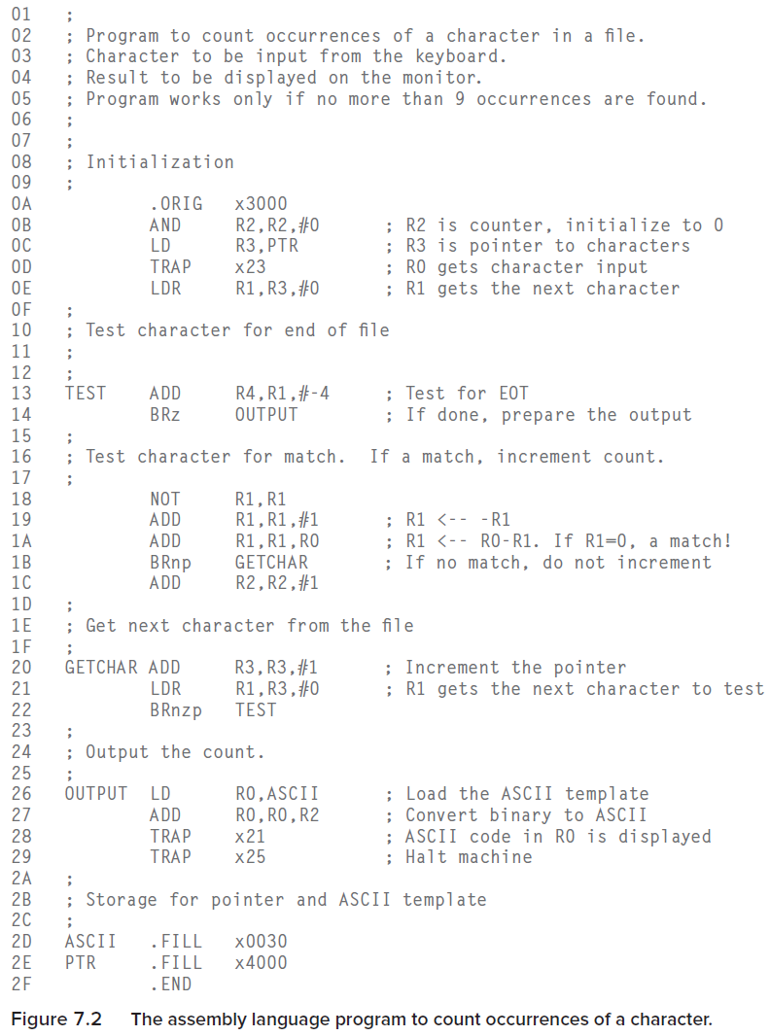
Example
Construct the symbol table for the program in Figure 7.2
Symbol | Address
TEST | X3004
GETCHAR | X300B
OUTPUT | X300E
ASCII | X3012
PTR | X3013

Slide 33
Second Pass: Generating Machine Language
For each executable assembly language statement, generate the corresponding machine language instruction.
If operand is a label, look up the address from the symbol table.
Potential problems:
Improper number or type of arguments
ex: NOT R1,#7 ADD R1,R2 ADD R3,R3,NUMBER
Immediate argument too large
ex: ADD R1,R2,#1023
Address (associated with label) not on the same page 被访问的标号地址不在当前指令直接寻址的范围之内
can’t use direct addressing mode

Slide 34
Practice
Using the symbol table constructed earlier, translate these statements into LC-3 machine language.
(Assume all addresses are on the current page.)
Statement | Machine Language
LD R3,PTR
ADD R4,R1,#-4
LDR R1,R3,#0
BRnp GETCHAR

Slide 35
Practice
Using the symbol table constructed earlier, translate these statements into LC-3 machine language.
(Assume all addresses are on the current page.)
Statement | Machine Language
LD R3,PTR | 0010 011 000010001
ADD R4,R1,#-4 | 0001 100 001 1 11100
LDR R1,R3,#0 | 0110 001 011 000000
BRnp GETCHAR | 0000 101 000000001

Slide 36
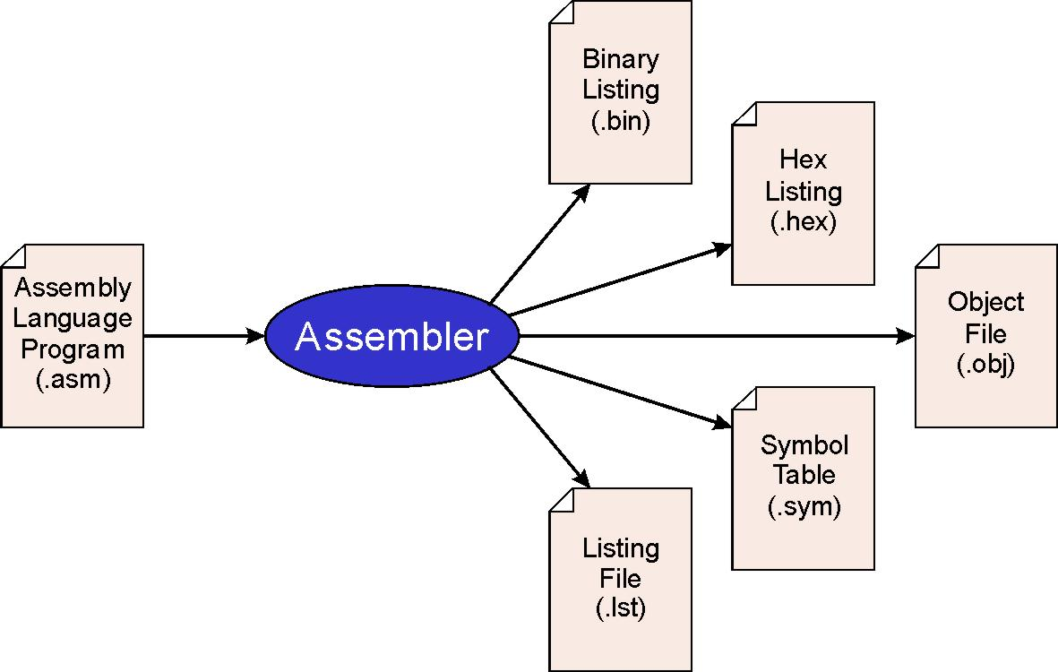
LC-3 Assembler
Using “assemble” (Unix) or LC3 Edit (Windows), generates several different output files.
This one gets loaded into the simulator.

Slide 37
Object File Format
LC-3 object file contains
Starting address (location where program must be loaded), followed by…
Machine instructions
Example
Beginning of “count character” object file looks like this:
0011000000000000 0101010010100000 0010011000010100 1111000000100011 . . .
.ORIG x3000
AND R2, R2, #0
LD R3, PTR
TRAP x23

Slide 38
Multiple Object Files
An object file is not necessarily a complete program.
system-provided library routines
code blocks written by multiple developers
For LC-3, can load multiple object files into memory, then start executing at a desired address.
system routines, such as keyboard input, are loaded automatically
loaded into “system memory,” below x1000
by convention, user code should be loaded between x3000 and xCFFF
each object file includes a starting address
be careful not to load overlapping object files

Slide 39
Linking and Loading
Loading is the process of copying an executable image into memory.
more sophisticated loaders are able to relocate images to fit into available memory
must readjust (重新适应) branch targets, load/store addresses
Linking is the process of resolving symbols between independent object files.
suppose we define a symbol in one module, and want to use it in another
some notation, such as .EXTERNAL, is used to tell assembler that a symbol is defined in another module
linker will search symbol tables of other modules to resolve symbols and complete code generation before loading

Slide 40
Outline
1
Review
Review
2
From ENIAC to the Stored Program Computer
Assembly Language Overview
3
A Machine Structure：von Neumann Model
Assembly Process
4
4
Summary
Summary

Slide 41
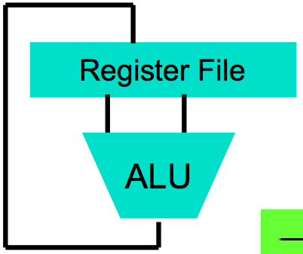
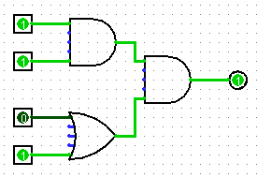
Summary: Assembly Language
High Level Language Program (e.g., C)
temp = v[k];
v[k] = v[k+1];
v[k+1] = temp;
Now, You are Here.
Compiler
lw $t0, 0($2)
lw $t1, 4($2)
sw $t1, 0($2)
sw $t0, 4($2)
Assembly Language Program (e.g., MIPS)
Anything can be represented as a number, i.e., data or instructions
Assembler
Machine Language Program (MIPS)
0000 1001 1100 0110 1010 1111 0101 1000
1010 1111 0101 1000 0000 1001 1100 0110
1100 0110 1010 1111 0101 1000 0000 1001
0101 1000 0000 1001 1100 0110 1010 1111
Machine Interpretation
Hardware Architecture Description (e.g., block diagrams)
ALUOP[0:3] <= InstReg[9:11] & MASK
Architecture Implementation
Logic Circuit Description (Circuit Schematic Diagrams)

Slide 42
Memory map of the LC-3
0x0000
Trap Vector Table
0x00FF
0x0100
Interrupt Vector Table
0x01FF
0x0200
Operating System
and Supervisor Stack
0x2FFF
0x3000
Program Text
PC
Global data section
R4(Global pointer)
Function1
R6
Heap (for dynamically
allocated memory)
R5
Function2
R6
R5
Run-time stack
R6 (stack pointer)
0xFDFF
R5 (frame pointer)
Function3
R6
0xFE00
Device Register
Addresses
0xFFFF
R5

