Slide 1
Chapter 8-1 Subroutines
计算系统概论A
Introduction to Computing Systems
（ CS1002A.01 ）
计算机科学与技术学院
School of Computer Science and Technology

Slide 2
Subroutines
A subroutine is a program fragment that. . .
Resides in user space (i.e, not in OS)
Performs a well-defined task
Is invoked (called) multiple times by a user program
Returns control to the calling program when finished
Virtues
Reuse code without re-typing it (and debugging it!)
Divide task into parts (or among multiple programmers)
Use vendor-supplied library of useful routines that one software engineer writes a program that requires such fragments and another software engineer writes the fragments.
math library
square root, sine, and arctangent,etc.

Slide 3
A simple illustration of a part of a program
01 START ST R1,SaveR1 ; Save registers needed
02 ST R2,SaveR2 ; by this routine
03 ST R3,SaveR3
04 ;
05 LD R2,Newline
06 L1 LDI R3,DSR
07 BRzp L1 ; Loop until monitor is ready
08 STI R2,DDR ; Move cursor to new clean line
09 ;
0A LEA R1,Prompt ; Starting address of prompt string
0B Loop LDR R0,R1,#0 ; Write the input prompt
0C BRz Input ; End of prompt string
0D L2 LDI R3,DSR
0E BRzp L2 ; Loop until monitor is ready
0F STI R0,DDR ; Write next prompt character
10 ADD R1,R1,#1 ; Increment prompt pointer
11 BRnzp Loop ; Get next prompt character
12 ;
13 Input LDI R3,KBSR
14 BRzp Input ; Poll until a character is typed
15 LDI R0,KBDR ; Load input character into R0
16 L3 LDI R3,DSR
17 BRzp L3 ; Loop until monitor is ready
18 STI R0,DDR ; Echo input character
19 ;
1A L4 LDI R3,DSR
1B BRzp L4 ; Loop until monitor is ready
1C STI R2,DDR ; Move cursor to new clean line
1D LD R1,SaveR1 ; Restore registers
1E LD R2,SaveR2 ; to original values
1F LD R3,SaveR3
20 JMP R7 ; Do the program’s next task

Slide 4
A simple illustration of a part of a program
21 ;
22 SaveR1 .BLKW 1 ; Memory for registers saved
23 SaveR2 .BLKW 1
24 SaveR3 .BLKW 1
25 DSR .FILL xFE04
26 DDR .FILL xFE06
27 KBSR .FILL xFE00
28 KBDR .FILL xFE02
29 Newline .FILL x000A ; ASCII code for newline
2A Prompt .STRINGZ ‘‘Input a character>’’

Slide 5
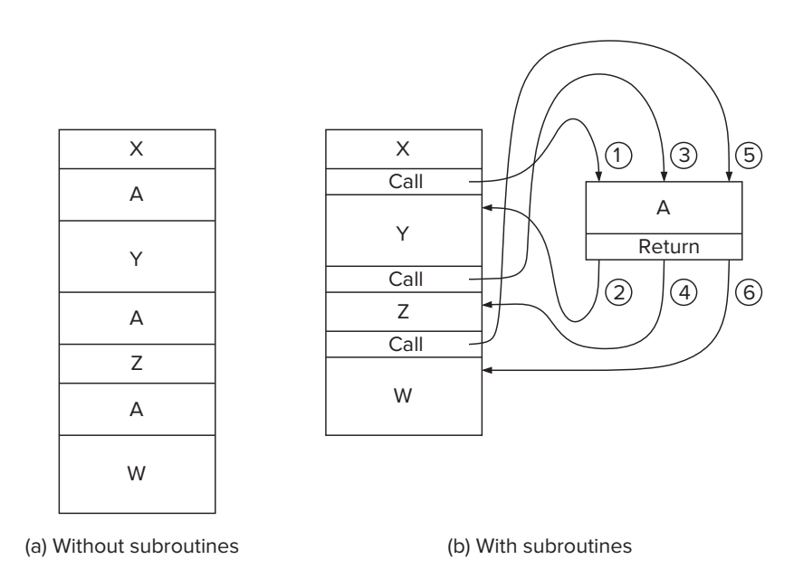
The Call/Return Mechanism

Slide 6
Control Instructions for Subroutines
15
14
13
12
11
10
9
8
7
6
5
4
3
2
1
0
BR
0
0
0
0
n
z
p
PCoffset9
JSR
0
1
0
0
1
PCoffset11
JSRR
0
1
0
0
0
0
0
BaseR
0
0
0
0
0
0
RTI
1
0
0
0
0
0
0
0
0
0
0
0
0
0
0
0
JMP
1
1
0
0
0
0
0
BaseR
0
0
0
0
0
0
RET
1
1
0
0
0
0
0
1
1
1
0
0
0
0
0
0
TRAP
1
1
1
1
0
0
0
0
TrapVector8

Slide 7
JSR

Slide 8
F
D
EA
JSR (PC-Relative)
OP
₁₆
GatePC
₁₆
GateMARMUX
EX
LD.PC
PC
DR
₃
MARMUX
+1
REG FILE
₁₆
₂
PCMUX
₁₆
₁₆
₁₆
₁₆
₁₆
LD.REG
S
[7:0]
SR2
SR2
OUT
SR1
OUT
SR1
SEXT
₊
₃
₃
ADDR2MUX
MUX
MUX
ADDR1MUX
₁₆
₁₆
[10:0]
₁₆
₁₆
₁₆
₁₆
₁₆
SEXT
[8:0]
LD.CC
₁₆
SEXT
FINITE STATE MACHINE
SR2MUX
[5:0]
SEXT
₁₆
N
Z
P
ALUK
_{A}
_{B}
[4:0]
SEXT
₂
ALU
LD.IR
IR
LOGIC
…
₁₆
₁₆
₁₆
RUN
GateALU
₁₆
GateMDR
₁₆
LD.MDR
MDR
MEMORY
MAR
LD.MAR
₁₆
INPUT
OUTPUT
MIO.EN
MUX
₁₆
MEM.EN,R,W

Slide 9
F
D
EA
JSR (PC-Relative)
OP
₁₆
GatePC
₁₆
GateMARMUX
EX
LD.PC
PC
DR
₃
MARMUX
+1
REG FILE
₁₆
₂
PCMUX
₁₆
₁₆
₁₆
₁₆
₁₆
LD.REG
S
[7:0]
SR2
SR2
OUT
SR1
OUT
SR1
SEXT
₊
₃
₃
ADDR2MUX
MUX
MUX
ADDR1MUX
₁₆
₁₆
[10:0]
₁₆
₁₆
₁₆
₁₆
₁₆
SEXT
[8:0]
LD.CC
₁₆
SEXT
FINITE STATE MACHINE
SR2MUX
[5:0]
SEXT
₁₆
N
Z
P
ALUK
_{A}
_{B}
[4:0]
SEXT
₂
ALU
LD.IR
IR
LOGIC
…
₁₆
₁₆
₁₆
RUN
GateALU
₁₆
GateMDR
₁₆
LD.MDR
MDR
MEMORY
MAR
LD.MAR
₁₆
INPUT
OUTPUT
MIO.EN
MUX
₁₆
MEM.EN,R,W

Slide 10
F
D
EA
JSR (PC-Relative)
OP
₁₆
GatePC
₁₆
GateMARMUX
EX
LD.PC
PC
DR
₃
MARMUX
+1
REG FILE
₁₆
₂
PCMUX
₁₆
₁₆
₁₆
₁₆
₁₆
LD.REG
S
[7:0]
SR2
SR2
OUT
SR1
OUT
SR1
SEXT
₊
₃
₃
ADDR2MUX
MUX
MUX
ADDR1MUX
₁₆
₁₆
[10:0]
₁₆
₁₆
₁₆
₁₆
₁₆
SEXT
[8:0]
LD.CC
₁₆
SEXT
FINITE STATE MACHINE
SR2MUX
[5:0]
SEXT
₁₆
N
Z
P
ALUK
_{A}
_{B}
[4:0]
SEXT
₂
ALU
LD.IR
IR
LOGIC
…
₁₆
₁₆
₁₆
RUN
GateALU
₁₆
GateMDR
₁₆
LD.MDR
MDR
MEMORY
MAR
LD.MAR
₁₆
INPUT
OUTPUT
MIO.EN
MUX
₁₆
MEM.EN,R,W

Slide 11
JSR (PC-Relative)
F
D
EA
OP
EX
S
₁₆
GatePC
₁₆
GateMARMUX
LD.PC
PC
DR
₃
MARMUX
+1
REG FILE
₁₆
₂
PCMUX
₁₆
₁₆
₁₆
₁₆
₁₆
LD.REG
[7:0]
SR2
SR2
OUT
SR1
OUT
SR1
SEXT
₊
₃
₃
ADDR2MUX
MUX
MUX
ADDR1MUX
₁₆
₁₆
[10:0]
₁₆
₁₆
₁₆
₁₆
₁₆
SEXT
[8:0]
LD.CC
₁₆
SEXT
FINITE STATE MACHINE
SR2MUX
[5:0]
SEXT
₁₆
N
Z
P
ALUK
_{A}
_{B}
[4:0]
SEXT
₂
ALU
LD.IR
IR
LOGIC
…
₁₆
₁₆
₁₆
RUN
GateALU
₁₆
GateMDR
₁₆
LD.MDR
MDR
MEMORY
MAR
LD.MAR
₁₆
INPUT
OUTPUT
MIO.EN
MUX
₁₆
MEM.EN,R,W

Slide 12
JSR (PC-Relative)
F
D
EA
OP
EX
S
₁₆
GatePC
₁₆
GateMARMUX
LD.PC
PC
DR
₃
MARMUX
+1
REG FILE
₁₆
₂
PCMUX
₁₆
₁₆
₁₆
₁₆
₁₆
LD.REG
[7:0]
SR2
SR2
OUT
SR1
OUT
SR1
SEXT
₊
₃
₃
ADDR2MUX
MUX
MUX
ADDR1MUX
₁₆
₁₆
[10:0]
₁₆
₁₆
₁₆
₁₆
₁₆
SEXT
[8:0]
LD.CC
₁₆
SEXT
FINITE STATE MACHINE
SR2MUX
[5:0]
SEXT
₁₆
N
Z
P
ALUK
_{A}
_{B}
[4:0]
SEXT
₂
ALU
LD.IR
IR
LOGIC
…
₁₆
₁₆
₁₆
RUN
GateALU
₁₆
GateMDR
₁₆
LD.MDR
MDR
MEMORY
MAR
LD.MAR
₁₆
INPUT
OUTPUT
MIO.EN
MUX
₁₆
MEM.EN,R,W

Slide 13
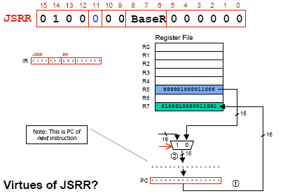
JSRR

Slide 14
F
D
EA
JSRR (Register)
OP
₁₆
GatePC
₁₆
GateMARMUX
EX
LD.PC
PC
DR
₃
MARMUX
+1
REG FILE
₁₆
₂
PCMUX
₁₆
₁₆
₁₆
₁₆
₁₆
LD.REG
S
[7:0]
SR2
SR2
OUT
SR1
OUT
SR1
SEXT
₊
₃
₃
ADDR2MUX
MUX
MUX
ADDR1MUX
₁₆
₁₆
[10:0]
₁₆
₁₆
₁₆
₁₆
₁₆
SEXT
[8:0]
LD.CC
₁₆
SEXT
FINITE STATE MACHINE
SR2MUX
[5:0]
SEXT
₁₆
N
Z
P
ALUK
_{A}
_{B}
[4:0]
SEXT
₂
ALU
LD.IR
IR
LOGIC
…
₁₆
₁₆
₁₆
RUN
GateALU
₁₆
GateMDR
₁₆
LD.MDR
MDR
MEMORY
MAR
LD.MAR
₁₆
INPUT
OUTPUT
MIO.EN
MUX
₁₆
MEM.EN,R,W

Slide 15
F
D
EA
JSRR (Register)
OP
₁₆
GatePC
₁₆
GateMARMUX
EX
LD.PC
PC
DR
₃
MARMUX
+1
REG FILE
₁₆
₂
PCMUX
₁₆
₁₆
₁₆
₁₆
₁₆
LD.REG
S
[7:0]
SR2
SR2
OUT
SR1
OUT
SR1
SEXT
₊
₃
₃
ADDR2MUX
MUX
MUX
ADDR1MUX
₁₆
₁₆
[10:0]
₁₆
₁₆
₁₆
₁₆
₁₆
SEXT
[8:0]
LD.CC
₁₆
SEXT
FINITE STATE MACHINE
SR2MUX
[5:0]
SEXT
₁₆
N
Z
P
ALUK
_{A}
_{B}
[4:0]
SEXT
₂
ALU
LD.IR
IR
LOGIC
…
₁₆
₁₆
₁₆
RUN
GateALU
₁₆
GateMDR
₁₆
LD.MDR
MDR
MEMORY
MAR
LD.MAR
₁₆
INPUT
OUTPUT
MIO.EN
MUX
₁₆
MEM.EN,R,W

Slide 16
F
D
EA
JSRR (Register)
OP
₁₆
GatePC
₁₆
GateMARMUX
EX
LD.PC
PC
DR
₃
MARMUX
+1
REG FILE
₁₆
₂
PCMUX
₁₆
₁₆
₁₆
₁₆
₁₆
LD.REG
S
[7:0]
SR2
SR2
OUT
SR1
OUT
SR1
SEXT
₊
₃
₃
ADDR2MUX
MUX
MUX
ADDR1MUX
₁₆
₁₆
[10:0]
₁₆
₁₆
₁₆
₁₆
₁₆
SEXT
[8:0]
LD.CC
₁₆
SEXT
FINITE STATE MACHINE
SR2MUX
[5:0]
SEXT
₁₆
N
Z
P
ALUK
_{A}
_{B}
[4:0]
SEXT
₂
ALU
LD.IR
IR
LOGIC
…
₁₆
₁₆
₁₆
RUN
GateALU
₁₆
GateMDR
₁₆
LD.MDR
MDR
MEMORY
MAR
LD.MAR
₁₆
INPUT
OUTPUT
MIO.EN
MUX
₁₆
MEM.EN,R,W

Slide 17
JSRR (Register)
F
D
EA
OP
EX
S
₁₆
GatePC
₁₆
GateMARMUX
LD.PC
PC
DR
₃
MARMUX
+1
REG FILE
₁₆
₂
PCMUX
₁₆
₁₆
₁₆
₁₆
₁₆
LD.REG
[7:0]
SR2
SR2
OUT
SR1
OUT
SR1
SEXT
₊
₃
₃
ADDR2MUX
MUX
MUX
ADDR1MUX
₁₆
₁₆
[10:0]
₁₆
₁₆
₁₆
₁₆
₁₆
SEXT
[8:0]
LD.CC
₁₆
SEXT
FINITE STATE MACHINE
SR2MUX
[5:0]
SEXT
₁₆
N
Z
P
ALUK
_{A}
_{B}
[4:0]
SEXT
₂
ALU
LD.IR
IR
LOGIC
…
₁₆
₁₆
₁₆
RUN
GateALU
₁₆
GateMDR
₁₆
LD.MDR
MDR
MEMORY
MAR
LD.MAR
₁₆
INPUT
OUTPUT
MIO.EN
MUX
₁₆
MEM.EN,R,W

Slide 18
JSRR (Register)
F
D
EA
OP
EX
S
₁₆
GatePC
₁₆
GateMARMUX
LD.PC
PC
DR
₃
MARMUX
+1
REG FILE
₁₆
₂
PCMUX
₁₆
₁₆
₁₆
₁₆
₁₆
LD.REG
[7:0]
SR2
SR2
OUT
SR1
OUT
SR1
SEXT
₊
₃
₃
ADDR2MUX
MUX
MUX
ADDR1MUX
₁₆
₁₆
[10:0]
₁₆
₁₆
₁₆
₁₆
₁₆
SEXT
[8:0]
LD.CC
₁₆
SEXT
FINITE STATE MACHINE
SR2MUX
[5:0]
SEXT
₁₆
N
Z
P
ALUK
_{A}
_{B}
[4:0]
SEXT
₂
ALU
LD.IR
IR
LOGIC
…
₁₆
₁₆
₁₆
RUN
GateALU
₁₆
GateMDR
₁₆
LD.MDR
MDR
MEMORY
MAR
LD.MAR
₁₆
INPUT
OUTPUT
MIO.EN
MUX
₁₆
MEM.EN,R,W

Slide 19
RET instruction
RET – return instruction
How to return
Place address in R7 in PC, Return the execution to the last calling point.
PC ← (R7)
15 14 13 12
11 10 9 8 7 6
5 4 3 2 1 0
RET
(JMP R7)
1 1 0 0
0 0 0
1 1 1
0 0 0 0 0 0

Slide 20
Example: Negate the value in R0
TwosComp NOT R0,R0 ;flip bits
ADD R0,R0,#1 ;add one
RET ;return to caller
To call from a program
;need to compute R4 = R1-R3
ADD R0,R3,#0 ;copy R3 to R0
JSR TwosComp ;negate
ADD R4,R1,R0 ;add to R1
...

Slide 21
Using Subroutines
Programmer must know
Address: or at least a label that will be bound to its address
Function: what it does
NOTE: The programmer does not need to know how the subroutine works, but what changes are visible in the machine’s state after the routine has run
Arguments: what they are and where they are placed
Return values: what they are and where they are placed

Slide 22
Passing Information To Subroutines
Argument(s)
Value passed in to a subroutine is called an argument
This is a value needed by the subroutine to do its job
Examples
TwosComp: R0 is number to be negated
OUT: R0 is character to be printed
PUTS: R0 is address of string to be printed
How?
In registers (simple, fast, but limited number)
In memory (many, but awkward, expensive)
Both

Slide 23
Getting Values From Subroutines
Return Values
A value passed out of a subroutine is called a return value
This is the value that you called the subroutine to compute
Examples
TwosComp: negated value is returned in R0
GETC: character read from the keyboard is returned in R0
How?
Registers, memory, or both
Single return value in register most common

Slide 24
Saving and Restore Registers
Like service routines, must save and restore registers
Who saves what is part of the calling convention
Generally use “callee-save(被叫方保存)” strategy, except for return values
Same as trap service routines
Save anything that subroutine alters internally that shouldn’t be visible when the subroutine returns
Restore incoming arguments to original values (unless overwritten by return value)
Remember
You MUST save R7 if you call any other subroutine or trap
Otherwise, you won’t be able to return!

Slide 25
Subroutine Template
01 SUB_NAME
02 ;Register Saving
03 ST R0, SUB_R0
04 ST R1, SUB_R1
05 …
06 ST R6, SUB_R6
07 ST R7, SUB_R7;Return address
08
09 ;***Code***
10 ;……
11 ;Register Restoring
12 LD R0, SUB_R0
13 LD R1, SUB_R1
14 …
15 LD R6, SUB_R6
16 LD R7, SUB_R7 ;Return address
17 RET

