Slide 1
Chapter 8-2 Memory Model for Program Execution & the Stack
计算机系统概论A
Introduction to Computing Systems
（ CS1002A.01 ）
计算机科学与技术学院
School of Computer Science and Technology

Slide 2
Outline
1
1
Review
Review
2
2
Memory Model for Program Execution
From ENIAC to the Stored Program Computer
3
3
A Machine Structure：von Neumann Model
The Stack
3
4
A Machine Structure：von Neumann Model
Implementing Functions in C Using a Stack

Slide 3
Outline
1
1
Review
Review
2
2
Memory Model for Program Execution
From ENIAC to the Stored Program Computer
3
3
A Machine Structure：von Neumann Model
The Stack
3
4
A Machine Structure：von Neumann Model
Implementing Functions in C Using a Stack

Slide 4
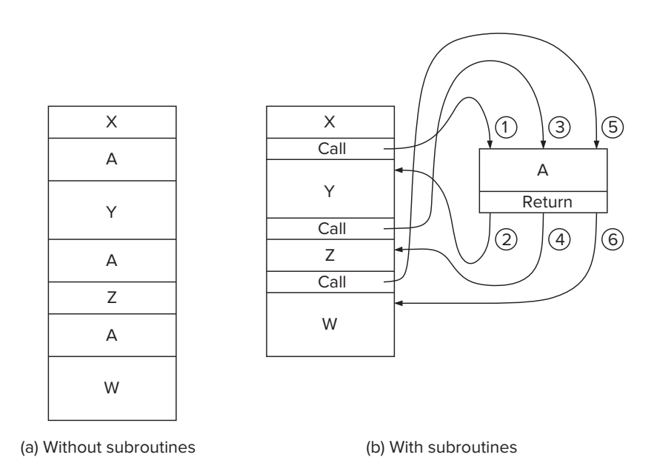
Review: The Call/Return Mechanism

Slide 5
Review: Control Instructions for Subroutines
15
14
13
12
11
10
9
8
7
6
5
4
3
2
1
0
BR
0
0
0
0
n
z
p
PCoffset9
JSR
0
1
0
0
1
PCoffset11
JSRR
0
1
0
0
0
0
0
BaseR
0
0
0
0
0
0
RTI
1
0
0
0
0
0
0
0
0
0
0
0
0
0
0
0
JMP
1
1
0
0
0
0
0
BaseR
0
0
0
0
0
0
RET
1
1
0
0
0
0
0
1
1
1
0
0
0
0
0
0
TRAP
1
1
1
1
0
0
0
0
TrapVector8

Slide 6
Review: Memory in Von Neumann Model

Slide 7
Review: Using Memory
Memory
Just a big “array”
“Indexed” by address
Accessed with loads and stores
LD/LDR/LDI
Read a word out of memory
Use different addressing mode
ST/STR/STI
Place a word in memory
Use different addressing mode

Slide 8
Review: Using Memory
Problem
What if the memory you want to access is far away?
LD/ST won’t work (PC-relative)
LDR/STR won’t work alone (need to get address in register)
Solution:LDI/STI
Place address of far away value nearby
Load address, then load/store from that

Slide 9
Today: Memory Model for Function Calls

Slide 10
Outline
1
1
Review
Review
2
2
Memory Model for Program Execution
From ENIAC to the Stored Program Computer
3
3
A Machine Structure：von Neumann Model
The Stack
3
4
A Machine Structure：von Neumann Model
Implementing Functions in C Using a Stack

Slide 11
Problem
How do we allocate memory during the execution of a program written in C?
Programs need memory for code and data such as instructions, global and local variables, etc.
Modern programming practices encourage many (reusable) functions, callable from anywhere.
Some memory can be statically allocated, since the size and type is known at compile time.
Some memory must be allocated dynamically, size and type is unknown at compile time.

Slide 12
Motivation
Why is memory allocation important? Why not just use a memory manager?
Allocation affects the performance and memory usage of every C, C++, Java program.
Current systems do not have enough registers to store everything that is required.
Memory management is too slow and cumbersome(大而笨重的) to solve the problem.
Static allocation of memory resources is too inflexible and inefficient, as we will see.

Slide 13
Goals
What do we care about?
Fast program execution
Efficient memory usage
Avoid memory fragmentation
Maintain data locality
Allow recursive calls
Support parallel execution
Minimize resource allocation
Memory should never be allocated for functions that are not executed.

Slide 14
Memory Model in the LC-3
0x0000
Trap Vector Table
0x00FF
0x0100
Interrupt Vector Table
0x01FF
0x0200
Operating System
and Supervisor Stack
0x2FFF
0x3000
Program Text
PC
Global data section
R4(Global pointer)
Function1
R6
Heap (for dynamically
allocated memory)
R5
Function2
R6
R5
Run-time stack
R6 (stack pointer)
0xFDFF
R5 (frame pointer)
Function3
R6
0xFE00
Device Register
Addresses
0xFFFF
R5

Slide 15
Outline
1
1
Review
Review
2
2
Memory Model for Program Execution
From ENIAC to the Stored Program Computer
3
3
A Machine Structure：von Neumann Model
The Stack
3
4
A Machine Structure：von Neumann Model
Implementing Functions in C Using a Stack

Slide 16
Abstract Data Types： Data Structures
Up to now, we have processed a single value
an integer
an ASCII character
The information in the real world is far more complex than simple, single numbers. We call these complex items of information abstract data types, or more colloquially（口语地） data structures， E.g.
a company’s organization chart
a list of items arranged in alphabetical order
We will study three abstract data types:
stacks
queues
and character strings

Slide 17
Stack: An Abstract Data Type
An important abstraction that you will encounter in many applications.
The fundamental model for execution of C, Java, Fortran, and many other languages.
We will describe two uses of the stack:
Evaluating arithmetic expressions
Store intermediate results on stack instead of in registers
Function calls
Store parameters, return values, return address, dynamic link(pointer to caller's stack frame)
Interrupt-Driven I/O (chapter 9)
Store processor state for currently executing program

Slide 18
Stack Data Structure
A LIFO (last-in first-out) storage structure
The first thing you put in is the last thing you take out
The last thing you put in is the first thing you take out
This means of access is what defines a stack, not the specific implementation.
Two main operations
PUSH: add an item to the stack
POP: remove an item from the stack
Error conditions:
Underflow (try to pop from empty stack)
Overflow (try to push onto full stack)
A register (eg. R6) holds address of top of stack (TOS)

Slide 19
A Physical Stack
Coin holder
1995
1996
1998
1998
1982
1982
1995
1995
Initial State
After
One Push
After Three
More Pushes
After
One Pop
Last quarter in is the first quarter out (LIFO)

Slide 20
A Hardware Stack Implementation
Data items move between registers
There are 5 registers in each of the following figures
Empty:
Yes
Empty:
No
Empty:
No
Empty:
No
/ / / / / /
TOP
#18
TOP
#12
TOP
#31
TOP
/ / / / / /
/ / / / / /
#5
#18
/ / / / / /
/ / / / / /
#31
/ / / / / /
/ / / / / /
/ / / / / /
#18
/ / / / / /
/ / / / / /
/ / / / / /
/ / / / / /
/ / / / / /
Initial State
After
One Push
After Three
More Pushes
After
Two Pops

Slide 21
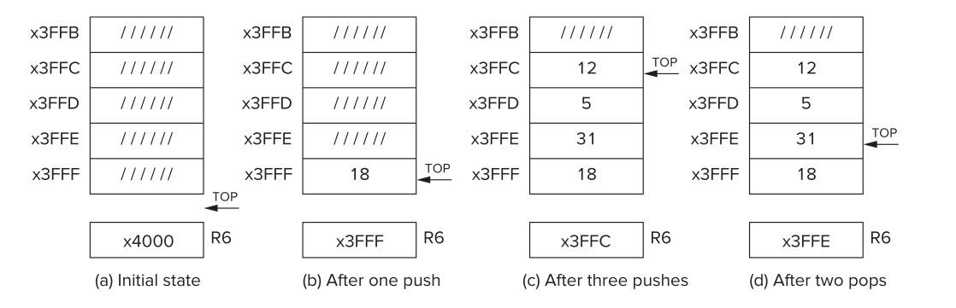
A Software Stack Implementation
Data items don't move in memory, just our idea about where TOP of the stack is
By convention, R6 holds the Top of Stack (TOS) Pointer (SP)

Slide 22
Basic Push and Pop Code
PUSH
ADD R6, R6, #-1 ; increment stack ptr STR R0, R6, #0 ; store data(R0) to TOS
POP
LDR R0, R6, #0 ; load data(R0) from TOS ADD R6, R6, #1 ; decrement stack ptr
Note: Stacks can grow in either direction (toward higher address or toward lower addresses)

Slide 23
Pop with Underflow Detection
If we try to pop too many items off the stack, an underflow condition occurs.
Check for underflow by checking TOS before removing data.
Return status code in R5 (0 for success, 1 for underflow)
POP LD R1, EMPTY ADD R2, R6, R1 ; Compare stack pointer BRz UNDER ; with x4000
; LDR R0, R6, #0 ; The actual ‘pop’ ADD R6, R6, #1 ; Adjust stack pointer
; AND R5, R5, #0 ; Success: return R5 = 0 RET UNDER AND R5, R5, #0 ; Underflow: return R5 = 1 ADD R5, R5, #1 RET EMPTY .FILL xC000 ; EMPTY = -x4000

Slide 24
Push with Overflow Detection
If we try to push too many items onto the stack, an overflow condition occurs.
Check for underflow by checking TOS before adding data.
Return status code in R5 (0 for success, 1 for overflow)
PUSH LD R1, MAX ADD R2, R6, R1 ; Compare stack pointer BRz OVER ; with MAX ADD R6, R6, #-1 ; Adjust stack pointer
STR R0, R6, #0 ; The actual ‘push’ AND R5, R5, #0 ; Success: return R5 = 0 RET OVER AND R5, R5, #0
ADD R5, R5, #1 ; Overflow: return R5 = 1 RET MAX .FILL xC005 ; MAX = -x3FFB

Slide 25
PUSH & POP in LC-3 - 1
01 ;
02 ; Subroutines for carrying out the PUSH and POP functions. This
03 ; program works with a stack consisting of memory locations x3FFF
04 ; through x3FFB. R6 is the stack pointer .
05 ;
06 POP AND R5,R5,#0 ; R5 <-- success
07 ST R1,Save1 ; Save registers that
08 ST R2,Save2 ; are needed by POP
09 LD R1,EMPTY ; EMPTY contains -x4000
0A ;
0B ADD R2,R6,R1 ; Compare stack pointer to x4000
0C BRz fail_exit ; Branch if stack is empty
0D ;
0E LDR R0,R6,#0 ; The actual "pop"
0F ADD R6,R6,#1 ; Adjust stack pointer
10 BRnzp success_exit
11 ;
12 PUSH AND R5,R5,#0
13 ST R1,Save1 ; Save registers that
14 ST R2,Save2 ; are needed by PUSH
15 LD R1,FULL ; FULL contains -x3FFB
16 ADD R2,R6,R1 ; Compare stack pointer to x3FFB
17 BRz fail_exit ; Branch if stack is full
18 ;

Slide 26
PUSH & POP in LC-3 - 2
19 ADD R6,R6,#-1 ; Adjust stack pointer
1A STR R0,R6,#0 ; The actual "push"
1B success_exit
LD R2,Save2 ; Restore original
1C LD R1,Save1 ; register values
1D RET
1E ;
1F fail_exit LD R2,Save2 ; Restore original
20 LD R1,Save1 ; register values
21 ADD R5,R5,#1 ; R5 <-- failure
22 RET
23 ;
24 EMPTY .FILL xC000 ; EMPTY contains -x4000
25 FULL .FILL xC005 ; FULL contains -x3FFB
26 Save1 .FILL x0000
27 Save2 .FILL x0000

Slide 27
Arithmetic Using a Stack (p387, chapter 10.2)
Instead of registers, some ISA's use a stack for source and destination operations. The computer always pops and pushes operands from the stack, and hence no addresses need to be specified explicitly. Therefore, stack machines are sometimes referred to as zero-address machines.
Example: ADD instruction pops two numbers from the stack, adds them, and pushes the result to the stack.
ADD vs. ADD R0,R1,R2
Evaluating (A+B)·(C+D) using a stack:
push A push B ADD push C push D ADD MULTIPLY pop result
x3FFB
x3FFC
x3FFD
x3FFE
x3FFF
x4000
SP

Slide 28
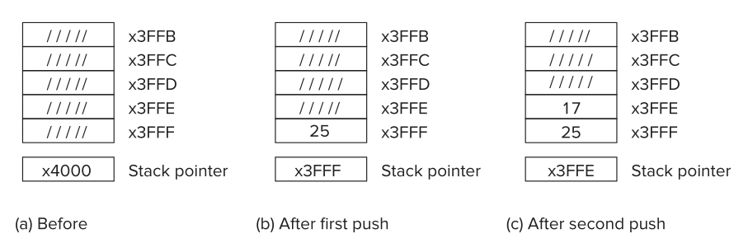
(25+17) x (3+2)

Slide 29
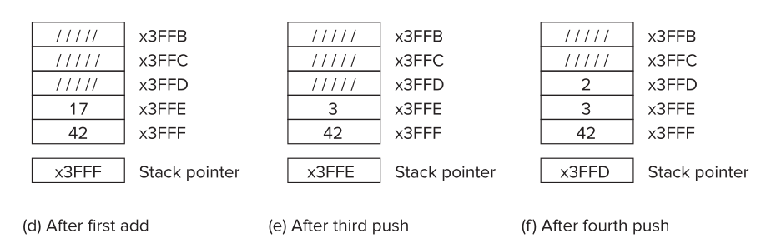
(25+17) x (3+2)

Slide 30
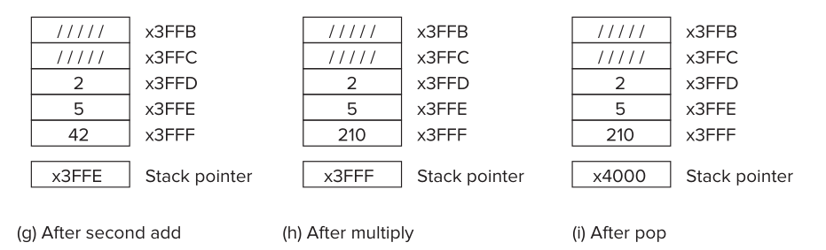
(25+17) x (3+2)

Slide 31
Outline
1
1
Review
Review
2
2
Memory Model for Program Execution
From ENIAC to the Stored Program Computer
3
3
A Machine Structure：von Neumann Model
The Stack
3
4
A Machine Structure：von Neumann Model
Implementing Functions in C Using a Stack

Slide 32
Function in C
Smaller, simpler, subcomponent of program
Provides abstraction
hide low-level details
give high-level structure to programmer, easier to understand overall program flow
enables separable, independent development
C functions
zero or multiple arguments passed in
single result returned (optional)
return value is always a particular type
In other languages, called procedures, subroutines, ...

Slide 33
Example of High-Level Structure
main() { SetupBoard(); /* place pieces on board */ DetermineSides(); /* choose black/white */
/* Play game */ do { WhitesTurn(); BlacksTurn(); } while (NoOutcomeYet()); }
Structure of program is evident, even without knowing implementation.

Slide 34
Functions in C
Declaration (also called prototype)
int Factorial(int n);
Function call -- used in expression
a = x + Factorial(f + g);
type of return value
name of function
types of all arguments
1. evaluate arguments
2. execute function
3. use return value in expression

Slide 35
Function Definition
State type, name, types of arguments
must match function declaration
give name to each argument (doesn't have to match declaration)
int Factorial(int n)
{
int i; int result = 1; for (i = 1; i <= n; i++) result *= i; return result;
}
gives control back to calling function and returns value

Slide 36
Why Declaration?
Since function definition also includes return and argument types, why is declaration needed?
Use might be seen before definition.
Compiler needs to know return and arg types and number of arguments.
Definition might be in a different file, written by a different programmer.
include a "header" file with function declarations only
compile separately, link together to make executable

Slide 37
Example
double ValueInDollars(double amount, double rate);
main() { ... dollars = ValueInDollars(francs, DOLLARS_PER_FRANC); printf("%f francs equals %f dollars.\n", francs, dollars); ...
}
double ValueInDollars(double amount, double rate)
{
return amount * rate;
}
declaration
function call (invocation)
definition

Slide 38
Storage Requirements
Code must be stored in memory so that we can execute the function.
Parameters must be sent from the caller to the callee so that the function receives them.
Local variables for the function must be stored somewhere, is one copy enough?
Return address must be stored so that control can be returned to the caller.
Return values must be sent from the callee to the caller, that’s how results are returned.

Slide 39
Function Call in C
Consider the following code:
What needs to be stored?
Code, parameters, local/global variables, return address/values
_{// main program}
_{Int a = 10;}
_{Int b = 20;}
_{Int c = foo(a,b);}
_{Int foo(int x,int y)}
{
_{Int z;}
_{z= x+y;}
_{return z;}
}

Slide 40
Possible Solution: Mixed Code and Data
Function implementation:
Can construct data section by appending foo_
Corresponding to the option 1 in text book p.497
foo BR foo_begin ;skip over data
foo_rv .BLKW 1 ;return value
foo_ra .BLKW 1 ;return address
foo_paramx .BLKW 1 ;‘x’ parameter
foo_paramy .BLKW 1 ;‘y’ parameter
foo_localz .BLKW 1 ;‘z’ local
foo_begin ST R7, foo_ra ;save return
…
_{LD R7, foo_ra ;restore return}
_{RET}

Slide 41
Possible Solution: Mixed Code and Data
Calling sequence
Code generation is relatively simple.
Few instructions are spent on moving data.
ST R1, foo_paramx ; R1 has ‘x’
ST R2, foo_paramy ; R2 has ‘y’
JSR foo ; Function call
LD R3, foo_rv ; R3 = return value

Slide 42
Possible Solution: Mixed Code and Data
Advantages:
Code and data are close together
Conceptually easy to understand
Minimizes register usage for variables
Data persists through life of program
Disadvantages:
Cannot handle recursion or parallel execution
Code is vulnerable to self-modification
代码容易自我修改
Code must be marked as “writable”
Consumes resource for inactive functions

Slide 43
Possible Solution: Separate Code and Data
Memory allocation
Code for foo() and bar() are somewhere else
Function code call is similar to mixed solution
foo_rv .BLKW 1 ; foo return value
foo_ra .BLKW 1 ; foo return address
foo_paramx .BLKW 1 ; foo ‘x’ parameter
foo_paramy .BLKW 1 ; foo ‘y’ parameter
foo_localz .BLKW 1 ; foo ‘z’ local
bar_rv .BLKW 1 ; bar return value
bar_ra .BLKW 1 ; bar return address
bar_paramw .BLKW 1 ; bar ‘w’ parameter

Slide 44
Possible Solution: Separate Code and Data
Advantages:
Code can be marked ‘read only’
Conceptually easy to understand
Early Fortran used this scheme
Data persists through life of program
Disadvantages:
Cannot handle recursion or parallel execution
Consumes resource for inactive functions

Slide 45
Real Solution: Run-time Stack
Instead of allocating the space for local variables statically (i.e., in a fixed place in memory), the space is allocated once the function starts executing.
When the function returns to the caller, its space is reclaimed （回收） to be assigned later to another function.
If the function is called from itself, the new invocation of the function will get its own space that is distinct from its other currently active invocations.

Slide 46
Run-time Stack： Stack frame
Each function has a memory template where it stores its local variables, some bookkeeping information(记账信息), and its parameter variables .This template is called its stack frame or activation record.
Whenever a function is called, its stack frame will be allocated somewhere in memory.
Because the calling pattern of functions naturally follows a stack-like pattern, this allocation and deallocation will follow the pushes and pops of a stack.

Slide 47
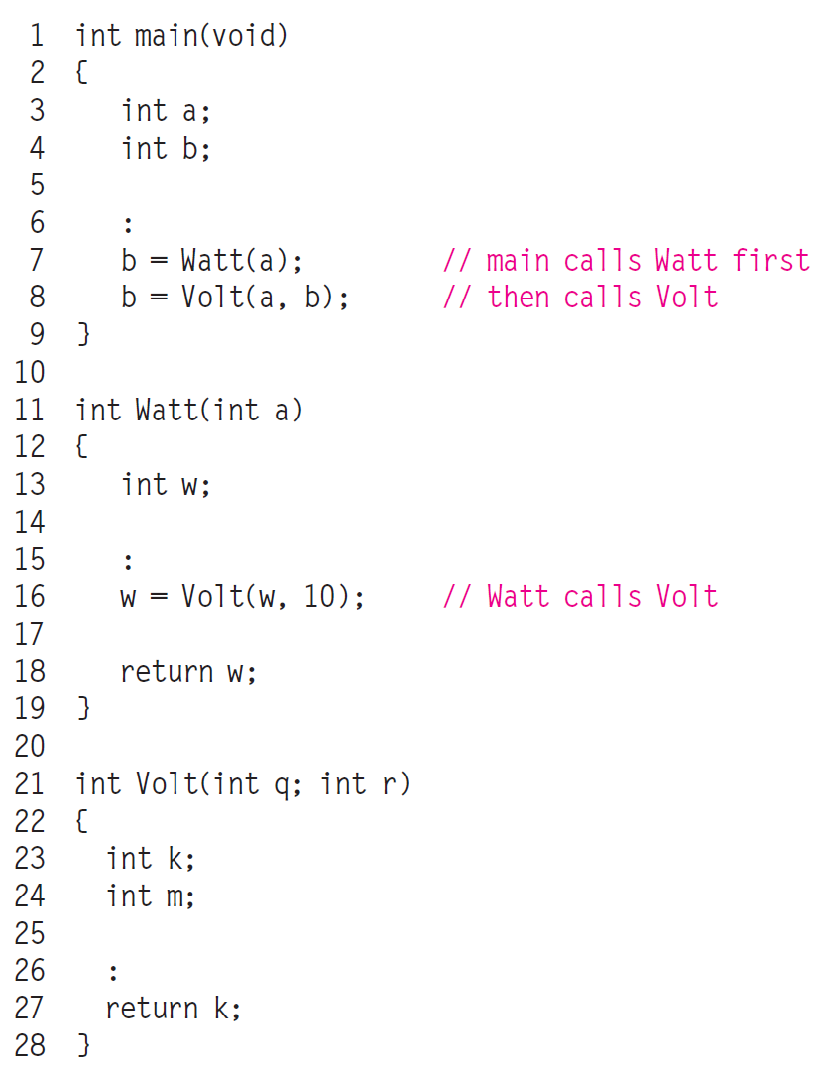
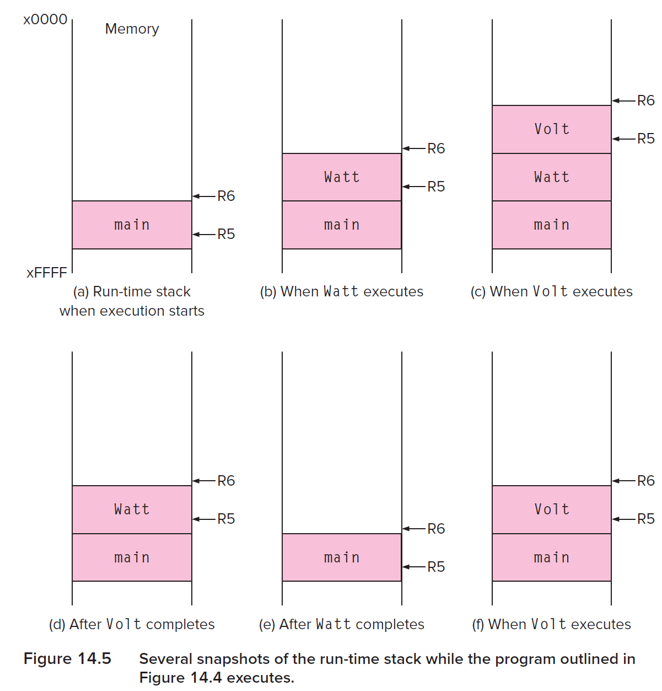
Run-time Stack: stack-like nature of function calls

Slide 48
Run-time Stack: frame pointer & stack pointer
We need some easy way to access the data in each function’s stack frame and also to manage the pushing and popping of stack frames.
For this, we will use R5 and R6. R5 points to some internal location within the stack frame at the top of the stack—it may point to the base of the local variables for the currently executing function. We call it the frame pointer (FP).
R6 always points to the very top of the stack. We call it the stack pointer (SP).

Slide 49
Run-time Stack: Stack frame
Consider what has to happen in a function call:
Caller must pass parameters to the callee.
Caller must transfer control to the callee.
Caller need to allocate space for the return value.
Caller need to save the return address.
Callee requires space for local variables.
Callee must return control to the caller.
Callee need to save the frame pointer of the caller
So, parameters, return value, return address, frame pointer, and local variables are stored on the stack.

Slide 50
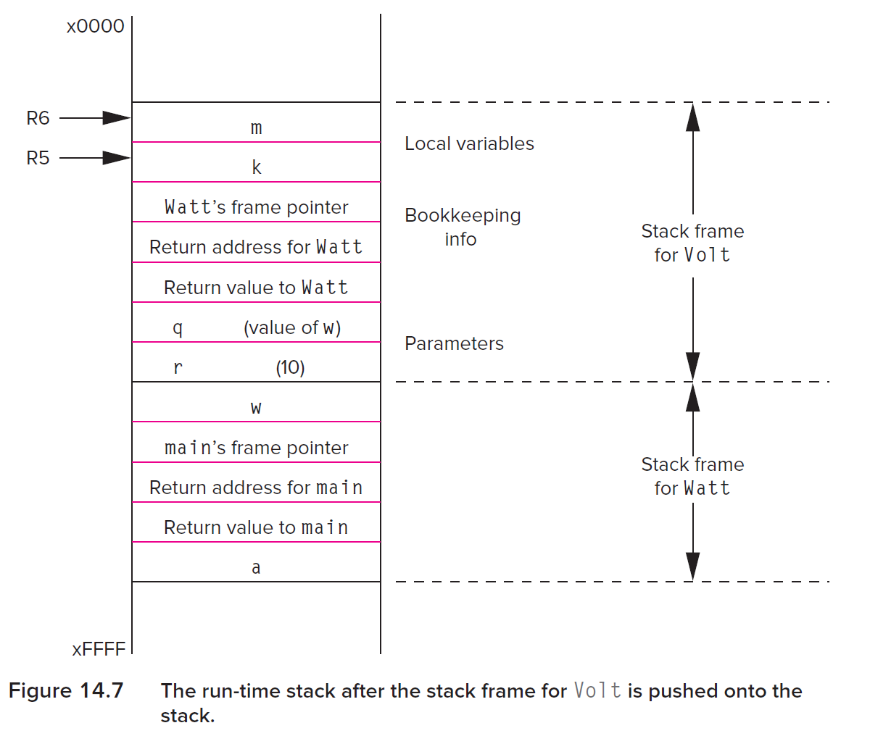
Run-time Stack: Stack frame
stack frame points to the base of the local variables for the currently executing function.

Slide 51
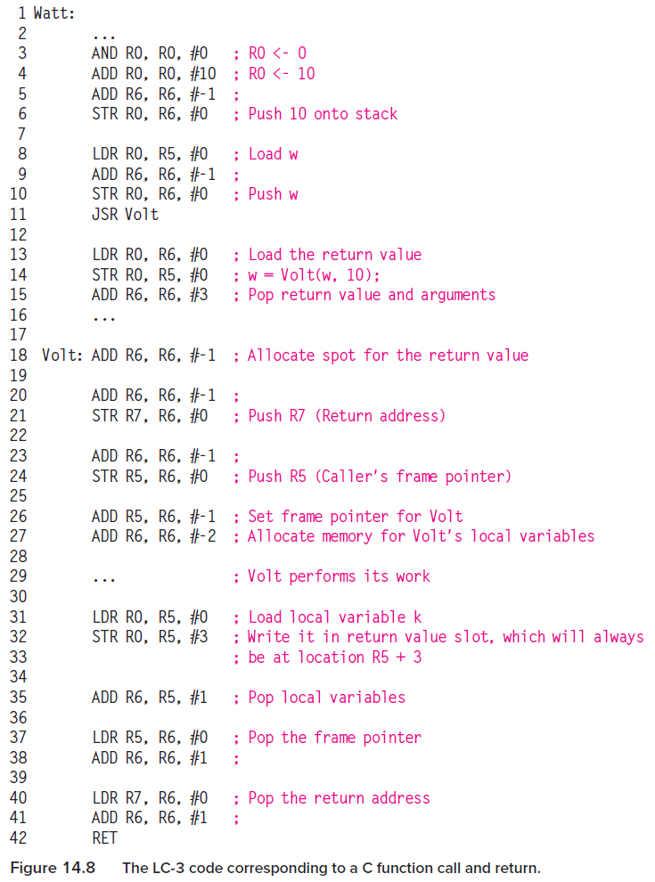
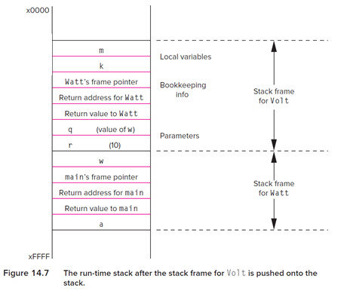
Run-time Stack: an example

Slide 52
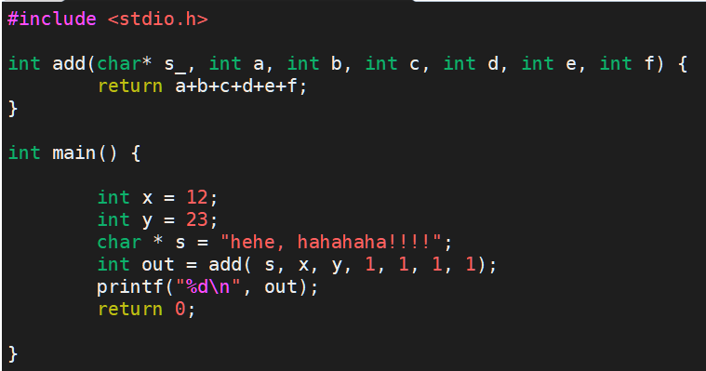
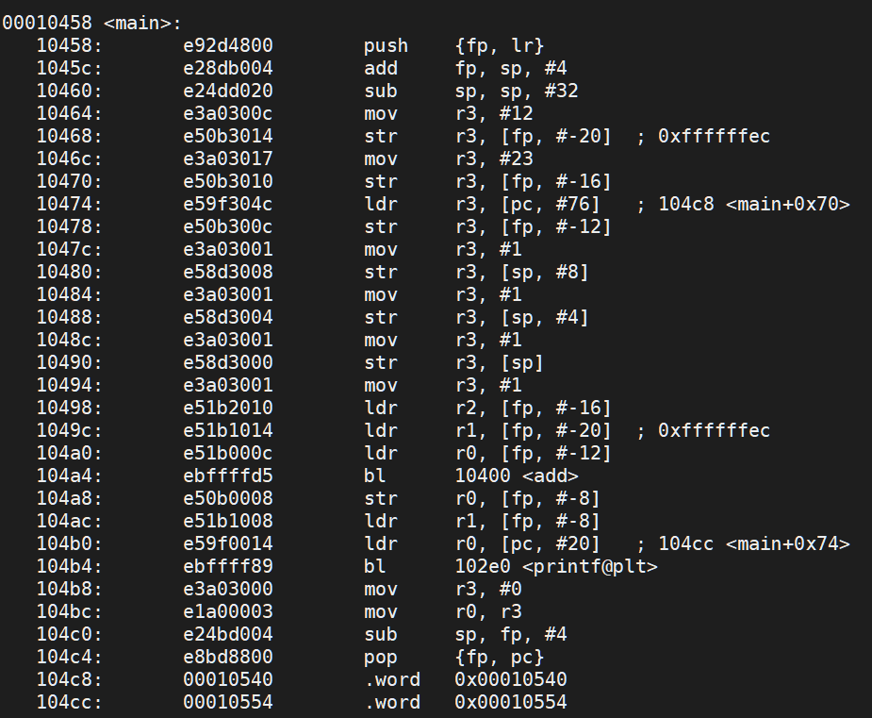
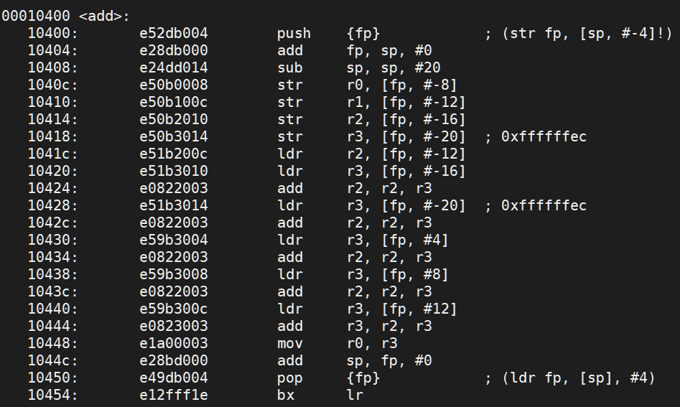

Run-time Stack: Stack frame

Slide 53
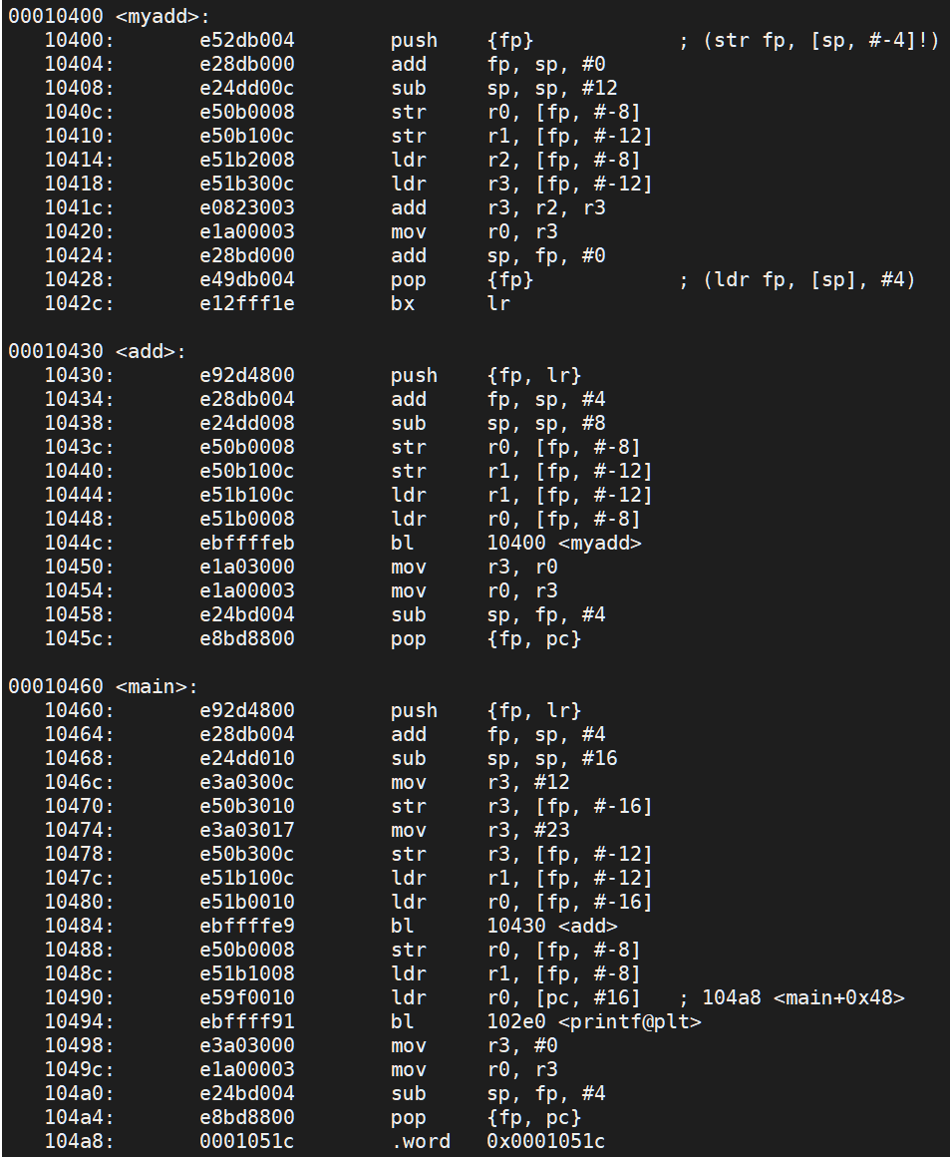
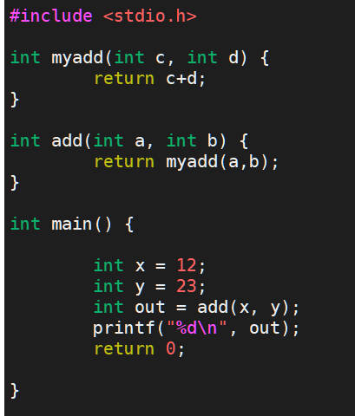
Run-time Stack: Stack frame

