Slide 1
Chapter 2-2 Operations and Other Data Types
计算机系统概论
Introduction to Computing Systems
（CS1002A.01 ）
计算机科学与技术学院
School of Computer Science and Technology

Slide 2
Outline
1
Operations on Bits: Arithmetic and Logical
2
Other Representation
3
Summary

Slide 3
Outline
1
Operations on Bits: Arithmetic and Logical
2
Other Representation
3
Summary

Slide 4
Operations: Arithmetic and Logical
A data type includes representation and operations.
We now have a good representation for signed integers, so let’s look at some arithmetic operations:
Addition
Subtraction
Sign Extension !!!
We’ll also look at overflow conditions for addition.
Multiplication, division, etc., can be built from these basic operations.
Logical operations are also useful:
AND
OR
NOT
Notes:
4

Slide 5
2’s Complement Signed Integers
MS bit is sign bit – it has weight –2^{n-1}.
Range of an n-bit number: -2^{n-1} through 2^{n-1} – 1.
The most negative number (-2^{n-1}) has no positive counterpart.
-2³ | 2² | 2¹ | 2⁰
0 | 0 | 0 | 0 | 0
0 | 0 | 0 | 1 | 1
0 | 0 | 1 | 0 | 2
0 | 0 | 1 | 1 | 3
0 | 1 | 0 | 0 | 4
0 | 1 | 0 | 1 | 5
0 | 1 | 1 | 0 | 6
0 | 1 | 1 | 1 | 7
-2³ | 2² | 2¹ | 2⁰
1 | 0 | 0 | 0 | -8
1 | 0 | 0 | 1 | -7
1 | 0 | 1 | 0 | -6
1 | 0 | 1 | 1 | -5
1 | 1 | 0 | 0 | -4
1 | 1 | 0 | 1 | -3
1 | 1 | 1 | 0 | -2
1 | 1 | 1 | 1 | -1
Notes:
5

Slide 6
Addition
As we’ve discussed, 2’s complement addition is just binary addition.
assume all integers have the same number of bits
ignore carry out
for now, assume that sum fits in n-bit 2’s complement representation
01101000 (104) 11110110 (-10)
+ 11110000 (-16) + (-9)
01011000 (88) (-19)
Assuming 8-bit 2’s complement numbers.
Notes:
6
11110110 (-10)
11110111 (-9)
----------------------
11101101 (-19)
Check: {11101101} = 00010011 = 16 + 2 + 1 = 19, or
-128+64+32+8+4+1 = 19

Slide 7
Subtraction
Negate subtrahend (减数，2nd number) and add.
assume all integers have the same number of bits
ignore carry out
for now, assume that the difference fits in n-bit 2’s complement representation
01101000 (104) 11110110 (-10)
- 00010000 (16) + (-9)
01101000 (104) 11110110 (-10)
+ 11110000 (-16) + (9)
01011000 (88) (-1)
减变加
Assuming 8-bit 2’s complement numbers.
Notes:
7
11110110 (-10)
11110111 (-9)
----------------------
11101101 (-19)
11110110 (-10)
00001001 (9)
----------------------
11111111 (-1)

Slide 8
Subtraction
Negate subtrahend (减数，2nd number) and add.
assume all integers have the same number of bits
ignore carry out
for now, assume that the difference fits in n-bit 2’s complement representation
01101000 (104) 11110110 (-10)
- 00010000 (16) + 11110111 (-9)
11101101 01101000 (104) 11110110 (-10)
+ 11110000 (-16) + (9)
01011000 (88) (-1)
减变加
Assuming 8-bit 2’s complement numbers.
Notes:
8
11110110 (-10)
11110111 (-9)
----------------------
11101101 (-19)
11110110 (-10)
00001001 (9)
----------------------
11111111 (-1)

Slide 9
Subtraction
Negate subtrahend (减数，2nd number) and add.
assume all integers have the same number of bits
ignore carry out
for now, assume that the difference fits in n-bit 2’s complement representation
01101000 (104) 11110110 (-10)
- 00010000 (16) + (-9)
01101000 (104) 11110110 (-10)
+ 11110000 (-16) + 00001001(9)
01011000 (88) 11111111 (-1)
减变加
Assuming 8-bit 2’s complement numbers.
Notes:
9
11110110 (-10)
11110111 (-9)
----------------------
11101101 (-19)
11110110 (-10)
00001001 (9)
----------------------
11111111 (-1)

Slide 10
Sign Extension
To add two numbers, we must represent them with the same number of bits.
If we just pad with zeroes on the left:
Instead, replicate the most significant bit -- the sign bit:
4-bit 8-bit
0100 (4) 00000100 (still 4)
1100 (-4) 00001100 (12, not -4)
4-bit 8-bit
0100 (4) 00000100 (still 4)
1100 (-4) 11111100 (still -4)
Notes:
10

Slide 11
Overflow
Recall the represent range of n-bit 2’complement Signed Integers
For an n-bit number:
-2^{n-1} ~ 2^{n-1} – 1
Can we use n-bit 2’complement to represent a value larger than 2^{n-1}-1? Or a value smaller than -2^{n-1} ?

Slide 12
Overflow
If operands are too big, then sum cannot be represented as an n-bit 2’s complement number.
We have overflow if:
signs of both operands are the same, and
the sign of sum is different.
01000 (8) 11000 (-8)
+ 01001 (9) + 10111 (-9)
10001 (-15) 01111 (+15)
Notes:
12

Slide 13
Overflow
Another test -- easy for hardware:
The carry into most significant bit is not equal to the carry out
01000 (8) 11000 (-8)
+ 01001 (9) + 10111 (-9)
10001 (-15) 01111 (+15)
01
10
Notes:
13

Slide 14
Overflow
Another test -- easy for hardware:
The carry into most significant bit is not equal to the carry out
01000 (8) 11000 (-8)
+ 01001 (9) + 10111 (-9)
10001 (-15) 01111 (+15)
01
10
WHY ？
Notes:
14

Slide 15
Logical Operations
Operations on logical TRUE or FALSE
two states -- takes one bit to represent:
TRUE=1, FALSE=0
View n-bit number as a collection of n logical values
operation applied to each bit independently
Bitwise (bit-wise) operation 按位运算
A | B | A AND B
0 | 0 | 0
0 | 1 | 0
1 | 0 | 0
1 | 1 | 1
A | B | A OR B
0 | 0 | 0
0 | 1 | 1
1 | 0 | 1
1 | 1 | 1
A | NOT A
0 | 1
1 | 0
Notes:
15
Bitwise 按位

Slide 16
Examples of Logical Operations
AND
useful for clearing bits, bitmask
AND with zero = 0
AND with one = no change
Inclusive OR 兼或
useful for setting bits
OR with zero = no change
OR with one = 1
NOT
unary operation -- one argument
flips every bit
11000101
AND 00001111
00000101
11000101
OR 00001111
11001111
NOT 11000101
00111010
Notes:
16

Slide 17
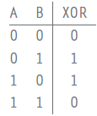
Examples of Logical Operations
Exclusive-OR (XOR) 异或
The output of XOR is 1 if one (but not both) of the two sources is 1. The output of XOR is 0 if both sources are 1 or if neither source is 1.
相同则为0，相异则为1
11000101
XOR 00001111
11001010
Notes:
17

Slide 18
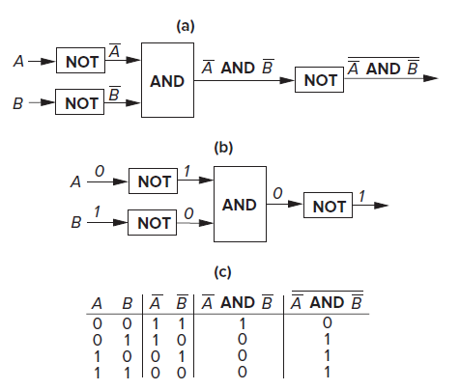

DeMorgan’s Laws 摩根定律
There are two well-known relationships between AND functions and OR functions, known as DeMorgan’s Laws.

Slide 19
Outline
1
Operations on Bits: Arithmetic and Logical
2
Other Representation
3
Summary

Slide 20
Fractions: Fixed-Point 小数：定点数 表示
How can we represent fractions?
Use a “binary point” to separate positive from negative powers of two -- just like “decimal point.”
2’s complement addition and subtraction still work.
if binary points are aligned
n | 2^{n}
0 | 1
1 | 2
2 | 4
3 | 8
4 | 16
5 | 32
6 | 64
7 | 128
8 | 256
9 | 512
10 | 1024
2⁻¹ = 0.5
2⁻² = 0.25
2⁻³ = 0.125
00101000.101
+ 11111110.110
00100111.011
(40.625)
+ (-1.25)
(39.375)
No new operations -- same as integer arithmetic.
Notes:
20

Slide 21
Very Large and Very Small Data
The LC-3 use the 16-bit 2’s complement data type,
One bit to identify positive or negative,
15bits to represent the magnitude of the value.
We can express values:
- 2¹⁵ through 2¹⁵ –1
(– 32768 through 32767)
How can we represent
very large and very small data?
Notes:
21

Slide 22
Very Large and Very Small Data
Large values: 6.023 x 10²³ ―― requires 79 bits
Small values: 6.626 x 10⁻³⁴ ―― requires >110 bits
How can we represent
very large and very small data?
使用定点数来保存这样的数将会占用很大的空间！
Notes:
22

Slide 23
Very Large and Very Small: Floating-Point 浮点
Large values: 6.023 x 10²³ ―― requires 79 bits
Small values: 6.626 x 10⁻³⁴ ―― requires >110 bits
Use equivalent of “scientific notation”: F x 2E
Need to represent F (fraction), E (exponent), and sign.
IEEE 754 Floating-Point Standard (32-bits):
1b
8b
23b
S
Exponent
Fraction
符号 指数 小数
Notes:
23

Slide 24
Normalized Form 规范型
Single-precision IEEE floating point number:
1 01111110 10000000000000000000000
Sign is 1 – number is negative.
Exponent field, unsigned integer, excess code, biased representations: 01111110 = 126 (decimal).
Fraction is .100000000000… = .5 (decimal).
Value = -1.5 x 2⁽¹²⁶⁻¹²⁷⁾ = -1.5 x 2⁻¹ = -0.75.
sign
exponent
fraction
Notes:
24

Slide 25

Floating Point Example
Example 2.13
6$\frac{5}{8}$ represented in the floating point data type
Example 2.14
Example 2.15

Slide 26
Very Small: Floating-Point
The smallest number that can be represented in normalized form is
N = 1.00000000000000000000000 × 2⁻¹²⁶

Slide 27
Very Small: subnormal numbers
The largest subnormal number is
N = 0.11111111111111111111111 × 2⁻¹²⁶
The smallest subnormal number is
N = 0.00000000000000000000001 × 2⁻¹²⁶
= 2⁻²³X2⁻¹²⁶=2⁻¹⁴⁹
Example
0 00000000 00001000000000000000000
2⁻⁵ X 2⁻¹²⁶ = 2⁻¹³¹

Slide 28
Infinities
So, what if the exponent is equal to 1111_1111?
If the exponent field contains 1111_1111, we use the floating point data type to represent various things, among them the notion of infinity.
Infinity is represented by the exponent field containing all 1s and the fraction field containing all 0s.
We represent positive infinity if the sign bit is 0 and negative infinity if the sign bit is 1

Slide 29
Floating-Point Operations
Question
Will the regular 2’s complement arithmetic work for Floating Point numbers?
Hint: In decimal, how do we compute
3.07 x 10¹² + 9.11 x 10⁸ ?

Slide 30
Text: ASCII Characters
ASCII: Maps 128 characters to 7-bit code.
both printable and non-printable (ESC, DEL, …) characters
00 | nul | 10 | dle | 20 | sp | 30 | 0 | 40 | @ | 50 | P | 60 | ` | 70 | p
01 | soh | 11 | dc1 | 21 | ! | 31 | 1 | 41 | A | 51 | Q | 61 | a | 71 | q
02 | stx | 12 | dc2 | 22 | " | 32 | 2 | 42 | B | 52 | R | 62 | b | 72 | r
03 | etx | 13 | dc3 | 23 | # | 33 | 3 | 43 | C | 53 | S | 63 | c | 73 | s
04 | eot | 14 | dc4 | 24 | $ | 34 | 4 | 44 | D | 54 | T | 64 | d | 74 | t
05 | enq | 15 | nak | 25 | % | 35 | 5 | 45 | E | 55 | U | 65 | e | 75 | u
06 | ack | 16 | syn | 26 | & | 36 | 6 | 46 | F | 56 | V | 66 | f | 76 | v
07 | bel | 17 | etb | 27 | ' | 37 | 7 | 47 | G | 57 | W | 67 | g | 77 | w
08 | bs | 18 | can | 28 | ( | 38 | 8 | 48 | H | 58 | X | 68 | h | 78 | x
09 | ht | 19 | em | 29 | ) | 39 | 9 | 49 | I | 59 | Y | 69 | i | 79 | y
0a | nl | 1a | sub | 2a | * | 3a | : | 4a | J | 5a | Z | 6a | j | 7a | z
0b | vt | 1b | esc | 2b | + | 3b | ; | 4b | K | 5b | [ | 6b | k | 7b | {
0c | np | 1c | fs | 2c | , | 3c | < | 4c | L | 5c | \ | 6c | l | 7c | |
0d | cr | 1d | gs | 2d | - | 3d | = | 4d | M | 5d | ] | 6d | m | 7d | }
0e | so | 1e | rs | 2e | . | 3e | > | 4e | N | 5e | ^ | 6e | n | 7e | ~
0f | si | 1f | us | 2f | / | 3f | ? | 4f | O | 5f | _ | 6f | o | 7f | del
Notes:
30

Slide 31
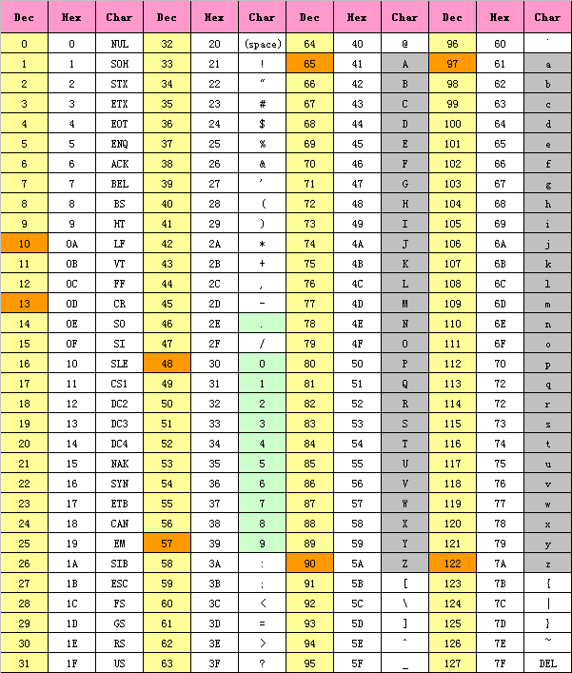
ASCII（American Standard Code for Information Interchange）

Slide 32
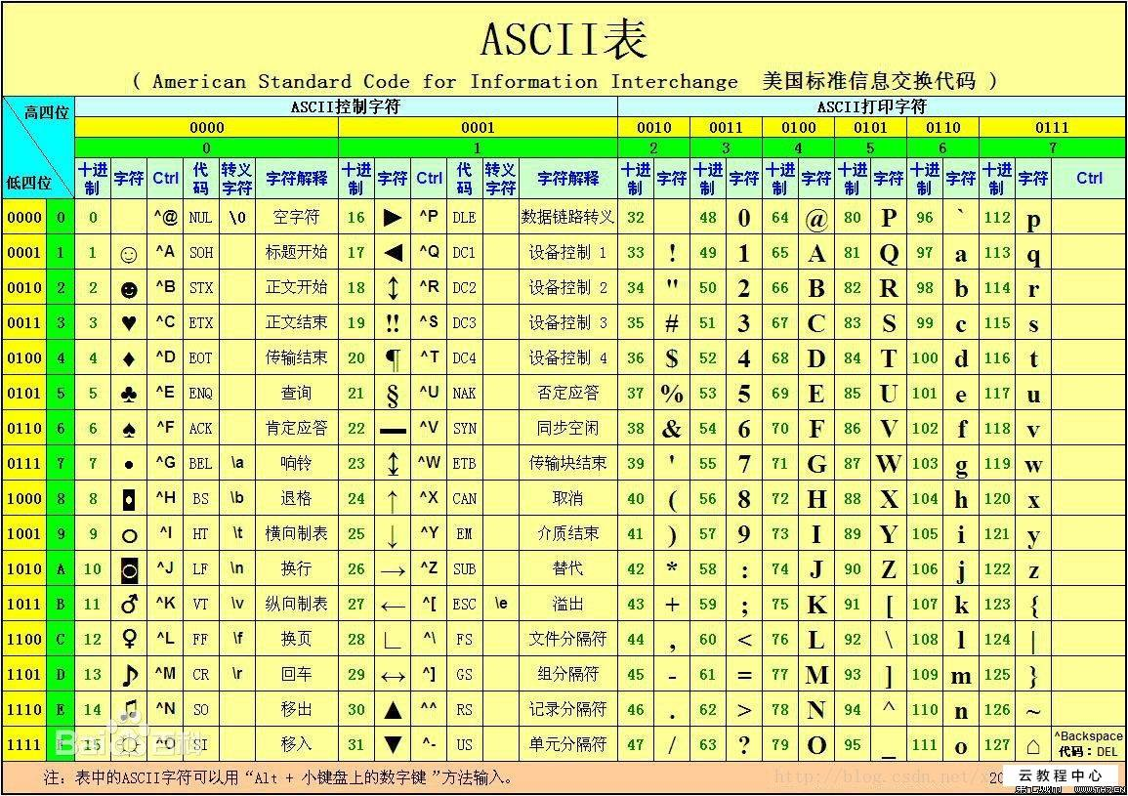
ASCII 码

Slide 33
Interesting Properties of ASCII Code
What is the relationship between a decimal digit ('0', '1', …) and its ASCII code?
“30h”
What is the difference between an upper-case letter ('A', 'B', …) and its lower-case equivalent ('a', 'b', …)?
“20h”
Given two ASCII characters, how do we tell which comes first in alphabetical order?
Are 128 characters enough? (http://www.unicode.org/
No new operations -- integer arithmetic and logic.

Slide 34
Other Data Types
Text strings
sequence of characters, terminated with NULL (0)
typically, no hardware support
Image
array of pixels
monochrome: one bit (1/0 = black/white)
color: red, green, blue (RGB) components (e.g., 8 bits each)
other properties: transparency
hardware support:
typically none, in general-purpose processors
MMX -- multiple 8-bit operations on 32-bit word
Sound
sequence of fixed-point numbers
Within the Computer: Everything is a Number.
Notes:
MMX（Multi Media eXtension，多媒体扩展指令集）

Slide 35
LC-3 Data Types
Some data types are supported directly by the instruction set architecture.
For LC-3, there is only one supported data type:
16-bit 2’s complement signed integer
Operations: ADD, AND, NOT
Other data types are supported by interpreting 16-bit values as logical, text, fixed-point, etc., in the software that we write.
Notes:
35

Slide 36
Outline
1
Operations on Bits: Arithmetic and Logical
2
Other Representation
3
Summary

Slide 37
Summary
Everything in a computer is a number, in fact only 0 and 1.
Integers are interpreted by adhering to fixed length
Negative numbers are represented with 2’s complement
Overflows can be detected utilizing the carry bit
We will get into some more representations later when we talk about floating point
Signed Magnitude & Biased representations are needed in floating point for specific uses
Not going to talk about ‘1’s complement’, its a joke that nobody uses

