Slide 1
Chapter 3-2 Combinational Logic Circuits & Basic Storage Elements
计算机系统概论
Introduction to Computing Systems
（ CS1002A.01 ）
计算机科学与技术学院
School of Computer Science and Technology

Slide 2
Outline
1
Review
2
Combinational Logic Circuits
3
Basic Storage Elements
4
Summary

Slide 3
Outline
1
Review
2
Combinational Logic Circuits
3
Basic Storage Elements
4
Summary

Slide 4
Review
Transistor: Building Block of Computers
Logically, each transistor acts as a switch
Combined to implement logic functions
AND, OR, NOT

Slide 5

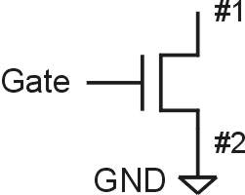
N-type MOS Transistor
Gate = 1
Gate = 0
Terminal #2 must be
connected to GND (0V).
MOS = Metal Oxide Semiconductor
two types: N-type and P-type
N-type
when Gate has positive voltage, short circuit between #1 and #2 (switch closed)
when Gate has zero voltage, open circuit between #1 and #2 (switch open)
Notes:
5

Slide 6
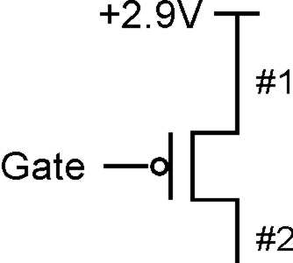
P-type MOS Transistor
Gate = 1
Terminal #1 must be
connected to +2.9V.
Gate = 0
P-type is complementary to N-type
when Gate has positive voltage, open circuit between #1 and #2 (switch open)
when Gate has zero voltage, short circuit between #1 and #2 (switch closed)
Notes:
6

Slide 7
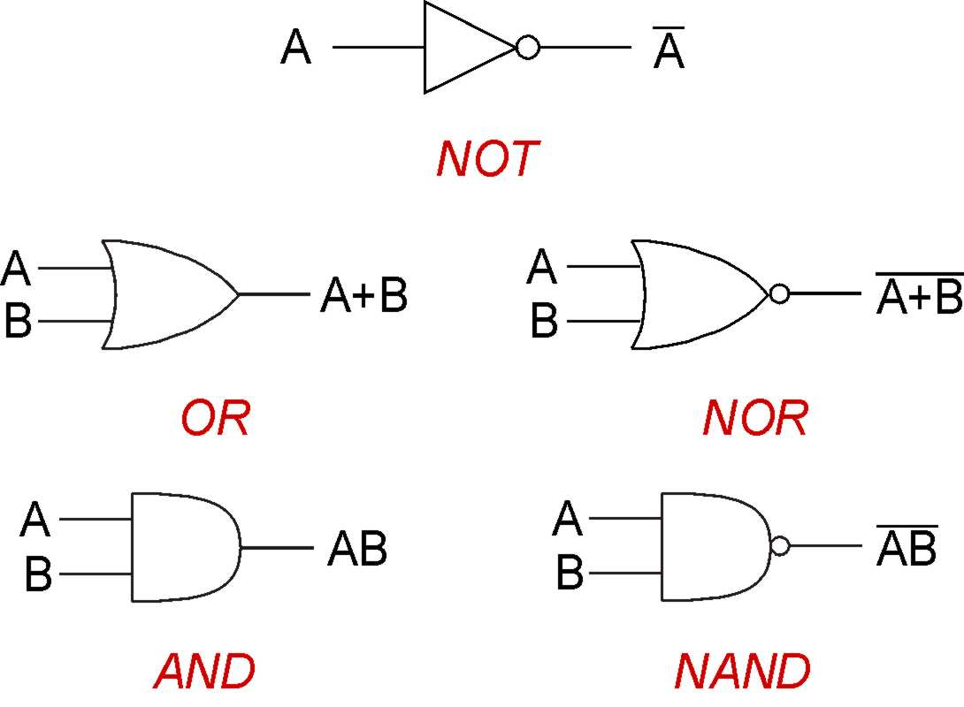
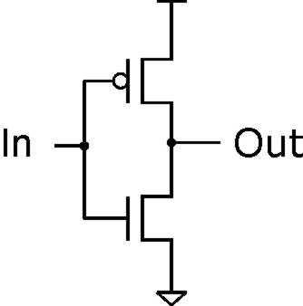
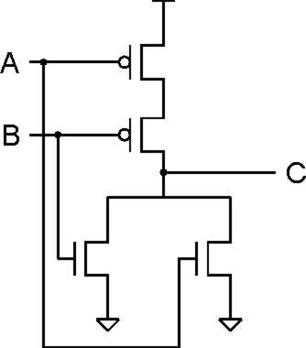
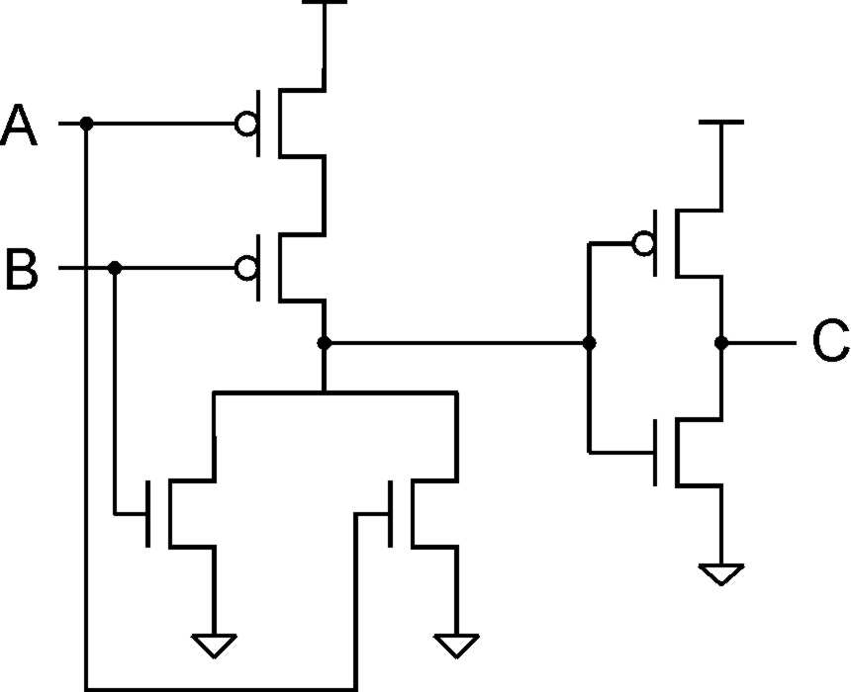
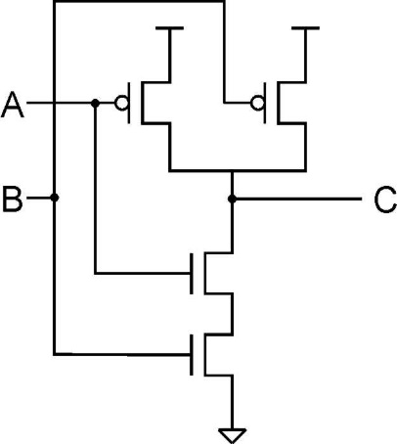
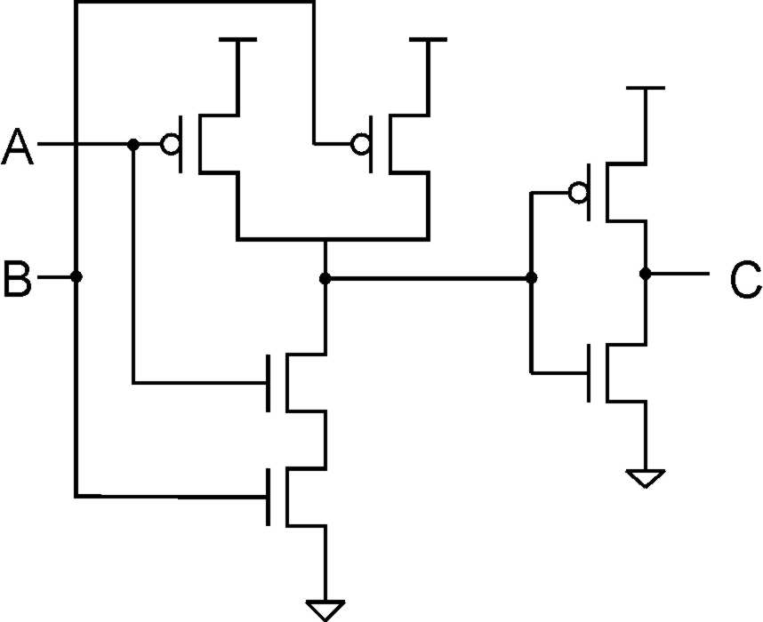
Gates

Slide 8
Today: Building Functions from Logic Gates
We've already seen how to implement truth tables using AND, OR, and NOT -- an example of combinational logic.
Combinational Logic Circuit
output depends only on the current inputs
stateless
Sequential Logic Circuit
output depends on the sequence of inputs (past and present)
stores information (state) from past inputs
We'll first look at some useful combinational circuits, then show how to use sequential circuits to store information.

Slide 9
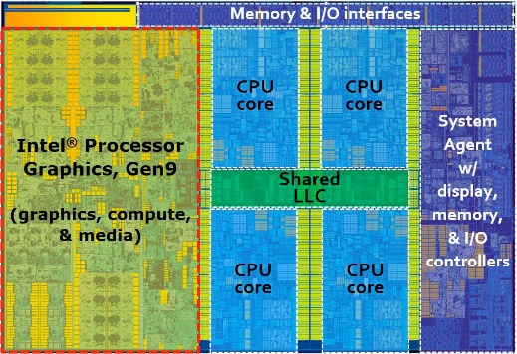

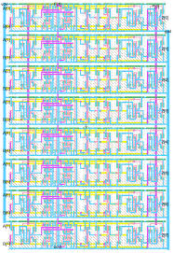
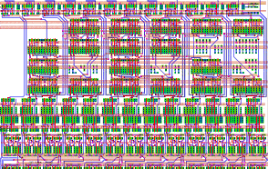
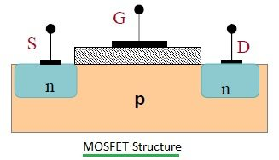
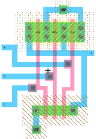
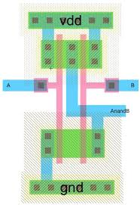
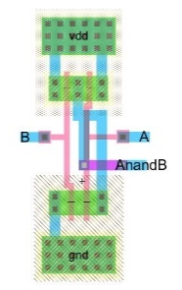
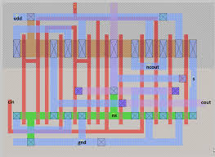
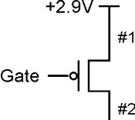
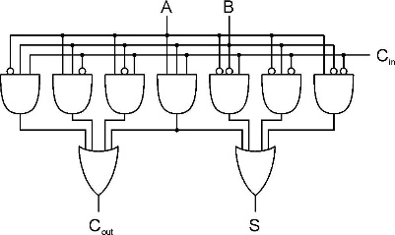
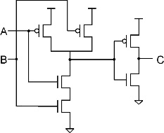
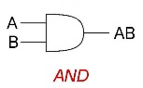

Approach: Bottom Up
Now, You are Here.
ALU
Full Adder
_{Integrated Circuit Design}
_{100 Modules/ IC}
_{0.25M~20G Devices}
Register Transfer Level (RTL) Design
_{1K~10K Cells/Module}
_{(100K Devices)}
And Here.
A
B
C_{in}
_{Gate Level Design}
_{Transistor Physical Layout}
+
Clk
Register
C_{out}
S
_{Scheme for}
_{Representing Information}
_{Circuit Level Design}
_{（Transistor Level Design）}
_{(2~8 Devices/Gate)}
Register Transfer Level (RTL) Design
_{2~16 Gates/Cell}
_{(16~64 Devices)}

Slide 10
Great Idea #3: Abstraction Helps Us Manage Complexity
Application
Solve a system of equations
Algorithm and Data Structure
Gaussian
elimination
Jacobi
iteration
Programming Language/Compiler
Red-black SOR
Multigrid
Operating System/Virtual Machines
Instruction Set Architecture (ISA)
FORTRAN
C
C++
Java
Microarchitecture
Sun SPARC
Intel x86
IBM PowerPC
Gates/Register-Transfer Level (RTL)
Pentium 4
Core 2 Duo
AMD Athlon X2
Analog/Digital Circuits
Electronic Devices
Ripple-carry adder
Carry-lookahead adder
Physics
Static CMOS
Dynamic CMOS
Nanomechanical

Slide 11
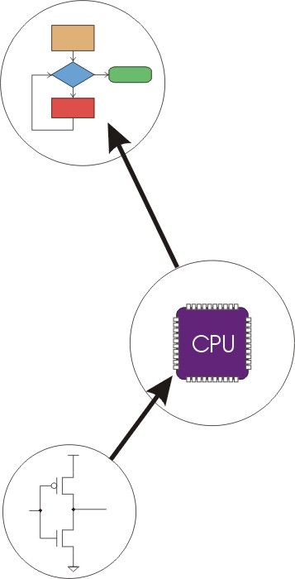
Great Idea #4: Software and Hardware Co-design
Application
Algorithm & Data Structure
Language
Software
Machine Architecture, ISA
Hardware
Microarchitecture
Logic and IC
Now, You are Here.
Device
Computer System: Layers of Abstraction
Notes:
11

Slide 12
Outline
1
Review
2
Combinational Logic Circuits
3
Basic Storage Elements
4
Summary

Slide 13
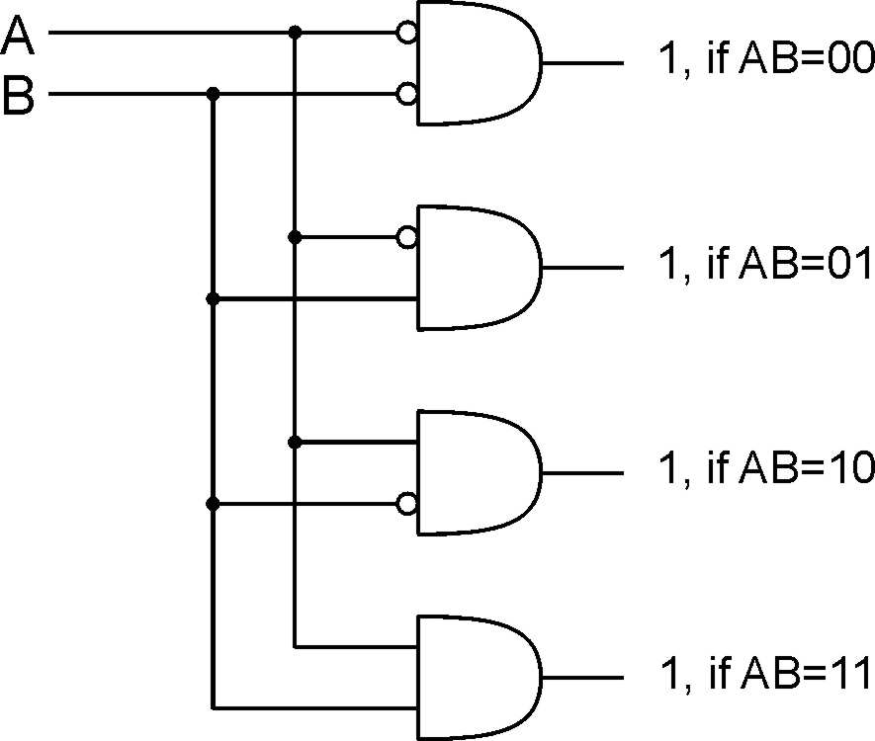
Decoder
2-bit
decoder
n inputs, 2^{n} outputs
exactly one output is 1 for each possible input pattern
Notes:
13
Uses of decoder:
convert memory/register address to a control line that selects that location
convert an opcode to one of n control lines

Slide 14
Decoder
2-bit
decoder
How many transistors?
n inputs, 2^{n} outputs
exactly one output is 1 for each possible input pattern
Notes:
14
Uses of decoder:
convert memory/register address to a control line that selects that location
convert an opcode to one of n control lines

Slide 15
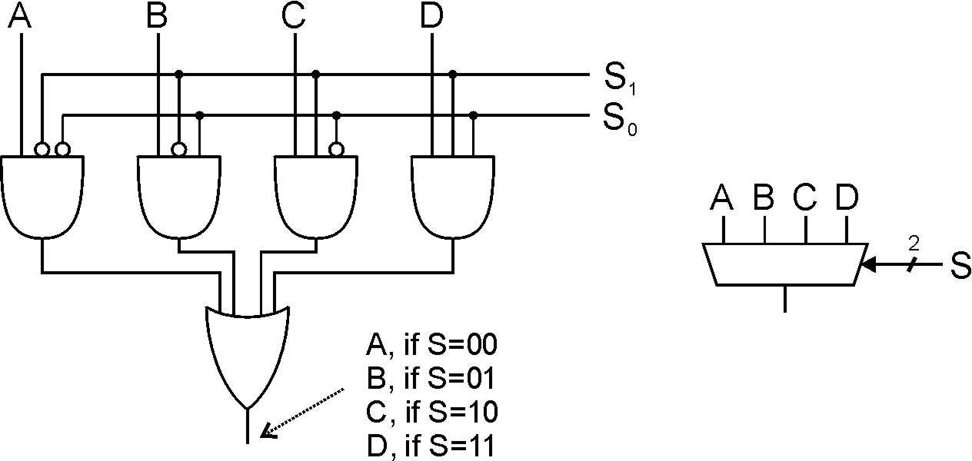
Multiplexer (MUX)
4-to-1 MUX
n-bit selector and 2^{n} inputs, one output
output equals one of the inputs, depending on selector
Notes:
15
Another view: decode S, and AND each output with one of the MUX inputs.
Also explain multi-bit inputs.
Uses of multiplexer:
select which input to use for function
select which computed value to pass to next stage (or to place on bus)

Slide 16
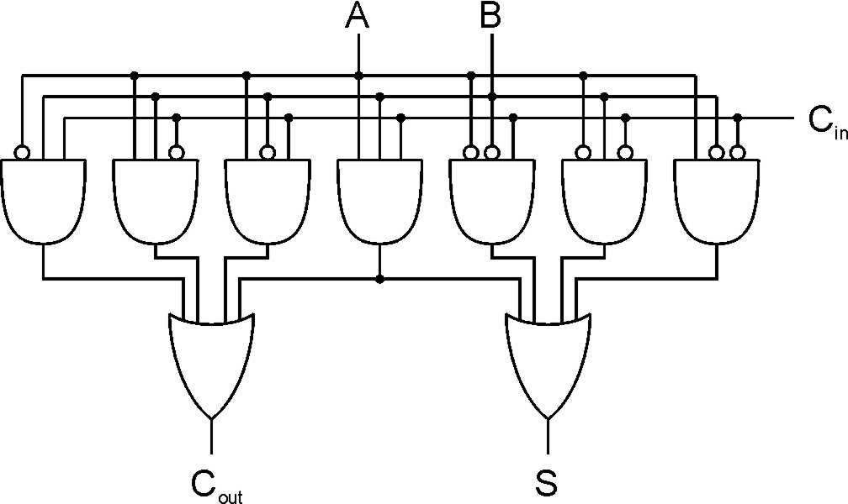
Full Adder
A | B | C_{in} | S | C_{out}
0 | 0 | 0 | 0 | 0
0 | 0 | 1 | 1 | 0
0 | 1 | 0 | 1 | 0
0 | 1 | 1 | 0 | 1
1 | 0 | 0 | 1 | 0
1 | 0 | 1 | 0 | 1
1 | 1 | 0 | 0 | 1
1 | 1 | 1 | 1 | 1
Add two bits and carry-in, produce one-bit sum and carry-out.
Notes:
16
A half-adder is one that doesn't take a carry-in.
Sum is one when 1 or 3 inputs are one. Carry-out is one when 2 or 3 inputs are one.

Slide 17
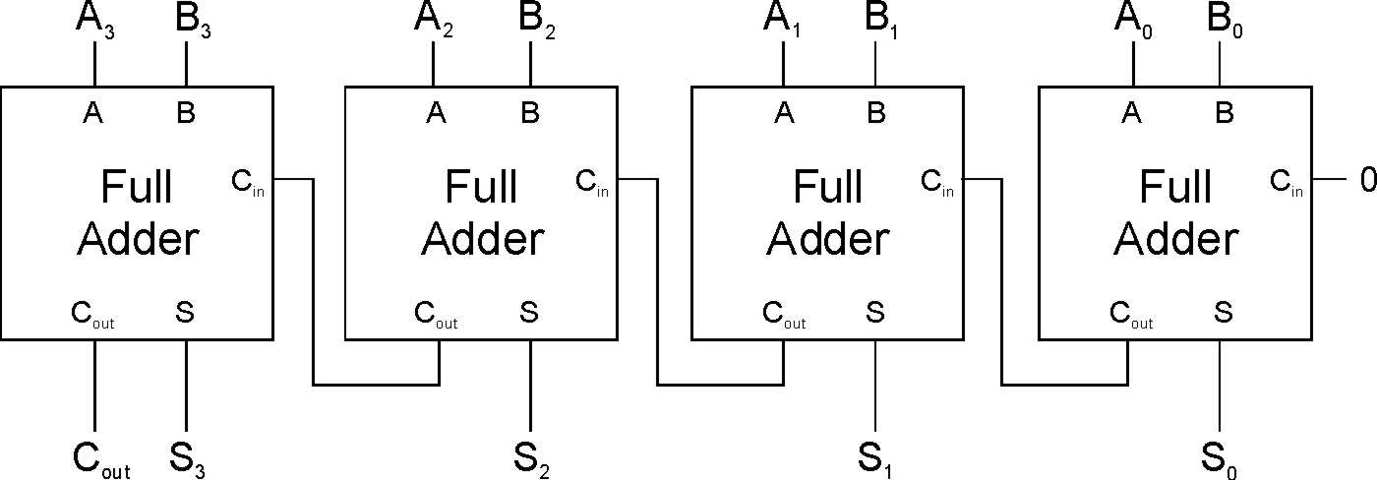
Four-bit Adder
Notes:
17
This is called a "ripple-carry" adder. The sum becomes valid as the carry ripples its way from the low bit to the high bit. How many gate delays until the output is settled?

Slide 18
Adder/Subtracter - Approach #1
A+B
A-B

Slide 19
Adder/Subtracter - Approach #2

Slide 20
Incrementor
Let’s create an incrementor
Input: A (as a 16-bit 2’s complement integer)
Output: A+1 (also as a 16-bit 2’s complement integer)
Approach #1 (impractical):
Use PLA-like techniques to implement circuit
Problem: 2¹⁶ or 65536 rows, 16 output columns
In theory, possible; in practice, intractable
Approach#2 (pragmatic):
Create a 1-bit incrementor circuit
Replicate it 16 times

Slide 21
One-bit Incrementor
Implement a single-column of an incrementor
A | C_{in} | S | C_{out}
0 | 0 | 0 | 0
0 | 1 | 1 | 0
1 | 0 | 1 | 0
1 | 1 | 0 | 1

Slide 22
Outline
1
Review
2
Combinational Logic Circuits
3
Basic Storage Elements
4
Summary

Slide 23
Combinational vs. Sequential
Combinational Circuit
always gives the same output for a given set of inputs
ex: adder always generates sum and carry, regardless of previous inputs
Sequential Circuit
stores information
output depends on stored information (state) plus input
so a given input might produce different outputs, depending on the stored information
example: ticket counter
advances when you push the button
output depends on previous state
useful for building “memory” elements and “state machines”
Notes:
23

Slide 24
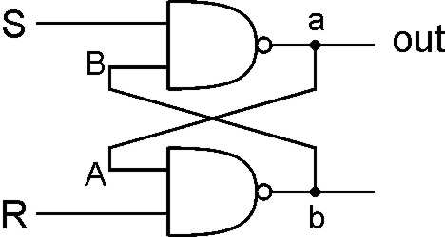
R-S Latch: Simple Storage Element
R is used to “reset” or “clear” the element – set it to zero.
S is used to “set” the element – set it to one.
If both R and S are 1, out could be either 1 or 0.
“quiescent” state -- holds its previous value
note: if a is 1, b is 0, and vice versa
1
1
0
1
1
0
1
1
0
0
1
0
1
1

Slide 25
Clearing the R-S latch
1
0
1
1
1
0
0
Output changes to zero.
1
1
1
0
1
0
1
0
0
Then set R=1 to “store” value in quiescent state.
Suppose we start with output = 1, then change R to 0.
Notes:
25
Setting R to zero forces b (and B) to 1, which forces a (and A) to zero.
This is a stable state, because R=0 and A=0 means b=1.
Bring R back to one then keeps the output at zero.
What is the result if we start with a=0?

Slide 26
Setting the R-S Latch
1
1
0
0
1
Output changes to one.
1
0
0
1
1
0
1
Then set S=1 to “store” value in quiescent state.
Suppose we start with output = 0, then change S to 0.
Notes:
26
Setting S to zero forces a (and A) to 1, which forces b (and B) to zero.
This is a stable state, because S=0 and B=0 means a=1.
Bring S back to one then keeps the output at one.
What is the result if we start with a=1?

Slide 27
R-S Latch Summary
R = S = 1
hold current value in latch
S =1 and R => 0,
set value to 0
R=1 and S => 0
set value to 1
R = S = 0
both outputs equal 1
final state determined by electrical properties of gates
Don’t do it!

Slide 28
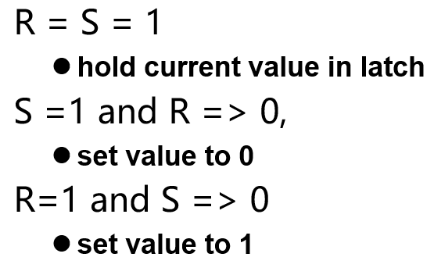
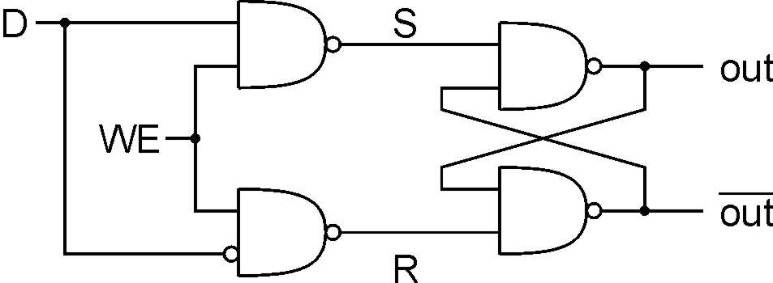
Gated D-Latch
Two inputs: D (data) and WE (Write Enable)
when WE = 1, latch is set to value of D
S = NOT(D), R = D
when WE = 0, latch holds previous value
S = R = 1
Notes:
28
The D-latch is used to store a single data bit. The latch is set to the value of D whenever WE=1; when WE=0, the current value is stored, no matter what D becomes.
Using D and not(D) to control S and R makes it easier to ensure that S and R are never zero at the same time.
WE allows us to control when a new value is written to the latch.

Slide 29
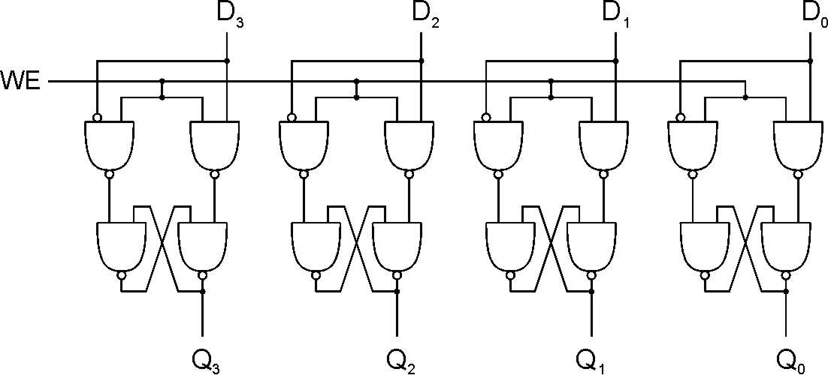
Register
A register stores a multi-bit value.
We use a collection of D-latches, all controlled by a common WE.
When WE=1, n-bit value D is written to register.

Slide 30
Representing Multi-bit Values
Number bits from right (0) to left (n-1)
just a convention -- could be left to right, but must be consistent
Use brackets [] to denote range: D[l:r] denotes bit l to bit r, from left to right
May also see A<14:9>, especially in hardware block diagrams.
15
0
A = 0101001101010101
A[14:9] = 101001
A[2:0] = 101

Slide 31
Memory
Address Space:
number of locations (usually a power of 2)
k = 2^{n}
locations
•
•
•
Addressability:
number of bits per location (e.g., byte-addressable)
m bits
Now that we know how to store bits, we can build a memory – a logical k × m array of stored bits.

Slide 32
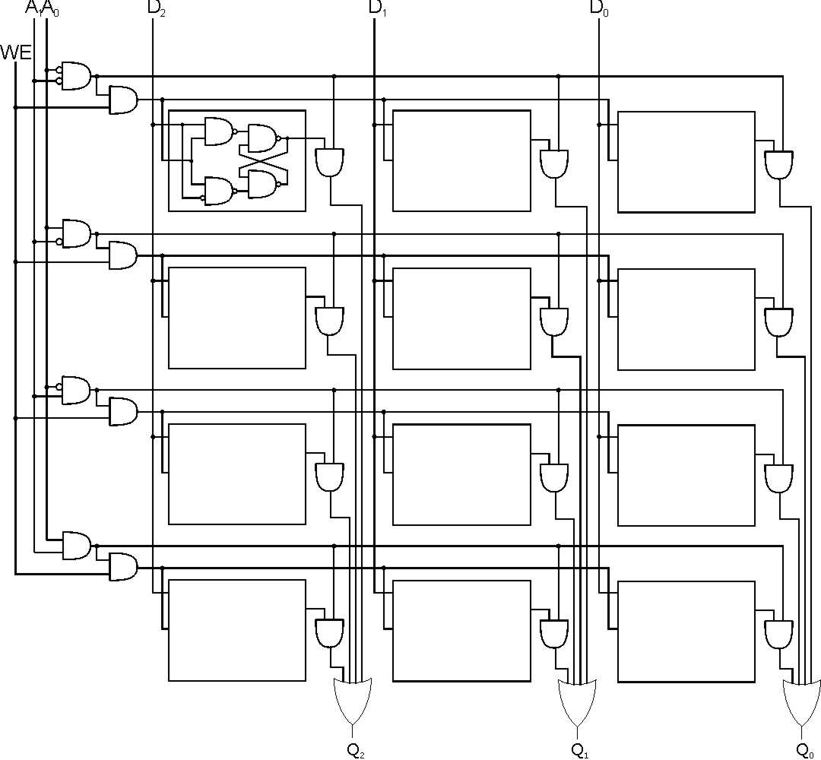
2² x 3 Memory
word select
word WE
input bits
address
write
enable
address
decoder
output bits
Notes:
32
Decoder asserts one of the word select lines, based on address.
Word select activates one of the output AND gates, which drives the selected data to the output OR gate. (For a read, this is basically a MUX -- decoder ANDed with signals, results ORed together.)
When writing, the only WE bits for the proper word are asserted (based on decoder again).

Slide 33
More Memory Details
This is a not the way actual memory is implemented.
fewer transistors, much more dense, relies on electrical properties
But the logical structure is very similar.
address decoder
word select line
word write enable
Two basic kinds of RAM (Random Access Memory)
Static RAM (SRAM)
fast, not very dense (bitcell is a latch)
Dynamic RAM (DRAM)
slower but denser, bit storage must be periodically refreshed
each bitcell is a capacitor (like a leaky bucket) that decays
Also, non-volatile memories: ROM, PROM, flash, …

Slide 34
SRAM Memory
Memory Data In
Write bitlines
m
Read Address Decoder
WE
. . .
D
D
D
Memory Read Address
Write Address Decoder
Read word line
. . .
Memory WriteAddress
D
D
D
n
Write word line
. . .
n
. . .
. . .
. . .
D
D
D
Gated
D-latch
D
Q
Read bitlines
WE
m
Memory Data Out

Slide 35
Outline
1
Review
2
Combinational Logic Circuits
3
Basic Storage Elements
4
Summary

Slide 36
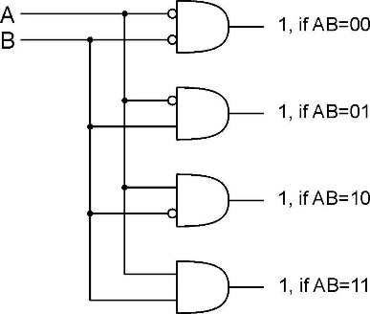
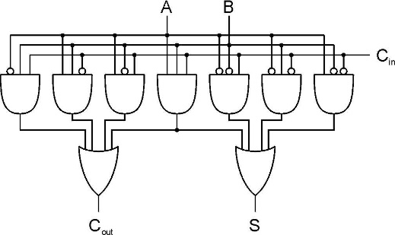

Basic Logical Structure

