Slide 1


Frame Timing and Pacing in XR
Where we are going we don’t need roads.
Jakob Bornecrantz
Open First

Slide 2
Jakob Bornecrantz
XR Architect @ Collabora FDO GH @Wallbraker
jakob@collabora.com
Notes:
Pause, let them read.

Slide 3
Talk to me about
XR, VR & AR
Volt Programming Language
Voxel/SVO rendering
FOSS & Society
Joining Collabora!
Notes:
Pause, let them read. Let them read the page a bit and introduce yourself
Not just about XR like a whole bunch of things!
Why not join Collabora? :D

Slide 4
Introduction to XR
Frame
Tools
Examples
Thoughts and wishlist
Notes:
Pause, let them read. This is what we going to talk about it.

Slide 5
Before we start
Already learned some new things
New user perspective
I may just have missed features
Desktop Linux
Not used on Android usage

Slide 6
Introduction to XR
Notes:
Pause, let them read.

Slide 7
What is AR & VR?
Also known as XR
X = A | V
Not eXtended Reality

Slide 8
How do we XR?
Program
Platform
Hardware
Notes:
Pause, let them read. Of course there are other things included in the full stack.
Graphics drivers, Kernel, etc…

Slide 9
Where does Monado fit in?
Program
Monado
Hardware
Notes:
Pause, let them read.
But we will focus on Monado.

Slide 10
What is Monado
XR Runtime
Implements the OpenXR API
Open Source
Drivers
Tracking
Notes:
Pause, let them read.

Slide 11
What is OpenXR
Made by Khronos
OpenGL, Vulkan and many more
Lets you write portable XR applications
Notes:
Pause, let them read.

Slide 12
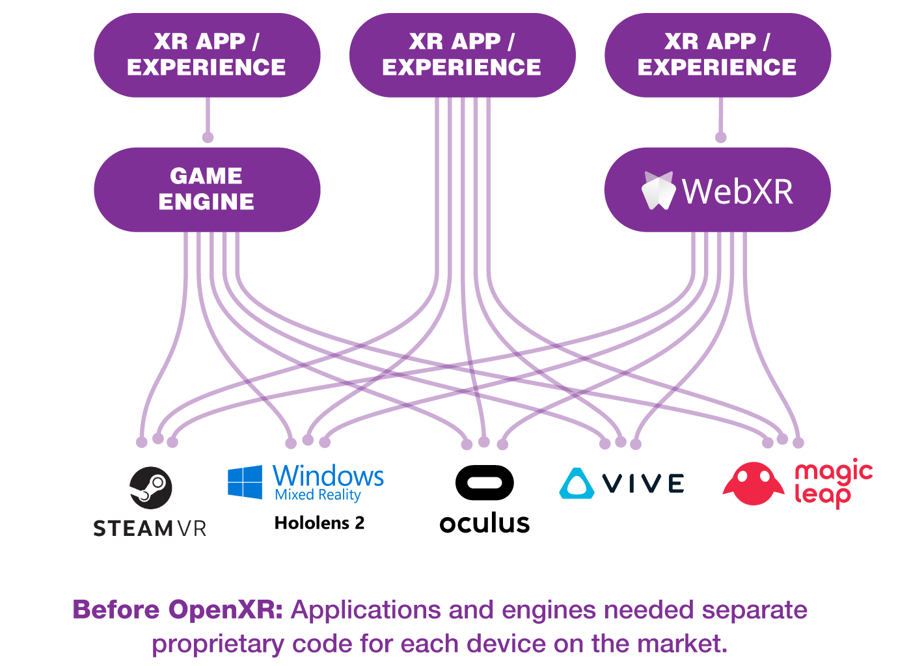
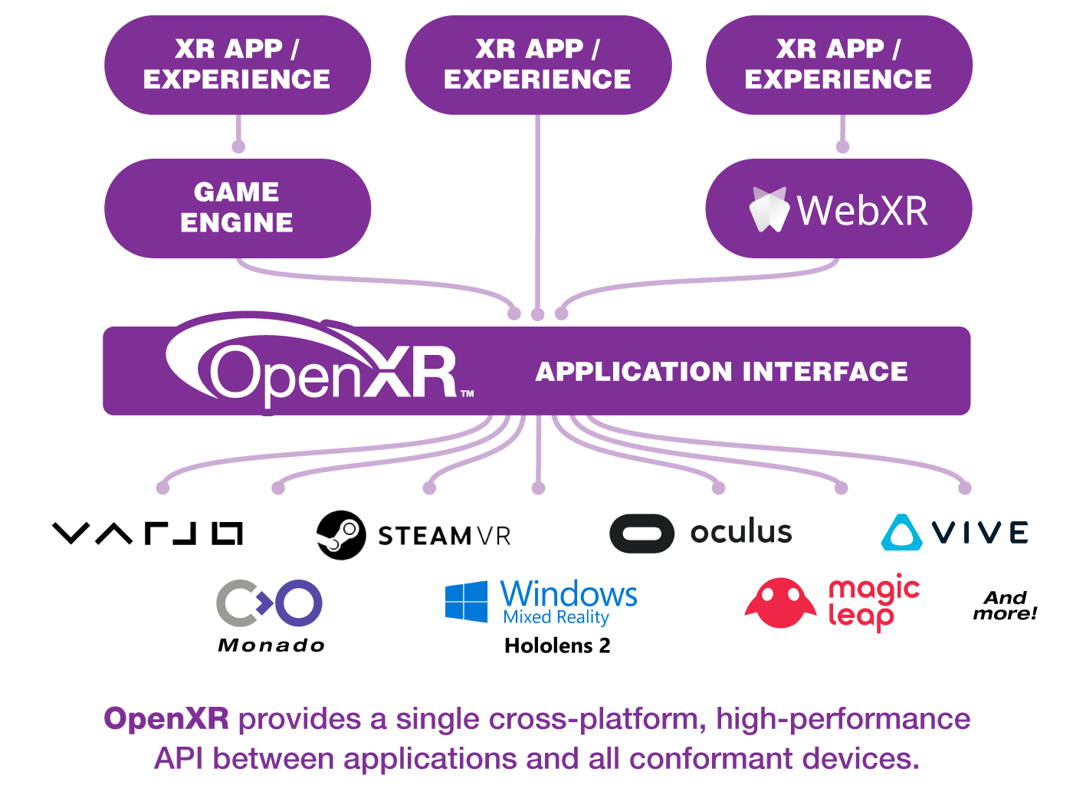
Notes:
Pause, let them read.

Slide 13
Problem space
😠
Frame misses
Bad controller/hand tracking
🤢
Very bad frame misses
Low Hz tracking compensation
Bad distortion correction
Notes:
Pause, let them read.

Slide 14
Frame misses
Beat Saber
Each song is about 2-5 minutes
Missing one frame every song is not acceptable
One missed frame per 10 minutes
High end 144Hz -> ~6.94ms frame time
10 * 60 * 144 = 86400
Hit 99.9988426%
Notes:
Pause, let them read.

Slide 15
Frame

Slide 16
Anatomy of a frame
CPU
Logic
Drawing
GPU
Notes:
Pause, let them read.

Slide 17
On a line
CPU
Draw
GPU
Notes:
Pause, let them read.

Slide 18
Waterfall
CPU
Draw
GPU
Notes:
Pause, let them read.

Slide 19
Waterfall
Thread 1
CPU
Thread 2
Draw
GPU
GPU
Notes:
Pause, let them read.

Slide 20
Pipeline
CPU
CPU
CPU
Draw
Draw
Draw
GPU
GPU
GPU
Notes:
Pause, let them read.

Slide 21
Tools

Slide 22
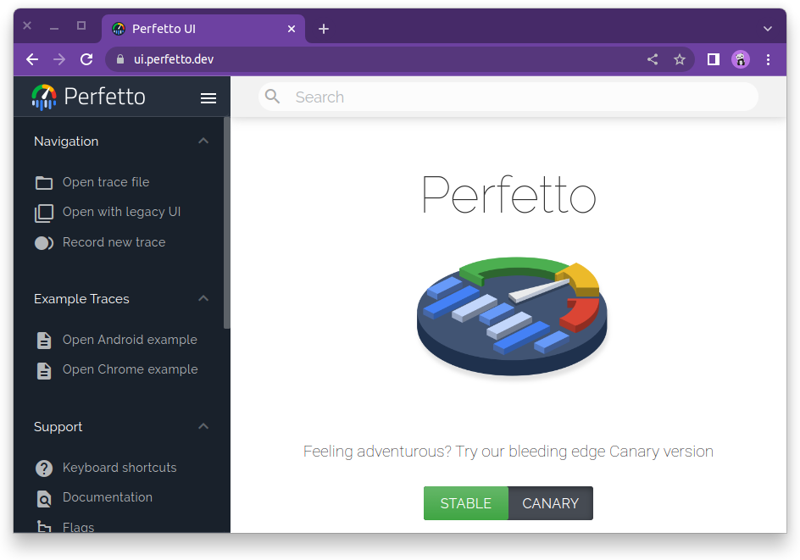
Notes:
Doesn’t really need a introduction

Slide 23
Home grown scripts
Dump data from Monado
Protobuf
Process in Python
Visualise using Bokeh
Notes:
Pause, let them read.

Slide 24
Examples

Slide 25
Perfetto graphs
Monado trace
Graphics composition
Compute composition
Notes:
Pause, let them read.

Slide 26
Monado Metrics
Pretty graphs
Compare to perfetto trace
Notes:
Pause, let them read.

Slide 27
Backup pictures
And for offline viewing

Slide 28
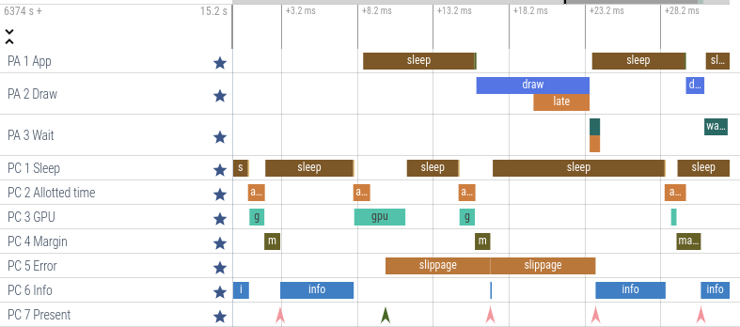
Notes:
Pause, let them take in the picture.

Slide 29
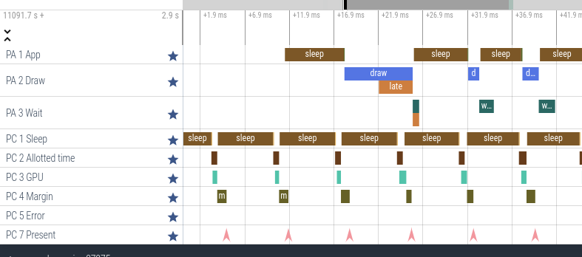
Notes:
Pause, let them take in the picture.

Slide 30
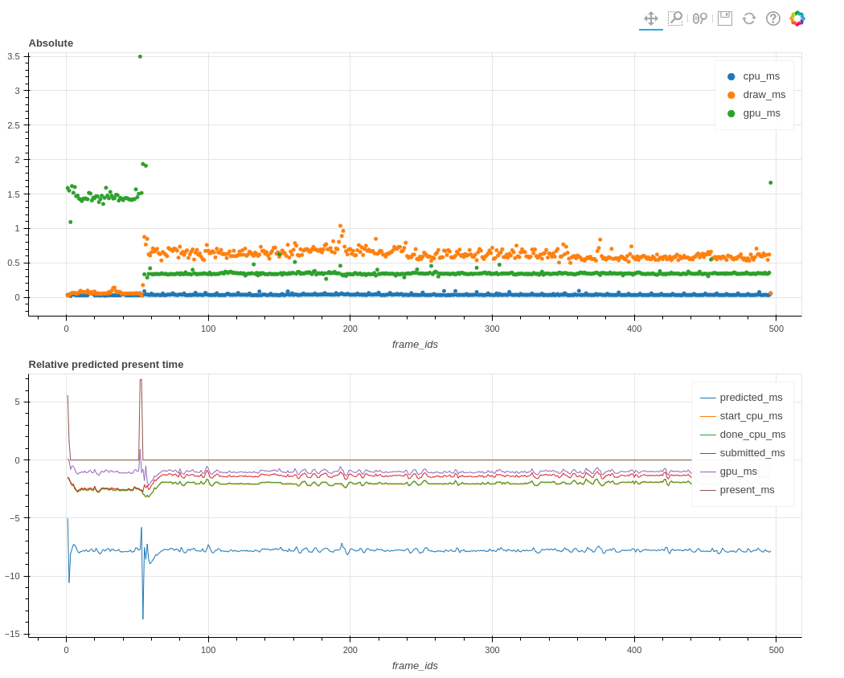
Notes:
Pause, let them take in the picture.

Slide 31
Thoughts and Wishlist
Pretty please…

Slide 32
Some thoughts
Perfetto limitations
Overlapping calls
I’m not a python programmer
I have no idea what am I doing?!
I may just have missed
Features
Solutions
Notes:
Pause, let them read.

Slide 33
Wishlist
C API
Packaged in distros
Monado is packaged
Packaged in “Android”
Easy to use AAR
Notes:
Pause, let them read. All Perfetto

Slide 34
Wishlist
GPU tracing
Just as nice as CPU process tracing
Tools available for Linux
Being able to group/relate bars
Group steps of a frame
CPU tracing dims unrelated bars when hovering
Notes:
Pause, let them read. All Perfetto

Slide 35
Better latency visualising?
Hard to do with CPU
GPU is work/tasked based
Save scheduled time
Notes:
Pause, let them read. All Perfetto

Slide 36
Better latency visualising?
Proc 1
Proc 2
Proc 3
Notes:
Pause, let them read.

Slide 37
Better latency visualising?
Proc 2
Proc 3
0.4ms
Notes:
Pause, let them read.

Slide 38

Questions?

Slide 39
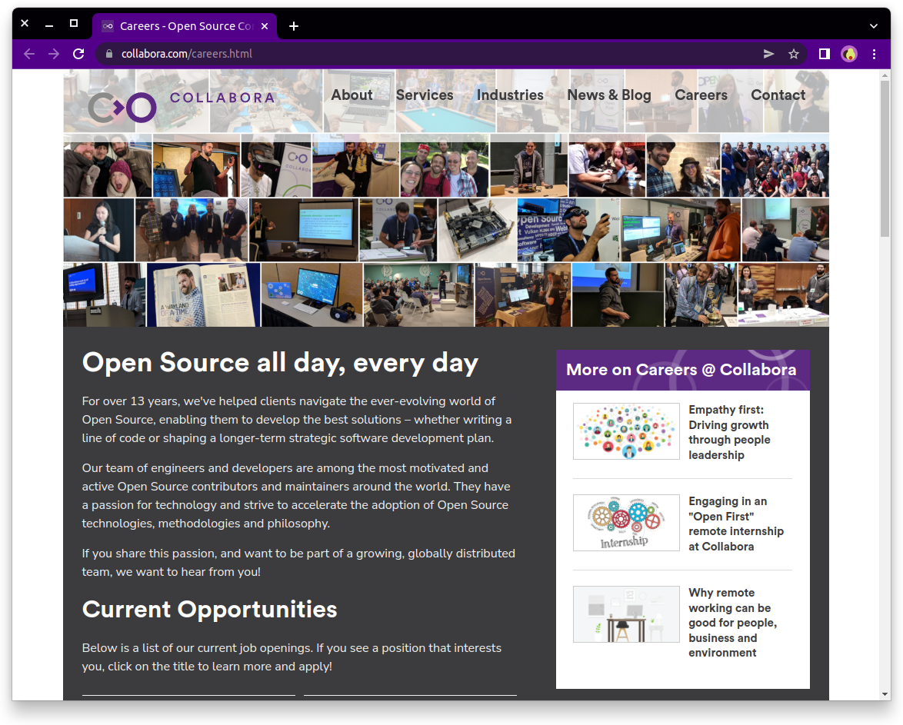
We are hiring!

Slide 40
Links
https://monado.freedesktop.org/
https://perfetto.dev
https://ui.perfetto.dev
https://gitlab.freedesktop.org/monado/utilities/metrics
https://www.collabora.com/careers.html

Slide 41
Thank you!

