Slide 1


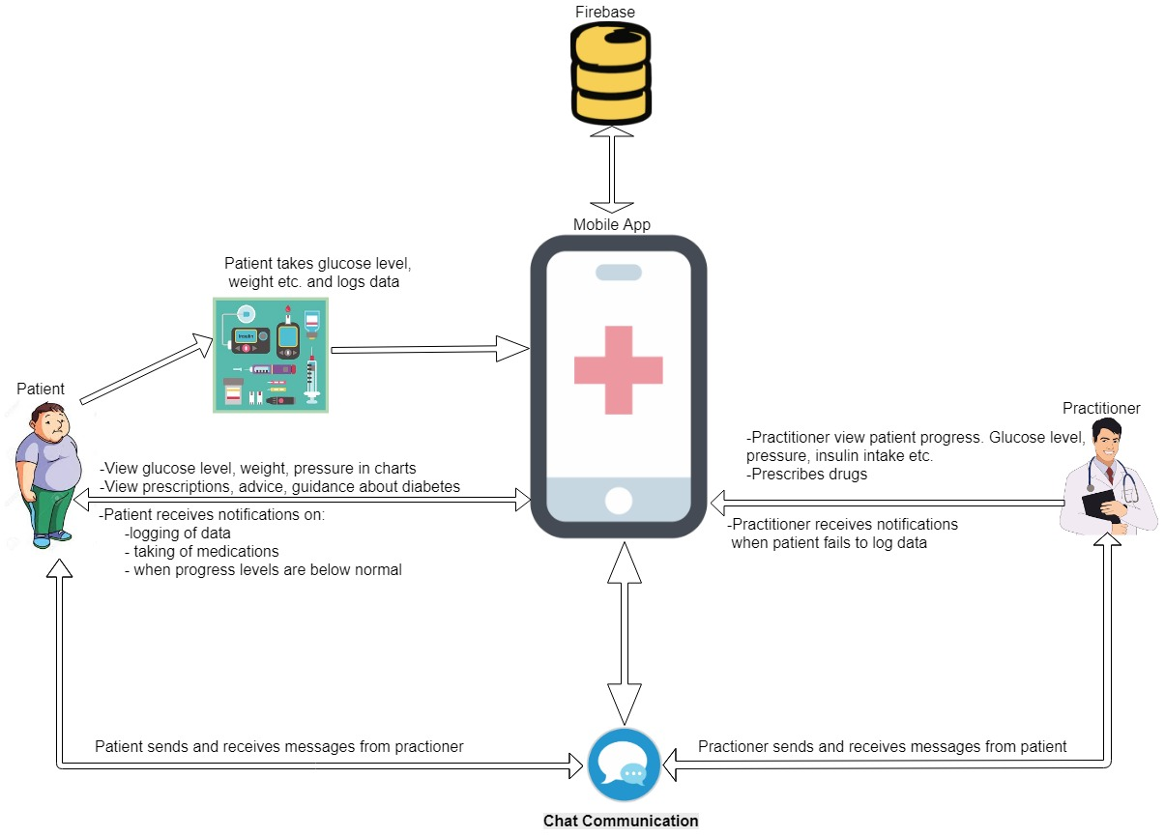
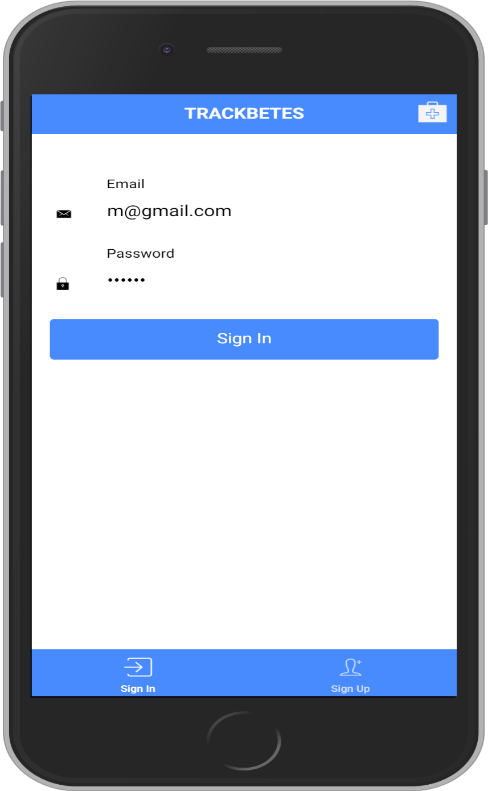
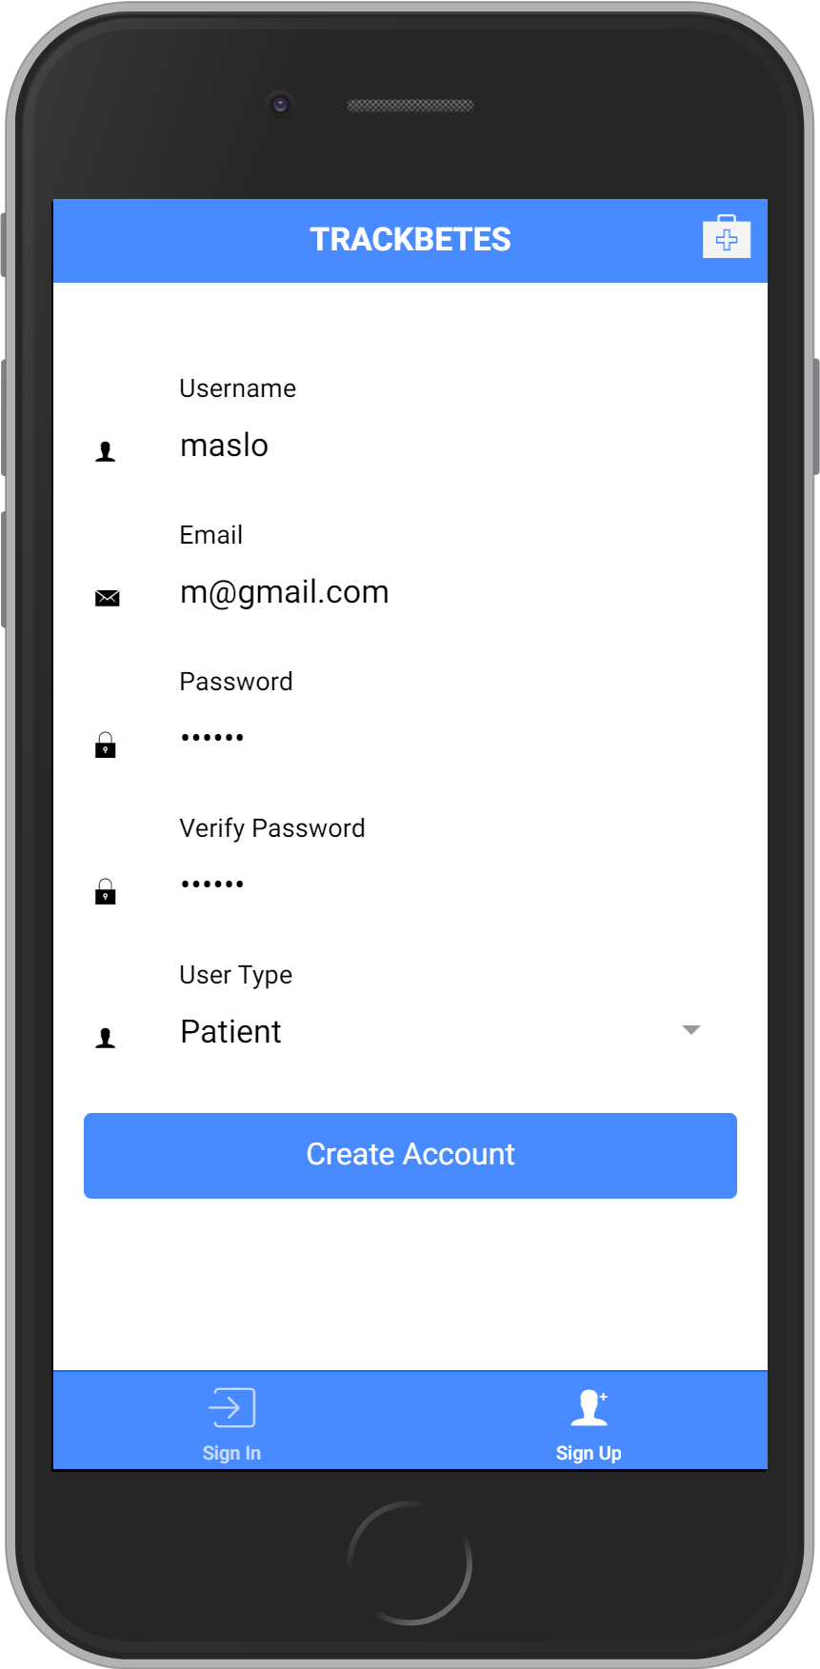
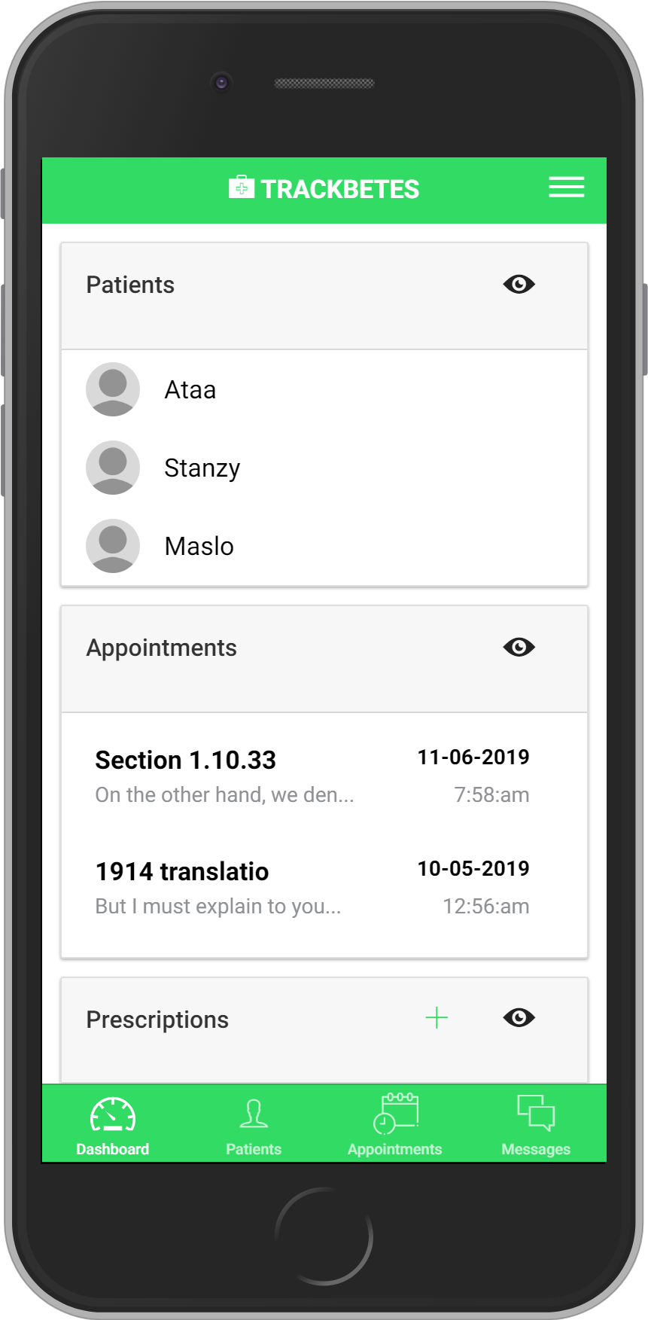
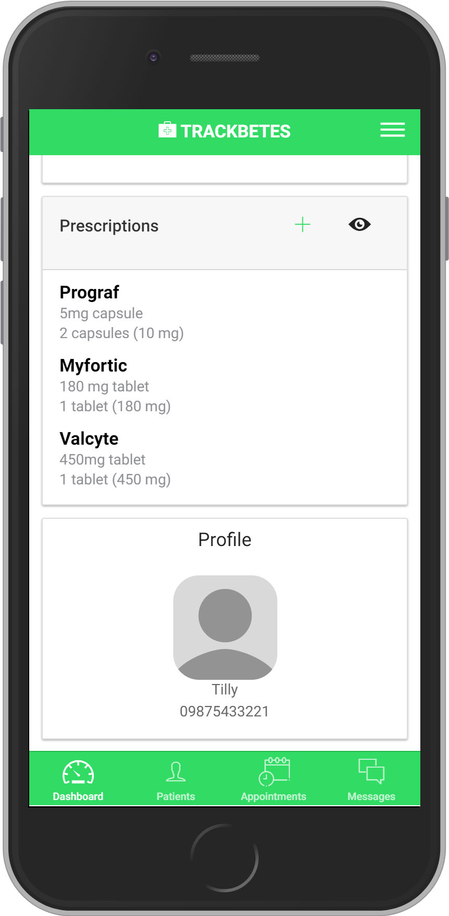
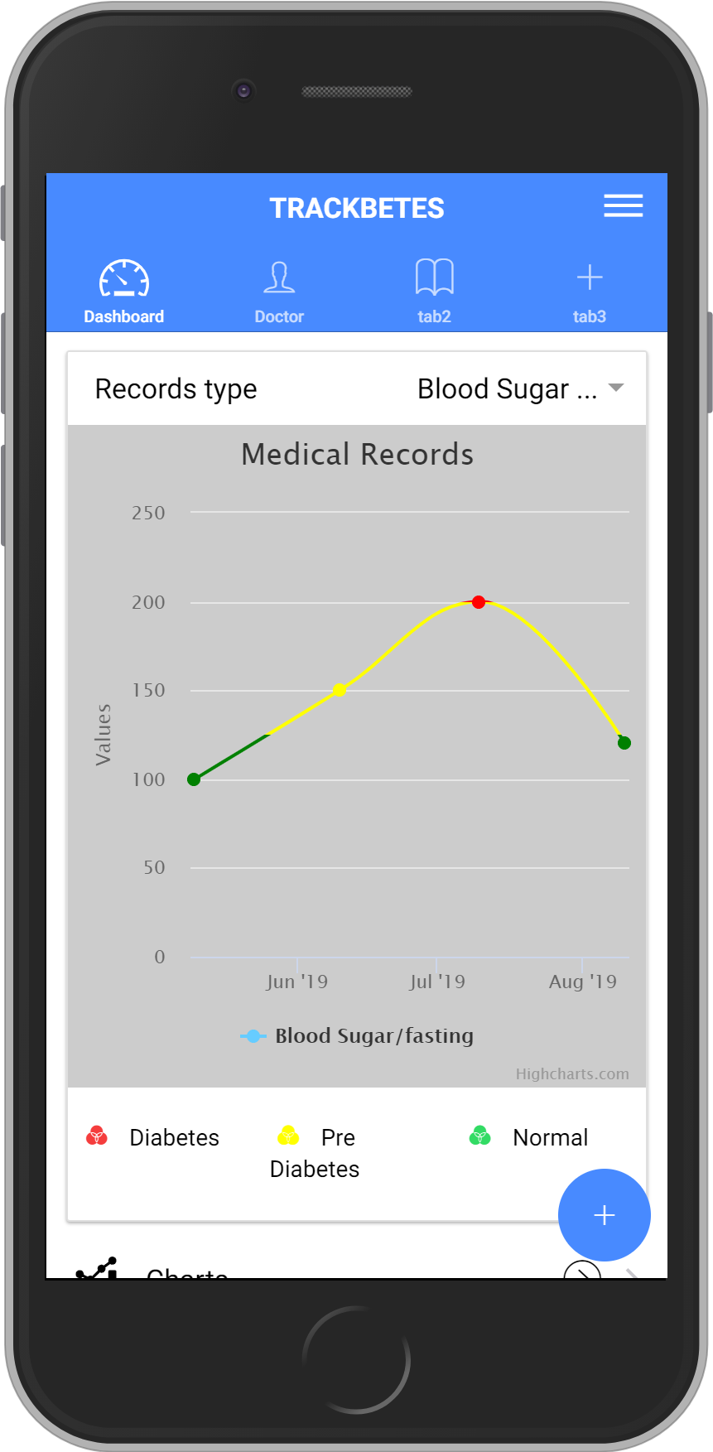
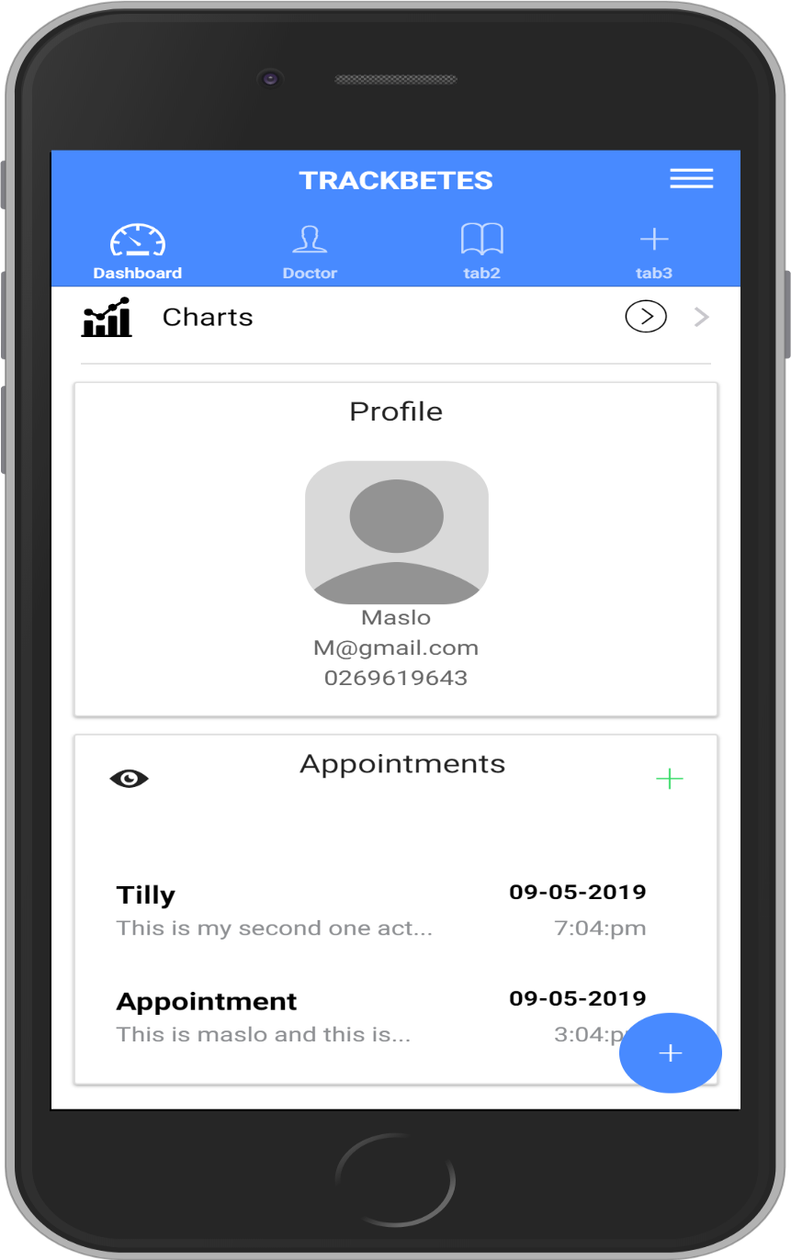
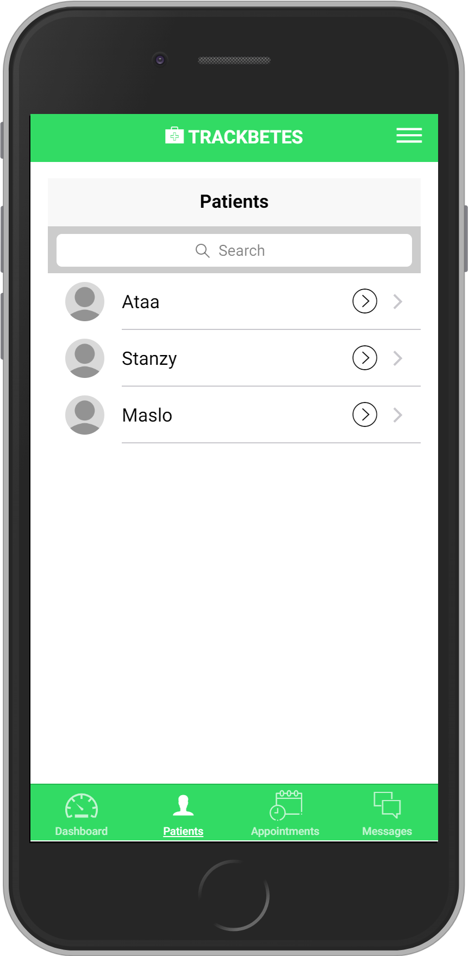
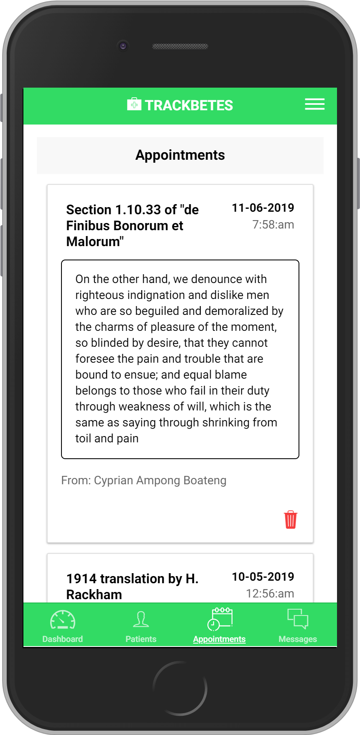
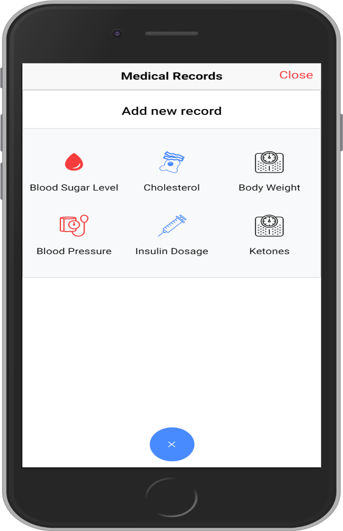
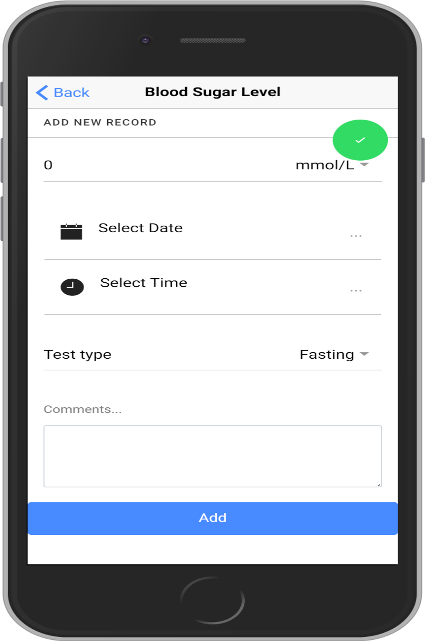
Mobile Application for Personal Diabetes Management
(Trackbetes)
Cyprian Ampong Boateng¹, Kwadwo Asamoa¹
¹Department of Computer Science, University of Ghana
Introduction
Architecture of the proposed System
Context: The world is gradually becoming a mobile device driven village, with individuals using their mobile devices anywhere and at anytime. Diabetic patients who require constant monitoring can utilize the advantages that mobile devices bring to the delivery of healthcare.
Objective: The project aims to assist diabetic patients to effectively monitor their diabetic progress .
Methodology: The proposed system is developed using the agile approach. The world is changing rapidly and so does the needs of users. The ability of the agile methodology to change at anytime when required, to suit user preference makes it very flexible and effective for the development of a mobile application.
Platform: Hybrid. Instead of building mobile applications for different mobile platforms like IOS and Android, a hybrid approach is used. This allows a single code base to be implemented on multiple mobile platforms and can be extended to the web easily when the need arises.
Conclusion: We recommend the use of diabetes monitoring mobile application projects to be considered for the monitoring and management of diabetes.
Fig. 1 General Overview of the Mobile Application for Personal Diabetes Management
Screenshots of the proposed system
Patients are allowed to select a specialist from a list of highly skilled professionals and use them as their guides, doctors and advisors. Patients can schedule appointments with their specialists, receive prescriptions from their specialists, send and receive chat messages with their specialists. With a personal assistant feature, the proposed system helps patients plan and manage their personal medications, diets and lifestyle.
Authentication
Doctor
Dashboard
Problem Definition
Imagine how tiring it will be for diabetic patients to manually write down all their recordings in terms of blood sugar, blood pressure, weight etc. in notebooks, the calculations they would have to do in order to determine their diabetes progress overtime, the errors they are susceptible to making, the inconsistencies that may arise when they forget to record vital information, the cost and stress involved in transportation to the hospital for appointments, prescriptions and medical checkups and not forgetting the queues they would have to endure at the hospital. Diabetes is a chronic disease which can live with an individual his or her whole life. Therefore, its treatment must be done with motivation, guidance and convenience. The proposed system seeks to provide a system which allows patients to easily and consistently log their medical records information, use interactive and self-explanatory charts to present patients’ diabetes progress and ensure a convenient interaction between a patient a diabetic specialist.
Conclusion
Sign In
Sign Up
Doctor’s Patients & Appointments
Mobile health is an economic and effective way of providing health care delivery to patients on demand and remotely. There are numerous systems spearheading mobile health in diabetes management. The proposed system brings on board certain features that contributes greatly to the field in question. However, features like wireless synchronization of the system with diabetes measurement devices will be a deal breaker when implemented with the system.
Patient
Dashboard
Medical Records Logging
How it works
References
Diabetes measurement is based on multiple factors. The blood sugar level, the blood pressure, weight, cholesterol and other medical conditions of patients are used to indicate their diabetes status. The proposed system allows the user to log these measurements easily. Based on the logs, graphs are drawn with colors and symbols indicating whether normal, pre diabetes and diabetes.
Medium. (2017). Why Agile Methodology for Mobile App Development? Retrieved from https://medium.com/@edeskhub/why-agile-methodology-for-mobile-app-development-e685b41ea462
WHO. (2018). Diabetes Retrieved from https://www.who.int/news-room/fact-sheets/detail/diabetes

