Slide 1


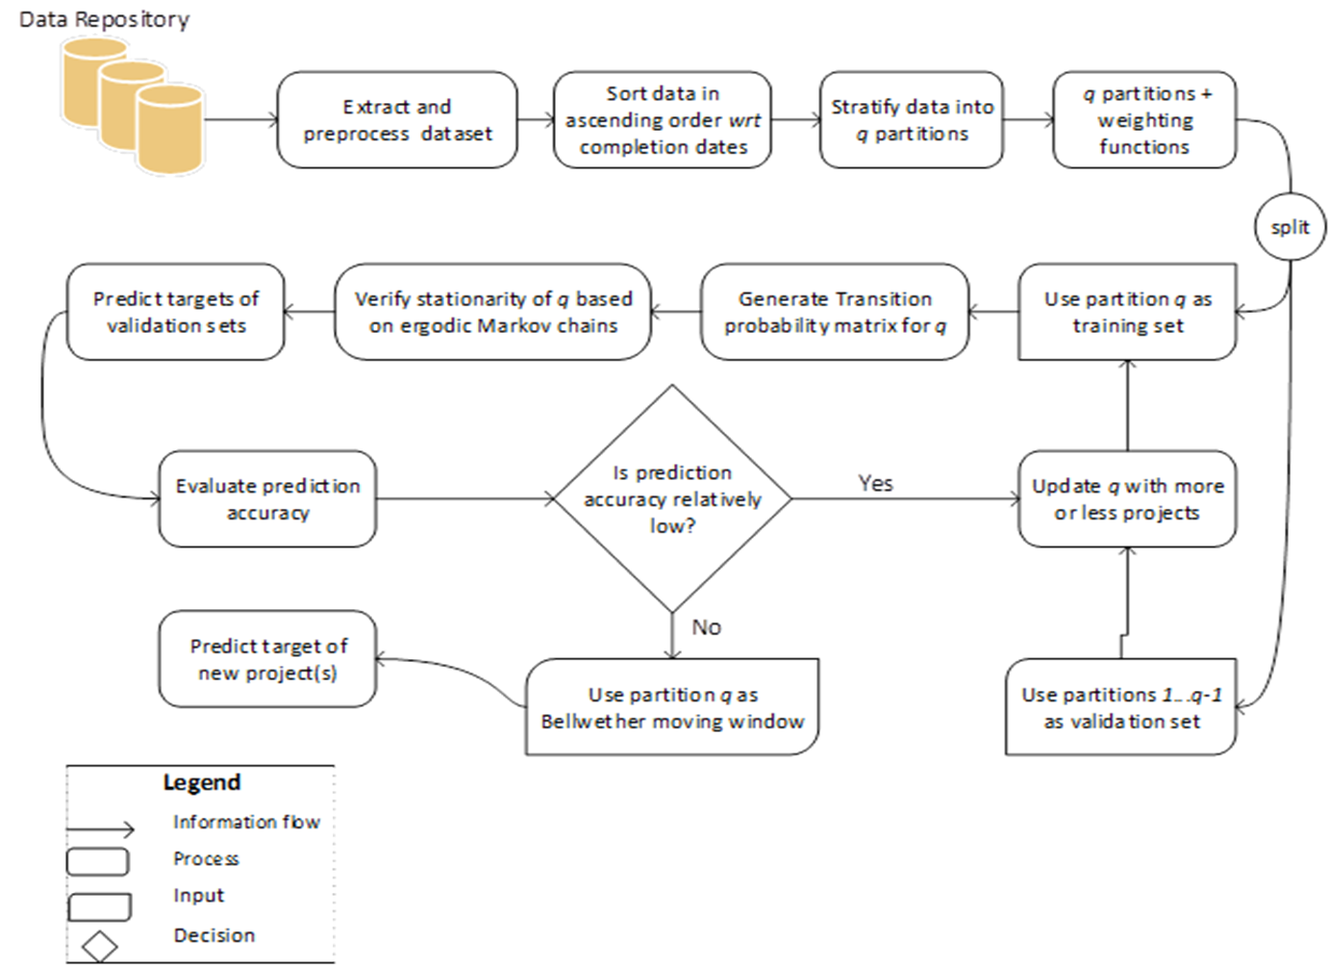
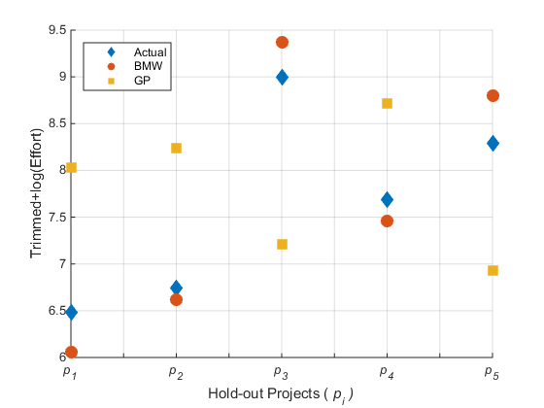
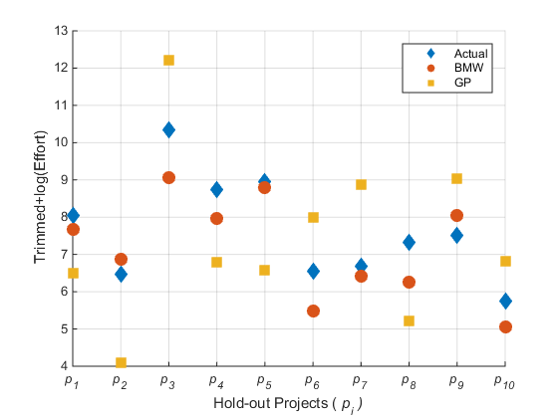
Investigating the Significance of the Bellwether Effect to improve Software Effort Prediction: Further Empirical Study
Solomon Mensah^{1*}, Jacky Keung², Stephen MacDonell³, Michael Bosu⁴, & Kwabena Bennin²
¹Department of Computer Science, University of Ghana, ²Department of Computer Science, City University of Hong Kong,
³Department of Information Science, University of Otago, New Zealand, ⁴Centre for Business, IT & Enterprise, Wintec, New Zealand
*smensah03@ug.edu.gh
Introduction
General Overview of the proposed Bellwether Framework
Context: Bellwether effect refers to the existence of exemplary projects (Bellwether) within a historical dataset that yields improved prediction accuracy.
Objective: The study aims at investigating the Bellwether effect on software effort prediction (SEP) accuracy.
Methodology: The existence of Bellwethers was empirically proven based on two main theories:
the prediction of a future event depends on previous event (based on Markov chains), and
recently completed projects (moving window) share similar characteristics with new projects.
Three sampling methods, namely SSPM, SysSam and RandSam were proposed to sample a feasible subset of exemplary and recently completed projects constituting the Bellwether moving window (BMW).
Results: Empirical results show that 1) Bellwether effect exists in studied datasets (ISBSG, Desharnais and Kitchenham datasets), and
2) the use of BMW with the Triweight function significantly improved prediction accuracy.
Conclusion: We recommend the use of BMW Bellwether projects to be considered for the setting up effective SEP models.
Fig. 1 General Overview of the Bellwether Method for sampling Bellwether moving windows (BMW)
SSPM: Bellwether Method
Conclusion
Bellwethers (BMW) are not rare and are recommended for predictive analysis.
The BMW yielded improved prediction accuracy when weighted with the Triweight function.
The study’s results add further weight to the recommended use of BMW for improved SEP accuracy.
Given a new project with an unknown software effort, select relevant projects to be used as the Bellwether using the following three main operators (SORT+CLUSTER, GENERATE TPM and APPLY):
SORT + CLUSTER
Given a set of N historical and completed projects, sort based on the project completion dates and stratify the data into q partitions.
GENERATE TPM
Generate the transition probability matrix (TPM) for the resulting weighted moving window and find the respective EMC. Refer to weighting functions in Fig. 2
APPLY
Apply the BMW, w_{q}* to the new project data (set as a hold-out) whose software effort is to be estimated.
Refer to framework in Fig. 1
Research Contribution
Fig. 3 Prediction of the p_{i} hold-out projects by the BMW and the growing portfolio (GP) in the Desharnais dataset. The diamond shape denotes the actual effort of p_{i} as recorded in the dataset. The circular shape denotes the predicted effort of p_{i} by the BMW and the square shape denotes the predicted effort of p_{i} by the GP.
Guideline for BMW
To the best of our knowledge, this is the first study to
theoretically and empirically demonstrate the existence of Bellwethers with defined window size and age for SEP,
introduce three Bellwether methods for sampling Bellwethers for improved prediction accuracy,
provide a guideline for sampling Bellwethers for its practical use in prediction modelling.
Projects which share similar characteristics (e.g. number of features, development and testing procedures) with the new projects are recommended.
The feature set, f_{new} of the new or hold-out project should be a subset of the feature set, f_{bell} of the BMW.
Posterior features (e.g. LOC, duration) are not considered for sampling the BMW.
We recommend trimming + log transformation as an effective data preprocessing method for obtaining the BMW.
Problem Definition
Results
Results from this study have shown that the the Bellwether moving window (BMW) should have an approximate window size of 50 to 80 projects and should not be older than 2 years old relative to the new projects.
Fig. 4 Prediction of the p_{i} hold-out projects by the Bellwether (BMW) and the growing portfolio (GP) in the ISBSG dataset
Given N chronological projects, the prediction accuracy is affected by the following challenges:
Different training and validation sets
Different window sizes and ages
Different weighting functions.
The challenge is how to sample BMW with defined window size and age from a given search space for improving SEP.
The BMW yielded improved accuracy against the growing portfolio benchmark.
The Triweight function applied on BMW yielded superior accuracy.
In using the BMW to make prediction on the new projects (hold-out), we realized that Deep Neural Networks (DNN) yielded superior accuracy (Fig. 3-4).
References
Weighting function Formula
Rectangular w(x) = 1, |x|<1
Triangular w(x) = 1 - |x|, |x|<1
Epanechnikov w(x) = 1 - x², |x|<1
Gaussian w(x) = exp(-2.5(x)²/2), |x|<∞
Biweight w(x) = 15/16(1-x²)², |x|≤1
Triweight w(x) = 35/32(1-x²)³, |x|≤1
B. Kitchenham, L. Madeyski, D. Budgen, J. Keung, P. Brereton, et al. "Robust statistical methods for empirical software engineering." Empirical Software Engineering, vol. 22, no. 2, pp. 579–630, 2017.
S. Mensah, J. Keung, S. G. Macdonell, M. F. Bosu, and K. E. Bennin, “Investigating the Significance of Bellwether Effect to improve Software Effort Estimation,” in 2017 IEEE International Conference on Software Quality, Reliability and Security (QRS), 2017, pp. 340–351.
S. Mensah, J. Keung, S. G. MacDonell, M. F. Bosu, and K. E. Bennin, “Investigating the Significance of the Bellwether Effect to Improve Software Effort Prediction: Further Empirical Study,” IEEE Transactions on Reliability, 2018, pp. 1–23.
Fig. 2. Weighting functions for BMW

