Slide 1
Web Tracking Ecosystem
Mapping the Structure of Corporate
Religious Profiling
The International Association for Computing and Philosophy, 2017 Annual Meeting
June 26 - 28
Claudio Agosti @_vecna
@raimondian Andrea Raimondi

Slide 2

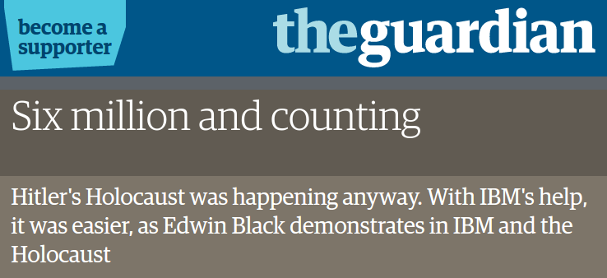
The memento from the past
https://www.theguardian.com/books/2001/feb/18/historybooks.features

Slide 3
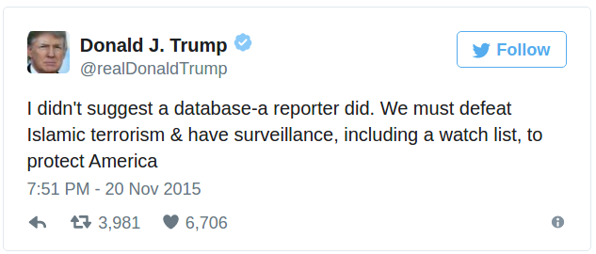
When an MSNBC reporter asked if “there should be a database or system
that tracks Muslims in this country”, Trump responded: “There should be a
lot of systems. Beyond databases. I mean, we should have a lot of systems.”
https://www.theguardian.com/us-news/2016/nov/27/donald-trump-muslim-registry-policy-possibility

Slide 4


Slide 5

Institutions and self limitation
Universal Declaration of Human Rights (art 2)
Census Bureau does not collect metadata based on religious preferences.
Blanket registration is unconstitutional.
Privacy Act 1974.
Census Bureau does not collect metadata based on religious preferences.
Blanket registration is unconstitutional.
Privacy Act 1974.
Census Bureau does not collect metadata based on religious preferences.
Blanket registration is unconstitutional.
Privacy Act 1974.
"Muslim registries", Big Data and Human Rights https://www.amnesty.org/en/latest/research/2017/02/muslim-registries-big-data-and-human-rights/

Slide 6
2017, are the safeguards enough ?
According to the USSC any information that a person
voluntarily discloses to a business or other entity loses all
Fourth Amendment protection.
https://en.wikipedia.org/wiki/Third-party_doctrine

Slide 7
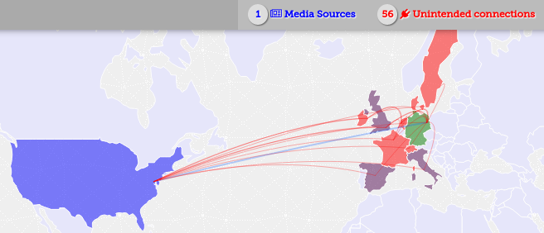
“Corporate profiling”
How can be done?
Users navigation tracking!
https://trackography.org

Slide 8

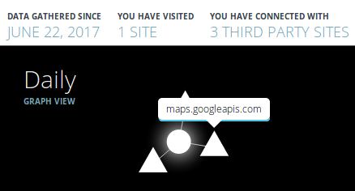

Slide 9
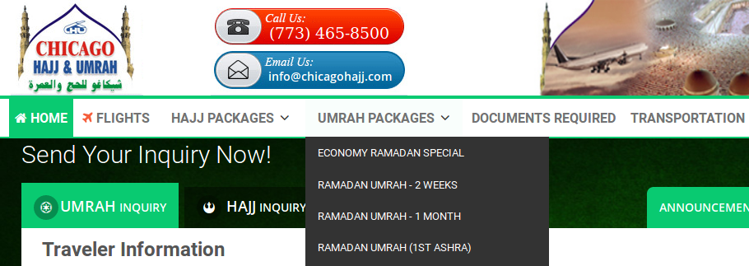
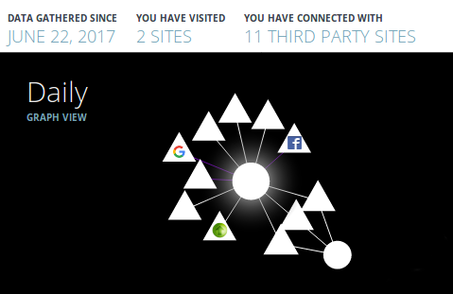

Slide 10

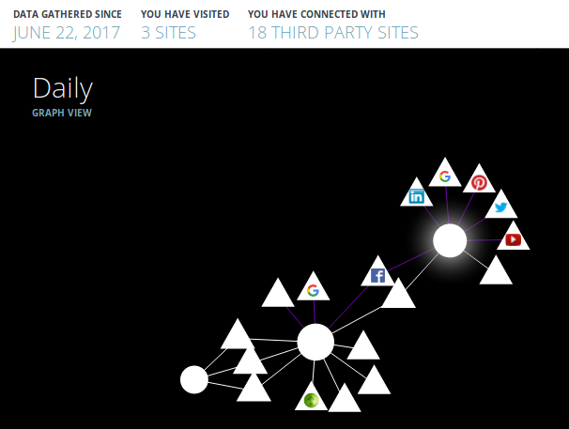

Slide 11

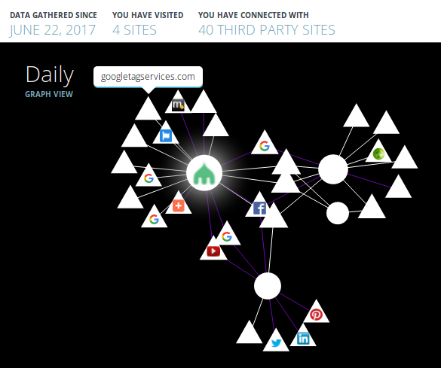

Slide 12
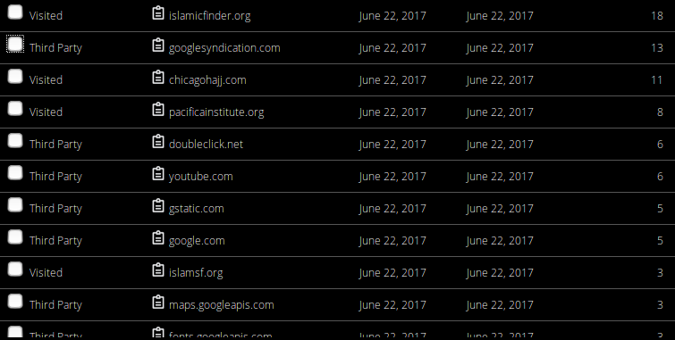
Website owner (or the IT) enables this profiling

Slide 13
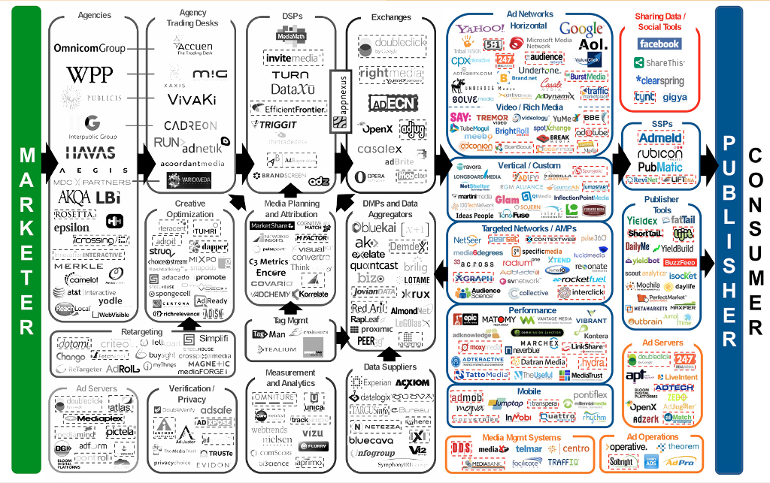
via LUMA partners

Slide 14
This society is it not based only on regulation and business.
If such discriminatory collection is done, it will be somehow exposed, persecuted and punished
Or, maybe, databases were the smoking gun of the Wikileaks era. Is it still so?

Slide 15

A corporate role play game!

Slide 16
SITE X, users:
32321432,Jun/24
74443434,Jun/24
56333223,Jun/24
54677743,Jun/24
78874222,Jun/24
86585432,Jun/24
83224556,Jun/24
75432222,Jun/25
86542222,Jun/25
78652522,Jun/25
SITE Y, users:
78874222,Jun/23
65464322,Jun/23
56437477,Jun/23
32122332,Jun/24
23425345,Jun/24
96658888,Jun/24
32324232,Jun/24
65476856,Jun/24
42423532,Jun/25
87676432,Jun/25
1st: The assets of your company is an huge amount of data without any special value, the goal is simply: having as much as possible, then resell it in the profiling market.

Slide 17
SITE categorization
SITE-X: Islam 99%, religion 99%
SITE-Y: Food 99%, Halal 95%, Vegetarian 30%
SITE-K: Religion 70%, Mosque 60%
SITE-O: Information 60%, Pictures 50%
SITE-I: Travel 95%, Arabic 70%
2nd: You can have third party database providing
Information outside of your business.

Slide 18
Algorithm #31212:
Look for the users in the last year, who have access:
Twice/week website tagged with Islam
For the 80% of the weeks in one solar year
Once/bi-month website tagged with Halal
3rd: An algorithm is like a research question: with the right one, you get valuable answer. Otherwise the data remain a useless amount of navigation records.
No accountability, no traces

Slide 19
Hard strategy: If your website expose sensible information, you should remove the trackers.
But many websites have ads-based business models. They will not remove behavioural trackers.
Soft strategy: If your website expose sensible information, and you are not an ads-based website, you should remove the trackers.
This can do! Such websites cannot justify the use of behavioural ads and they will incur in no loss from the removal of the trackers.

Slide 20
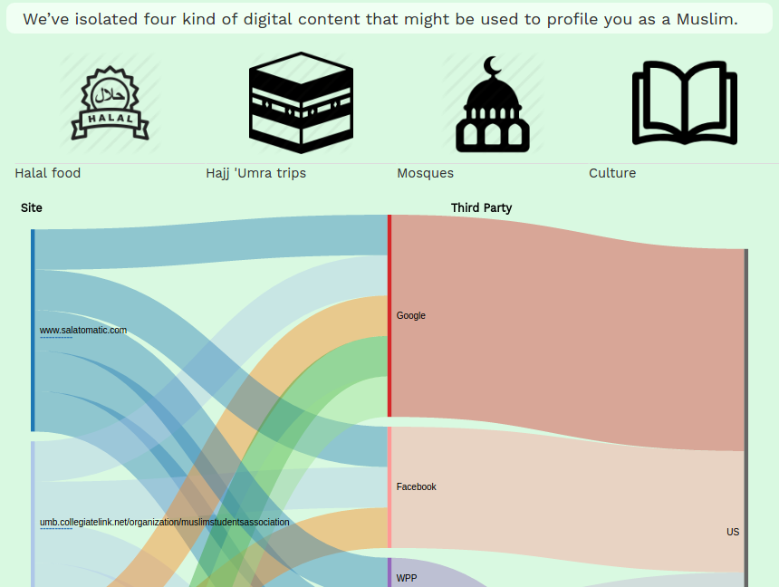
https://american.muslims.tracking.exposed

Slide 21
Take-home points
Web tracking technologies can be used to enforce discrimination policies.
Our analysis is open source and so the website content, we look for persons belonging to the appropriate community in taking interest on this.
We cannot take down the web tracking ecosystem, but we can reduce its impact by assessing individual responsibility.
https://american.muslims.tracking.exposed tool allows
  web administrators to check their tracking network and remove unneeded trackers (we’ve to campaign for it!)
  researchers to analyze ethically relevant sub-set of the tracking ecosystem (we can provide data and historical trend)
claudio@tracking.exposed

