Slide 1


Technical Monitoring
Presented by Tracy Joyner

Slide 2

Feedly is the tool chosen to stay informed about topics and trends related to the Menu Maker project as outlined in the given Functional Specifications.
Monitoring Tool

Slide 3
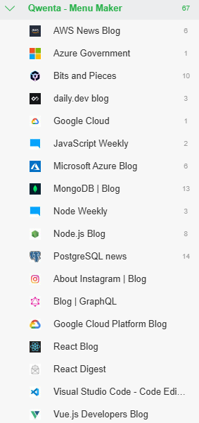
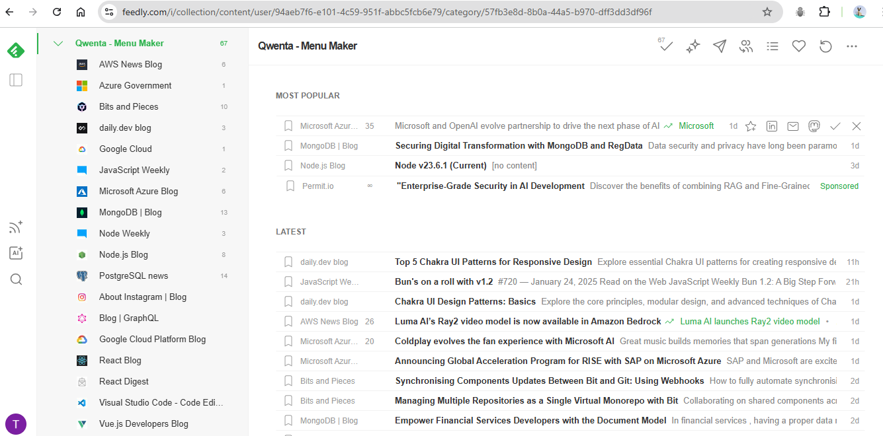
Sources
Feedly allows the team to find, save, and share quality relevant sources to keep up with technological trends.

Slide 4
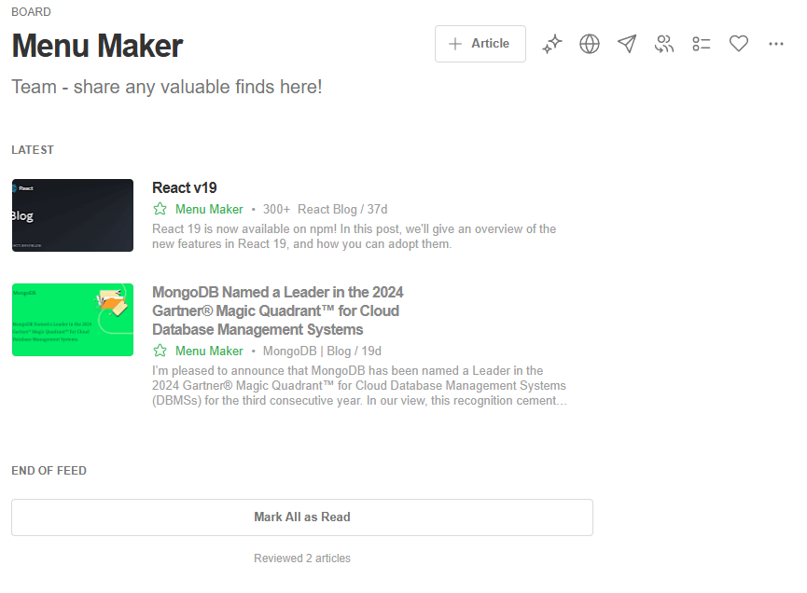
Team collaboration
Feedly allows the creation of Team Boards where team members can save valuable content. Team members can also highlight and add notes to relevant portions of saved sources. A newsletter can be generated to keep team members informed.

Slide 5

Summary
The use of Feedly for technical monitoring and further web research has prompted the recommendations outlined in the Technical Specifications document including the use of React, Node, and Mongo DB. The continued use of Feedly will assist the team in checking for technological updates.
Menu Maker Feedly URL:
https://feedly.com/i/collection/content/user/94aeb7f6-e101-4c59-951f-abbc5fcb6e79/category/57fb3e8d-8b0a-44a5-b970-dff3dd3df96f

