Slide 1


Project Management
Presented by Tracy Joyner

Slide 2
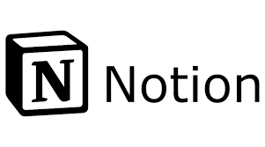
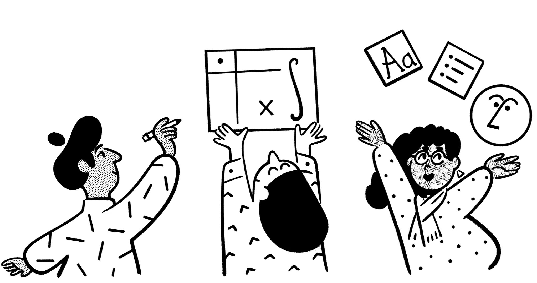
Notion is the tool chosen for team collaboration. It’s Kanban Board allows clear visualization of tasks and overall progress.
Project Management Tool

Slide 3
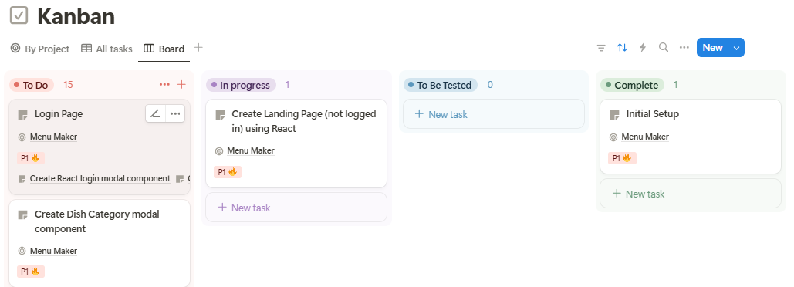
Kanban Board
https://www.notion.so/16b70abe98fe8002ba91f587f3761df6?v=17970abe98fe80f388d3000c30c73b99
Menu Maker Notion URL:

Slide 4
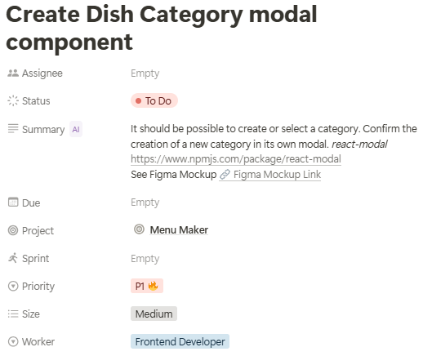
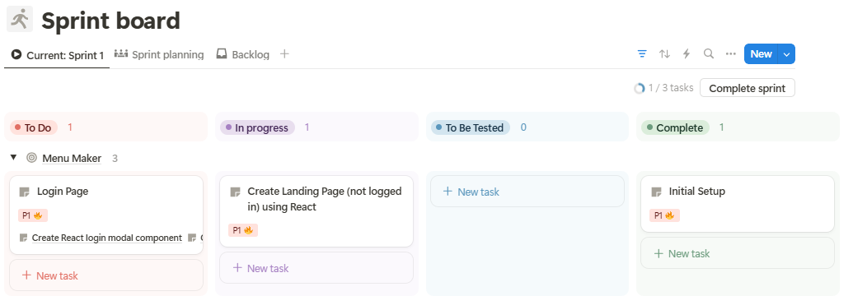
Collaboration
Notion readily shows each task and all it’s details so team members can easily keep track of what’s going on and leave comments as needed.
Tasks can be separated by sprint for easy progress management.

Slide 5
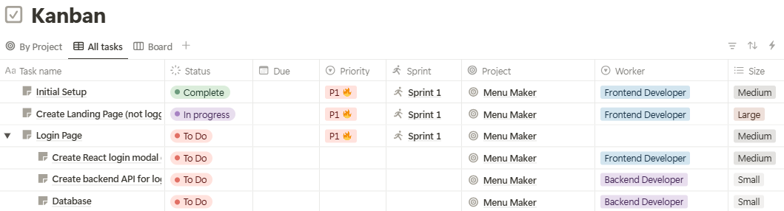
Summary
The use of the Notion Kanban Board, Task Lists, and supporting capabilities makes it ideal for Project Management and team collaboration.

