Slide 1


Technical Solution
Presented by Tracy Joyner

Slide 2
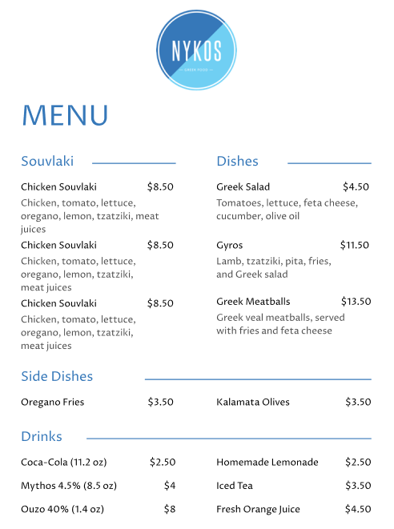
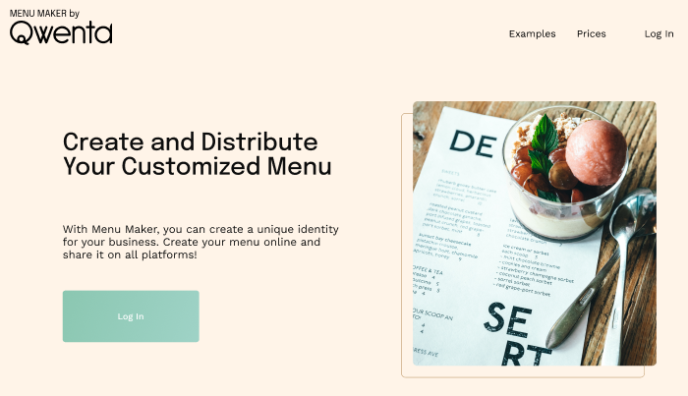
Menu Maker

Slide 3
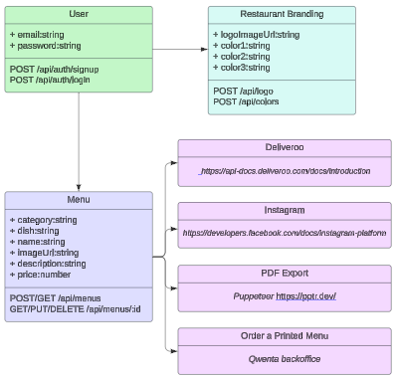
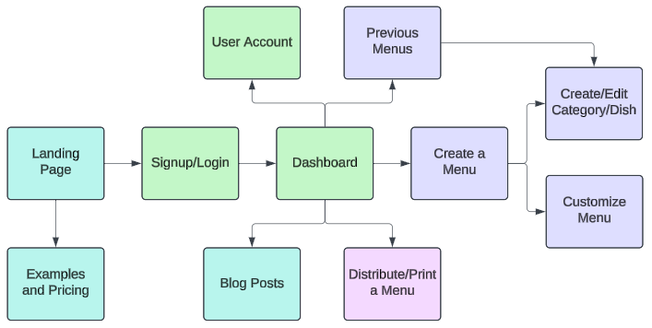
Menu Maker
Website flow and database models

Slide 4

Technical Monitoring
The use of Feedly for technical monitoring and further web research has prompted the recommendations outlined in the Technical Specifications document including the use of React, Node, and Mongo DB. The continued use of Feedly will assist the team in checking for technological updates.
Menu Maker Feedly URL:
https://feedly.com/i/collection/content/user/94aeb7f6-e101-4c59-951f-abbc5fcb6e79/category/57fb3e8d-8b0a-44a5-b970-dff3dd3df96f

Slide 5

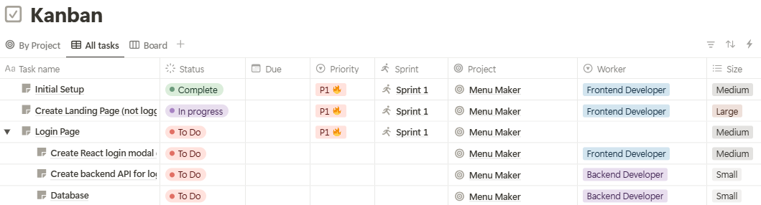
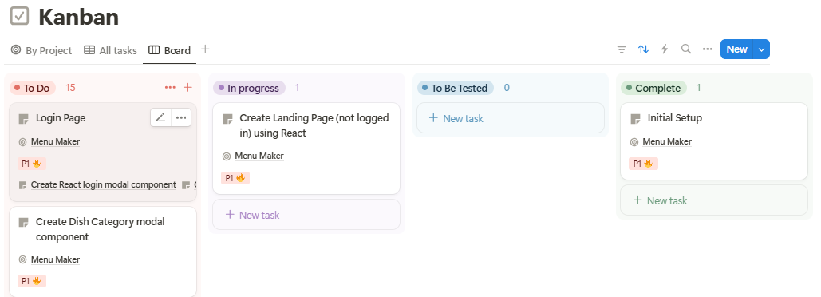
Project Management Tool
The use of the Notion Kanban Board, Task Lists, and supporting capabilities makes it ideal for Project Management and team collaboration.
Menu Maker Notion URL:
https://www.notion.so/16b70abe98fe8002ba91f587f3761df6?v=17970abe98fe80f388d3000c30c73b99

Slide 6

Communication
Kick-off meeting with all parties to communicate project expectations and specifications. Separate project staff meeting afterwards to organize tasks for the initial sprint.
Daily sprint stand-ups for project staff to communicate task status and resolve issues.
Weekly evaluation of progress with project staff and adjustment of tasks if necessary.
Bi-weekly sprint review to obtain feedback and validate results with the client. Separate project staff meeting to identify changes and prioritize tasks for the next sprint.

Slide 7
Summary
For the Technical Monitoring, Feedly was chosen to keep the team up to date with any technological updates or changes; the Technical Solutions document outlines the choices and reasons to use React, Node, MongoDB, and official API’s for Menu Maker; and the chosen Project Management Tool is Notion which allows for excellent team collaboration and project tracking. I am excited to start the Menu Maker by Qwenta Project!

