Slide 1
These are a few of my favorite things (about Quarto presentations)
Tracy K Teal

Slide 2

science

Slide 3
Sometimes you need words - Person Name

Slide 4
“Tracy’s love language is Google docs.” - Hadley Wickham

Slide 5
Quarto: Making presentations fun again

Slide 6
Quarto: Making presentations fun again for the first time

Slide 7
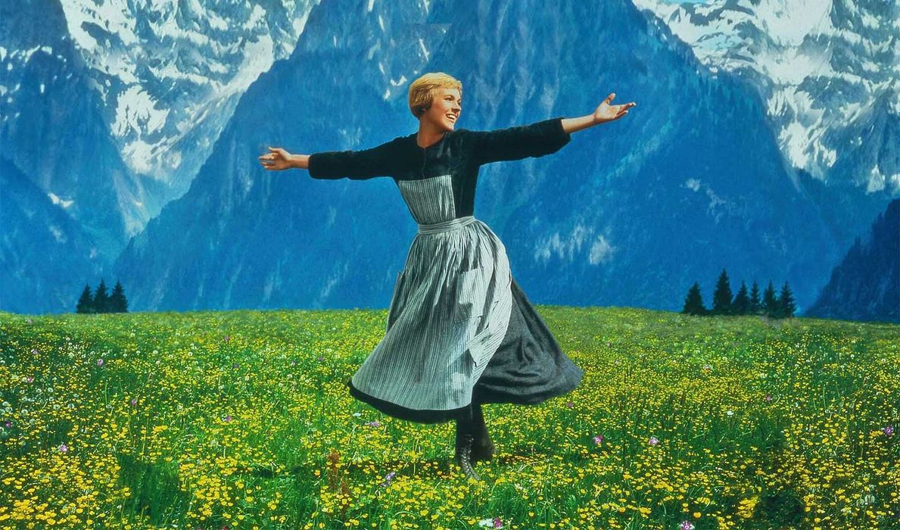
music

Slide 8
Raindrops on roses and Whiskers on kittens Bright coppper kettles and Warm woolen mittens Brown paper packages tied up with string These are a few of my favorite things

Slide 9
Raindrops on roses = Visual edits

Slide 10
Whiskers on kittens = Columns and tables

Slide 11
Columns
Other favorite things
Ice cream
R
Python
Least favorite things
Banana flavor
Slamming doors
Nails on chalkboards
Locking keys in car

Slide 12
Columns
Other favorite things
Ice cream
R
Python
Least favorite things
Banana flavor
Slamming doors
Nails on chalkboards
Locking keys in car

Slide 13
Code
:::: {.columns} ::: {.column width="60%"} **Other favorite things** * Ice cream * R * Python ::: ::: {.column width="40%"} **Least favorite things** * Banana flavor * Slamming doors * Nails on chalkboards * Locking keys in car ::: ::::

Slide 14
Name | AveStar | NumReviews
Honey Salted Caramel Almond Ice Cream | 5.00 | 102
New York Super Fudge Chunk® | 4.90 | 63
White Chocolate Raspberry Truffle Ice Cream | 4.88 | 168
Chocolate Ice Cream | 4.87 | 90
Peanut Butter World® | 4.85 | 68
Tables
Favorite ice creams

Slide 15
Bright copper kettles = Notes for the speaker

Slide 16
Slide with speaker notes
Slide content
Notes:
Speaker notes go here.

Slide 17
## Slide with speaker notes Slide content ::: {.notes} Speaker notes go here. :::

Slide 18
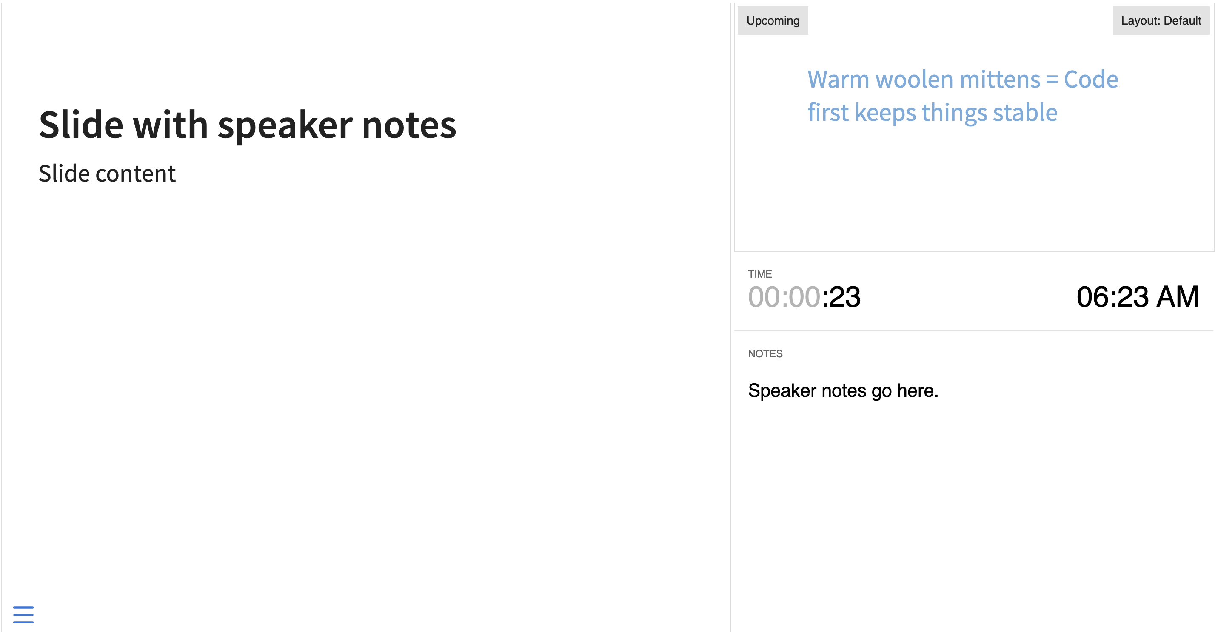
Speaker view

Slide 19
Warm woolen mittens = Code first keeps things stable

Slide 20
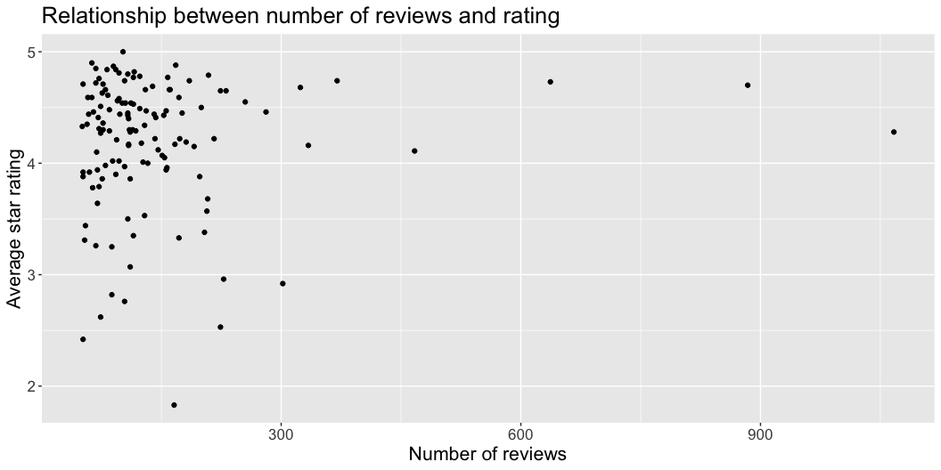
ggplot(data = ave_ic, mapping = aes(x = NumReviews, y = AveStar)) + geom_point() + ggtitle("Relationship between number of reviews and rating") + xlab("Number of reviews") + ylab("Average star rating") + theme(text=element_text(size = 16))

Slide 21
Brown paper packages = Themes to delight in

Slide 22
Tied up with string = Formats to share

Slide 23
HTML
PDF

Slide 24
Visual edits Columns and tables Notes for the speaker Code first keeps slides stable Themes to delight in and formats to share These are a few of my favorite things

Slide 25
Learn more
Documentation on Quarto presentations
This slide deck, including videos
When you click the Render button a presentation will be generated that includes both content and the output of embedded code. You can embed code like this:
[1] 2

