Slide 1
General considerations for RNA-seq quantification for differential expression Tracy K. Teal Assistant Professor Microbiology & Molecular Genetics July 30, 2014
Adapted from NGS RNASeq slides
Author: Ian Dworkin

Slide 2
What are the goals of your research? Why did you generate all of the RNAseq data in the first place?
RNA-seq is generated for a number of reasons
Transcriptome assembly (& SNP discovery)
Transcript discovery (variants for Transcription start site, alternative splicing, etc..)
Quantification of (alternative transcripts)
Differential expression analysis across treatments.

Slide 3
What was once thought to be separate goals are now clearly recognized as intertwined.
Early work for RNA-seq tried to “mirror” the type of gene level analysis used in microarrays.
However, RNA-seq has demonstrated how important it is to take into account alternative transcripts, even when attempting to get “gene level” measures.

Slide 4
How do we put together a useful pipeline for RNAseq
What are the steps we need to consider?

Slide 5
How do we put together a useful pipeline for RNAseq?
What are the steps we need to consider?
Quality filtering
Genome/transcriptome assembly.
Mapping reads to genome/transcriptome.
Deal with alternative transcripts (new transcriptome)?
Remap & count reads.
Differential expression

Slide 6
Quality filtering Your analysis is only as good as your data
Quality control and removal of poor-quality reads (FASTQC, RNASeQC, fastx, …)
Remove adapters and linkers (FASTQC, Trimmomatic, …)

Slide 7
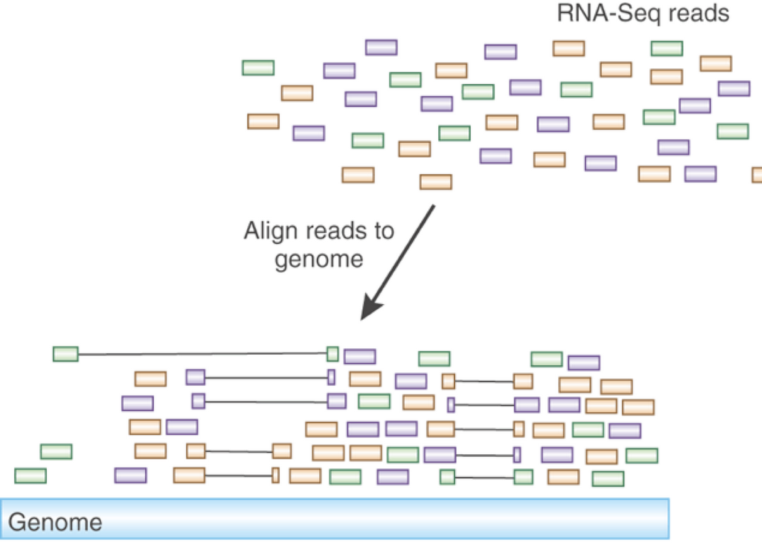
Mapping reads Ultimately all analyses require read mapping
Image credit: Nir Friedman lab

Slide 8
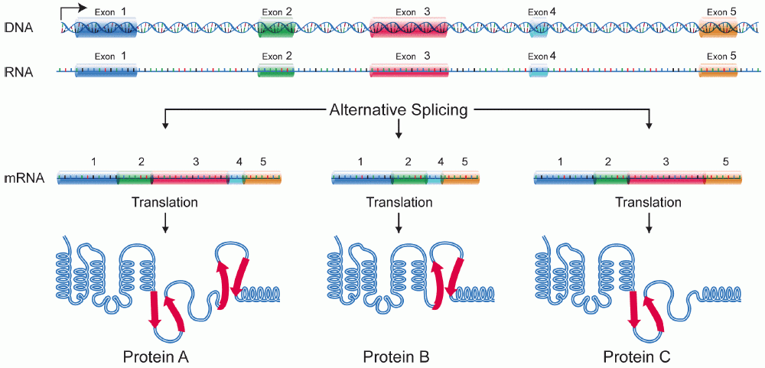
Challenge: alternative splicing

Slide 9
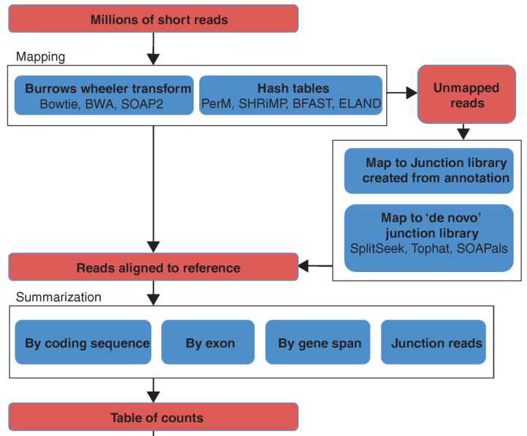
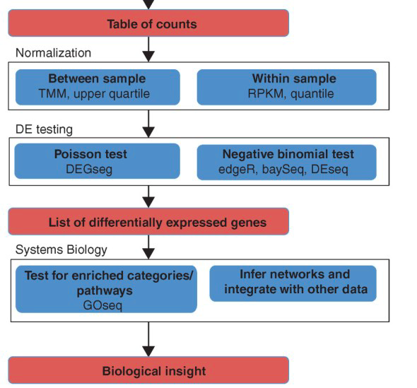
Overview of RNA-Seq analysis pipeline for detecting differential expression
Quality filter
Oshlack et al., From RNA-seq reads to differential expression results, Genome Biology 2010.

Slide 10
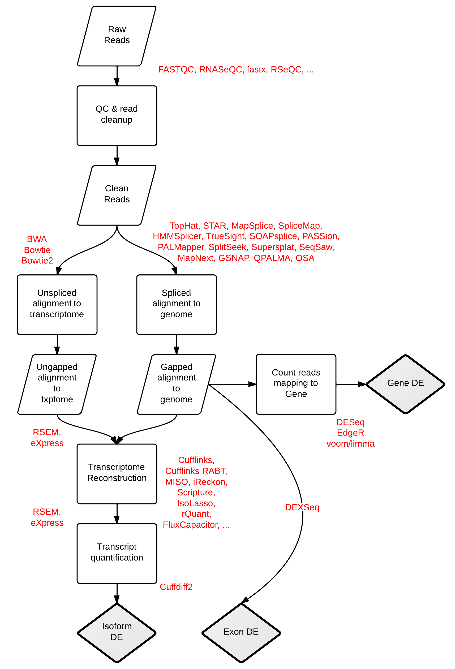
RNA-seq Workflows and Tools. Stephen Turner. Figshare. http://dx.doi.org/10.6084/m9.figshare.662782

Slide 11
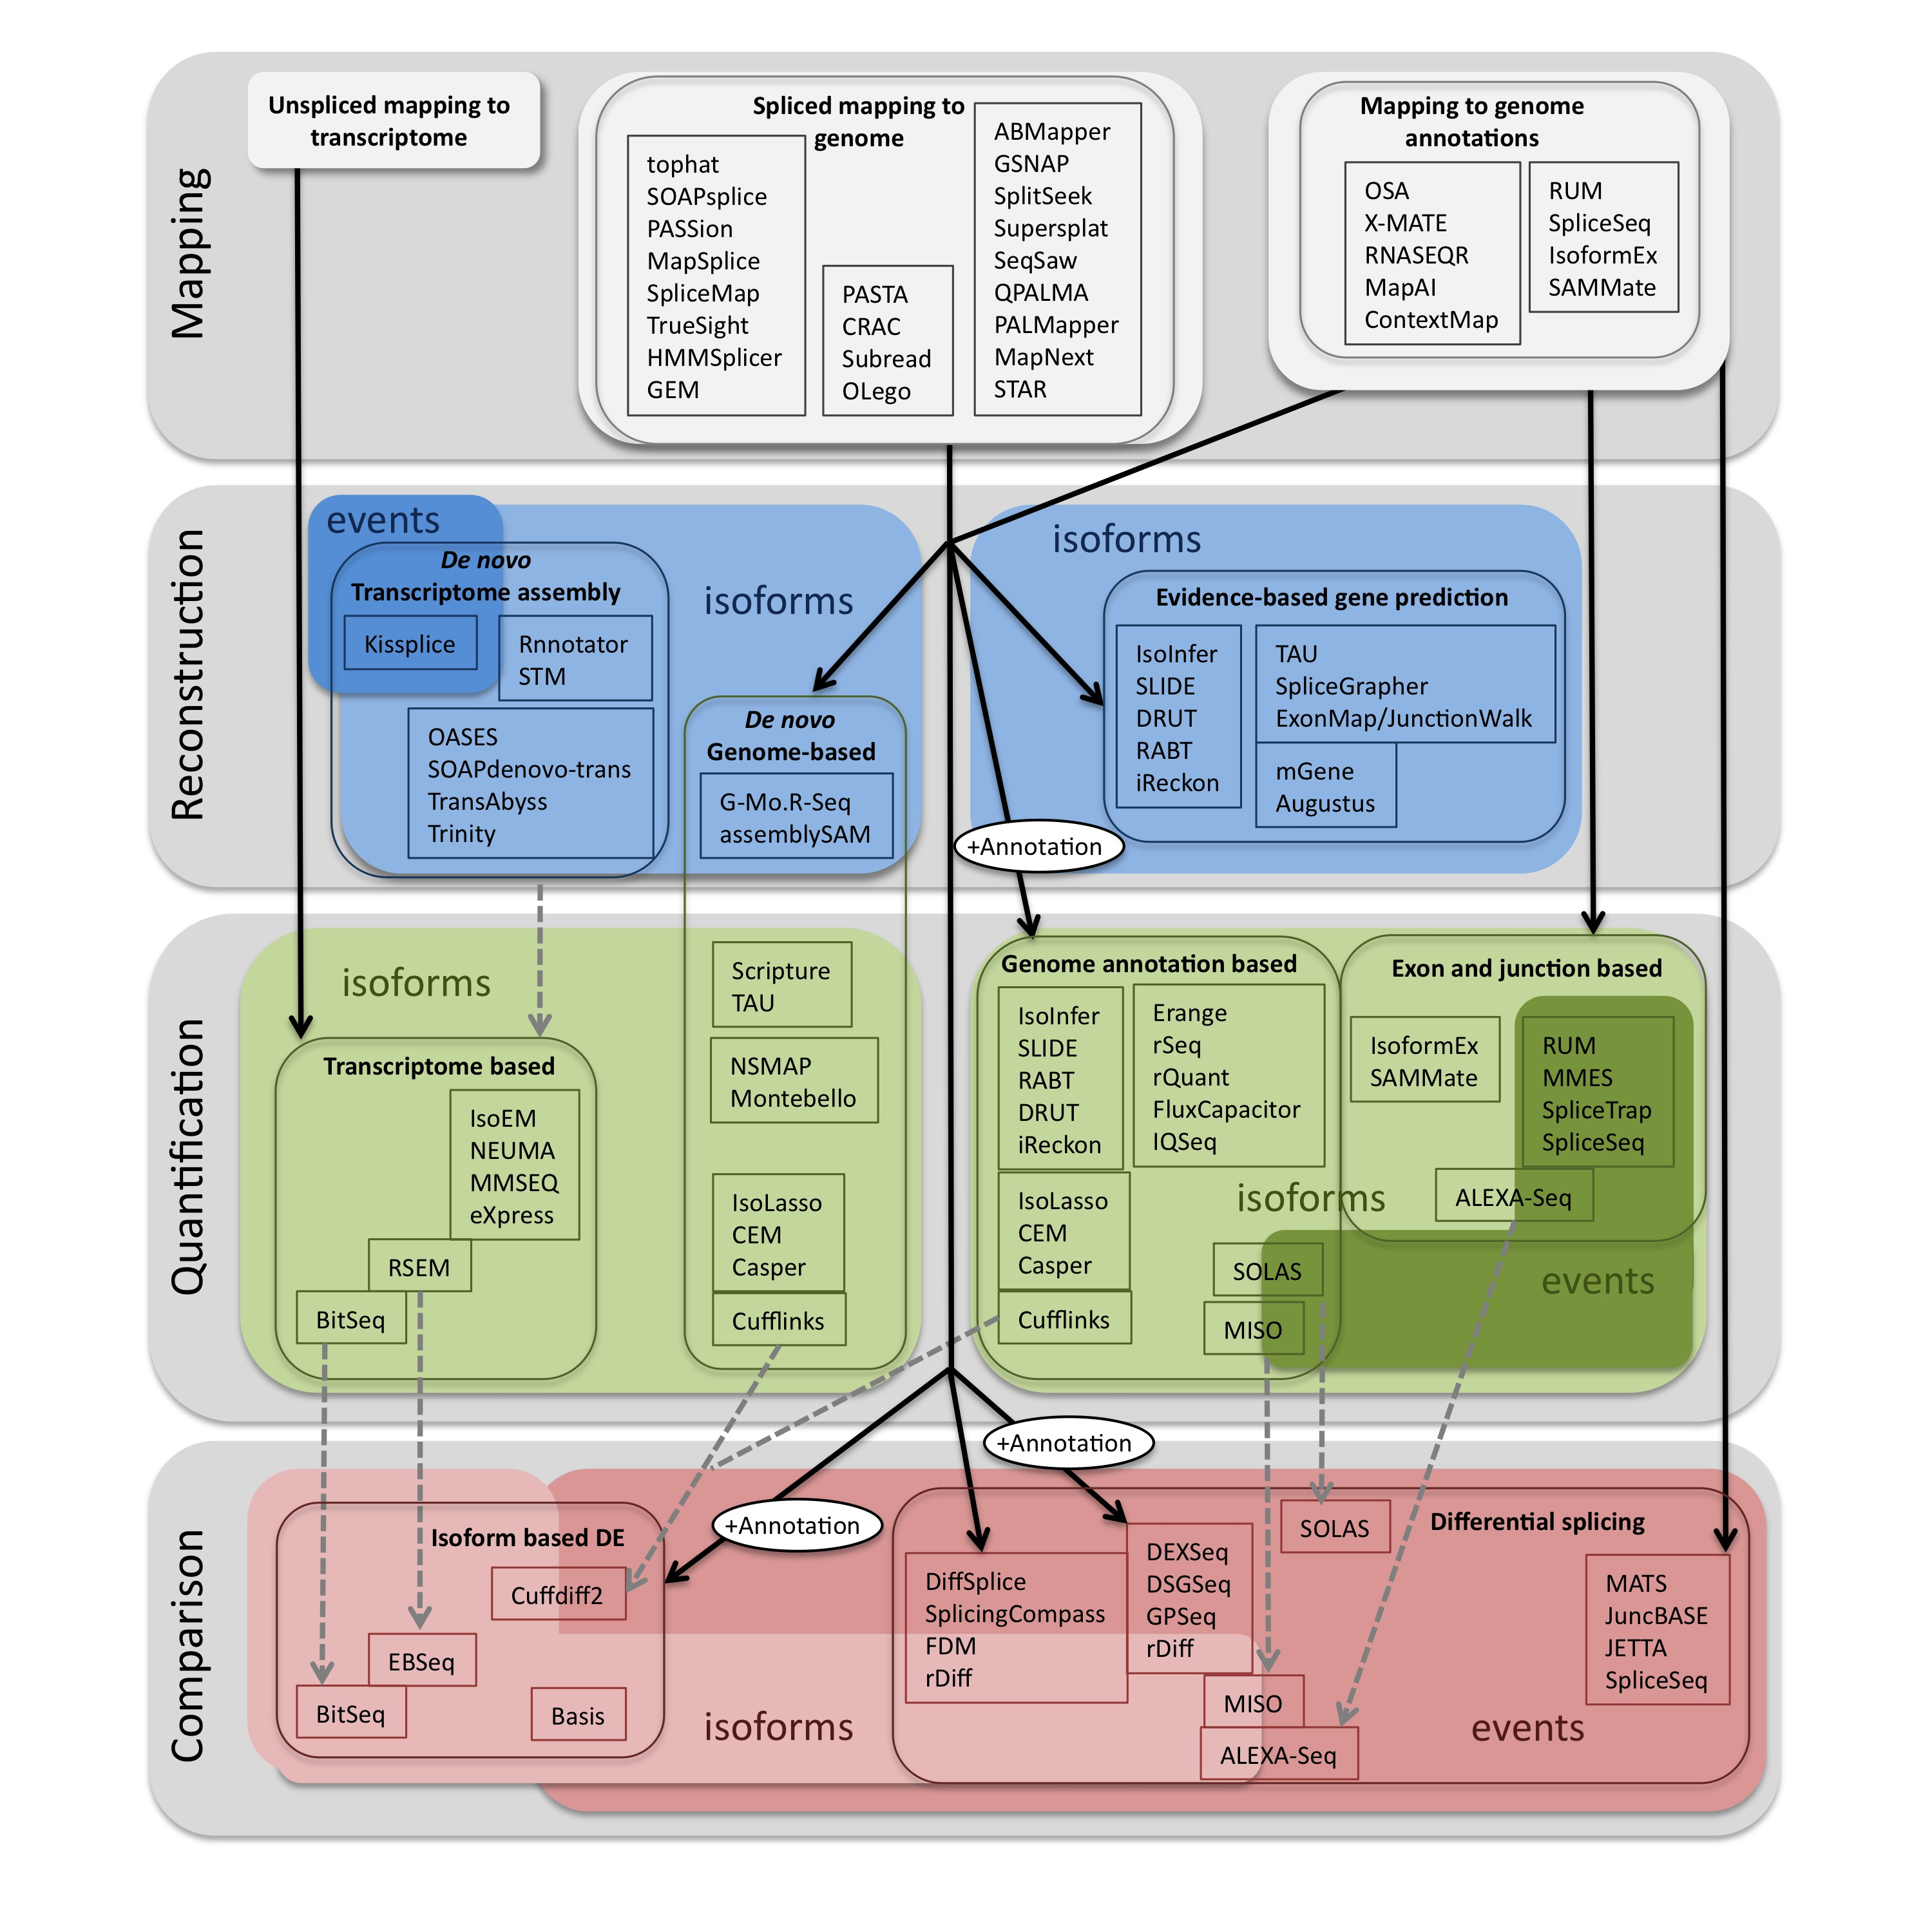
Pipelines for RNA-seq (geared towards splicing)
Alamancos et al. Methods to Study Splicing from RNA-Seq http://arxiv.org/abs/1304.5952
Figshare. http://dx.doi.org/10.6084/m9.figshare.679993

Slide 12
The “tuxedo” protocol for RNA-seq
Trapnell C et al
Differential gene and transcript expression analysis of RNA-seq experiments with TopHat and Cufflinks
Nature Protocols 7, 562–578 (2012)

Slide 13
Nookaew et al 2102 NAR

Slide 14
How should we map reads
Do we want to map to a reference genome (with a “splice aware” aligner)?
Or do we want to map to a transcriptome directly?

Slide 15
Mapping to the genome
How do we deal with alternative transcripts or paralogs during mapping?
"splicing aware" aligners:
Exon First: (Tophat, MapSplice, SpliceMap) Fig1A Garber
Step 1 - map reads to genome
Step 2 -unmapped reads are split, and aligned.
Seed & extend (Fig1B Garber) (GSNAP, QPALMA)
kmers from reads are mapped (the seeds), and then extended

Slide 16
Garber et al. 2011

Slide 17
Mapping to a transcriptome
What might be the downside to mapping to the
transcriptome? Incomplete transcriptomes can lead to errors in inferred expression levels. Potentially less well annotated.
For this Burrows-Wheeler is faster than seed based approaches (shrimb & stampy), but the latter may be preferred if mapping to "distant" transcriptomes.

Slide 18
Which to use
If a (close to?) perfect match transcriptome assembly is available for mapping. Burrows-wheeler based aligners can be much faster than seed based methods (upto 15x faster)
BW based aligners have reduced performance once mismatches are considered.
Exponential decrease in performance with each additional mismatch (iteratively performs perfect searches).
Seed methods may be more sensitive when mapping to transcriptomes of distantly related species (or high polymorphism rates).
From Garber et al. 2011

Slide 19
Counting
One of the most difficult issues has been how to count reads.
What are some of the issues that we need to account for during counting of reads?

Slide 20
Counting
We are interested in transcript abundance.
But we need to take into account a number of things.
How many reads in the sample.
Length of transcripts
GC content and sequencing bias

Slide 21
Counting
Normalizing a transcript's read count by both its length and the total number of mapped reads in the sample
RPKM (Reads Per Kilobase of transcript per Million mapped reads) – Mortazavi et al 2008
FPKM (Fragments Per Kilobase of transcript per Million mapped reads). Avoids double counting in paired-end sequencing.

Slide 22
Garber et al. Computational methods for transcriptome annotation and quantification using RNA-seq.
Nat Methods, Jun 2011

Slide 23
Accounting for multiple isoforms
- Only count reads that map uniquely to an isoform. Can be very problematic, when isoforms do not have unique exons.
- so called "isoform-expression" methods (cufflinks, MISO) model the uncertainty parametrically (often using MLE). The model with the best mix of isoforms that models the data (highest joint probability) is the best estimate. How this is handled differs a great deal by the different model.

Slide 24
Garber et al. 2011

Slide 25
Trapnell C et al
Differential analysis of gene regulation at transcript resolution with RNA-seq
Nat Biotechnol. 2013 Jan;31(1):46-53

Slide 26
Differential expression
DEseq (http://www.ncbi.nlm.nih.gov/pubmed/20979621)
EDGE-R
EBseq (RSEM/EBseq)
RSEM (http://deweylab.biostat.wisc.edu/rsem/)
eXpress (http://bio.math.berkeley.edu/eXpress/overview.html)
Beers simulation pipeline(http://www.cbil.upenn.edu/BEERS/)
DEXseq (http://bioconductor.org/packages/release/bioc/html/DEXSeq.html)
Limma (voom)
Htseq (python library) works with DEseq

Slide 27
Differentially expressed genes based on software for quantification
Differentially expressed genes based on software for mapping
Nookaew et al 2102 NAR

Slide 28
Problems with cufflink and cuffdiff? Reproducibility…
http://seqanswers.com/forums/showthread.php?t=20702
http://seqanswers.com/forums/showthread.php?t=17662
http://seqanswers.com/forums/showthread.php?t=23962
http://seqanswers.com/forums/showthread.php?t=21020
http://seqanswers.com/forums/showthread.php?t=21708
http://www.biostars.org/p/6317/

Slide 29
So, what to do?

Slide 30
Example workflows and tutorials
Ian Dworkin’s NGS course protocols
http://ged.msu.edu/angus/tutorials-2013/index.html
Bacterial RNA-Seq workflow from Ben Johnson & Rob Abramovitch
http://www.abramovitchlab.com/#/rna-seq-computational-methods/
Canadian Bioinformatics workshops
http://bioinformatics.ca/workshops/2013/informatics-rna-sequence-analysis-2013
Trinity and Tuxedo tutorials
http://trinityrnaseq.sourceforge.net/rnaseq_workshop.html
Samtools for variant calling

Slide 31
The “tuxedo” protocol for RNA-seq
Trapnell et al 2012

Slide 32
Overviews of RNA-Seq
Graber et al, Computational methods for transcriptome annotation and quantification using RNA-seq, Nat Methods, Jun 2011
http://jura.wi.mit.edu/bio/education/hot_topics/RNAseq/RNAseqDE_Dec2011.pdf

Slide 34
Aligning to a transcriptome or a genome
Aligning to a genome, you have to account for the different splice variations
Aligning to a transcriptome, you have the different isoforms, so the mapping is more straightforward
However, you might have to assemble your own transcriptome

Slide 35
How to assemble multiple alternative spliced transcripts?
In the presence of AS, conventional assembly may be erroneous, ambiguous, or truncated.
truncated
truncated
1
2
3
Overlapping
correct
truncated

Slide 36
Need to use splice-aware assemblers
Cufflinks (most commonly used)
Scripture
Trinity
Trans-ABySS
GRIT

