Slide 1

Online Matching
Sampling WithOut Replacement
Meets
Zhiyi Huang Chui Shan Lee Jianqiao Lu Xinkai Shu*
The University of Hong Kong
WINE 2024
* Xinkai is now a postdoc at Max Planck Institute for Informatics

Slide 2
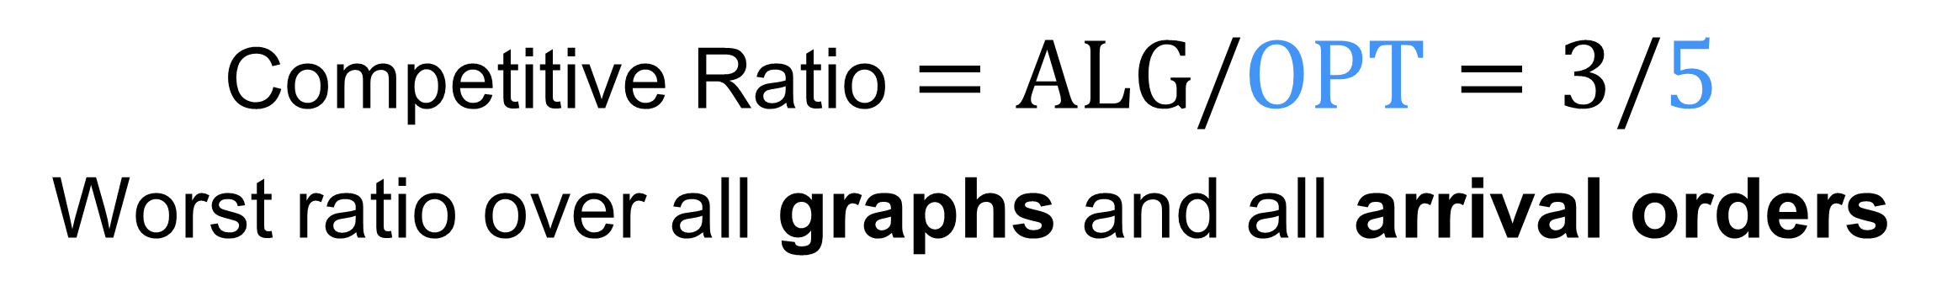
Online Bipartite Matching
Karp, Vazirani, Vazirani (1990)
Online
Offline
Competitive Ratio $=ALG/OPT=3/5$
Worst ratio over all graphs and all arrival orders

Slide 3








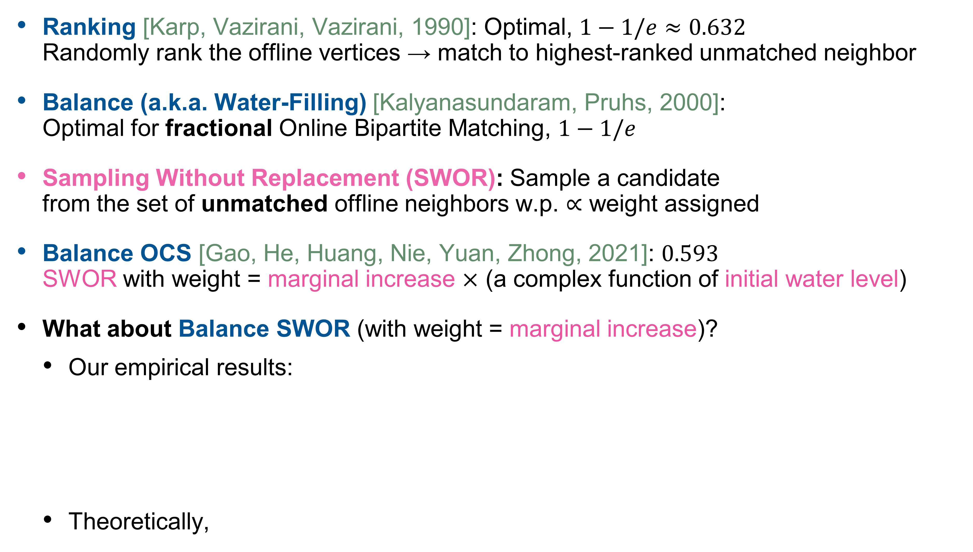


Ranking [Karp, Vazirani, Vazirani, 1990]: Optimal, $1−1/e≈0.632$ Randomly rank the offline vertices → match to highest-ranked unmatched neighbor
Balance (a.k.a. Water-Filling) [Kalyanasundaram, Pruhs, 2000]: Optimal for fractional Online Bipartite Matching, $1−1/e$
Sampling Without Replacement (SWOR): Sample a candidate from the set of unmatched offline neighbors w.p. $∝$ weight assigned
Balance OCS [Gao, He, Huang, Nie, Yuan, Zhong, 2021]: $0.593$ SWOR with weight = marginal increase $×$ (a complex function of initial water level)
What about Balance SWOR (with weight = marginal increase)?
Our empirical results:
Theoretically,
$½$
$½$
$½$
$½$
$¼$
$¾$
Datasets used in Borodin et al. (2020):
$$1$$
Algorithm | Caltech36 | Reed98 | CE-GN | CE-PG | beause | mbeaflw
Balance SWOR | 0.840 | 0.830 | 0.924 | 0.924 | 0.919 | 0.956
Balance OCS | 0.835 | 0.828 | 0.922 | 0.923 | 0.918 | 0.956
Ranking | 0.824 | 0.818 | 0.921 | 0.920 | 0.914 | 0.953
$$⅛$$
$$⅞$$
$$0.513$$

Slide 4

Online Stochastic Matching
Feldman, Mehta, Mirrokni, Muthukrishnan (2009)
Poisson arrival rate
Type graph
Random graph
0
1.5
1
0.8
Offline
Time
Online types
0.5
0.2
1
Competitive Ratio$=E[ALG]/E[OPT]$
Worst ratio over all type graphs and all arrival rates

Slide 5
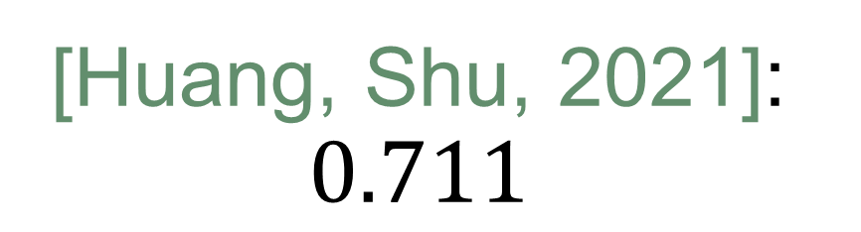

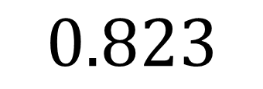

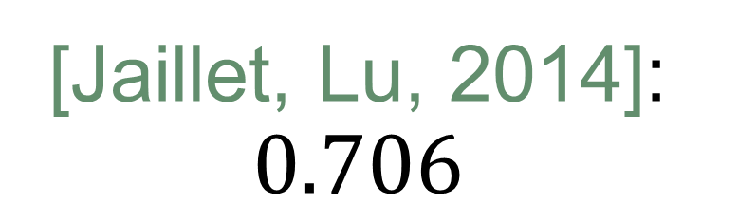


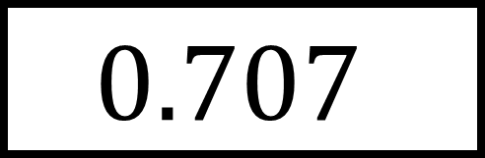
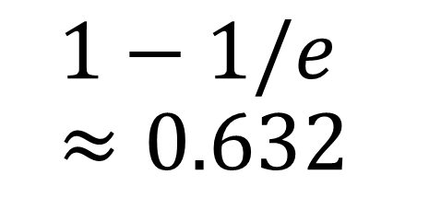
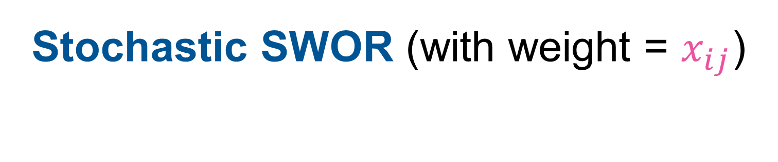
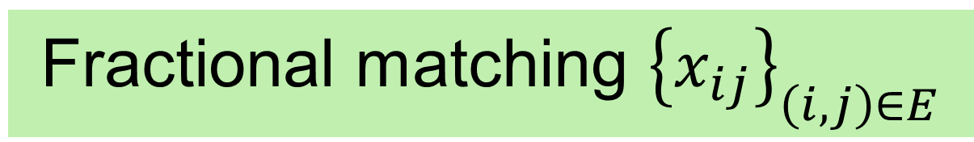
Type graph
Step 1: Preprocessing, i.e. solving an LP relaxation
Fractional matching ${\left\{x_{ij}\right\}}_{\left(i,j\right)∈E}$
Step 2: Online decisions
Arrival rates
Current availability of offline vertices
* Result holds even for the Random Order Model
Two Choices
[Huang et al. 2019; Jin, Williamson, 2022]: $0.669$*
[Mahdian, Yan, 2011]: $0.696$*
[Manshadi et al., 2012]: $0.702$
[Huang, Shu, 2021]: $0.711$
Hardness
[Manshadi et al., 2012]
Suggested Matching [Feldman et al., 2009]
Poisson OCS [Huang et al., 2022]: $0.716$
[Jaillet, Lu, 2014]: $0.706$
$$1−1/e \\ ≈0.632$$
Multiple Choices
$$0.823$$
Stochastic SWOR (with weight = $x_{ij}$)
Indep. random selection + Matching LP
Correlated selection + Better LPs
$$0.707$$
* Results for the Random Order Model are omitted

Slide 6
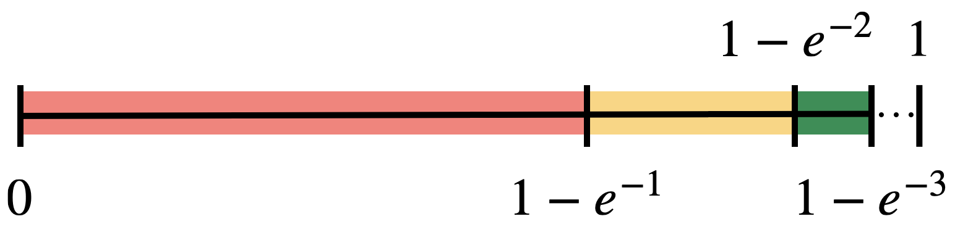

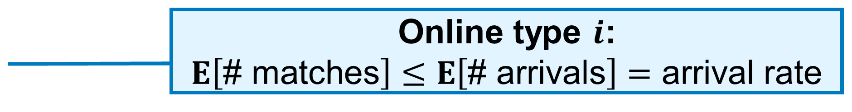


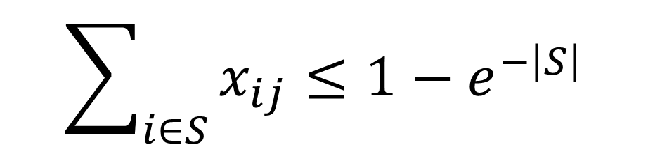
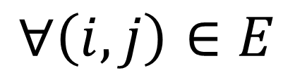


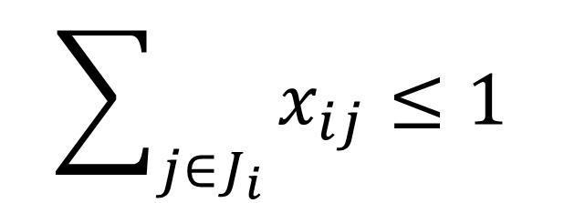
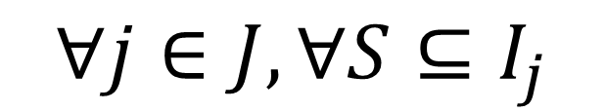

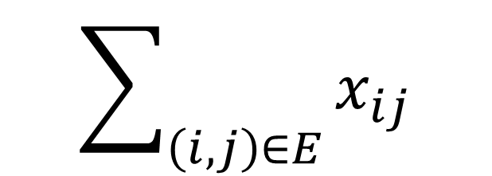

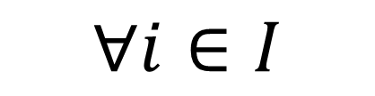

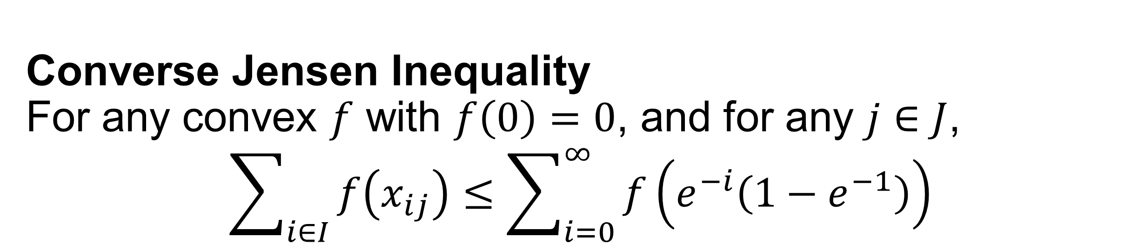

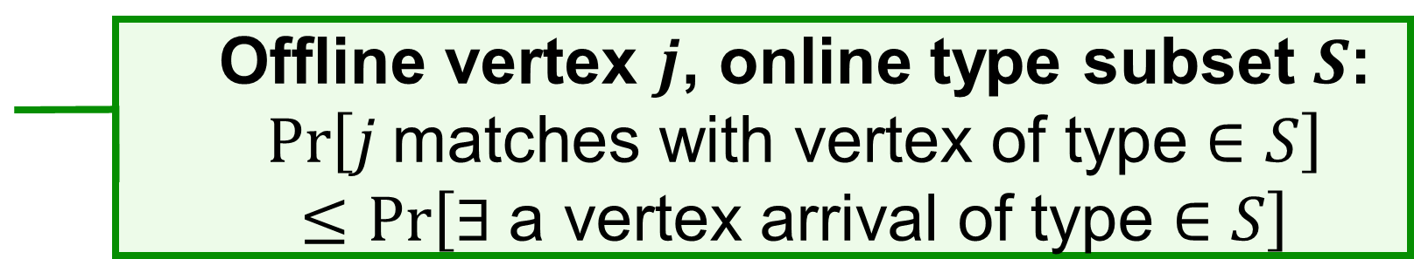


Natural Linear Program
Huang, Shu (2021)
Assume unit arrival rates in this talk.
Let $x_{ij}=\operatorname{Pr}\left[j \text{is} \text{matched} \text{to} \text{a} \text{type}\text{−}i \text{vertex}\right]$.
$$\sum_{\left(i,j\right)∈E}{x_{ij}}$$
$$E\left[\text{Total}\text{ \# }\text{matche}\text{s}\right]$$
$$\max{}$$
$$\sum_{j∈J_{i}}{x_{ij}≤1}$$
Online type $i$: $E\left[\text{\# }\text{matches}\right]$ $≤$ $E\left[\text{\# }\text{arrivals}\right]$ $=$ arrival rate
$$∀i∈I$$
$$\sum_{i∈S}{x_{ij}≤1−e^{−\left|S\right|}}$$
Offline vertex $j$, online type subset $S$: $$\operatorname{Pr}\left[j \text{match}\text{es} \text{with} \text{vertex} \text{of} \text{type}∈S\right]$$ $≤$ $\operatorname{Pr}\left[∃ \text{a} \text{vertex} \text{arrival} \text{of} \text{type}∈S\right]$
(Poisson constraints)
$$∀j∈J, ∀S⊆I_{j}$$
$$x_{ij}≥0$$
$$∀\left(i,j\right)∈E$$
Converse Jensen Inequality For any convex $f$ with $f\left(0\right)=0$, and for any $j∈J$,
$$\sum_{i∈I}{f\left(x_{ij}\right)}≤\sum_{i=0}^{∞}{f\left(e^{−i}\left(1−e^{−1}\right)\right)}$$
$$e^{−0}\left(1−e^{−1}\right)$$
$$e^{−1}\left(1−e^{−1}\right)$$
$$⋯$$
$$⋯$$
$$0$$
$$⋯$$
$$1−e^{−1}$$
$$1−e^{−2}$$
$$1$$

Slide 7
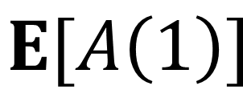
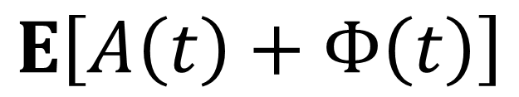
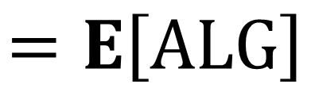
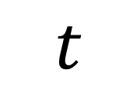
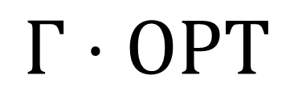
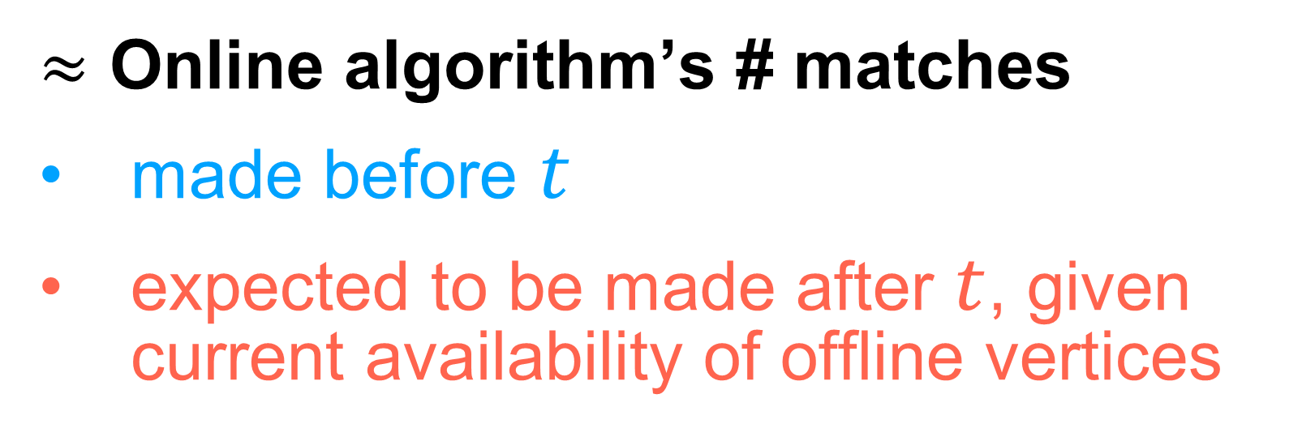

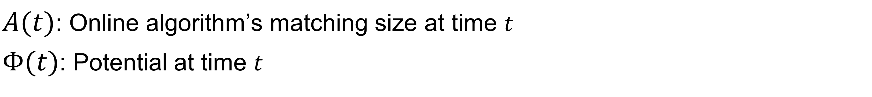


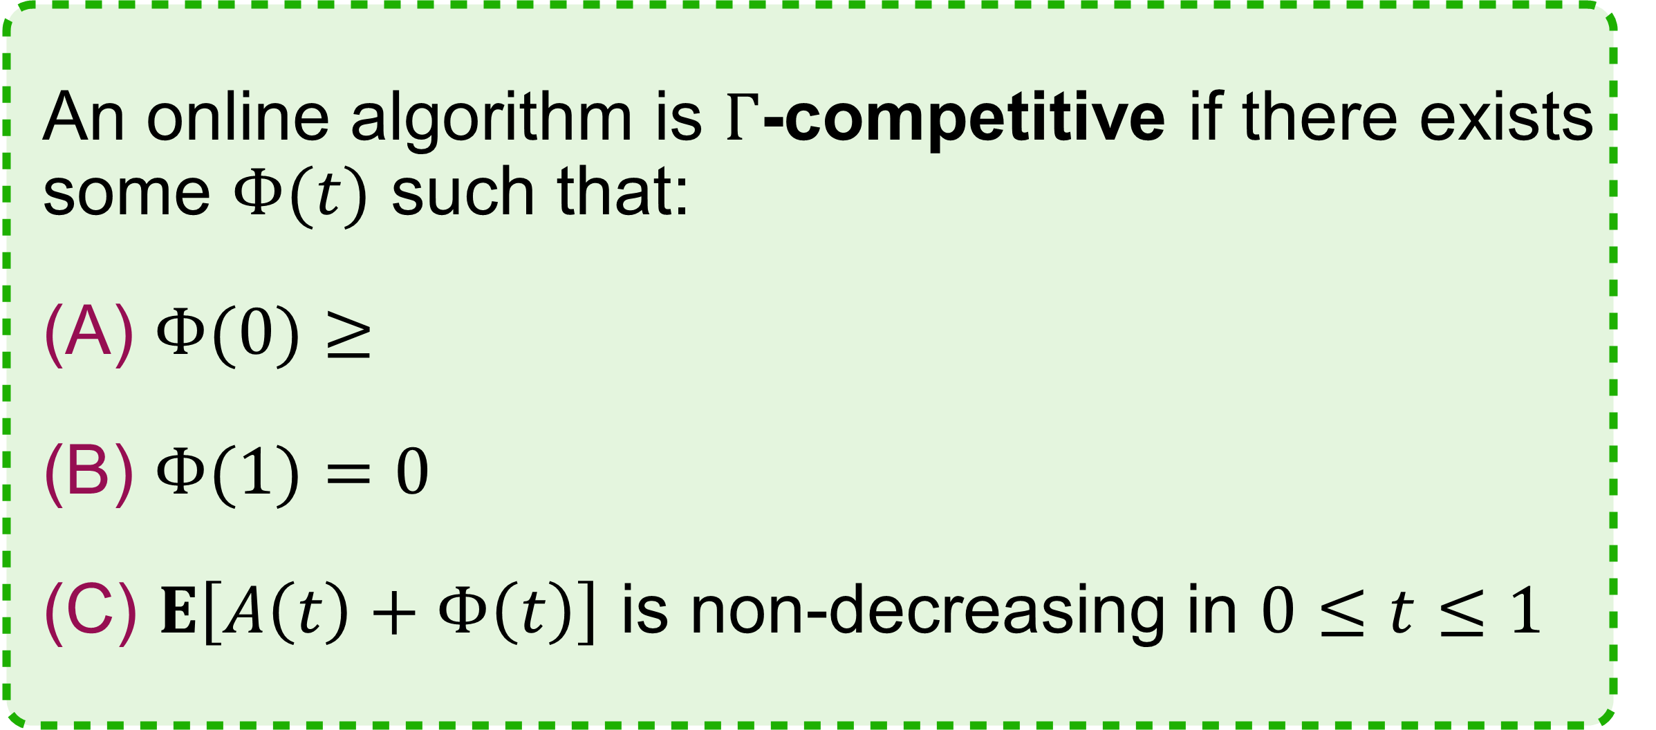
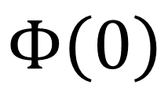

Potential Function Analysis
$≈$ Online algorithm’s # matches
made before $t$
expected to be made after $t$, given current availability of offline vertices
$A(t)$: Online algorithm’s matching size at time $t$
$Φ(t)$: Potential at time $t$
An online algorithm is $Γ$-competitive if there exists some $Φ(t)$ such that:
$Φ(0)≥$
$Φ(1)=0$
$E\left[A\left(t\right)+Φ\left(t\right)\right]$ is non-decreasing in $0≤t≤1$
$$E\left[A\left(t\right)+Φ\left(t\right)\right]$$
$$Γ⋅OPT$$
$$A$$
$E[A\left(1\right)]$
$$Φ\left(0\right)$$
$$Φ$$
$$=E\left[ALG\right]$$
$$0$$
$$t$$
$$1$$

Slide 8
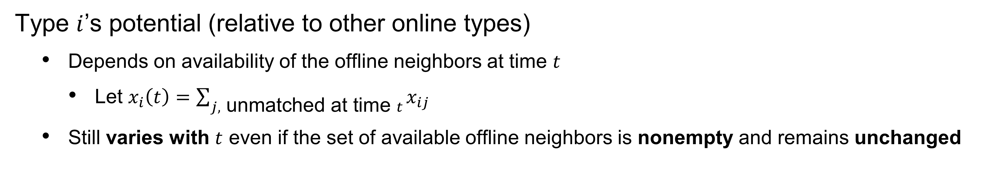
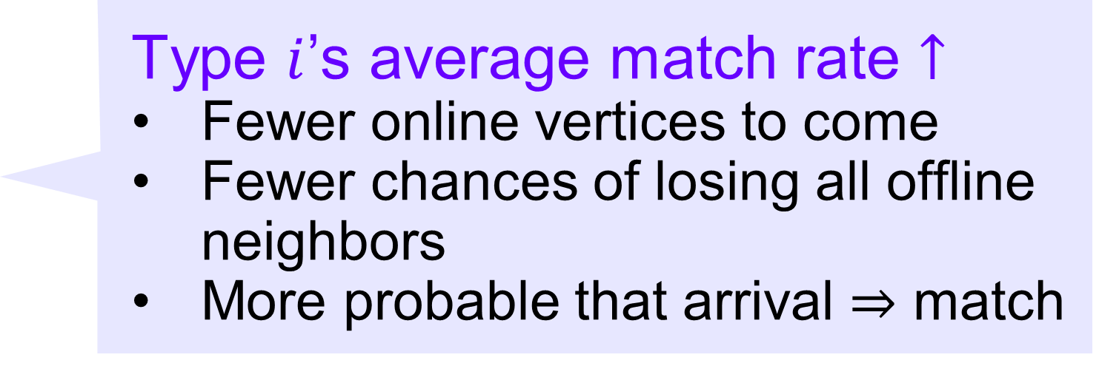
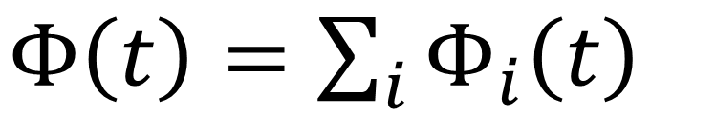






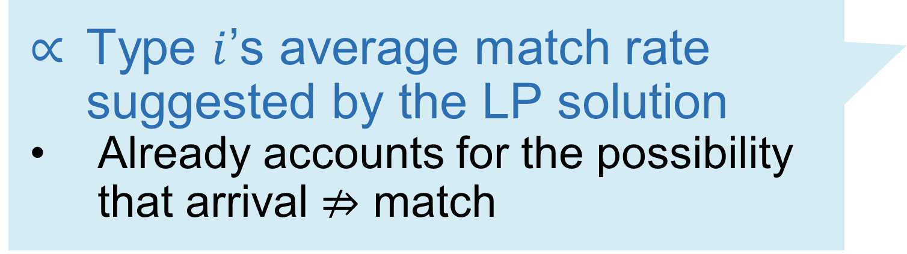



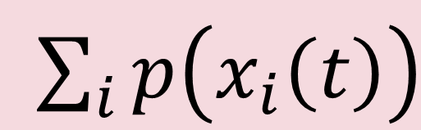

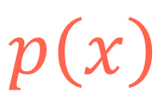

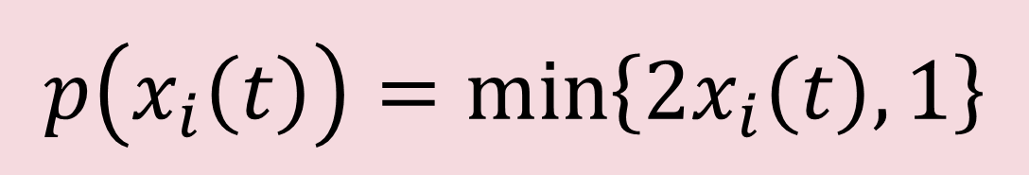
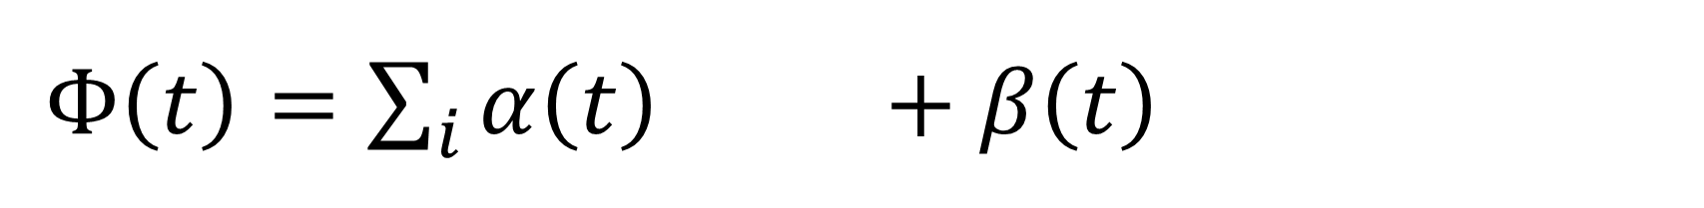


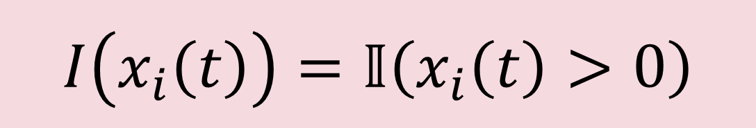
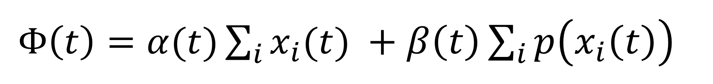
Our Potential Function
$Φ\left(t\right)=α(t)\sum_{i}{x_{i}(t) }+β\left(t\right)\sum_{i}{p\left(x_{i}\left(t\right)\right)}$
$Φ\left(t\right)=\sum_{i}{α\left(t\right)x_{i}\left(t\right)+β\left(t\right)p\left(x_{i}\left(t\right)\right)}$
$\sum_{i}{x_{i}\left(t\right)}$
$\sum_{i}{p\left(x_{i}\left(t\right)\right)}$
$Φ\left(t\right)=\sum_{i}{Φ_{i}\left(t\right)}$
Type $i$’s potential (relative to other online types)
Depends on availability of the offline neighbors at time $t$
Let $x_{i}\left(t\right)=\sum_{j, \text{unmatched} \text{at} \text{time} t}{x_{ij}}$
Still varies with $t$ even if the set of available offline neighbors is nonempty and remains unchanged
Type $i$’s average match rate suggested by the LP solution
Already accounts for the possibility that arrival $⇏$ match
Type $i$’s average match rate $↑$
Fewer online vertices to come
Fewer chances of losing all offline neighbors
More probable that arrival $⇒$ match
$$0$$
$$x_{i}\left(t\right)$$
$$x_{i}\left(t\right)$$
Type $i$’s arrival rate
Arrival $⇒$ match
$$I\left(x\right)$$
$$I\left(x\right)$$
$$1$$
$$I\left(x_{i}\left(t\right)\right)=𝕀\left(x_{i}\left(t\right)>0\right)$$
$$p\left(x\right)$$
$$1$$
$$p\left(x_{i}\left(t\right)\right)=\min\left\{2x_{i}\left(t\right),1\right\}$$
$$p\left(x_{i}\left(t\right)\right)$$
$$0$$
$$x$$
$$1$$

Slide 9
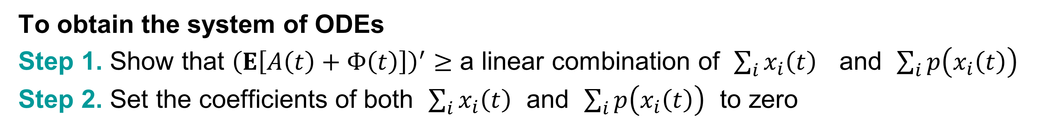
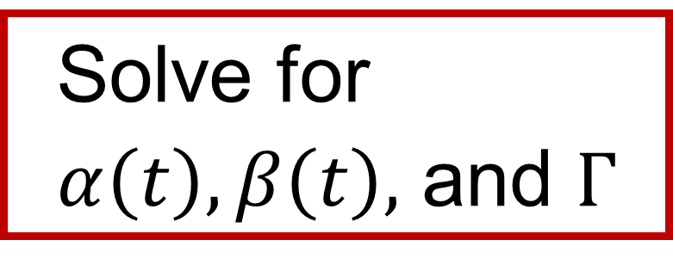
















Our Potential Function
$Φ\left(t\right)=α(t)\sum_{i}{x_{i}(t) }+β\left(t\right)\sum_{i}{p\left(x_{i}\left(t\right)\right)}$
$\sum_{i}{x_{i}\left(t\right)}$
$\sum_{i}{p\left(x_{i}\left(t\right)\right)}$
Solve for $α\left(t\right), β\left(t\right),$ and $Γ$
$Φ\left(0\right)≥Γ⋅OPT$
$Φ\left(1\right)=0$
$E\left[A\left(t\right)+Φ\left(t\right)\right]$ is non-decreasing in $0≤t≤1$
Boundary conditions
A system of 2 ODEs
Easy, except for the component ${\left(\sum_{i}{p\left(x_{i}\left(t\right)\right)}\right)}^{′}$
To obtain the system of ODEs
Step 1. Show that ${\left(E\left[A\left(t\right)+Φ\left(t\right)\right]\right)}^{′}≥$ a linear combination of $\sum_{i}{x_{i}\left(t\right)}$ and $\sum_{i}{p\left(x_{i}\left(t\right)\right)}$
Step 2. Set the coefficients of both $\sum_{i}{x_{i}\left(t\right)}$ and $\sum_{i}{p\left(x_{i}\left(t\right)\right)}$ to zero
$\sum_{i}{x_{i}\left(t\right)}$
$\sum_{i}{p\left(x_{i}\left(t\right)\right)}$
$\sum_{i}{x_{i}\left(t\right)}$
$\sum_{i}{p\left(x_{i}\left(t\right)\right)}$
$$I\left(x\right)$$
$p\left(x\right)$ is chosen to be piecewise-linear to support Step 1
To allow the combined change of $p\left(x_{i}\left(t\right)\right)$ due to any match to be expressed as a linear combination of $\sum_{i}{x_{i}\left(t\right)}$ , $\sum_{i}{p\left(x_{i}\left(t\right)\right)}$ and some constant
Step 1 would be challenging to achieve otherwise
$$1$$
$$p\left(x\right)=\min\left\{2x,1\right\}$$
$\sum_{i}{x_{i}\left(t\right)}$
$\sum_{i}{p\left(x_{i}\left(t\right)\right)}$
$$0$$
$$x$$
$$1$$
$0.706$, and improve to $0.707$ if choosing $p\left(x\right)=\min\left\{2.3507x,1\right\}$

Slide 10



De-randomization
From Stochastic SWOR to Regularized Greedy
An online algorithm is $Γ$-competitive if there exists some $Φ\left(t\right)$ such that:
$Φ\left(0\right)≥Γ⋅OPT$
$Φ\left(1\right)=0$
$E\left[A\left(t\right)+Φ\left(t\right)\right]$ is non-decreasing in $0≤t≤1$
Independent of algorithm’s decision
Stochastic SWOR’s random choice is expected to weakly increase $A\left(t\right)+Φ\left(t\right)$
Deterministic choice exists
Regularized Greedy
Match any online vertex to an unmatched offline neighbor $j$ that leads to the smallest decrease of the potential $Φ\left(t\right)$
Regularization term
$0.707$, the first poly-time deterministic algorithm that beats $1−1/e$

Slide 11
Summary
 | SWOR algorithm | Sampling weights
Online Bipartite Matching | Balance SWOR | Balance
Online Stochastic Matching | Stochastic SWOR | Natural LP
They’re empirically good! Improve current analyses?
Potential function analysis framework enables analysis & de-randomization of:
Stochastic SWOR → Regularized Greedy
Top Half Sampling, the state-of-the-art algorithm for Edge-Weighted Online Stochastic Matching with Free Disposal [Huang et al., 2022]
and more…?
Thank you! Questions?

