Slide 1


On the Hardness of Opinion Dynamics Optimization with $L_{1}$-Budget on Varying Susceptibility to Persuasion
T-H. Hubert Chan & Chui Shan Lee
The University of Hong Kong

Slide 2
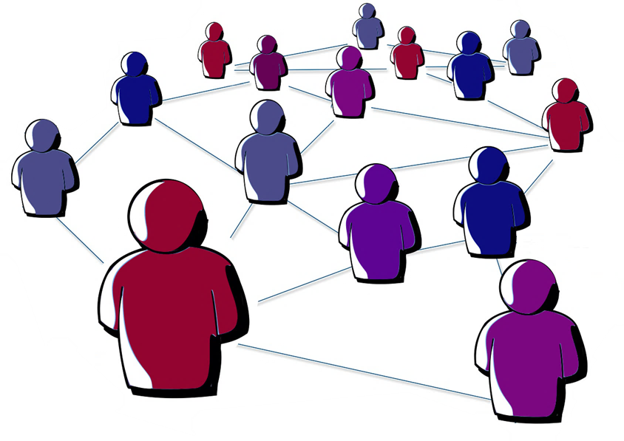











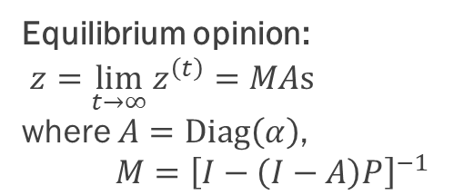



Opinion Dynamics Model
Our model originates from the work of DeGroot (1974) as well as Friedkin and Johnsen (1999)
Innate opinion vector $s$
Resistance vector $α$
Interaction matrix $P$
$$1$$
$$2$$
$$⋮$$
Agent
$$i$$
$$i$$
$$⋮$$
$$n$$
Initial expressed opinion: $z^{\left(0\right)}$
More stubborn
At time $t+1$:
$$s_{i}$$
$$z_{1}^{\left(t\right)}$$ | $$z_{2}^{\left(t\right)}$$ | $$⋯$$ | $$z_{i}^{\left(t\right)}$$ | $$⋯$$ | $$z_{n}^{\left(t\right)}$$
$$α_{i} : 1−α_{i}$$
Equilibrium opinion:
$z=\lim_{t→∞}{z^{\left(t\right)}}=MAs$ where $A=Diag\left(α\right)$, $M={\left[I−\left(I−A\right)P\right]}^{−1}$
$$z_{1}^{\left(t+1\right)}$$ | $$z_{2}^{\left(t+1\right)}$$ | $$⋯$$ | $$z_{i}^{\left(t+1\right)}$$ | $$⋯$$ | $$z_{n}^{\left(t+1\right)}$$

Slide 3
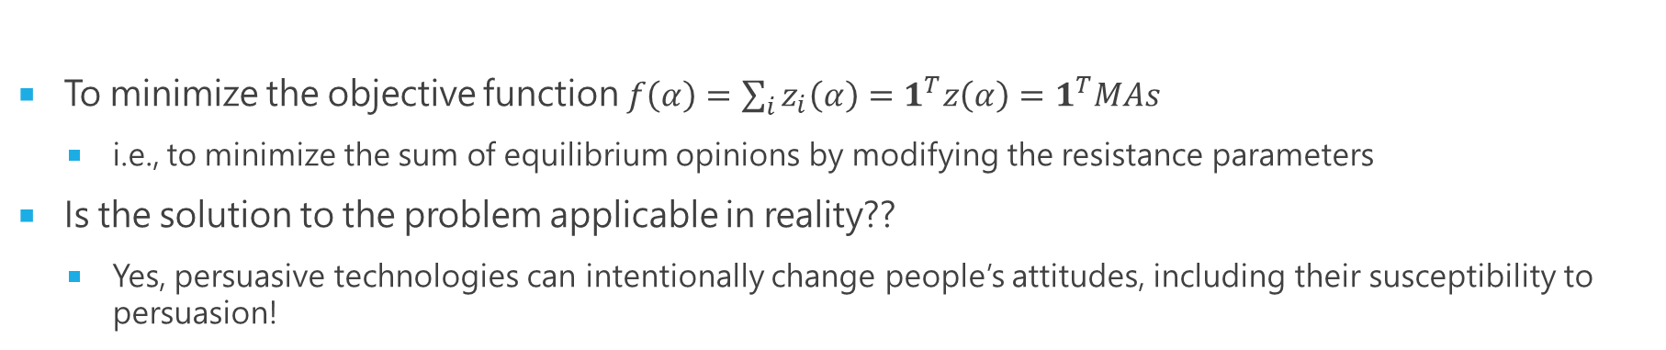













Opinion Susceptibility Problem
To minimize the objective function $f\left(α\right)=\sum_{i}{z_{i}\left(α\right)}=1^{T}z\left(α\right)=1^{T}MAs$
i.e., to minimize the sum of equilibrium opinions by modifying the resistance parameters
Is the solution to the problem applicable in reality??
Yes, persuasive technologies can intentionally change people’s attitudes, including their susceptibility to persuasion!
The trivial case: $α∈{\left[0,1\right]}^{N}$
Unbudgeted variant
$L_{0}$-budgeted variant
$L_{1}$-budgeted variant
Given initial resistance $\hat{α}$ and budget $k$,
Given initial resistance $\hat{α}$ and budget $k$,
Innate opinion$s_{i}$
1
2
$1$-norm ball
6
3
$$\hat{α}$$
$$k$$
5
4
# $≤k$
Feasible region of $α$
OPT: Set $α_{2}=1$, $α_{i}=0$ for $i≠2$
Feasible range of $α_{i}$
= Resistance adjusted

Slide 4
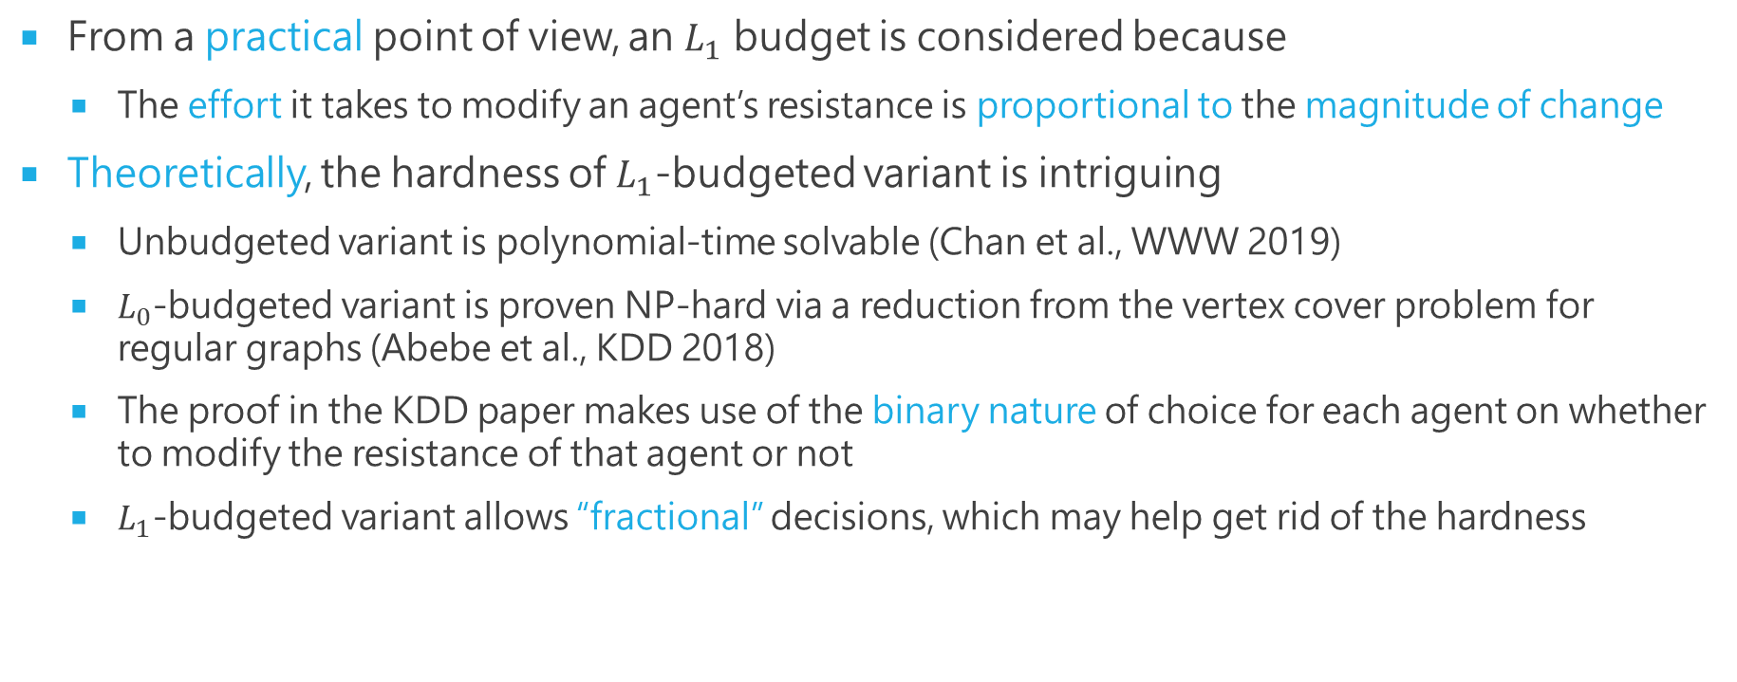
Motivation of the Study
From a practical point of view, an $L_{1}$ budget is considered because
The effort it takes to modify an agent’s resistance is proportional to the magnitude of change
Theoretically, the hardness of $L_{1}$-budgeted variant is intriguing
Unbudgeted variant is polynomial-time solvable (Chan et al., WWW 2019)
$L_{0}$-budgeted variant is proven NP-hard via a reduction from the vertex cover problem for regular graphs (Abebe et al., KDD 2018)
The proof in the KDD paper makes use of the binary nature of choice for each agent on whether to modify the resistance of that agent or not
$L_{1}$-budgeted variant allows “fractional” decisions, which may help get rid of the hardness

Slide 5
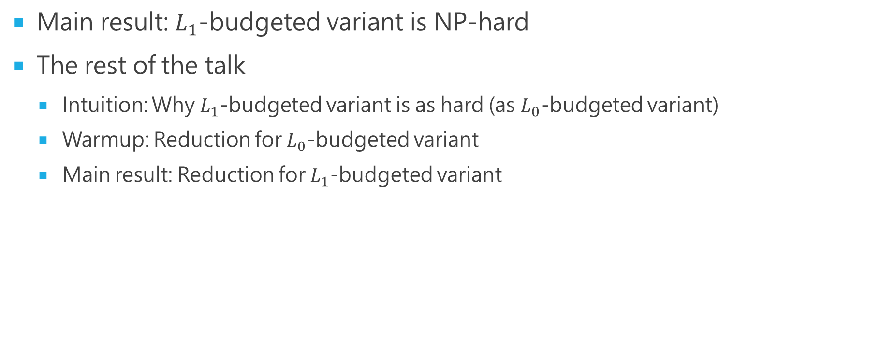
Outline
Main result: $L_{1}$-budgeted variant is NP-hard
The rest of the talk
Intuition: Why $L_{1}$-budgeted variant is as hard (as $L_{0}$-budgeted variant)
Warmup: Reduction for $L_{0}$-budgeted variant
Main result: Reduction for $L_{1}$-budgeted variant

Slide 6



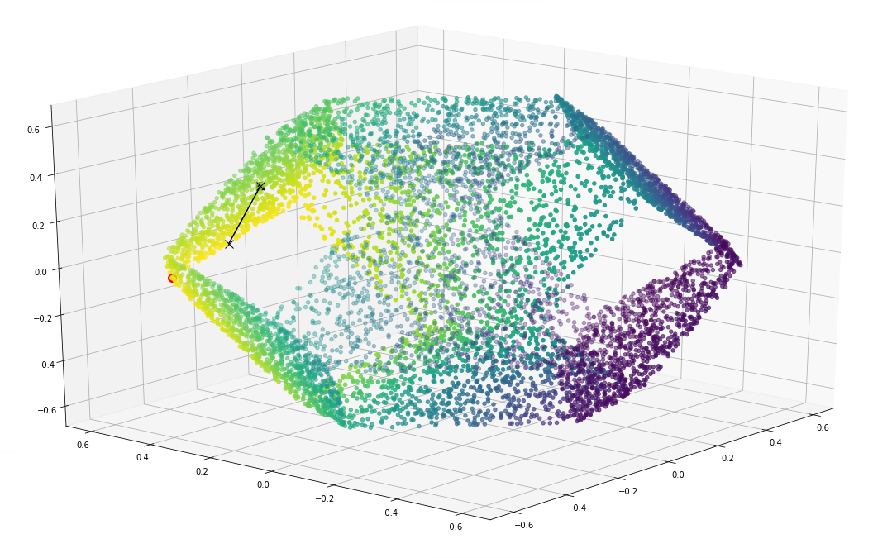
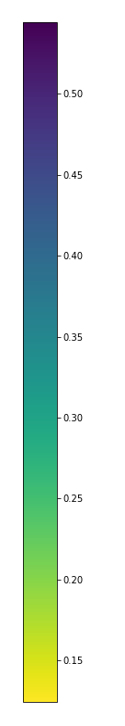
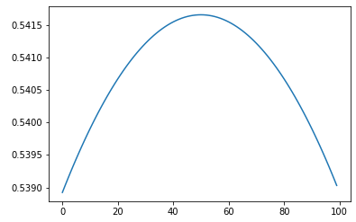




Intuition: Why $L_{1}$-budgeted variant is as hard
“Budget-focus effect”
Low innate opinions, accepting budgets
High innate opinion
To minimize the sum of equilibrium opinions,
All agents are well-connected
Example: a 3-agent model
Agent 1 has innate opinion 1
Agents 2 and 3 have innate opinions 0
All agents are well-connected (The interaction matrix is a clique)
$f\left(α\right)$
${\left(0.4,0.4,0.8\right)}^{T}$
${\left(0.4,0.6,0.6\right)}^{T}$
${\left(0.4,0.8,0.4\right)}^{T}$

Slide 7
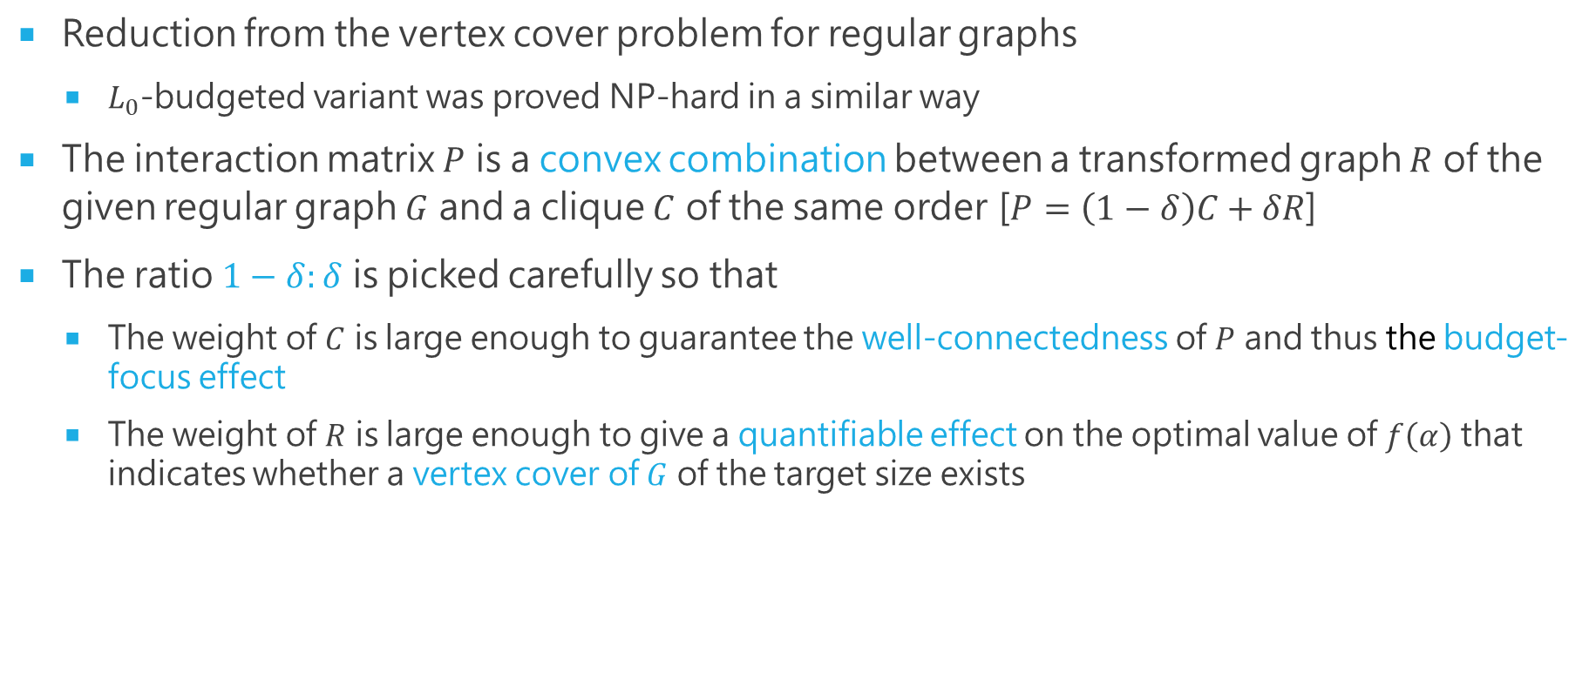
Proof Overview
Reduction from the vertex cover problem for regular graphs
$L_{0}$-budgeted variant was proved NP-hard in a similar way
The interaction matrix $P$ is a convex combination between a transformed graph $R$ of the given regular graph $G$ and a clique $C$ of the same order [$P=\left(1−δ\right)C+δR$]
The ratio $1−δ:δ$ is picked carefully so that
The weight of $C$ is large enough to guarantee the well-connectedness of $P$ and thus the budget-focus effect
The weight of $R$ is large enough to give a quantifiable effect on the optimal value of $f\left(α\right)$ that indicates whether a vertex cover of $G$ of the target size exists

Slide 8
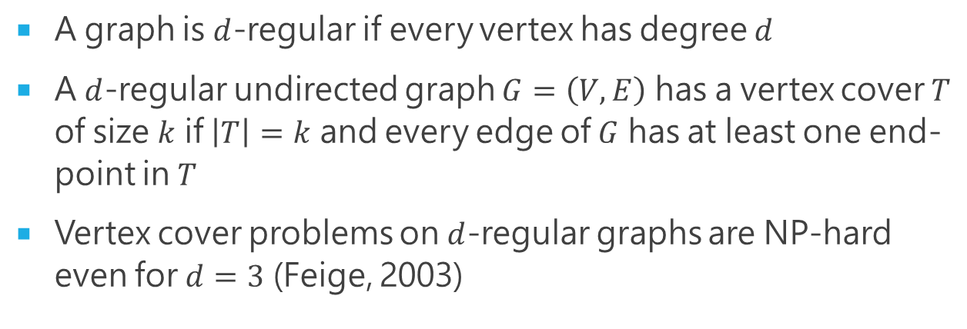

Vertex Cover Problem for Regular Graphs
A graph is $d$-regular if every vertex has degree $d$
A $d$-regular undirected graph $G=\left(V,E\right)$ has a vertex cover $T$ of size $k$ if $\left|T\right|=k$ and every edge of $G$ has at least one end-point in $T$
Vertex cover problems on $d$-regular graphs are NP-hard even for $d=3$ (Feige, 2003)
A $4$-regular graph

Slide 9


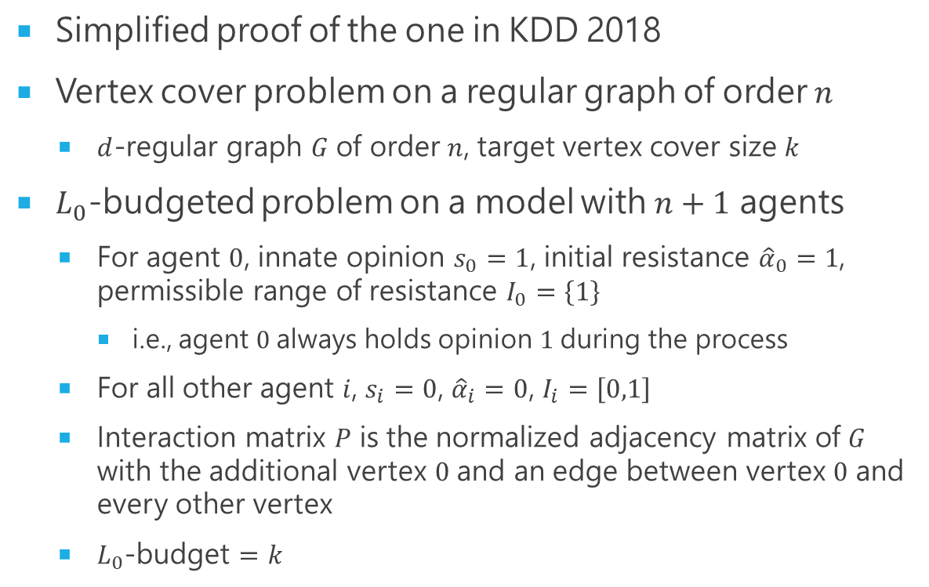
Warmup: Reduction for $L_{0}$-budgeted Variant
Simplified proof of the one in KDD 2018
Vertex cover problem on a regular graph of order $n$
$d$-regular graph $G$ of order $n$, target vertex cover size $k$
$L_{0}$-budgeted problem on a model with $n+1$ agents
For agent $0$, innate opinion $s_{0}=1$, initial resistance ${\hat{α}}_{0}=1$, permissible range of resistance $I_{0}=\left\{1\right\}$
i.e., agent $0$ always holds opinion $1$ during the process
For all other agent $i$, $s_{i}=0$, ${\hat{α}}_{i}=0$, $I_{i}=\left[0,1\right]$
Interaction matrix $P$ is the normalized adjacency matrix of $G$ with the additional vertex $0$ and an edge between vertex $0$ and every other vertex
$L_{0}$-budget $=k$
$G$, a $4$-regular graph
Agent 0
$$P=\left[ \begin{matrix}0 & 1/6 & 1/6 & 1/6 & 1/6 & 1/6 & 1/6 \\ 1/5 & 0 & 1/5 & 1/5 & 1/5 & 1/5 & 0 \\ 1/5 & 1/5 & 0 & 1/5 & 0 & 1/5 & 1/5 \\ 1/5 & 1/5 & 1/5 & 0 & 1/5 & 0 & 1/5 \\ 1/5 & 1/5 & 0 & 1/5 & 0 & 1/5 & 1/5 \\ 1/5 & 1/5 & 1/5 & 0 & 1/5 & 0 & 1/5 \\ 1/5 & 0 & 1/5 & 1/5 & 1/5 & 1/5 & 0\end{matrix} \right]$$

Slide 10

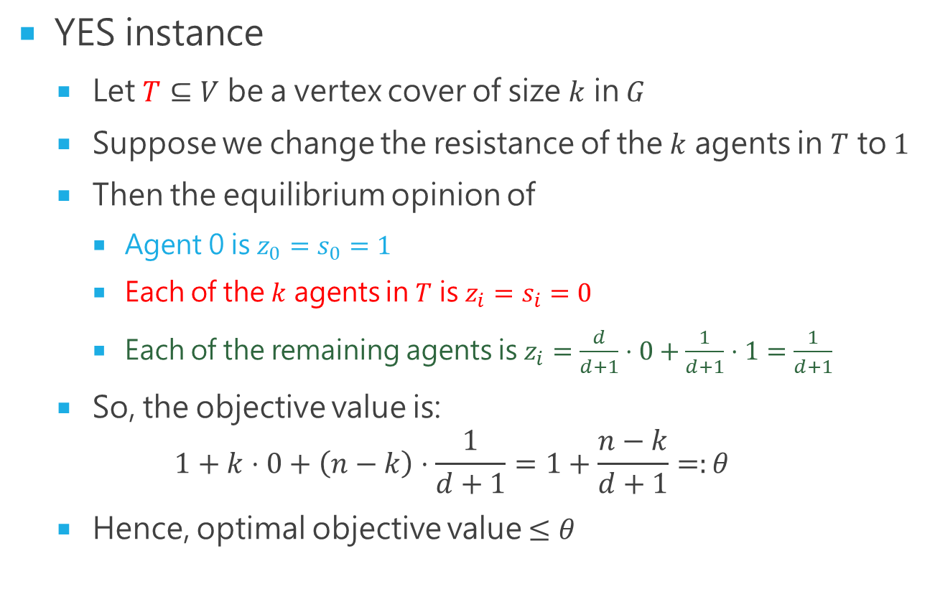
Warmup: Reduction for $L_{0}$-budgeted Variant
YES instance
Let $T⊆V$ be a vertex cover of size $k$ in $G$
Suppose we change the resistance of the $k$ agents in $T$ to $1$
Then the equilibrium opinion of
Agent 0 is $z_{0}=s_{0}=1$
Each of the $k$ agents in $T$ is $z_{i}=s_{i}=0$
Each of the remaining agents is $z_{i}=\frac{d}{d+1}⋅0+\frac{1}{d+1}⋅1=\frac{1}{d+1}$
So, the objective value is: $1+k⋅0+\left(n−k\right)⋅\frac{1}{d+1}=1+\frac{n−k}{d+1}=:θ$
Hence, optimal objective value $≤θ$
Agent 0
$$k=4$$

Slide 11



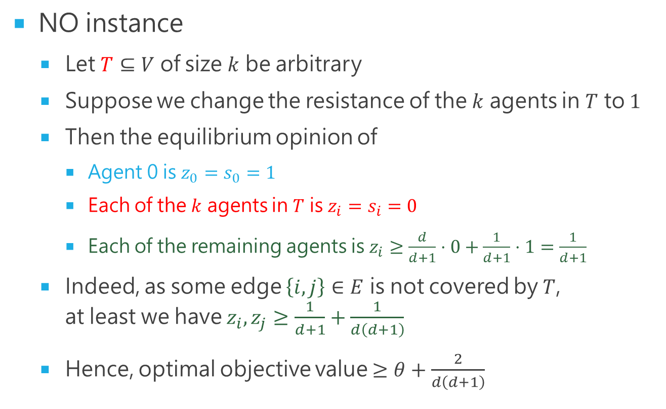
Warmup: Reduction for $L_{0}$-budgeted Variant
NO instance
Let $T⊆V$ of size $k$ be arbitrary
Suppose we change the resistance of the $k$ agents in $T$ to $1$
Then the equilibrium opinion of
Agent 0 is $z_{0}=s_{0}=1$
Each of the $k$ agents in $T$ is $z_{i}=s_{i}=0$
Each of the remaining agents is $z_{i}≥\frac{d}{d+1}⋅0+\frac{1}{d+1}⋅1=\frac{1}{d+1}$
Indeed, as some edge $\left\{i,j\right\}∈E$ is not covered by $T$, at least we have $z_{i},z_{j}≥\frac{1}{d+1}+\frac{1}{d\left(d+1\right)}$
Hence, optimal objective value $≥θ+\frac{2}{d\left(d+1\right)}$
Agent 0
$$i$$
$$j$$
$$k=3$$

Slide 12


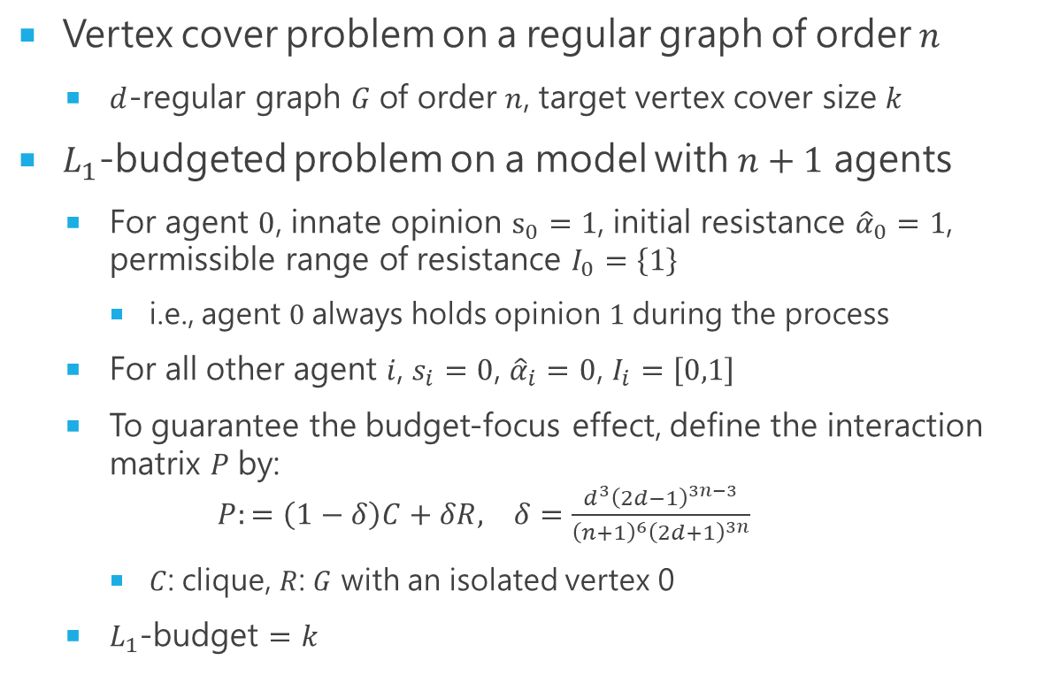
Main Result: Reduction for $L_{1}$-budgeted Variant
Vertex cover problem on a regular graph of order $n$
$d$-regular graph $G$ of order $n$, target vertex cover size $k$
$L_{1}$-budgeted problem on a model with $n+1$ agents
For agent $0$, innate opinion $s_{0}=1$, initial resistance ${\hat{α}}_{0}=1$, permissible range of resistance $I_{0}=\left\{1\right\}$
i.e., agent $0$ always holds opinion $1$ during the process
For all other agent $i$, $s_{i}=0$, ${\hat{α}}_{i}=0$, $I_{i}=\left[0,1\right]$
To guarantee the budget-focus effect, define the interaction matrix $P$ by: $P:=\left(1−δ\right)C+δR, δ=\frac{d^{3}{\left(2d−1\right)}^{3n−3}}{{\left(n+1\right)}^{6}{\left(2d+1\right)}^{3n}}$
$C$: clique, $R$: $G$ with an isolated vertex 0
$L_{1}$-budget $=k$
$G$, a $4$-regular graph
Agent 0
$$C$$
$$R$$

Slide 13
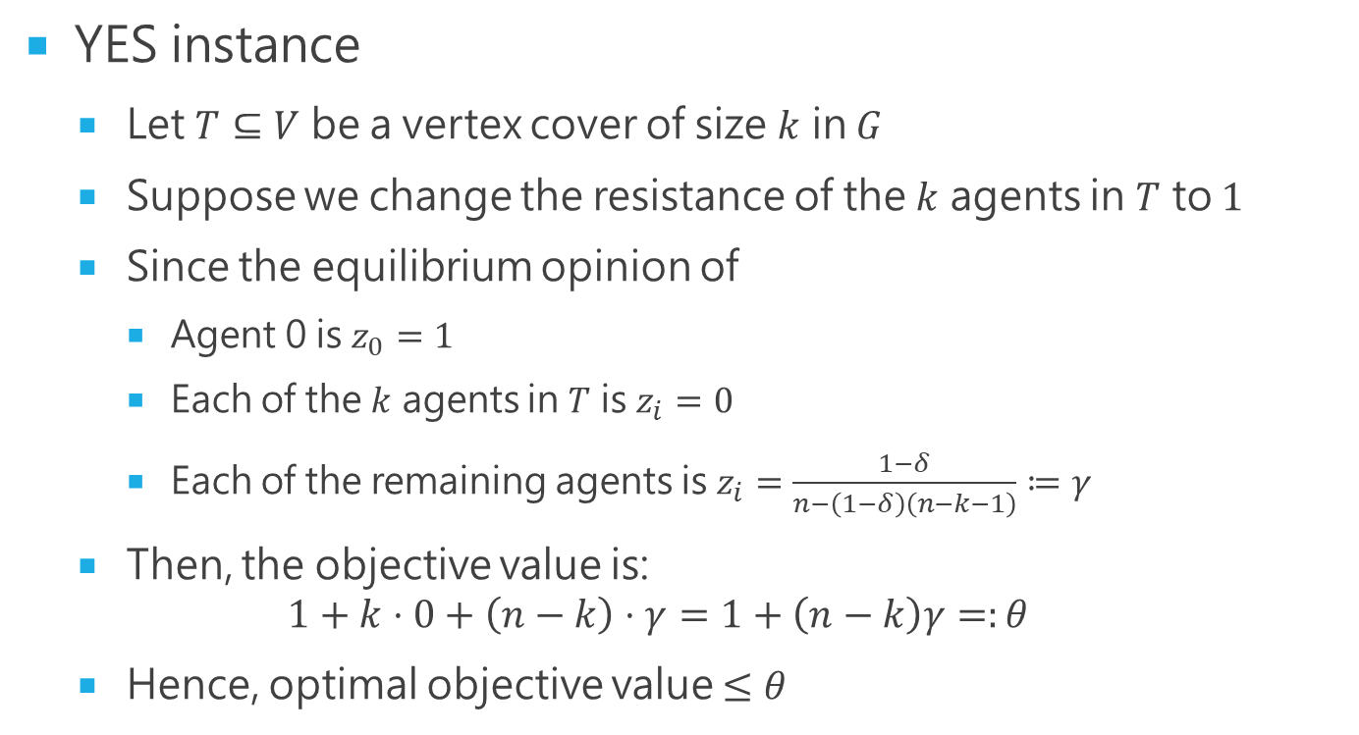
Main Result: Reduction for $L_{1}$-budgeted Variant
YES instance
Let $T⊆V$ be a vertex cover of size $k$ in $G$
Suppose we change the resistance of the $k$ agents in $T$ to $1$
Since the equilibrium opinion of
Agent 0 is $z_{0}=1$
Each of the $k$ agents in $T$ is $z_{i}=0$
Each of the remaining agents is $z_{i}=\frac{1−δ}{n−\left(1−δ\right)\left(n−k−1\right)}≔γ$
Then, the objective value is: $1+k⋅0+\left(n−k\right)⋅γ=1+\left(n−k\right)γ=:θ$
Hence, optimal objective value $≤θ$

Slide 14
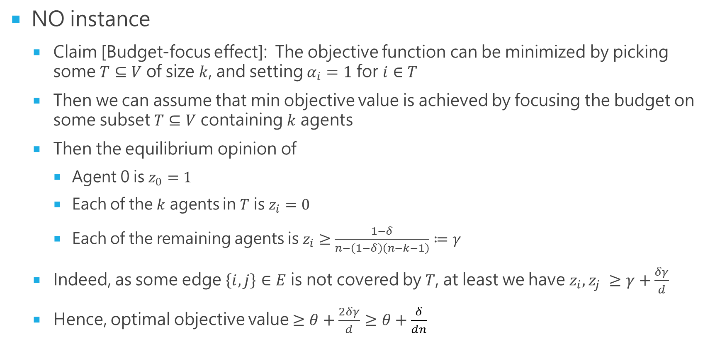
Main Result: Reduction for $L_{1}$-budgeted Variant
NO instance
Claim [Budget-focus effect]: The objective function can be minimized by picking some $T⊆V$ of size $k$, and setting $α_{i}=1$ for $i∈T$
Then we can assume that min objective value is achieved by focusing the budget on some subset $T⊆V$ containing $k$ agents
Then the equilibrium opinion of
Agent 0 is $z_{0}=1$
Each of the $k$ agents in $T$ is $z_{i}=0$
Each of the remaining agents is $z_{i}≥\frac{1−δ}{n−\left(1−δ\right)\left(n−k−1\right)}≔γ$
Indeed, as some edge $\left\{i,j\right\}∈E$ is not covered by $T$, at least we have $z_{i},z_{j} ≥γ+\frac{δγ}{d}$
Hence, optimal objective value $≥θ+\frac{2δγ}{d}≥θ+\frac{δ}{dn}$

Slide 15


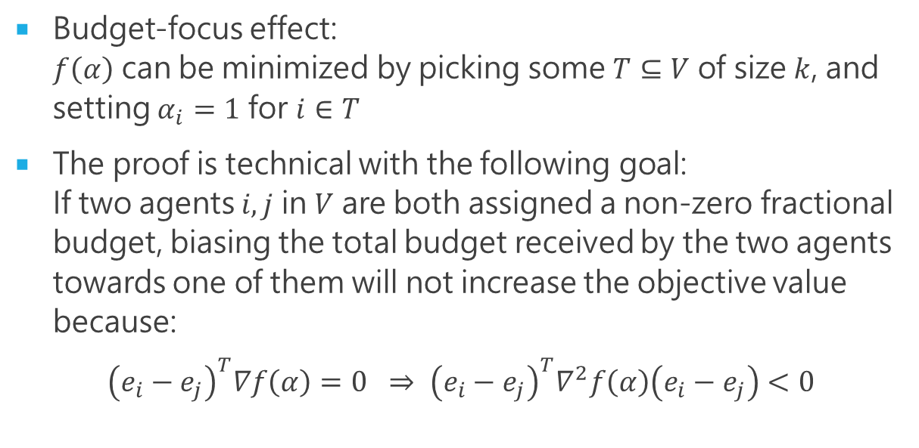



Main Result: Proving the Claim
Budget-focus effect: $f\left(α\right)$ can be minimized by picking some $T⊆V$ of size $k$, and setting $α_{i}=1$ for $i∈T$
The proof is technical with the following goal: If two agents $i,j$ in $V$ are both assigned a non-zero fractional budget, biasing the total budget received by the two agents towards one of them will not increase the objective value because:
$${\left(e_{i}−e_{j}\right)}^{T}∇f\left(α\right)=0 ⇒ {\left(e_{i}−e_{j}\right)}^{T}∇^{2}f\left(α\right)\left(e_{i}−e_{j}\right)<0$$
$f\left(α\right)$
${\left(0.4,0.4,0.8\right)}^{T}$
${\left(0.4,0.6,0.6\right)}^{T}$
${\left(0.4,0.8,0.4\right)}^{T}$

Slide 16
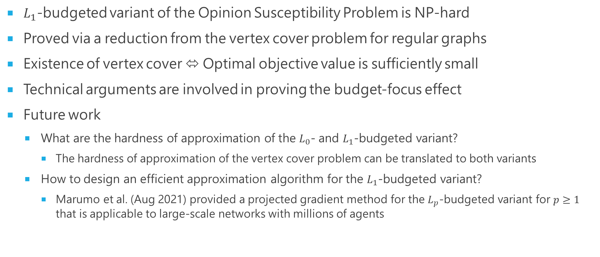
Conclusion
$L_{1}$-budgeted variant of the Opinion Susceptibility Problem is NP-hard
Proved via a reduction from the vertex cover problem for regular graphs
Existence of vertex cover ⬄ Optimal objective value is sufficiently small
Technical arguments are involved in proving the budget-focus effect
Future work
What are the hardness of approximation of the $L_{0}$- and $L_{1}$-budgeted variant?
The hardness of approximation of the vertex cover problem can be translated to both variants
How to design an efficient approximation algorithm for the $L_{1}$-budgeted variant?
Marumo et al. (Aug 2021) provided a projected gradient method for the $L_{p}$-budgeted variant for $p≥1$ that is applicable to large-scale networks with millions of agents

Slide 17
REFERENCES
Abebe, R., Kleinberg, J.M., Parkes, D.C., Tsourakakis, C.E.: Opinion dynamics with varying susceptibility to persuasion. In: KDD. pp. 1089–1098. ACM (2018). https://doi.org/10.1145/3219819.3219983
Alfa, A., Xue, J., Ye, Q.: Entrywise perturbation theory for diagonally dominant M-matrices with applications. Numerische Mathematik 90, 401–414 (2002). https://doi.org/10.1007/s002110100289
Chan, T.H., Liang, Z., Sozio, M.: Revisiting opinion dynamics with varying susceptibility to persuasion via non-convex local search. In: WWW. pp. 173–183. ACM (2019). https://doi.org/10.1145/3308558.3313509
DeGroot, M.H.: Reaching a consensus. Journal of the American Statistical Association 69(345), 118–121 (1974), http://www.jstor.org/stable/2285509
Feige, U.: Vertex cover is hardest to approximate on regular graphs. Manuscript (2003)
Friedkin, N.E., Johnsen, E.C.: Social inﬂuence networks and opinion change. Advances in Group Processes 16, 1–19 (1999)

Slide 18
Thank you!

