Slide 1
Superscalar
Dongming Liu, Elijah Ye, Tracy Miao

Slide 2
Overview
CP1: RV32I ISA and basic pipelining
CP2: L1 caches + hazards and static branch prediction
CP3: Advanced Design Options
M Extension (Dadda Tree)
Cache System Overview + L2 Cache
Next Line Prefetcher (Sad story QAQ)
Fully Parameterized Cache
CP4: Design Competition
Trade-offs

Slide 3
M Extension
Advance Multiplier (Dadda Tree)
Simple Divider (Shift-Subtract)

Slide 4
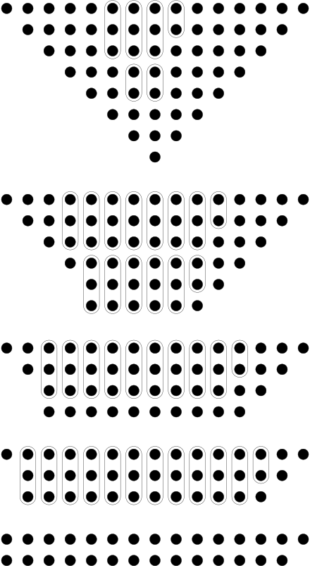
Multiplier (Dadda Tree)
The algorithm from Wikipedia
For each stage from … to 1, reduce each column start at the lowest weight column c_0 according to the following rules:
If height of c_i <= d_j , not reduction, move to c_(i+1)
If height of c_i <= d_j , add the top two elements in a half-adder, placing the result at the bottom of the column and the carry at the bottom of column c_(i+1), then move to column c_(i+1)
Else, add the top three elements in a full-adder, placing the result at the bottom of the column and the carry at the bottom of column c_(i+1), restart step 1
It produces two rows of bits at the end
The result of the multiplication is the sum of the two rows of bits
Note:
j is the stage index, i is the column index
d_j is defined by: d_1 = 2, d_(j+1) = floor( 1.5 * d_j )
The initial value of j is chosen as the largest value such that d_j < min(n_1, n_2) where n_1 and n_2 are the number of bits in the input multiplicand and multiplier.
d_1 = 2, d_2 = 3, d_3 = 4 , d_4 = 6, d_5 = 9, d_6 = 13 …
(8x8) Dadda Tree diagram from Wikipedia
Notes:
We use a python script to generate the entire dadda tree.
The classic multiplication would be the grade school multiplication. The long multiplication that everyone know.
After multiplying each row, you will just add those things up to get to your final result. This process can somehow be done in parallel.
And here is the idea which dadda propose, is to reduce the parallel adds into different stages.

Slide 5
Simple Divider (Shift-Subtract)
We implement a simple long division divider
The pseudo-code from Wikipedia
if D = 0 then error(DivisionByZeroException) end
Q := 0 -- Initialize quotient and remainder to zero
R := 0
-- Where n is number of bits in N
for i := n − 1 .. 0 do
R := R << 1 -- Left-shift R by 1 bit
R(0) := N(i) -- Set the least-significant bit of R equal to bit i of the numerator
if R ≥ D then
R := R − D
Q(i) := 1
end
end
 | next_data | divisor | Result (quotient) | data
start | 00000000 01001110 | 00100010 |  | 00000000 01001110
shift | 00000000 10011100 |  | 00000000(0) | 00000000 10011100
shift | 00000001 00111000 |  | 00000001(0) | 00000001 00111000
shift | 00000010 01110000 |  | 00000010(0) | 00000010 01110000
shift | 00000100 11100000 |  | 00000100(0) | 00000100 11100000
shift | 00001001 11000000 |  | 00001001(0) | 00001001 11000000
shift | 00010011 10000000 |  | 00010011(0) | 00010011 10000000
shift | 00100111 00000000 |  | 00000101(1) | 00100111 00000000
shift | 00000101 00000001 |  | 00001010(0) | 00001010 00000010
8-bit division example of 78 divided 34, the quotient = 2 (data lower half),
Remainder = 10 (data upper half)
Notes:
Pseudo Code from Wikipedia (https://en.wikipedia.org/wiki/Division_algorithm)
Long division
if D = 0 then error(DivisionByZeroException) end
Q := 0 -- Initialize quotient and remainder to zero
R := 0
for i := n − 1 .. 0 do -- Where n is number of bits in N
R := R << 1 -- Left-shift R by 1 bit
R(0) := N(i) -- Set the least-significant bit of R equal to bit i of the numerator
if R ≥ D then
R := R − D
Q(i) := 1
end
End To lazy, put it in Chinese 将被除数扩展成16位的数据，低8位为被除数的值，高八位的值全为0。开始时，被除数扩展成16位数据传给data，然后运算。对比data的高八位和除数，如果除数 < 高8位，此时商置1，赋值给data的最低位，然后将data高8位减去除数。最后将data向左移位一位，准备下一次比较。计算8次后。Data的高8位数据就为余数，低八位就为商。
For English speaker…
Extend the dividend to 16 bits. The lower 8 bits will be the dividend and upper 8 bit will be 0 at the beginning.
At start stage, the dividend is 0 extended to 16 bits and loaded into data. Then the operation begins. Compare the upper 8 bits with the divisor, if divisor < upper 8 bits, set current quotient to be 1 and assign it to the LSB of data. Then, subtract the divisor from the upper 8 bits and left shift data once to prepare for next comparison. If divisor > upper 8 bits, set current quotient to be 0 and assign it to the LSB of data. Then, only left shift the data once. After 8 iteration, the top 8 bits will be our remainder of the division, and the lower 8 bits will be our quotient of the division.

Slide 6
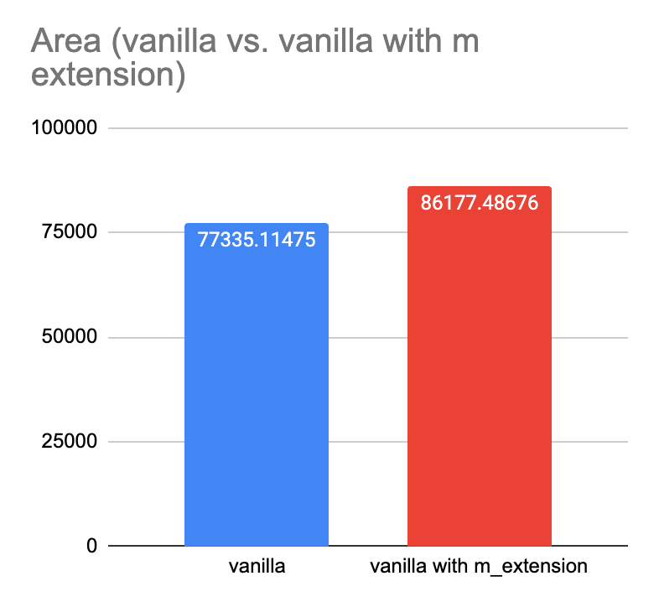
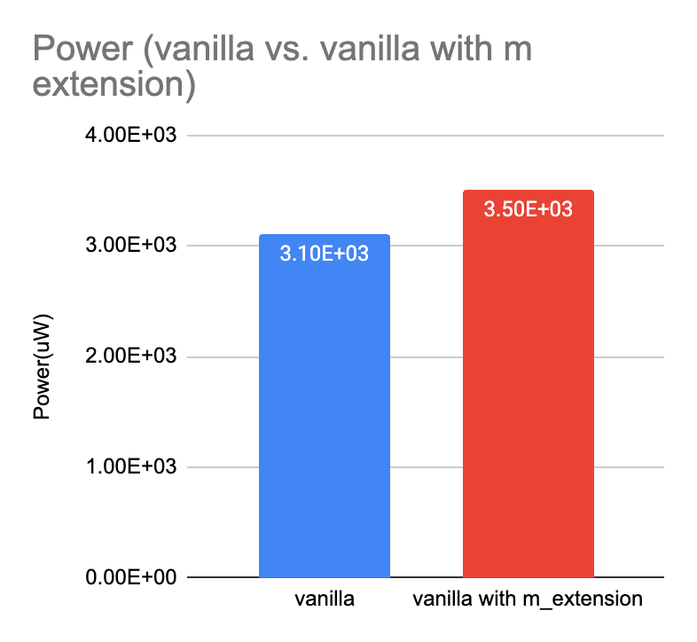
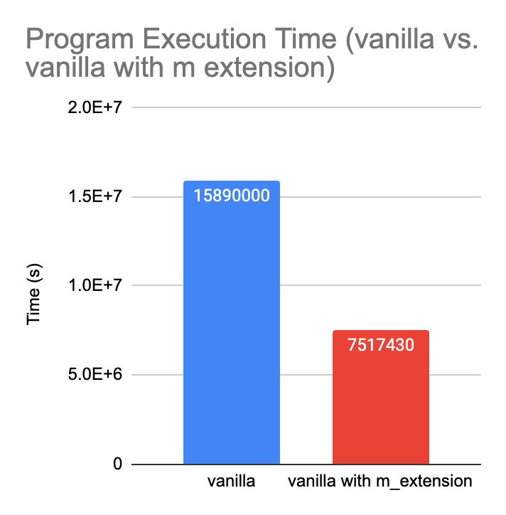
Performance with M Extension
Testing with a clock period of 10000 ps

Slide 7
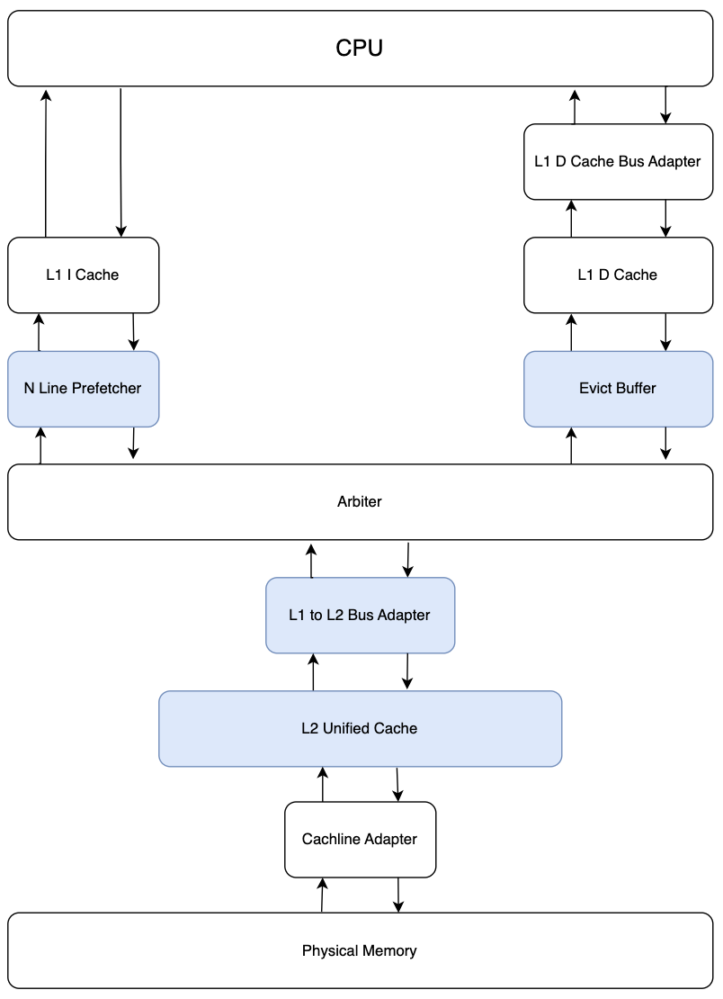
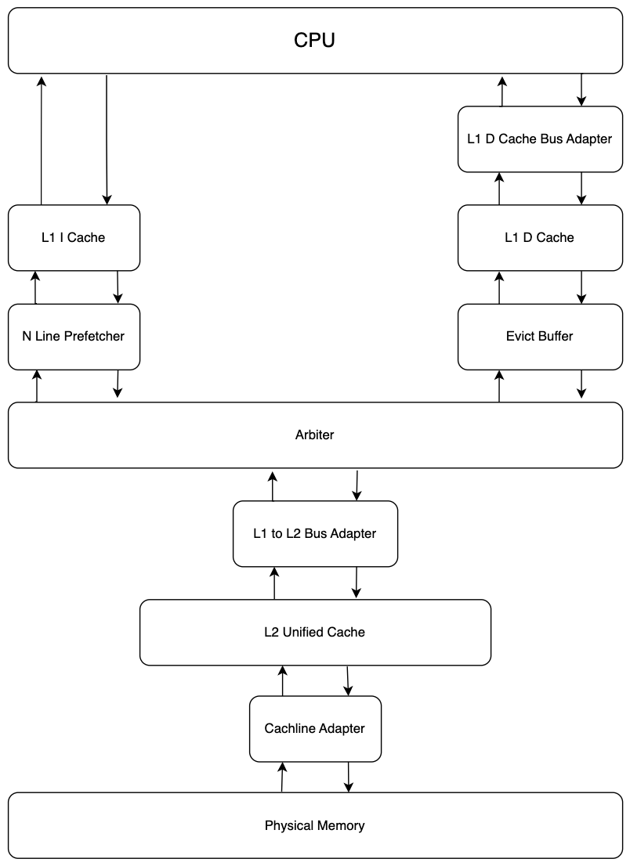
Cache System Overview
Things we do differently…

Slide 8
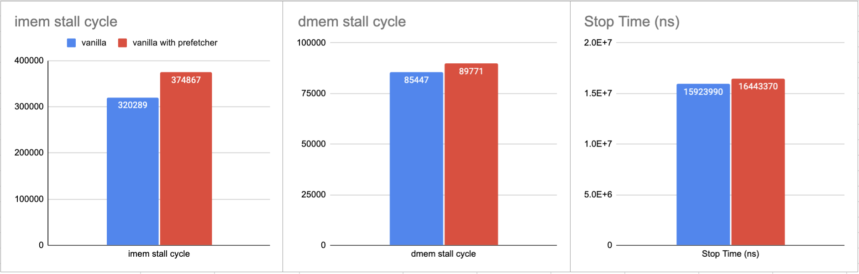
Performance with Next Line Prefetcher

Slide 9
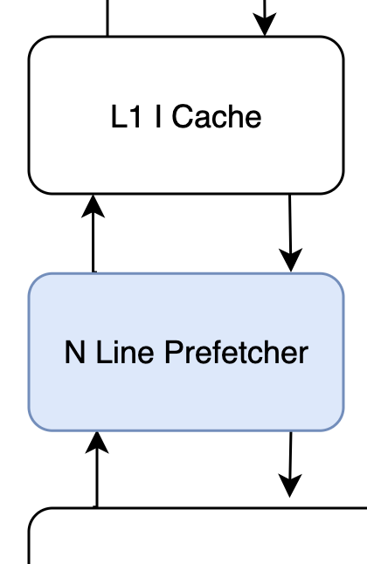
Understanding the Stats
Worse in all performance counter
Shared data bandwidth
Things to do differently
Utilizing idle state correctly in arbiter
Notes:
From the previous slide, we have seen that this bad prefetcher is worse in all performance counters.
That’s why both stall time increased.
Actually, the number of instruction cache misses stays the same.
The reason is because this prefetcher is sharing data bus bandwidth.
We can improve this by moving prefetcher into arbiter. Arbiter is only triggered when there’s a miss from L1 cache.
When L1 cache not miss, arbiter will be in idle state, then at that time, we can prefetch the next line of instruction into a buffer that sits in arbiter.

Slide 10
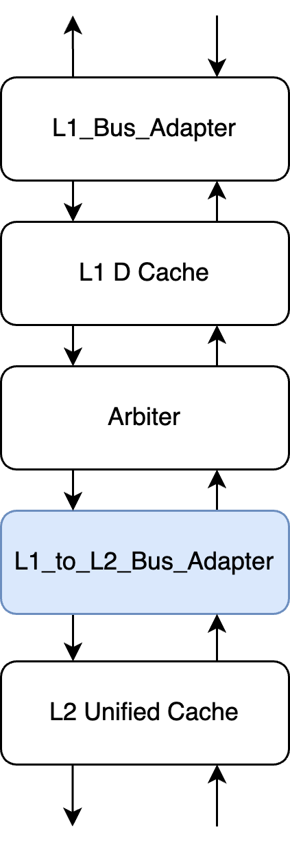
Fully Parameterized Cache
Parameterizing number of sets is easy!
But how we parameterized our cacheline size?
– not only change the data width of corresponding components
– add one more bus adapter between Arbiter and L2 Cache
– in order to meet the area constraint & keep our L2 Cache
Notes:
Here is the parameterized cache part, which helped us a lot especially on tuning the parameters to meet the constraints for the competition. Parameterizing the number of cache sets is easy, so we can begin with the cacheline size. At the very beginning, we actually did not plan to parameterize the cacheline size, but when it came to CP4, we found that if we wanted to keep our unified L2 cache, we had to reduce the cachelinesize. Here is how we parameterize it

Slide 11
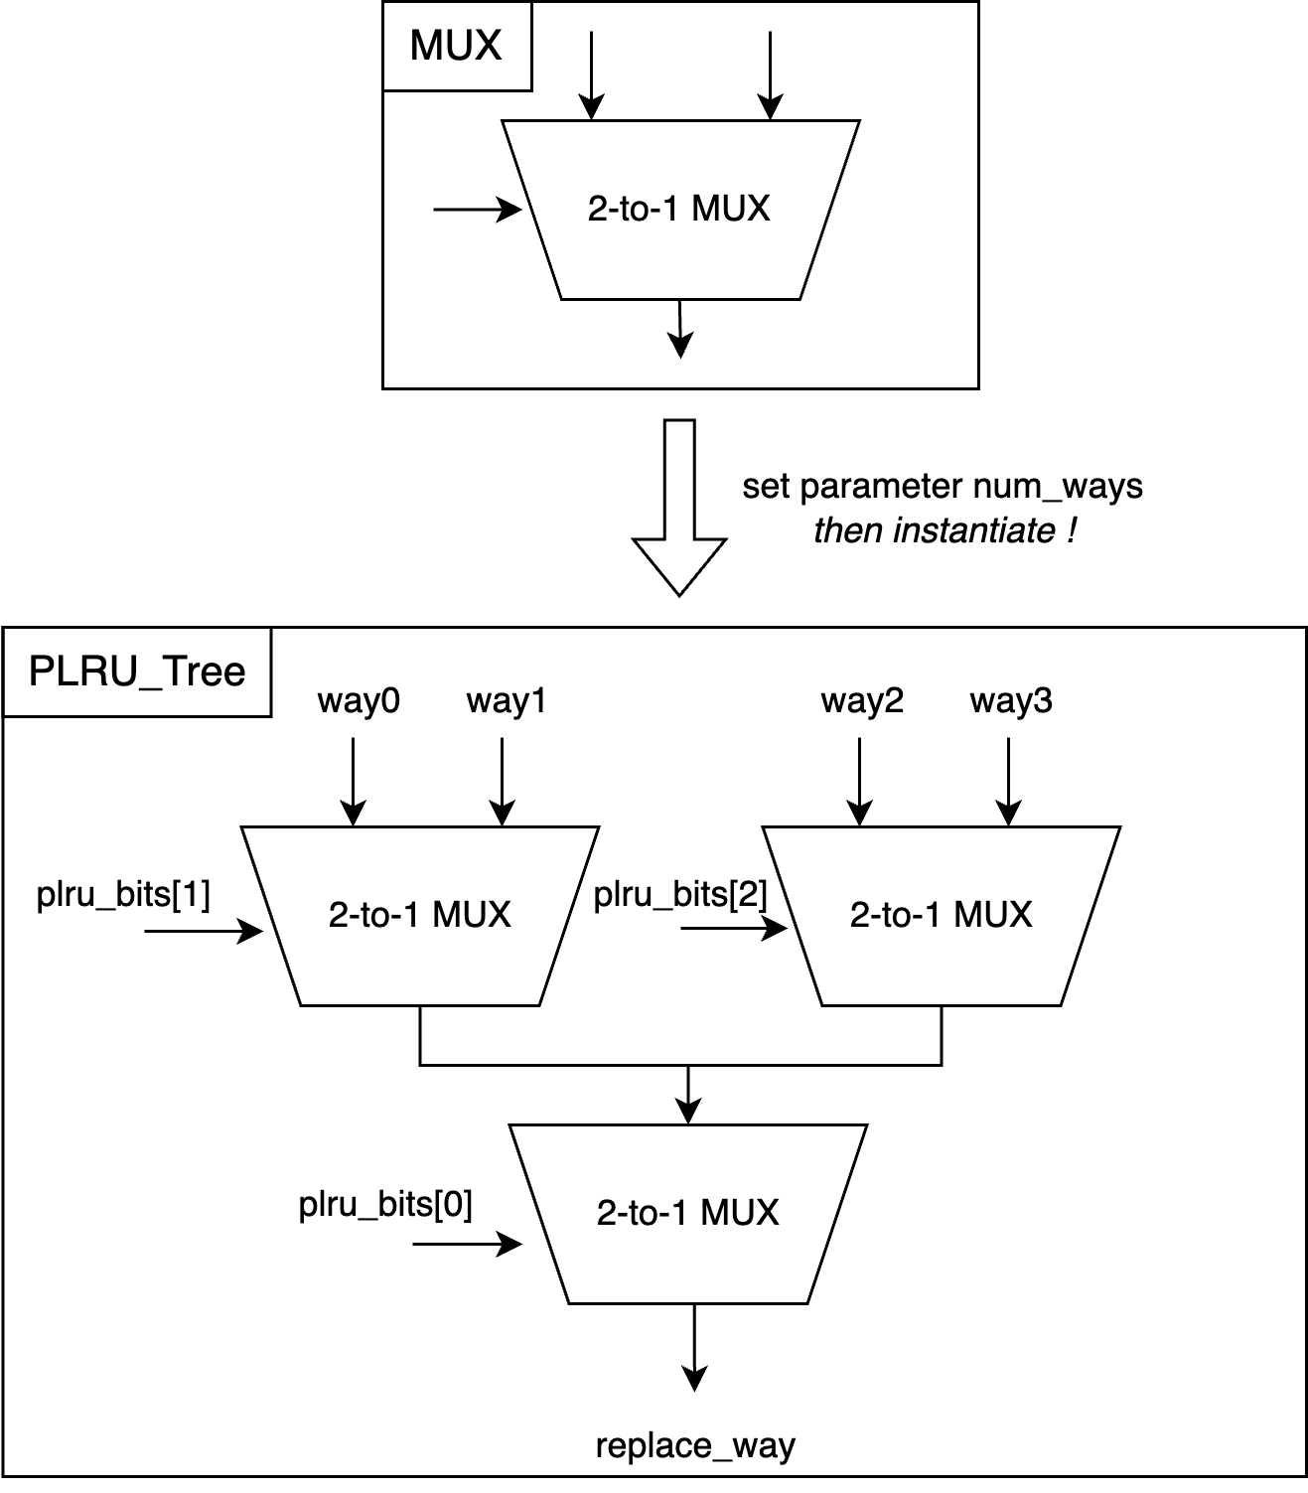
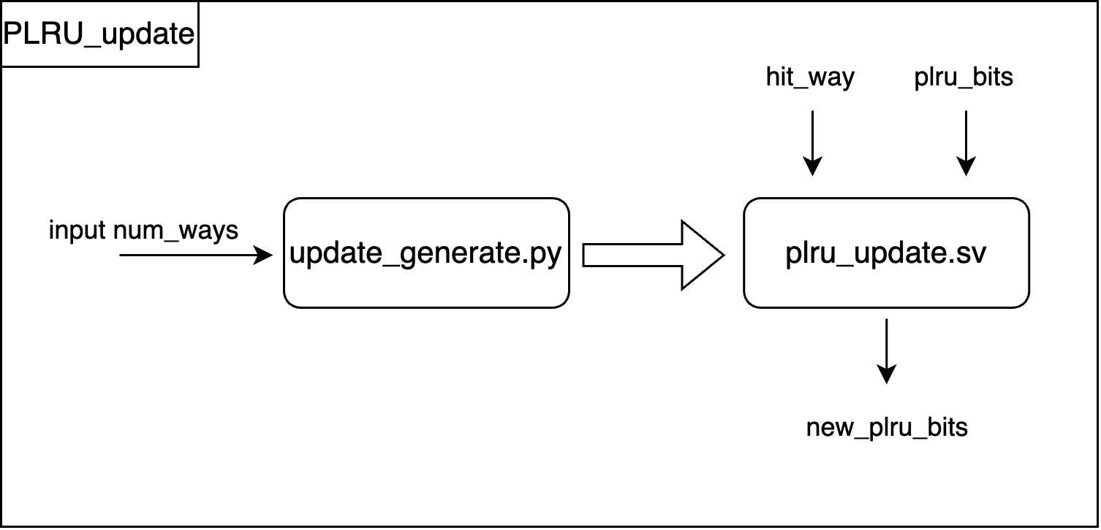
Fully Parameterized Cache
How we parameterize PLRU?
– use python to generate PRLU bits update logic for different ways
– instantiate MUXes to build PLRU tree
Notes:
The second step is parameterizing the number of ways, the tricky part is how to parameterize the PLRU because different num of ways has different configuration of plru tree as well as the plru update logic. So, in order to do it as automatically as possible, we use a python script which can generate a sv module that is able to create the update logic according to different ways like graph on the left, . ….And we also have a sv module that can instantiate some number of 2-to-1 muxes according to how we set the parameter num_ways, and the input to this module is plru_bits updated by the left module here. on the right, is an example of how we generate the 4 way plru tree, as we can see, we instantiate 3 muxes here, and input the plru bits to get the output , which is the corresponding replace_way.
Tree Array Data Structures:
3 level tree for example,
[0,1,2,3,4,5,6]
00 ------------- | -------------
/ \ 1 2 / \ / \ 3 4 5 6

Slide 12
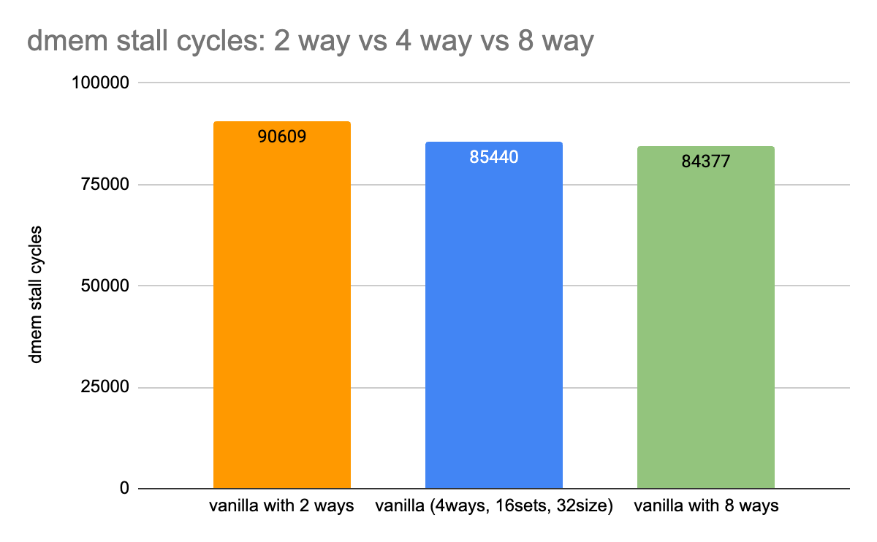
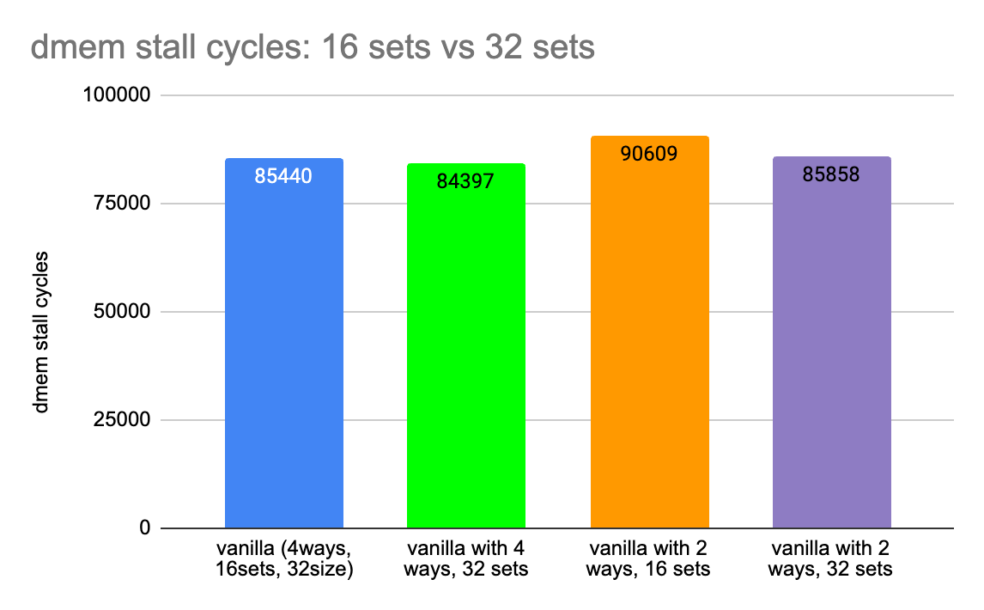
Performance with Parameterized Cache
Notes:
Here is the performance with different cache parameters, like different ways and different num of sets. We observe that larger cache size reduces the dmem stall cycles and also reduce the cache miss counts. But larger cache costs more areas.

Slide 13
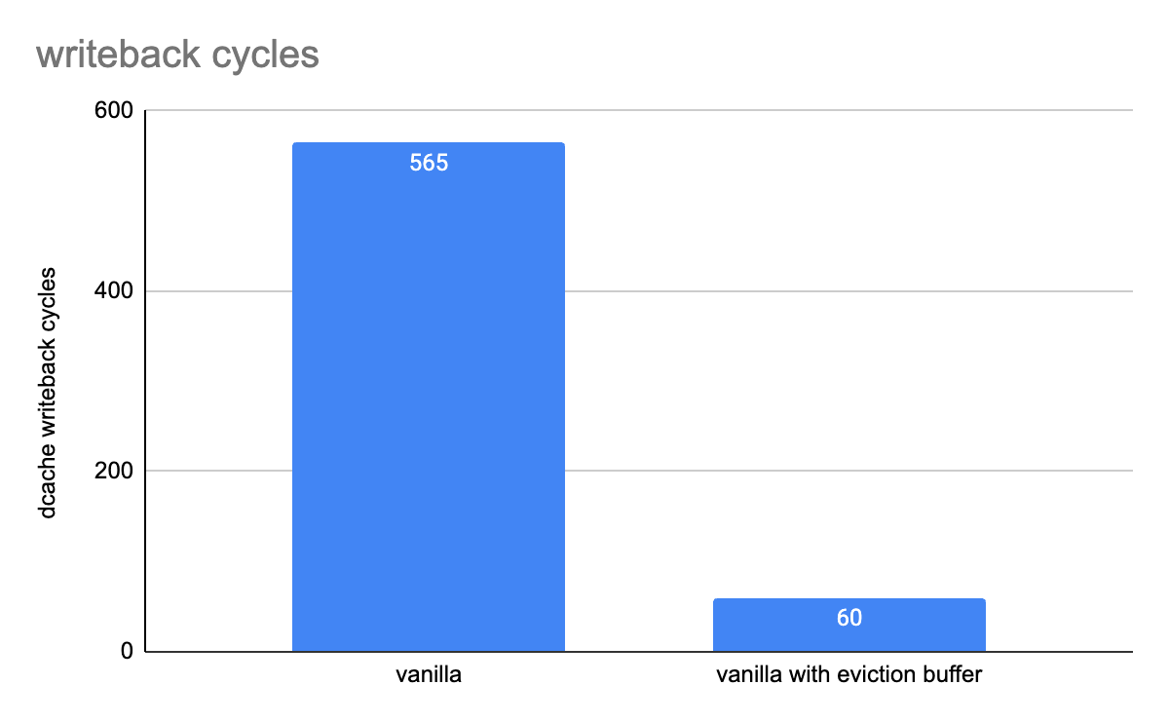
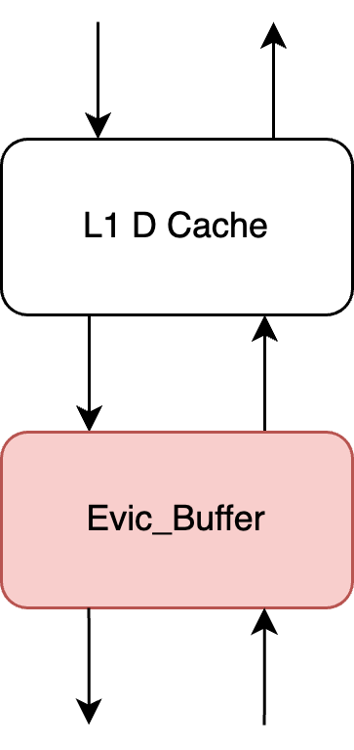
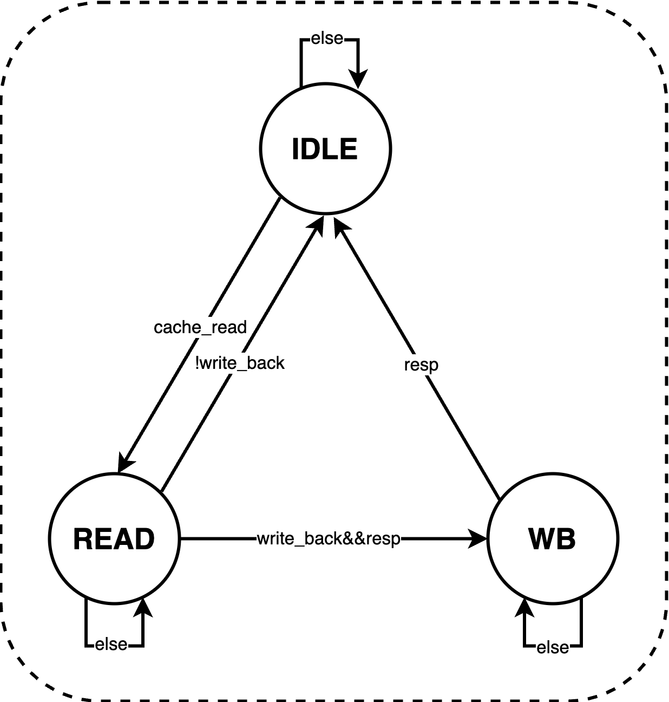
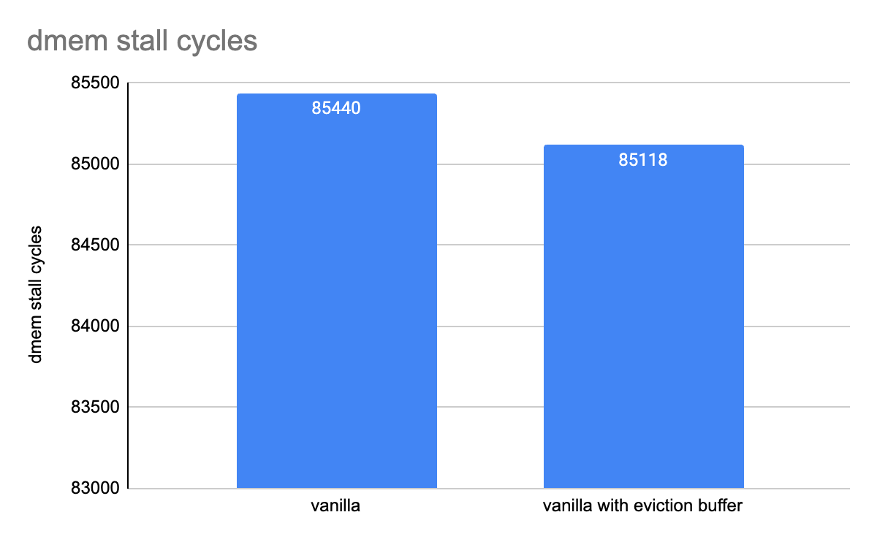
Eviction Buffer
Do the write back at background
Save D Cache write back cycles
Notes:
In addition, we also make a simple eviction buffer for the CP3 consists of three states, namely idle, read and writeback. And this buffer is placed between the L1 D cache and the arbiter. The main function of it is basically do the write back at background so that we can save some d cache writeback cycles. On the right side is how much time it can save in terms of the writeback cycles. Compared with baseline, we can see it really save most of the writeback cycles, but on the other hand, it adds one more component on the path from cpu to memory, so it can add some additional access time for memory operations due to the longer path and also affect the frequency a little bit. But in all, it still does some positive effect if we keep frequency the same.

Slide 14

Trade off: Overview
Reason
Optimization
Area
Max Frequency
Notes:
The first reason is obvious, we have the strict area constraint which is 75,000
The first version of our CPU is around 77,000 without any advance features
After adding all the advance features, our design area even reached 130,000. It was almost doubling the area constraint
In order to optimize the area, we mainly focused on our cache, and some simplification of our M extension
In order to optimize the Max Frequency, we simplified our critical path through truncting our M extension and removing eviction buffer.

Slide 15
Trade-off 1: Area
Number of ways
4 way L1 Data Cache to 1 way
4 way L2 Unified Cache to 2 way
Cacheline size
L2 to L1 Bus Adaptor
Change L1 cacheline size from 256 bits to 128 bits
M extension
Only preserved MUL and DIVU

Slide 16
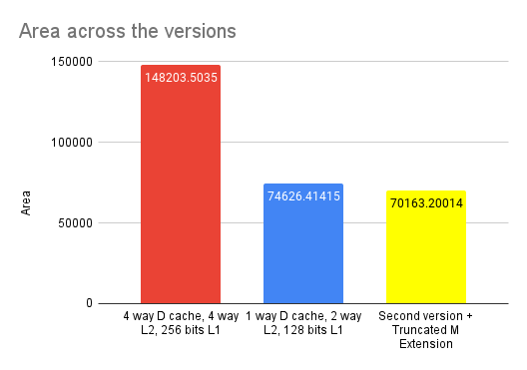
Stats on Area Differences
Area fluctuates as we change the clock period
The second one might be over 75,000 in some clock period

Slide 17
Trade-off 2: Pushing to the highest frequency
Truncting M Extension
Only with MUL and DIVU left
Pushed Max Frequency from 540 MHz to 714 MHz
Removing Eviction Buffer
Though at the same frequency, it is better that we have Eviction Buffer. However, Eviction Buffer also limited our Max Frequency
Once we removed it, we were able to push our Max Frequency from 714 MHz to 740 MHz, and thus, having a higher PD^2 and PD^3 which landed us at 3rd place

