Slide 1

Public Sentiment Analysis on USAID After Trump’s Withdrawal
Group 6

Slide 2


Slide 3

Introduction
Social media platforms like Reddit and Twitter provide real-time public opinions on political and international affairs.
USAID (United States Agency for International Development) has been a topic of discussion, especially after Trump’s withdrawal from key funding programs.
This project aims to analyze public sentiment on USAID using social media data, focusing on Reddit.

Slide 4

Problem Statement
Traditional media often lacks real-time insights into public sentiment.
Existing studies on USAID do not extensively analyze public opinion using social media data.
Limited access to Twitter data due to API restrictions necessitates alternative sources.
There is a need for an automated system to track, analyze, and visualize sentiment trends.

Slide 5

Objectives
Analyze public sentiment on USAID after Trump’s withdrawal.
Extract key discussion themes from Reddit posts.
Compare sentiment across platforms (if other data sources are added later).
Build a chatbot for interactive sentiment queries.

Slide 6

Methodology
Data Collection
Web scraping Reddit for posts related to USAID.
Filtering by keywords (e.g., "USAID Trump withdrawal").
Storing data with columns: Post ID, Title, Text, Author, Subreddit, Score, Upvote Ratio, Comments, Created At, Timestamp, URL.

Slide 7

Data Processing & Sentiment Analysis
Data Pre-processing:
Text cleaning (removing stop words, punctuation, etc.).
Converting timestamps to readable dates.
Removing irrelevant or duplicate posts.
Sentiment Analysis:
Using a pre-trained NLP model (e.g., BERT, or fine-tuned transformer models).
Categorizing sentiment as Positive, Negative, or Neutral.

Slide 8

Topic Extraction & Visualization
Topic Extraction:
Applying NLP techniques like LDA (Latent Dirichlet Allocation) or TF-IDF to extract key themes.
Creating a word cloud or displaying top keywords.
Visualization & Time Series Analysis:
Plotting sentiment trends over time.
Analyzing spikes in sentiment changes based on key events.

Slide 9
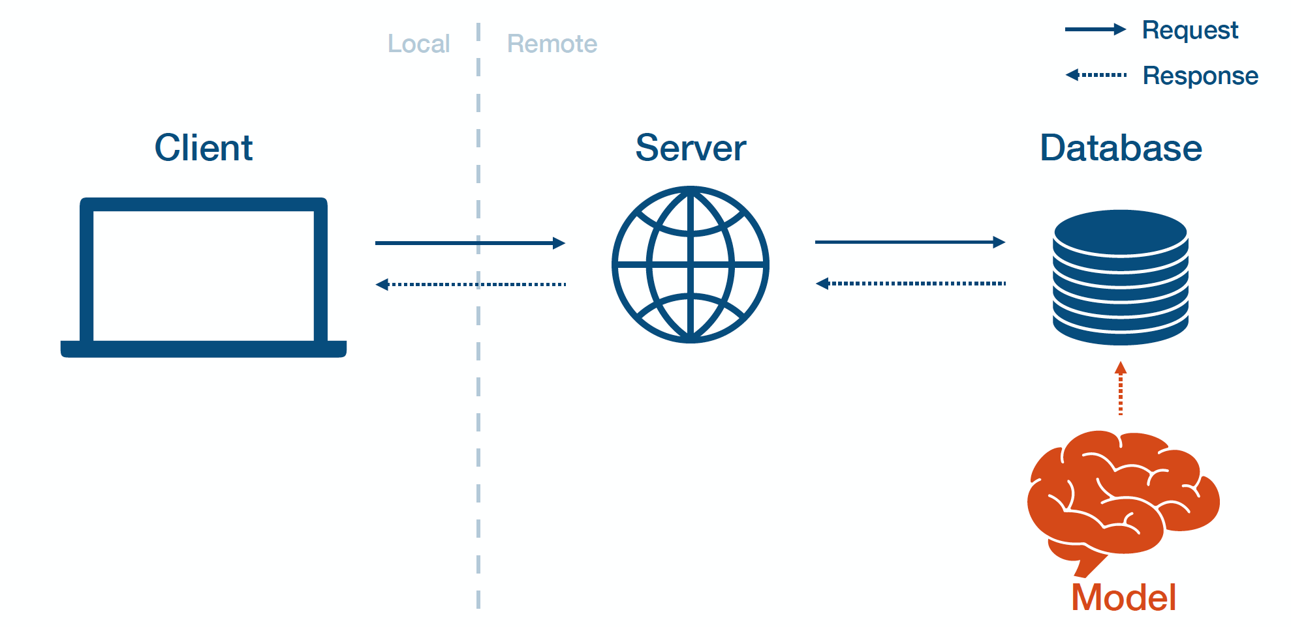
Model Deployment
Developing a web-based dashboard using huggingface.
Enabling user input: Search term & Date range.
Displaying sentiment summary, time series graphs, and topic extraction results.
Providing a Download CSV option for further analysis.
Integrating a chatbot for interactive analysis.

Slide 10

Project Completion
This project will provide a data-driven approach to understanding public sentiment on USAID.
It will help policymakers, researchers, and the public gauge real-time opinions.
The web app will be an interactive tool for sentiment tracking and analysis.
The chatbot will provide interactive sentiment analysis by allowing users to query public opinion trends, explore key discussion topics, track sentiment changes over time, and download relevant data.

