Slide 1

An app to detect
heart arrhythmias
Tracy Teague
NYC Fall 2019

Slide 2

Cardiovascular disease is the leading cause of death

Slide 3
Cardiovascular disease is the leading cause of death
17.9 million deaths per year

Slide 4
Cardiovascular disease is the leading cause of death
17.9 million deaths per year
75% in low- and middle-income countries

Slide 5

Electrocardiograms (ECGs) are a low-cost, non-invasive way to detect heart arrythmias
Notes:
https://arxiv.org/pdf/1805.00794.pdf

Slide 6
Electrocardiograms (ECGs) are a low-cost, non-invasive way to detect heart arrythmias
Notes:
https://arxiv.org/pdf/1805.00794.pdf

Slide 7
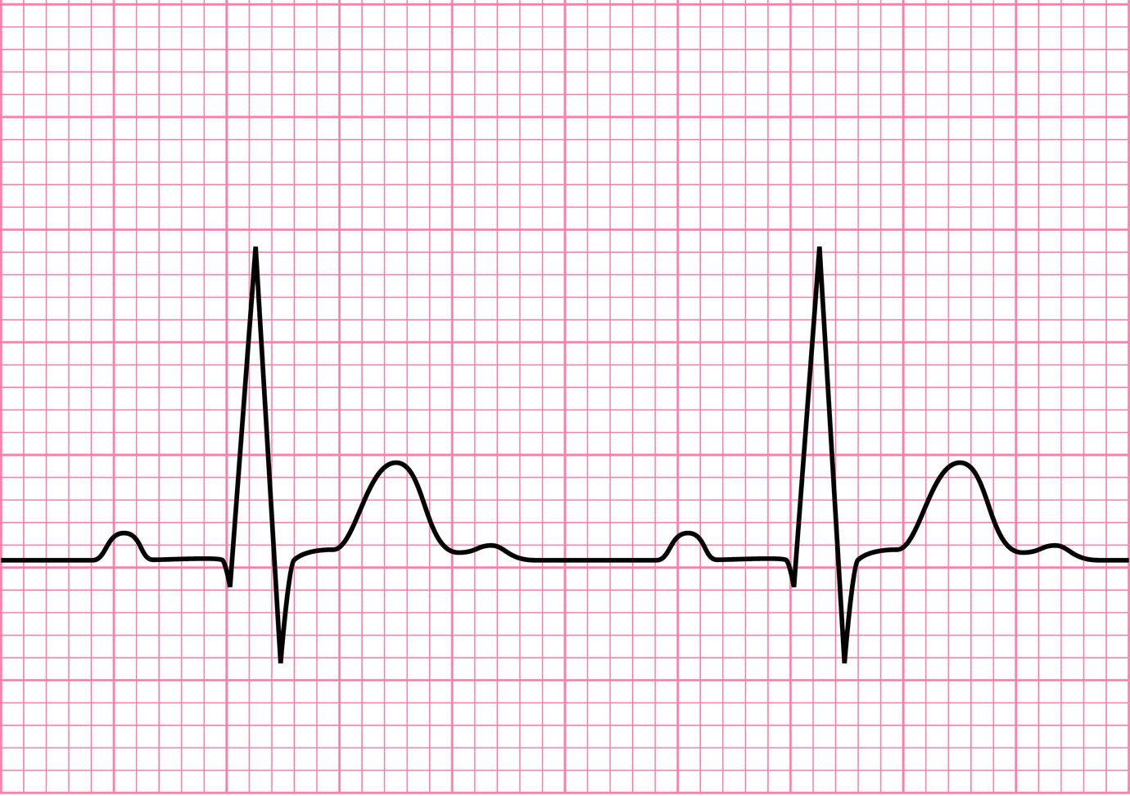
Electrocardiograms (ECGs) are a low-cost, non-invasive way to detect heart arrythmias
Notes:
https://arxiv.org/pdf/1805.00794.pdf

Slide 8
Develop an app using an algorithm to detect heart arrhythmias

Slide 9

Develop an app using an algorithm to detect heart arrhythmias

Slide 10
Develop an app using an algorithm to detect heart arrhythmias
ECG Interpreter

Slide 11
Develop an app using an algorithm to detect heart arrhythmias
ECG Interpreter
Abnormal
Normal

Slide 12
Develop an app using an algorithm to detect heart arrhythmias
ECG Interpreter
Abnormal
Normal

Slide 13
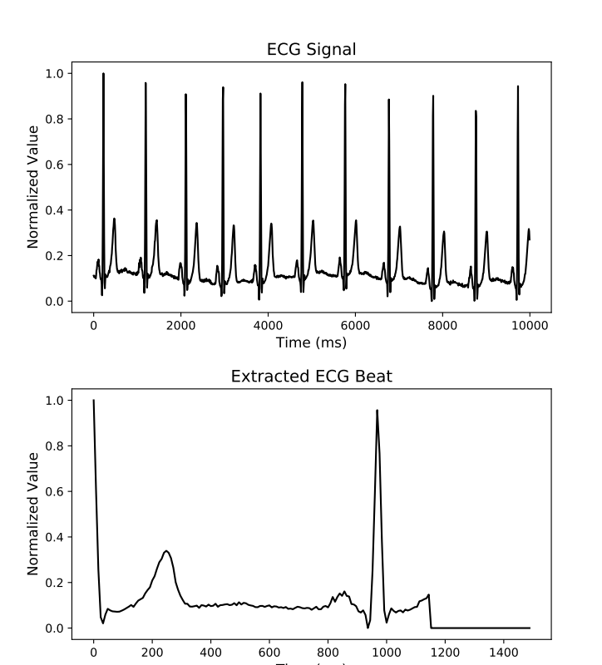
Obtained and preprocessed ECG recordings from MIT-BIH arrhythmia database to produce 100K observations
MIT-BIH Arrhythmia Database
47 subjects
30-min ECG recordings
Labeled beats
N
Notes:
MIT-BIH arrhythmia Database: https://www.physionet.org/physiobank/database/mitdb/

Slide 14
Obtained and preprocessed ECG recordings from MIT-BIH arrhythmia database to produce 100K observations
MIT-BIH Arrhythmia Database
47 subjects
30-min ECG recordings
Labeled beats
Preprocessing
Resampled
Normalized
Weighted classes
Notes:
MIT-BIH arrhythmia Database: https://www.physionet.org/physiobank/database/mitdb/
48 half-hour excerpts of 2-channel ambulatory ECG recordings
Obtained from 47 subjects studied by the BIH arrhythmia laboratory between 1975 and 1979

Slide 15
Trained convolutional neural network model to classify multiple types of arrhythmia
INPUT
Beat Signal
1D vector
Beat Signal
1D vector
Beat Signal
1D vector
Notes:
Add layers, etc.?

Slide 16
Trained convolutional neural network model to classify multiple types of arrhythmia
INPUT
INPUT
MODEL
Beat Signal
1D vector
Beat Signal
1D vector
Train
80034 obs
Conv (ReLU)
5
x
Pool
Flatten
Dense (Sigmoid)
Notes:
Add layers, etc.?

Slide 17
Trained convolutional neural network model to classify multiple types of arrhythmia
INPUT
MODEL
OUTPUT
Beat Signal
1D vector
Heartbeat Classification
Normal
LBB
RBB
APB
PVC
Train
80034 obs
Conv (ReLU)
5
x
Pool
Flatten
Dense (Sigmoid)
Notes:
Left bundle branch block beat
Right bundle branch block beat
Atrial premature beat
Premature ventricular contraction

Slide 18
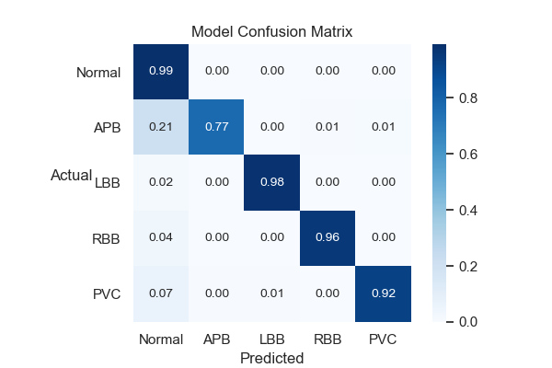
Model classifies beats with 97.7% accuracy

Slide 19
False negative rate was highest for atrial premature beat (APB)
False Negative Rate

Slide 20

Flask app provides interface for non-specialists to screen ECG signals

Slide 21
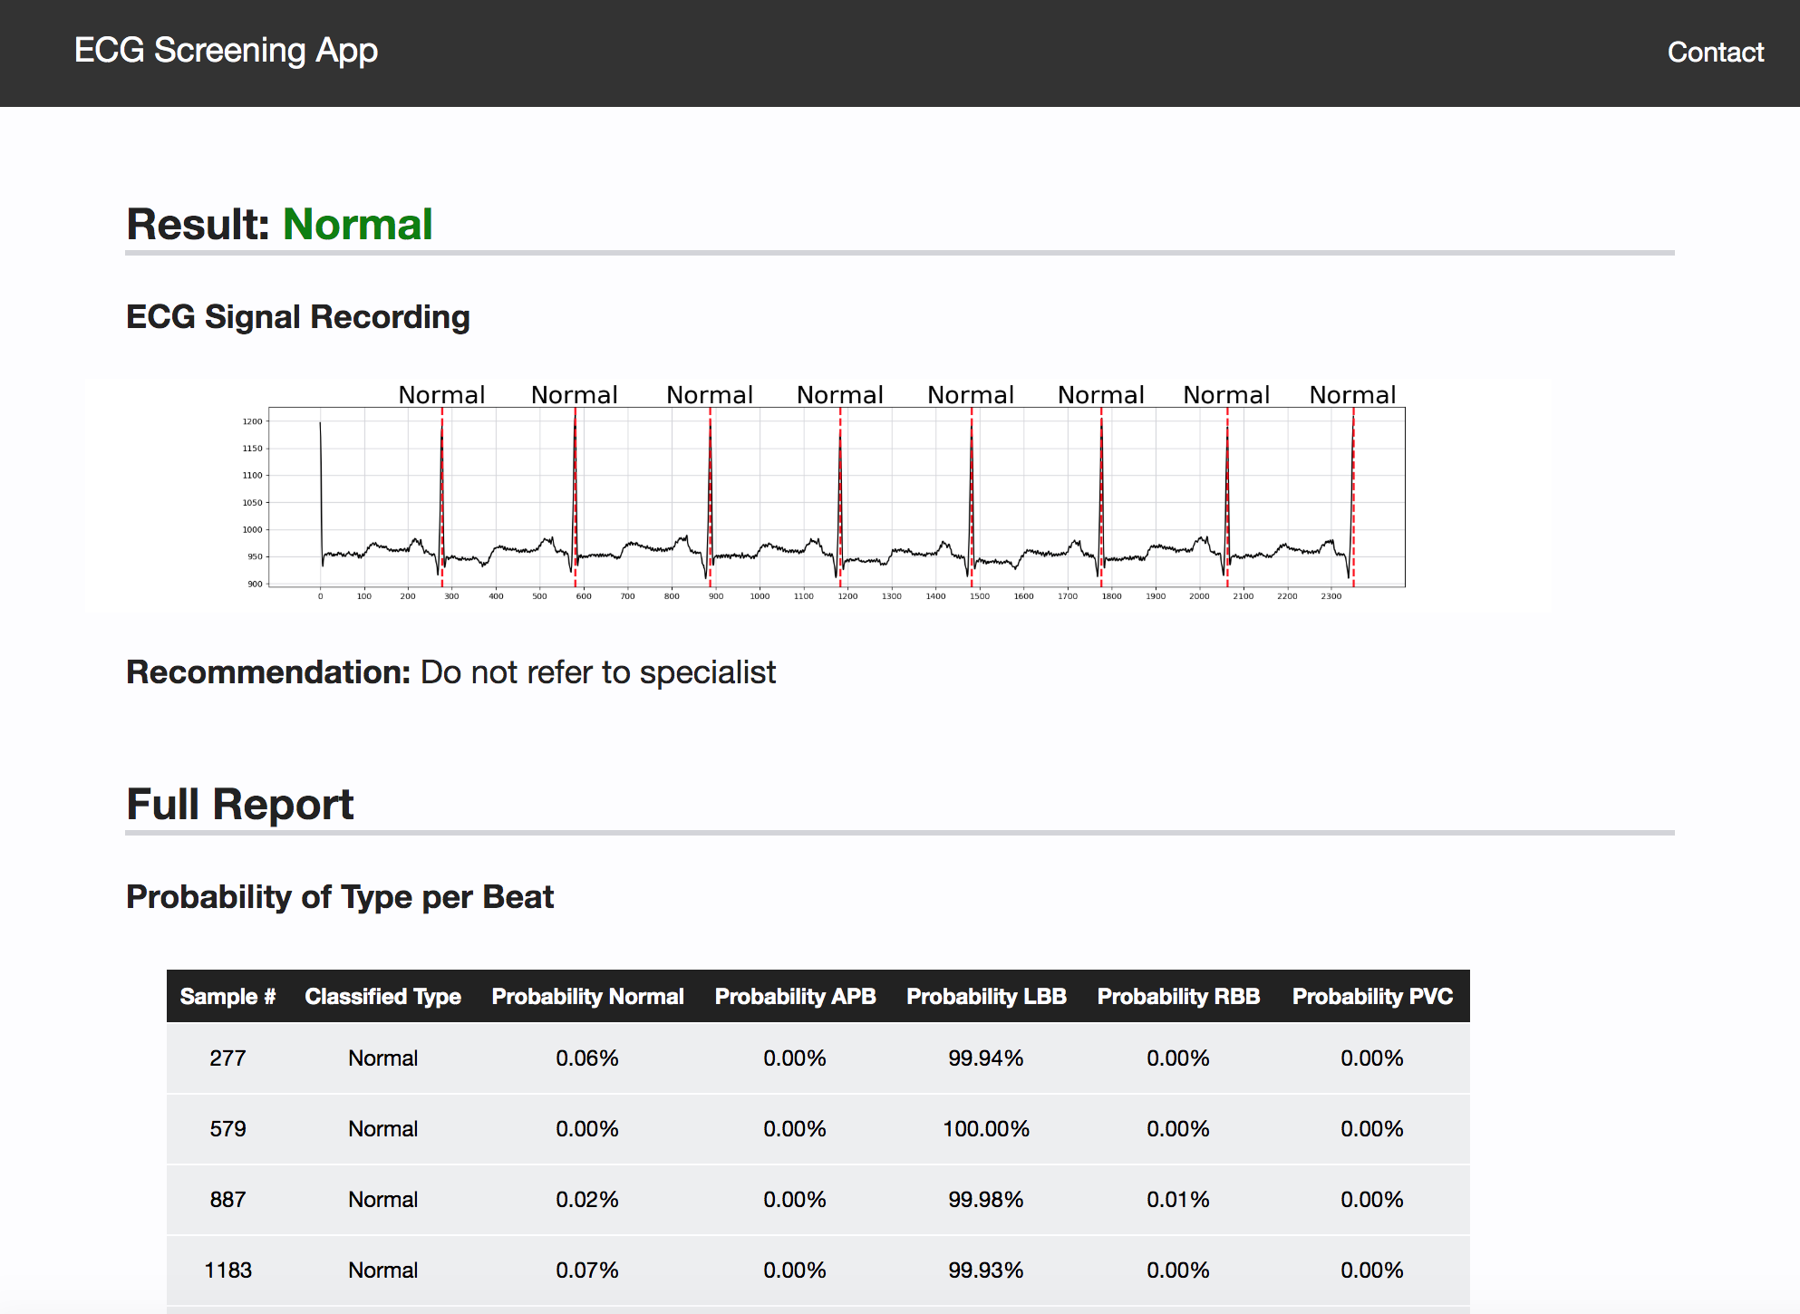
Flask app provides interface for non-specialists to screen ECG signals

Slide 22



Thank you.
Contact Information
tracy.teague05@gmail.com
tracy-teague
tracyteague

Slide 23
Appendix

Slide 24
References
MIT-BIH Arrhythmia Database
World Health Organization (WHO)

Slide 25
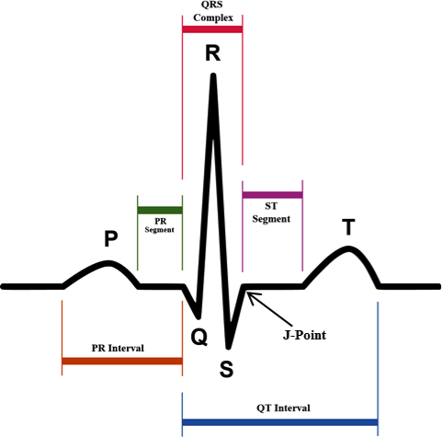
Beats annotated at R of each PQRST wave
Triggers main pumping contractions

Slide 26
Beats annotated at R of each PQRST wave
R R R

