Slide 1
Development methodology
Improving the Design of Code
using “Functional" patterns

Slide 2
Agenda
Motivation
Benefits
Thinking functional while designing your code
Examples of what are and not
Bridging between Object-oriented and Functional Patterns
Refactoring walk-through
Notes:
We have focused learning and sharing more on technologies/frameworks and this time we want to touch on a practical topic that we deal with everyday task : design and writing production code. The “functional thinking” mindset is not bound to programming, not to language-specifics only but to code design overall instead. So all can benefit. I learn myself to apply and I felt it paid off , so just want to share...
This topic is not new to most of us. Just want to bring it up to our attention in the most practical way.
It is A good development methodology needs conception and design before coding properly.
If you do not need to take time to think and design your program before starting to code, you are either working on trivial things or missing something larger.

Slide 3
Why care ?
Designing and writing “functional” code is not about feeling proud of ourselves.
It has profound productivity implications and long-term consequences such as
making code more flexible or efficient
improving the readability and correctness of code
reducing coupling among program components
reducing memory overhead
solving concurrency issues from mutability
Notes:
A functional language doesn't rely on mutating a variable. Because of this, we don't have to protect the "shared state" of a variable, because the value is fixed. This in turn avoids the majority of the hoop jumping that traditional languages have to go through to implement an algorithm across processors or machines.

Slide 4
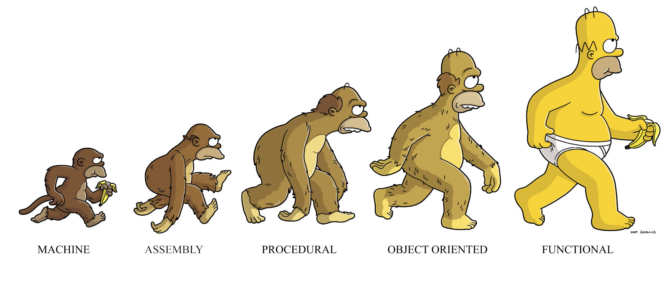
Thinking functional while designing your code
a different way of thinking…
focuses on the “what” is being done…
as opposed to the “how” it’s being done as in Object Oriented and Imperative thinking.
learning the syntax of a new language is easy, but learning to think under a different paradigm, “functional”, is hard.
abstracting logic as independent functions, no shared state (no side-effect), no mutable data, control flow expressed by combining functions
Object-oriented programming makes code understandable by encapsulating moving parts. Functional programming makes code understandable by minimizing moving parts.
--Author of Working with Legacy Code
Notes:
This session helps you transition from a Java writing imperative thinker to a functional thinker, using Java.

Slide 5
A simple example…
Imperative thinking
private int counter = 0;
public void incrementMutableCounter() {
counter++;
}
Functional thinking
public int incrementCounter(int counter) {
return counter++;
}
➔ independent function, no shared state (no side-effect), no mutable data
Notes:
functional programming is about programming with pure functions and immutable state, while imperative programming relies heavily on mutability.
There is no non-determinism without mutable states. There is no race condition or dead lock without mutable states. Mutable states are the root of the problem.

Slide 6
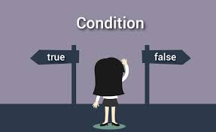
Another example…
Imperative thinking
UseCase foundOne = null; for (UseCase usecase: useCases) { if (usecase.conditionMet()) { foundOne = usecase; return; } } if (foundOne != null) { foundOne.execute(); }
Functional thinking
useCases.stream().filter(obj -> obj.conditionMet()).findFirst().get().execute();
➔ control flow expressed by combining functions
Notes:
The real gain is not having three lines of code less. Very similar problems occur over and over again. If the functional approach is used, every time we’ll write less logic, reducing the odds of introducing errors and less side-effects caused by state manipulation in imperative approach.

Slide 7

Bridging between
Object-oriented and Functional Patterns
Share the same goal: technique for making code more flexible, reusable or efficient by turning a block of code into an object that can be passed around
Lambdas in Java make a bunch of the classic design patterns easier to implement
Few most commonly used design patterns in code!
Factory Pattern in Spring Dependency injections (@Autowire, @Value…)
Strategy Pattern allows us to dynamically swaps out logic at run-time
Builder Pattern allows us to build the object step-by-step without passing too many arguments or optional ones from client.
What problems do these 2 solve ?
Readability
The conditionals tend to grow out of control --> more error prone
Coupling --> not easy to maintain and unit test.
Notes:
Pattern is like a known solution to a known problem

Slide 8
Avoid CONDITIONALS, “if”! “else”! “Switch”! …
Solving a coding challenge without the use of any conditionals is possible!
Patterns which only differ in their ”if” conditions can be reused
Replace Conditional with Polymorphism (recommended by Martin Fowler)
move each leg of the conditional to an overriding method in a subclass
make the original method abstract
Replace Conditional Logic with Strategy Pattern
use an Enum with Functions to implement the Strategy Pattern
to cut down number of sub classes introduced
to write less and flexible code with Java 8 lamdas, expressions and @FunctionalInterfaces
See next…
reduce coupling among program components • reduce memory overhead

Slide 9
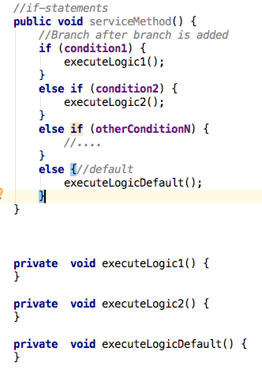
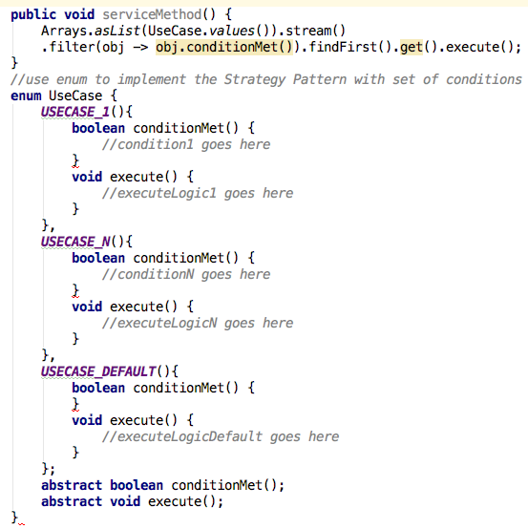
Strategy Pattern - Move each leg of the conditional to constant-specific methods of rich Enum type.
- Replace your original method with the much, much cleaner and easier-to-read lamda !

Slide 10
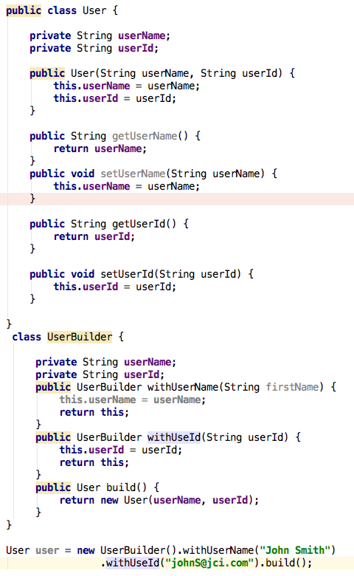
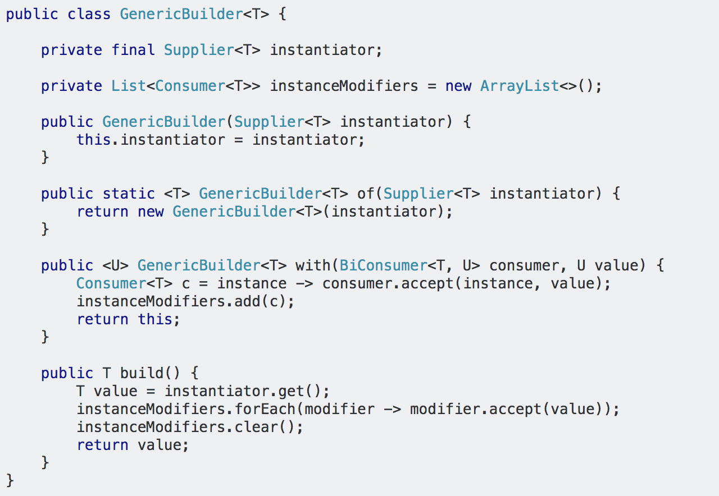
Builder Pattern
The old school approach with a lot of code duplication
The functional and stateless approach using Lamdas
The Generic Builder for building all POJOs
One Builder to rule them all !!!!
User user = GenericBuilder.of(User::new) .with(User::setUserName, "John Smith").
.with(User::setUserId, "johnS@jci.com").build();

Slide 11


