Slide 1
Memory Systems
Memory Hierarchy, Caching, and Virtual Memory

Slide 2
Memory Hierarchy and Caching

Slide 3
The Memory Hierarchy
Registers
L1 cache (SRAM)
L2 cache (SRAM)
Main memory (DRAM)
Local secondary storage (disks)
Remote secondary storage (distributed file systems, web servers)
Faster
Larger, Cheaper

Slide 4
Locality
Data is more likely to be referenced if it is near other recently referenced data, or was recently referenced itself
Temporal Locality
If data was recently accessed, it is likely to be accessed again
Spatial Locality
If data was recently accessed, other data near it is likely to be accessed as well

Slide 5
Locality Example
int sumvec (int v[N])
{
int i, sum = 0;
for (i = 0; i < N; i++)
sum += v[i];
return sum;
}
Temporal Locality
sum
i
Spatial Locality
v
Reference Pattern
stride-1

Slide 6
Locality Example
int sumarraycols (int a[M][N])
{
int i, j, sum = 0;
for (j = 0; j < N; j++)
for (i = 0; i < M; i++)
sum += a[i][j];
return sum;
}
Why is the bad spatial locality?

Slide 7
Caching
Registers
L1 cache (SRAM)
L2 cache (SRAM)
Main memory (DRAM)
Local secondary storage (disks)
Remote secondary storage (distributed file systems, web servers)
Faster
Larger, Cheaper

Slide 8
Cache Blocks
Level k
Level k + 1
4
9
14
3
0
1
2
3
4
5
6
7
8
9
10
11
12
13
14
15

Slide 9
Cache Hits
Level k
Level k + 1
9 ?
4
14
3
9
0
1
2
3
4
5
6
7
8
9
10
11
12
13
14
15
9
9

Slide 10
Cache Misses
Level k
Level k + 1
2 ?
4
9
14
3
0
1
2
3
4
5
6
7
8
9
10
11
12
13
14
15
2
4
MISS
2

Slide 11
Cache Read Algorithm
CPU sends address to the cache
If the address is in the cache
Return the value to the CPU
If the address is not in the cache
Retrieve the value from memory
Write the value to the cache
Select a victim if necessary
Return the value to the CPU

Slide 12
Cache Write Algorithms
Write-Through
Write-Back
Write data to the cache
Simultaneously write the data to memory
CPU may write to a write buffer to mitigate the cost
The write buffer updates memory at a later time
Write data to the cache
Do not write to memory at this time
When the entry is replaced (removed from the cache), write the data to memory

Slide 13
Cache Blocks
Spatial Locality
Instead of loading one byte of memory at a time, load a whole region of memory into the cache
Called a block, and its size is the blocksize of the cache
Memory Address
Cache Index | Byte Offset
0 | 1
Cache
Block | Offset | Data
0 | 0 | 0xA1
 | 1 | 0xB2
1 | 0 | 0xC3
 | 1 | 0xD4
read

Slide 14
Cache Implementations
Direct Mapped
Fully Associative
Set Associative

Slide 15
Direct Mapped Cache
Each memory location belongs in exactly one cache entry
Memory
Address | Data
0
1
2
3
4
5
6
7
Cache
Address | Data
0
1
2
3
Cache Address = Memory Address mod N

Slide 16
How do you know which you’re reading?
Memory Address
Tag | Index | Offset
Cache
Look up index
Check valid flag
If false, go to memory
Check Tag
If no match, go to memory
Index | Valid | Dirty | Tag | Data
0 | T | F | 0x00 | 0x A1 E5
1 | F | F | 0x01 | 0x B2 F6
2 | T | T | 0x02 | 0x C3 A7
3 | T | F | 0x01 | 0x D4 B8
Used for write-back algorithm

Slide 17
Fully Associative Cache
A memory location could go anywhere in the cache
Memory Address
Tag | Offset
Cache
Look up tag
Check valid flag
If false, go to memory
Check Tag
If no match, go to memory
Tag | Valid | Dirty | Data
0x01AE | T | F | 0x A1 E5
0x1CB9 | F | F | 0x B2 F6
0xF2A0 | T | T | 0x C3 A7
0x61D8 | T | F | 0x D4 B8

Slide 18
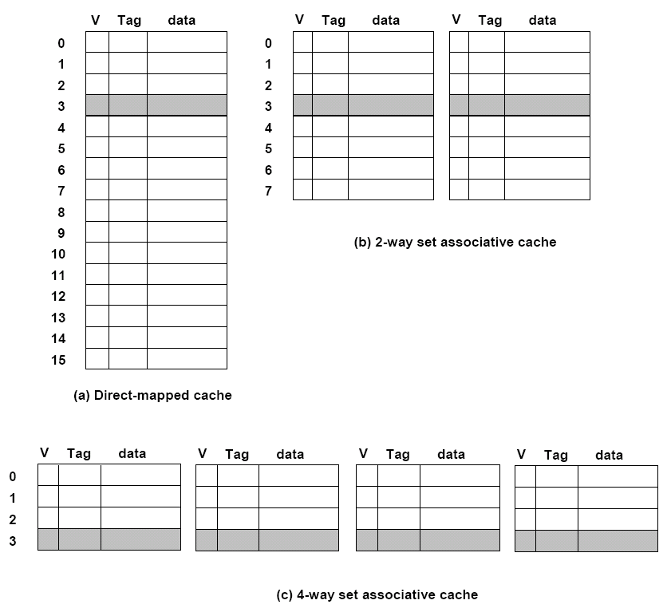
Set Associative Cache

Slide 19
Set Associative Cache
Memory Address
Tag | Index | Offset
Cache
Index
0
1
2
3
Valid | Dirty | Tag | Data
T | F | 0x00 | 0x A1 E5
F | F | 0x01 | 0x B2 F6
T | T | 0x02 | 0x C3 A7
T | F | 0x01 | 0x D4 B8
Valid | Dirty | Tag | Data
F | F | 0x01 | 0x E5 1A
T | T | 0x00 | 0x F6 2B
F | F | 0x00 | 0x A7 3C
T | T | 0x02 | 0x B8 4D
Extreme Associativity
What is 1-way?
What is N-way?

Slide 20
Virtual Memory Systems

Slide 21
Why Virtual Memory?
Allows us to use a larger working set than the physical memory we have
Store processes’ working sets on disk and use the physical memory as a cache for the disk
Reduces fragmentation in physical memory
Provides protection against “bad” software

Slide 22
Paged Virtual Memory
Pages
The working set is divided into uniformly sized chunks
The size of pages is known as the pagesize
Pages are logical – they represent data
Frames
Physical memory is divided into uniformly sized regions
Frames are the same size as pages
Frames are physical – a block of physical memory
Logical pages fit into physical frames
Page Table
Maintains the mapping from logical pages to physical frames
Translates virtual memory addresses into physical addresses
One for each process

Slide 23
The Page Table
Stored in physical memory
Page Table Base Register (PTBR) stores the address of the current process’ page table, so hardware can perform translation
Maps pages to frames
Used to translate virtual address to physical ones
Virtual Addresses
Two parts – virtual page number (VPN) and offset
Translation
Look up the VPN in the page table
Replace the VPN with the physical frame number (PFN) from the page table
The offset remains unchanged

Slide 24
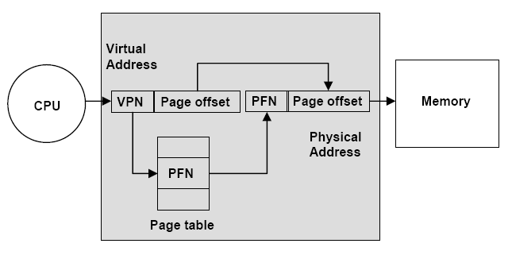
Address Translation

Slide 25
Segmented Virtual Memory
Divides a process’ working set into multiple address spaces, called segments
Segments can be different sizes
Allows better organization
More fine-grained protection
Virtual Addresses have two parts:
Segment number
Offset
Segment Table
Maps segment numbers to base addresses in physical memory
Allows translation of virtual addresses to physical addresses

Slide 26
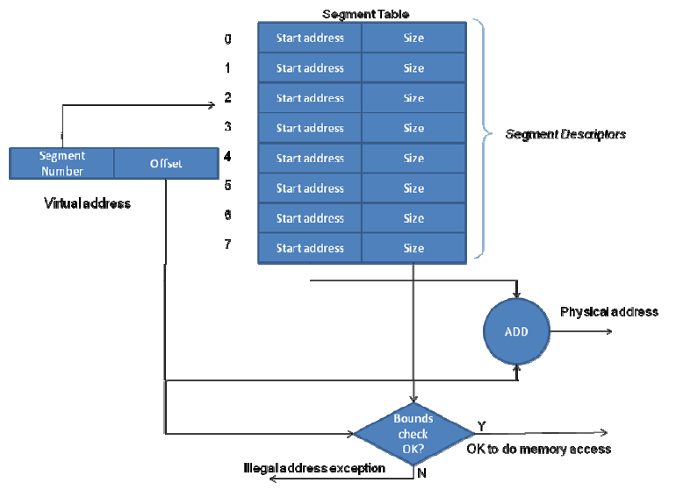
Address Translation

Slide 27
Accelerating Address Translation
Every memory access requires two trips to memory
Read page/segment table and translate virtual address
Read the data at the physical address
Reduce number of trips to memory by creating an address translation cache
Translation Look-aside Buffer (TLB)
Recent address translations are stored for reuse
Translates on a page-to-frame basis
So spatial locality applies

Slide 28
Translation Look-aside Buffer (TLB)
Table entries:
Virtual Page Number
Physical Frame Number
Valid / Invalid flag
User / Kernel flag
Why?
Allows combining paging and segmentation
How?

Slide 29
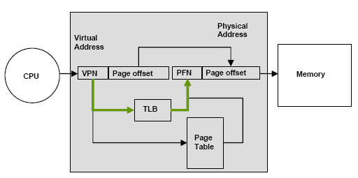
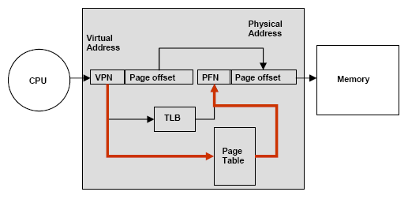
Address Translation with the TLB
TLB Hit
TLB Miss
Allows combining paging and segmentation
How?

Slide 30
Page Faults
What happens when a page is not in physical memory?
Page Table Entries have a valid bit to indicate whether a page is in physical memory
If valid bit is false when a page is accessed, a page fault is raised
Page Fault Handler
Block the process
Why?
Find a free page frame
Select a victim to replace if necessary
Copy the page from disk into the free frame
Update the page table
Unblock the process

Slide 31
Examples
Let’s Test Our Knowledge!

