Slide 1
Networking

Slide 2
Network Protocol Stack
A protocol is a convention for how computers talk to each other
Different protocols accomplish different jobs
Routing, reliable transport, session maintenance, etc.
Therefore several protocols are usually used together
How should the software to hand network protocols be arranged in the computer?
Monolithic network-handling system
Separate modules for each protocol layered on top of each other – a network stack
Push data down the stack to send
Pop data up the stack to receive

Slide 3
The OSI Model
Layer 7 – Application
Layer 6 – Presentation
Layer 5 – Session
Layer 4 – Transport
Layer 3 – Network
Layer 2 – Link
Layer 1 – Physical
Network-based applications
e.g. HTTP, FTP, POP, SMTP or proprietary protocols such as for instant messaging
Responsible for transferring messages between systems
e.g. User Datagram Protocol (UDP), Transmission Control Protocol (TCP)
Responsible for routing a packet to its destination across networks
e.g. Internet Protocol (IP)
Transmits data packets on a local network
e.g. Ethernet, Token Ring, ATM
Provides a mechanism to transmit bits on a physical medium
e.g. copper wire, coaxial cable, fiber optics, wi-fi
Manages a communication session between processes on two host systems
e.g. Sockets
Handles functionalities common to multiple applications

Slide 4
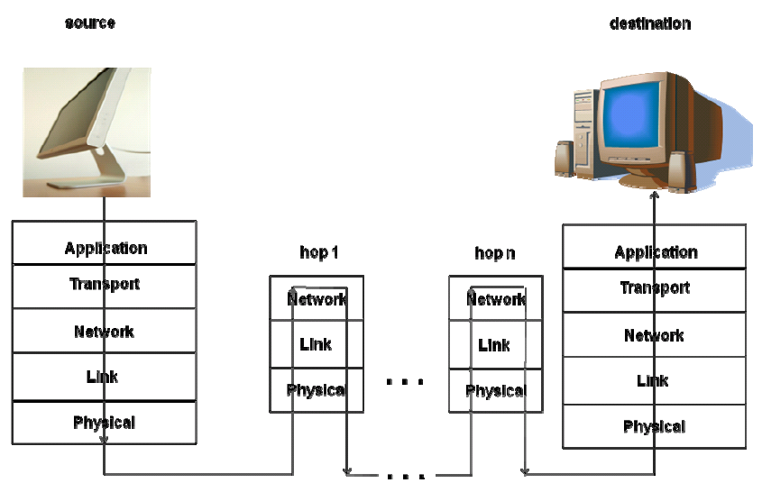
How the Stack Works
Link Header | Network Header | Transport Header | Higher-level Headers | Payload (Application Data)

Slide 5
Layer 2 – Ethernet
Computers are connected by a bus – a single wire connected to all hosts that they share
Each host is assigned an address called a MAC address
MAC addresses are hard-coded into the networking hardware
To send a message a host
Waits until the wire is quiet
Begins transmitting – all hosts see the message
The host whose MAC address matches the packet accepts it
Collisions – when more than one host talks at a time
Everyone stops talking and tries again later
Exponential backoff

Slide 6
Switched Ethernet
Collision detection / exponential backoff doesn’t scale
Switches are devices that divide a network into segments
Segments are isolates – packets cross boundaries only if their destination is in the new segment
However, what if the switch is not sure where the packet needs to go?
It broadcasts it, like a hub, and acts like unswitched Ethernet
As packets pass through it, it learns which machines live in which segments by the packets it receives (i.e. the sender address)

Slide 7
Layer 3 – Internet Protocol (IP)
Local area networks are limited in size
Link layer protocols do not scale (even switched Ethernet)
Need to send packets to machines in different LANs
Network Layer routes packets from one LAN to another
LANs may not be connected directly, so packets must be routed over a number of “hops”
What is needed for the Network Layer?
A globally unique address (IP address)
Must be based on local topology
A routing algorithm (how to decide which hops to take)
A routing table, to store data for the routing algorithm

Slide 8
Distance Vector Algorithm
A router knows the cost to its adjacent (directly connected) routers
Routers periodically exchange routing tables with their neighbors
Upon receiving a routing table form a neighbor, a router updates its costs
And possibly next hops if a new lower cost route is available
Routing Table
for router A
Destination | Next Hop | Cost
A | - | 0
B | B | 10
C | C | 12
D | C | 18
E | B | 30
F | B | 17
G | C | 20
H | B | 28
I | C | 23

Slide 9
Related Protocols Not Covered Here
There are some other protocols that help IP do its job
Address Resolution Protocol (ARP)
Helps router at the destination network find the LAN address for the destination machine
Domain Name System (DNS)
Allows assigning domain names to a host or collections of hosts
Easier for users to read and remember than IP addresses
Helps hosts to retrieve the IP address for a domain name
Dynamic Host Configuration Protocol (DHCP)
Automatically assigns IP addresses to hosts in the network
Caution: assigned IP addresses can change over time!

Slide 10
Layer 4 – Transport Control Protocol (TCP)
Layers 1-3 route packets from a source to destination
What happens if a packet gets lost?
What happens if packets arrive out of order?
What happens if there are errors in the packet when it arrives?
TCP solves these problems with:
A sequence number in every packet
Positive acknowledgement of packet receipt
Connection-based protocol

Slide 11
TCP Connection Establishment
Client sends a connection request packet
Contains the sequence number the client will use for its first data packet
Server responds with an ACK packet
Contains the sequence number the server will use for its first data packet to the client
Client sends and ACK to the server

Slide 12
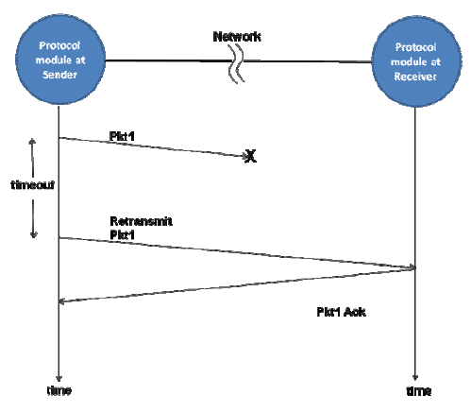
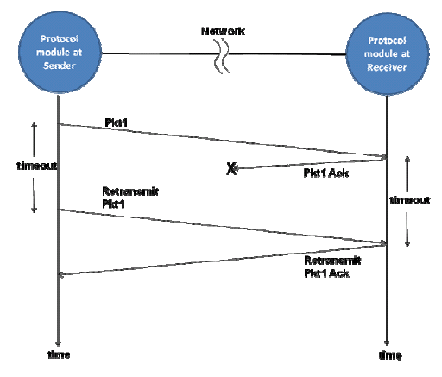
TCP Reliable Transport

Slide 13
TCP Connection Teardown
Client sends a teardown request to the server
Server responds with an ACK
Server sends a teardown request to the client
Client responds with an ACK

Slide 14
TCP Congestion Control
When a network link or router gets too busy, many packets may be lost
TCP alleviates this by slowing down its transmit rate when it detects congestion
What’s good about this?
What’s bad?

Slide 15
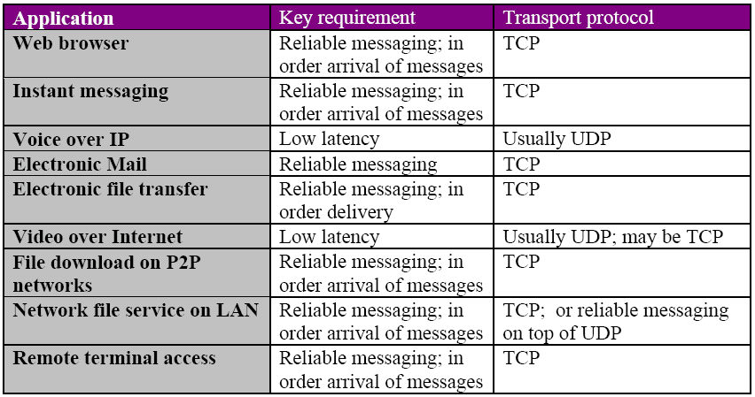
TCP vs. UDP

Slide 16
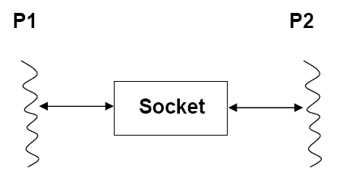
Sockets
An IP address identifies a host to route a packet to
What does the host do with the packet when it’s received?
Introducing the Socket
A socket identifies a connection between two processes
Now the destination host can give the packet data to the particular process that wants it
IP Address

Slide 17
How does the host know which process to route to?
Each process is identified by the pair:
<IP address, port number>
The port number tells the host which process to route to
Assigning port numbers
When a process wants to communicate, it gets a port number
The process may choose a unused port number (e.g. 80 for web servers)
Or it may allow the OS to assign one (e.g. web browsers)
A process may get more than one port number, but a port is never assigned to more than one process (at a time)
For example, different ports may be for different kinds of communication
A connection is established when a process sends its <IP, port> to a destination <IP, port>
Both endpoints now have a socket, which is:
[<src IP, src port>, <dst IP, dst port>]

Slide 18
The End

