Slide 1
Concurrent Programming
Threads (using pthreads as an example)

Slide 2
What is a thread?
A thread is a unit of execution
Allows concurrent programming
How are they different from processes?
A process may contain many threads
The threads share an address space
They are more lightweight (less overhead)
Communication between threads (vs. IPC) is
Easier
Lightweight (less overhead)

Slide 3
Anatomy of a Thread
Each thread has its own:
Program Counter (PC)
Stack
And Stack Pointer (SP)
Data registers
Threads in the same process share:
The address space
Global data
Heap
Code
Shared libraries
Open files
Signal handlers

Slide 4
Programming Threads
Create threads
Terminate threads
Communicate between threads
Synchronize threads

Slide 5
Creating Threads
typedef void* (func) (void*);
int pthread_create (pthread_t *tid, pthread_attr_t *attr,
func *f, void *arg);
Creates a new thread
f is a pointer (function name) to the start routine for the thread
Function definition must be a particular format
arg is a pointer to arguments for f
attr allows you to specify additional attributes for the thread
For now we’ll just assume it’s NULL (meaning no attributes)
The thread ID for the new thread is written in tid

Slide 6
Terminating Threads
The thread’s start routine returns
The thread terminates itself with the pthread_exit function
Another thread terminates it with the pthread_cancel function
The entire process terminates
Any thread calls a function like exit or abort
The kernel terminates the process

Slide 7
Exiting Threads
int pthread_exit (void *thread_return);
The calling thread is terminated
This function does not return!
The thread can return a value by passing it to thread_return
More on how to read a thread’s return value later!

Slide 8
Canceling Other Threads
int pthread_cancel (pthread_t tid);
Terminates the thread specified by tid
The thread ends wherever it happens to be in the code
Where does tid come from?
Remember pthread_create gives the thread ID if the thread just created

Slide 9
Communication Between Threads
Besides arguments at creation and return values at termination…
Shared Variables
Multiple threads reference the same instance of a variable
Global variables
Static variables – sometimes
Dynamically allocated (heap) objects – sometimes
Variables on the stack (e.g. local variables) – usually not

Slide 10
Shared Variable Example
#define N 2
void *thread(void *vargp);
char **ptr;
int main() {
int i;
pthread_t tid;
char *msgs[N] = {
“Hello from foo”,
“Hello from bar”
};
ptr = msgs;
for (i = 0; i < N; i++)
pthread_create(&tid, NULL, thread, (void*) i);
pthread_exit(NULL);
}
void *thread(void *vargp) {
int myid = (int)vargp;
static int cnt = 0;
printf(“[%d]: %s (cnt=%d)\n”, myid, ptr[myid], ++cnt);
}

Slide 11
What’s the problem with shared variables?
Data Races
Multiple threads access the same shared variable
At least one is a write
Causes non-determinism
Different results depending on how the threads are scheduled

Slide 12
Data Race Example
#define N 2
void *thread(void *vargp);
int count;
int main() {
int i;
pthread_t tid;
for (i = 0; i < N; i++)
pthread_create(&tid, NULL, thread, (void*) i);
pthread_exit(NULL);
}
void *thread(void *vargp) {
int x = count;
count = x + 1;
}
What if the thread is preempted here?
Is that the result we want?
What is the value of count?

Slide 13
Synchronizing Threads
Clearly there is a need for threads to coordinate their activities!
Types of Synchronization
Mutual Exclusion (mutex)
Only one thread can be in the critical section at a time
Barriers
Threads wait for all threads to reach the synchronization point
Signaling
Beyond the scope of this presentation
Wait for a thread to terminate (pthread_join)

Slide 14
Mutual Exclusion
Initializes a mutex
You can use different pthread_mutex_t to create separate critical section (e.g. to protect different variables)
Assume attr is NULL (no additional attributes)
Lock the mutex – begins a critical section
Other threads who call lock will block until this thread unlocks
Unlock the mutex – ends a critical section
Allows another thread to enter the critical section
int pthread_mutex_init(pthread_mutex_t *mutex,
pthread_mutexattr_t *attr);
int pthread_mutex_lock(pthread_mutex_t *mutex);
int pthread_mutex_unlock(pthread_mutex_t *mutex);

Slide 15
Mutex Example
#define N 2
void *thread(void *vargp);
int count;
pthread_mutex_t count_mutex;
int main() {
int i;
pthread_t tid;
pthread_mutex_init(&count_mutex, NULL);
for (i = 0; i < N; i++)
pthread_create(&tid, NULL, thread, (void*) i);
pthread_exit(NULL);
}
void *thread(void *vargp) {
pthread_mutex_lock(&count_mutex);
int x = count;
count = x + 1;
pthread_mutex_unlock(&count_mutex);
}
I have omitted error checking… you should not! ☺

Slide 16
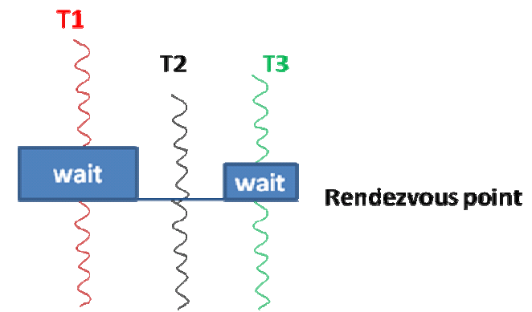
Barrier Synchronization
Each participating thread specifies a rendezvous point
When a thread reaches the rendezvous point it blocks until all threads reach the point
All threads are then allowed to proceed from the rendezvous point

Slide 17
Waiting for a thread to terminate
int pthread_join(pthread_t tid, void **thread_return);
Blocks calling thread until thread tid terminates
If thread tid terminates before pthread_join is called
The thread terminates but its resources are not cleaned up
When pthread_join is called later, it does not block and tid’s resources are cleaned up at this time
The return value of thread tid is returned in thread_return
Only one thread can pthread_join a particular thread
Why?
How can we get around this? (Hint: combine two synchronization methods)

Slide 18
What if I don’t want to join?
int pthread_detach(pthread_t tid);
Every thread must be joined exactly once
Why?
There is a way to avoid this
Detach the thread with pthread_detach
A detached thread’s resources are cleaned up as soon as it terminates
A detached thread does need to be joined
In fact it cannot be joined! – Why?

Slide 19
Where to find more details
Specification of pthreads functions
Book chapter 12
man pages
Deadlocks
Book chapter 12
Dining Philosophers problem
Book chapter 12
Search online

