Slide 1
Computer Systems An Integrated Approach to Architecture and Operating Systems
Chapter 1
Introduction
©Copyright 2008 Umakishore Ramachandran and William D. Leahy Jr.

Slide 2

What’s Inside the Box?

Slide 3
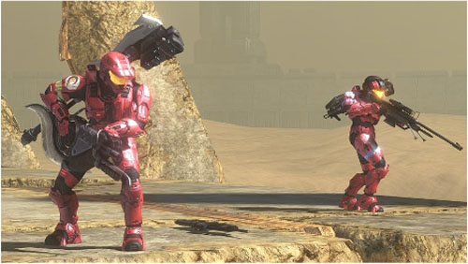
Levels of Abstraction

Slide 4
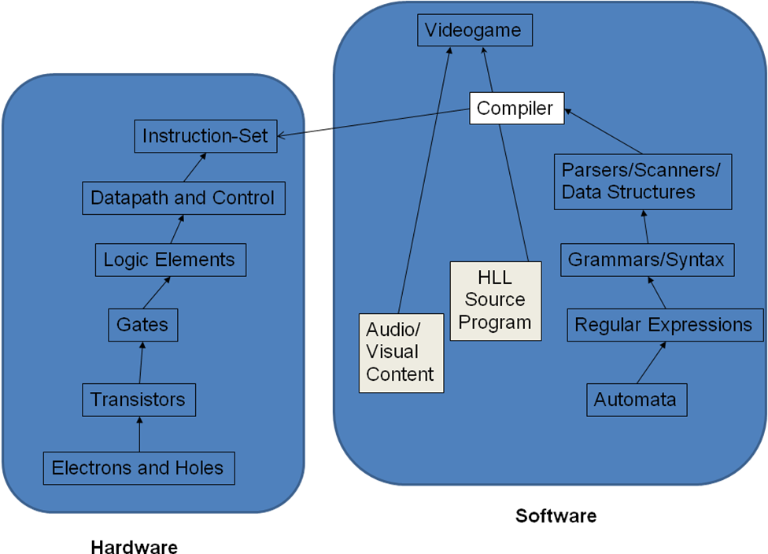
Hardware Software Interface

Slide 5
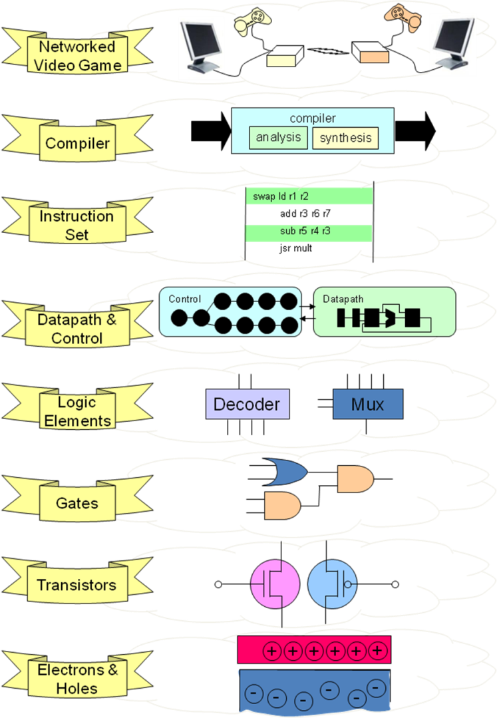
From Electrons & Holes to a Multiplayer Video Game

Slide 6
The Role of the Operating System
Resource manager
Provide consistent interface to resources
Job scheduler

Slide 7
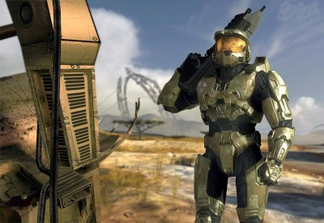

Client Application
(Halo 3)
Player clicks mouse
cursor on target

Slide 8
Client Application
(Halo 3)
Player clicks mouse
cursor on target
OS: Recognizes interrupt
Sends it to client application
It's a mouse interrupt!

Slide 9
Client Application
(Halo 3)
Player clicks mouse
cursor on target
OS: Recognizes interrupt
Sends it to client application
It's a mouse interrupt!
CLIENT

Slide 10

Client Application
(Halo 3)
Player clicks mouse
cursor on target
OS: Recognizes interrupt
Sends it to client application
It's a mouse interrupt!
CLIENT
Client Application creates
message to send to server
application

Slide 11

Client Application
(Halo 3)
Player clicks mouse
cursor on target
OS: Recognizes interrupt
Sends it to client application
It's a mouse interrupt!
CLIENT
Client Application creates
message to send to server
application
OS: Sends
Message to
server

Slide 12
Client Application
(Halo 3)
Player clicks mouse
cursor on target
OS: Recognizes interrupt
Sends it to client application
It's a mouse interrupt!
CLIENT
Client Application creates
message to send to server
application
SERVER
OS: Sends
Message to
server
Got a message!
OS: Receives
Message sends
to server application

Slide 13
Client Application
(Halo 3)
Player clicks mouse
cursor on target
OS: Recognizes interrupt
Sends it to client application
It's a mouse interrupt!
CLIENT
Client Application creates
message to send to server
application
SERVER
OS: Sends
Message to
server
Application examines
message and state of
game and determines
Master Chief dies! Sends
message back to client.
Got a message!
OS: Receives
Message sends
to server application

Slide 14
Client Application
(Halo 3)
Player clicks mouse
cursor on target
OS: Recognizes interrupt
Sends it to client application
It's a mouse interrupt!
CLIENT
Client Application creates
message to send to server
application
SERVER
OS: Sends
Message to
server
Application examines
message and state of
game and determines
Master Chief dies! Sends
message back to client.
Got a message!
OS: Receives
Message sends
to server application
OS: Sends
Message to client

Slide 15
Client Application
(Halo 3)
Player clicks mouse
cursor on target
OS: Recognizes interrupt
Sends it to client application
It's a mouse interrupt!
CLIENT
Client Application creates
message to send to server
application
SERVER
OS: Sends
Message to
server
OS: Receives
message and
sends it to
application
Application examines
message and state of
game and determines
Master Chief dies! Sends
message back to client.
Got a message!
OS: Receives
Message sends
to server application
OS: Sends
Message to client

Slide 16
Client Application
(Halo 3)
Player clicks mouse
cursor on target
OS: Recognizes interrupt
Sends it to client application
It's a mouse interrupt!
CLIENT
Client Application creates
message to send to server
application
ClientApplication generates
required images, etc.
Sends I/O requests to OS
SERVER
OS: Sends
Message to
server
OS: Receives
message and
sends it to
application
Application examines
message and state of
game and determines
Master Chief dies! Sends
message back to client.
Got a message!
OS: Receives
Message sends
to server application
OS: Sends
Message to client

Slide 17
Client Application
(Halo 3)
Player clicks mouse
cursor on target
OS: Recognizes interrupt
Sends it to client application
OS changes I/O devices to
show Master Chief blowing
up!!!
It's a mouse interrupt!
CLIENT
ut oh!
Client Application creates
message to send to server
application
ClientApplication generates
required images, etc.
Sends I/O requests to OS
SERVER
OS: Sends
Message to
server
OS: Receives
message and
sends it to
application
Application examines
message and state of
game and determines
Master Chief dies! Sends
message back to client.
Got a message!
OS: Receives
Message sends
to server application
OS: Sends
Message to client

Slide 18
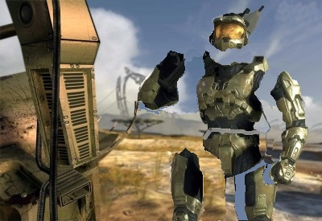
Client Application
(Halo 3)
BAM!!!
Player clicks mouse
cursor on target
OS: Recognizes interrupt
Sends it to client application
OS changes I/O devices to
show Master Chief blowing
up!!!
It's a mouse interrupt!
CLIENT
ut oh!
Client Application creates
message to send to server
application
ClientApplication generates
required images, etc.
Sends I/O requests to OS
SERVER
OS: Sends
Message to
server
OS: Receives
message and
sends it to
application
Application examines
message and state of
game and determines
Master Chief dies! Sends
message back to client.
Got a message!
OS: Receives
Message sends
to server application
OS: Sends
Message to client

Slide 19
Client Application
(Halo 3)
BAM!!!
Player clicks mouse
cursor on target
OS: Recognizes interrupt
Sends it to client application
OS changes I/O devices to
show Master Chief blowing
up!!!
It's a mouse interrupt!
CLIENT
ut oh!
Client Application creates
message to send to server
application
ClientApplication generates
required images, etc.
Sends I/O requests to OS
SERVER
OS: Sends
Message to
server
OS: Receives
message and
sends it to
application
Application examines
message and state of
game and determines
Master Chief dies! Sends
message back to client.
Got a message!
OS: Receives
Message sends
to server application
OS: Sends
Message to client

Slide 20
What’s Happening Inside the Box?
Processor
Memory
I/O
Parallelism
Networking

Slide 21
Layers of Abstraction
Application (Algorithms expressed in High Level Language)
System software (Compiler, OS, etc.)
Computer Architecture
Machine Organization (Datapath and Control)
Sequential and Combinational Logic Elements
Logic Gates
Transistors Solid-State Physics (Electrons and Holes)

Slide 22
Where Does This Course Fit?
Fundamentals of Digital Electronic & Logic Design
Fundamentals of Programming
Integrated Approach to Computer Architecture and Operating Systems
Advanced Topics in Operating Systems
Advanced Topics in Computer Architecture
Advanced Topics in Computer Networks

Slide 23
Questions?

