Slide 1
CSCI 544
Deep Learning for NLP:
Lecture 5
http://sami.haija.org/cs544/DL5

Slide 2
Agenda
Knowledge Gaps: BatchNorm, Dropout, p-Norm
Sequence Models
Review of architecture.
Coding
Word2Vec
Motivation
Results
Derivation

Slide 3
Why should you pay attention?
Deep Learning assignment 2 will likely be coding RNNs!
Word2vec is useful in-practice

Slide 4
Agenda
Knowledge Gaps: BatchNorm, Dropout, p-Norm [whiteboard]
Sequence Models
Review of architecture.
Coding
Word2Vec
Motivation
Results
Derivation

Slide 5
Agenda
Knowledge Gaps: BatchNorm, Dropout, p-Norm
Sequence Models
Review of architecture.
Coding
Word2Vec
Motivation
Results
Derivation

Slide 6
Model Overview
(I, like, this, movie)
Sentiment Classifier
(or Predict Next word)
Translation
POS Tagging
positive
Classification: Fixed-length output
mujhe yah philm pasand hai
(PN, V, A, N)
Same-length output (aka segmentation in vision)
Variable-length output
Each task has different output type: part of the model (encoder) does not care about output type. Only decoder cares about output type!

Slide 7
Model Overview
Legend
(I, like, this, movie)
Zero vector
Word Embeddings
RNN Cell
State Vector

Slide 8
Model Overview
(I, like, this, movie)
Encoder
Zero vector

Slide 9
Model Overview
(I, like, this, movie)
Encoder
Zero vector
Classification Decoder
positive

Slide 10
Model Overview
(I, like, this, movie)
Encoder
Zero vector
POS Tagger
POS Tagger
POS Tagger
POS Tagger
PN
V
A
N

Slide 11
Model Overview
(I, like, this, movie)
Encoder
Zero vector
Translation (variable-length) Decoder
Sentence in target language

Slide 12
Sequence Models: Coding
We will code RNN’s using Keras interface: tf.keras.layers.RNN
tf.embedding_lookup(var, indices):
Arg: var is float (matrix) tensor of size [N, d].
Arg: indices is int matrices of any dimensions, size=S
Returns: tensor of size: S + [d], selecting rows from “var” that are indicated by indices.
tf.math.cumsum(tensor): computes cumulative sum along some axis.
Hint: It is possible to create one-hot vectors to account for variable length.

Slide 13
Agenda
Knowledge Gaps: BatchNorm, Dropout, p-Norm
Sequence Models
Review of architecture.
Coding
Word2Vec
Motivation
Results
Derivation

Slide 14
Sequence Models: Coding
Whiteboard
Code on next slide

Slide 15
max_length = … ; num_tags = ... ; num_terms = …
x = tf.placeholder(tf.int64, [None, max_length])
y_onehot = tf.placeholder(tf.float32, [None, max_length, num_tags])
lengths_onehot = tf.placeholder(tf.float32, [None, max_length])
embeddings = tf.get_variable('embeddings', [num_terms, 10])
x_embeddings = tf.nn.embedding_lookup(embeddings, x)
cell = MinimalRNNCell(num_tags) # You must implement MinimalRNNCell
layer = tf.keras.layers.RNN(cell, return_sequences=True)
model_output = layer(x_embeddings)
# Compute loss
sigmoid = tf.nn.sigmoid(model_output)
cross_entropy = -y_onehot * tf.log(sigmoid + 1e-6) - (1-y_onehot) * tf.log(1 - sigmoid + 1e-6)
cross_entropy = tf.reduce_sum(cross_entropy, axis=2) # Remove the label axes
# Mask it by lengths.
csum_cross_entropy = tf.math.cumsum(cross_entropy, axis=1)
loss = tf.reduce_sum(csum_cross_entropy * lengths_onehot)

Slide 16
Agenda
Knowledge Gaps: BatchNorm, Dropout, p-Norm
Sequence Models
Review of architecture.
Coding
Word2Vec
Motivation
Results
Derivation

Slide 17
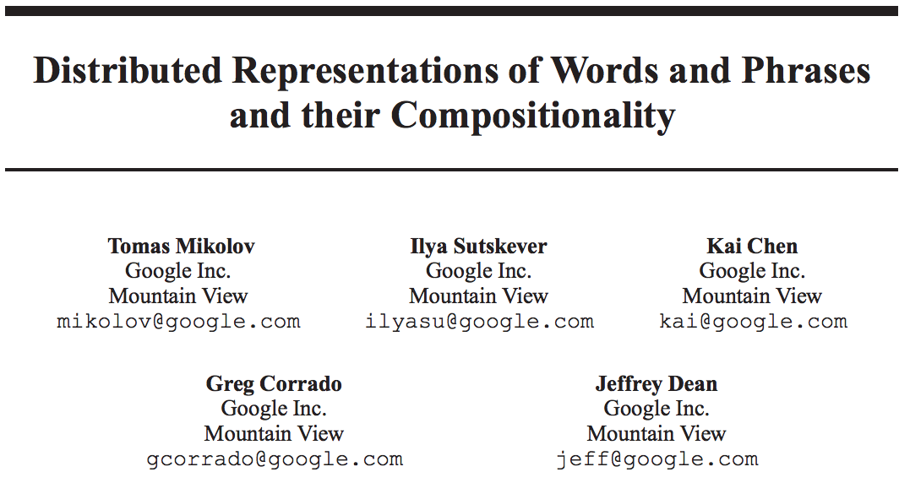
Word2vec Paper [NeurIPS’13, 11k+ citations]

Slide 18
Word2Vec: Motivation
Convert every word in the vocabulary into embedding coordinates.
Such that, words that are frequently co-used are close to each other.
Somehow also learns:
v_{i} - v_{j} represents relationship of word i to word j
Why word2vec?
Words are “discrete”, but embeddings are “continuous”.
We saw in DL Coding Assignment 1: first layer can be converted to an “embedding layer”. Isn’t that sufficient?
Training embeddings as part of a discriminative task (= trained to predict labels) gives embeddings good for that specifically for that task.
What if we want our embeddings to generalize across many tasks?
Word2vec trains embeddings without knowing the task beforehand.

Slide 19
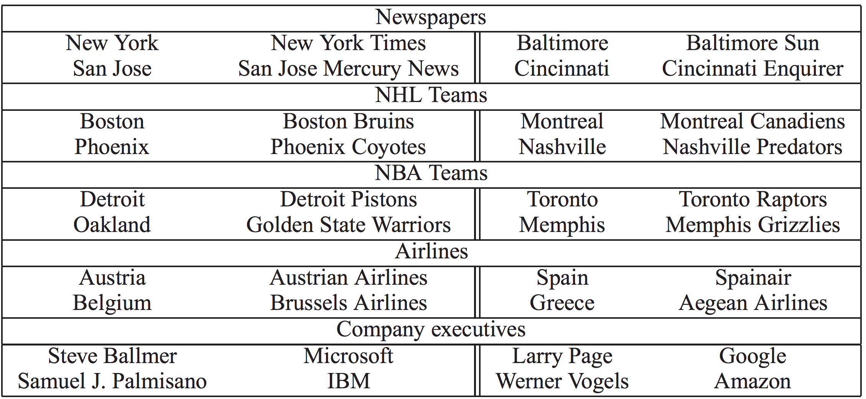
Word2vec: Results on Learning Analogies
v_{man} - v_{king} + v_{woman}
= v_{queen}
v_{paris} - v_{france} + v_{spain}
= v_{barcelona}
General analogies:

Slide 20
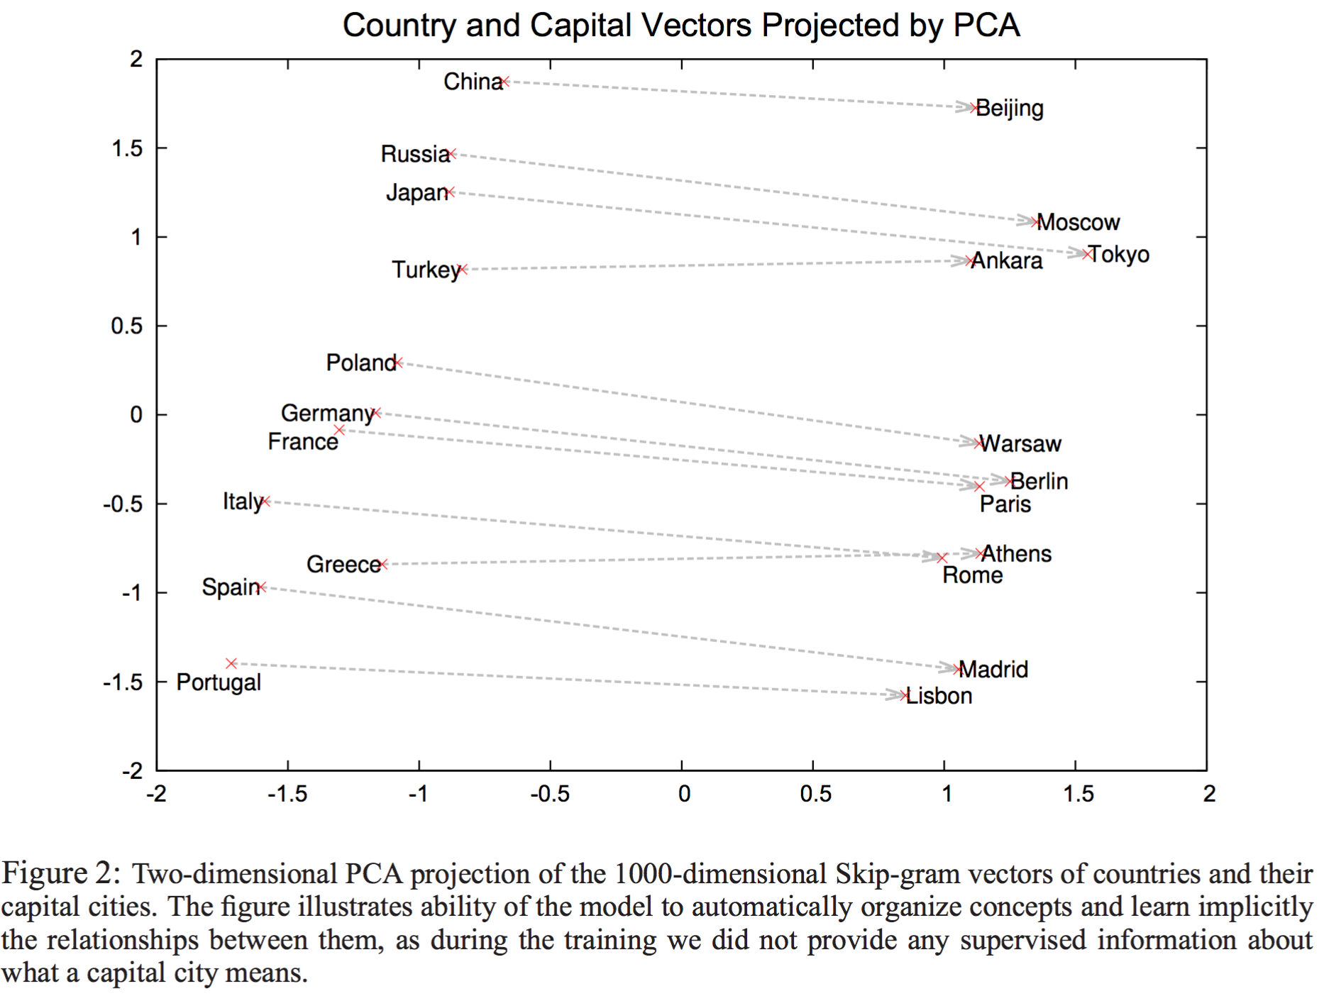
Word2vec: Results
Direction implies something!
v₁- v₂ for “capital of” relationship

Slide 21
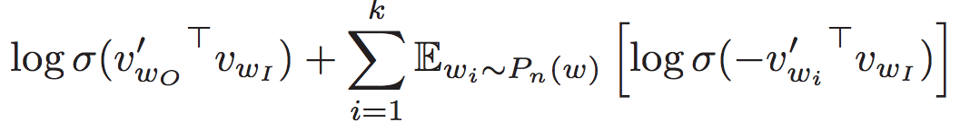
Word2Vec: Derivation [whiteboard]
Derive loss from Cross Entropy
Where P_{n}(w) is U(w)^{3/4}/Z, where U is unigram counts
Context Size Sampling: w2v does *not* select all adjacent terms within window C. Instead, it samples c~Uniform{1, C} and selects closest c-terms.

