Slide 1
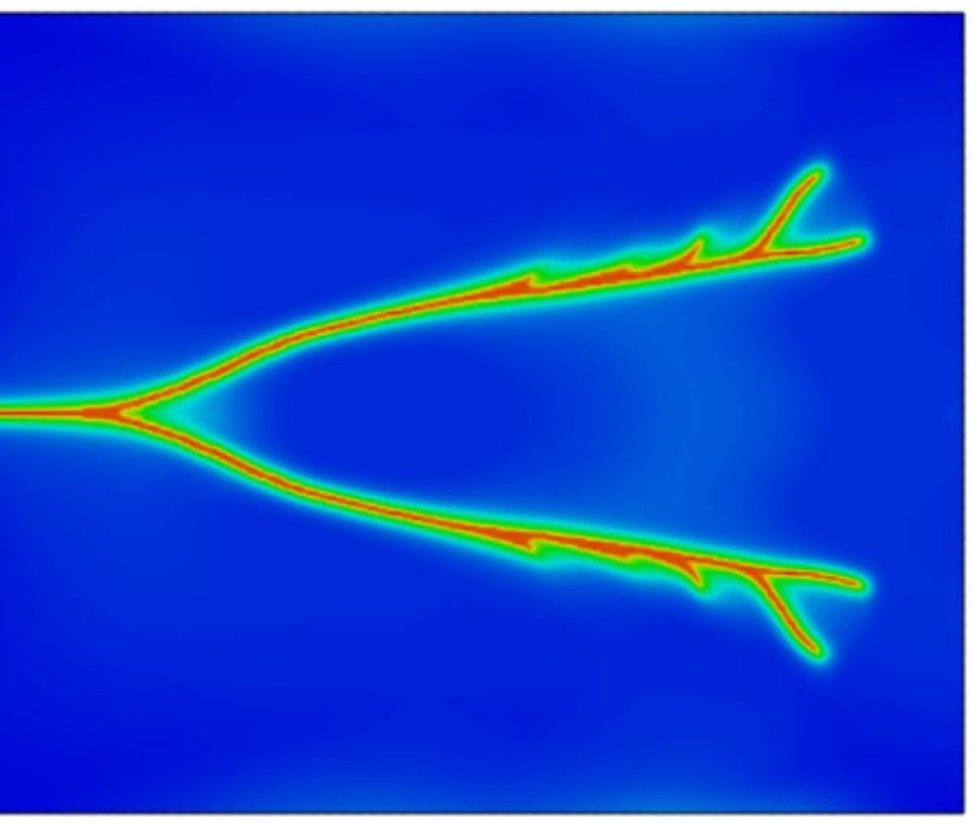
Parallel phase field simulation of Fracture propagation in poroelastic media
Notes:
Good afternoon, I am very excited to present my class final project, focusing on predicting hydrocarbon production using deep learning

Slide 2
Skeleton
short research proposal containing novel extensions of any of the techniques you have learned in the class.
Goal, specific objectives, current state of the
knowledge/previous work, techniques to be used, and expected results.
Goal: What’s the “big” problem? Why important? Statement of the problem: If you can “clearly”
state the problem, it often automatically suggests a solution.
2. Specific objectives: Step-by-step path to the goal.
3. Current state of the knowledge/previous work.
4. Techniques to be used: How to solve it? Big idea? Well-planned detail?
5. Expected results: Research full of surprises but needs hypothesis/test; broader impacts—so what?

Slide 3
What are my main goals?
Main goals of my work
Matlab parallelization of my coupled code
Phase field modeling

Slide 4
Why is this work relevant?
Tangible benefits

Slide 5
Why hasn’t this been done already?
Technical problems that make that goal difficult to achienve

Slide 6
What is your work focusing on? Main elements of my approach
Content

Slide 7
What makes you think you can do it? How do you handle the challenges?
How does your approach handle technical problems that have prevented progress in the past?

Slide 8
What are the novelty?
What are the unique, novel, and critical technologies developed in your approach

Slide 9
What are other applications of your work?
What are the potential spin-off

Slide 10
How can progress be measured?
How can anyone tell when you are succeeded

Slide 11
What have you accomplished thus far?
a

Slide 12
What is your schedule for the work remaining
W

