Slide 1
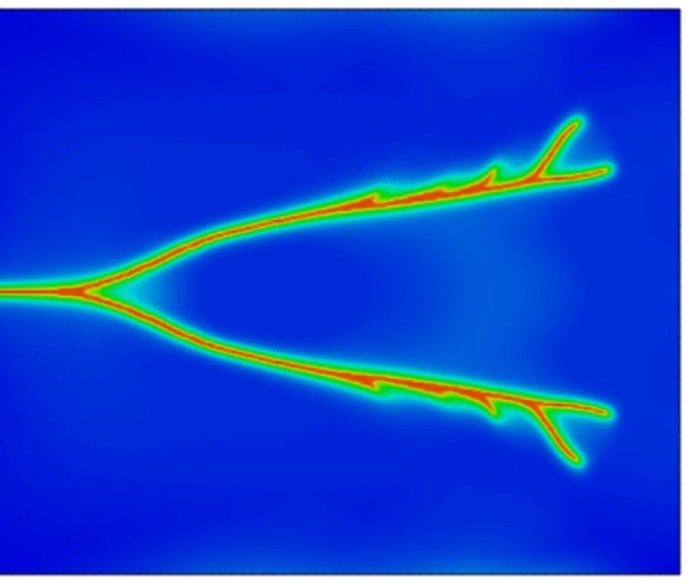
Parallel phase field simulation of Fracture propagation in poroelastic media
Notes:
Good afternoon, I am very excited to present my class final project, focusing on predicting hydrocarbon production using deep learning

Slide 2
Skeleton
short research proposal containing novel extensions of any of the techniques you have learned in the class.
Goal, specific objectives, current state of the
knowledge/previous work, techniques to be used, and expected results.
Goal: What’s the “big” problem? Why important? Statement of the problem: If you can “clearly”
state the problem, it often automatically suggests a solution.
2. Specific objectives: Step-by-step path to the goal.
3. Current state of the knowledge/previous work.
4. Techniques to be used: How to solve it? Big idea? Well-planned detail?
5. Expected results: Research full of surprises but needs hypothesis/test; broader impacts—so what?

Slide 3
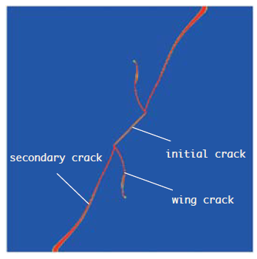
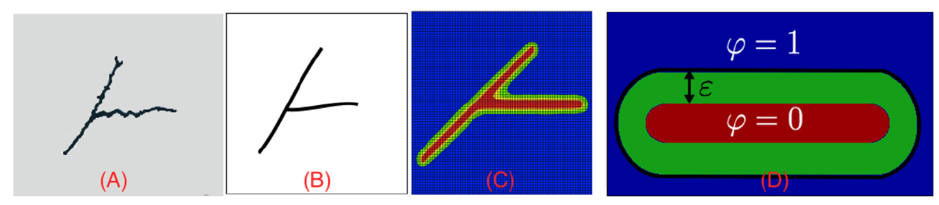
Phase Field Modeling
Numerical representation of fracture using a continuous auxiliary field
Naturally incorporate multi-field physics: process coupling, crack nucleation, growth, branching…
Easier computational implementation compared to discrete fracture modeling
Wu et al. 2019
Wheeler et al. 2020
Notes:
The method substitutes boundary conditions at the interface by a partial differential equation for the evolution of an auxiliary field (the phase field) that takes the role of an order parameter.
Important because

Slide 4
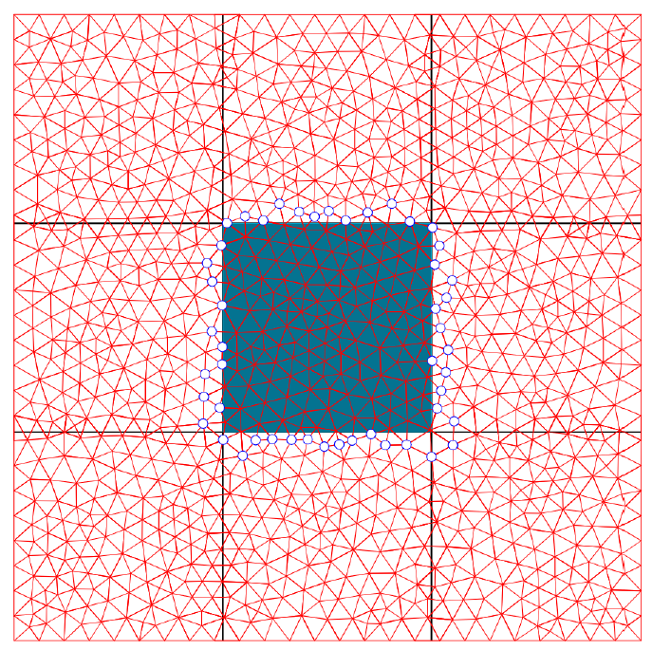
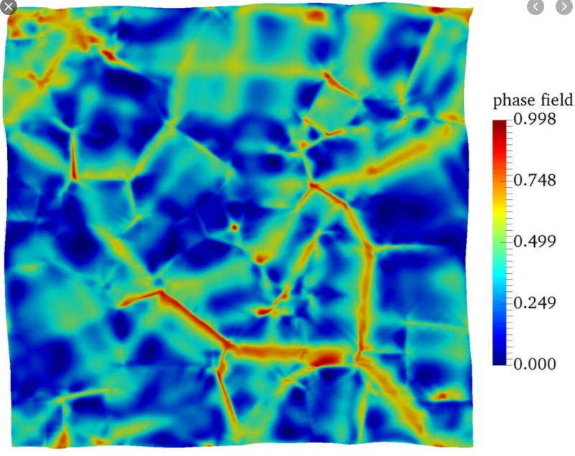
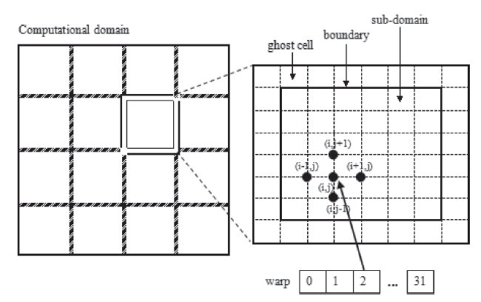
Computational Parallelization
Parallelization of the computational framework
Reduce computational cost due to required sufficiently refined mesh for phase field variable
Employ existing finite element libraries to implement fracture
Poromechanics Lab
Zhu et al. 2014
Notes:
To resolve high gradient of phase field variable
d. Simulations of coupled poromechanical or thermoporomechanical processes in field scales with high resolution usually require parallel computing capabilities. The flow models, the geomechanics model, and the thermodynamics model are modularized in the Integrated Parallel Accurate Reservoir Simulator (IPARS) which has been developed at the Center for Subsurface Modeling at the University of Texas at Austin. The IPARS framework handles structured (logically rectangular) grids and was originally designed for element-based data communication, such as the pressure data in the flow models. To parallelize the node-based geomechanics model, we enhance the capabilities of the IPARS framework for node-based data communication. Because the geomechanics linear system is more costly to solve than those of flow and thermodynamics models, the performance of linear solvers for the geomechanics model largely dictates the speed and scalability of the coupled simulator.

Slide 5
Why is this work relevant?
Tangible benefits

Slide 6
Why hasn’t this been done already?
Technical problems that make that goal difficult to achienve

Slide 7
What is your work focusing on? Main elements of my approach
Content

Slide 8
What makes you think you can do it? How do you handle the challenges?
How does your approach handle technical problems that have prevented progress in the past?

Slide 9
What are the novelty?
What are the unique, novel, and critical technologies developed in your approach

Slide 10
What are other applications of your work?
What are the potential spin-off

Slide 11
How can progress be measured?
How can anyone tell when you are succeeded

Slide 12
What have you accomplished thus far?
a

Slide 13
What is your schedule for the work remaining
W

