Slide 1

AI IN HEALTH HACKATHON 2026
MediPATH
Predictive Disease Intelligence System
Helping doctors predict what comes next — not replacing them.
Track 3: Health Data Analytics · March 2026 · Team MediPATH
10–15 yrs
Markov+ML
SHAP XAI
EHR-Ready
Patient History
Core Model
Explainability
Integration
Notes:
1

Slide 2
THE PROBLEM
Healthcare is Reactive.
It Should Be Predictive.
80% of chronic disease deaths in sub-Saharan Africa occur before age 70 — almost all from late or missed diagnosis (WHO, 2023)
👁
Doctors See Only Today
🔗
No Connection to Future Risk
🚑
Treatment, Not Prevention
Current EMR systems show the latest visit — not 10+ years of health history. Long-term patterns are invisible.
No system links past disease records to future risk. Data is stored but never analysed for progression patterns.
Clinicians treat disease after it appears. By then, the window for low-cost, high-impact intervention has closed.
Team MediPATH · AI in Health Hackathon 2026 · Track 3: Health Data Analytics · Problem
Notes:
2

Slide 3
OUR SOLUTION
MediPATH — What It Does
An AI clinical decision-support system that uses 10–15 years of patient history to predict which disease a patient is most likely to develop next — and recommends preventive action before it appears.
01
Learn from the Past
02
Compare & Match
03
Predict & Prevent
Model learns typical disease progression from thousands of patients with diabetes, hypertension, stroke, and kidney disease over 10–15 years.
For each new patient, MediPATH checks whether their symptoms, history, and risk factors match known disease trajectories.
Outputs a ranked list of likely future conditions with probability scores and recommended clinical actions — before the next disease appears.
Team MediPATH · AI in Health Hackathon 2026 · Track 3: Health Data Analytics · Solution
Notes:
3

Slide 4
HOW IT WORKS
System Flowchart
1 Patient
Data Input
2 Pattern
Matching
3 Decision
Gate
4 Context
Layer
5 Prediction
Output
Doctor enters
5 key diseases
ML compares vs
training data
≥4/5 match?
High confidence
Env · Family
Lifestyle · BMI
Risk scores +
SHAP why
Chain Disease Progression
Contextual Fallback (when match < 4/5)
Hypertension
Diabetes
Kidney Dis.
Dialysis
🌍
Environment
🧬
Family History
Region, climate, pollution
Hereditary conditions
→ 61%
→ 48%
→ 34%
Each arrow represents the transition probability from one disease state to the next, learned from 10–15 years of longitudinal patient records.
🏃
Lifestyle
📊
Demographics
Diet, smoking, exercise
Age, gender, BMI
Team MediPATH · AI in Health Hackathon 2026 · Track 3: Health Data Analytics · How It Works
Notes:
4

Slide 5
SYSTEM ARCHITECTURE
Three-Layer Architecture
Data Layer
Processing Layer
Output Layer
Patient EHR Records
Data Cleaning Module
Risk Score Calculator
Lab Results Database
Feature Extraction
Disease Prediction API
Doctor Clinical Records
Markov Chain Builder
SHAP Explainer Module
Medication History
ML Training Pipeline
Doctor Dashboard UI
Symptom Logs & Intake
Pattern Recognition
Alert & Report Engine
Core Technologies:
Python 3.x
TensorFlow
Flask API
MySQL
Jupyter
Team MediPATH · AI in Health Hackathon 2026 · Track 3: Health Data Analytics · Architecture
Notes:
5

Slide 6
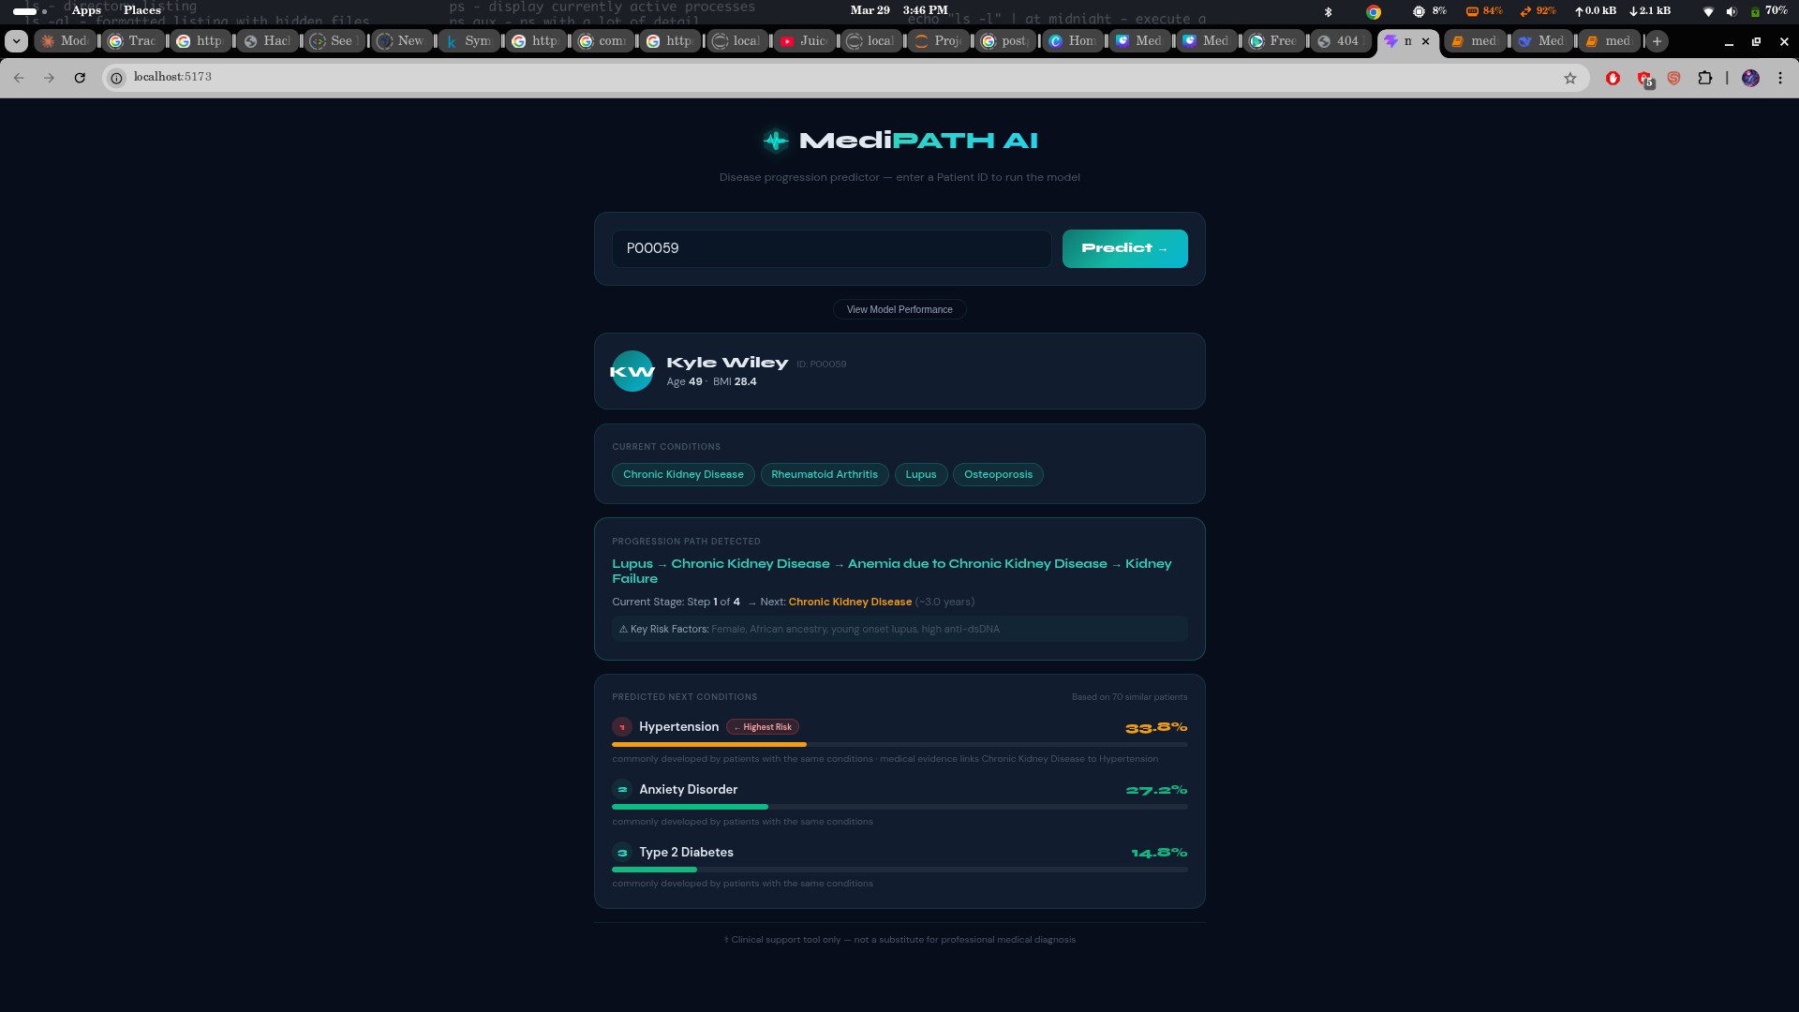
PROTOTYPE
Live System Output — Doctor Dashboard
MediPATH Clinical Dashboard · Patient P00059
Team MediPATH · AI in Health Hackathon 2026 · Track 3: Health Data Analytics · Prototype Demo
Notes:
6

Slide 7
RESULTS
Model Performance & Impact
84%
91%
0.89
< 2s
Overall Accuracy
Recall (High-Risk)
AUC-ROC Score
Prediction Latency
on held-out test set
sensitivity on high-risk cases
Diabetes prediction model
per patient at runtime
Algorithm Comparison
SHAP Explainability — Type 2 Diabetes
Algorithm | Accuracy | Interp. | Role
Markov Chain | — | High | Primary progression
Random Forest | 84% | Medium | Pattern matching
Gradient Boost | 81% | Low | Risk refinement
Neural Net | 79% | Very Low | Experimental
Blood Pressure
34%
Glucose Trend
28%
Family History
21%
BMI
17%
Team MediPATH · AI in Health Hackathon 2026 · Track 3: Health Data Analytics · Results
Notes:
7

Slide 8
CONCLUSION
MediPATH
What
Comes
Next
is not just a project. It is a step toward saving lives.
✓
Predicts disease before symptoms appear using Markov Chain + ML
Hospital pilot programme
✓
Doctor-first: clinical decision support — not autonomous replacement
✓
Cold-start problem solved with doctor-seeded training data
Mobile patient app
✓
Explainable AI — doctors always see the 'why' behind every prediction
Wearable integration
✓
Built for sub-Saharan Africa's healthcare reality, scalable globally
✓
Privacy-compliant, EHR-integration ready, future-proof architecture
Public health dashboard
Thank You — We Welcome Your View
Notes:
8

