Slide 1
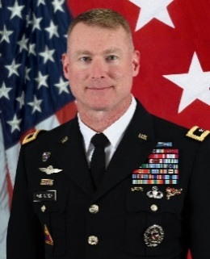
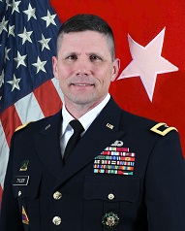
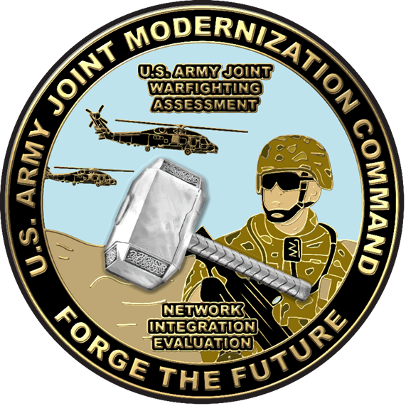
Major General
Terrence J. McKenrick
Outgoing Commander
Joint Modernization Command
Brigadier General
Joel K. Tyler
Incoming Commander
Joint Modernization Command
Major General Terrence J. McKenrick assumed duties as the Commanding General of U.S. Army Joint Modernization Command on August 20th, 2015. He was commissioned in Infantry from the U.S. Military Academy at West Point. He most recently served as Deputy Commanding General (Operations) of 1st Armored Division and Director of Central Command Forward in Jordan.
He previously served as Deputy Director for Operations of the National Military Command Center in the J-3 Directorate of the Joint Staff. He also served as Chief of Staff of the Office of Security Cooperation in Iraq. Prior to his joint assignments, he served as Commander of the 192d Infantry Brigade at Fort Benning and Commander of the Warrior Transition Brigade at Walter Reed Army Medical Center.
He previously served in command and staff positions from platoon through Joint Staff level, including tours of duty with 3rd Infantry Regiment (The Old Guard), 25th Infantry Division, U.S. Army Pacific, Total Army Personnel Command, 75th Ranger Regiment, 2nd Ranger Battalion, U.S. European Command, 4th Ranger Training Battalion, V Corps, and Multi-National Corps in Iraq. He served an overseas assignment in Hawaii, two tours in Germany, deployment for Operation Uphold Democracy in Haiti, two tours for Operation Iraqi Freedom, and deployment to Jordan for Operation Inherent Resolve and Operation Spartan Shield.
He earned a Master of Science Degree in National Resource Strategy from the Eisenhower School for National Security, and a Master of Arts Degree in Human Resources from Hawaii Pacific University.
His awards and decorations include two Defense Superior Service Medals, three Legions of Merit, Bronze Star Medal, Defense Meritorious Service Medal, five Meritorious Service Medals, Joint Service Commendation Medal, three Army Commendation Medals, Joint Service Achievement Medal, four Army Achievement Medals, Expert Infantryman Badge, Ranger Tab, Master Parachutist Badge, Air Assault Badge, Pathfinder Badge, and Joint Chiefs of Staff Identification Badge.
He is married to the former Elizabeth Hruby and they have two sons and a daughter, 2LT Christian McKenrick, Mariah, and Justice.
Brigadier General Joel K. Tyler was commissioned in Armor from the University of Arkansas Army ROTC in 1988. He is currently assigned as a Deputy Commanding General (DCG) for the 1st Armored Division at Fort Bliss, Texas. BG Tyler served as the J-3 for Combined/Joint Task Force – Operation Inherent Resolve from September 2015-August 2016. His other assignments include service in the Federal Republic of Germany, Republic of Korea, and around the continental United States in both FORSCOM and TRADOC assignments. He has deployed to OPERATION DESERT SHIELD/STORM, OPERATION IRAQI FREEDOM, and OPERATION SPARTAN SHIELD.
He is a graduate of the Scout Platoon Leader's Course, Armor Officer Basic and Advanced Courses, the Field Artillery Officer Advanced Course, Combined Arms and Services Staff School, the Command and General Staff College, and the United States Naval War College. He holds a B.A. in Political Science from the University of Arkansas, M.S. from Central Michigan University in Public Administration, and M.A. from the College of Naval Warfare in National Security and Strategic Studies.
BG Tyler’s awards include the Defense Superior Service Medal, Legion of Merit, Bronze Star Medal, Defense Meritorious Service Medal, Army Meritorious Service Medal, Army Commendation Medal, the Army Achievement Medal, Iraq Campaign Medal, National Defense Service Medal, Global War on Terrorism Expeditionary and Service Medals, Korean Service Medal, Saudi Arabian/Kuwait Liberation Medal, Kuwait Liberation Medal, Overseas Service Ribbon, Parachutist Badge, and the Army Staff Identification Badge.
He is married to the former Miss Stacy Hunter of Radcliff, Kentucky; their children are Caroline and Sophia, and hound dogs Dash and Riley.

