Slide 1
Joint Concept for Integrated Campaigning Executive Overview Brief January 2016

Slide 2
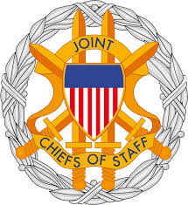
We traditionally see ourselves at either peace or war, with war being an undesirable exception.
War/Conflict
“The Campaign
Effort”
Peace
Peace
In response, we’re pre-disposed to seek a rapid, conclusive “end” and return to normalcy – even though that is not our historical experience.
At times, the DoD exhibits an incomplete understanding of war/conflict (Ex. our “first battles”). Moreover, we’ve created and maintained a framework to our liking – one in a manner of how we would prefer conflict to unfold, but not one reflecting reality.
Within the defense community, this has led to a narrow and inelastic interpretation of operational art and a flawed philosophy and model of campaigning.

Slide 3
Is this a fair model of the universe of competitive Int’l Relations and Differing Styles of Warfare and Conflict?
Do we understand how to campaign in this space?
The ambiguity, diffusion of political power, and proliferation of lethal technologies presented in this space exacerbate the ‘U.S. way of war’.
Problems in Int’l Rel in this space don’t necessarily lend themselves to rapid, decisive operations
Success requires deep understanding, persistence, perseverance & adaptive and agile joint forces
Traditional / Conventional Warfare
WW II 1941
Iraq 2003
Unconventional Warfare
Korea 1950
WW I 1918
More
Severe
Iraq 1990
Grenada 1983
North Korea 2015
Panama 1989
China 2015
Civil War 1861
Iran 2015
Israel/Lebanon
Russia/Georgia 2008
We like to think we understand this space fairly well. We consider this style of warfare our strength/advantage
Focused on state on state conflict using overwhelming military force to achieve total victory or unconditional surrender
However, twice in the past 100 years, this has led to an Armistice condition.
Resources and processes (man, equip, train, budget, institutions, laws, and authorities) are set up/optimized for this space
Our experience is viewed as successful military operations with mostly enduring and acceptable outcomes
Russia/Ukraine 2015
ISIS
Afghanistan 2007
Consequence
AQ Pre-2001
Vietnam 1961
Columbia 1978
Yemen 2015
Dominican Republic 1965
Lybia 2011
Nicaragua 1912
Guatemala 1966
Philippines 1899
Cold War 1945-1989
Less
Severe
Political Warfare
Irregular Warfare
‘Peace’
Spectrum of Competition and Conflict
‘War’
Do we have adequate theories, concepts, tools, practices, and elements of design to campaign effectively across the entire spectrum of conflict and competition?

Slide 4
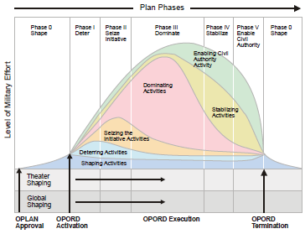
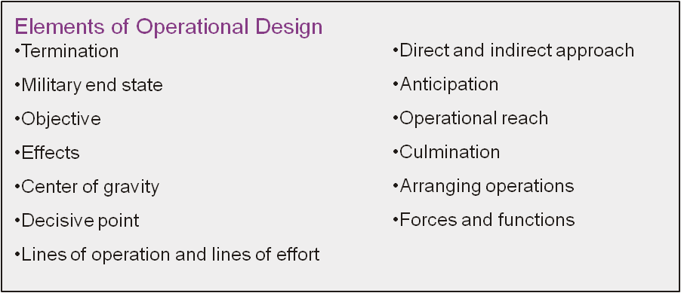
Is the current “Notional Plan Phasing Construct “ the tool that seeks to account for that universe?
Peace
War/Conflict
Peace
Whether we meant
it to be or not, this
illustration has become
a substitute campaign
model across DoD.
JP 5-0, Joint Operational Planning

Slide 5
When do we ‘think’ we actually campaign?
Peace
War/Conflict
Peace
Phase 0 – Shaping
JP 1, JP 3-0, & JP 5-0 describe CCMDRs’ actions in this space as “routine and normal activities”
…the model suggests that either DoD is either at peace or waging warfare – but accounts for very little in-between. JP 1.0’s Chapter IV characterizes CCDRs’ duties as:
“CCDRs are responsible for the development and production of joint plans and orders.
During peacetime, they act to deter war through military engagement and security
cooperation activities and prepare to execute other missions that may be required.
During a conflict/combat, they plan and conduct campaigns and major operations to
accomplish assigned missions.” -JP 1.0
JP 5-0, Joint Operational Planning

Slide 6
Where do we focus our institutional attention?
Peace
War/Conflict
Peace
DoD’s philosophy, processes, intellectual efforts, focus on and optimize for Phases II and III. Of course for good reasons, but we can account for more.
“Steady-State”?? “Sustained Conflict”? Post-Conflict?
JP 5-0, Joint Operational Planning

Slide 7
What comes after military success? What do we tell ourselves we do after achieving military success?
At times, DoD sees this space as discretionary. Alternatively, history demonstrates that it’s a very demanding and essential part of the campaign/conflict.
Peace
War/Conflict
Peace
At issue is - this is where we create conditions to achieve or enable desirable and sustainable outcomes.
Assessing this space as “optional” doesn’t alleviate the risks resonant and posed by these conditions; nor that we won’t have to conduct missions required in this space.
CCDRs consistently execute tasks normally associated with phases IV and V throughout Phase Zero.
“Steady-State”?? “Sustained Conflict”? Re-characterization
JP 5-0, Joint Operational Planning

Slide 8
Thoughts on Termination and Military Endstate
Peace
War/Conflict
Peace
?
In one area of our joint doctrinal prose, we say the military endstate is used to define termination criteria; in another area, we say termination criteria defines the military endstate. Moreover, we say POTUS/SECDEF “give” us the termination criteria; however, analysis of our model suggests these terms are fairly synonymous, but not centered on or tied to achieving a sustainable political outcome.

Slide 9
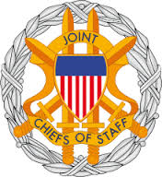
An Incongruent Trinity The Relationship of Military End State, Termination, and Realizing the Aim-
Military
End State
?
Termination
?
Realize Aim*
?
-There is an intellectual gap in how DoD theorizes the translation of military success/advantage into enduring and favorable outcomes. Where in the model would you plot
Termination?,… Military End State?,… Realizing the Aim?
We need to recognize that we have adopted a poor and ahistorical model to describe that translation,
selected bad terms to describe that model, and defined those terms with even worse descriptions.
We don’t account for a achieving a sustainable outcome in our philosophy of campaigning and joint
design methodology. Joint doctrine explains that in planning - we’ll be “told” what to do after we’ve rapidly and decisively defeated the adversary – Really?? Are there adversarial approaches that avoid or are immune to rapid, decisive operations? What are examples of relevant elements of design that would be useful in crafting campaigns to counter those styles of warfare? How would we translate Mil success in those conditions into outcomes? …….How should we begin to re-think our philosophy of campaigning
*Aim or Outcome is not a current element of Joint Operational Design

Slide 10
How has the US effectively turned military victory into achievement of the aim and favorable, sustainable success?
Acceptable
Security
Situation
New and
Favorable
Conditions
Bi-lateral
partnership
Enduring
Commitment
Re-Characterization
Of the Conflict
War/Conflict
Success/Armistice
Migration
Transition
X X X X ?
Perpetuation
Advantageous
Political
Outcome
Sustainable/Acceptable
Political Outcome
Consolidation Consolidation Consolidation
First of all, a sustainable outcome(s) is the aim of every campaign, not simply the destruction of the adversaries’
war-making capability, or merely to attain a Military Endstate and then seek Termination. Successful US-led campaigns account for the deep understanding required, amount of force needed, and time necessary to deliver/enable sustainable outcomes as we move from sustained conflict through a re-characterization period; to creating favorable conditions(when we do it right); then to acceptable security situations; and later to a partnership and an enduring commitment to perpetuate our gains/realized advantage. Furthermore, successful campaigns seek to consolidate gains as they materialize. Consolidation isn’t elective or discretionary, its required and perpetual. Joint leaders can’t wait for an imaginary time/space where conflict and risk are absent in order to consolidate. Finally, Joint Forces execute tasks from all phases, all the time throughout the campaign. Our current joint campaign construct doesn't account for the level of effort, time, and forces required to turn military victory into successful and sustainable outcomes.

Slide 11
Trend of U.S. Consolidation/Commitment Beyond Armed Conflict 1898-2015
- Accomplishing just military objectives doesn’t necessarily lead to political aims or to the termination of military operations in support and sustainment of those policy goals. The aspect of finality is elusive.
Success requires a continued level of military effort beyond sustained conflict to consolidate gains in order to realize/enable the political outcome in the dynamic conditions following military success, and afterwards, perpetuate and sustain that outcome.
History shows that U.S. forces continue to operate long after the cessation of sustained armed conflict, sometimes for years or decades. Joint Force presence enables the other elements of national power.
* In many instances the conflict phase took only weeks or months to achieve - far less than the "1 year" annotation depicts. Often there was little or no major combat activity and consolidation activities began immediately.
Conflict
Consolidation/Commitment
17 Aug 2015

Slide 12
Where do we think we see risk across the model?
Peace
War/Conflict
Peace
DoD views the preponderance of risk occurring in Phase III.
“Steady-State”?? “Sustained Conflict”? Re-Characterization
JP 5-0, Joint Operational Planning

Slide 13
Where do we see risk?
Peace
War/Conflict
Peace
“Steady-State” “Real War” Re-Characterization
Is there risk across all three spaces?
JP 5-0, Joint Operational Planning

Slide 14
How are our competitors operating? (1 of 2) Are they really operating within our Phase 0? Or….
Peace
War/Conflict
Peace
Adaptive enemies are countering our model by operating below our thresholds for action and avoiding our strengths
More and more, we are realizing there is no such thing as a steady-state, only varying degrees of dynamic states as a function of the “continual ebb and flow of international relations”
Our current model is based on how we “wish” campaigning and conflict unfolded, for the style of warfare
we would prefer to fight. However, it doesn’t reflect the US’ historical experience or reality. It doesn’t
Enable the most effective and informed application of the joint force or the Pentagon's essential
institutional processes. Finally, using this model throughout joint education constrains or even inhibits
senior leader development.
JP 5-0, Joint Operational Planning

Slide 15
Are our potential adversaries’ approaches unfolding within a gap of our Joint Campaigning philosophy and construct? (2 of 2)
?
Chinese
SCS Coercion
Russian
Aggression
nK
Provocation
Iranian
Influence
TCP
?
GCP
State and non-state adversarial approaches are accomplishing wartime-like objectives beyond the reach, authorization, and effectiveness of existing theater campaign efforts and US law, title, and code but far short of provoking the US toward seeking a legitimate Int’l community charter(such as an UNSCR or NATO Defense Treaty Article) or unilateral response. Our current philosophy of campaigning doesn’t recognize this nuance. An alternative model must enable the US to legitimately campaign in this space to actually counter and defeat adversary approaches characterized by episodic and continual confrontations of narrative, cyber intrusion, influence actions, and ambiguous force without sustained conflict
JP 5-0, Joint Operational Planning

Slide 16
The Frustration of Alternative Styles of Warfare
“Hybrid warfare is a term that sought to capture the blurring and blending of previously separate categories of conflict. It uses a blend of military, economic, diplomatic, criminal, and informational means to achieve desired political goals.”
“ The Chairman of the Joint Chiefs of Staff, General Martin Dempsey, has referred to these hybrid threats as an “inflection point” in modern war. Indeed, in the disordered post-Cold War world, hybrid warfare remains an excellent framework for understanding the changing character of war(fare).”
“The concept,…. allows NATO to avoid action because a range of activities – from the aggressive use of disinformation by Moscow, to economic pressure, to bribery and threats, to use of “locals” to stir up protests – become conveniently categorized as being under the threshold of war. Indeed as one expert, James Sherr, has observed,…Russia(n) hybrid warfare could “cripple a state before that state even realizes the conflict had begun,” and yet it manages to “slip under NATO’s threshold of perception and reaction.” Sherr is right.”
Hybrid threats provide the “perfect” conundrum: the injection of so much uncertainty that NATO collapses under its own principle of allied consensus. At what point does the alliance decide if the Lithuanian President, Dalia Grybauskaite, is correct when she remarked that Lithuania was “already under attack,” with the first stage of confrontation taking place – informational war, propaganda and cyber attack?
Dr. Nadia Schadlow, “The Problem with Hybrid War”, War on the Rocks, 2 April 2015
(http://warontherocks.com/2015/04/the-problem-with-hybrid-warfare/

Slide 17
Changes in the Character of Armed Conflict
According to General Valery Gerasimov, Chief of the Russian General Staff
Traditional Military Methods
New Military Methods
Military action starts after strategic
deployment (Declaration of War)
Military action starts by groups during
peacetime (War is not declared at all)
Non-contact clashes between highly
maneuverable inter-specific fighting groups
Annihilation of the enemy’s military power by
short-time precise strikes in strategic military
and civilian infrastructure
Massive use of high-precision weapons and
special operations, robotics, and weapons that
use new physical principles (direct energy
weapons – lasers, shortwave radiation, etc.)
Use of armed civilians (4 civilians; 1 military)
Simultaneous strike on the enemies units and
facilities in all of the territory
Use of Asymmetric and indirect methods
Management of troops in a unified informational sphere
Sphere.
Frontal Clashed between large units
consisting mostly of ground units
-Defeat of Manpower, firepower, taking control
of regions and borders to gain territorial control
-Destruction of economic power and territorial
annexation
-Combat operations on land, sea, and air
-Management of troops by rigid hierarchy
and governance
Berzins, Janis, “Russia’s New Generation Warfare in Ukraine: Implications for Defense Policy” The Journal of Military Operations – discussions on the Conduct of War. Pp. 4-7 The IJ Infinity Group. Tel Aviv, 2014.

Slide 18
Main Guidelines for developing Russian military capabilities by 2020…
From direct destruction to direct influence
From direct annihilation of the opponent to its “inner decay” (and will)
From a war with weapons and technology to a culture of war
Form a war with conventional forces to specifically prepared forces and
commercial irregular groupings
From the traditional (3D) battle ground to information/psychological warfare and war of perceptions.
From direct clash to “contactless war”
From a superficial and compartmented war to a total war, including the enemy’s side and base
From war in the physical environment to a war in the human consciousness and in cyberspace
From symmetric to asymmetric warfare by a combination of political, economic, information, technological, and ecological campaigns
From a war in defined period of time to a state of permanent war as the natural condition in national life.
Berzins, Janis, “Russia’s New Generation Warfare in Ukraine: Implications for Defense Policy” The Journal of Military Operations – discussions on the Conduct of War. Pp. 4-7 The IJ Infinity Group. Tel Aviv, 2014.

Slide 19
Modern Russian Approach Compared to DoD’s JOPES Phasing Construct (Bins vs. Phases)
Invisible
Visible
Bin #4
Bin #8
Destabilize thru propaganda to increase discontent,
boosted by the arrival of “bands” of
militaries, escalating subversion.
Roll over the remaining points of
resistance and destroy surviving
enemy units by special operations
Bin #7
Bin #3
Combined targeted information,
electronic warfare & aerospace ops
continuous air force harassment,
with the use of high-tech weapons
Coercion & Undermining
Bribe, Intimidate,
Deceive government
and military officials
Bin #2
Bin #6
Info/Diplomatic Deception
Confuse/Stymie/Mislead
Adversary’s understanding
and decision making
Commence military action w/ all types, forms, methods, and forces. Preceded by large scale recon
and subversive missions.
Bin #1
Bin #5
Non-military asymmetric
warfare - “Favorable
POL/MIL & economic setup”
Establish of no-fly zones over the adversary’s country, impose blockades, Extensive use of private military companies in close cooperation with armed opposition units.
In the context of employment, these groupings of activities seem more like bins of tool boxes or capabilities
the Russians apply based on local/area METT-TC as opposed to sequential and mechanical phases.

Slide 20
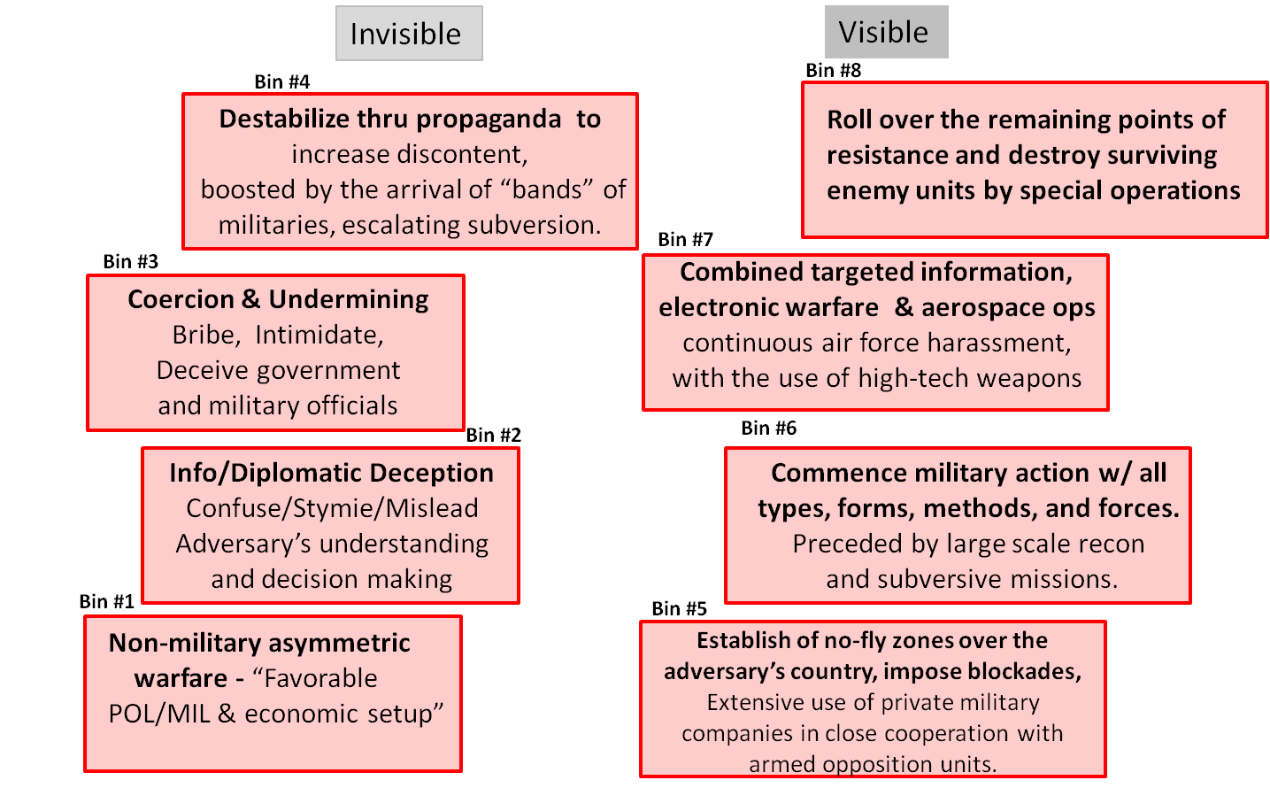
The Russian “New Gen” Approach compared to how we prefer conflict to unfold
Does the current campaign framework “substitute” help us think through the military’s role and contribution in countering our potential adversaries’ modern styles of warfare?
War/Conflict
“The Campaign
Effort”
Peace
Peace
What the Russians are willing to pursue against our partners’ interests in the space that we want to consider “peacetime” is dramatic.
Many nations, including our possible adversaries don’t have the same bi-furcated view that they are either at peace or war. They see their actions “…as a natural part of the ebb and flow of international relations “
ver3

Slide 21
Are we seeing other similar approaches unfolding?
War/Conflict
Coercion,
Provocation cycle,
Mal-influence
ISIL
“The Campaign
Effort”
Peace
Peace
It’s not too hard to intellectually place the Chinese, nK, ISIL, and Iranian unfolding activities in the same space.
ver3

Slide 22
What are the Joint Forces’ capabilities and range of activities within in the theater campaign’s current description?
Public Affairs
MISO
Precision Strike
Civil Affairs
IO
Missile Defense
UW
Coop w/ NGOs
IAD
HA/DR
Detect Threat Networks
R&S
CT
1206
Personnel Recovery
SSA
FID
FMO
MIL Deception
Raids
COIN/SFA
EW
NEO
MIL Engagement
Counter WMD
ISR
MN Exercises
Intel Sharing
Strategic Deploy
What do our bins of capabilities look like? What should the bins look like? Are these “tools” really integrated or synchronized within a coherent model for campaigning beyond traditional
armed conflict? Are these just functional activities employed wherever they can be “squeezed in”, toward loosely or ill-defined objectives? Can we organize, authorize, and arrange these capabilities to counter the adversaries approaches we see currently unfolding?

Slide 23
Don’t we need to actually campaign in all spaces?, Do we continue campaigning after sustained hostilities subside?
Peace
War/Conflict
Peace
???
???
Have we properly defined this space we currently refer to as Phase 0? How about Phases IV/V and beyond.
Do we have a clear understanding and framework of how to campaign in these spaces? What is our Theory of Shaping? What is the Joint Force’s Theory of Consolidation?
Do we currently recognize and appreciate the requirements and demands beyond “just” military victory to actually translate that success into real outcomes?
JP 5-0, Joint Operational Planning

Slide 24
Are we really accounting for the universe of competitive International Relations and Conflict in our model?
Traditional / Conventional Warfare
WW II 1941
Iraq 2003
Unconventional Warfare
Korea 1950
WW I 1918
More
Severe
Iraq 1990
Grenada 1983
North Korea 2015
Panama 1989
China 2015
Civil War 1861
Iran 2015
Israel/Lebanon
Russia/Georgia 2008
Russia/Ukraine 2015
ISIS
Afghanistan 2007
Consequence
AQ Pre-2001
Vietnam 1961
Columbia 1978
Yemen 2015
Dominican Republic 1965
Lybia 2011
Nicaragua 1912
Guatemala 1966
Philippines 1899
Cold War 1945-1989
Less
Severe
Political Warfare
Irregular Warfare
‘Peace’
Spectrum of Competition and Conflict
‘War’
Are we effectively preparing future joint leaders?

Slide 25
Emerging Examples of Alternative Campaigning Models will seek to describe, illustrate, and account for:
Traditional / Conventional Warfare
WW II 1941
Unconventional Warfare
Iraq 2003
Korea 1950
WW I 1918
More
Severe
Iraq 1990
1. An expanded & relevant array of elements of joint operational design (true campaign design)
2. A methodology/description for the idea of shaping
3. A methodology for translating military success into sustainable outcomes.
4. The interdependence needed to achieve sustainable outcomes.
5. Ideas for embedded assessment
6. That political aims will continually evolve.
7. The NMS’ expanded view of the continuum of conflict.
8. Hybrid relationships. (Flexible command relationships)
9. Multiple aspects of risks of non action, risk of strategic failure, risk of changed environment
after operations, risks missed opportunities.
10. The relationship between actions at the strategic level and operational campaigning.
* And up to 5-10 more aspects
Grenada 1983
North Korea 2015
Panama 1989
China 2015
Civil War 1861
Iran 2015
Israel/Lebanon
Russia/Georgia 2008
Russia/Ukraine 2015
ISIS
Afghanistan 2007
Consequence
AQ Pre-2001
Vietnam 1961
Columbia 1978
Yemen 2015
Dominican Republic 1965
Lybia 2011
Nicaragua 1912
Guatemala 1966
Philippines 1899
Cold War 1945-1989
Less
Severe
Political Warfare
Irregular Warfare
‘Peace’
Spectrum of Competition and Conflict
‘War’

Slide 26
Joint Concept for Integrated Campaigning Executive Overview Brief January 2016

