Slide 1
Mathematical models of epidemics
As a matter of fact, all epidemiology, concerned as it is with
the variation of disease from time to time or from place to place, must be considered mathematically.
Sir Ronald Ross
Tomasz Raducha
Faculty of Physics
University of Warsaw
08.03.2016

Slide 2
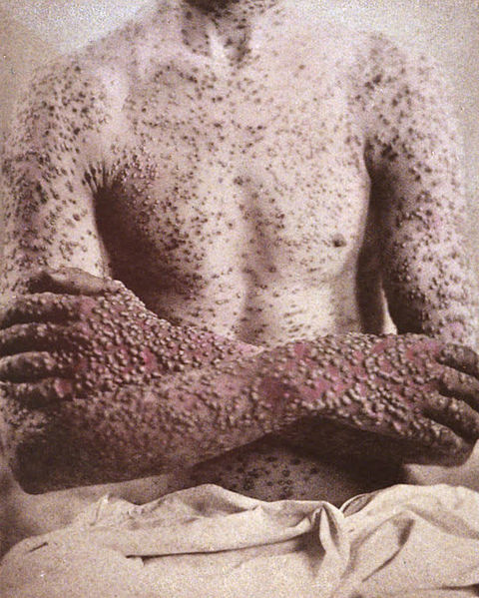
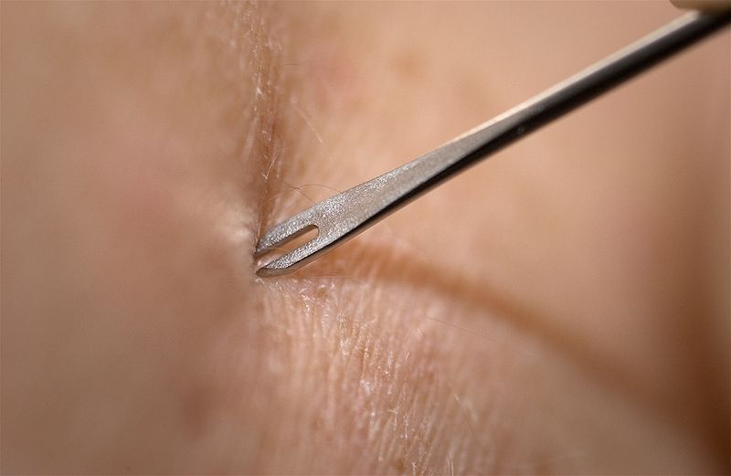
Daniel Bernoulli 1766 (Basel)
Smallpox epidemic in Europe
Inoculation controversy
Bernoulli received empirical data from Charles Marie de la Condamine

Slide 3
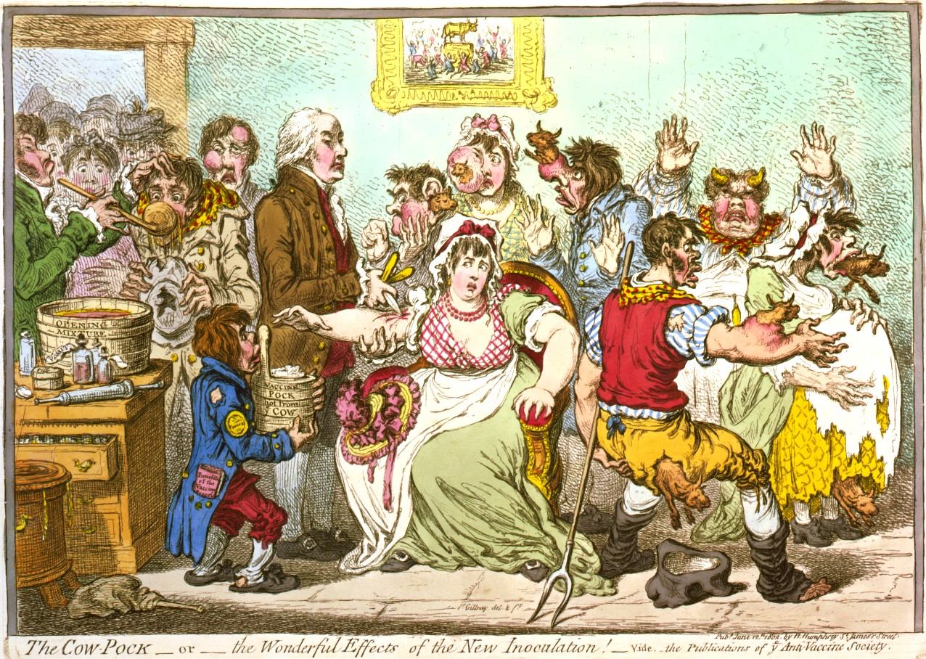

Slide 4



u(a) – probability of a newborn to be alive and susceptible at age a
w(a) – probability of a newborn to be alive and immune at age a

Slide 5
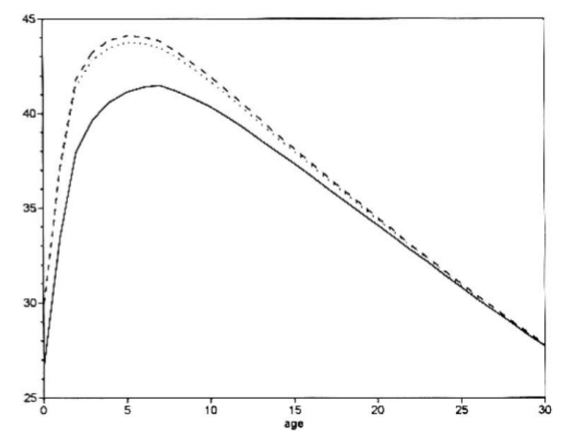
Two differential equations
Consistent with Halley's tables for Wroclaw
Bernoulli
E(a|age)
Halley
The life expectancy of individuals who have survived a given age.

Slide 6

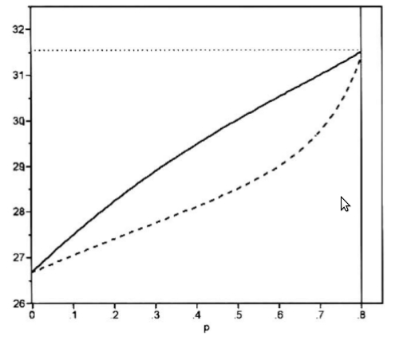
No epidemic when >80% of population is vaccinated
vaccinated
E(a|0)
average
non-vaccinated
Life expectancy at birth as a function
of the proportion immunized p

Slide 7
W. O. Kermack and A. G. McKendrick 1927
Differential epidemic model
No age dependency
Three classes of people
    S – susceptible
    I – infected
    R – recoverd or removed (dead)
Dynamical model – S, I, R depends on time

Slide 8
SI (SIS) model
S I
r – rate of becoming ill
a – rate of recovery

Slide 9
SI (SIS) model
Stationary state:

Slide 10
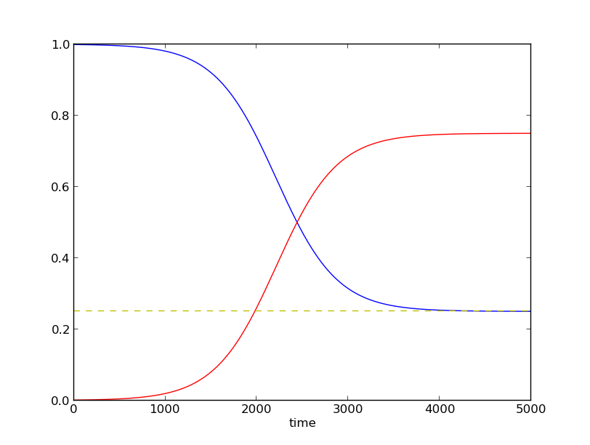
SI (SIS) model

Slide 11
Two definitions of epidemic:
1. Initial growth of number
of infected individuals
2. Significant fraction of people
infected at some point

Slide 12
SIR model
S I R
r – rate of becoming ill
a – rate of recovery

Slide 13
SIR model
Stationary state:

Slide 14
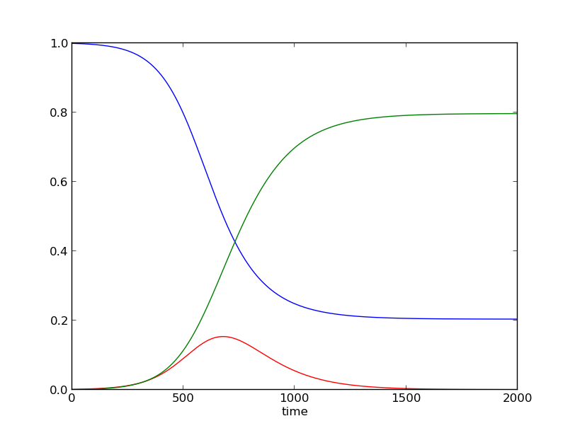
SIR model

Slide 15
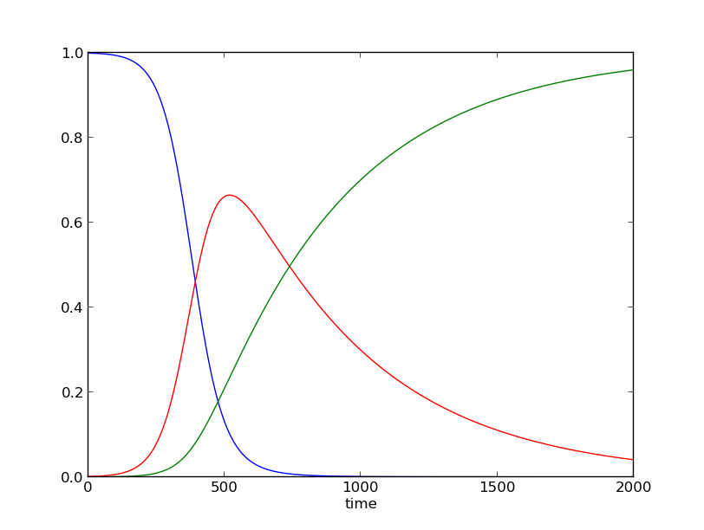
SIR model

Slide 16
SIRS model
S I R S
r – rate of becoming ill
a – rate of recovery
c – rate of becoming susceptible

Slide 17
SIRS model
Stationary state:

Slide 18
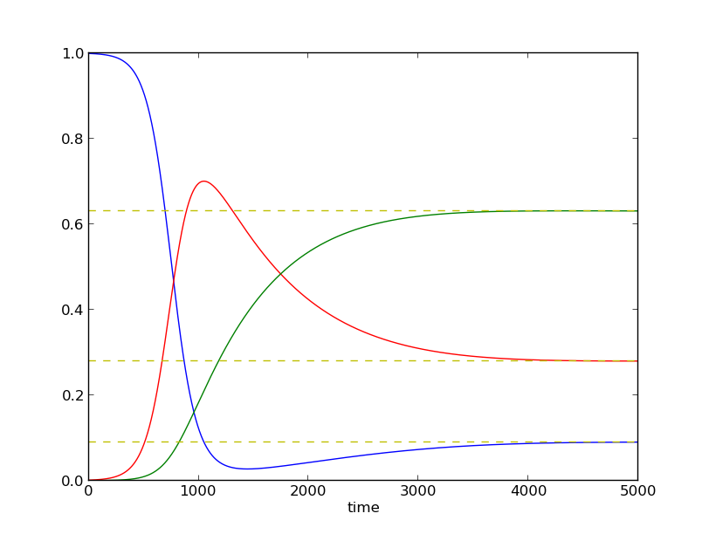
SIRS model

Slide 19
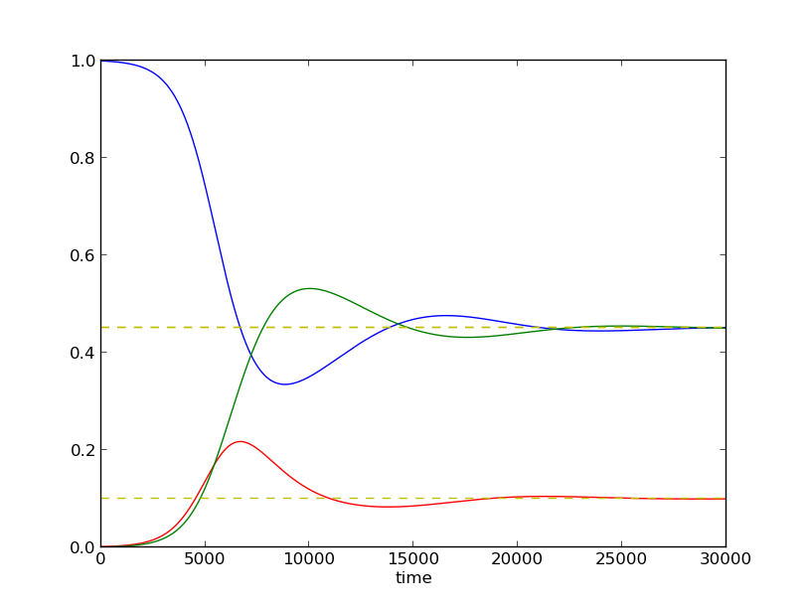
SIRS model

Slide 20
SEIR model
S E I R
r – rate of becoming exposed
a – rate of recovery
d – rate of becoming ill

Slide 21
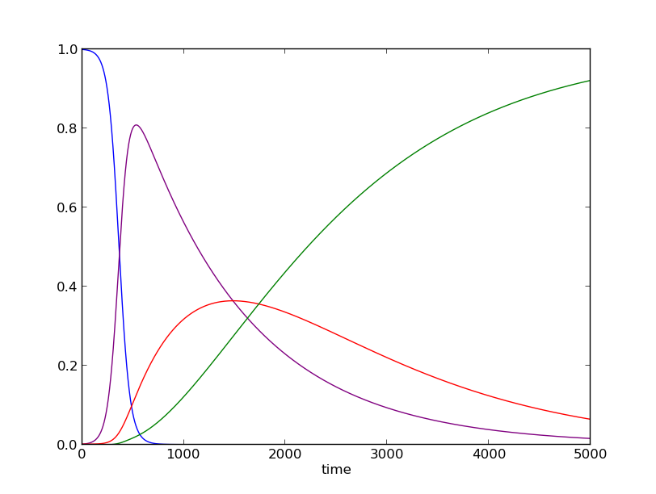
SEIR model

Slide 22
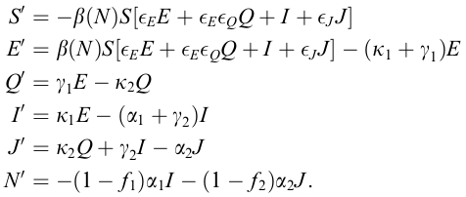
many, many more...
e. g. SEQIJR model
Taking into account quarantined, isolated, hospitalized...

Slide 23
SIS model on networks
Node – person
Edge – connection along which infection can spread

Slide 24
SIS model on networks
Node – person
Edge – connection along which infection can spread
In each time step:
    Susceptible node is infected with probability r, if it has at least one infected neighbor
    Infected node is cured with probability a
Effective spreading rate λ = r/a
One can set a = 1 without lack of generality

Slide 25
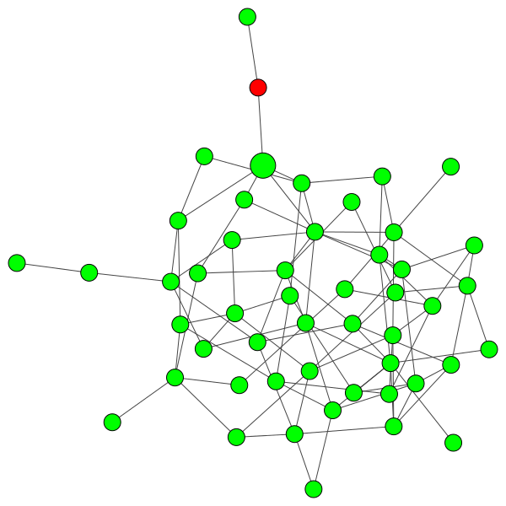

Slide 26
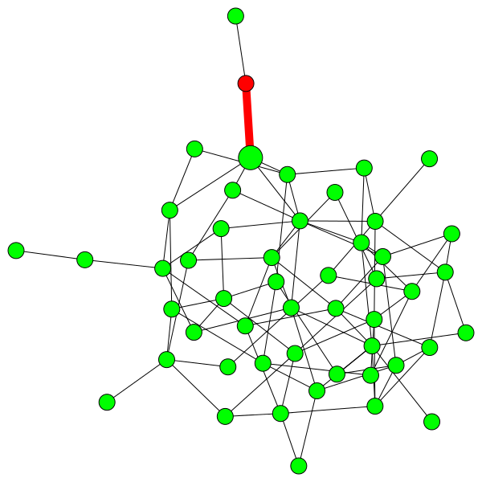

Slide 27
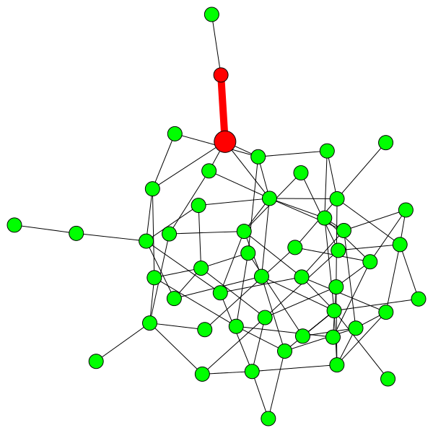

Slide 28
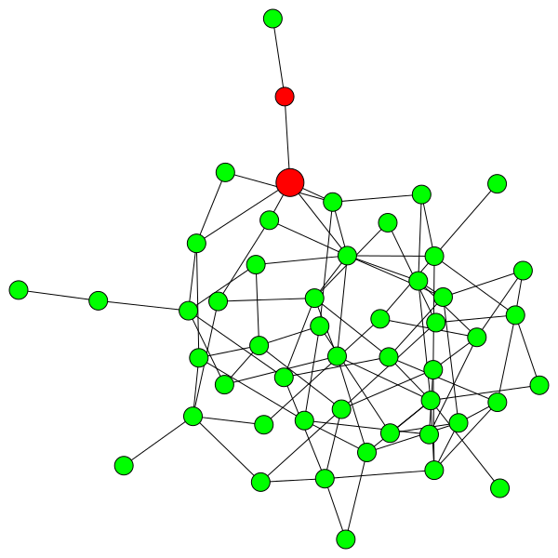

Slide 29
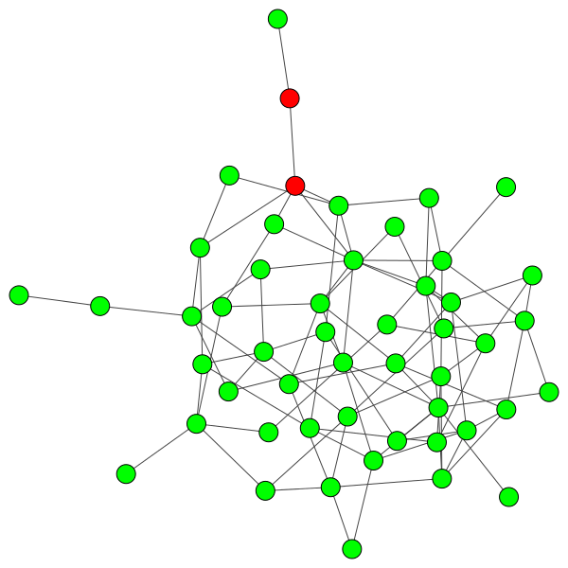

Slide 30
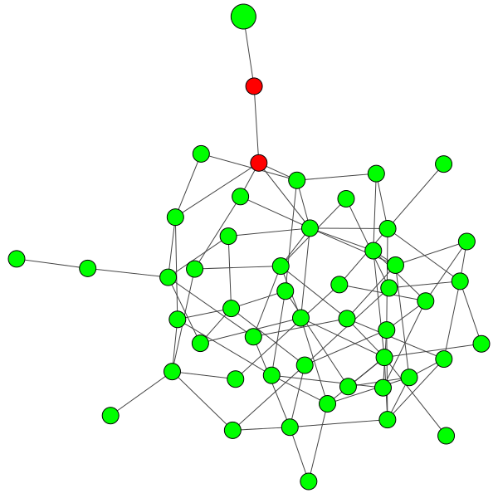

Slide 31
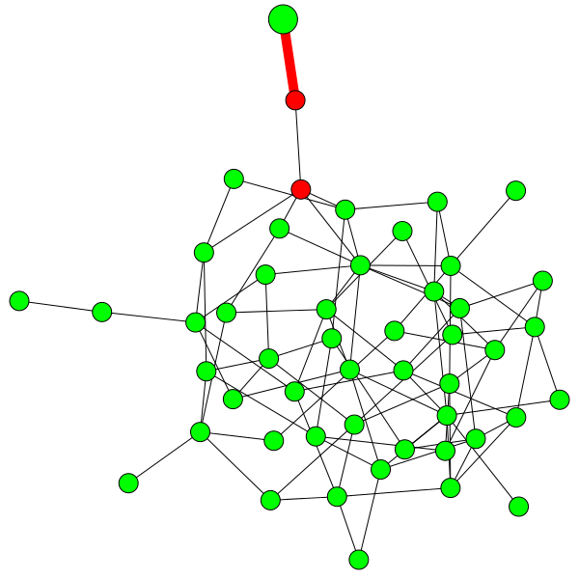

Slide 32
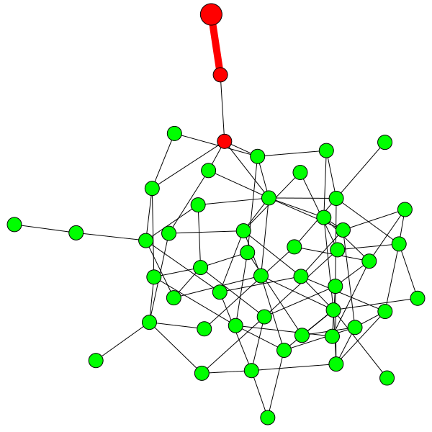

Slide 33
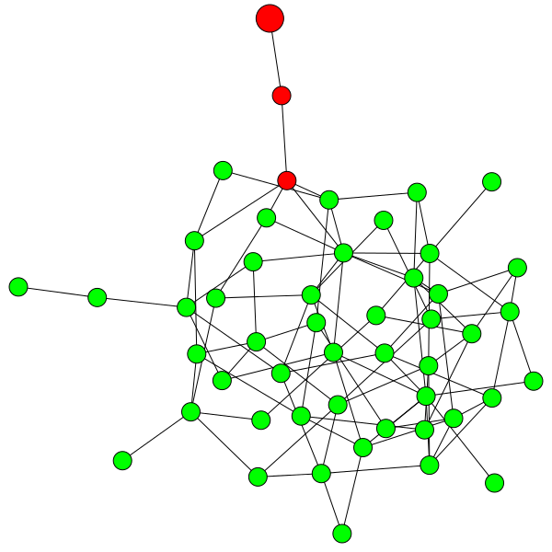

Slide 34


Slide 35
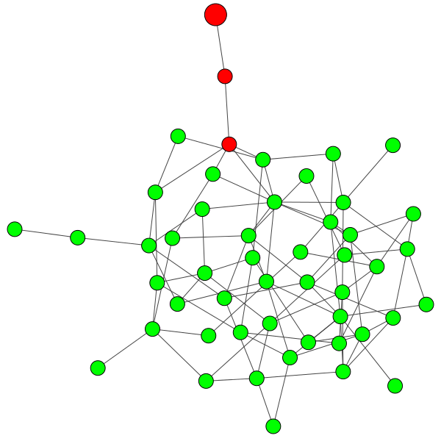

Slide 38
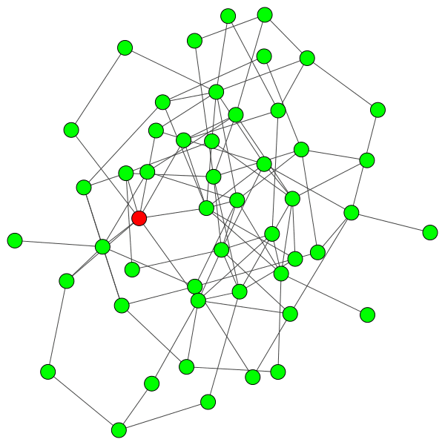
ER network – epidemic spreads

Slide 39
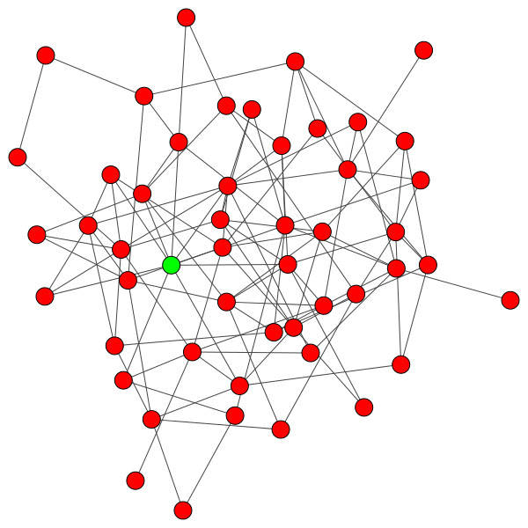
ER network – epidemic dies

Slide 40
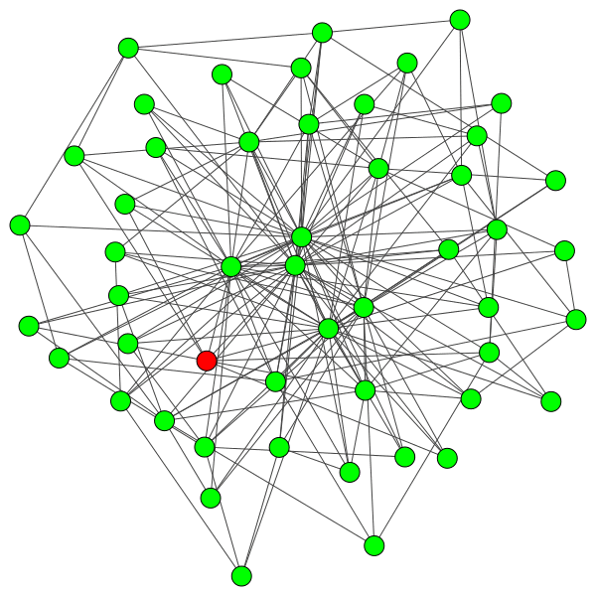
BA network – epidemic spreads

Slide 41
ER networks – mean field approach
binomial distribution

Slide 42
ER networks – mean field approach
binomial distribution
Critical threshold:
Below threshold – no epidemic
Above threshold – epidemic

Slide 43
BA networks – mean field approach

Slide 44
BA networks – mean field approach
Critical threshold:
No threshold – always epidemic

Slide 45

Scale-free netowrks in society?
Sexual contacts - SF
Venereal diseases
Very dificult to stop

Slide 46
Vaccinating
Uniform vaccinating gN people
On ER network – critical threshold:
On BA network – critical threshold:
Better solutions on BA networks:
Vaccinating proportional to k
Targeted vaccinating of hubs

Slide 47

Thank you for your attention

Slide 48
Sources:
Dietz, Heesterbeek „Daniel Bernoulli’s epidemiological model revisited” Mathematical Biosciences 2002
Kermack, McKendrick „A contribution to the mathematical theory of epidemics” Proceedings of the Royal Society of London 1927
Brauer „The Kermack–McKendrick epidemic model revisited” Mathematical Biosciences 2005
Weiss „The SIR model and the Foundations of Public Health” Materials Matemàtics 2013
A. Fronczak, P. Fronczak „Świat sieci złożonych. Od fizyki do internetu” Wydawnictwo Naukowe PWN 2009, chapter 5.4
Dorogovtsev, Goltsev „Critical phenomena in complex networks” Reviews of Modern Physics 2008, chapter V
Pastor-Satorras, Vespignani „Epidemic dynamics and endemic states in complex networks” Physical Review E 2001
Pastor-Satorras, Vespignani „Epidemic Spreading in Scale-Free Networks” Physical Review Letters 2001
Moreno, Pastor-Satorras, Vespignani „Epidemic outbreaks in complex heterogeneous networks” The European Physical Journal B 2002
Newman „Spread of epidemic disease on networks” Physical Review E 2002
Pastor-Satorras, Vespignani „Immunization of complex networks” Physical Review E 2002
Serrano, Boguna „Percolation and Epidemic Thresholds in Clustered Networks” Physical Review Letters 2006
Gross, Dommar D’Lima, Blasius „Epidemic Dynamics on an Adaptive Network” Physical Review Letters 2006
Pictures: Wikimedia Commons

