Slide 1
Git guide
I want you to learn how to see the repo in your mind and stage the changes one by one
by Tomasz Radziejewski

Slide 2
What is git and why you use it
Basically git is a version control software which allows multiple developers to work on the same project without interfering with each other

Slide 3
Benefits of using git
Backtrace of all changes made over time
Reverse changes if needed
All developers always has a complete copy
of everything

Slide 4
Creating a new repository is easy as
Create a new directory (mkdir git-guide)
Open it (cd git-guide)
Perform initialization (git init)
Initialized empty Git repository in /gh/git-guide/.git/

Slide 5
Git status
$ git status
On branch master
Initial commit
nothing to commit (create/copy files and use "git add" to track)

Slide 6
Three states of the change
Committed (already stored)
Modified (changed but not committed yet)
Staged (modified file marked as ready to go with next commit)

Slide 7
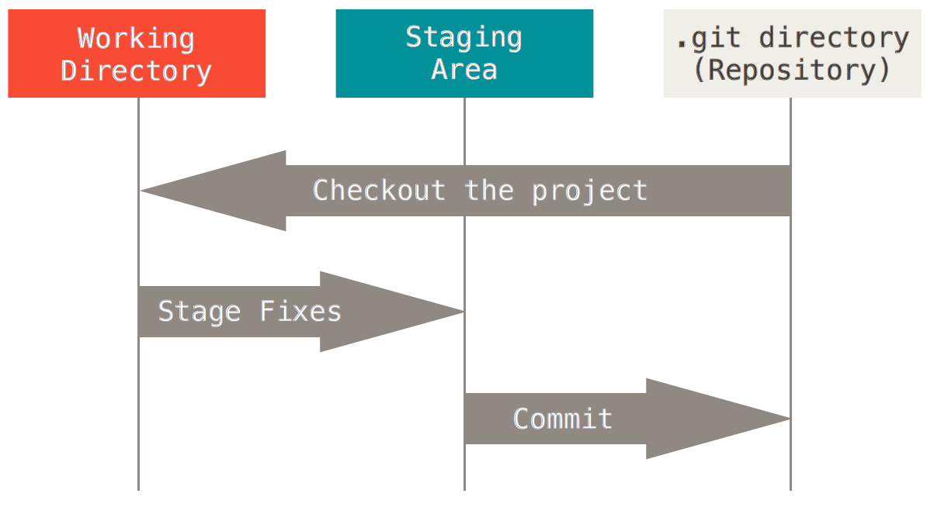

Slide 8
Making changes
$ git status
On branch master
Initial commit
Untracked files:
(use "git add <file>..." to include in what will be committed)
.~lock.git-guide.odp#
git-guide.odpg

Slide 9
Making changes
$ git status
On branch master
Changes not staged for commit:
(use "git add <file>..." to update what will be committed)
(use "git checkout -- <file>..." to discard changes in working directory)
modified: git-guide.fodp
no changes added to commit (use "git add" and/or "git commit -a")

Slide 10
Making changes
Adding file contents to the index
'git add' [--verbose | -v] [--dry-run | -n] [--force | -f] [--interactive | -i] [--patch | -p]
[--edit | -e] [--[no-]all | --[no-]ignore-removal | [--update | -u]]
[--intent-to-add | -N] [--refresh] [--ignore-errors] [--ignore-missing]
[--] [<pathspec>...]
More info: http://git-scm.com/docs/git-add

Slide 11
Making changes
Save changes in the repository
'git commit' [-a | --interactive | --patch] [-s] [-v] [-u<mode>] [--amend]
[--dry-run] [(-c | -C | --fixup | --squash) <commit>]
[-F <file> | -m <msg>] [--reset-author] [--allow-empty]
[--allow-empty-message] [--no-verify] [-e] [--author=<author>]
[--date=<date>] [--cleanup=<mode>] [--[no-]status]
[-i | -o] [-S[<key-id>]] [--] [<file>...]
More info: http://git-scm.com/docs/git-commit

Slide 12
Git style guide - branches
Short and descriptive names
# good
$ git checkout -b oauth-migration
# bad - too vague
$ git checkout -b login_fix
Delete your branches if no longer needed
Use personal feature branches if multiple developers works on same thing
$ git checkout -b feature-a/tomasz

Slide 13
Git style guide - commits
One logical change per commit
Commit early and often
Commits should be in logical order

Slide 14
Git style guide – commit message
Use editor instead of terminal for commit message
First line is a summary (it should be capitalized, written in imperative present tense and no longer than 50 characters, do not put a period at the end)
Add empty line after summary line
Describe why the change is needed, what effects it could have, add references to dependent commits or resources

Slide 15
Git style guide – commit message
Short (50 chars or fewer) summary of changes
More detailed explanatory text, if necessary. Wrap it to
72 characters. In some contexts, the first
line is treated as the subject of an email and the rest of
the text as the body. The blank line separating the
summary from the body is critical (unless you omit the body
entirely); tools like rebase can get confused if you run
the two together.
Further paragraphs come after blank lines.
- Bullet points are okay, too
- Use a hyphen or an asterisk for the bullet,
followed by a single space, with blank lines in
between
Source http://tbaggery.com/2008/04/19/a-note-about-git-commit-messages.html

Slide 16
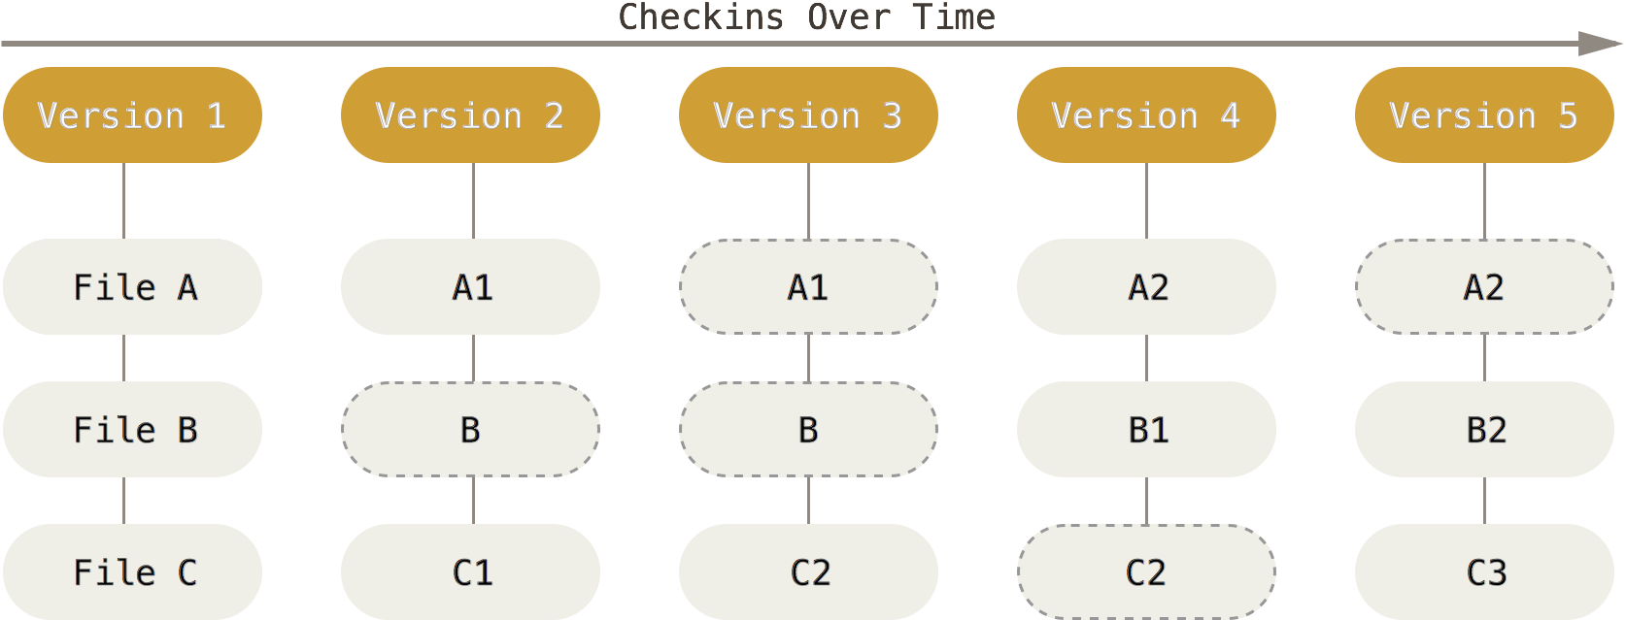
Snapshots, Not Differences
Git treats changes as a set of individual snapshots (picture of how all your files look like at the particular moment). Not changes files are not stored again.

Slide 17
Ignoring changes
Add patterns to .gitignore file for specify untracked files to ignore
Stop tracking currently tracked files: git rm --cached
Handy tool for generate .gitignore files: https://www.gitignore.io/

Slide 18
Git stash
Command saves local changes away and reset working directory to HEAD commit
If you want stash untracked (e.g. new) files add it first or use --include-untracked or --all (stash ignored files as well) options
To list stashes use git stash list
To apply changes from stash to working directory use git stash pop

Slide 19
Git pull or fetch?
Git fetch will take changes from remote server but not affects your local branches
Git pull = git fetch + git merge (automatically merges without your review first)

Slide 20
Git references
Refs
HEAD
Tag
Remotes

Slide 21
Refs
Every object stored by git is identified by SHA1 hash – a checksum.
Ref is a simple name which stores the SHA1 value.
$ echo "1a410efbd13591db07496601ebc7a059dd55cfe9" > .git/refs/heads/master

Slide 22
HEAD
The HEAD is a symbolic link to a branch you are currently on.
$ cat .git/HEAD
ref: refs/heads/master
HEAD^n – n parent of the tip of the HEAD
HEAD~n – n ancestor commit

Slide 23
G H I J
\ / \ /
D E F
\ | / \
\ | / |
\|/ |
B C
\ /
\ /
A
A = = A^0
B = A^ = A^1 = A~1
C = A^2 = A^2
D = A^^ = A^1^1 = A~2
E = B^2 = A^^2
F = B^3 = A^^3
G = A^^^ = A^1^1^1 = A~3
H = D^2 = B^^2 = A^^^2 = A~2^2
I = F^ = B^3^ = A^^3^
J = F^2 = B^3^2 = A^^3^2

Slide 24
Github: https://github.com
Github is a remote server for repositories hosting. It is a community of developers (source of example code) and graphical interface for managing projects
Github is a tool for collaborative work with other teammates

Slide 25
Github - Fork
Make a copy of someones repository and do whatever you want with it, e.g. fix bugs
Example: Go to https://github.com/tradziej/git-guide and click a Fork in the top-right corner

Slide 26
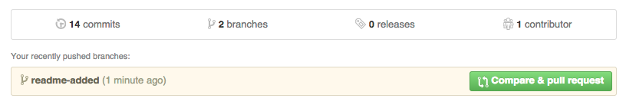
Github – Pull Request
Kind of ask to the original project owner for merge your changes.

Slide 27
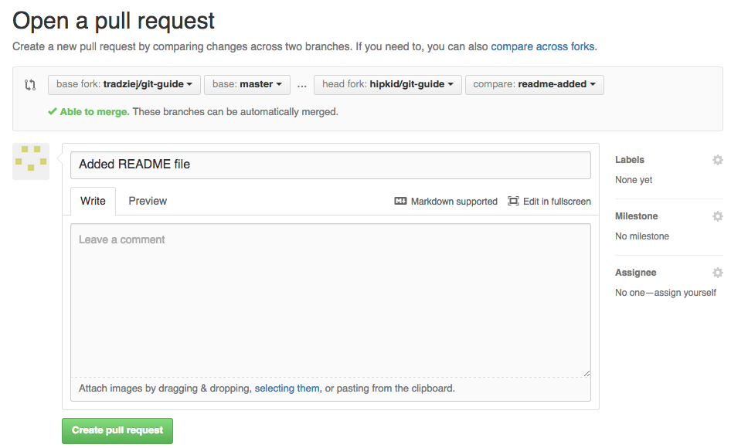

Slide 28
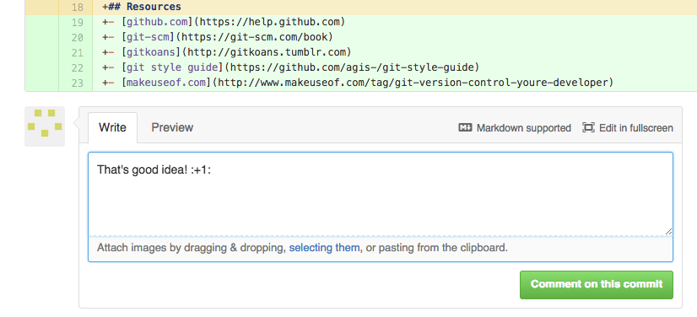
Github – code review
Project collaborators see all new commits in the pull request and could comment every line

Slide 29
Github - accounts
Free accounts for Open Source
Private repositories for individual and organizations
Github Enterprise on your own secure environment

Slide 30
References
https://help.github.com
https://git-scm.com/book
http://gitkoans.tumblr.com
https://github.com/agis-/git-style-guide
http://www.makeuseof.com/tag/git-version-control-youre-developer
http://www.kernel.org/pub/software/scm/git/docs/git-rev-parse.html

