Slide 1
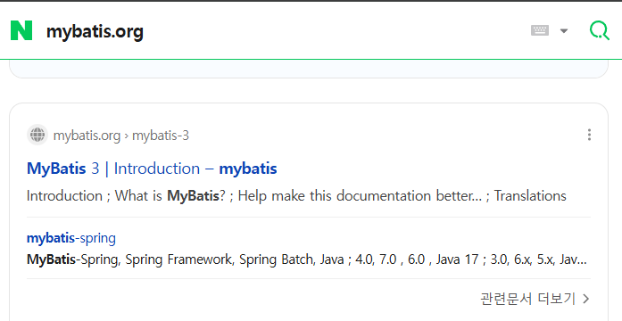

Slide 2
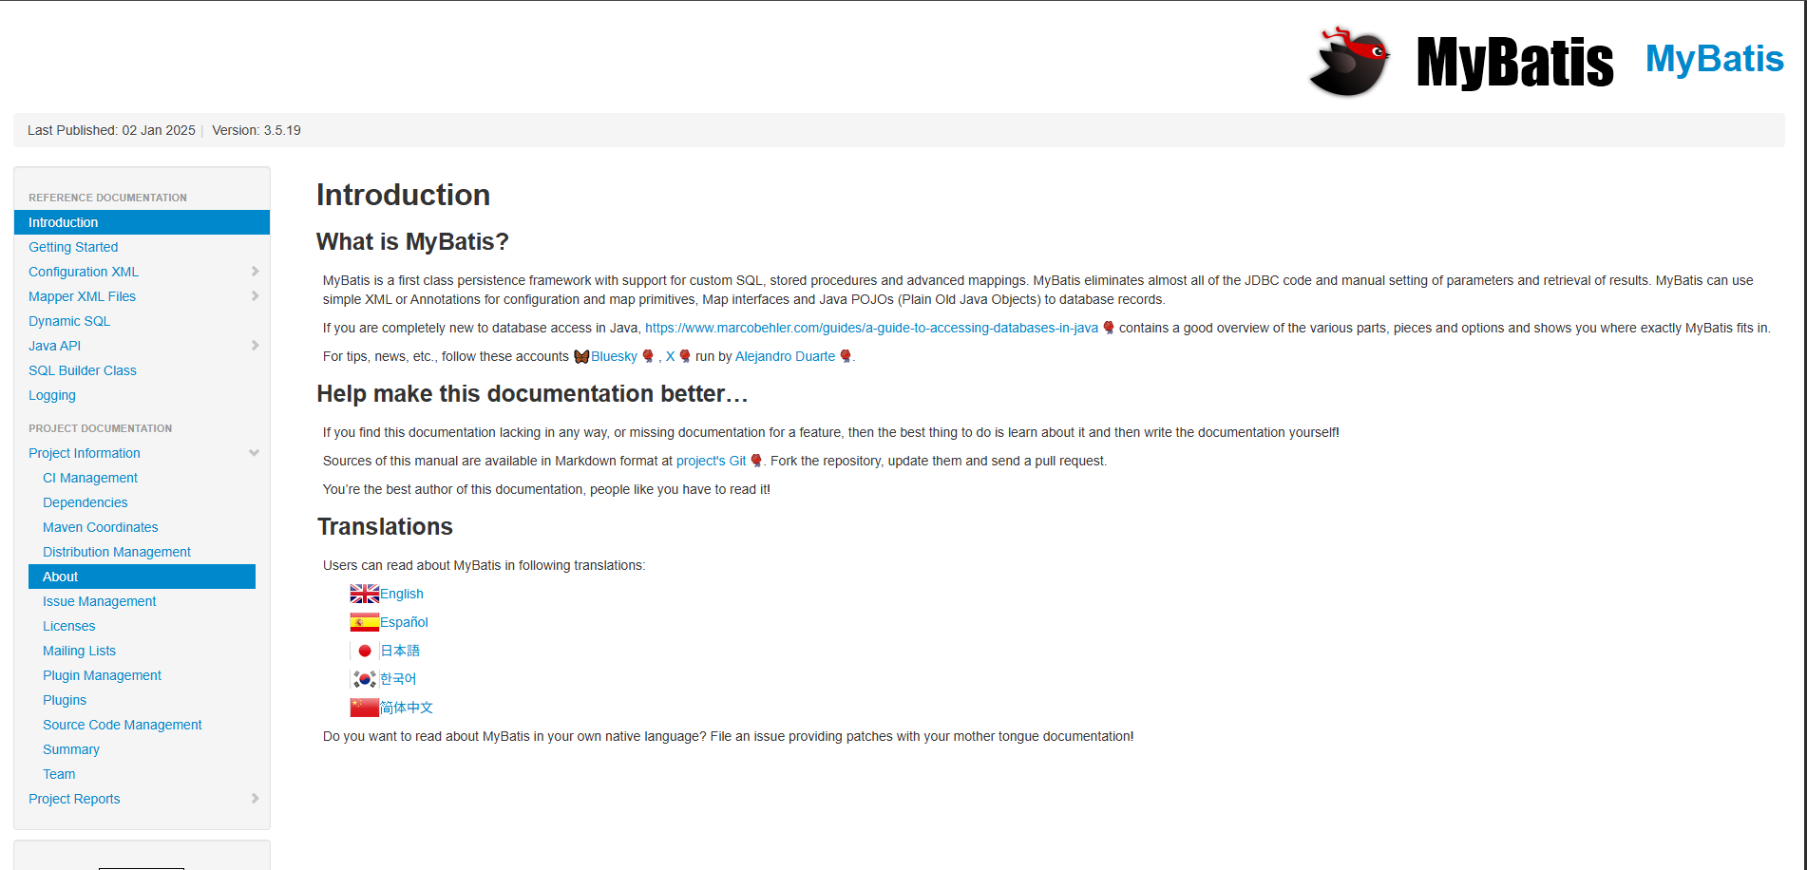

Slide 3
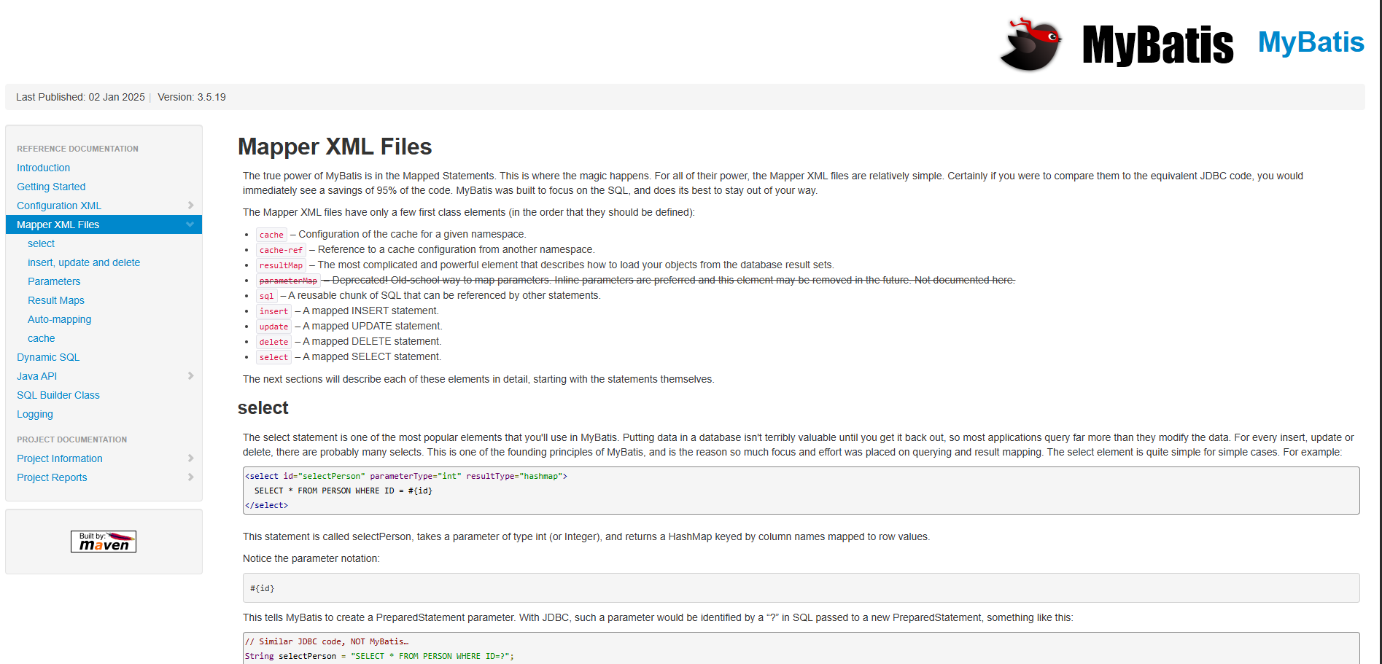

Slide 4
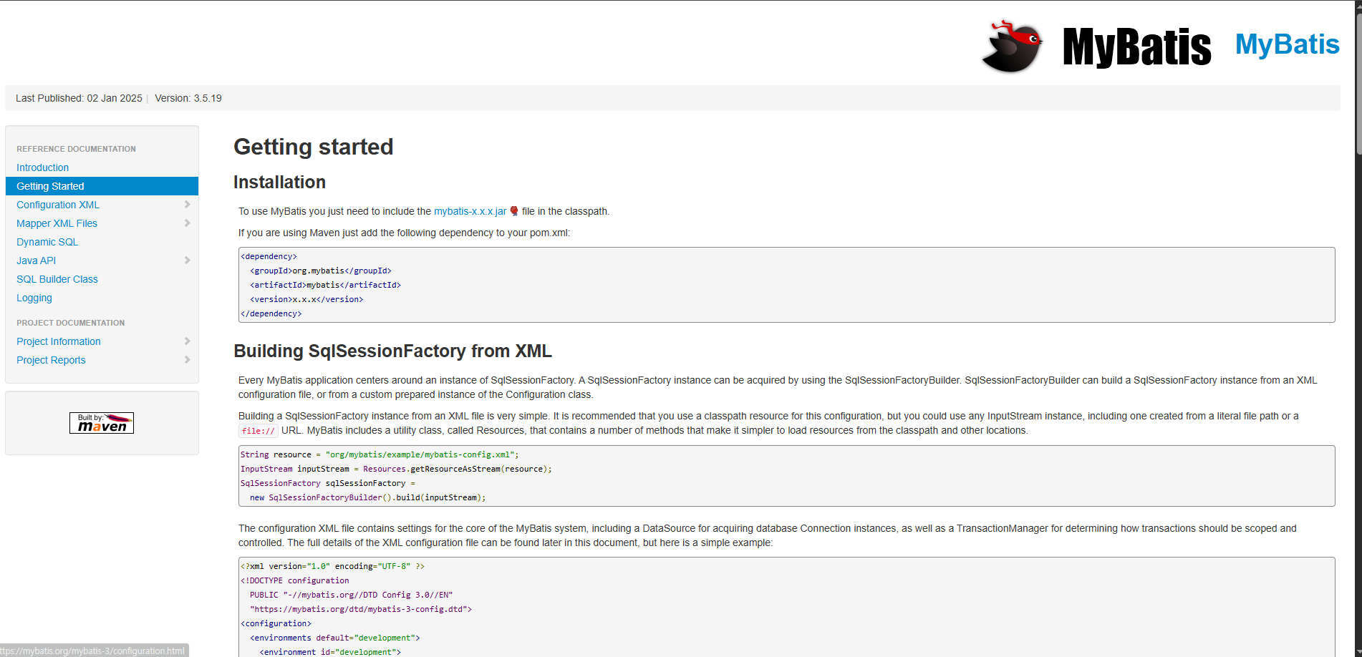
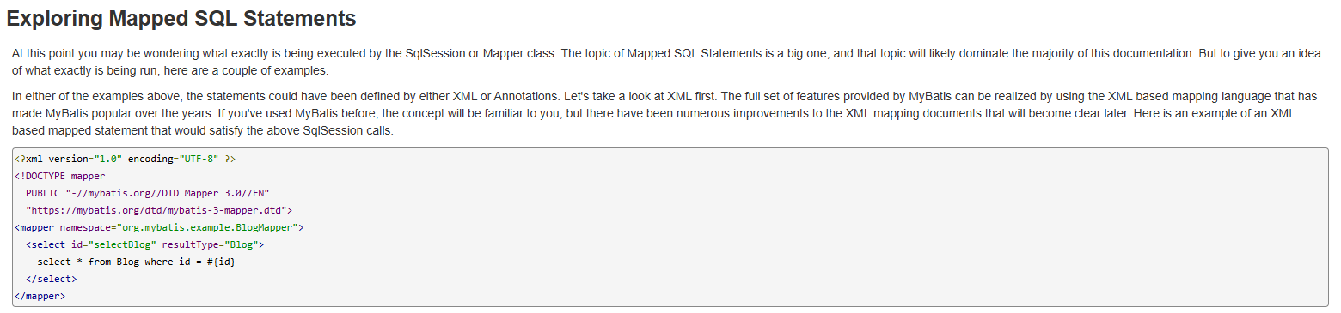
복붙
<!DOCTYPE mapper
PUBLIC "-//mybatis.org//DTD Mapper 3.0//EN"
"https://mybatis.org/dtd/mybatis-3-mapper.dtd">
<mapper namespace="org.mybatis.example.BlogMapper">
<select id="selectBlog" resultType="Blog">
select * from Blog where id = #{id}
</select>
</mapper>

Slide 5
