Slide 1
ZALANDO | NETWORK PLANNING
Case Study
Warehouse Inbound Forecast
Daily Receipt Volume Forecast — June 2022
Statistical lag model · Day-of-week segmentation · Out-of-sample validation

Slide 2
What This Covers
01
Problem context & data
Two inputs: 5 months of order-to-receipt history + June sales forecast
02
Key insights from exploration
Orders arrive over multiple days · day-of-week patterns drive the model
03
Modelling approach & validation
Lag distribution, method choices, and out-of-sample May validation
04
June forecast output
Daily receipts Jun 1–30, total 2,435,582 items, key patterns to watch

Slide 3
Goal & Data
What we set out to do
Predict daily warehouse receipt volumes for all 30 days of June 2022.
The model is a distribution mechanism — the total June demand level comes from a business-provided sales forecast; the model adds the operational timing pattern on top.
Why it matters
Warehouse staffing and inbound capacity planning depend on accurate daily receipt volumes — not just monthly totals.
Input 1 — Historical Data
Jan 1 – May 31, 2022
1,763 rows | 151 unique order dates
Covers order-to-receipt item volumes
Receipt dates extend to Jun 11 (late-May spillover)
Input 2 — June Sales Forecast
Jun 1–30, 2022 (all 30 days)
Total forecast: 2,433,610 items
Day-of-week shape consistent with history
Jun 28 high-order day retained (183,785 items)

Slide 4
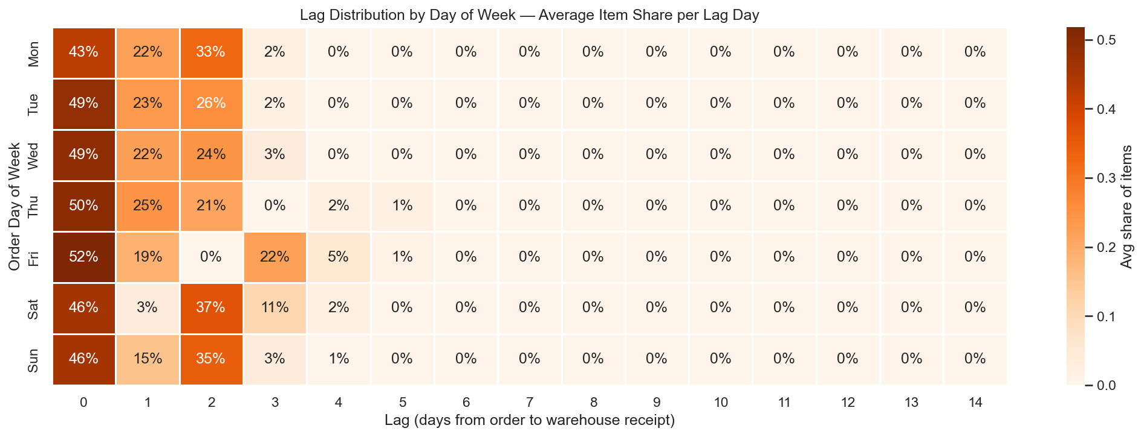
Key Insight: Orders Arrive Across Multiple Days
How items flow
Each day's orders are received at the warehouse over the following 0–4 days, not all at once.
~50% arrive same day (lag 0)
~92% within 2 days
~99.9% within 4 days → cap lag at 4
Day of week changes everything
Friday orders skip Saturday processing — most arrive Monday–Tuesday (lag 3). Saturday orders also peak Monday (lag 2). Sunday warehouse operations are reduced.
→ Lag distribution must be segmented by day of week.

Slide 5
Modelling Approach — Four Steps
Day-of-week segmented lag distribution applied in 4 steps. Validation precedes the June output to prove the approach works first.
4.1
4.2
4.3
4.4
Build lag distribution
Validate on May
Rebuild on Jan–May
Apply to June
Jan–Apr train set 120 order dates 17–18 per day-of-week
Apply to actual May orders Compare vs actual receipts MAE / MAPE / Bias / RMSE
Retrain on full history More data, more reliable Largest shift: Sun lag 0 −3.4pp
June forecast + May spillover → write expected_output.csv
→
→
→
Why not ML? Dataset too small (~151 unique order dates), operational mechanism is clear (weekend closures, processing schedules), statistical approach is far more interpretable.

Slide 6
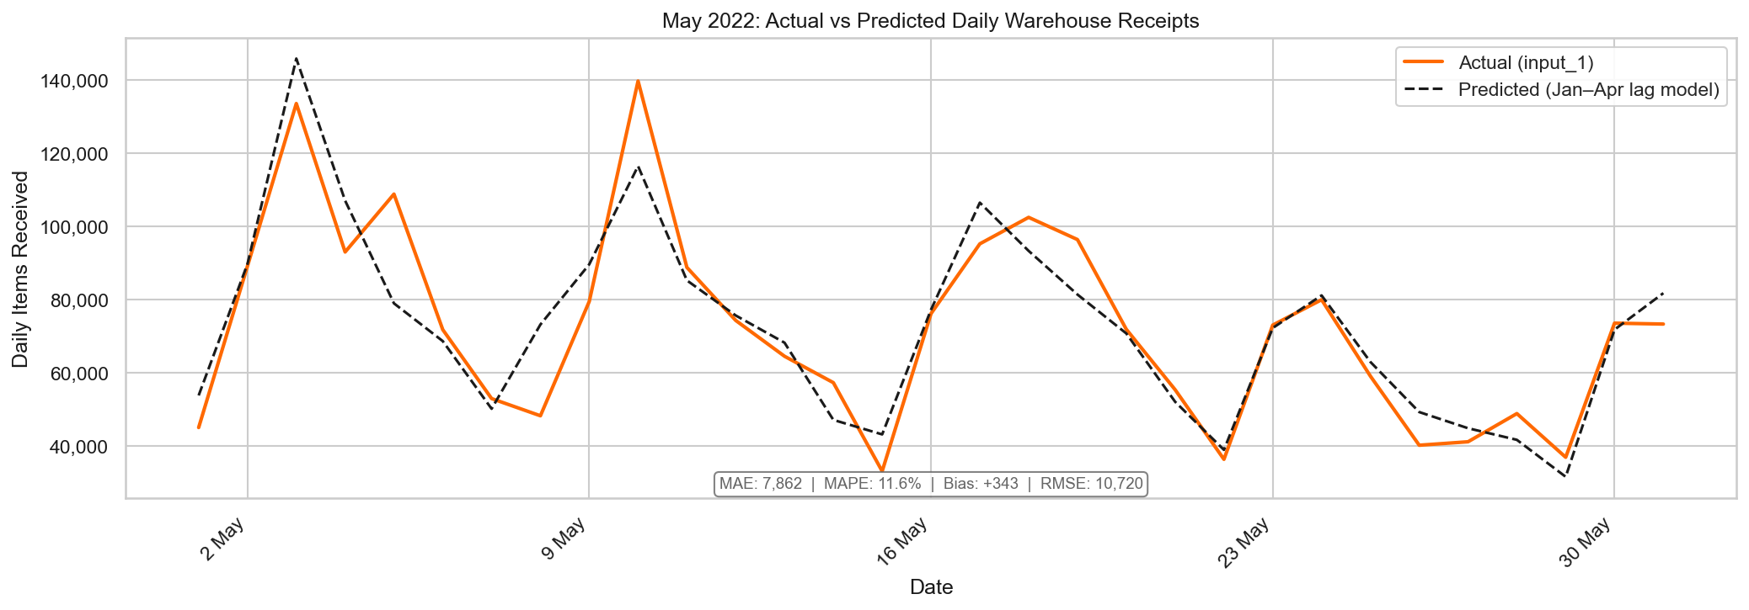
Model Validation — May 2022 (Out-of-Sample)
Trained on Jan–Apr only. Applied to actual May orders + April spillover.
MAE
7,862 items/day
~11% of avg daily receipts — timing spread
MAPE
11.6%
Acceptable for a statistical lag model
Bias
+343 items/day
Negligible — no systematic over/under-forecast
RMSE
10,720 items
RMSE/MAE = 1.36 — no extreme peak-day misses
Monthly total: predicted 2,249,715 vs actual 2,239,069 → 0.5% over · Well-calibrated · Proceed to June

Slide 7
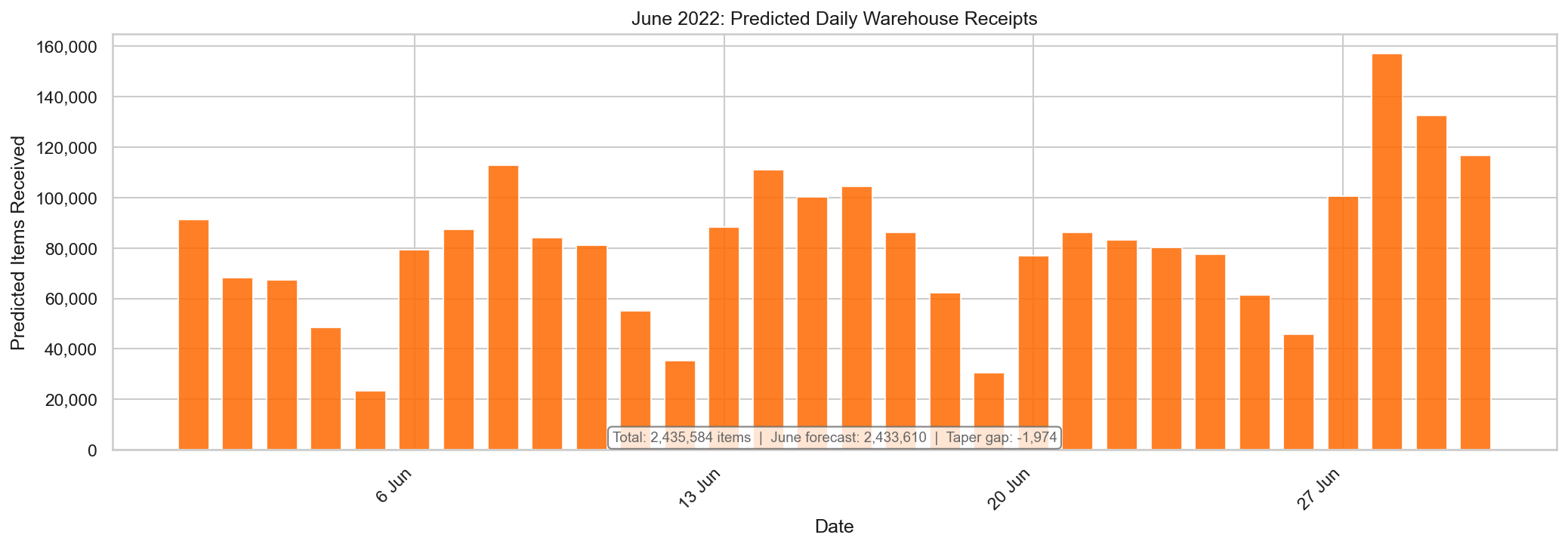
June 2022 Forecast — Daily Warehouse Receipts
Total forecast receipts:
2,435,582 items
June order forecast: 2,433,610 (+1,972 net — May spillover > month-end taper)

Slide 8
Key Patterns in the June Forecast
Sundays consistently low
Mondays consistently peak
23k–46k items
76k–101k items
Reduced warehouse operations. Jun 5: 23,318 · Jun 12: 35,485 · Jun 19: 30,595 · Jun 26: 45,816
Monday receipts absorb Fri/Sat/Sun order spillover. Most capacity-constrained day of the week.
Jun 1–4 elevated
Jun 27–30 spike
+75,284 items spillover
Jun 28: 157,058 items
Known May-order receipts added directly from input_1. Jun 1 alone: +51,835 items (68% of total spillover).
Jun 28 high-order day (183,785 orders in input_2) propagates through lags 0–2 into Jun 28–30.

Slide 9
Limitations & Scope of Improvement
Current limitations
Scope of improvement
Forecast accuracy dependency
Rolling retraining
Model distributes timing only. If input_2 order volumes are wrong, receipt totals are off by a similar proportion — outside the model's control.
Re-fit lag distribution monthly as new data arrives — captures gradual operational changes without manual intervention.
Static lag distribution
Uncertainty intervals
Assumes lag patterns are stable over time. Operational changes (new shifts, carriers, warehouse expansion) are not captured without retraining.
Add ±1 MAE confidence bands around the daily forecast to support capacity planning scenarios (optimistic / base / conservative).
Month-end taper
Multi-warehouse extension
Jun 27–30 lag 1–4 contributions fall in July and are excluded. Declining receipts at month-end are correct model behaviour, not an error.
Same approach generalises to a network-level planning tool with site-specific lag profiles per fulfilment centre.

Slide 10
Appendix
Methodology detail · Supporting analysis · Method decisions

Slide 11
Appendix A1 — Data Quality Checks
Input 1 (Historical) — Anomaly detected and imputed
Row 1731 (May 29): items = 27,533,000 — 367.9× the next highest value of 74,843. Identified as a data entry error.
IQR method flagged 326 rows (18.5%) — rejected. Structural right-skew drives Q1 to 19 (long-lag trickles), producing an upper bound of 13,529 that incorrectly flags legitimate high-volume records.
Treatment: imputed with median lag-0 value for Sunday orders (32,161). May 2022 total restored to ~2.24M (from ~29.7M inflated value).
Input 2 (Forecast) — One high value reviewed and retained
Jun 28: Forecated_items = 183,785 (IQR upper bound: 142,837 — 1.3× exceedance).
Not a data entry error: 1.3× vs 367.9× for the input_1 anomaly. Business-provided forecast input retained as-is. Likely reflects a planned promotion or end-of-month sales event — propagates naturally as a receipt spike on Jun 28–30.

Slide 12
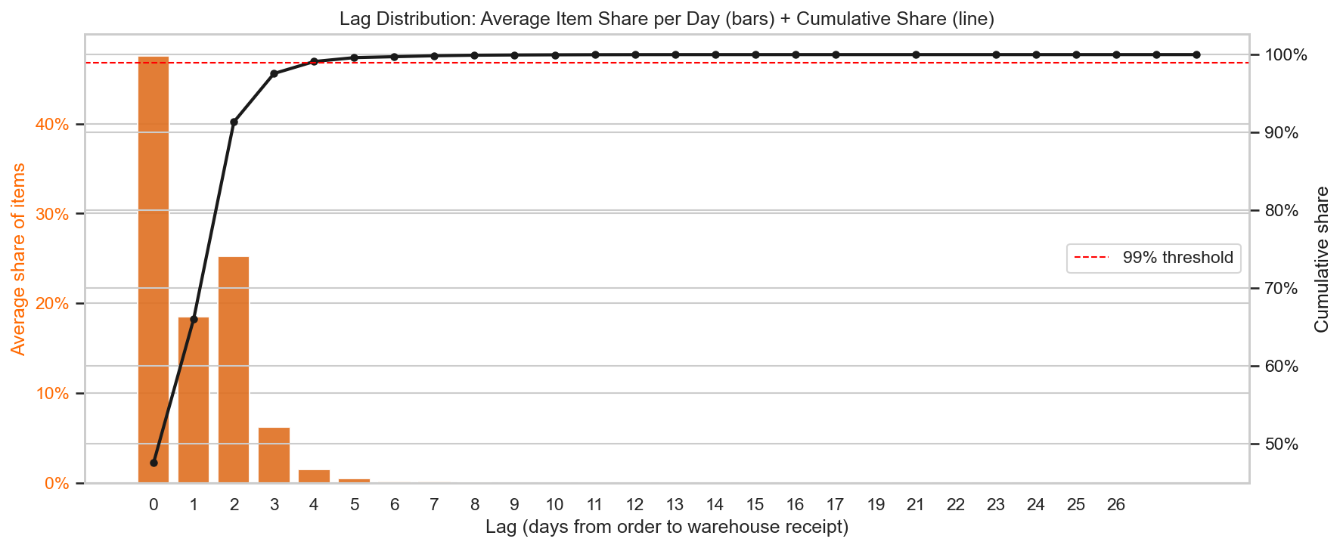
Appendix A2 — Item-Weighted Lag Distribution
Item-weighted view: each item counts equally (not each row). Lag capped at 4 days — captures 99.9% of item volume. Row-weighted 99th percentile (16 days) overstates the tail due to many long-lag rows carrying only a handful of items.

Slide 13
Appendix A3 — Modelling Method Decisions
Statistical, not ML
~151 unique order dates is too small for ML to generalise reliably. The operational mechanism (weekend closures, carrier schedules) is clear and directly modelled by a lag distribution. Statistical approach is interpretable for a business audience.
Aggregate-shares, not mean-of-shares
Aggregate-shares weights each item equally — correct for distributing item volumes. Mean-of-shares weights each calendar date equally, so a quiet Monday votes the same as a busy one. This skews lag 0 upward by up to 2.12pp (Tuesday). Aggregate-shares gives the more accurate warehouse planning estimate.
Day-of-week segmentation, not calendar-week
Fri/Sat/Sun have structurally different lag profiles (lag-3 spike on Fri, lag-2 peak on Sat, suppressed lag-1 on Sun). Calendar week shows stable order/receiving alignment across all 22 weeks — CW segmentation would produce thin, unreliable buckets without accuracy gains.

