Slide 1
Estimating treatment effects for policy evaluation
Thomas Meath

Slide 2
Hypothetical Situation
Intervention
OHSU implements an algorithm to flag patients with a high risk of post-discharge infection
Outcome measure
90-day readmission rates

Slide 3
What do we mean by treatment effects?
Two parallel universes
one where the intervention occurred
one where the intervention did not occur
Policy effect = difference between the outcomes in those universes
E(Y = 1|T=1) – E(Y=1|T=0)

Slide 4
Causal inference with observational data?
The Dream:
To be able to say, this intervention caused the outcome to change by X
The Reality:
There are a number of other things that may have caused changes to the outcome
Each evaluation method attempts to adjust or account for some of those alternative hypotheses

Slide 5
Prediction vs Inference
Prediction problems:
How accurately can we predict the outcome?
We care primarily about the accuracy of our prediction, not the individual coefficients.
We can use whatever model produces the best accuracy!

Slide 6
Prediction vs Inference
Inference problems:
How much does our treatment change the outcome?
We care very much about the individual coefficients, and it is important to correctly isolate the correct change.
This means the form of the underlying model is very important.
(See Berkson’s Paradox)

Slide 7
Classic confounding
T treatment
Y Outcome

Slide 8
Classic confounding
X confounder
T treatment
Y Outcome

Slide 9
Classic confounding – adjusted out
X confounder
T treatment
Y Outcome

Slide 10
Not confounding – in the causal pathway
X confounder
T treatment
Y Outcome

Slide 11
Not confounding – downstream of outcome
X confounder
T treatment
Y Outcome

Slide 12
Pre-post tests
Difference between pre- and post-intervention outcomes
$$Y=β_{0}+β_{1}∗PostPeriod+β_{x}∗X+ε$$
Assumptions:
Outcomes would stay the same over time in the absence of the intervention

Slide 13
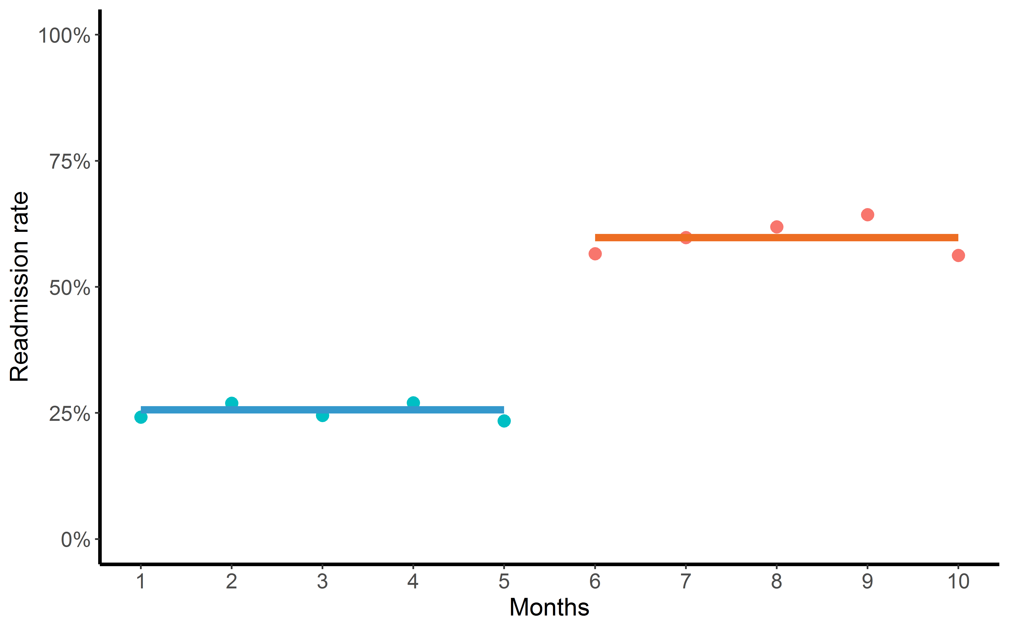
Pre-post tests
Intervention
T

Slide 14
Pre-post tests
Assumptions:
Outcomes would stay the same over time in the absence of the intervention
Protects against:
Baseline value for outcomes
Does not protect against:
If the outcome was already getting better or worse
Anything that changed outcomes unrelated to the intervention

Slide 15
Interrupted Time Series (ITS)
Difference between outcomes in the post-intervention period and predicted outcomes assuming no intervention
$$Y=β_{0}+β_{1}∗f(Time)+β_{2}∗PostPeriod+ β_{x}∗X+ε$$

Slide 16
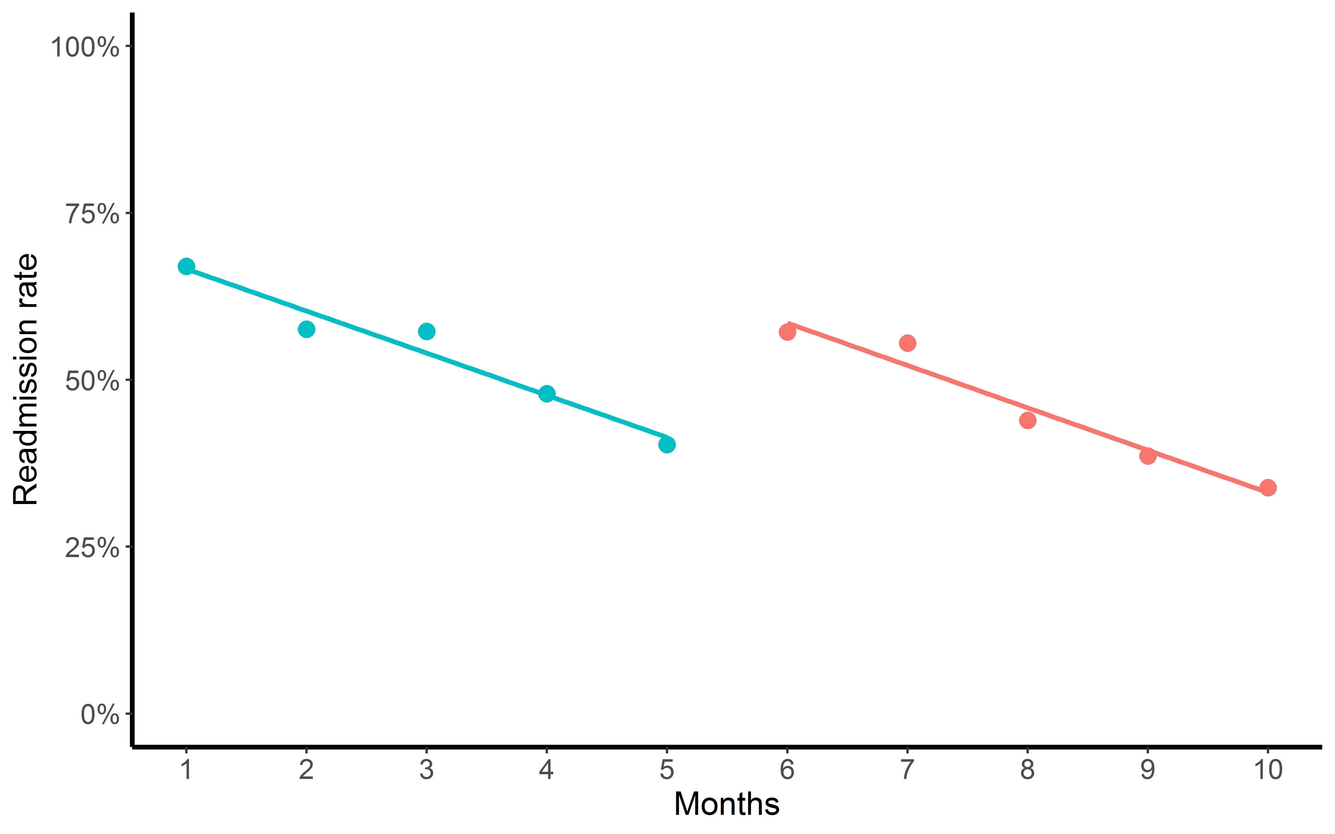
Interrupted Time Series (ITS)
Intervention
T

Slide 17
Interrupted Time Series (ITS)
Assumptions:
We can use pre-period data to accurately predict what would happen without an intervention.
Protects against:
Baseline level of the outcome
If the outcome was already getting better or worse
Does not protect against:
Anything that changed outcomes unrelated to the intervention in the post-period

Slide 18
Two group post-mean comparison
Difference in outcome between the treatment and control group in the post-intervention period
$$Y=β_{0}+β_{1}∗Treatment+ β_{x}∗X+ε$$

Slide 19
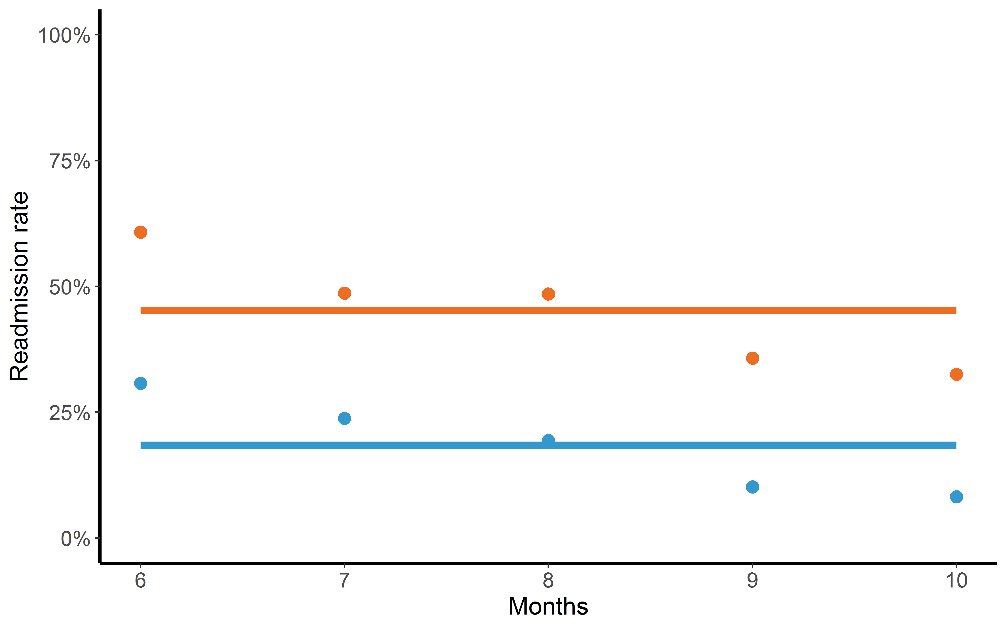
Two group post-mean comparison
T

Slide 20
Simple two group comparison
Assumptions:
Outcomes for the two groups would be the same if neither or both received the intervention
Protects against:
Anything unrelated to the intervention that changed outcomes equally for both groups
Does not protect against:
Any baseline differences in levels or slopes between the two groups
Any non-intervention changes that effected only one group

Slide 21

Difference-in-differences
Calculates the difference between the pre- and post-period for both treatment and control groups, then estimates the difference between those differences
$$Y=β_{0}+β_{1}∗Treatment+ β_{2}∗PostPeriod+ \\ β_{3}∗Treatment∗PostPeriod+ β_{x}∗X+ε$$

Slide 22
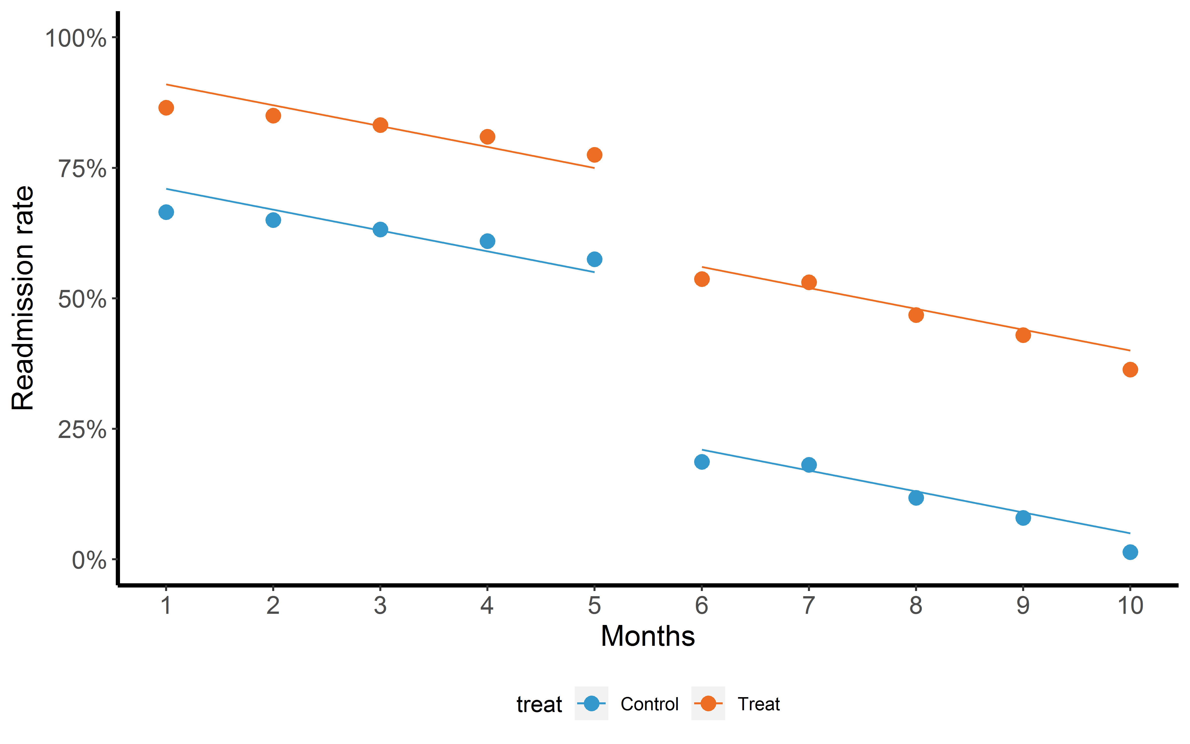
Difference-in-differences
T = D_{t} - D_{c}
Intervention
D_{t}
D_{c}

Slide 23
Difference-in-differences
Assumptions:
Parallel trends assumption – Difference in outcomes between groups remains constant over time
Protects against:
Baseline differences in outcomes between the two groups
Non-invention related changes that occurred in both groups
Does not protect against:
Non-intervention related changes that only occurred in the treated
Differences in baseline trajectory (slope) between the groups

Slide 24
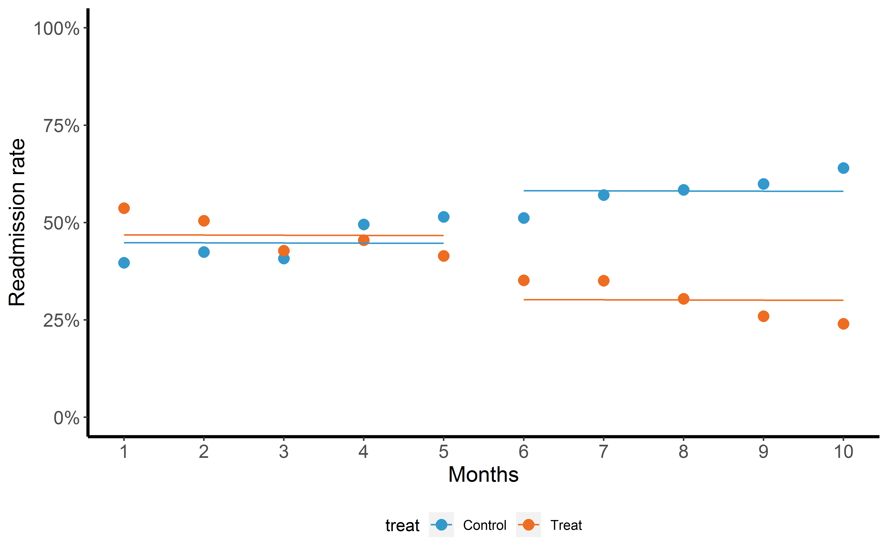
Parallel pre-trend test
Intervention

Slide 25
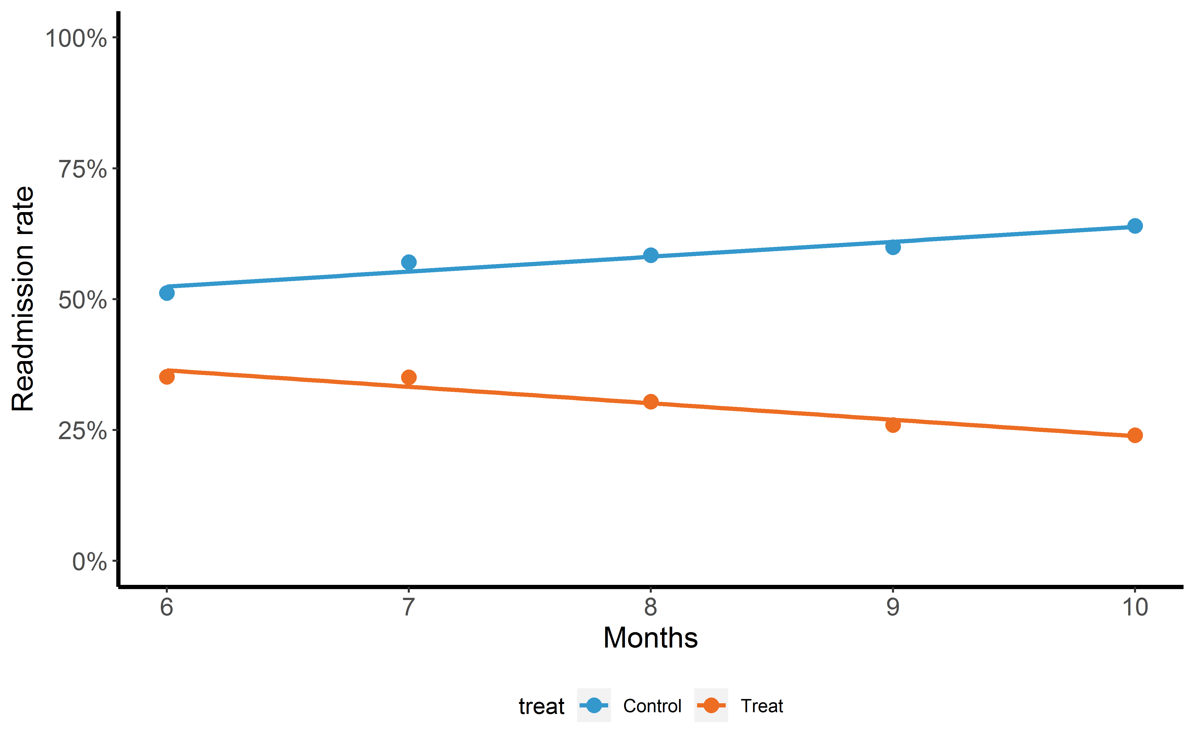
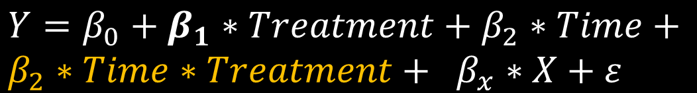
Parallel pre-trend test
$$Y=β_{0}+β_{1}∗Treatment+β_{2}∗Time+ \\ β_{2}∗Time∗Treatment+ β_{x}∗X+ε$$

Slide 26
Violation of parallel trends
Propensity Score Weighting / Matching
Explicitly modeling the difference between trends
Choosing a better control group

Slide 27
Propensity Scores
Propensity score weighting and matching is a method that attempts to remove difference between the treatment and control groups
Predict allocation of treatment using observed covariates
Use weighting or matching to ensure both your treatment and control group had an equal probability of receiving treatment
If done correctly, the two groups should now be comparable
BUT: The details matter! (Lindner, 2018)

Slide 28

Explicitly modeling pre-intervention trends
The basic diff-in-diff assumes parallel pre-trends:
We can add an extra term to model the difference in trends:
$$Y=β_{0}+β_{1}∗Treatment+ β_{2}∗PostPeriod+ \\ β_{3}∗Treatment∗PostPeriod+ β_{x}∗X+ε$$
$$Y=β_{0}+β_{1}∗Treatment+ β_{2}∗Post+β_{t}∗f\left(time\right)∗Treatment \\ + β_{3}∗Treatment∗PostPeriod+ β_{x}∗X+ε$$

Slide 29
Choose a better control group
Violations of assumptions generally mean your two groups are not comparable
The best solution is to choose a good control group
Random treatment assignment produces the best control groups

Slide 30
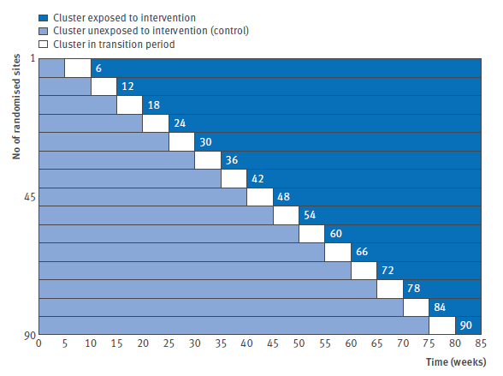
Other methods
Step-wedge design
The intervention is implemented in waves, and we compare those with and without intervention at any point
socialresearchmethods.net/kb/quasird.htm

Slide 31
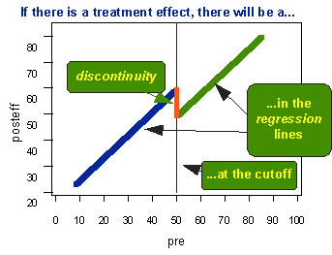
Other methods
Regression discontinuity
Treatment is assigned based on some arbitrary cutpoint of a continuous measurement.
We can compare those on slightly above the cut point to those slightly below the cut point
socialresearchmethods.net/kb/quasird.htm

Slide 32
Questions?

