Slide 1
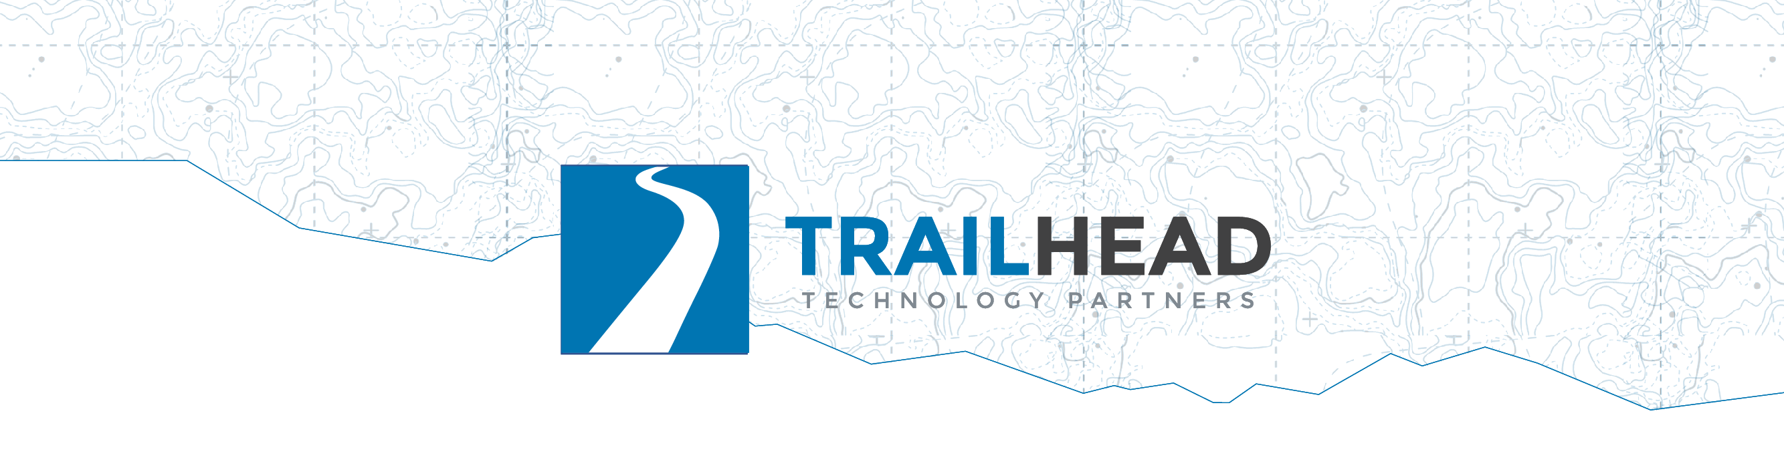
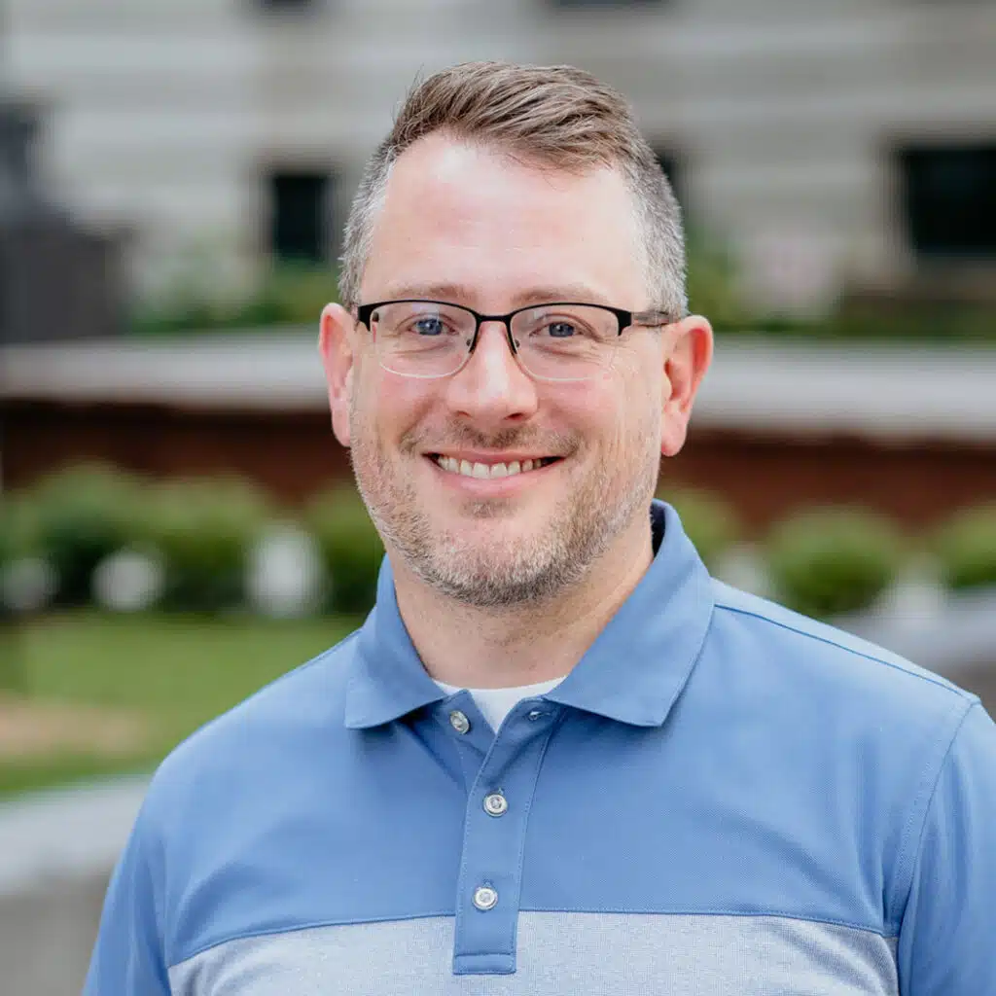
Building Pragmatic AI
10 AI Features Your Users Actually Want
Jonathan “J.” Tower
Notes:
Title slide stays up while people settle. The repo URL comes later, on Get Set Up, once the story has landed.
Ask who did the SETUP.md pre-work. Anyone who didn't should say so now, not in the first lab.

Slide 2

Saturday. 5:58 a.m.
Notes:
A hiker. Alarm before dawn, coffee in the car, ninety minutes to the trailhead.
She planned this trip in a trip-planning app. (It's our fictional app, Trailhead Guides; the room will live in its data all day.)

Slide 3

Avalanche Lake Trail
Notes:
The trail she picked. Moderate, family-rated, a lake at the end.
The app showed photos, distance, elevation. All accurate.

Slide 4

41 trip reports
Notes:
The app also had forty-one trip reports for this trail. Real hikers, real conditions, about 1,200 words each.
Ask the room: who reads forty-one essays before a day hike?

Slide 5
She read three.
Notes:
The top three. "Beautiful." "Crowded by ten." "Bring bug spray."

Slide 6

"The footbridge at the creek is gone. We had to turn around."
Report #14 of 41
Notes:
Report fourteen. One sentence, buried in a paragraph about huckleberries.
She never saw it.

Slide 7
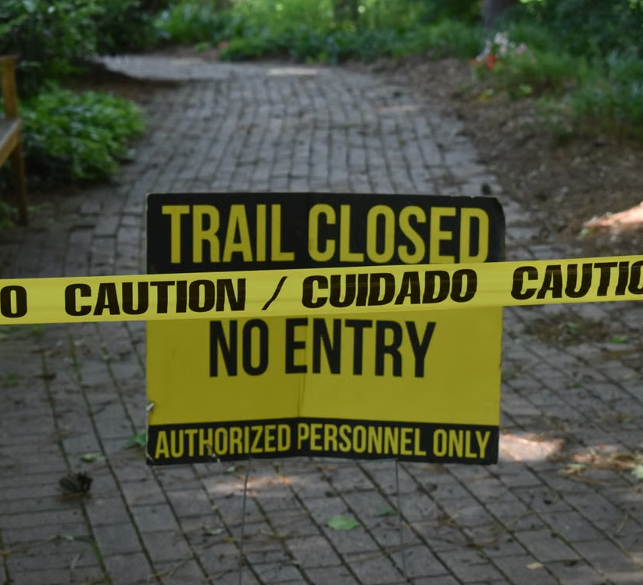
Mile 2 is where she found out.
Notes:
Two hours of driving, two miles of walking, and the trip is over at a creek she can't cross.
Beat of silence, then the turn:

Slide 8

The answer was there, but it was buried in a mountain of text.
Notes:
The data was in the product. A user needed one sentence of it, and the product's job was to surface that sentence.
Every feature you build today exists to close exactly this kind of gap.
And this bridge, this trail, this body of data: you'll meet them all day.
That washout is planted in the workshop data, and by this afternoon your code will find it.

Slide 9
The Problem

Slide 10
The Wrong Question and the Better One
❌ "Where can we use AI?"
Notes:
Every company is asking this question right now.

Slide 11
The Wrong Question and the Better One
❌ "Where can we use AI?"
✅ "What problems can AI best solve for our users?"
Notes:
Today asks the second one.
This is the thesis. Say it plainly and come back to it in every module: every feature today opens with a user who is stuck, and the AI only shows up as the answer.
The technology is the last thing we talk about in each feature, not the first.

Slide 12

Ten shippable AI features that solve problems your users already have, and the judgment to know when to build each.
Notes:
The promise of the day.
Not a survey, not vendor slides: you build these, you measure them, and you leave with a decision framework for picking the first one to ship at work.

Slide 13

What You Leave Able to Do
Summaries &
Validations
Notes:
Who this is for: you write software for a living, you can make an HTTP request, and you haven't shipped an LLM feature yet, or you've shipped one and want the other nine.
Say the four outcomes out loud, one per reveal; these are the promises the day is measured against, and they come back one at a time in each module's debrief. One outcome per module.
Module 1: summaries shaped for a purpose and records your code validated, all on your laptop.

Slide 14

What You Leave Able to Do
Summaries &
Validations
Search &
Cited Answers
Notes:
Module 2: search by meaning, and answers grounded in your documents with citations your code checks.

Slide 15

What You Leave Able to Do
Summaries &
Validations
Search &
Cited Answers
Routing &
a Human Gate
Notes:
Module 3: routing that never misses the expensive class, and a human gate with an audit trail.

Slide 16

What You Leave Able to Do
Summaries &
Validations
Search &
Cited Answers
Routing &
a Human Gate
A Bounded
Agent Loop
Notes:
Module 4: an agent loop bounded by a step budget, small enough to read.

Slide 17
What You Leave Able to Do
Summaries &
Validations
Search &
Cited Answers
Routing &
a Human Gate
A Bounded
Agent Loop
See 10;
Build 4+
Notes:
You see all ten demoed; you build four, one per module.
If someone in the room has shipped all of this already, they are a helper for the day; say so now.

Slide 18


Jonathan "J." Tower
Founding Partner
  13x Microsoft MVP in .NET & AI
  VP of .NET Foundation
Blue Blazes podcast host

Slide 19
Environment Setup

Slide 20
Get Set Up
🦙 ollama.com/download
Notes:
This is SETUP.md, revealed line by line; the finished checklist stays up.
ollama.com/download: one installer, no GPU needed.

Slide 21
Get Set Up
🦙 ollama.com/download
⬇️ ollama pull · llama3.2 · phi3 · nomic-embed-text
Notes:
The pulls, one per command: ollama pull llama3.2 then ollama pull phi3 then ollama pull nomic-embed-text.
Models are about 5 GB total.

Slide 22
Get Set Up
🦙 ollama.com/download
⬇️ ollama pull · llama3.2 · phi3 · nomic-embed-text
🧰 VS Code + REST Client (humao.rest-client)
Notes:
REST Client from the terminal: code --install-extension humao.rest-client.
JetBrains users can skip REST Client; the built-in HTTP client opens the same .http files.

Slide 23
Get Set Up
🦙 ollama.com/download
⬇️ ollama pull · llama3.2 · phi3 · nomic-embed-text
🧰 VS Code + REST Client (humao.rest-client)
⌨️ C#, Python, or TypeScript, and its runtime
Notes:
Runtimes: .NET 10 SDK, uv for Python, or Node. Pick the one you read fastest.

Slide 24
Get Set Up
🦙 ollama.com/download
⬇️ ollama pull · llama3.2 · phi3 · nomic-embed-text
🧰 VS Code + REST Client (humao.rest-client)
⌨️ C#, Python, or TypeScript, and its runtime
📦 git clone github.com/trailheadtechnology/10-ai-features-workshop
Notes:
The clone: git clone https://github.com/trailheadtechnology/10-ai-features-workshop.git

Slide 25
Get Set Up
🦙 ollama.com/download
⬇️ ollama pull · llama3.2 · phi3 · nomic-embed-text
🧰 VS Code + REST Client (humao.rest-client)
⌨️ C#, Python, or TypeScript, and its runtime
📦 git clone github.com/trailheadtechnology/10-ai-features-workshop
☁️ Azure OpenAI: nothing to install
Notes:
Azure endpoint and deployment names are already in the lab files; the key is handed out in the room.
Ask for hands: who has all three models pulled? Anyone without them starts copying from the USB drives now, during the framing, rather than in the first lab.

Slide 26
Verify Your Setup
/modules/M0-opening/F00-setup-and-framing/http/smoke-test.http
💬 Local chat
🔢 Local embedding
☁️ Azure chat
✅ Three JSON responses, no red text
🖐️ Broken? Raise a hand now.
Notes:
Full path: modules/M0-opening/F00-setup-and-framing/http/smoke-test.http. Paste the room key over <KEY FROM INSTRUCTOR> for the Azure request.
Room key (key2): in instructor.local.md at the repo root (untracked). Write it on the whiteboard, not a slide. Regenerate it after the workshop; the command is in the same file.
Setup comes after the story and the framing, not before: they need to know why they are here first. Still get it done well before the first lab, because the most expensive twenty minutes of a hands-on workshop is the twenty minutes in the first lab when a third of the room finds out their setup does not work.
Fallbacks exist for exactly this moment. Walk the room while people run it. Curl versions are in the lab README.

Slide 27
Which “Users”?

Slide 28
"Users" Is a Broad Word
🥾 The hiker planning Saturday
Notes:
The obvious user: the hiker from the story, planning Saturday.

Slide 29
"Users" Is a Broad Word
🥾 The hiker planning Saturday
📊 An admin facing 300 reviews
Notes:
The PM with 300 gear reviews and no time to read them.

Slide 30
"Users" Is a Broad Word
🥾 The hiker planning Saturday
📊 An admin facing 300 reviews
🏞️ The ranger facing a full inbox
Notes:
The ranger with a full inbox and an emergency somewhere in it.

Slide 31
Modules and Schedule

Slide 32
The Modules
1 · Understanding: summarize, extract, sentiment
Notes:
Module 1, Understanding: summarize, extract, sentiment. 75 minutes.

Slide 33
The Schedule
Module | Features | Time
00 Opening | Setup, context | 45 min
01 Understanding | F01 Summarize, F02 Extract F03 Sentiment | 75 min
02 Finding | F04 Search F05 RAG F06 Recommend | 75 min
03 Deciding | F07 Route F08 Detect F09 Approve | 75 min
04 Doing | F10 Agent capstone | 60 min
05 Closing | A decision framework | 30 min
Notes:
Breaks between modules and an hour for lunch after Module 2.

Slide 34
How Each Module Works
3 75-Min Modules
  3 AI features per module
  20 min mine for overview
  50 min yours for labs
  1 lab Recommended · 2 Challenge
A 60-minute capstone module
  1 AI feature
  1 lab for everyone
Recap
NOTE: Breaks any time, especially during labs
Notes:
The instructor half: the module's theme, then all three features demoed live in .NET. The build half is yours.

Slide 35
Languages and Frameworks

Slide 36



Language Choices
Notes:
The .NET projects are the demo; the Python and TypeScript ports produce the same output, so pick whichever you read fastest.

Slide 37
Language Choices
Notes:
The .NET projects are the demo; the Python and TypeScript ports produce the same output, so pick whichever you read fastest.

Slide 38
Models

Slide 39
Local Models, Cloud When Needed
Local Models (~5 GB, no GPU):
    💻 llama3.2
    💻 phi3
    💻 nomic-embed-text
  Cloud Model (my subscription):
    ☁️ Cloud models where it helps: F03, F05, F10*
  *NOTE: F10 is the only recommended lab, others are optional
Notes:
Two payoffs: you learn where free/private/small is enough, and most of the day survives conference wifi.
Rows 1 through 8 of the framework mostly run on free local models. That is a finding your leadership will care about on its own.

Slide 40
Every Model Is an HTTP Call
localhost:11434 → /api/chat · /api/embed
Notes:
Ollama listens on localhost:11434: /api/chat and /api/embed. It also exposes an OpenAI-compatible /v1.

Slide 41
Every Model Is an HTTP Call
localhost:11434 → /api/chat · /api/embed
…openai.azure.com/…/chat/completions + api-key
Notes:
Foundry serves gpt-4.1 and gpt-5.5 per deployment name, at the chat/completions path with an api-key header.

Slide 42
Every Model Is an HTTP Call
localhost:11434 → /api/chat · /api/embed
…openai.azure.com/…/chat/completions + api-key
Same request shape · a URL and a key apart
Notes:
Show one request to each on screen: the smoke test's local chat and its cloud chat, side by side. Point at the URL and the header. Same request shape, a URL and a key apart.

Slide 43
Every Model Is an HTTP Call
localhost:11434 → /api/chat · /api/embed
…openai.azure.com/…/chat/completions + api-key
Same request shape · a URL and a key apart
The SDKs are wrappers over these POSTs
Notes:
Feature 00's smoke test sends these requests raw, with the SDK removed; Microsoft.Extensions.AI and the openai package are wrappers over these POSTs. This is why the three language tracks look alike and why local-to-cloud is a config change, which the next slide makes concrete in code.

Slide 44
Meet The App

Slide 45
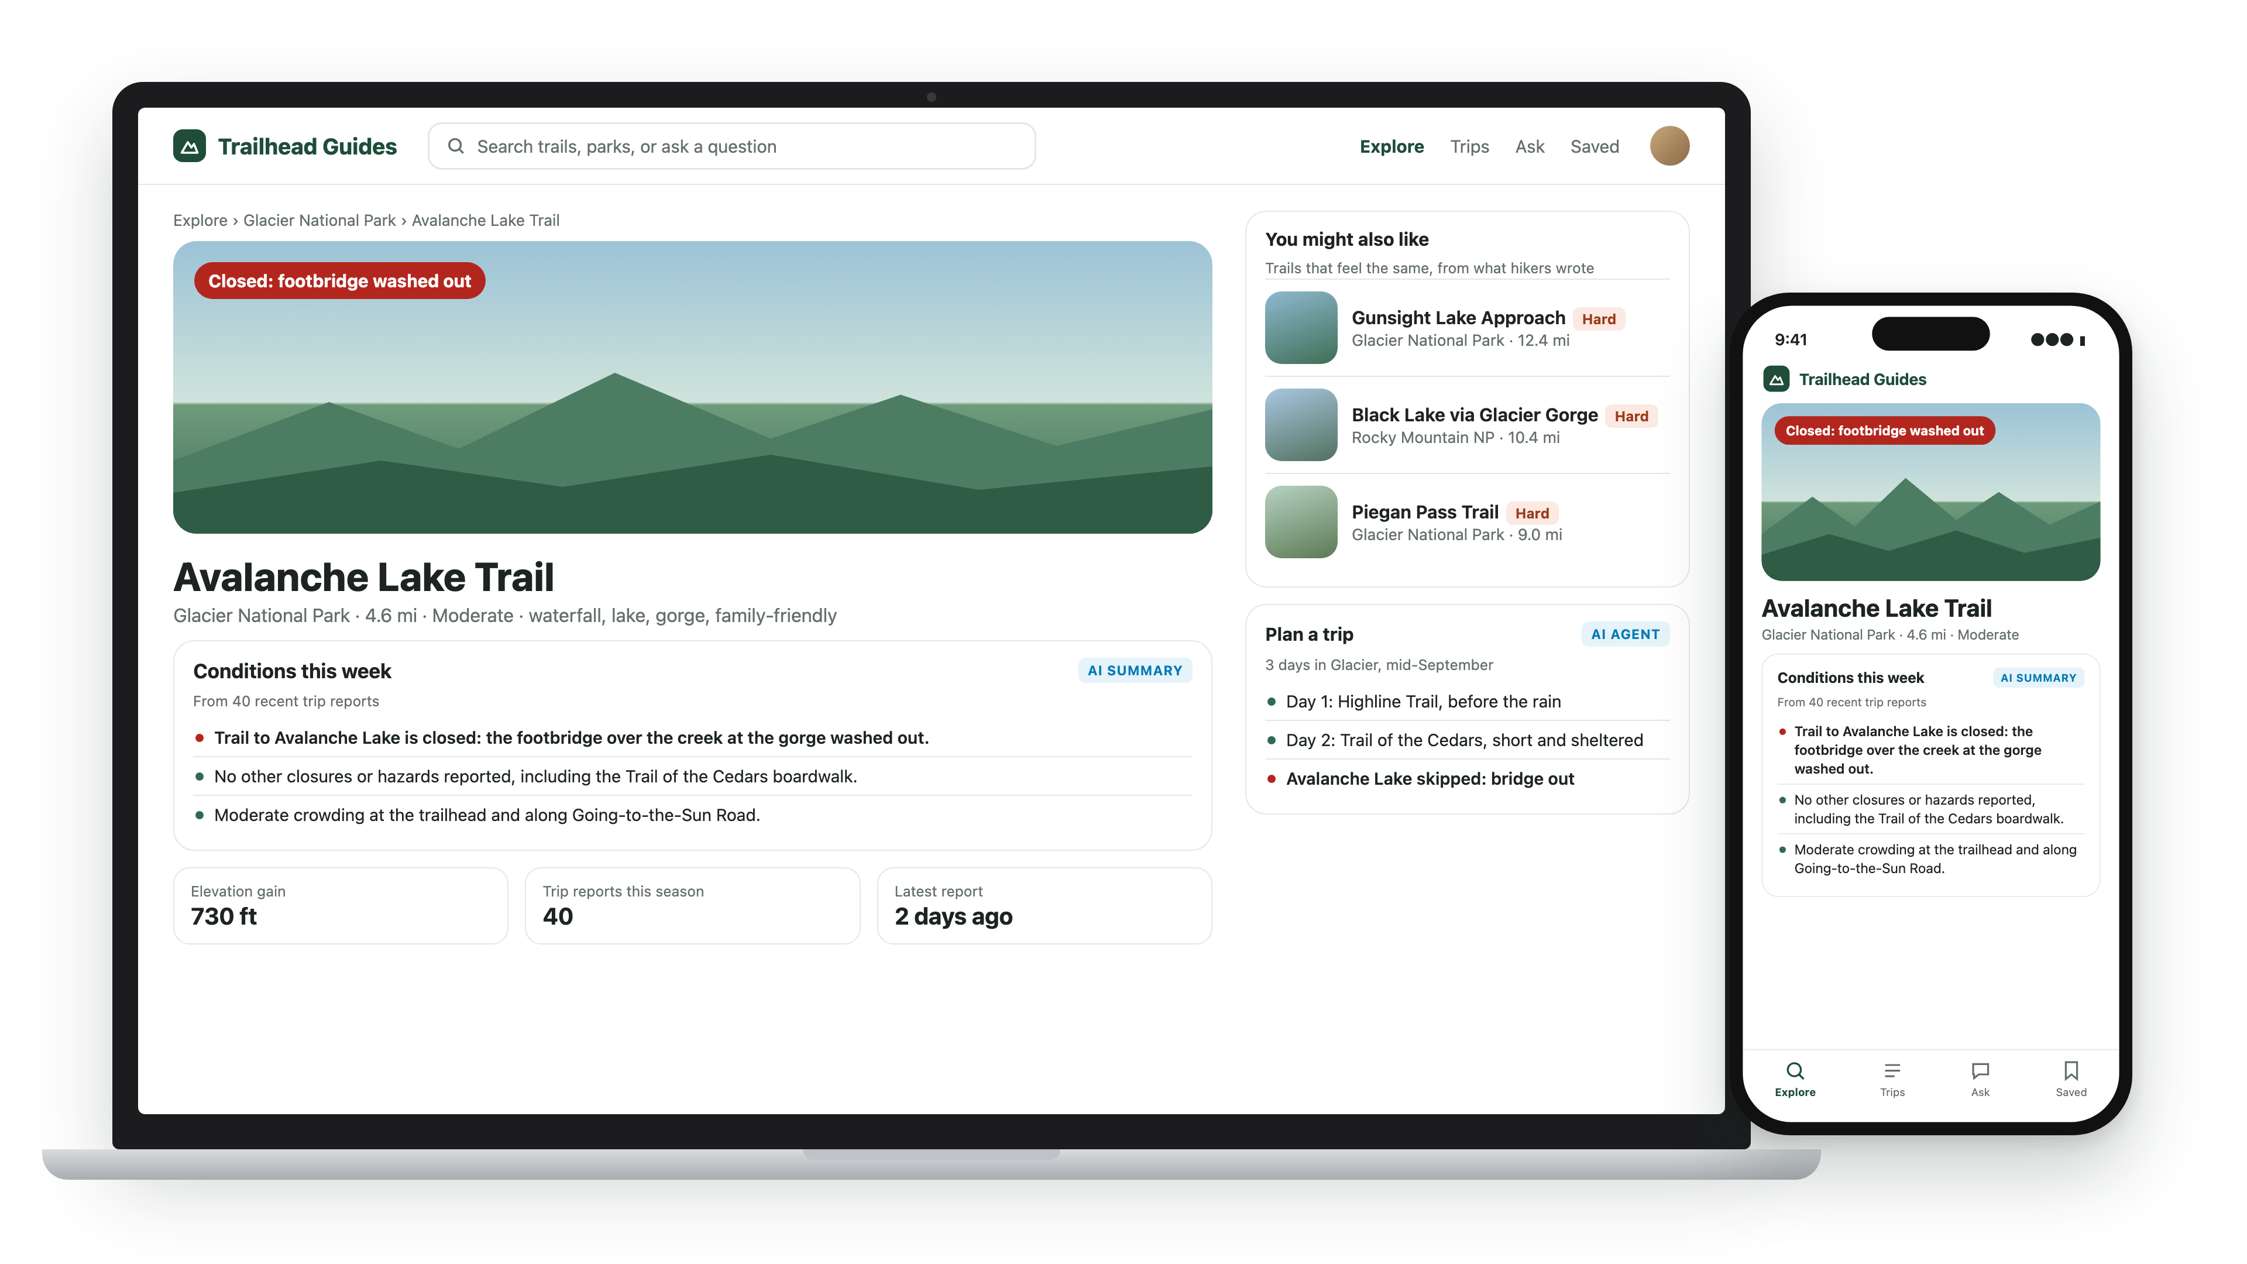
Meet Trailhead Guides
Notes:
This is the app from the story. Fictional, built for today, and every feature you see runs inside it.
Two minutes, not a tour; each lab doc describes its own data when people get there.

Slide 46
Meet the Data
🗺️ 200 trails
📃 40 trip reports
🎒 300 gear reviews
📜 25 regulation docs
📥 A full email inbox
🌧️ 500 condition reports
🔌 Mock APIs (weather / campsites / permits)
⚠️ 100% synthetic
Notes:
Three hundred gear reviews with star ratings that lie. Feature 03 measures how often.
Twenty-five regulation documents, written like real ones. Feature 05 answers questions from them, with citations.

