Slide 1
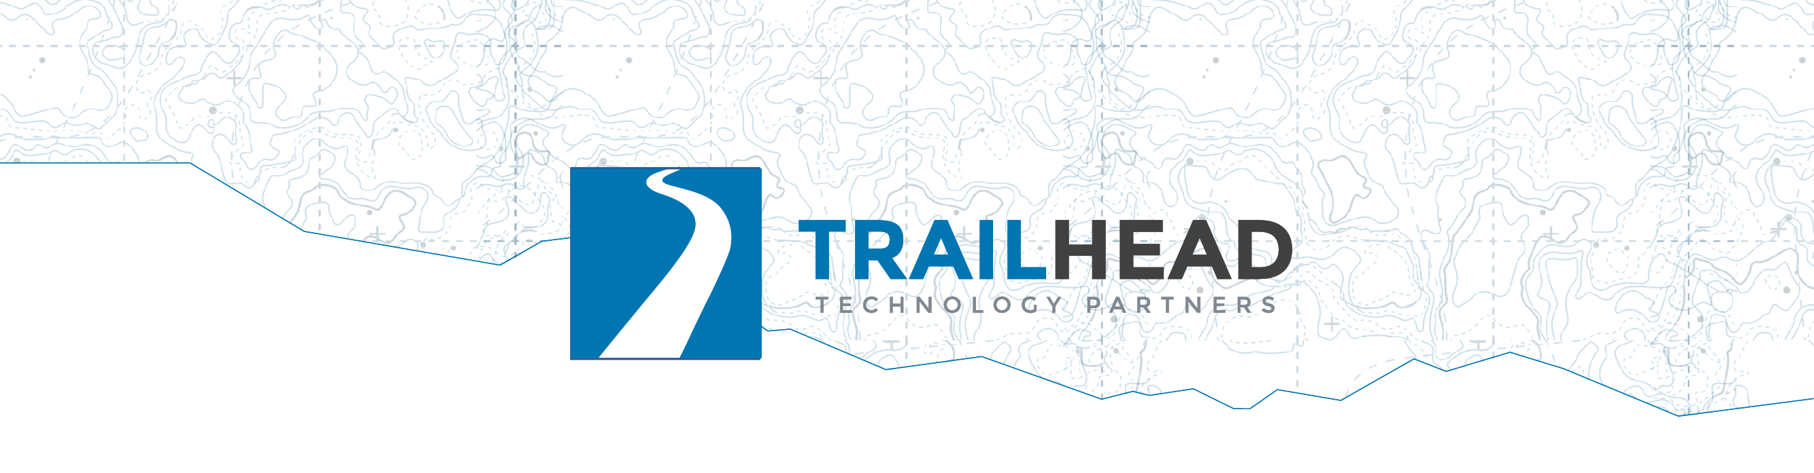
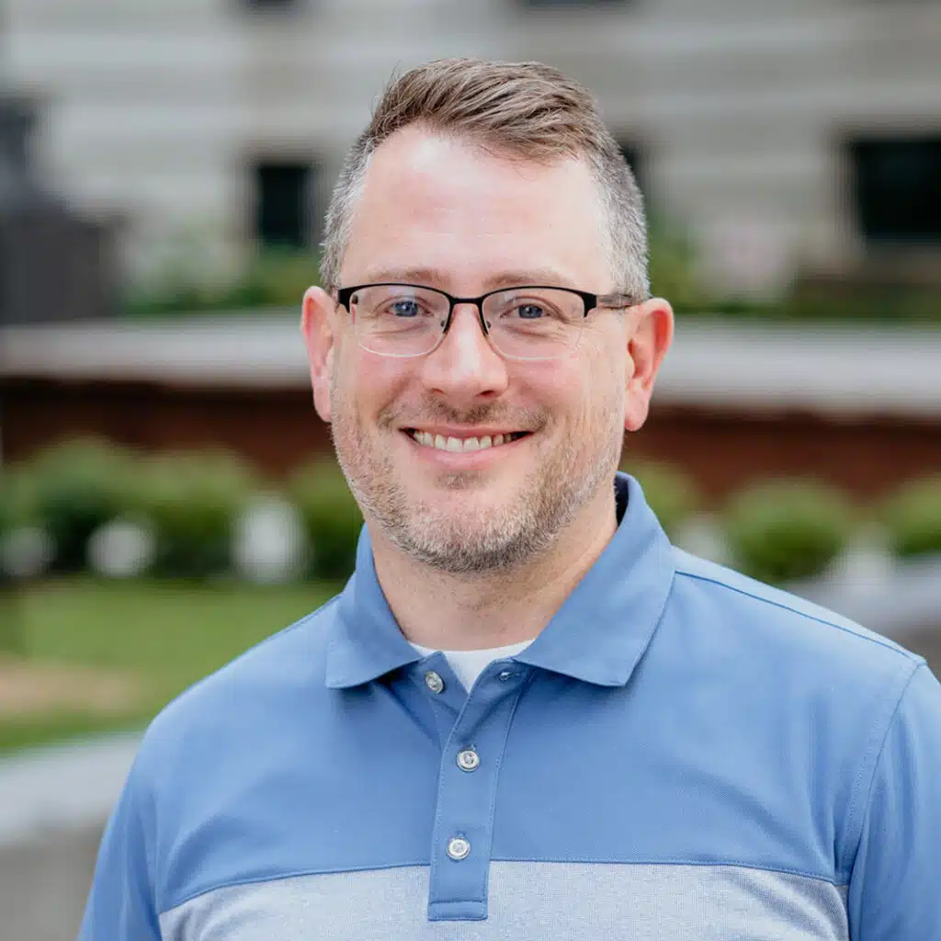

Building Pragmatic AI
Module 1: Understanding
Notes:
Making sense of messy content, and everything runs on your laptop.

Slide 2

This Module
F01 Summarize
Notes:
One model call + one careful instruction; the rhythm is three demos, then your lab hour.
Three features, one shape: a single chat call and a carefully written instruction. No vector database, no training, no cloud.
01: forty trip reports become a three-bullet briefing.

Slide 3

This Module
F01 Summarize
F02 Extract
Notes:
02: the same prose becomes a database row, and your code decides whether to believe it.

Slide 4

This Module
F01 Summarize
F02 Extract
F03 Sentiment
Notes:
03: three hundred reviews get a label, and you measure which model deserves the money.
The thread to watch all module: asked for something it cannot find, a model supplies something plausible rather than nothing. 01 invents a closure, 02 invents a distance, 03 believes the sarcasm. A better model does not fix it; a tighter instruction, a null-able schema, and checking code do.
Set the rhythm expectation out loud: three quick demos with a card for your boss after each, then the room builds for an hour: 01 recommended, 02 and 03 for anyone with time left.

Slide 5
F01 · Summarization
Notes:
The user problem, spoken over this slide, 60 seconds: forty trip reports for Avalanche Lake Trail, 1,200 words each. Somewhere in there: is the bridge out, and are the mosquitoes bad? Nobody reads forty essays; they skim three and miss the warning in the fourth. The hiker at mile two from the opening story is this feature's user.
The concept needs no slide: one chat call, a document, an instruction. "Summarize this" produces a book report; a real product asks for a summary with a purpose and a shape. The demo shows exactly that.

Slide 6
Turn a long document into the short version its reader needs.
Notes:
The textbook version: automatic summarization produces a shorter text that keeps the key information of the source. Read the slide, let it sit a beat, then the problem.

Slide 7
DEMO · F01 Summarization

Slide 8
F01 · Summarization · Demo: What to Watch
The raw report first
❌ Naive prompt: faithful, generic, useless
✅ Purpose-built prompt: the bridge surfaces
Grounding lines — without them, ~half of runs invent a closure
Same call, new shape: a one-line trail status
Notes:
~8 min · cd modules/M1-understanding/F01-summarization/dotnet
Files: tr-0004.md = the story's report, bridge buried mid-text · tr-0001.md = clean report, nothing closed (hallucination bait)
Flags: none = naive "Summarize this" · --briefing = 3 hiker bullets · --headline = one-line trail card · --audience ranger = same report, different reader
1. Open data/tr-0004.md, scroll. The bridge is one sentence, mid-report.
2. Before: cd starter && dotnet run -- ../../data/tr-0004.md. Book report. Right model, wrong instruction.
3. After: cd ../complete && dotnet run -- --briefing. Same report, three bullets, washout leads. Show the prompt.
4. dotnet run -- --briefing ../../data/tr-0001.md: the clean report, nothing closed. Last two prompt lines: 11 of 24 became 1 of 24.
5. dotnet run -- --headline: one line for a card.
6. Line 11: localhost:11434. No key, nothing left the room.
Cut: 5, then 4.

Slide 9
F01 · Summarization · Leadership Card
When: Too much content for people to read, easy-to-miss detail buried in avalanche of text.
Notes:
Reviews, tickets, reports, meeting notes, threads. One call per document.

Slide 10
F01 · Summarization · Leadership Card
When: Too much content for people to read, easy-to-miss detail buried in avalanche of text.
Think: "Our users are drowning in text we already have. A few hours of work turns it into automatic answers."
Notes:
The line for your boss; read it. Row 1 of the framework.

Slide 11
F01 · Summarization · Leadership Card
When: Too much content for people to read, easy-to-miss detail buried in avalanche of text.
Think: "Our users are drowning in text we already have. A few hours of work turns it into automatic answers."
Difficulty:
Easy
Notes:
The line for your boss; read it. Row 1 of the framework.

Slide 12
F02 · Extraction
Notes:
The user problem, spoken, 60 seconds: Trailhead wants a "trail stats" panel — which trails, when, how far, what wildlife, what condition. All of it exists as prose across the forty reports, and today a human would re-read and re-type it. So the panel doesn't exist.
This one gets the module's one concept slide, because the pipeline — and where it lies to you — is the lesson.

Slide 13
Pull facts out of free-form text
into fields your code can query.
Notes:
The textbook version: information extraction turns unstructured text into structured data. JSON mode guarantees the shape; it does not guarantee the truth.

Slide 14
F02 · How It Works
Trip report
Notes:
The input is prose: the same trip report from 01.

Slide 15
F02 · How It Works
Trip report
Prompt: fields, types, examples, "null when absent"
Notes:
The prompt is the schema in words: fields, types, examples, and "null when absent."

Slide 16
F02 · How It Works
Trip report
Prompt: fields, types, examples, "null when absent"
llama3.2 in JSON mode
Notes:
llama3.2 in JSON mode. JSON mode guarantees syntax, not truth.

Slide 17
F02 · How It Works
Trip report
Prompt: fields, types, examples, "null when absent"
llama3.2 in JSON mode
Parse and validate against the schema
Notes:
Parse and validate against the schema. This is the box people skip.

Slide 18
F02 · How It Works
Trip report
Prompt: fields, types, examples, "null when absent"
llama3.2 in JSON mode
Parse and validate against the schema
Store, or reject and log
Notes:
Store, or reject and log. A silently stored zero is the bug.

Slide 19
F02 · How It Works
Trip report
Prompt: fields, types, examples, "null when absent"
llama3.2 in JSON mode
Parse and validate against the schema
Store, or reject and log
The model writes JSON; your code decides whether to believe it
Notes:
The model writes JSON; your code decides whether to believe it.

Slide 20
F02 · How It Works
Trip report
Prompt: fields, types, examples, "null when absent"
llama3.2 in JSON mode
Parse and validate against the schema
Store, or reject and log
The model writes JSON; your code decides whether to believe it
The null rule and the validator are the feature
Notes:
The null rule and the validator are the feature. Say plainly that extraction without validation is a data-corruption feature.

Slide 21
F02 · How It Works
Trip report
Prompt: fields, types, examples, "null when absent"
llama3.2 in JSON mode
Parse and validate against the schema
Store, or reject and log
The model writes JSON; your code decides whether to believe it
The null rule and the validator are the feature
A rejected record is a good outcome
Notes:
A rejected record is a good outcome; it is the pipeline telling you the truth.

Slide 22
DEMO · F02 Extraction

Slide 23
F02 · Extraction · Demo: What to Watch
A C# record (TripFacts) · typed response · no parsing
❌ No distance in the report → distance_mi: 5.0
✅ Nullable fields + "null when not stated"
Run it 3×: better ≠ guaranteed
The last mile is a validator — ordinary code
Notes:
~10 min · cd modules/M1-understanding/F02-extraction/dotnet
Files: tr-0007.md = full report, every field present · tr-0011.md = sparse report, no distance stated (the null test)
Args: a report path; complete with no args runs both
1. Same kind of report as 01. This time the goal is a database row.
2. Before: cd starter && dotnet run -- ../../data/tr-0007.md. JSON asked for in the prompt. Fences, preamble, drifting field names.
3. After: cd ../complete && dotnet run -- ../../data/tr-0007.md. TripFacts record, typed response, no parsing.
4. dotnet run -- ../../data/tr-0011.md, three times. Nulls where there is nothing, and watch what still slips.
5. Point at the validator: PASS or REJECT. A rejected record is a good outcome.
Cut: 4's repeats.

Slide 24
F02 · Extraction · Leadership Card
When: Valuable data trapped in documents nobody will re-type.
Notes:
Invoices, resumes, support emails, contracts, legacy records.

Slide 25
F02 · Extraction · Leadership Card
When: Valuable data trapped in documents nobody will re-type.
Think: "We have years of data trapped in documents. This turns it into queryable rows without anyone re-typing it."
Notes:
The line for your boss. Row 2.

Slide 26
F02 · Extraction · Leadership Card
When: Valuable data trapped in documents nobody will re-type.
Think: "We have years of data trapped in documents. This turns it into queryable rows without anyone re-typing it."
Difficulty:
Medium
Notes:
Medium. If asked about cost: days to a working pipeline; the real work is schema design and spot-checking accuracy.

Slide 27
F03 · Sentiment
Notes:
The user problem, spoken, 60 seconds: the Cascade 65 backpack has 300 reviews. Are people happy, and what are they mad about? Star ratings lie — "4 stars, but the hip belt broke on day two." The user here is the product team, not the hiker; track the signal weekly and a defect surfaces months before returns spike.
No concept slide: this is classification, and the demo IS the lesson — the day's model-selection experiment. phi3 free and local vs gpt-4.1 on Azure, same prompt, and you measure instead of assume.

Slide 28
Read text and judge the feeling behind it: positive, negative, or mixed.
Notes:
The textbook version: sentiment analysis identifies the emotional polarity of a piece of text. The stars lie; the words mostly don't.

Slide 29
DEMO · F03 Sentiment

Slide 30
F03 · Sentiment · Demo: What to Watch
One method · positive | negative | mixed · swap = one DI line
20 easy through phi3: fast, free, correct
Same 20 through Azure: 9 of 10 identical
The hard set through both — diff on screen
📊 phi3 9/10 · 7/10 — gpt-4.1 10/10 · 10/10
Notes:
~10 min · cd modules/M1-understanding/F03-sentiment/dotnet
Files: easy.jsonl = 10 plain reviews · hard.jsonl = 10 sarcastic or split reviews · reference-labels.json = the hand labels
Flags: --easy / --hard = one set; none = both · starter takes a review id (default gr-0007, the sarcastic one)
1. Open data/hard.jsonl. Find a two-star review with glowing text. Stars lie.
2. Before: cd starter && dotnet run. One method, one label, gr-0007. Show the DI line: the swap is one line.
3. After: cd ../complete && dotnet run -- --easy. phi3 9/10, gpt-4.1 10/10. Paid for one review.
4. dotnet run -- --hard: phi3 7/10, gpt-4.1 10/10. Diff on screen. Every miss goes the frontier model's way.
5. The recipe: labeled sample, run both, count disagreements, price the errors.
Cut: 3, go straight to 4.

Slide 31
F03 · Sentiment · Leadership Card
When: A high-volume text stream needing a judgment call.
Notes:
Reviews, NPS verbatims, tickets, mentions, survey answers.

Slide 32
F03 · Sentiment · Leadership Card
When: A high-volume text stream needing a judgment call.
Think: "We measured: the free local model matches the expensive one on most of this task, and we know exactly which slice needs the big gun."
Notes:
The line for your boss, and today you measured it. Row 3.

Slide 33
F03 · Sentiment · Leadership Card
When: A high-volume text stream needing a judgment call.
Think: "We measured: the free local model matches the expensive one on most of this task, and we know exactly which slice needs the big gun."
Difficulty:
Easy
Notes:
Easy. If asked about cost: days; the classifier is trivial, the diligence is a labeled sample and an error count.

Slide 34
Lab 1: ~60 Minutes
⭐ Recommended: F01 Summarization
⛰️ Challenge: F02 Extraction · F03 Sentiment
FNN-lab.md · http/ollama.http · expected-output.md · data/
✅ Done = your output similar to expected-output.md
Notes:
Start with 01 regardless of experience: one endpoint, one prompt, two reports; everything else today assumes you've made one model call and seen what comes back. New to this? Budget the full time and do the stretch goal.
Pick 03 if your question at work is "which model should we pay for" — its Azure half needs the room key. 02's done-check: the sparse report comes back with nulls and the validator says PASS/REJECT honestly.
Finished everything? Help someone near you.

Slide 35
Lab 1: Debrief
How'd it go? Observations? Questions?
Notes:
Ask two people what surprised them.
Prompts if quiet: what surfaced the buried bridge, and what invented one? Rows 1–3 of the framework are done. Break, then Module 2.

