Slide 1
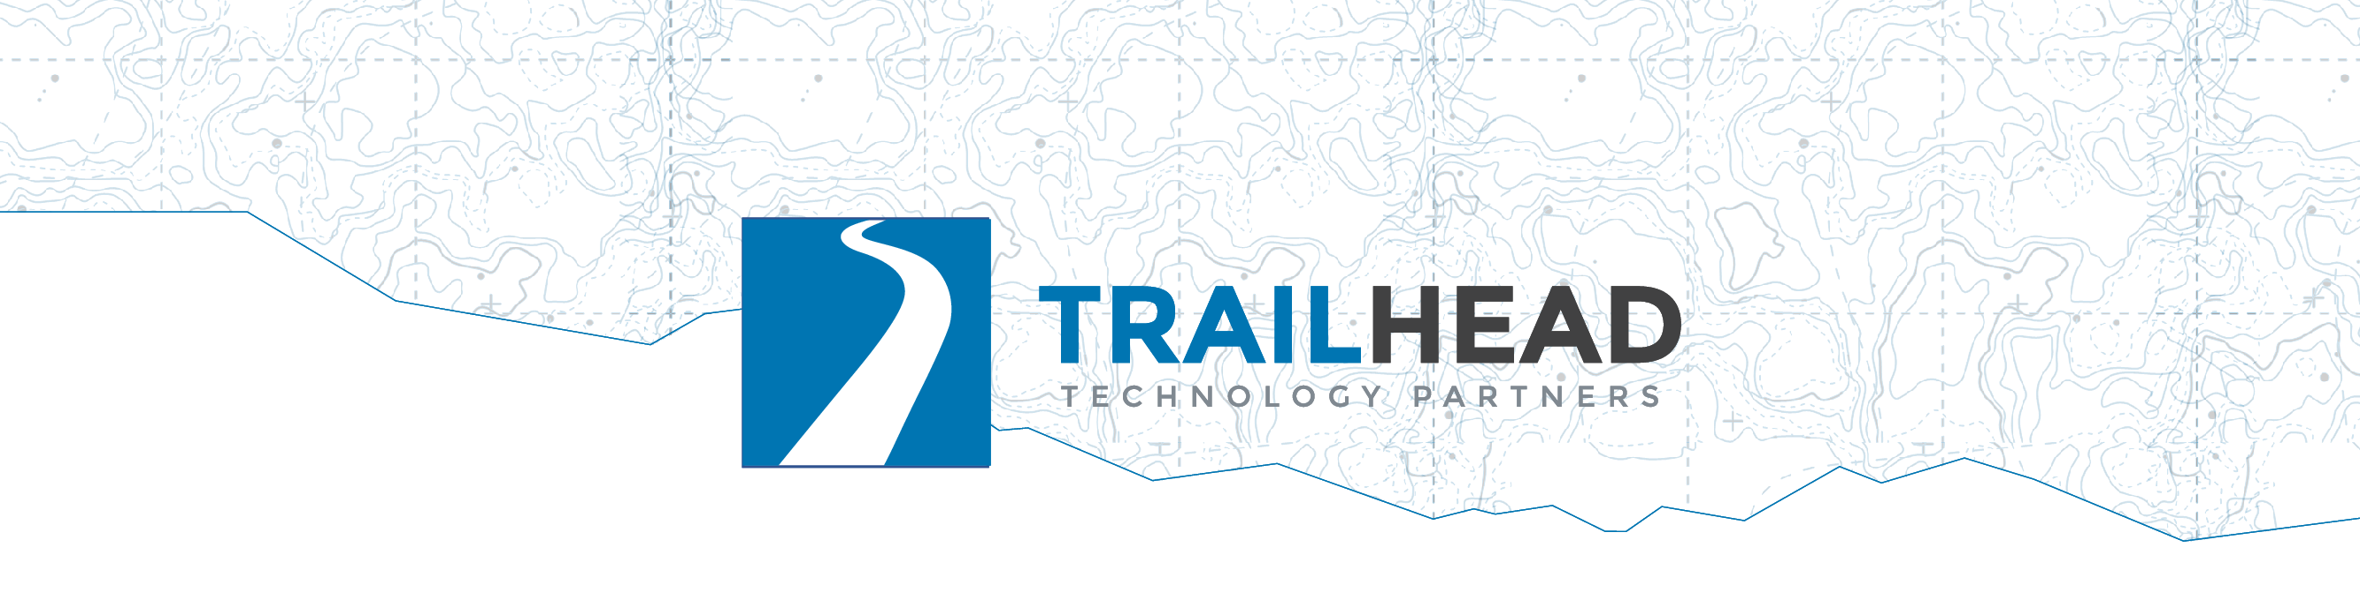
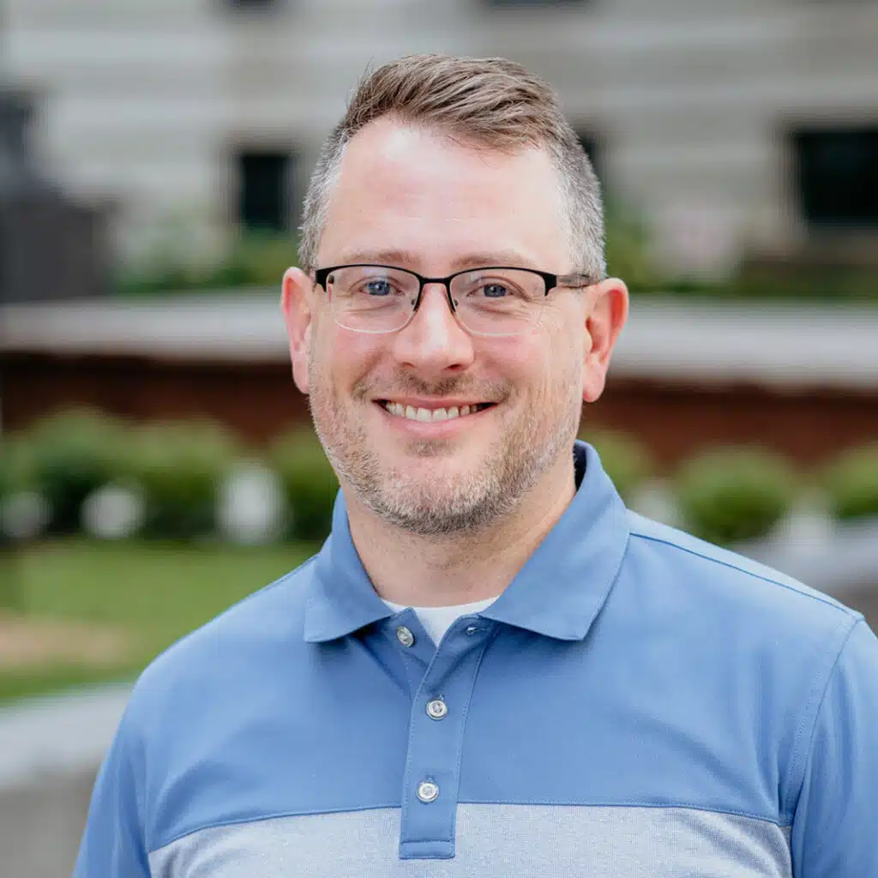
Building Pragmatic AI
10 AI Features Your Users Actually Want
Jonathan “J.” Tower
Notes:
The repo URL comes up on the Get Set Up slide; advance to it while people settle.
Ask who did the SETUP.md pre-work. Anyone who didn't should say so now, not in the first lab.

Slide 2
Get Set Up
🦙 ollama.com/download
Notes:
This is SETUP.md, revealed line by line; the finished checklist stays up.
ollama.com/download: one installer, no GPU needed.

Slide 3
Get Set Up
🦙 ollama.com/download
⬇️ ollama pull · llama3.2 · phi3 · nomic-embed-text
Notes:
The pulls, one per command: ollama pull llama3.2 then ollama pull phi3 then ollama pull nomic-embed-text.
Models are about 5 GB total.

Slide 4
Get Set Up
🦙 ollama.com/download
⬇️ ollama pull · llama3.2 · phi3 · nomic-embed-text
🧰 VS Code + REST Client (humao.rest-client)
Notes:
REST Client from the terminal: code --install-extension humao.rest-client.
JetBrains users can skip REST Client; the built-in HTTP client opens the same .http files.

Slide 5
Get Set Up
🦙 ollama.com/download
⬇️ ollama pull · llama3.2 · phi3 · nomic-embed-text
🧰 VS Code + REST Client (humao.rest-client)
⌨️ C#, Python, or TypeScript — and its runtime
Notes:
Runtimes: .NET 10 SDK, uv for Python, or Node. Pick the one you read fastest.

Slide 6
Get Set Up
🦙 ollama.com/download
⬇️ ollama pull · llama3.2 · phi3 · nomic-embed-text
🧰 VS Code + REST Client (humao.rest-client)
⌨️ C#, Python, or TypeScript — and its runtime
📦 git clone github.com/trailheadtechnology/10-ai-features-workshop
Notes:
The clone: git clone https://github.com/trailheadtechnology/10-ai-features-workshop.git

Slide 7
Get Set Up
🦙 ollama.com/download
⬇️ ollama pull · llama3.2 · phi3 · nomic-embed-text
🧰 VS Code + REST Client (humao.rest-client)
⌨️ C#, Python, or TypeScript — and its runtime
📦 git clone github.com/trailheadtechnology/10-ai-features-workshop
☁️ Azure OpenAI: nothing to install
Notes:
Azure endpoint and deployment names are already in the lab files; the key is handed out in the room.
Ask for hands: who has all three models pulled? Anyone without them starts copying from the USB drives now, during the framing, rather than in the first lab.

Slide 8
First, Prove Your Machine Works
http/smoke-test.http
💬 local chat · 🔢 local embeddings · ☁️ Azure chat
✅ Three JSON responses, no red text
🖐️ Broken? Raise a hand now.
Notes:
Full path: modules/M0-opening/F00-setup-and-framing/http/smoke-test.http. Paste the room key over <KEY FROM INSTRUCTOR> for the Azure request.
Room key (key2): in instructor.local.md at the repo root (untracked). Write it on the whiteboard, not a slide. Regenerate it after the workshop; the command is in the same file.
Do this before the framing, about ten minutes in, because the most expensive twenty minutes of a hands-on workshop is the twenty minutes in the first lab when a third of the room finds out their setup doesn't work.
Fallbacks exist for exactly this moment. Walk the room while people run it. Curl versions are in the lab README.

Slide 9

Saturday. 5:58 a.m.
Notes:
A hiker. Alarm before dawn, coffee in the car, ninety minutes to the trailhead.
She planned this trip in a trip-planning app. (It's our fictional app, Trailhead Guides; the room will live in its data all day.)

Slide 10
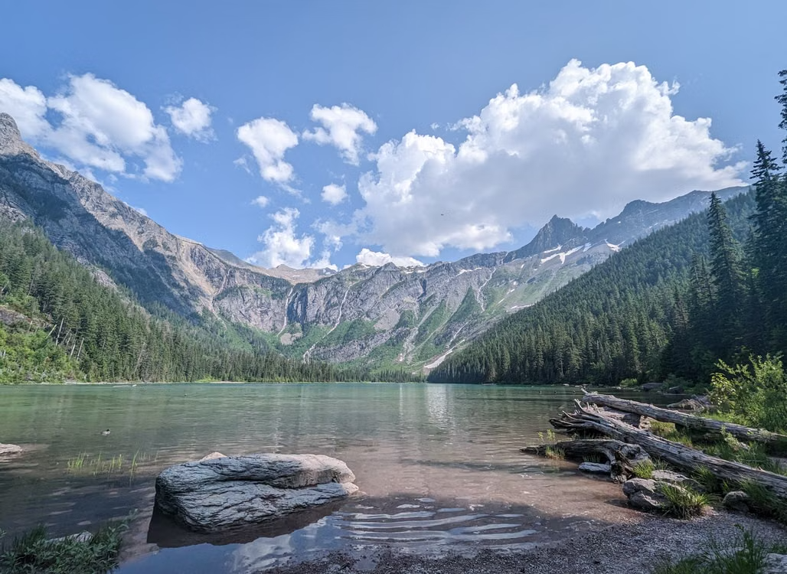
Avalanche Lake Trail
Notes:
The trail she picked. Moderate, family-rated, a lake at the end.
The app showed photos, distance, elevation. All accurate.

Slide 11

41 trip reports
Notes:
The app also had forty-one trip reports for this trail. Real hikers, real conditions, about 1,200 words each.
Ask the room: who reads forty-one essays before a day hike?

Slide 12
She read three.
Notes:
The top three. "Beautiful." "Crowded by ten." "Bring bug spray."

Slide 13
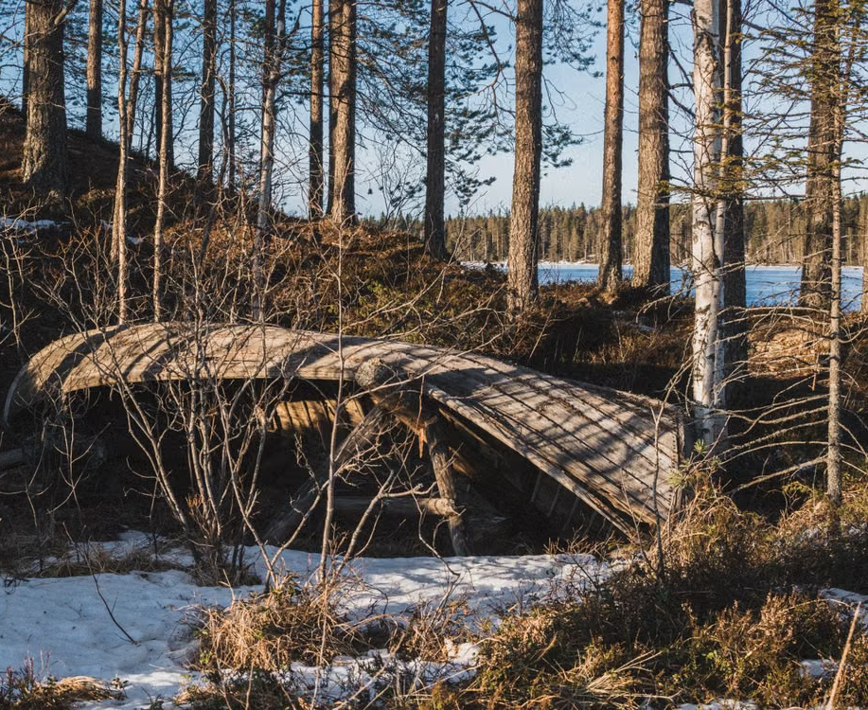
"The footbridge at the creek is gone. We had to turn around."
Report #14 of 41
Notes:
Report fourteen. One sentence, buried in a paragraph about huckleberries.
She never saw it.

Slide 14
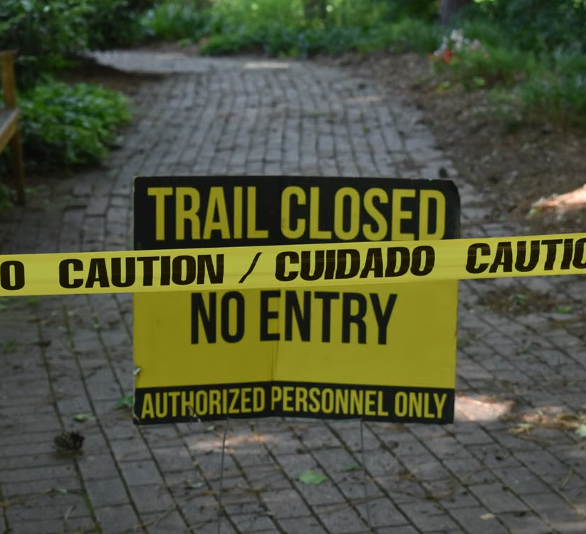
Mile 2 is where she found out.
Notes:
Two hours of driving, two miles of walking, and the trip is over at a creek she can't cross.
Beat of silence, then the turn:

Slide 15

The answer existed, but it was buried.
Notes:
The data was in the product. A user needed one sentence of it, and the product's job was to surface that sentence.
Every feature you build today exists to close exactly this kind of gap.
And this bridge, this trail, this body of data: you'll meet them all day.
That washout is planted in the workshop data, and by this afternoon your code will find it.

Slide 16

Ten shippable AI features that solve problems your users already have, and the judgment to know when to build each.
Notes:
The promise of the day.
Not a survey, not vendor slides: you build these, you measure them, and you leave with a decision framework for picking the first one to ship at work.

Slide 17
The Wrong Question and the Better One
❌ "Where can we use AI?"
Notes:
Every company is asking this question right now.

Slide 18
The Wrong Question and the Better One
❌ "Where can we use AI?"
✅ "What problems can AI best solve for our users?"
Notes:
Today asks the second one.
This is the thesis. Say it plainly and come back to it in every module: every feature today opens with a user who is stuck, and the AI only shows up as the answer.
The technology is the last thing we talk about in each feature, not the first.

Slide 19
"Users" Is a Broad Word
🥾 The hiker planning Saturday
Notes:
The obvious user: the hiker from the story, planning Saturday.

Slide 20
"Users" Is a Broad Word
🥾 The hiker planning Saturday
📊 The PM facing 300 reviews
Notes:
The PM with 300 gear reviews and no time to read them.

Slide 21
"Users" Is a Broad Word
🥾 The hiker planning Saturday
📊 The PM facing 300 reviews
🏞️ The ranger facing a full inbox
Notes:
The ranger with a full inbox and an emergency somewhere in it.

Slide 22
"Users" Is a Broad Word
🥾 The hiker planning Saturday
📊 The PM facing 300 reviews
🏞️ The ranger facing a full inbox
Features 03, 07, and 08 might serve the people running the product.
Notes:
Stakeholders are users too. "Nobody has time to read all of this" is a real user problem; it just belongs to a user on your payroll.

Slide 23

What You Leave Able to Do
Summaries &
Validations
Notes:
Who this is for: you write software for a living, you can make an HTTP request, and you haven't shipped an LLM feature yet, or you've shipped one and want the other nine.
Say the four outcomes out loud, one per reveal; these are the promises the day is measured against, and they come back one at a time in each module's debrief. One outcome per module.
Module 1: summaries shaped for a purpose and records your code validated, all on your laptop.

Slide 24

What You Leave Able to Do
Summaries &
Validations
Search &
Cited Answers
Notes:
Module 2: search by meaning, and answers grounded in your documents with citations your code checks.

Slide 25

What You Leave Able to Do
Summaries &
Validations
Search &
Cited Answers
Routing &
a Human Gate
Notes:
Module 3: routing that never misses the expensive class, and a human gate with an audit trail.

Slide 26

What You Leave Able to Do
Summaries &
Validations
Search &
Cited Answers
Routing &
a Human Gate
A Bounded
Agent Loop
Notes:
Module 4: an agent loop bounded by a step budget, small enough to read.

Slide 27
What You Leave Able to Do
Summaries &
Validations
Search &
Cited Answers
Routing &
a Human Gate
A Bounded
Agent Loop
See 10;
Build 4+
Notes:
You see all ten demoed; you build four, one per module.
If someone in the room has shipped all of this already, they are a helper for the day; say so now.

Slide 28
The Modules
1 · Understanding — summarize, extract, sentiment
Notes:
Module 1, Understanding: summarize, extract, sentiment. 90 minutes.

Slide 29
The Modules
1 · Understanding — summarize, extract, sentiment
2 · Finding — search, RAG, recommend
Notes:
Module 2, Finding: search, RAG, recommend. 90 minutes, then an hour for lunch.

Slide 30
The Modules
1 · Understanding — summarize, extract, sentiment
2 · Finding — search, RAG, recommend
3 · Deciding — route, detect, approve
Notes:
Module 3, Deciding: route, detect, approve. 90 minutes.

Slide 31
The Modules
1 · Understanding — summarize, extract, sentiment
2 · Finding — search, RAG, recommend
3 · Deciding — route, detect, approve
4 · Doing — the agent capstone
Notes:
Module 4, Doing: the agent capstone, everyone. 60 minutes. Then the closing, 30 minutes.
Breaks between modules and an hour for lunch after Module 2.

Slide 32
The Schedule
Module | Features | Time
00 Opening | Setup, context | 30 min
01 Understanding | F01 Summarize, F02 Extract F03 Sentiment | 90 min
02 Finding | F04 Search F05 RAG F06 Recommend | 90 min
03 Deciding | F07 Route F08 Detect F09 Approve | 90 min
04 Doing | F10 Agent capstone | 60 min
05 Closing | A decision framework | 30 min
Notes:
Breaks between modules and an hour for lunch after Module 2.

Slide 33

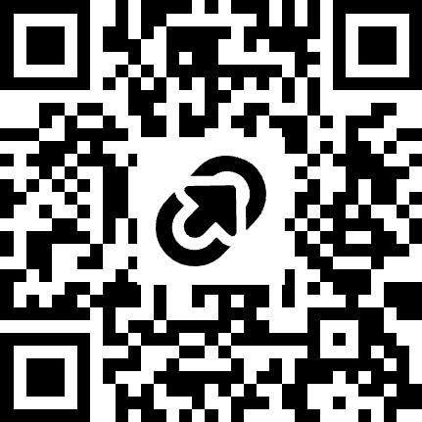
Jonathan "J." Tower
LET’S TALK
Principal Consultant & Partner
13x Microsoft MVP in .NET and AI
VP of .NET Foundation
Blue Blazes podcast host
jtower@trailheadtechnology.com
trailheadtechnology.com/blog
jtowermi
Jonathan “J.” Tower
tinyurl.com/th-offer
github.com/trailheadtechnology/10-ai-features-workshop
Notes:
Quick intro, then the free offer: tinyurl.com/th-offer, on screen again at the end.

Slide 34
How Each Module Works
30 min mine · 60 min yours
Notes:
The instructor half: the module's theme, then all three features demoed live in .NET. The build half is yours.

Slide 35
How Each Module Works
30 min mine · 60 min yours
1 lab Recommended · 2 Challenge
Notes:
Pick the Recommended lab unless you have a reason not to; the other two are for anyone with time left, and every lab has a stretch goal.

Slide 36
How Each Module Works
30 min mine · 60 min yours
1 lab Recommended · 2 Challenge
The capstone: everyone
Notes:
The capstone splits 10 and 50 instead of 30 and 60, and there is no menu: everyone builds it.

Slide 37
How Each Module Works
30 min mine · 60 min yours
1 lab Recommended · 2 Challenge
The capstone: everyone
Finishing one lab per module = success
Notes:
Set expectations hard here. Ten labs in a day is not the goal, and nobody is behind. Helping the person next to you is a good use of leftover time.

Slide 38




Many Language Choices
Notes:
The .NET projects are the demo; the Python and TypeScript ports produce the same output, so pick whichever you read fastest.

Slide 39
Many Language Choices
Notes:
The .NET projects are the demo; the Python and TypeScript ports produce the same output, so pick whichever you read fastest.

Slide 40
Every Feature Ends with the Same Card
When to reach for it
Notes:
When to reach for it: the user problem this feature answers.

Slide 41
Every Feature Ends with the Same Card
When to reach for it
Think: the line for your boss
Notes:
Think: the one line you say to your boss.

Slide 42
Every Feature Ends with the Same Card
When to reach for it
Think: the line for your boss
Difficulty: easy, medium, or hard
Notes:
Difficulty: easy, medium, or hard, as measured by building all ten.

Slide 43
Every Feature Ends with the Same Card
When to reach for it
Think: the line for your boss
Difficulty: easy, medium, or hard
10 cards → the decision framework
Notes:
The cards become the framework we assemble in the closing session; it's the artifact you take back to work. Point at docs/decision-framework.md in the repo now so people know it exists.

Slide 44
Local First, Cloud When Needed
💻 llama3.2 · phi3 · nomic-embed-text (~5 GB, no GPU)
Notes:
Three local models, about 5 GB, no GPU. Free, private, and they run on the laptop in front of you.

Slide 45
Local First, Cloud When Needed
💻 llama3.2 · phi3 · nomic-embed-text (~5 GB, no GPU)
☁️ Foundry only where quality matters: F03, F05, F10
Notes:
Foundry only where model quality changes the answer: 03's comparison, 05's generation, and the capstone.

Slide 46
Local First, Cloud When Needed
💻 llama3.2 · phi3 · nomic-embed-text (~5 GB, no GPU)
☁️ Foundry only where quality matters: F03, F05, F10
Free, private, offline-tolerant
Notes:
Two payoffs: you learn where free/private/small is enough, and most of the day survives conference wifi.
Rows 1 through 8 of the framework mostly run on free local models. That is a finding your leadership will care about on its own.

Slide 47
The Shape of Every Feature
Your data (a report, a query, an inbox)
Notes:
Build the diagram box by box as you talk, and leave the picture in people's heads for the day. It starts with your data: a report, a query, an inbox.

Slide 48
The Shape of Every Feature
Your data (a report, a query, an inbox)
Prompt: instruction + data + the shape you want back
Notes:
A prompt: the instruction, the data, and the shape you want back.

Slide 49
The Shape of Every Feature
Your data (a report, a query, an inbox)
Prompt: instruction + data + the shape you want back
Model, over HTTP (Ollama or Foundry)
Notes:
The model, over HTTP. Ollama on the laptop or Foundry in the cloud; same box.

Slide 50
The Shape of Every Feature
Your data (a report, a query, an inbox)
Prompt: instruction + data + the shape you want back
Model, over HTTP (Ollama or Foundry)
Output your code checks
Notes:
Output your code checks before anything trusts it.

Slide 51
The Shape of Every Feature
Your data (a report, a query, an inbox)
Prompt: instruction + data + the shape you want back
Model, over HTTP (Ollama or Foundry)
Output your code checks
Your UI
Notes:
Your UI. The user never sees the model.

Slide 52
The Shape of Every Feature
Your data (a report, a query, an inbox)
Prompt: instruction + data + the shape you want back
Model, over HTTP (Ollama or Foundry)
Output your code checks
Your UI
Ten features, one shape
Notes:
Ten features, one shape. What changes per feature is the data going in, the instruction, and what your code does with what comes back.

Slide 53
The Shape of Every Feature
Your data (a report, a query, an inbox)
Prompt: instruction + data + the shape you want back
Model, over HTTP (Ollama or Foundry)
Output your code checks
Your UI
Ten features, one shape
The model is one box; the rest is ordinary software
Notes:
The model is one box; the rest is ordinary software your team already writes.

Slide 54
The Shape of Every Feature
Your data (a report, a query, an inbox)
Prompt: instruction + data + the shape you want back
Model, over HTTP (Ollama or Foundry)
Output your code checks
Your UI
Ten features, one shape
The model is one box; the rest is ordinary software
Later modules add boxes, never replace them
Notes:
Modules 2 to 4 add a vector store, a retrieval step, a tool loop. Every module opens with a version of this diagram with more boxes; point back to this one each time.

Slide 55
Every Model Is an HTTP Call
localhost:11434 → /api/chat · /api/embed
Notes:
Ollama listens on localhost:11434: /api/chat and /api/embed. It also exposes an OpenAI-compatible /v1.

Slide 56
Every Model Is an HTTP Call
localhost:11434 → /api/chat · /api/embed
…openai.azure.com/…/chat/completions + api-key
Notes:
Foundry serves gpt-4.1 and gpt-5.5 per deployment name, at the chat/completions path with an api-key header.

Slide 57
Every Model Is an HTTP Call
localhost:11434 → /api/chat · /api/embed
…openai.azure.com/…/chat/completions + api-key
Same request shape · a URL and a key apart
Notes:
Show one request to each on screen: the smoke test's local chat and its cloud chat, side by side. Point at the URL and the header. Same request shape, a URL and a key apart.

Slide 58
Every Model Is an HTTP Call
localhost:11434 → /api/chat · /api/embed
…openai.azure.com/…/chat/completions + api-key
Same request shape · a URL and a key apart
The SDKs are wrappers over these POSTs
Notes:
The http/ track is the real thing with the SDK removed; Microsoft.Extensions.AI and the openai package are wrappers over these POSTs. This is why "any language" is true and why local-to-cloud is a config change, which the next slide makes concrete in code.

Slide 59
One Line of Code, Any Provider
IChatClient · IEmbeddingGenerator
Notes:
Every .NET demo uses Microsoft.Extensions.AI: IChatClient for chat, IEmbeddingGenerator for vectors.

Slide 60
One Line of Code, Any Provider
IChatClient · IEmbeddingGenerator
Ollama ↔ Azure = one DI line
Notes:
Ollama today, Azure OpenAI tomorrow, is a change in DI registration, not in the feature. Show the two registration lines side by side.

Slide 61
One Line of Code, Any Provider
IChatClient · IEmbeddingGenerator
Ollama ↔ Azure = one DI line
F03 and F05 (both optional) do the swap live
Notes:
03 and 05 do the swap live, and both are optional labs.
This is the one "framework" slide of the day; move on. That is all the framework talk the day needs.

Slide 62
Meet Trailhead Guides
The app from the story
Notes:
This is the app from the story. Fictional, built for today, and every feature you see runs inside it.
Two minutes, not a tour; each lab doc describes its own data when people get there.

Slide 63
Meet Trailhead Guides
The app from the story
🗺️ 200 trails · 40 trip reports
Notes:
Two hundred trails in the catalog. Forty trip reports, about 1,200 words each, written by people who love gear more than brevity.
Switch to VS Code: modules/M1-understanding/F01-summarization/data/tr-0004.md. Scroll slowly. Do not read it aloud.
Airport sandwiches. Huckleberry ice cream. And somewhere in the middle, one sentence about a bridge. That is the problem feature 01 solves in about twenty minutes.

Slide 64
Meet Trailhead Guides
The app from the story
🗺️ 200 trails · 40 trip reports
🎒 ~300 gear reviews · 📜 25 regulation docs
Notes:
Three hundred gear reviews with star ratings that lie. Feature 03 measures how often.
Twenty-five regulation documents, written like real ones. Feature 05 answers questions from them, with citations.

Slide 65
Meet Trailhead Guides
The app from the story
🗺️ 200 trails · 40 trip reports
🎒 ~300 gear reviews · 📜 25 regulation docs
📥 an inquiry inbox · ~500 condition reports
Notes:
One hundred visitor inquiries; two are emergencies, and feature 07 must never miss them.
Five hundred trail-condition reports, boring on purpose. Feature 08 finds the two clusters that are not.

Slide 66
Meet Trailhead Guides
The app from the story
🗺️ 200 trails · 40 trip reports
🎒 ~300 gear reviews · 📜 25 regulation docs
📥 an inquiry inbox · ~500 condition reports
🔌 mock weather / campsite / permit APIs
Notes:
Weather, campsites, permits: JSON files in a folder. Nothing today calls a real park. Feature 10 treats them as real.

Slide 67
Meet Trailhead Guides
The app from the story
🗺️ 200 trails · 40 trip reports
🎒 ~300 gear reviews · 📜 25 regulation docs
📥 an inquiry inbox · ~500 condition reports
🔌 mock weather / campsite / permit APIs
⚠️ 100% synthetic
Notes:
Real park names, invented rules. Do not plan a trip from it.
Two facts are planted in this corpus and you will meet them all day. The footbridge on Avalanche Lake Trail, trail-0117, washed out in June 2026: her bridge from the story. And a bear-activity spike on Hidden Meadow Trail, trail-0042, late June into early July, which nobody mentions until feature 08 finds it.

