Slide 1
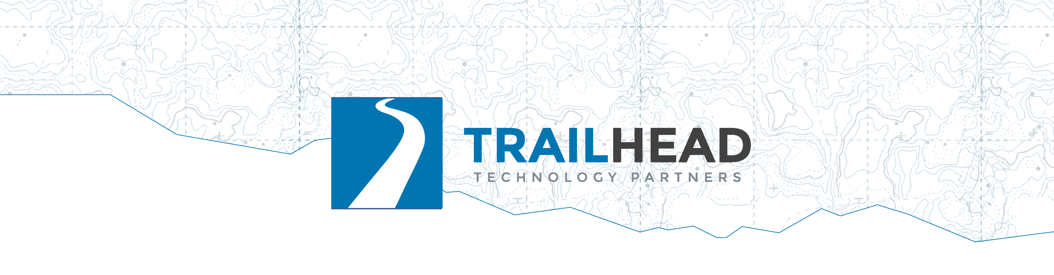
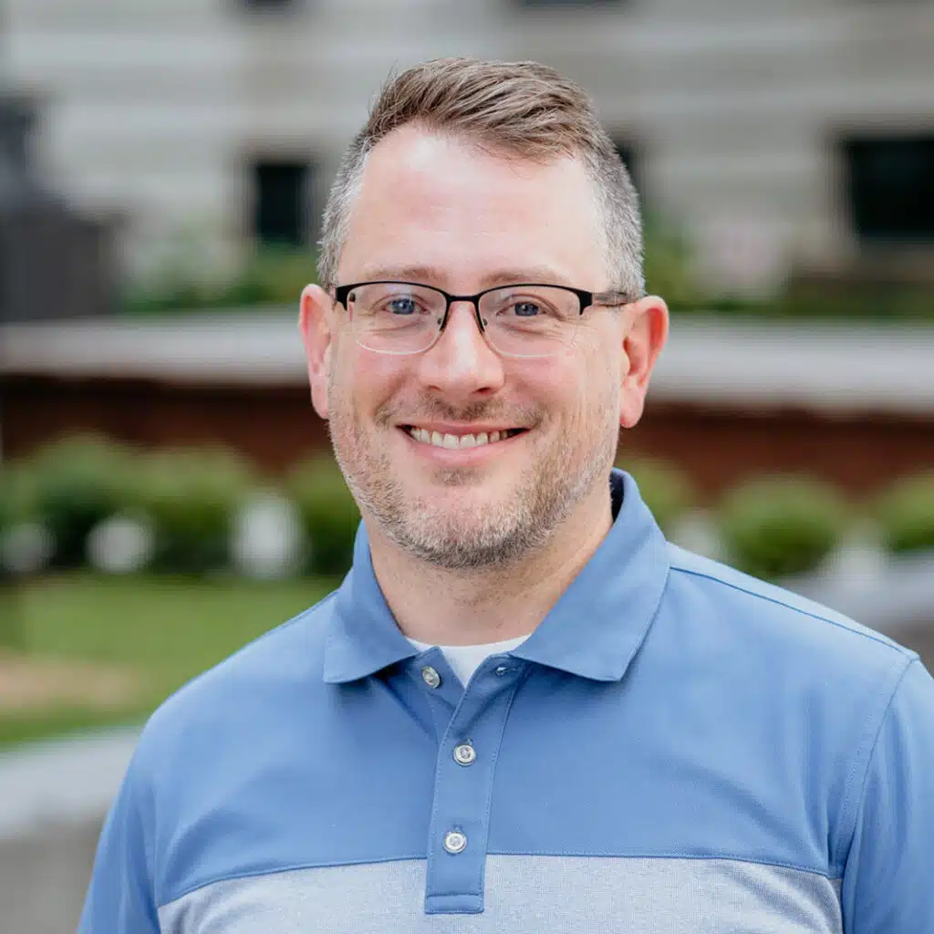

Building Pragmatic AI
Closing: The Thing You Take Back to Work
Notes:
Ten features, ten cards, one table: docs/decision-framework.md.

Slide 2
Back to the First Slide
❌ "Where can we add AI?"
Notes:
Where we started this morning.

Slide 3
Back to the First Slide
❌ "Where can we add AI?"
✅ "What problems can AI best solve for our users?"
Notes:
Every feature today started with a stuck user, and the AI showed up as the answer rather than the premise.

Slide 4

The Framework, All Ten Rows
F01 Summarize
Notes:
One cell per advance: name each feature as it lands, a few seconds apiece. The day, replayed in ten beats.
Summarize: the bridge surfaced from forty reports.

Slide 5

The Framework, All Ten Rows
F01 Summarize
F02 Extract
Notes:
Extract: a database row your code validated.

Slide 6

The Framework, All Ten Rows
F01 Summarize
F02 Extract
F03 Sentiment
Notes:
Sentiment: measured, and the free model held on everything but sarcasm.

Slide 7

The Framework, All Ten Rows
F01 Summarize
F02 Extract
F03 Sentiment
F04 Search
Notes:
Search: what users mean, not what they type.

Slide 8

The Framework, All Ten Rows
F01 Summarize
F02 Extract
F03 Sentiment
F04 Search
F05 RAG
Notes:
RAG: the campfire answer, cited, and the chunk boundary that nearly broke it.

Slide 9

The Framework, All Ten Rows
F01 Summarize
F02 Extract
F03 Sentiment
F04 Search
F05 RAG
F06 Recommend
Notes:
Recommend: more like this, and the daypack that taught you about complements.

Slide 10

The Framework, All Ten Rows
F01 Summarize
F02 Extract
F03 Sentiment
F04 Search
F05 RAG
F06 Recommend
F07 Route
Notes:
Route: the emergency at the top of its own queue, every run.

Slide 11

The Framework, All Ten Rows
F01 Summarize
F02 Extract
F03 Sentiment
F04 Search
F05 RAG
F06 Recommend
F07 Route
F08 Detect
Notes:
Detect: the washout from three reports, not a one-star review.

Slide 12

The Framework, All Ten Rows
F01 Summarize
F02 Extract
F03 Sentiment
F04 Search
F05 RAG
F06 Recommend
F07 Route
F08 Detect
F09 Approve
Notes:
Approve: the model types, a person decides, the log proves it.

Slide 13

The Framework, All Ten Rows
F01 Summarize
F02 Extract
F03 Sentiment
F04 Search
F05 RAG
F06 Recommend
F07 Route
F08 Detect
F09 Approve
F10 Agent
Notes:
Agent: the loop that planned the trip and checked the bridge.
The full table lives in decision-framework.md: # · Feature · When · Think · Difficulty, the same three fields as every card today. (Paste the real table over this slide, or demo it from the repo.)
Don't read it. Let it sit on screen while you explain how to use it, which is the next section. It's dense on purpose; it's a reference, and they have it in the repo.

Slide 14
What the Day Measured, Not Assumed
Sentiment: 7/10 vs 10/10 — only on the hard slice
Notes:
A free local model matched the frontier model on ordinary reviews and lost only on the sarcastic ones.

Slide 15
What the Day Measured, Not Assumed
Sentiment: 7/10 vs 10/10 — only on the hard slice
Chunking: 75% → 97% · a 10× model bought 3 points
Notes:
Better chunking, not a bigger model, moved RAG's flagship question.

Slide 16
What the Day Measured, Not Assumed
Sentiment: 7/10 vs 10/10 — only on the hard slice
Chunking: 75% → 97% · a 10× model bought 3 points
Classifier: 2/2 emergencies · drafter: 0/3
Notes:
The classifier caught both emergencies every run; the drafting model failed the emergency every run.

Slide 17
What the Day Measured, Not Assumed
Sentiment: 7/10 vs 10/10 — only on the hard slice
Chunking: 75% → 97% · a 10× model bought 3 points
Classifier: 2/2 emergencies · drafter: 0/3
Local agent: all four tools < 1 run in 5
Notes:
The local agent reached all four planning tools in fewer than one run in five. That is why the capstone runs on a frontier model.

Slide 18
What the Day Measured, Not Assumed
Sentiment: 7/10 vs 10/10 — only on the hard slice
Chunking: 75% → 97% · a 10× model bought 3 points
Classifier: 2/2 emergencies · drafter: 0/3
Local agent: all four tools < 1 run in 5
Every number: an expected-output.md
Notes:
The runs are checked in behind every number.
This is the credibility slide. "We ran it and here is what happened" is a stronger pitch than "the vendor says."

Slide 19
What We Didn't Do Today, on Purpose
No fine-tuning
No vector database product
No agent framework
Reach for them when a measured problem asks
Notes:
Nothing today needed fine-tuning. Cosine similarity in a loop carried three features. The agent loop fit on screen.
Optional slide; cut if short on time. It heads off the "but shouldn't we be using X" question.

Slide 20
Your Move
Notes:
The recap is actions, not topics. Four moves, each one slide, each something they can do Monday.

Slide 21
Mark What Your Users Hate
The "when to reach for this" column
Notes:
Go down the "when" column.

Slide 22
Mark What Your Users Hate
The "when to reach for this" column
Mark the rows your users would recognize
Notes:
Mark every row that describes a problem your users actually have.

Slide 23
Mark What Your Users Hate
The "when to reach for this" column
Mark the rows your users would recognize
Row 0: list the ten things they hate doing
Notes:
Row 0 is the same exercise before any feature: list the ten things they hate doing, and the features pick themselves.
This is the workshop's framing question turned into a Monday-morning exercise. It happens in a meeting room, not a codebase.

Slide 24
Sort by Cost, Cheapest First
The cheapest marked row = your first AI feature
Notes:
Sort your marked rows by the difficulty column, easiest first; the top of that list is the first feature, and the Think column is how you pitch it.

Slide 25
Sort by Cost, Cheapest First
The cheapest marked row = your first AI feature
Rows 1–8: mostly free local models
Notes:
Rows 1 through 8 mostly run on free local models. Worth repeating here; it changes the budget conversation before it starts.

Slide 26
Lead with the Human in the Loop
Row 9 de-risks the rest
Notes:
Row 9 de-risks the rest. Leading with the human-in-the-loop design is usually what gets the other rows approved.

Slide 27
Lead with the Human in the Loop
Row 9 de-risks the rest
Say where the human sits · what gets logged
Notes:
Say where the human sits and what gets logged, before anyone asks.

Slide 28
Pitch One Feature, Not a Strategy
The user's problem, in their words
Notes:
Lead with the user's problem in their words, and how often it happens.

Slide 29
Pitch One Feature, Not a Strategy
The user's problem, in their words
The row · the cost · local vs paid
Notes:
Name the row. Say what it costs in days or weeks and what it costs to run; say what runs local and what needs a paid model, and why.

Slide 30
Pitch One Feature, Not a Strategy
The user's problem, in their words
The row · the cost · local vs paid
How you'll measure it
Notes:
Say how you'll measure it: the labeled sample and the error you're tuning never to make. Reference feature 03's recipe: labeled sample, run both, count disagreements, price the errors. It generalizes.

Slide 31
Pitch One Feature, Not a Strategy
The user's problem, in their words
The row · the cost · local vs paid
How you'll measure it
Ask for one feature
Notes:
Ask for one feature. This is the shape of the conversation the framework enables: a small, measurable, de-risked ask.

Slide 32
Everything Is in the Repo
github.com/trailheadtechnology/10-ai-features-workshop
Every lab · every .http · every expected output
starter/ and complete/ in .NET, Python, TypeScript
The corpus is yours
SETUP.md still works tomorrow

Slide 33
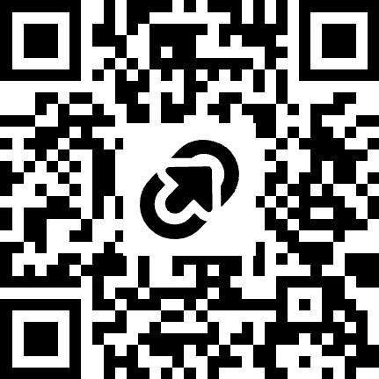

Thanks! Questions?
LET’S TALK
Jonathan "J." Tower
13x Microsoft MVP in .NET and AI
VP of .NET Foundation
Blue Blazes podcast host
jtower@trailheadtechnology.com
trailheadtechnology.com/blog
jtowermi
Jonathan “J.” Tower
tinyurl.com/th-offer
github.com/trailheadtechnology/10-ai-features-workshop
Notes:
Leave the framework slide up again during Q&A if it's more useful than this one. The free offer (tinyurl.com/th-offer) is on this slide; point at it once.

