Slide 1
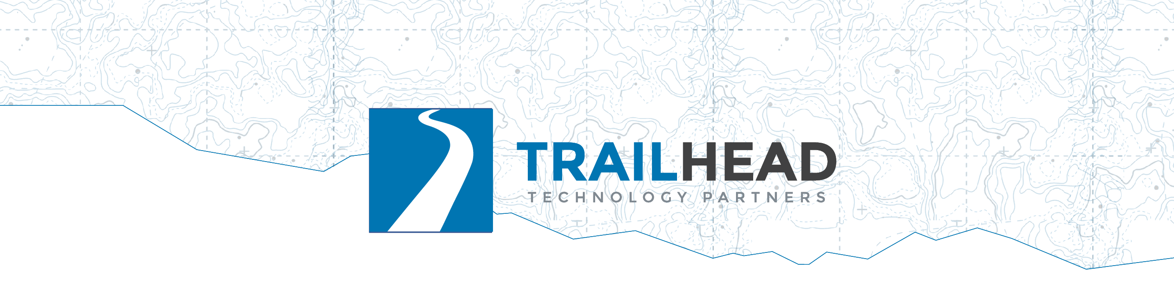
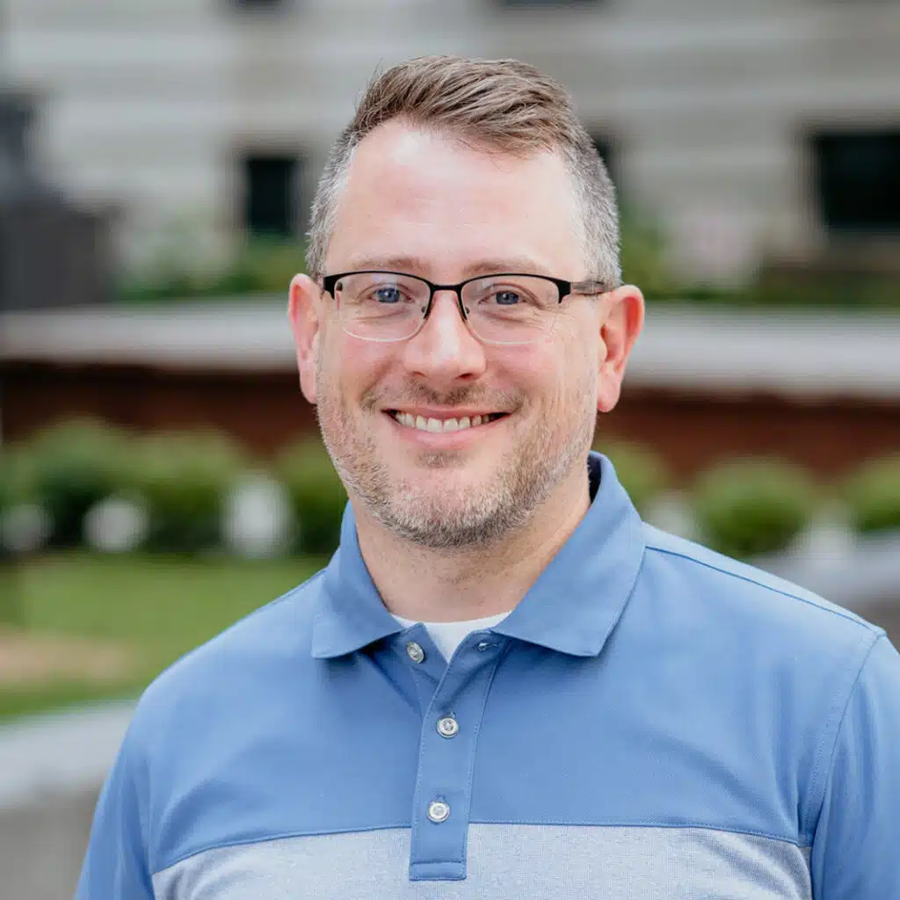
Mission-Critical Code
What NASA’s Power of Ten Can Teach Us
Jonathan “J.” Tower
Notes:
Welcome

Slide 2

What we can learn from NASA’s Power of Ten that will help us create more reliable software

Slide 3

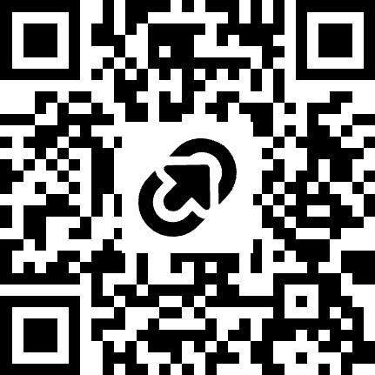
Jonathan "J." Tower
LET’S TALK
Principal Consultant & Partner
13x Microsoft MVP in .NET and AI
VP of .NET Foundation
Blue Blazes podcast host
jtower@trailheadtechnology.com
trailheadtechnology.com/blog
jtowermi
Jonathan “J.” Tower
tinyurl.com/th-offer
github.com/trailheadtechnology/power-of-ten

Slide 4
Thanks! Questions?
LET’S TALK
Jonathan "J." Tower
13x Microsoft MVP in .NET and AI
VP of .NET Foundation
Blue Blazes podcast host
jtower@trailheadtechnology.com
trailheadtechnology.com/blog
jtowermi
Jonathan “J.” Tower
tinyurl.com/th-offer
github.com/trailheadtechnology/power-of-ten

