Slide 1


Pragmatic AI in .NET
10 AI Features Users Want in Your .NET Apps
Jonathan “J.” Tower
Notes:
Title slide stays up while people settle.

Slide 2

Saturday. 5:58 a.m.
Notes:
A hiker. Alarm before dawn, coffee in the car, ninety minutes to the trailhead.
She planned this trip in a trip-planning app.

Slide 3
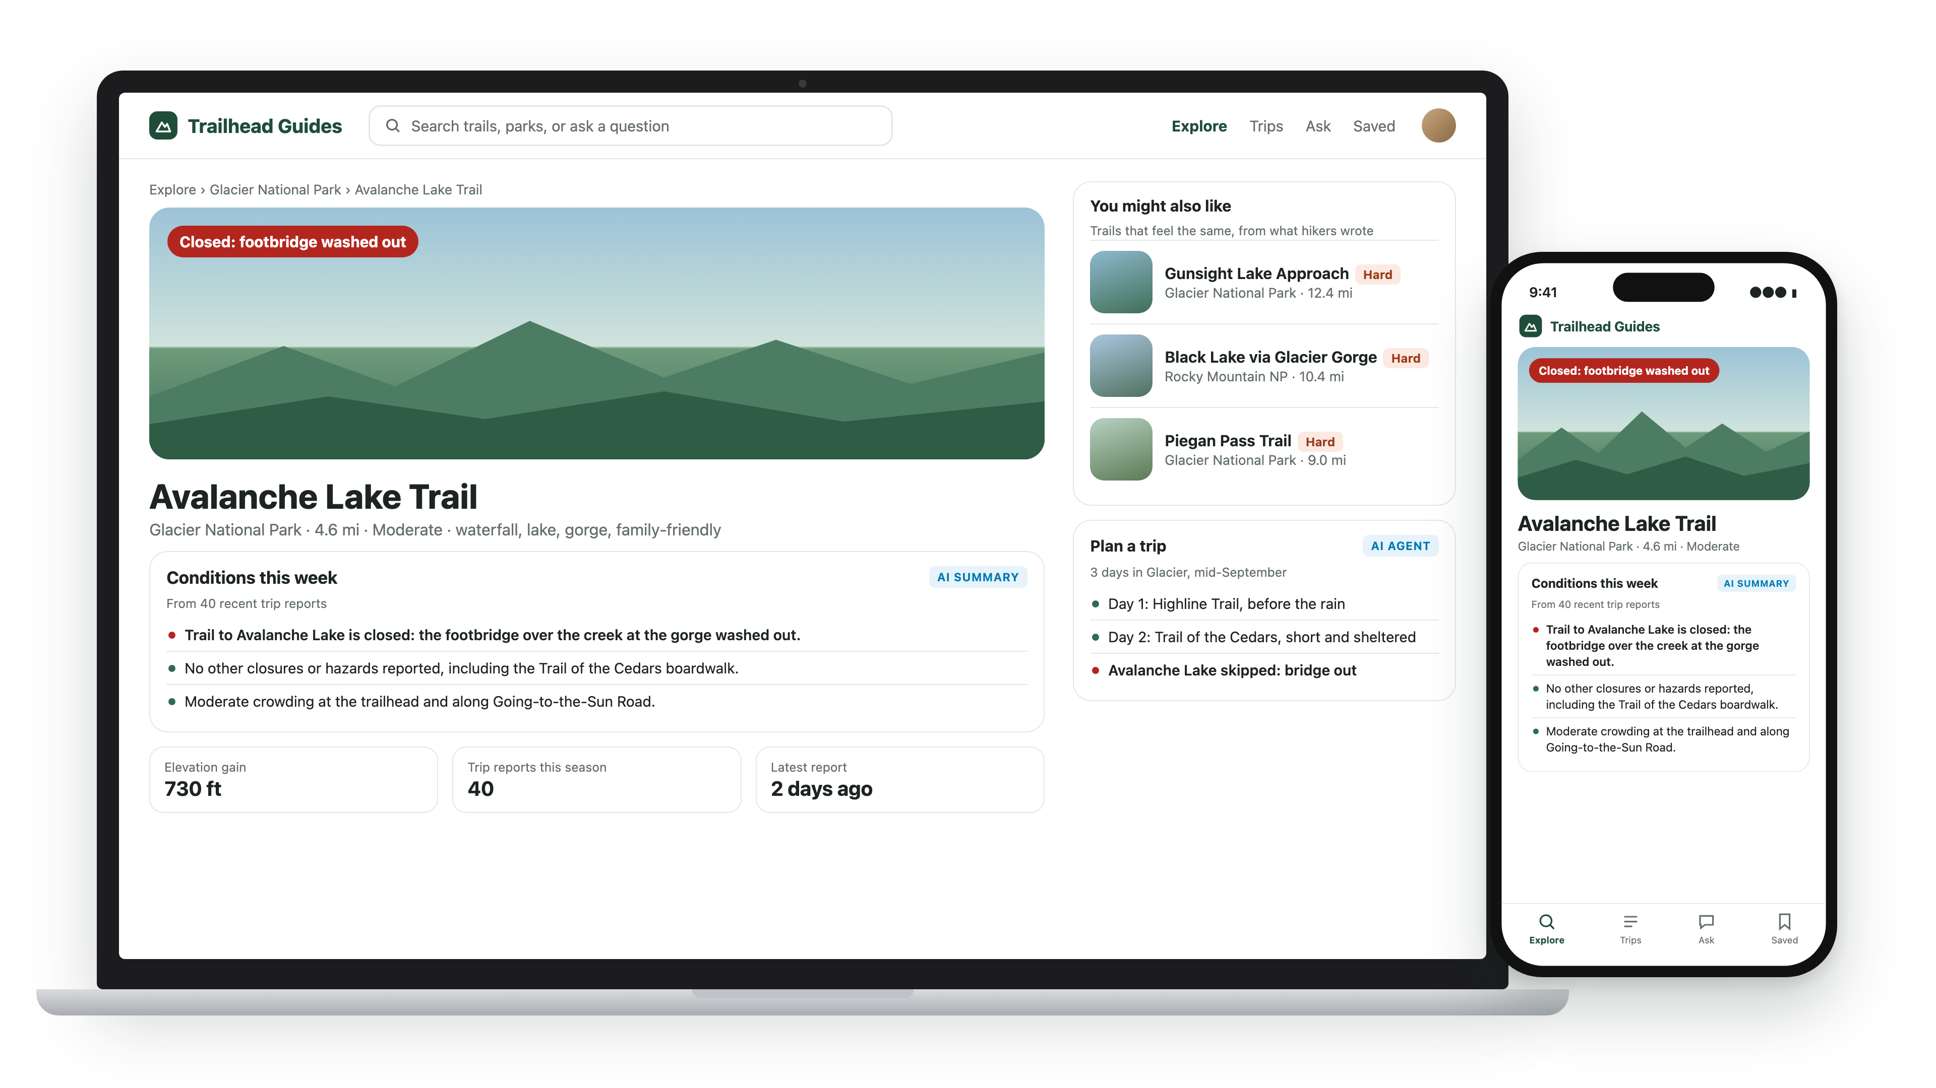
Notes:
(It's our fictional app, Trailhead Guides; every demo in the next hour runs on its data.)

Slide 4
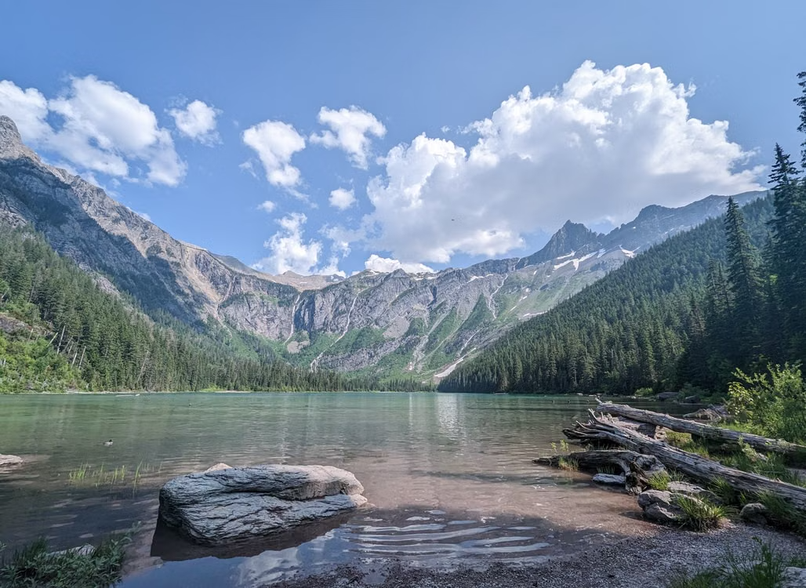
Avalanche Lake Trail.
Notes:
The trail she picked. Moderate, family-rated, a lake at the end.
The app showed photos, distance, elevation. All accurate.

Slide 5

40 trip reports.
Notes:
The app also had forty trip reports for this trail. Real hikers, real conditions, about 1,200 words each.
Ask the room: who reads forty essays before a day hike?

Slide 6
She only read 3.
Notes:
The top three. "Beautiful." "Crowded by ten." "Bring bug spray."

Slide 7
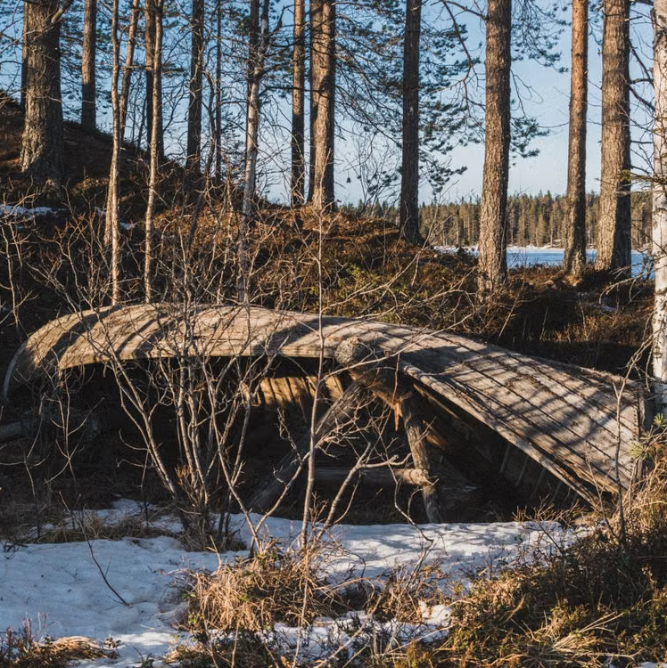
"The footbridge at the creek is gone. We had to turn around."
Report #14 of 40
Notes:
Report fourteen. One sentence, buried in a paragraph about huckleberries.
She never saw it.

Slide 8
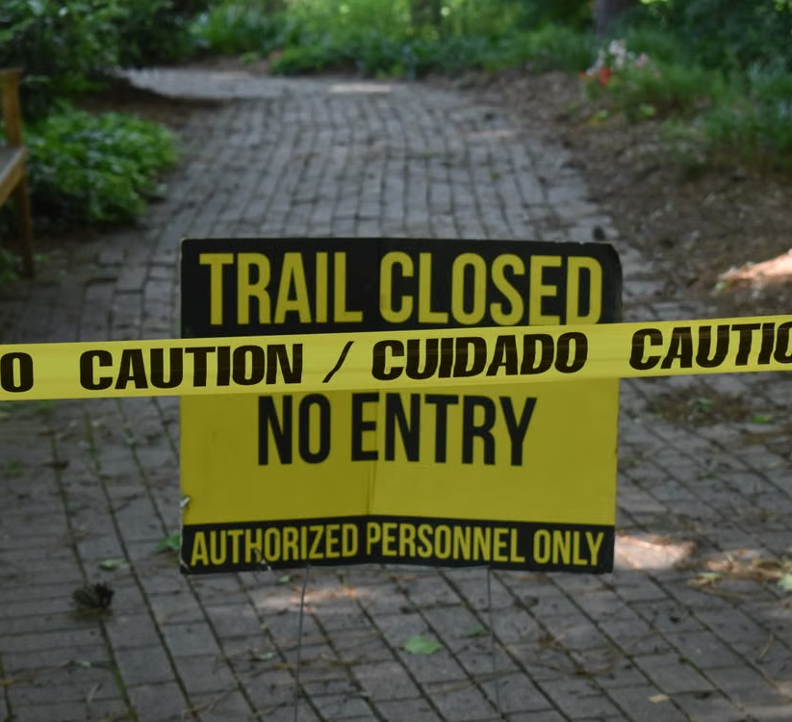
Mile 2 is where she found out.
Notes:
Two hours of driving, two miles of walking, and the trip is over at a creek she can't cross.
Beat of silence, then the turn:

Slide 9

The answer was there, but it was buried in a mountain of text.
Notes:
The data was in the product. A user needed one sentence of it, and the product's job was to surface that sentence.
Every feature in the next hour exists to close exactly this kind of gap.
That bridge is planted in the demo data, and before the hour is up, code will find it.

Slide 10

Ten shippable AI features that solve problems your users already have, and the judgment to know when to build each.
Notes:
The promise of the hour.
Not a survey, not vendor slides: ten features, each starting from a stuck user, and four of them running live.

Slide 11










What We'll Talk About
F01 Summarize
F02 Extract
F03 Sentiment
F04 Search
F05 RAG
F06 Recommend
F07 Route
F08 Detect
F09 Approve
F10 Agent
Notes:
Agent: a loop that plans the trip.

Slide 12
What We'll Talk About
F01 Summarize
F02 Extract
F03 Sentiment
F04 Search
F05 RAG
F06 Recommend
F07 Route
F08 Detect
F09 Approve
F10 Agent
Notes:
All ten get the problem, the idea, and the picture.
These four also get the code, and they run live.

Slide 13



Jonathan "J." Tower
Founding Partner
  13x Microsoft MVP in .NET & AI
  VP of .NET Foundation
Blue Blazes podcast host

Slide 14
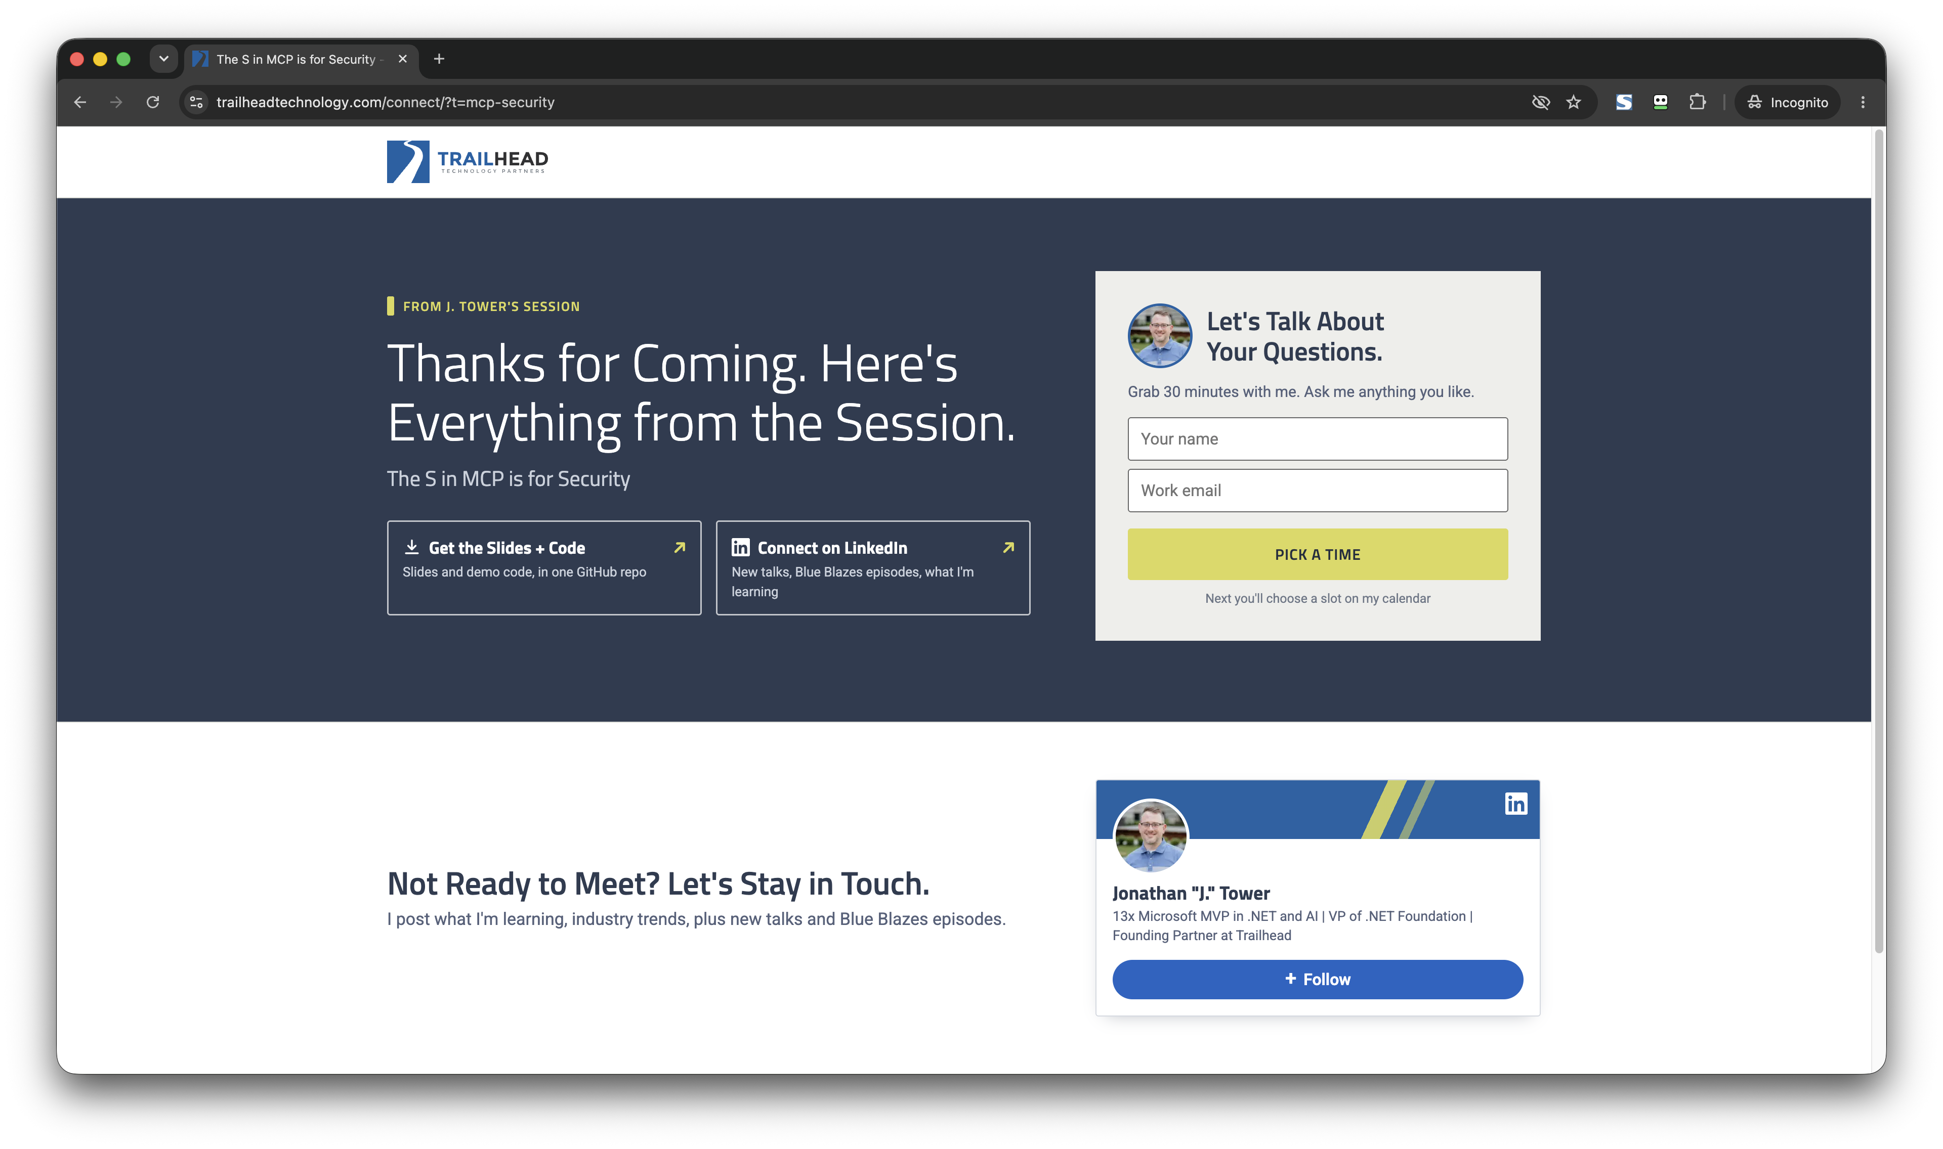

Slide 15
The Wrong Question and the Better One
❌ "Where can we use AI?"
Notes:
Every company is asking this question right now.

Slide 16
The Wrong Question and the Better One
❌ "Where can we use AI?"
✅ "What problems can AI best solve for our users?"
Notes:
This talk asks the second one.
This is the thesis: every feature opens with a user who is stuck, and the AI only shows up as the answer.
The technology is the last thing we talk about in each feature, not the first.

Slide 17
Local Models, Cloud When Needed
Local Models (~5 GB, no GPU):
    💻 llama3.2
    💻 phi3
    💻 nomic-embed-text
  Cloud Model (my subscription):
    ☁️ Cloud models where it helps: F03, F05, F10
Notes:
Most of these run on free local models, on this laptop, with nothing leaving the room.
The cloud shows up where model size matters: RAG's answers and the agent.
That split is a finding your leadership will care about on its own.

Slide 18
Every Model Is an HTTP Call
localhost:11434 → /api/chat · /api/embed
Notes:
Ollama listens on localhost:11434: /api/chat and /api/embed. It also exposes an OpenAI-compatible /v1.

Slide 19
Every Model Is an HTTP Call
localhost:11434 → /api/chat · /api/embed
…openai.azure.com/…/chat/completions + api-key
Notes:
Foundry serves gpt-4.1 and gpt-5.5 per deployment name, at the chat/completions path with an api-key header.

Slide 20
Every Model Is an HTTP Call
localhost:11434 → /api/chat · /api/embed
…openai.azure.com/…/chat/completions + api-key
Same request shape · a URL and a key apart
Notes:
Same request shape, a URL and a key apart.
In .NET, one interface wraps both. Next slide.

Slide 21
One Interface, Local or Cloud
// Ollama on this laptop: free, private, small.
public static IChatClient Local(string model = "llama3.2") =>
new OllamaApiClient(new Uri("http://localhost:11434"), model);
// Azure OpenAI on Foundry: same interface, different constructor.
public static IChatClient Cloud(string deployment) =>
new AzureOpenAIClient(new Uri(Endpoint), new ApiKeyCredential(Key))
.GetChatClient(deployment)
.AsIChatClient();
// Embeddings stay local in every demo.
public static IEmbeddingGenerator<string, Embedding<float>> Embedder() =>
new OllamaApiClient(new Uri("http://localhost:11434"), "nomic-embed-text");
Notes:
Microsoft.Extensions.AI: IChatClient. Local is Ollama, a URI and a model name.

Slide 22
One Interface, Local or Cloud
// Ollama on this laptop: free, private, small.
public static IChatClient Local(string model = "llama3.2") =>
new OllamaApiClient(new Uri("http://localhost:11434"), model);
// Azure OpenAI on Foundry: same interface, different constructor.
public static IChatClient Cloud(string deployment) =>
new AzureOpenAIClient(new Uri(Endpoint), new ApiKeyCredential(Key))
.GetChatClient(deployment)
.AsIChatClient();
// Embeddings stay local in every demo.
public static IEmbeddingGenerator<string, Embedding<float>> Embedder() =>
new OllamaApiClient(new Uri("http://localhost:11434"), "nomic-embed-text");
Notes:
Cloud is the same interface with a different constructor.
The key comes from user-secrets, never the source: this code is on a projector.

Slide 23
One Interface, Local or Cloud
// Ollama on this laptop: free, private, small.
public static IChatClient Local(string model = "llama3.2") =>
new OllamaApiClient(new Uri("http://localhost:11434"), model);
// Azure OpenAI on Foundry: same interface, different constructor.
public static IChatClient Cloud(string deployment) =>
new AzureOpenAIClient(new Uri(Endpoint), new ApiKeyCredential(Key))
.GetChatClient(deployment)
.AsIChatClient();
// Embeddings stay local in every demo.
public static IEmbeddingGenerator<string, Embedding<float>> Embedder() =>
new OllamaApiClient(new Uri("http://localhost:11434"), "nomic-embed-text");
Notes:
Embeddings stay local in every demo.
Every demo from here on calls one of these three and nothing else.

Slide 24
F01 · Summarization
Notes:
Forty trip reports for Avalanche Lake, 1,200 words each.
Is the bridge out? Are the mosquitoes bad? Nobody reads forty essays; they skim three and miss the warning in the fourth.
The hiker at mile two is this feature's user.

Slide 25
Turn a long document into the
short version its reader needs.
Notes:
The textbook version: automatic summarization produces a shorter text that keeps the key information of the source. Read the slide, let it sit a beat, then the problem.

Slide 26
F01 · How It Works
Report Posted
tr-0004.md
Notes:
One trip report, just posted: tr-0004, the story's report. The washed-out bridge is one sentence in paragraph four.

Slide 27
F01 · How It Works
~1,200 words
Report Posted
tr-0004.md
App
Notes:
Your app reads the file: about 1,200 words of prose.

Slide 28
F01 · How It Works
Ollama
llama3.2
~1,200 words
Report Posted
tr-0004.md
App
Notes:
One model: llama3.2 on Ollama, on this laptop. No key, nothing leaves the room.

Slide 29
F01 · How It Works
"In 3 bullets, tell a hiker…"
+ the report text
Ollama
llama3.2
~1,200 words
Report Posted
tr-0004.md
App
Notes:
One call: an instruction with a purpose and a shape, then the whole report as a single user message.

Slide 30
F01 · How It Works
"In 3 bullets, tell a hiker…"
+ the report text
Ollama
llama3.2
~1,200 words
• Closed: bridge out
• No other hazards
• Moderate crowds
Report Posted
tr-0004.md
App
Notes:
Back come three bullets, and the bridge leads.

Slide 31
F01 · How It Works
"In 3 bullets, tell a hiker…"
+ the report text
Ollama
llama3.2
~1,200 words
• Closed: bridge out
• No other hazards
• Moderate crowds
Report Posted
tr-0004.md
App
Trail Page
Notes:
The app stores them with the report, so the trail page shows them to every hiker who comes after.

Slide 32
F01 · How It Works
"In 3 bullets, tell a hiker…"
+ the report text
Ollama
llama3.2
~1,200 words
• Closed: bridge out
• No other hazards
• Moderate crowds
Report Posted
tr-0004.md
×40, once, when posted
App
Trail Page
Notes:
Forty reports is forty calls, one per report, each made once, when it's posted. Not one per hiker. No pipeline, no vector database, no training.

Slide 33
Use it when there's
too much text for anyone to read it all.
Notes:
Use it when: too much content for people to read, and the detail that matters is easy to miss.
Where you'll find it: reviews, tickets, reports, meeting notes, threads.

Slide 34
F02 · Extraction
Notes:
Trailhead wants a trail stats panel: which trail, when, how far, what wildlife, what condition.
All of it exists as prose across the reports, and today a human would re-read and re-type it.
So the panel doesn't exist.

Slide 35
Pull facts out of free-form text
Into a format your code can use.
Notes:
The textbook version: information extraction turns unstructured text into structured data. JSON mode guarantees the shape; it does not guarantee the truth.

Slide 36
F02 · How It Works
20 Trip Reports
tr-0001 … tr-0020
Notes:
The input is the backlog of trip reports: 20 files of prose nobody will re-type.

Slide 37
F02 · How It Works
prose + date posted
20 Trip Reports
tr-0001 … tr-0020
App
Notes:
The app reads each one, plus the date it was posted, so "July 19th" gets a year. Prose in; the goal is a database row out.

Slide 38
F02 · How It Works
Ollama
llama3.2
prose + date posted
20 Trip Reports
tr-0001 … tr-0020
App
Notes:
Same local model as 01: llama3.2 on Ollama.

Slide 39
F02 · How It Works
report text + JSON schema
"null when absent"
Ollama
llama3.2
prose + date posted
20 Trip Reports
tr-0001 … tr-0020
App
Notes:
The request carries the schema: fields, types, descriptions, and "null when absent."
JSON mode guarantees syntax, not truth.

Slide 40
F02 · How It Works
report text + JSON schema
"null when absent"
Ollama
llama3.2
prose + date posted
{"trail_name": "",
"date_hiked": "2026-06-24",
"distance_mi": 0}
20 Trip Reports
tr-0001 … tr-0020
App
Notes:
Back comes valid JSON. For tr-0017: a blank trail name and distance_mi: 0. Zero is a value; nothing downstream will question it.

Slide 41
F02 · How It Works
report text + JSON schema
"null when absent"
Ollama
llama3.2
prose + date posted
{"trail_name": "",
"date_hiked": "2026-06-24",
"distance_mi": 0}
20 Trip Reports
validate
tr-0001 … tr-0020
App
Notes:
So the app validates: plain code, one rule per field. Blanks, zeros, unparseable dates, names the report never mentions: rejected.
This is the box people skip.

Slide 42
F02 · How It Works
report text + JSON schema
"null when absent"
Ollama
llama3.2
prose + date posted
{"trail_name": "",
"date_hiked": "2026-06-24",
"distance_mi": 0}
20 Trip Reports
validate
Trail
Stats
DB
tr-0001 … tr-0020
App
"distance_mi": null
Notes:
What passes gets stored: extracted.json. The rejected field is stored as null, not zero.

Slide 43
F02 · How It Works
report text + JSON schema
"null when absent"
Ollama
llama3.2
prose + date posted
{"trail_name": "",
"date_hiked": "2026-06-24",
"distance_mi": 0}
20 Trip Reports
validate
Trail
Stats
DB
tr-0001 … tr-0020
App
Reject Log
"distance_mi": null
"distance_mi": 0
Notes:
What fails gets logged: rejected.json. A rejected record is a good outcome; it is the pipeline telling you the truth.
The model writes JSON; your code decides whether to believe it.
The null rule and the validator are the feature. Extraction without validation is a data-corruption feature.

Slide 44
F02 · The Call
var (report, posted, park) = await Load(file);
// Prose in, typed object out. The record is the schema.
var response = await client.GetResponseAsync<TripFacts>($"""
Extract the trail facts from this trip report, posted {posted}.
Use null for any field the report does not state,
and empty arrays when nothing applies. Do not guess.
{report}
""", options);
TripFacts raw = response.Result;
// The schema guarantees it parses, not that it is true.
var verdicts = Validate(raw, report);
ShowRow(id, raw, verdicts);
Notes:
GetResponseAsync of TripFacts: the library sends the record as a JSON schema and hands back a typed object.
No JSON parsing anywhere.

Slide 45
F02 · The Call
var (report, posted, park) = await Load(file);
// Prose in, typed object out. The record is the schema.
var response = await client.GetResponseAsync<TripFacts>($"""
Extract the trail facts from this trip report, posted {posted}.
Use null for any field the report does not state,
and empty arrays when nothing applies. Do not guess.
{report}
""", options);
TripFacts raw = response.Result;
// The schema guarantees it parses, not that it is true.
var verdicts = Validate(raw, report);
ShowRow(id, raw, verdicts);
Notes:
Then plain code decides whether to believe it.

Slide 46
F02 · The Schema
record TripFacts(
string? TrailName,
string? DateHiked,
[property: Description("Round-trip distance in miles, as stated " +
"in the report. null, never 0, if the report gives no " +
"distance. Never estimate.")]
double? DistanceMi,
double? ElevationGainFt,
string[] Wildlife,
string[] Conditions,
string[] Hazards);
Notes:
Every scalar is nullable. A non-nullable field forces the model to invent a value for it.

Slide 47
F02 · The Schema
record TripFacts(
string? TrailName,
string? DateHiked,
[property: Description("Round-trip distance in miles, as stated " +
"in the report. null, never 0, if the report gives no " +
"distance. Never estimate.")]
double? DistanceMi,
double? ElevationGainFt,
string[] Wildlife,
string[] Conditions,
string[] Hazards);
Notes:
The descriptions do the prompting: null, never 0. Every field has one; this is the one that matters.

Slide 48
F02 · The Validator
static List<Verdict> Validate(TripFacts f, string sourceText) =>
[
// A name the source text never contains does not get to be a fact.
Grounded("trail_name", f.TrailName, sourceText),
ValidDate("date_hiked", f.DateHiked),
// 0 is the dangerous near-miss: it is a value, so a pipeline stores it
// and nothing downstream ever questions it. The honest answer is null.
InRange("distance_mi", f.DistanceMi, max: 100, unit: "mi"),
InRange("elevation_gain_ft", f.ElevationGainFt, max: 20000, unit: "ft"),
];
Notes:
Grounded: a name the report never contains is a name the model supplied.

Slide 49
F02 · The Validator
static List<Verdict> Validate(TripFacts f, string sourceText) =>
[
// A name the source text never contains does not get to be a fact.
Grounded("trail_name", f.TrailName, sourceText),
ValidDate("date_hiked", f.DateHiked),
// 0 is the dangerous near-miss: it is a value, so a pipeline stores it
// and nothing downstream ever questions it. The honest answer is null.
InRange("distance_mi", f.DistanceMi, max: 100, unit: "mi"),
InRange("elevation_gain_ft", f.ElevationGainFt, max: 20000, unit: "ft"),
];
Notes:
Dates: for the sparse report, llama3.2 returns the string "null". This catches it.

Slide 50
F02 · The Validator
static List<Verdict> Validate(TripFacts f, string sourceText) =>
[
// A name the source text never contains does not get to be a fact.
Grounded("trail_name", f.TrailName, sourceText),
ValidDate("date_hiked", f.DateHiked),
// 0 is the dangerous near-miss: it is a value, so a pipeline stores it
// and nothing downstream ever questions it. The honest answer is null.
InRange("distance_mi", f.DistanceMi, max: 100, unit: "mi"),
InRange("elevation_gain_ft", f.ElevationGainFt, max: 20000, unit: "ft"),
];
Notes:
Zero is a value; nothing downstream will question it. The honest answer is null.

Slide 51
DEMO · F02 Extraction
Notes:
~2.5 min · demo terminal · cd code · ollama serve running
Files: data/extract/tr-*.md = trip reports; the demo runs the first 20 · the park comes from each report's front matter, not the model
Flags: none · ~30 s, one line per report
1. dotnet run -- extract: one JSON line per report. Red = the validator said no.
2. tr-0017: "" and 0 where it should be null. Rejected, stored as null.
3. tr-0020: a blank trail name. Same rule, caught again.
4. Last line: 20 stored, 3 rejected fields stored as null. extracted.json is the table.
Cut: 4.

Slide 52
Use it when the data you need for an app is
stuck in documents nobody wants to re-type.
Notes:
Where you'll find it: invoices, resumes, support emails, contracts, legacy records.

Slide 53
F03 · Sentiment
Notes:
The Cascade 65 backpack has 300 reviews. Are people happy, and what are they mad about?
Star ratings lie: "4 stars, but the hip belt broke on day two."
The user is the product team, not the hiker.

Slide 54
Read text and judge the feeling behind it:
positive, negative, or mixed.
Notes:
The textbook version: sentiment analysis identifies the emotional polarity of a piece of text. The stars lie; the words mostly don't.

Slide 55
F03 · How It Works
Gear Review
gr-0004 ★★
Notes:
One gear review: gr-0004. Two stars, and the words say the pack deserves five.

Slide 56
F03 · How It Works
review text
Gear Review
gr-0004 ★★
App
Notes:
The app sends one review at a time.

Slide 57
F03 · How It Works
Ollama
phi3
review text
Gear Review
gr-0004 ★★
App
Notes:
First model: phi3, 2 GB, local, free.

Slide 58
F03 · How It Works
positive | negative | mixed?
"…deserves five, the
manual deserves jail."
Ollama
phi3
review text
Gear Review
gr-0004 ★★
App
Notes:
The prompt asks for one word from three, then the review text. Temperature 0.

Slide 59
F03 · How It Works
positive | negative | mixed?
"…deserves five, the
manual deserves jail."
Ollama
phi3
review text
"negative"
Gear Review
gr-0004 ★★
App
Notes:
phi3 says negative. It read the stars and the anger at the manual.

Slide 60
F03 · How It Works
positive | negative | mixed?
"…deserves five, the
manual deserves jail."
Ollama
phi3
review text
"negative"
same prompt
Gear Review
gr-0004 ★★
"mixed"
App
Azure
gpt-4.1
Notes:
Same prompt bytes to gpt-4.1 on Azure. It says mixed.

Slide 61
F03 · How It Works
positive | negative | mixed?
"…deserves five, the
manual deserves jail."
Ollama
phi3
review text
"negative"
same prompt
Gear Review
gr-0004 ★★
"mixed"
App
Azure
gpt-4.1
Hand Labels
gr-0004: mixed
Notes:
Twenty hand labels are the answer key. Label the sample yourself before you run anything; agreement between models is not correctness.

Slide 62
F03 · How It Works
positive | negative | mixed?
"…deserves five, the
manual deserves jail."
Ollama
phi3
review text
"negative" ✗
hard set
phi3 7/10
gpt-4.1 10/10
same prompt
Gear Review
gr-0004 ★★
"mixed" ✓
App
Azure
gpt-4.1
Hand Labels
gr-0004: mixed
Notes:
Score both. Hard set: phi3 7 of 10, gpt-4.1 10 of 10. Easy set: nine versus ten.
Easy reviews don't need the big model; the sarcastic slice does, and now you know which slice is which because you measured it.

Slide 63
F03 · How It Works
positive | negative | mixed?
"…deserves five, the
manual deserves jail."
Ollama
phi3
review text
"negative" ✗
hard set
phi3 7/10
gpt-4.1 10/10
same prompt
Gear Review
gr-0004 ★★
"mixed" ✓
App
Azure
gpt-4.1
all 300 reviews · phi3 · 33 s
worst: Scree Trail Runners
9 of 13 negative
Hand Labels
gr-0004: mixed
Notes:
Then ship it: phi3 on every review in the store, 300 in 33 seconds, free.
The product team's answer: Scree Trail Runners, 9 of 13 negative. That's the dashboard row.

Slide 64
Use it when a high-volume text stream
needs a judgment call.
Notes:
Where you'll find it: reviews, NPS verbatims, tickets, mentions, survey answers.

Slide 65
F04 · Semantic Search
Notes:
"Dog-friendly waterfall hike, not too steep."
Keyword search returns almost nothing, because no description says "not too steep." The best trail says "a gentle grade shaded by cedars."
Three bad results and the user goes back to asking strangers on Reddit.

Slide 66
Search by what words mean,
not by which words appear.
Notes:
The textbook version (Wikipedia): search with meaning, as distinguished from lexical search, where the engine looks for literal matches of the query words. Read the slide, let it sit a beat, then the problem.

Slide 67
F04 · How It Works
1 · Index, once
30 Trails
trails-slice.json
Notes:
Two phases. Index, once: thirty trail descriptions from trails-slice.json.

Slide 68
F04 · How It Works
1 · Index, once
descriptions
30 Trails
trails-slice.json
App
Notes:
The app reads the descriptions at startup, not per search.

Slide 69
F04 · How It Works
1 · Index, once
Ollama
nomic-embed-text
descriptions
30 Trails
trails-slice.json
App
Notes:
One model: nomic-embed-text on Ollama. It doesn't write anything; it turns text into numbers.

Slide 70
F04 · How It Works
1 · Index, once
30 descriptions
Ollama
nomic-embed-text
descriptions
[0.0611, -0.0001,
-0.2007, …]
768 numbers each
30 Trails
trails-slice.json
App
Notes:
Thirty descriptions in, thirty vectors out. 768 numbers each, and similar meaning lands close.

Slide 71
F04 · How It Works
1 · Index, once
30 descriptions
Ollama
nomic-embed-text
descriptions
[0.0611, -0.0001,
-0.2007, …]
768 numbers each
30 Trails
Trail
Vector
List
trails-slice.json
App
{id, name, vector} ×30
Notes:
Keep one vector per trail. Here that's a list in memory; pgvector or Azure AI Search is the same math at scale.

Slide 72
F04 · How It Works
2 · Search, every query
Ollama
nomic-embed-text
"dog-friendly waterfall
hike, not too steep"
User Search
Trail
Vector
List
App
Notes:
Search, every query. A user types "dog-friendly waterfall hike, not too steep." No trail description contains those words.

Slide 73
F04 · How It Works
2 · Search, every query
the query
Ollama
nomic-embed-text
"dog-friendly waterfall
hike, not too steep"
[768 numbers]
User Search
Trail
Vector
List
App
Notes:
Embed the query the same way, with the same model. The only model call turns text into numbers.

Slide 74
F04 · How It Works
2 · Search, every query
the query
Ollama
nomic-embed-text
"dog-friendly waterfall
hike, not too steep"
[768 numbers]
User Search
cosine(q, v) ×30
Trail
Vector
List
App
Notes:
Cosine similarity against every stored vector: ten lines of plain code.

Slide 75
F04 · How It Works
2 · Search, every query
the query
Ollama
nomic-embed-text
"dog-friendly waterfall
hike, not too steep"
[768 numbers]
0.77 Carlon Falls
0.73 Copeland Falls
0.73 Grotto Falls
User Search
cosine(q, v) ×30
Trail
Vector
List
App
Notes:
Top results with scores: all four dog-friendly waterfall trails lead, none of which say "dog-friendly" or "steep."
Nothing is generated.

Slide 76
Use it when users describe what they want, and search only knows what things are called.
Notes:
The search box users complain about.
Also: any catalog where people describe what they want instead of naming it.

Slide 77
F05 · RAG
Notes:
"Can I have a campfire at Sperry Chalet in September?"
The answer is paragraph four of a 12-page regulations document nobody will read.
A plain chatbot can't know your documents. At best it says go check the website; at worst it guesses, and confidently wrong about fire rules is worse than no answer.

Slide 78
Look in your documents as the source; the
model composes an answer from what it finds.
Notes:
The textbook version (AWS/NVIDIA): retrieval-augmented generation has the model consult an authoritative knowledge source outside its training data before generating, so answers are grounded in your content and can cite it.

Slide 79
F05 · How It Works
Visitor
Notes:
A visitor asks: can I have a campfire at Sperry Chalet in September? The answer is paragraph four of a document nobody reads.

Slide 80
F05 · How It Works
"Can I have a campfire
at Sperry in September?"
Visitor
App
Notes:
The app takes the question.

Slide 81
F05 · How It Works
"Can I have a campfire
at Sperry in September?"
Visitor
Park
Doc
Chunks
App
{id, text, vector} ×250
Notes:
The park docs were split into 250 chunks and embedded once, before anyone asked: 04's index step, on documents.

Slide 82
F05 · How It Works
the question
Ollama
nomic-embed-text
"Can I have a campfire
at Sperry in September?"
[768 numbers]
Visitor
Park
Doc
Chunks
App
{id, text, vector} ×250
Notes:
Embed the question the same way, with the same model.

Slide 83
F05 · How It Works
the question
Ollama
nomic-embed-text
"Can I have a campfire
at Sperry in September?"
[768 numbers]
cosine + keyword → top 3
Visitor
Park
Doc
Chunks
App
camping-guide:04.2 1.00
frontcountry:04.1-2 0.90
yosemite-fire:03 0.90
{id, text, vector} ×250
Notes:
Cosine plus a keyword score against every chunk, keep the top 3. The keyword half is what makes "Sperry" count.
The right chunk wins, 1.00 to 0.90. Ranks 2 and 3 are relevant and wrong: fire rules that say fires are allowed.

Slide 84
F05 · How It Works
top 3 chunks + question
the question
Azure gpt-4.1
Ollama
nomic-embed-text
"Can I have a campfire
at Sperry in September?"
[768 numbers]
cosine + keyword → top 3
Visitor
Park
Doc
Chunks
App
camping-guide:04.2 1.00
frontcountry:04.1-2 0.90
yosemite-fire:03 0.90
{id, text, vector} ×250
Notes:
Now the chat model, gpt-4.1 on Azure: the top 3 chunks plus the question, and a prompt that says answer only from these, cite the chunk, or say the documents don't say.
Generation is 01 with reading material. The model reads instead of remembers.

Slide 85
F05 · How It Works
top 3 chunks + question
the question
Azure gpt-4.1
Ollama
nomic-embed-text
"Can I have a campfire
at Sperry in September?"
[768 numbers]
Wood fires prohibited
year-round at Sperry.
[camping-guide:04.2]
cosine + keyword → top 3
check citations ✓
Visitor
Park
Doc
Chunks
App
camping-guide:04.2 1.00
frontcountry:04.1-2 0.90
yosemite-fire:03 0.90
{id, text, vector} ×250
Notes:
The app checks every citation against the chunks it sent, then answers: wood fires are prohibited year-round, with the source.
Two failure spots: the wrong chunk, or a bad split. Splitting a fire rule from its exception produced "campfires are fine" 4 runs in 20; re-splitting at subsections, 0 in 60. Chunking is a correctness decision.

Slide 86
F05 · Before, and Retrieve
if (question == "") question = "Is the Avalanche Lake Trail open right now?";
IChatClient llm = Clients.Cloud("gpt-4.1");
// Before: no documents. The model answers from memory.
if (!grounded) { await Stream(llm, question); return; }
// 1. Retrieve: the three chunks closest to the question.
var top = await Retrieve(question, topK: 3);
Notes:
Before: the question goes straight to gpt-4.1. No documents.

Slide 87
F05 · Before, and Retrieve
if (question == "") question = "Is the Avalanche Lake Trail open right now?";
IChatClient llm = Clients.Cloud("gpt-4.1");
// Before: no documents. The model answers from memory.
if (!grounded) { await Stream(llm, question); return; }
// 1. Retrieve: the three chunks closest to the question.
var top = await Retrieve(question, topK: 3);
Notes:
Retrieve is 04's search: embed the question, cosine against 250 precomputed chunk vectors, keep 3.
Blended with a keyword score so a proper noun like "Sperry" counts.

Slide 88
F05 · Ground
var answer = await Stream(llm, $"""
You are a park information assistant. Answer the visitor's
question using ONLY the context below.
- Do not use outside knowledge.
- Cite the chunk_id of each chunk you relied on, in square
brackets, exactly as it appears in the context.
- If none of the context is relevant, reply exactly: "{Refusal}"
A question about "right now" is answered from the context:
today is September 23, 2026, and a notice in effect "until
further notice" is still in effect.
Context:
{string.Join("\n\n", top.Select(c => $"chunk_id: {c.Id}\n{c.Text}"))}
Question: {question}
""");
Notes:
The rules: only this context, cite the chunk id, or say the documents don't say.

Slide 89
F05 · Ground
var answer = await Stream(llm, $"""
You are a park information assistant. Answer the visitor's
question using ONLY the context below.
- Do not use outside knowledge.
- Cite the chunk_id of each chunk you relied on, in square
brackets, exactly as it appears in the context.
- If none of the context is relevant, reply exactly: "{Refusal}"
A question about "right now" is answered from the context:
today is September 23, 2026, and a notice in effect "until
further notice" is still in effect.
Context:
{string.Join("\n\n", top.Select(c => $"chunk_id: {c.Id}\n{c.Text}"))}
Question: {question}
""");
Notes:
"Right now" needs today's date in the prompt. Without it, the model refuses a question the docs can answer.

Slide 90
F05 · Ground
var answer = await Stream(llm, $"""
You are a park information assistant. Answer the visitor's
question using ONLY the context below.
- Do not use outside knowledge.
- Cite the chunk_id of each chunk you relied on, in square
brackets, exactly as it appears in the context.
- If none of the context is relevant, reply exactly: "{Refusal}"
A question about "right now" is answered from the context:
today is September 23, 2026, and a notice in effect "until
further notice" is still in effect.
Context:
{string.Join("\n\n", top.Select(c => $"chunk_id: {c.Id}\n{c.Text}"))}
Question: {question}
""");
Notes:
Then the three chunks, each labeled with its id, and the question. The model reads instead of remembers.

Slide 91
F05 · Verify
// 3. Verify: every citation must point at a chunk we retrieved.
var bad = Citations(answer).Where(id => !top.Any(c => c.Id == id));
Console.WriteLine(bad.Any()
? $"\n!! INVALID CITATIONS: {string.Join(", ", bad)}"
: $"\n[citations valid: {string.Join(", ", Citations(answer).Distinct())}]");
Notes:
Citations are just strings the model wrote. Check every one against what we actually sent.
In production an invalid citation means retry or refuse, never show.

Slide 92
DEMO · F05 RAG
Notes:
~3.5 min · demo terminal · cd code · ollama serve running · ./key.sh status = set (gpt-4.1)
Files: data/rag/chunks.jsonl = 250 chunks of 25 park docs · chunk-embeddings.json = their vectors, precomputed
Flags: --ungrounded = no documents · a quoted question replaces the default
1. Before: dotnet run -- rag --ungrounded: "check nps.gov." It can't know your data.
2. After: dotnet run -- rag: top 3 chunks, then closed, footbridge washed out, cited. The story's bridge.
3. dotnet run -- rag "Can I have a campfire at Sperry in September?": the diagram's question. Wood fires prohibited year-round, cited.
4. dotnet run -- rag "Are there EV charging stations in Glacier National Park?": "The provided documents don't say." The refusal is a feature.
Cut: 3.

Slide 93
Use it when the answer is written down,
but people still ask.
Notes:
Where you'll find it: internal knowledge bases, support and policy docs, product documentation.

Slide 94
F06 · Recommendations
Notes:
A hiker just finished Avalanche Lake, loved it, and the app says nothing.
"You'd probably like these three" never got built, because everyone assumes it needs a data-science team and six months.

Slide 95
Suggest the next thing a user will want,
from what they liked/did already.
Notes:
The textbook version: a recommender system predicts what a user will prefer. Today's shortcut is content-based (similarity of descriptions); the classical version is collaborative filtering over behavior data.

Slide 96
F06 · How It Works
Just Finished
trail-0117
Notes:
A hiker just finished Avalanche Lake and loved it. The app says nothing. That's the gap.

Slide 97
F06 · How It Works
Avalanche Lake
(trail-0117)
Just Finished
trail-0117
App
Notes:
The app knows which trail: trail-0117.

Slide 98
F06 · How It Works
Avalanche Lake
(trail-0117)
Just Finished
Trail
Vector
List
trail-0117
App
{id, vector} ×30
Notes:
The same kind of vectors 04 built, one per trail, already stored. No new index.

Slide 99
F06 · How It Works
Avalanche Lake
(trail-0117)
cosine(v0117, v) ×29
drop trail-0117
Just Finished
Trail
Vector
List
trail-0117
App
{id, vector} ×30
Notes:
Look up Avalanche Lake's own vector and score every other trail against it. Leave the target out.

Slide 100
F06 · How It Works
Avalanche Lake
(trail-0117)
0.78 Gunsight Lake
0.78 Black Lake
0.77 Piegan Pass
cosine(v0117, v) ×29
drop trail-0117
Just Finished
no model call
Trail
Vector
List
trail-0117
App
{id, vector} ×30
Notes:
Top matches: Gunsight Lake, Black Lake, Piegan Pass. Hard lake hikes, like the one they just did.
And no model call at request time: no chat model, no prompt. Recommendations are 04's math pointed at an item instead of a query.

Slide 101
Use it when users finish one thing
and you want to suggest the next.
Notes:
Any catalog or content library.
The same vectors as search; collaborative filtering comes later, when behavior data exists.

Slide 102
F07 · Classification & Routing
Notes:
Every message to Trailhead lands in one inbox: permits, conditions, complaints, lost-and-found, and sometimes a real emergency.
A ranger triages by hand once or twice a day. The emergency sits unread for four hours behind the granola questions.

Slide 103
Give each message a label, and
let the label pick the queue.
Notes:
The textbook version: text classification assigns one of a fixed set of categories to a piece of text; routing is what the label triggers. Zero-shot means the categories are described in plain language, with no training data.

Slide 104
F07 · How It Works
Visitor Message
inq-0013
Notes:
One inbox, everything mixed together. Here's inq-0013, a voicemail transcript.

Slide 105
F07 · How It Works
"my husband went out
this morning… almost ten"
Visitor Message
inq-0013
App
Notes:
The app reads each message in turn.

Slide 106
F07 · How It Works
Ollama
llama3.2
"my husband went out
this morning… almost ten"
Visitor Message
inq-0013
App
Notes:
A small local model: llama3.2.

Slide 107
F07 · How It Works
message + 7 labels
(JSON schema enum)
Ollama
llama3.2
"my husband went out
this morning… almost ten"
Visitor Message
inq-0013
App
Notes:
The prompt is the taxonomy: seven labels with a description each. The schema pins the answer to those seven, so it can't invent an eighth.

Slide 108
F07 · How It Works
message + 7 labels
(JSON schema enum)
Ollama
llama3.2
"my husband went out
this morning… almost ten"
{"category":
"emergency"}
Visitor Message
inq-0013
App
Notes:
Back comes one label: emergency.

Slide 109
F07 · How It Works
message + 7 labels
(JSON schema enum)
Ollama
llama3.2
"my husband went out
this morning… almost ten"
{"category":
"emergency"}
switch on label
Visitor Message
Emergency
inq-0013
Permits
App
Conditions
+ 4 more queues
Notes:
The model only labels. Your code routes: a plain switch sends each label to its queue, emergencies to the top.
And there's an unsure label for the message that needs two queues. inq-0035 lands there, which is correct.

Slide 110
F07 · How It Works
message + 7 labels
(JSON schema enum)
Ollama
llama3.2
"my husband went out
this morning… almost ten"
{"category":
"emergency"}
switch on label
18/20 correct
Visitor Message
emergencies 2/2
Emergency
inq-0013
Permits
App
Conditions
+ 4 more queues
Hand Labels
reference-labels.json
Notes:
Score it against hand labels: 18 of 20. The number that matters is emergency recall, 2 of 2, and zero false emergencies.
The misses get fixed by editing the category descriptions, not the code.

Slide 111
F07 · The Loop
IChatClient client = Clients.Local("llama3.2");
// Same message, same queue, every run. Scoring needs that.
var options = new ChatOptions { Temperature = 0 };
foreach (var inquiry in LoadInquiries())
{
// Only a Category can come back: every label has a queue.
var response = await client.GetResponseAsync<TriageResult>(
Prompt(inquiry.text), options);
var queue = Route(response.Result.Category);
queues[queue].Add(inquiry); // the label picks the queue
results.Add((inquiry, response.Result.Category));
}
// Accuracy is the headline. Emergency recall decides whether it ships:
// a missed emergency is a person waiting in a queue nobody watches.
Score(results);
Notes:
Local llama3.2 at temperature 0: same message, same queue, every run.

Slide 112
F07 · The Loop
IChatClient client = Clients.Local("llama3.2");
// Same message, same queue, every run. Scoring needs that.
var options = new ChatOptions { Temperature = 0 };
foreach (var inquiry in LoadInquiries())
{
// Only a Category can come back: every label has a queue.
var response = await client.GetResponseAsync<TriageResult>(
Prompt(inquiry.text), options);
var queue = Route(response.Result.Category);
queues[queue].Add(inquiry); // the label picks the queue
results.Add((inquiry, response.Result.Category));
}
// Accuracy is the headline. Emergency recall decides whether it ships:
// a missed emergency is a person waiting in a queue nobody watches.
Score(results);
Notes:
Structured output again, 02's trick. The answer can only be one of the Category values.

Slide 113
F07 · The Loop
IChatClient client = Clients.Local("llama3.2");
// Same message, same queue, every run. Scoring needs that.
var options = new ChatOptions { Temperature = 0 };
foreach (var inquiry in LoadInquiries())
{
// Only a Category can come back: every label has a queue.
var response = await client.GetResponseAsync<TriageResult>(
Prompt(inquiry.text), options);
var queue = Route(response.Result.Category);
queues[queue].Add(inquiry); // the label picks the queue
results.Add((inquiry, response.Result.Category));
}
// Accuracy is the headline. Emergency recall decides whether it ships:
// a missed emergency is a person waiting in a queue nobody watches.
Score(results);
Notes:
Two numbers. Accuracy is the headline; emergency recall decides whether it ships.

Slide 114
F07 · The Taxonomy Is the Prompt
- permit: reserving, changing, canceling, or paying for a permit, pass,
or reservation, including billing problems and missing confirmations
for a permit application, and asking whether an activity such as
commercial photography needs a special use permit.
- conditions: asking whether a trail, road, or area is open, safe, or
passable right now: snow, water levels, washouts, wildlife activity, closures.
- complaint: unhappy about a park facility, service, or staff member
and wants it acknowledged or fixed.
- lost-and-found: reporting a lost or found physical item.
- emergency: a person may be hurt, missing, or in danger right now and
needs immediate human attention.
- general: anything else: park rules, fees, trip planning, questions that fit none of the above.
- unsure: two different queues both have to act before this message can
be resolved, so no single queue owns it.
Notes:
Seven labels, each one a plain-language description. No training data.
This is zero-shot classification.

Slide 115
F07 · The Taxonomy Is the Prompt
- permit: reserving, changing, canceling, or paying for a permit, pass,
or reservation, including billing problems and missing confirmations
for a permit application, and asking whether an activity such as
commercial photography needs a special use permit.
- conditions: asking whether a trail, road, or area is open, safe, or
passable right now: snow, water levels, washouts, wildlife activity, closures.
- complaint: unhappy about a park facility, service, or staff member
and wants it acknowledged or fixed.
- lost-and-found: reporting a lost or found physical item.
- emergency: a person may be hurt, missing, or in danger right now and
needs immediate human attention.
- general: anything else: park rules, fees, trip planning, questions that fit none of the above.
- unsure: two different queues both have to act before this message can
be resolved, so no single queue owns it.
Notes:
Emergency. The prompt goes on to say: if anyone might be hurt, answer emergency and stop.

Slide 116
F07 · The Taxonomy Is the Prompt
- permit: reserving, changing, canceling, or paying for a permit, pass,
or reservation, including billing problems and missing confirmations
for a permit application, and asking whether an activity such as
commercial photography needs a special use permit.
- conditions: asking whether a trail, road, or area is open, safe, or
passable right now: snow, water levels, washouts, wildlife activity, closures.
- complaint: unhappy about a park facility, service, or staff member
and wants it acknowledged or fixed.
- lost-and-found: reporting a lost or found physical item.
- emergency: a person may be hurt, missing, or in danger right now and
needs immediate human attention.
- general: anything else: park rules, fees, trip planning, questions that fit none of the above.
- unsure: two different queues both have to act before this message can
be resolved, so no single queue owns it.
Notes:
Unsure is its own label, and narrow: the message two queues must both act on.
Fixing a misroute means editing a sentence here, not the code. The photography line on permit is one: before it, inq-0030 went to the front desk.

Slide 117
DEMO · F07 Classification & Routing
Notes:
~2.5 min · demo terminal · cd code · ollama serve running
Files: data/triage/inquiries-slice.jsonl = 20 inbox messages · reference-labels.json = hand labels, evaluation only
Flags: none · ~5 s
1. dotnet run -- triage: each message gets a label and a queue. Red PAGE lines: inq-0013 and inq-0041 go to dispatch.
2. -- queues --: the inbox, sorted. Dispatch first. inq-0030, the photographer, is in permits-office because of one sentence in the taxonomy.
3. -- evaluation --: 18/20, emergencies 2/2. Recall is the number that ships it.
Cut: 2's last sentence.

Slide 118
Use it when every message waits for
someone to read it and pass it on.
Notes:
Where you'll find it: support, sales leads, HR, incoming documents.

Slide 119
F08 · Anomaly Detection
Notes:
About 500 trail-condition reports a season, and almost all of them say "muddy in spots, otherwise fine."
Then three hikers in one week report the same washed-out bridge, and nobody notices.
The park hears about it from a one-star review a month later.

Slide 120
Spot the item in a stream
that doesn't look like the rest.
Notes:
The textbook version: anomaly detection identifies items that deviate significantly from the majority of the data. Here the "majority" is a centroid of embedded reports and deviation is cosine distance.

Slide 121
F08 · How It Works
New Report
trail-0117
Notes:
Barely an AI feature: embeddings plus arithmetic. One trail's condition reports, checked one at a time as they arrive.

Slide 122
F08 · How It Works
as each one arrives
New Report
trail-0117
App
Notes:
The app sends each new report to be embedded.

Slide 123
F08 · How It Works
Ollama
nomic-embed-text
as each one arrives
New Report
trail-0117
App
Notes:
nomic-embed-text, the same model as 04.

Slide 124
F08 · How It Works
"classification: " + text
Ollama
nomic-embed-text
as each one arrives
[768 numbers]
New Report
trail-0117
App
Notes:
With the classification: prefix. The prefix is in the model card, and it matters: without it the bridge report ranks 11th; with it, 2nd.

Slide 125
F08 · How It Works
"classification: " + text
Ollama
nomic-embed-text
as each one arrives
[768 numbers]
c = mean(earlier)
New Report
trail-0117
App
Notes:
Average the vectors of every earlier report for this trail. That point is the centroid of "normal": mud, bugs, crowds.

Slide 126
F08 · How It Works
"classification: " + text
Ollama
nomic-embed-text
as each one arrives
[768 numbers]
c = mean(earlier)
d = 1 − v·c
New Report
d > 0.23: flag
trail-0117
App
Notes:
The new report's distance from it. Over 0.23 gets flagged.
Replaying all 40 in date order, after 20 reports of history: 6 flagged, 5 of them the washout. The sixth is about glacier lilies.

Slide 127
F08 · How It Works
"classification: " + text
Ollama
nomic-embed-text
as each one arrives
[768 numbers]
c = mean(earlier)
d = 1 − v·c
New Report
d > 0.23: flag
trail-0117
2+ in 14 days
App
Alert
06-19: 2nd bridge report,
a day after the first
Notes:
The alert rule is the feature: one flagged report is noise, two in fourteen days is an event. It fired on June 19, on the second bridge report, one day after the first.
The model only made vectors: one embedding per report, 0 chat completions. Some AI features are mostly arithmetic wearing an AI badge.

Slide 128
Use it when an exception is
expensive to miss.
Notes:
Where you'll find it: tickets, logs, safety reports, transaction notes, review streams.
Pairs with F07. Classification handles the categories you knew to define, and anomaly detection catches the ones you didn't.

Slide 129
F09 · Human-in-the-Loop
Notes:
The ranger has forty replies to write, most of them boilerplate typed a hundred times.
The obvious move is to let the AI answer. The obvious disaster is the AI telling a visitor campfires are fine during a burn ban, on official letterhead.

Slide 130
The AI drafts it, but a person approves
before anything goes out.
Notes:
The textbook version (IBM): a human actively participates in the operation, supervision, or decision-making of an automated system. The machine gets the efficiency; the human keeps the judgment.

Slide 131
F09 · How It Works
Routed Inquiry
inq-0005
Notes:
A product pattern, not a model feature. It starts with an inquiry 07 already routed: the Avalanche Lake washout question.

Slide 132
F09 · How It Works
category: conditions
+ retrieved docs (F05)
Routed Inquiry
inq-0005
App
Notes:
The app gets the category from 07 and retrieves the park docs the way 05 does.

Slide 133
F09 · How It Works
category: conditions
+ retrieved docs (F05)
policy lane:
draft → approve
Routed Inquiry
inq-0005
App
Notes:
A policy table sits in front of the model: auto-send, draft-for-approval, or human-only, by error cost and reversibility. Conditions questions are draft-for-approval.

Slide 134
F09 · How It Works
inquiry + retrieved docs
Ollama
llama3.2
category: conditions
+ retrieved docs (F05)
"Dear Visitor, the
footbridge… (§4.1)"
policy lane:
draft → approve
Routed Inquiry
inq-0005
App
Notes:
The model drafts a reply from the inquiry and the retrieved docs. This one is accurate and cited.

Slide 135
F09 · How It Works
inquiry + retrieved docs
Ollama
llama3.2
category: conditions
+ retrieved docs (F05)
"Dear Visitor, the
footbridge… (§4.1)"
policy lane:
draft → approve
Routed Inquiry
inq-0005
App
Ranger
approve · edit · reject
Notes:
A ranger approves, edits, or rejects. This box is the feature.
The easiest question in the queue came back with the closure reversed and the right document cited. Only a person reading it catches that.

Slide 136
F09 · How It Works
inquiry + retrieved docs
Ollama
llama3.2
category: conditions
+ retrieved docs (F05)
"Dear Visitor, the
footbridge… (§4.1)"
policy lane:
draft → approve
Routed Inquiry
inq-0005
App
Ranger
Outbox
approve · edit · reject
approved text only
Notes:
Only approved text reaches the outbox.

Slide 137
F09 · How It Works
inquiry + retrieved docs
Audit Log
decisions.jsonl
Ollama
llama3.2
category: conditions
+ retrieved docs (F05)
"Dear Visitor, the
footbridge… (§4.1)"
policy lane:
draft → approve
Routed Inquiry
inq-0005
App
Ranger
Outbox
approve · edit · reject
approved text only
Notes:
Every decision is logged: draft, decision, final text, and the edit distance. Today's edits are tomorrow's prompt, and the log is how a lane earns promotion.

Slide 138
F09 · How It Works
inquiry + retrieved docs
Audit Log
decisions.jsonl
Ollama
llama3.2
category: conditions
+ retrieved docs (F05)
"Dear Visitor, the
footbridge… (§4.1)"
policy lane:
draft → approve
Routed Inquiry
emergency:
inq-0005
never reaches the model
App
Ranger
Outbox
approve · edit · reject
approved text only
Notes:
Emergencies skip the whole diagram. Told in the prompt not to draft for an emergency, the model drafted a reassuring reply three times out of three. A prompt instruction is a request; a policy lane is a guarantee.
The model types, a person decides, the log proves it.

Slide 139
Use it when AI-generated content
goes out under your name.
Notes:
Support replies, quotes, claims decisions.
Often what makes the other nine shippable.

Slide 140
F10 · Agentic Workflows
Notes:
"Plan me a 3-day trip in Glacier for mid-September."
Today the user checks the forecast, searches trails, cross-references conditions, checks campsites, and files a permit: five tools, one afternoon.
They didn't want search results; they wanted the trip planned.
It uses 04's search, 08's condition reports, and 09's human gate, all at once.

Slide 141
A model that picks which tools to call,
in a loop, until the job is done.
Notes:
The textbook version: an agent is given a goal and tools; it chooses an action, your code executes it, it observes the result, and it repeats until the goal is met or a budget runs out. Reason, act, observe, repeat.

Slide 142
F10 · How the Loop Works
Trip Request
Notes:
An agent is a model given tools and a goal, running in a loop. It starts with a trip request.

Slide 143
F10 · How the Loop Works
"Plan me a 3-day trip
in Glacier, Sept 14-16"
Trip Request
App
Notes:
Your app owns the loop. Not a framework, not the model.

Slide 144
F10 · How the Loop Works
Azure
gpt-5.5
"Plan me a 3-day trip
in Glacier, Sept 14-16"
Trip Request
App
Notes:
The model: gpt-5.5 on Azure. Tool-calling reliability is where model size pays.

Slide 145
F10 · How the Loop Works
messages + tools[5]
Azure
gpt-5.5
"Plan me a 3-day trip
in Glacier, Sept 14-16"
Trip Request
App
Notes:
The request goes out with the conversation so far and five tool descriptions. The descriptions are the model's manual; they're all it knows about your tools.

Slide 146
F10 · How the Loop Works
messages + tools[5]
Azure
gpt-5.5
"Plan me a 3-day trip
in Glacier, Sept 14-16"
tool_call:
search_trails(park)
Trip Request
App
Notes:
The model returns one of two things: "call this tool with these arguments," or a final answer. Here: search_trails for Glacier.

Slide 147
F10 · How the Loop Works
messages + tools[5]
Azure
gpt-5.5
"Plan me a 3-day trip
in Glacier, Sept 14-16"
tool_call:
search_trails(park)
run the tool
Trip Request
search_trails
get_weather
get_trail_conditions
check_campsites
request_permit
App
Tools (your code)
Notes:
Your code runs the tool. The model never touches weather, trails, conditions, or campsites itself.

Slide 148
F10 · How the Loop Works
messages + tools[5]
Azure
gpt-5.5
"Plan me a 3-day trip
in Glacier, Sept 14-16"
tool_call:
search_trails(park)
run the tool
messages += result
Trip Request
search_trails
get_weather
get_trail_conditions
check_campsites
request_permit
App
[{"id":"trail-0003",…}]
Tools (your code)
Notes:
The result is appended to the conversation and the model is called again.

Slide 149
F10 · How the Loop Works
messages + tools[5]
Azure
gpt-5.5
"Plan me a 3-day trip
in Glacier, Sept 14-16"
tool_call:
search_trails(park)
run the tool
messages += result
Trip Request
loop ≤ 12 steps
search_trails
get_weather
get_trail_conditions
check_campsites
request_permit
permit → ask first
App
[{"id":"trail-0003",…}]
Tools (your code)
Notes:
Around and around: a step budget of 12 so it cannot loop forever, and a confirmation gate before request_permit.
That gate is 09, inside the loop.
Tools return errors instead of throwing; every call, argument, and result is printed as it runs.

Slide 150
F10 · How the Loop Works
messages + tools[5]
Azure
gpt-5.5
"Plan me a 3-day trip
in Glacier, Sept 14-16"
tool_call:
search_trails(park)
3-day itinerary
+ full trace
(7–11 tool calls)
run the tool
messages += result
Trip Request
loop ≤ 12 steps
search_trails
get_weather
get_trail_conditions
check_campsites
request_permit
permit → ask first
App
[{"id":"trail-0003",…}]
Tools (your code)
Notes:
Out comes an itinerary and a full trace: seven to eleven tool calls depending on the run. Which trails it checks, and what it does about a closed one, is the model's call. That's the feature.
The demo prints the trace; it does not persist one. Shipping this means durable storage next to 09's approval record.

Slide 151
F10 · The Loop Is a Library Call
IChatClient client = new ChatClientBuilder(Clients.Cloud("gpt-5.5"))
// The step budget: the only bound on the loop.
.UseFunctionInvocation(configure: c => c.MaximumIterationsPerRequest = 12)
.Build();
var options = new ChatOptions
{
Tools =
[
AIFunctionFactory.Create(SearchTrails),
AIFunctionFactory.Create(GetWeather),
AIFunctionFactory.Create(GetTrailConditions),
AIFunctionFactory.Create(CheckCampsites),
AIFunctionFactory.Create(RequestPermit),
],
};
Notes:
The loop from the diagram is one line: UseFunctionInvocation.
Twelve steps, then it stops. That budget is the only bound on the loop.

Slide 152
F10 · The Loop Is a Library Call
IChatClient client = new ChatClientBuilder(Clients.Cloud("gpt-5.5"))
// The step budget: the only bound on the loop.
.UseFunctionInvocation(configure: c => c.MaximumIterationsPerRequest = 12)
.Build();
var options = new ChatOptions
{
Tools =
[
AIFunctionFactory.Create(SearchTrails),
AIFunctionFactory.Create(GetWeather),
AIFunctionFactory.Create(GetTrailConditions),
AIFunctionFactory.Create(CheckCampsites),
AIFunctionFactory.Create(RequestPermit),
],
};
Notes:
Five plain C# methods. The model reads their [Description]s and decides which to call, with what arguments, and when it is done.
It sees the descriptions and nothing else, and it picks the order.

Slide 153
F10 · The Gate
[Description("Submit a backcountry permit request. This files a real " +
"request, so use it once, at the end, after the plan is settled.")]
static string RequestPermit(
[Description("Park name")] string park,
[Description("Permit zone, e.g. 'Lake McDonald / Sperry'")] string zone,
[Description("e.g. '2026-09-14 to 2026-09-16'")] string dates,
[Description("Number of people")] int groupSize = 2)
{
// The one irreversible action never runs on the model's say-so.
if (Gate && !HumanApproves($"File a permit for {zone}, {dates}?"))
return Result("""{"status": "cancelled", "message":
"The user declined. Do not retry; say no permit was filed."}""");
return Result(Permits["submit_response"]!.ToJsonString());
}
Notes:
One of the five tools. The description is the model's whole manual for it.

Slide 154
F10 · The Gate
[Description("Submit a backcountry permit request. This files a real " +
"request, so use it once, at the end, after the plan is settled.")]
static string RequestPermit(
[Description("Park name")] string park,
[Description("Permit zone, e.g. 'Lake McDonald / Sperry'")] string zone,
[Description("e.g. '2026-09-14 to 2026-09-16'")] string dates,
[Description("Number of people")] int groupSize = 2)
{
// The one irreversible action never runs on the model's say-so.
if (Gate && !HumanApproves($"File a permit for {zone}, {dates}?"))
return Result("""{"status": "cancelled", "message":
"The user declined. Do not retry; say no permit was filed."}""");
return Result(Permits["submit_response"]!.ToJsonString());
}
Notes:
The one irreversible action never runs on the model's say-so.
That's 09, inside the loop. A declined permit goes back to the model as a result, not an exception.

Slide 155
DEMO · F10 Agentic Workflows
Notes:
~4.5 min · demo terminal · cd code · ./key.sh status = set (gpt-5.5) · backup recordings in code/backup
Files: data/agent/trails.json = 200 trails · condition-reports.jsonl = 08's stream, the bridge is in it · mock-apis/ = weather, campsites, permits
Flags: --no-gate = the Before · extra words = your own request
1. Before: dotnet run -- agent --no-gate: ~40 s. Narrate the [tool] lines. It finds the bridge and files the permit on its own.
2. After: dotnet run -- agent: same trace, then it stops at [gate]. Type y.
3. Point at the trace: it checked conditions on each trail it picked, and dropped the closed one.
Cut: 1; say what it does instead.
Over 90 s, or no network: Ctrl+C, then script -p backup/agent-no-gate.rec or script -p backup/agent.rec (a real run, replayed at real speed).

Slide 156
Use it to give AI a goal and the right tools,
and let it work out the steps.
Notes:
Where you'll find it: trip planning, onboarding, procurement, incident response, report assembly.

Slide 157
Back to the First Slide
❌ "Where can we use AI?"
Notes:
Where we started.

Slide 158
Back to the First Slide
❌ "Where can we use AI?"
✅ "What problems can AI best solve for our users?"
Notes:
Every feature started with a stuck user, and the AI showed up as the answer rather than the premise.

Slide 159
Your Move
You’ve Seen the Patterns, Apply it To Your Systems
Notes:
The recap is actions, not topics. Five moves, each something you can do Monday.

Slide 160

Your Move
Look for the
Overlap
Notes:
Look for the overlap: a real pain your users have, and a task AI is good at.
Go down the list of ten and circle the ones your product already has the data for.

Slide 161

Your Move
Look for the
Overlap
Start Small
and Easy
Notes:
Start with the easiest, most obvious problem.
Summaries, search, and routing are days, not months, and they run on free local models.

Slide 162

Your Move
Look for the
Overlap
Start Small
and Easy
Keep It
Safe
Notes:
Keep a human in the loop until the feature earns trust. 09 is what gets the other nine approved.
And test it: a labeled sample and the error you're tuning never to make.

Slide 163

Your Move
Look for the
Overlap
Start Small
and Easy
Keep It
Safe
Local vs.
Cloud
Notes:
Local is free and private; cloud is where size pays.
Measure both on the same labeled sample, the way 03 did, and price the errors.

Slide 164

Your Move
Look for the
Overlap
Start Small
and Easy
Keep It
Safe
Local vs.
Cloud
Keep
Trying
Notes:
All ten features, in .NET, Python, and TypeScript, with a lab for each.
The full-day workshop version of this talk lives in that repo.

Slide 165
Jonathan "J." Tower
Thanks! Questions?
Founding Partner
  13x Microsoft MVP in .NET & AI
  VP of .NET Foundation
Blue Blazes podcast host

