Slide 1
High-Risk Project
AI in Healthcare – Dr. Ying Ding
Presented by: Cuong Nguyen (cn23596)

Slide 2

Introduction
Goal: Leverage LLMs to generate synthetic data modeled on real clinical OMOP datasets. Store this synthetic data in a database and build a web app that allows users to explore it using SQL.
Approach:
Identify and load an OMOP-formatted dataset to guide synthetic generation
Extract schemas from the original tables
Use OpenAI to generate synthetic data matching each schema
Store the synthetic data in a DuckDB database
Build an interactive web app using Streamlit for SQL-based exploration

Slide 3
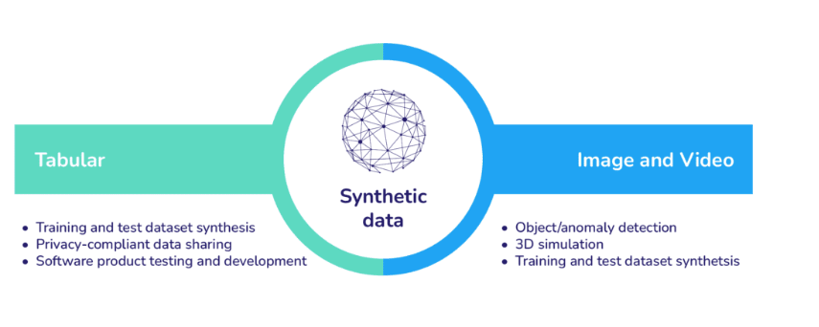
Why Synthetic Data Matters
Real clinical data is hard to access
Due to HIPAA and institutional review constraints, many researchers can't access real patient data.
Synthetic data enables reproducible research
Public datasets are often too limited. Synthetic data allows ML models to be trained, shared, and compared without privacy concerns.
Essential for Machine Learning development LLMs, risk prediction models, and time-series models need large, structured datasets.
Synthetic data allows safe experimentation at scale.
Supports fairness and robustness testing
Researchers can simulate rare conditions or demographic variations to stress test algorithms.

Slide 4
System Design
Schema Extraction
Load synthetic OMOP CSV files and extract schema from each.
Synthetic Data Generation (LLM)
Use OpenAI to generate realistic data rows per schema, preserving relationships.
Storage in DuckDB Store all generated data in DuckDB tables for fast, SQL-native querying.
Interactive Web App
Streamlit app allows users to write SQL and explore the data interactively.

Slide 5
Technologies
Layer | Tool | Purpose
Data Source | OMOP CSVs (dbt-synthea) | source schema and table structure
LLM | OpenAI GPT-4 | generate realistic synthetic data per schema
Storage | DuckDB | In-memory SQL engine for fast analytics
Frontend | Streamlit | build the interactive query UI
Deployment | Streamlit Cloud | host app and expose public access
Versioning | GitHub | track code/data and enable sharing

Slide 6
Load Data
Observational Medical Outcomes Partnership (OMOP) data was chosen for this project because it provides a widely adopted, standardized format for representing real-world clinical information. By using the OMOP Common Data Model, the synthetic dataset aligns with how many healthcare institutions store and analyze EHR data.
# pandas for data munging, openai for API calls
!pip install pandas openai
# install streamlit and duckdb
!pip install streamlit duckdb --quiet
# setup
import pandas as pd, os
!git clone https://github.com/OHDSI/dbt-synthea.git
%cd /content/dbt-synthea/seeds/synthea
# settings
input_dir = "/content/dbt-synthea/seeds/synthea"
table_names = ["patients", "conditions", "encounters", "medications", "observations", "procedures"]
tables, schemas = {}, {}
# load data and extract schema
for table in table_names:
path = os.path.join(input_dir, f"{table}.csv")
if os.path.exists(path):
df = pd.read_csv(path)
tables[table] = df
schemas[table] = [{"name": col, "type": str(df[col].dtype)} for col in df.columns]
print(f"\nschema for `{table}` ({df.shape[0]} rows):")
[print(f" - {col['name']}: {col['type']}") for col in schemas[table]]
else:
print(f"file not found: {table}.csv")
# preview top rows
for table, df in tables.items():
print(f"\npreview of `{table}`:")
display(df.head(5))

Slide 7
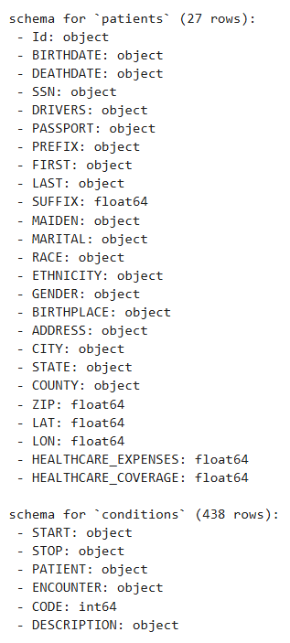
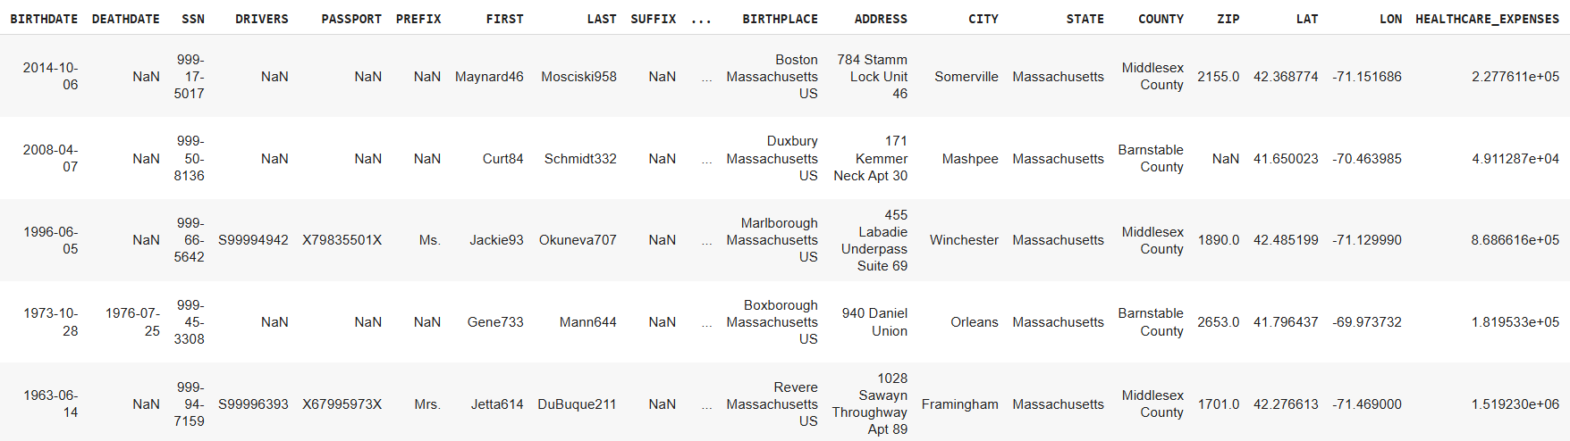
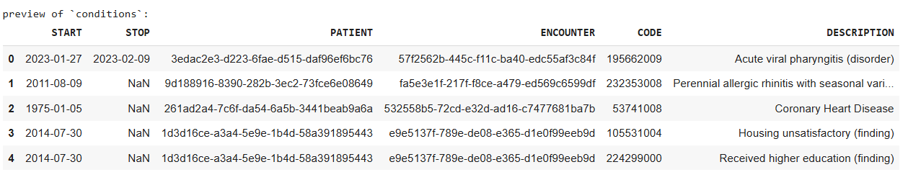
Data and Schema Preview

Slide 8
Synthetic Data Generation
# generate (5 patients) and save synthetic omop data via openai
import os, json, pandas as pd
from getpass import getpass
from openai import OpenAI
api_key = getpass("Enter your OpenAI API key: ")
client = OpenAI(api_key=api_key)
output_dir = "/content/omop_synthetic"
os.makedirs(output_dir, exist_ok=True)
num_patients = 5
synthetic_patient_ids = [f"p-{i+1:03}" for i in range(num_patients)]
# generate synthetic patients
def generate_synthetic_patients():
prompt = f"""you are a healthcare data generator. create {num_patients} patient records using only these ids: {synthetic_patient_ids}.
fields: Id, BIRTHDATE, DEATHDATE, SSN, DRIVERS, PASSPORT, PREFIX, FIRST, LAST, MAIDEN, SUFFIX, MARITAL, RACE, ETHNICITY, GENDER, BIRTHPLACE, ADDRESS, CITY, STATE, COUNTY, ZIP, LAT, LON, HEALTHCARE_EXPENSES, HEALTHCARE_COVERAGE.
use yyyy-mm-dd dates, nulls in 10–20% of optional fields, valid U.S. data, LAT (25–49), LON (-125 to -66). return json list."""
try:
msg = [{"role": "user", "content": prompt}]
resp = client.chat.completions.create(model="gpt-4", messages=msg, temperature=0.5, max_tokens=2000)
df = pd.DataFrame(json.loads(resp.choices[0].message.content))
df.to_csv(os.path.join(output_dir, "patients_synthetic.csv"), index=False)
print("patients_synthetic.csv saved")
return df
except Exception as e:
print("Error parsing GPT output:", e)
return pd.DataFrame()
# run patients + preview
patients_df = generate_synthetic_patients()
if not patients_df.empty: display(patients_df.head())

Slide 9
Synthetic Data Generation – Part2
# generate other tables using schemas
def generate_synthetic_table(name, schema):
prompt = f"generate 10 `{name}` records using schema: {json.dumps(schema)}. use only these PATIENT ids: {synthetic_patient_ids}. return json list."
try:
msg = [{"role": "user", "content": prompt}]
resp = client.chat.completions.create(model="gpt-4", messages=msg)
df = pd.DataFrame(json.loads(resp.choices[0].message.content))
df.to_csv(os.path.join(output_dir, f"{name}_synthetic.csv"), index=False)
print(f"{name}_synthetic.csv saved")
return df
except Exception as e:
print(f"error in {name}:", e)
return pd.DataFrame()
# loop and generate based on schemas
for name in ["conditions", "encounters", "medications", "observations", "procedures"]:
if name in schemas:
df = generate_synthetic_table(name, schemas[name])
if not df.empty: display(df.head())

Slide 10
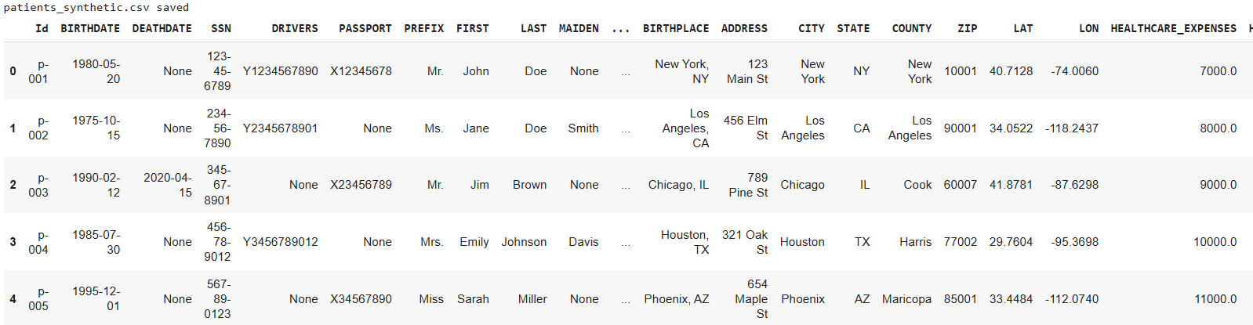
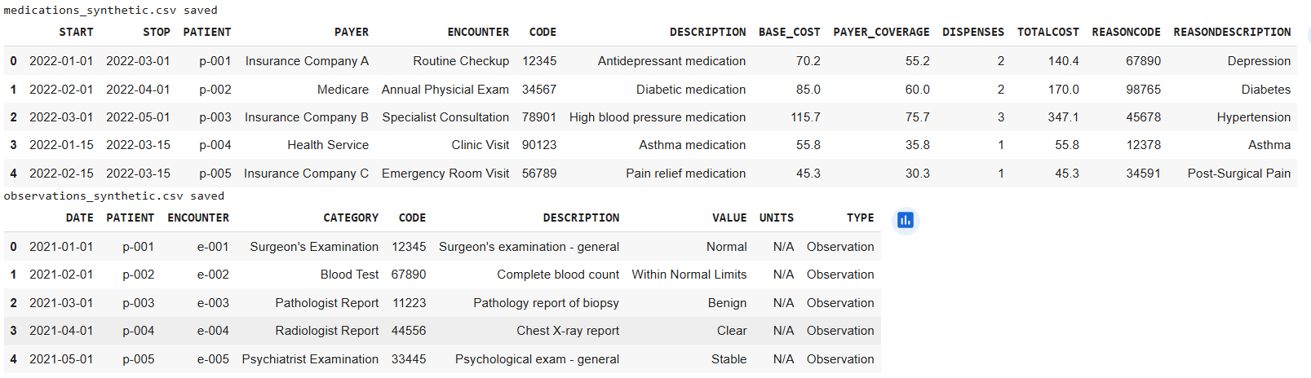
Generated Data Preview

Slide 11
Web App
%%writefile /content/high-risk-project/streamlit_duckdb_app.py
import streamlit as st, duckdb, os, pandas as pd
st.set_page_config(page_title="Synthetic OMOP Explorer"); st.title("Synthetic OMOP Explorer")
DATA_DIR = "omop_synthetic"
tables = {t: f"{t}_synthetic.csv" for t in ["patients", "conditions", "encounters", "medications", "observations", "procedures"]}
con = duckdb.connect()
# load tables
for name, file in tables.items():
path = os.path.join(DATA_DIR, file)
if os.path.exists(path): con.sql(f"CREATE OR REPLACE TABLE {name} AS SELECT * FROM read_csv_auto('{path}')")
# preview mode
if st.checkbox("Show available tables and columns"):
for name in tables:
st.subheader(name)
try: st.dataframe(con.sql(f"SELECT * FROM {name} LIMIT 5").df())
except Exception as e: st.error(f"Error loading `{name}`: {e}")
# user query input
st.subheader("Run SQL Query")
query = st.text_area("Enter SQL query:", "SELECT * FROM patients LIMIT 5")
if st.button("Run"):
try: df = con.sql(query).df(); st.success(f"Returned {len(df)} rows"); st.dataframe(df)
except Exception as e: st.error(f"Query failed: {e}")

Slide 12
Git
# store GitHub token securely
from getpass import getpass
GITHUB_TOKEN = getpass("Enter your GitHub PAT (Personal Access Token): ")
# clone repo using HTTPS + token
%cd /content/
!git clone https://{GITHUB_TOKEN}@github.com/trainheart09/high-risk-project.git
%cd high-risk-project
import shutil
# move app and synthetic files
shutil.copy("/content/high-risk-project/streamlit_duckdb_app.py", "./")
shutil.copytree("/content/omop_synthetic", "./omop_synthetic", dirs_exist_ok=True)
# create requirements.txt
with open("requirements.txt", "w") as f:
f.write("streamlit\nduckdb\npandas")
# if not already in the repo folder, cd into it
%cd /content/high-risk-project
# copy the updated file
!cp /content/high-risk-project/streamlit_duckdb_app.py .
# commit and push
!git config --global user.name "Cuong Nguyen"
!git config --global user.email "you@example.com"
!git add streamlit_duckdb_app.py
!git commit -m "Initial commit"
!git push

Slide 13
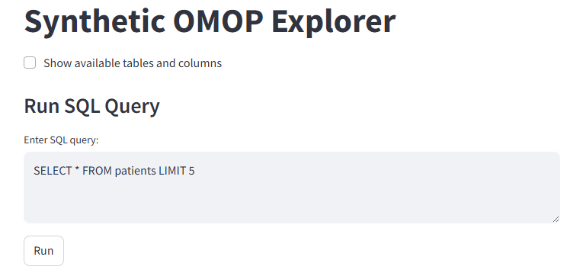
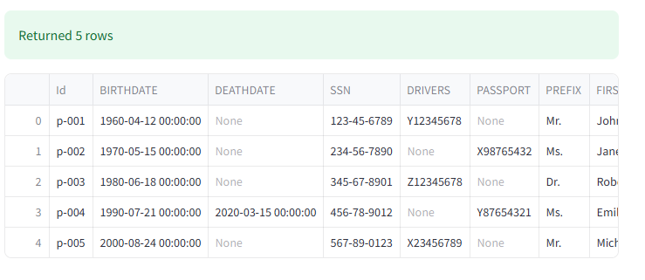
Web App
https://high-risk-project-ezftohk6rcnsgtezlokrs8.streamlit.app/
Register an account on streamlit.io
Linked Github’s repository with streamlit’s account
Streamlit Cloud will start the app automatically

Slide 14
Conclusion
This project demonstrates the feasibility and value of using large language models (LLM) to generate realistic synthetic OMOP healthcare data for research and machine learning development. By extracting schemas from clinical datasets, generating linked synthetic records with GPT-4, and making the data explorable through a Streamlit + DuckDB web app, we created a privacy-safe environment for experimentation. This approach not only enables broader access to EHR-like data but also lays the foundation for testing algorithms and AI tools without regulatory barriers. Future work could include expanding the data types, supporting temporal queries, and integrating visual analytics for richer insights.

