Slide 1
Collection

Slide 2
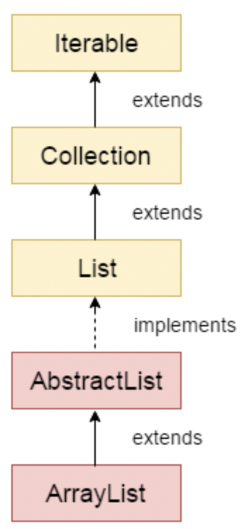
ArrayList
Array List
Java ArrayList class uses a dynamic array for storing the elements.
The ArrayList in Java can have the duplicate elements also
Default initial capacity of an ArrayList is 10
Properties
Size not fixed
N null values
Allowed duplicate
Random Access
Not synchronized

Slide 3
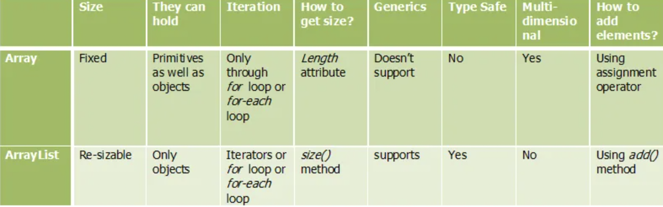
Array Vs ArrayList

Slide 4
Advantages of Array List
You can define ArrayList as re-sizable array. Size of the ArrayList is not fixed. ArrayList can grow and shrink dynamically.
Elements can be inserted at or deleted from a particular position.
ArrayList class has many methods to manipulate the stored objects.
If generics are not used, ArrayList can hold any type of objects.
You can traverse an ArrayList in both the directions – forward and backward using ListIterator.

Slide 5
LinkedList
LinkedList can have multiple null elements.
LinkedList can have duplicate elements.
LinkedList class in Java is not of type Random Access
The LinkedList can be used as stack.
The LinkedList can also be used as ArrayList, Queue, SIngle linked list and doubly linked list.

Slide 6
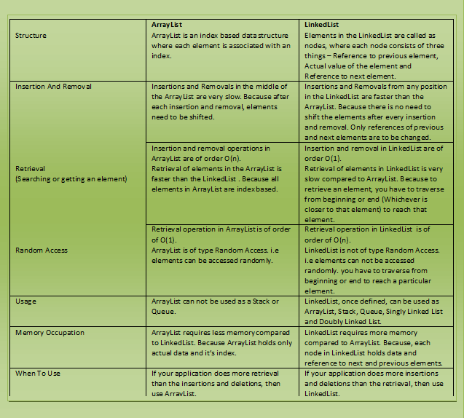
ArrayList Vs Linked List

Slide 7
Iterator Vs ListIterator
Iterator
Using Iterator, you can traverse List, Set and Queue type of objects.
traverse the elements only in forward direction
Iterator you can only remove the elements from the collection.
you can NOT iterate a list from the specified index.
ListIterator
traverse only List objects.
traversing of elements in both the directions.
Using ListIterator, you can perform modifications(insert, replace, remove) on the list
you can iterate a list from the specified index.

Slide 8
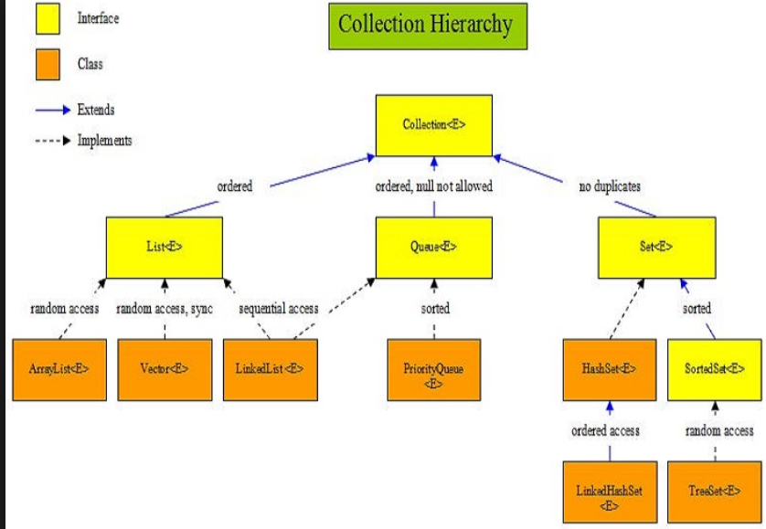

Slide 9
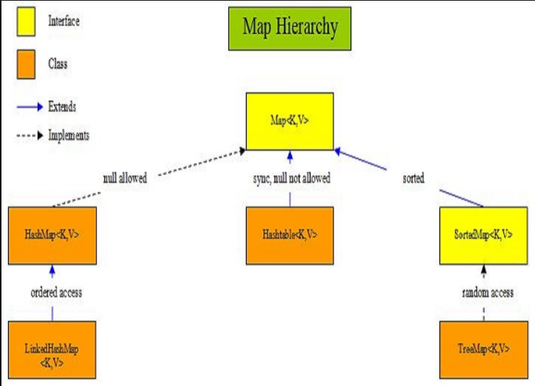

Slide 10
Why Collections Interface?
We do not have to write code to implement these data structures and algorithms manually.
Our code will be much more efficient as the collections framework is highly optimized.

Slide 11
Method of Collection
add()
inserts the specified element to the collection
size()
returns the size of the collection
remove()
removes the specified element from the collection
iterator()
returns an iterator to access elements of the collection
addAll()
adds all the elements of a specified collection to the collection
removeAll()
- removes all the elements of the specified collection from the collection
clear()
- removes all the elements of the collection

Slide 12
Map
Key,Value
Unique keys.
Each key-value pairs of the map are stored as Map.Entry objects.
Map.Entry is an inner interface of Map interface.

Slide 13
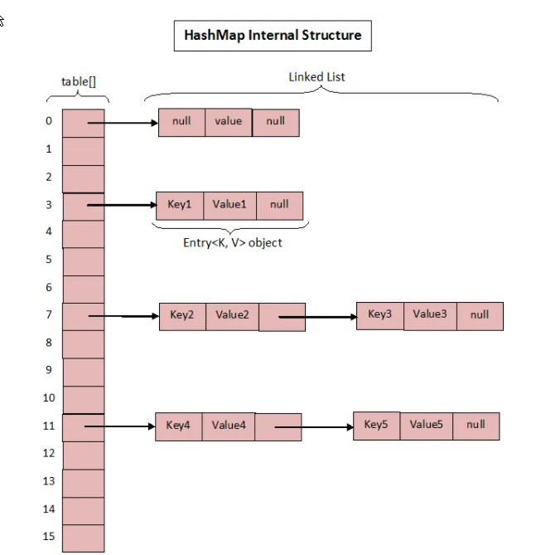
HashMap
This class makes no guarantees as to the order of the map.
doesn’t allow duplicate keys. But it can have duplicate values.
can have multiple null values and only one null key.

Slide 14
How get() works in map?
If the key is null,
it calls getForNullKey() method.
else
Hash code of the specified key is calculated.
Calls indexFor()- To find out the index of the specified key in the table[] array.
Iterate though linked list at that position and checks for the key using equals() method.
If the key is found, it returns the value associated with it
Else
Otherwise returns null.

Slide 15
TreeMap
Contains only unique values.
Java TreeMap is non synchronized.
Java maintains ascending order.

Slide 16
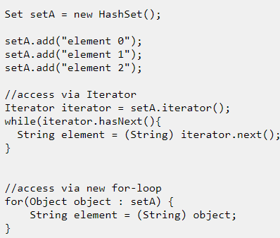
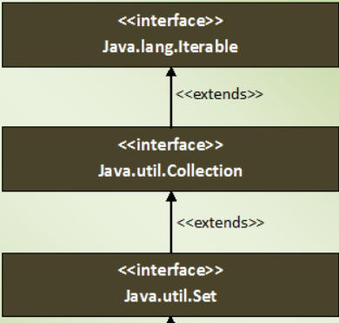
Set
No duplicates.
1 Null Element
Sets are Unordered and Order based on Implementation.
HashSet - Hash code of elements.
TreeSet - As per supplied Comparator
LinkedHashSet- insertion order.
Compare two set instances of different implementation types (HashSet, TreeSet and LinkedHashSet).

Slide 17
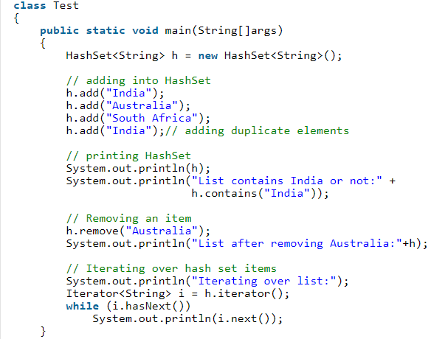
HashSet
HashSet is hashmap internally.
Unordered
Serializable and Cloneable interfaces.
No Duplicate values are not allowed.
NULL elements are allowed in HashSet.

Slide 18
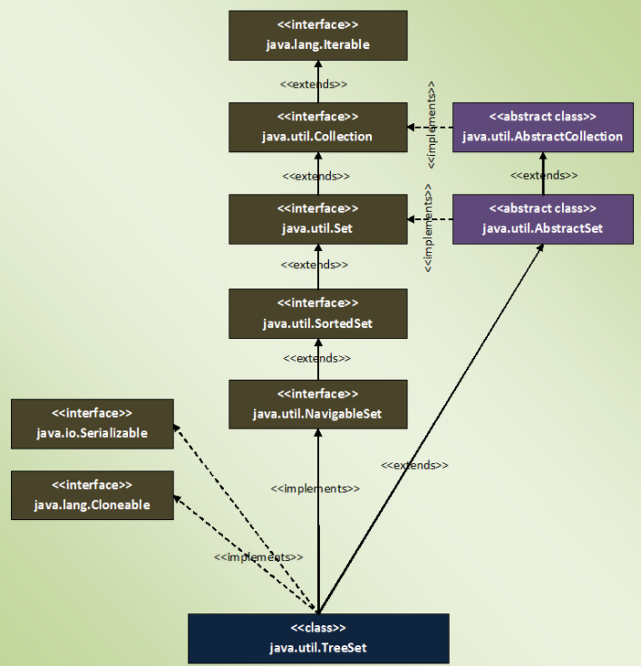
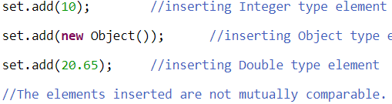
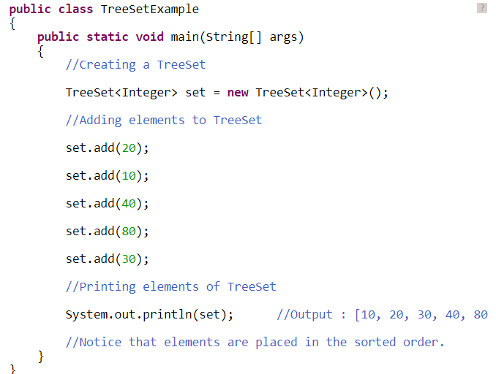
TreeSet
Sorted according to supplied Comparator.
Elements must naturally comparable.
No Null.
Fail Fast
Internally uses HashMap.

Slide 19
FailFast
Iterators in java are used to iterate over the Collection objects.Fail-Fast iterators immediately throw ConcurrentModificationException if there is structural modification of the collection.
Structural modification means adding, removing any element from collection while a thread is iterating over that collection.
Iterator on ArrayList, HashMap classes are some examples of fail-fast Iterator.

Slide 20
FailSafe
Fail-Safe iterators don’t throw any exceptions if a collection is structurally modified while iterating over it. This is because, they operate on the clone of the collection, not on the original collection and that’s why they are called fail-safe iterators.
Fail-safe iterators allow modifications of a collection while iterating over it.
Iterator on CopyOnWriteArrayList, ConcurrentHashMap classes are examples of fail-safe Iterator.

Slide 21
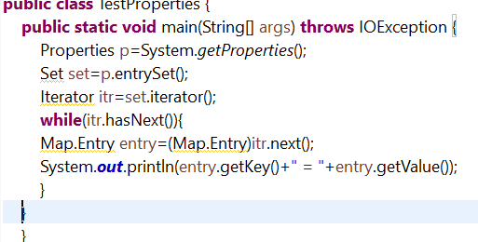
Properties

Slide 22
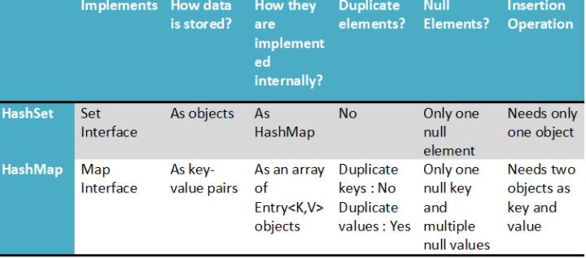
HashSet Vs HashMap

Slide 23
Design Pattern
Design patterns represent the best practices used by experienced object-oriented software developers.
Design patterns are solutions to general problems that software developers faced during software development.

Slide 24
Use of Design Pattern
Common platform for developers
Design patterns provide a standard terminology and are specific to particular scenario. For example, a singleton design pattern signifies use of single object so all developers familiar with single design pattern will make use of single object and they can tell each other that program is following a singleton pattern.
Best Practices
Design patterns have been evolved over a long period of time and they provide best solutions to certain problems faced during software development. Learning these patterns helps unexperienced developers to learn software design in an easy and faster way.

Slide 25
Types of Design Pattern
Creational Patterns
way to create objects while hiding the creation logic, rather than instantiating objects directly using new operator.
Structural Patterns
These design patterns concern class and object composition. Concept of inheritance is used to compose interfaces and define ways to compose objects to obtain new functionalities.
Behavioural Patterns
These design patterns are specifically concerned with communication between objects.
J2EE Patterns
These design patterns are specifically concerned with the presentation tier. These patterns are identified by Sun Java Center.

Slide 26
Creational Design Pattern : Singleton
This pattern involves a single class which is responsible to create an object while making sure that only single object gets created. This class provides a way to access its only object which can be accessed directly without need to instantiate the object of the class.
Steps:
Create a Singleton Class.
Get the only object from the singleton class.

