Slide 1

Design Pattern

Slide 2

TOC
Solid Principles Design Patterns
Introduction Design Patterns - Creational
Design Patterns -Structural
Design Patterns - Behavioural
2

Slide 3
SOLID Principle
S - SRP- Single Responsibility Principle
O - OP – Open Closed Principal
L - LSP – Liskov Substitution Principle
I - ISP – Interface Segregation Principle
D - DIP – Dependency Inversion Principle

Slide 4
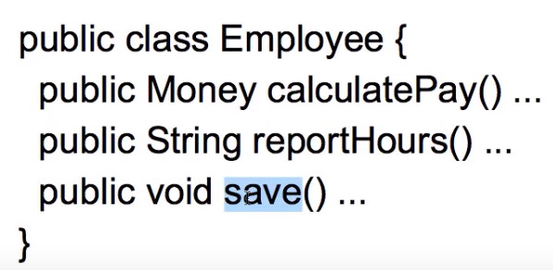
Single Responsibility Principle
A class should have one and only one reason to change.
Increase the possibility of reusability

Slide 5

What is Design Pattern
Subtitle

Slide 6
Design Pattern
Typical solutions to commonly occurring problems in software design. They are like pre-made blueprints that you can customize to solve a recurring design problem in your code.
The pattern is not a specific piece of code, but a general concept for solving a particular problem.
Advantages:
Reusable in multiple projects
Provide solutions for an effective system architecture
Provide clarity and transparency to the application design
Provide robust and highly maintainable code for easy understanding and debug
6

Slide 7
Algorithm Vs Design Pattern
Algorithm | Design Pattern
Always defines a clear set of actions that can achieve some goal, | More high-level description of a solution.
Specific to one problem | Belongs to multiple problems
Eg: Cooking recipe | Eg: blueprint where order of implementation is up to you.

Slide 8
History of Patterns
First described by Christopher Alexander A Pattern Language: Towns, Buildings, Construction.
The idea was picked up by four authors: Erich Gamma, John Vlissides, Ralph Johnson, and Richard Helm in which they applied the concept of design patterns to programming.
The book featured 23 patterns solving various problems of object-oriented design and became a best-seller very quickly. Due to its lengthy name, people started to call it “the book by the gang of four” which was soon shortened to simply “the GoF book”.

Slide 9
Classification of Design Pattern
Creational patterns provide object creation mechanisms that increase flexibility and reuse of existing code.
Structural patterns explain how to assemble objects and classes into larger structures, while keeping the structures flexible and efficient.
Behavioral patterns take care of effective communication and the assignment of responsibilities between objects.

Slide 10

Creational Design Pattern
Object Relational Mapping
10

Slide 11
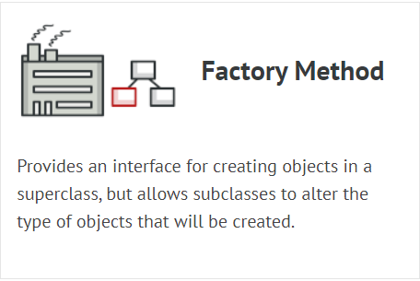
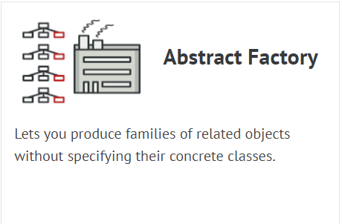
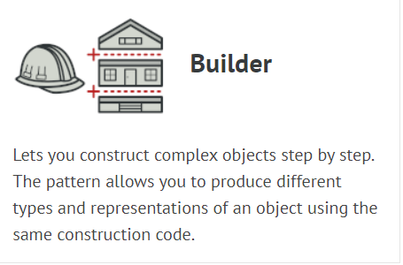
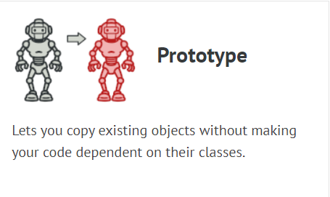

Creational Design Pattern
Provide various object creation mechanisms, which increase flexibility and reuse of existing code.

Slide 12
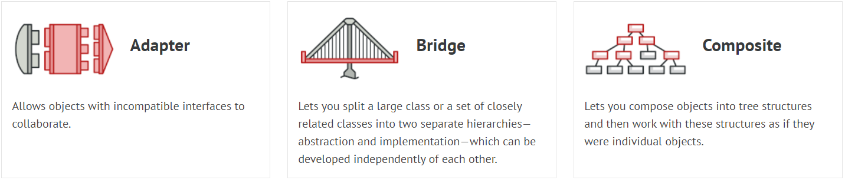
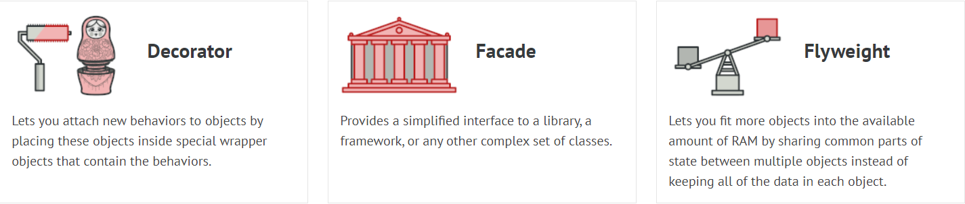
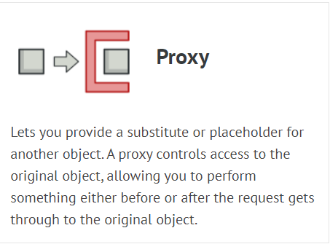
Structural Design Pattern
Structural patterns explain how to assemble objects and classes into larger structures while keeping these structures flexible and efficient.

Slide 13
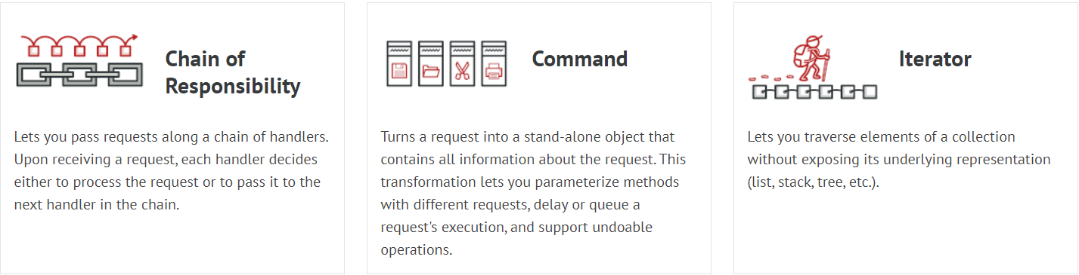
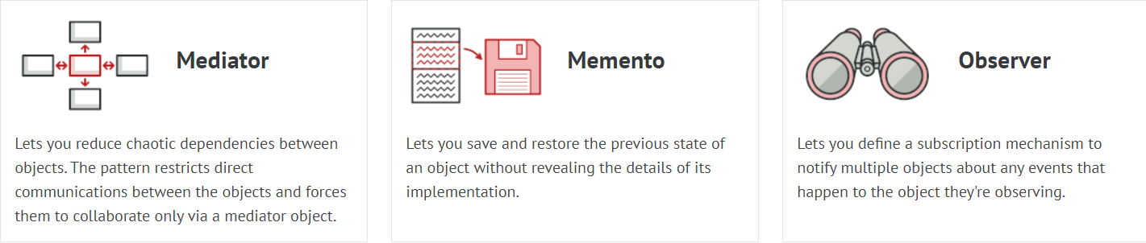
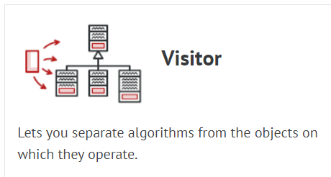
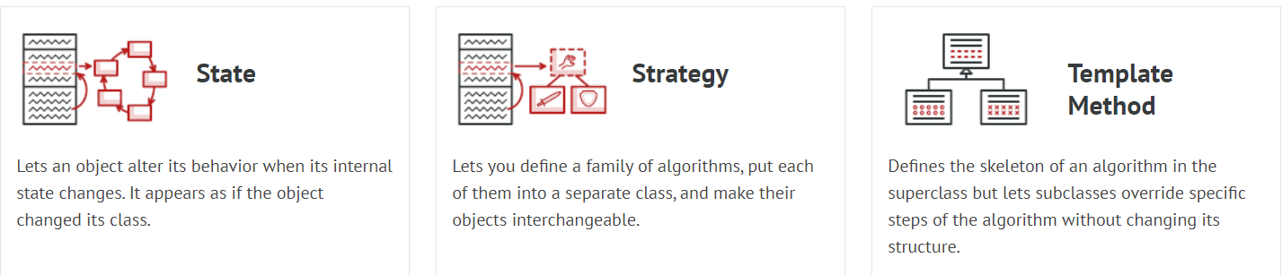
Behavioural Design Pattern
Behavioural design patterns are concerned with algorithms and the assignment of responsibilities between objects.

Slide 14
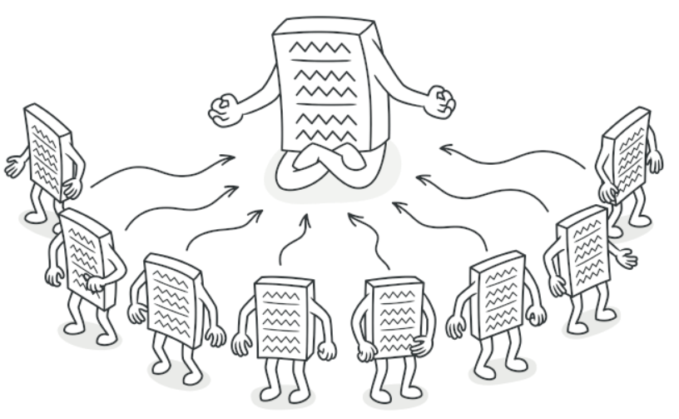
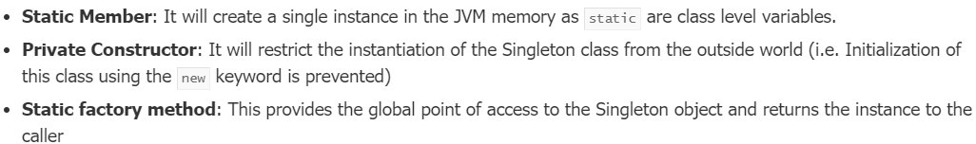
Creational – Singleton Design Pattern
Singleton is a creational design pattern that lets you ensure that a class has only one instance, while providing a global access point to this instance.
Real Time Example
Logger classes
Design the application that needs to work with the serial port.
To Implement SDP:-
Lazy Initialization – which means that it restricts the instance creation until it is requested for the first time.

Slide 15
Creational – Singleton Design Pattern
Ensure that a class has just a single instance
Provide a global access point to that instance

Slide 16
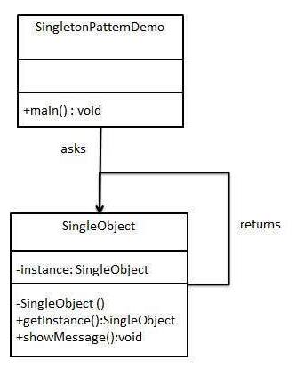
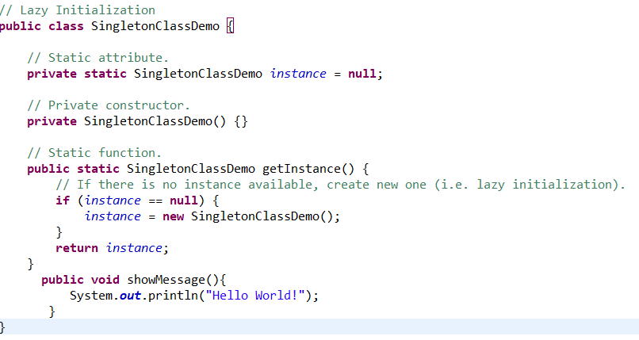
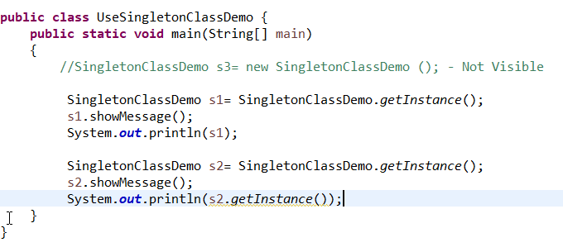
Creational – Singleton Design Pattern
Singleton is a creational design pattern that lets you ensure that a class has only one instance, while providing a global access point to this instance.

Slide 17
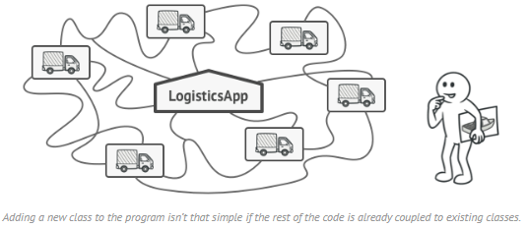
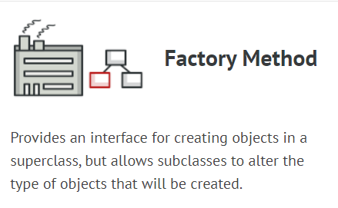
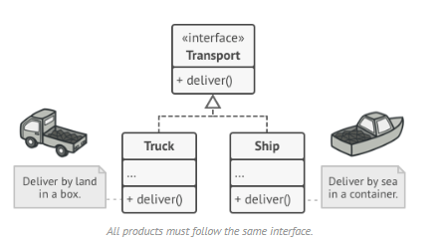
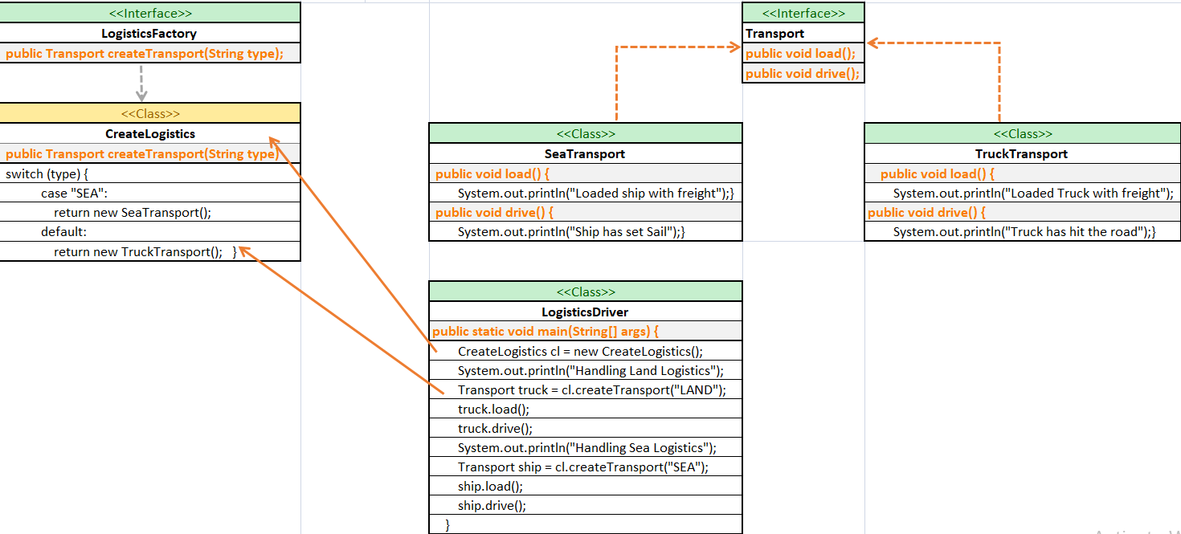
Creational – Factory Design Pattern
Problem – Logistics management application.
Your app can only handle transportation by trucks, so the bulk of your code lives inside the Truck class.
Later receive dozens of requests from sea transportation companies to incorporate sea logistics into the app.
Solution – Adding ship class -> Add Air class -> Nasty code and complexity
In Factory pattern, we create object without exposing the creation logic to the client and refer to newly created object using a common interface.
https://examples.javacodegeeks.com/factory-pattern-java-example/

Slide 18
Creational – Factory Design Pattern
Applications
Use the Factory Method when you don’t know beforehand the exact types and dependencies of the objects your code should work with.
Use the Factory Method when you want to save system resources by reusing existing objects instead of rebuilding them each time.
Pros | Cons
You avoid tight coupling between the creator and the concrete products. | The code may become more complicated since you need to introduce a lot of new subclasses to implement the pattern. The best case scenario is when you’re introducing the pattern into an existing hierarchy of creator classes.
Single Responsibility Principle. You can move the product creation code into one place in the program, making the code easier to support.
Open/Closed Principle. You can introduce new types of products into the program without breaking existing client code.
https://examples.javacodegeeks.com/factory-pattern-java-example/

